Slide 1
Alignment: How?

Slide 2
Imagine…
One coherent implementation framework to align competing initiatives and avoid repeatedly shifting focus to new initiatives
A simple message to district, community/school leaders and staff about how the framework aligns initiatives to support an overall improvement strategy
Core features of practices and support of these practices are aligned across the system

Slide 3
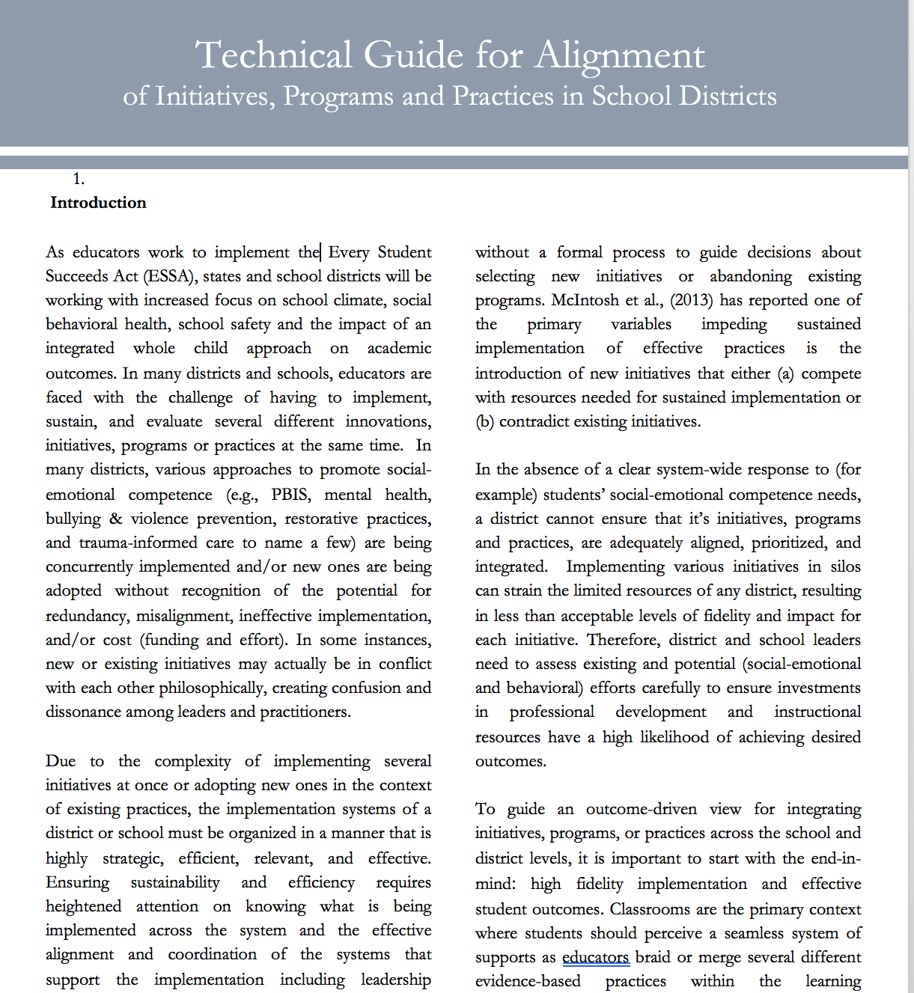
Technical Guide for Alignment

Slide 5
Alignment Process: Section 1: Assessment of Current Initiatives Step 1: Form an executive level team
Authority
Knowledge
Communication/feedback loops
Regularly scheduled meetings

Slide 6
Step 2: Define Valued Outcomes
Define overarching outcomes
Identify priority concerns
Form consensus around data points

Slide 7
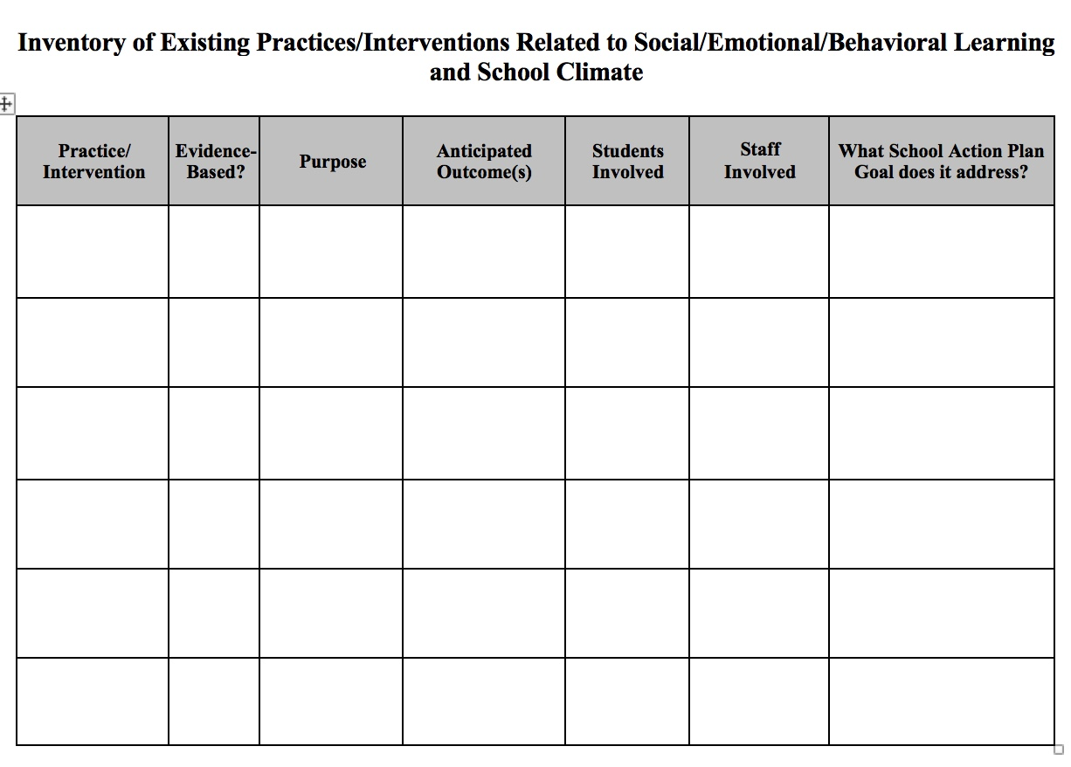
Step 3: Create Inventory of Related Initiatives
Notes:
https://www.pbisvermont.org/wp-content/uploads/2017/12/Inventory-of-Existing-Practices-Related-to-SEBL-and-School-Climate.docx

Slide 8
Step 4: Identify Core Features for Initiatives Targeted for Alignment
Coordination
Fidelity measures
Specific core practices across tiers
Outcome measures
Screening measures
PD plan

Slide 9
Step 5: Analyze and Make Decisions for Alignment of Initiatives
Determine areas of commonality and differences/conflict
Review items that are left blank
Determine initiatives that could be eliminated

Slide 10
Step 6: Design Plan for Effective Alignment
Systems
Data
Practices
PD plan

Slide 11
Alignment Process: Section 2: Adopt a formal process of adding new initiatives
For any new initiatives being considered, determine their “fit,” including evidence-base among other initiatives
If team determines new practice/initiative to be adopted, team determines how the new practice/initiative can be aligned within the existing framework for related initiatives

