Slide 1
You will be muted during this session. Please use the chat box or raise your hand.
Intensive Level Training
Ken Kramberg, Amanda Babcock, Jeremy Tretiak,
and Jon Kidde
April, 2021
All materials can be found here: https://www.pbisvermont.org/training-resources/intensive-training/
Questions? Contact Anne Dubie at anne.dubie@uvm.edu

Slide 2
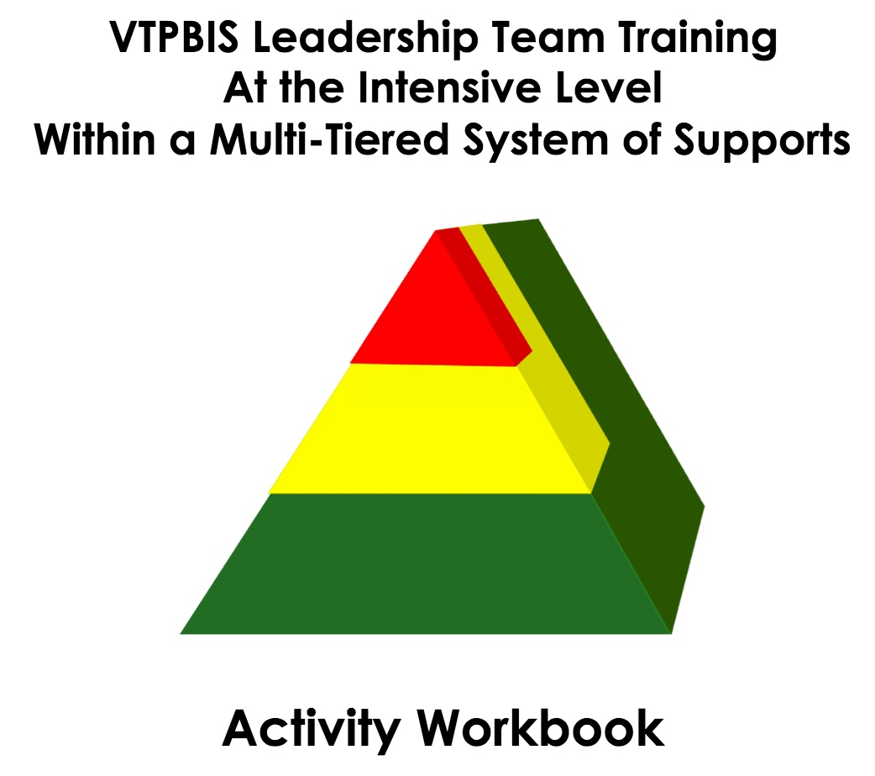
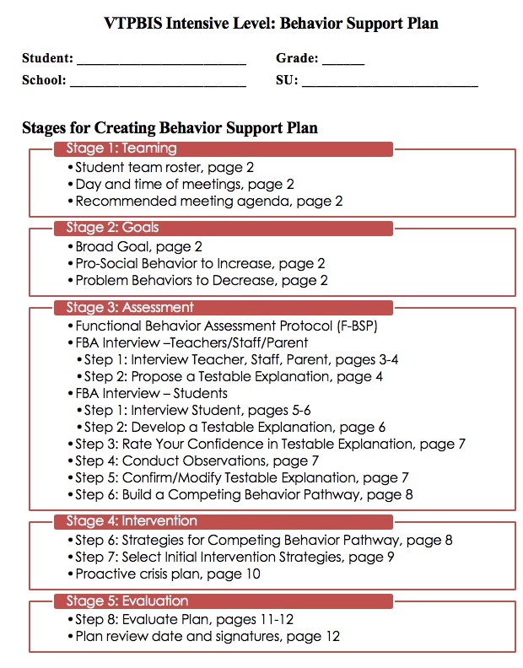
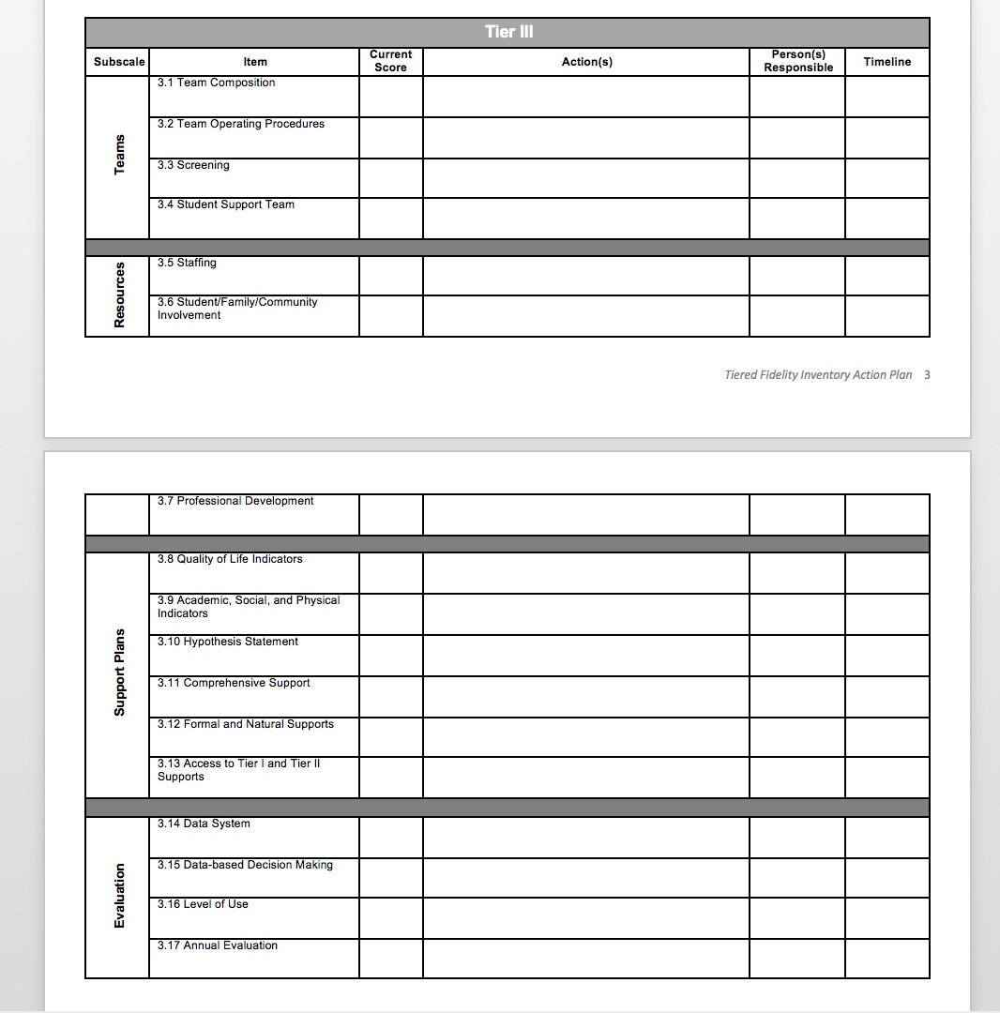
VTPBIS Intensive Materials on Website
https://www.pbisvermont.org/training-resources/intensive-training/
Workbook:
https://drive.google.com/open?id=1Sg8NRZ0D2910jioQc8_joV_Evln04J7t2aOkgRmjZWk
Go to “File”, then “Make a Copy” and give it a name and share it with the team
Notes:
Explain what’s on the site and where to find the materials
PowerPoint
Staff Handbook Template
Workbook
*point out TFI Action Planning Form

Slide 3
Two Things:
Learning and Installing the Intensive Level of PBIS cannot be accomplished in a 10-hour session. We will provide follow up implementation training/coaching upon request.
This is different from other VTPBIS training!

Slide 4
Learning Outcomes
By the end of our time together, your team will have:
Increased fluency in VTPBIS – systems, data and practices
Strengthened Tier II
Used data to guide action planning
Practiced the use of the VTPBIS Behavior Support Plan
Begun the development of an Intensive Implementation Plan and roll-out activities
Planned and scheduled year-long meetings
Had a good time together!
Notes:
Talk about pace and differentiation activities

Slide 5
When you see this star…
It indicates that the information/activities on that slide correlate with an item on the TFI (Tiered Fidelity Inventory)
TFI

Slide 6
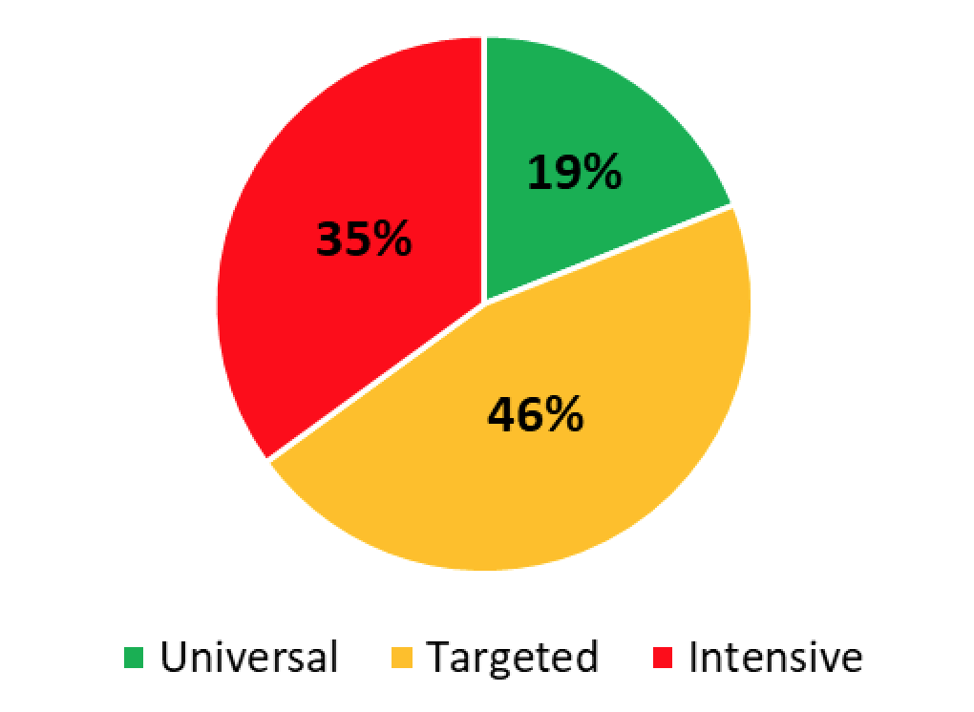
Implementation Levels (N=165)
SY 2020
165 Schools
48 SUs/SDs

Slide 7
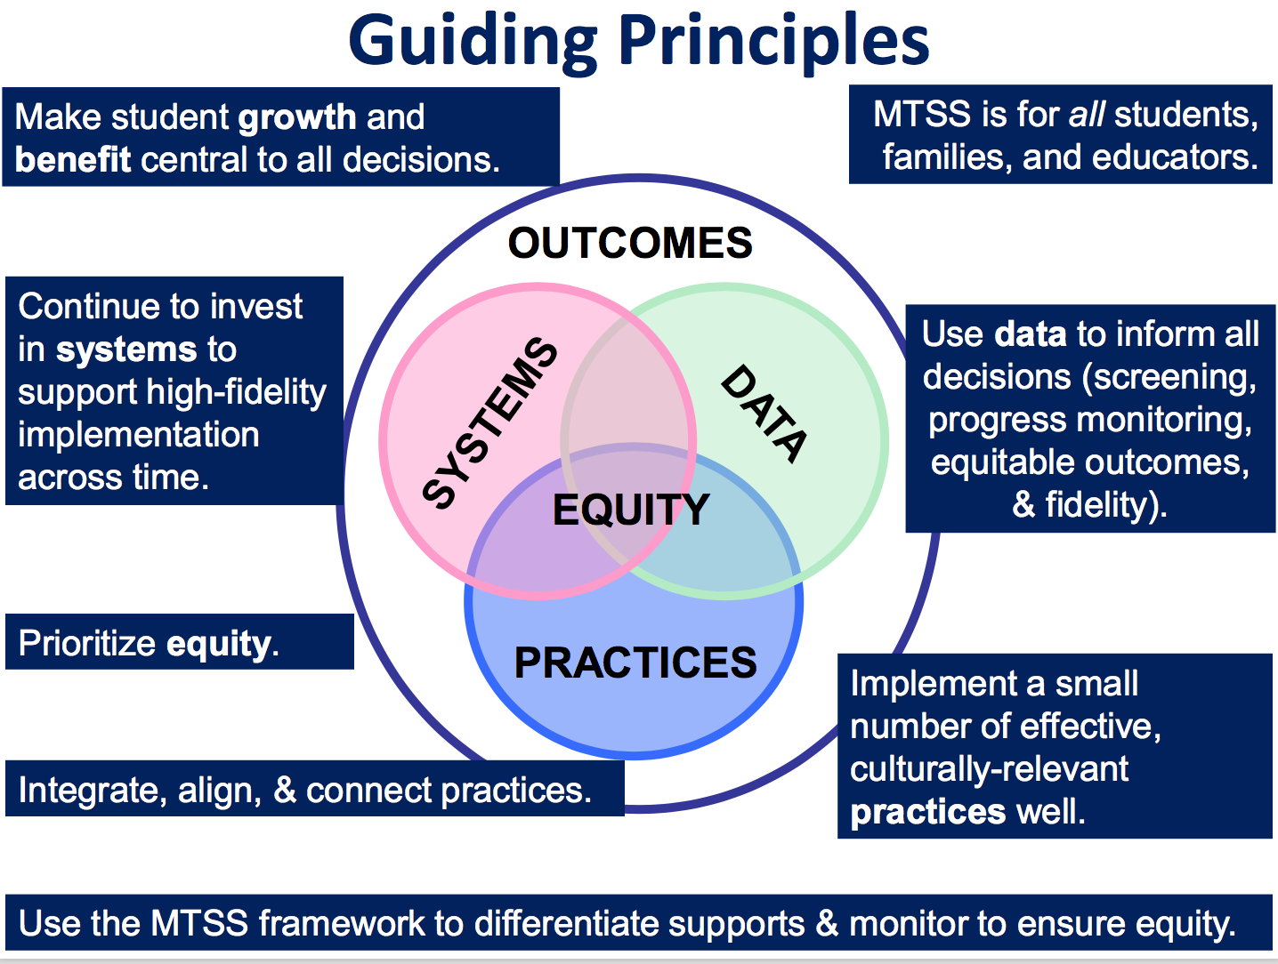
“The fundamental purpose of PBIS is to make schools more effective and equitable learning environments.”
Rob Horner, Co-Director of the OSEP Technical Assistance Center for PBIS
Notes:
Talk about MTSS
Systems: Importance of a teaming infrastructure – how are you connecting with other teams doing SEL work?
Agree that it’s a priority and communicate widely
Work with community partners Staff Handbook
Action plan
Practices: Have an understanding of SEL
Have an inventory of what already exists
Bring in community resources/interventions
Data: Formal/Informal surveys and screeners
Use data to prioritize making the smallest change for the greatest impact
Do you look at your SWIS data by ethnicity? If not, could you?

Slide 8
Setting up for Success

Slide 9
Opening Activity
Notes:
First item in workbooks

Slide 10
Restorative Principles
Exploring Relationship
Agency & Choice
Meaningful Engagement
Responsibility/ Accountability

Slide 11
Continuum: Mindset Shift

Slide 12
BEST Expectations
Be Respectful
Engage
Strengths-based
Team Solutions
Activity:
BREAK-OUT GROUPS by B, E, S,T
Talk about how you want to be together to promote these expectations in action.

Slide 13
What are your team norms and roles?
Norms:
Make collaboration more effective by guiding team behavior
Enable team members to hold each other accountable
Promotes efficiency
Roles
Facilitator
Time keeper
Note taker
Etc.
Notes:
Have audience call out examples of team norms.
Examples:
Begin and end the meeting on time
Follow the agenda
Having a parking lot
What else?
As we come together as learners and team members, it’s really important that we use our time during this training wisely so that we are most efficient. Setting up norms and roles during this training is critically important because…Read SLIDE. In a few… as leadership teams, you will spend some time creating your meeting norms and roles…that will be used throughout the training…
Roles and responsibilities help team build internal capacity for holding effective and focused meetings
http://www.schoolimprovementcoach.org/manual/7%20Norms%20and%20Roles.pdf

Slide 14
Activity #1
In your workbook:
Create your norms and roles for your team this week
Notes:
First item in workbooks

Slide 15
Let’s Get Grounded

Slide 16
Implementation Challenge
Risk Factors
Protective Factors
Antisocial behavior
Substance Use
Disability
Mental illness
Self-management skills
Interpersonal skills
Healthy habits
Academic competence
School connectedness
Notes:
Every day we are working with students, families and colleagues who come into our schools with precipitating factors that we may or may not know about – such as mental illness, substance abuse, or disability. These risk factors can be balanced by such things as being successful at learning, being physically active and having strong social or daily living skills.
Schools that engage students in rigorous and relevant academic opportunities while promoting the development of healthy social, emotional, and behavioral routines and habits can help balance out these risk factors to overcome struggles.

Slide 17
Implementation Challenge
Protective Factors
INEFFECTIVE RESPONSE
Reactive management
Exclusion, segregation, isolation
Train & hope
Non-evidence-based practices
Subjective decision making
Low quality implementation of evidence-based practices
Risk Enhancers
Trauma
Negative modelling
Family, school, community disruption
Discrimination
School connectedness
Academic competence
Healthy habits
Interpersonal skills
Self-management skills
Notes:
Amy
However, balancing the boat becomes harder when risk factors are heavier than the protective factors due to trauma, outside influences such as negative peer modeling, family disruption, bullying, and explicit and implicit bias.
Keeping our boat afloat requires a balancing of the effects of life’s challenges with supports
As educators, we need to explicitly focus on both learning about these risk factors and the things that influence them while avoiding some of the responses that WE KNOW DO NOT WORK!

Slide 18
Implementation Challenge
EFFECTIVE RESPONSE
Trauma-informed decision making
Prevention-based behavioral sciences
Tiered support systems
Data-based decision-making teaming
Continuous coached professional development
High fidelity implementation
Proactive, competent, informed leadership
Risk Enhancers
Trauma
Negative modelling
Family, school, community disruption
Discrimination
Protective Factors
INEFFECTIVE RESPONSE
Reactive management
Exclusion, segregation, isolation
Train & hope
Non-evidence-based practices
Subjective decision making
Low quality implementation of evidence-based practices
School Connectedness
Academic competence
Healthy habits
Interpersonal skills
Self-management skills
Intentionally creating connections and relationships
Notes:
We can play a DELIBERATE role in promoting protective factors for so many of our students through carefully selecting effective responses.
This institute provide some of the gems for your treasure chest that can help you even the keel for our learners and our schools;
Offerings have a focus on charting a course of prevention within a system that provides access to learning for students.
Several strands delve into how to use data to make the most effective and efficient decisions to help navigate the waters.
There are many topic-based consultants here that can help you take your team’s learning to a higher level beyond just training with the goal of high fidelity implementation.
It is hero’s work, daunting, exhilarating and rewarding.

Slide 19
Implementation Science
Exploration
Installation
Initial Implementation
Full Implementation
Innovation
Sustainability
2-4 years

Slide 20
What does this mean to you and how can you promote this way of thinking?
“Instructional supports, practices, and interventions can be tiered – students can not! There are no “tier 2 students” (or tier 3 or tier 1). By assigning this type of label to students we make their current status permanent. That is the antithesis of the concepts underlying a multi-tiered system of supports.”
VTmtss Field Guide 2019

Slide 21
Continuum of Support for “Dylan” within MTSS-B/PBIS & MTSS-A
Universal
Targeted
Intensive
Anger Mgt.
Math
Label Behavior, Not Students!
Science
Adult relationships
Attendance
Reading
Peer Interaction
Notes:
Every student has competencies. Label behavior not STUDENTS. Everyone at one point or another needs targeted or intensive supports. Dylan is doing great in reading but may need more support in Math and with anger management.

Slide 22
Activities #2a and 2b
2a. In your Workbook: Draw a triangle and jot down some traits of your student corresponding to levels of support needed.
2b. In your Workbook: Read the Heart of the Matter and answer the questions about your student.
In the Behavior Support Plan, top of p. 3, write the student’s strengths in the Student Profile.
Notes:
Not in workbook

Slide 23
Solidifying Tier II

Slide 24
SW-PBIS Supports for All Students
Intensive Supports – Individualized interventions provided to students with most complex emotional and behavioral needs.
Wraparound
1-5%
5-15%
80-90%
Complex FBA/BSP
Simple FBA/BSP
Individualized CICO
Targeted Supports – Provided to students determined to be “at-risk” of emotional and behavioral challenges.
Social/Academic
Instructional Groups
Check-in/Check-out
Universal Supports – Supports provided to all students. Expectations are taught, reinforced, and monitored in all settings.
School & Class-wide expectations & supports
Notes:
Need to have a system that builds from the base…
VT had schools with really good individualized systems and schools that do a great job with Universal supports. It’s building the supports in between that has been the challenge. It doesn’t come naturally.
Ken

Slide 25
Ensure Check-In/Check-Out (CICO) supports are in place
TFI
Default targeted intervention. WHY?
Most students receive multiple ODRs for peer or adult attention.
Evidence indicates CICO is effective practice for reducing acting out behavior related to attention seeking.
Schools must have strong CICO in place!
Notes:
Jean

Slide 26
Big Ideas about Check-in/Check-out (CICO)
It works!
Provides prompts for positive feedback (5:1)
Provides structure for corrective feedback
Easily embedded into classroom routines
If 70% of students not responding to CICO, need to examine systems features
Circling numbers is not an intervention
Can be expanded to additional problem behaviors once Basic CICO is in place

Slide 27
All Check In-Check Out programs have:
a positive caring adult
daily positive interactions with teachers & other adults
supervision and monitoring of students
more performance feedback
Notes:
Jean

Slide 28
Statistically Speaking …
Receiving CICO (from SWIS)
Up to 12% of students with chronic problem behaviors act out for adult or peer attention
Why?
Notes:
0 TO 4%

Slide 29
Activity #3
Do the Math:
Given your enrollment, how many students would benefit from CICO?
> Write this in your workbook, top of Pg. 6
Notes:
First item in workbooks

Slide 30
Daily Progress Report (DPR) Sample
NAME:______________________ DATE:__________________
Teachers please indicate YES (2), SO-SO (1), or NO (0) regarding the student’s achievement in relation to the following sets of expectations/behaviors.
“Individualized Student Card linked to Tier 3 FBA/BIP"
EXPECTATIONS | 1 st block | 2 nd block | 3 rd block | 4 th block
Be Safe | 2 1 0 | 2 1 0 | 2 1 0 | 2 1 0
Be Respectful | 2 1 0 | 2 1 0 | 2 1 0 | 2 1 0
Be Responsible | 2 1 0 | 2 1 0 | 2 1 0 | 2 1 0
Total Points
Teacher Initials
Use your words
Use deep breathing
Keep arm’s distance
Use #2 voice level when upset
Ask for breaks
Self-monitor with DPR
Adapted from Grant Middle School STAR CLUB
Adapted from Responding to Problem Behavior in Schools: The Behavior Education Program by Crone, Horner, and Hawken
Notes:
30
Remember to review this in slide show so you can see that it is animated.

Slide 31
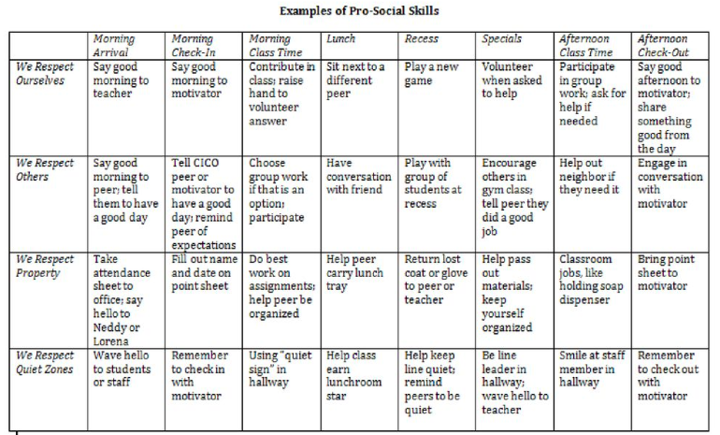
Adding Internalizing Characteristics to Teaching Matrix
Notes:
Just an example of how to apply PBIS teaching matrix to internalizing. Can be for a student in particular.

Slide 33
Individualizing CICO: Video
https://www.youtube.com/watch?v=btFC13oz9mM
Notes:
This video is a little over 9 minutes. While it talks about referral to the targeted team, this school did much more individualizing at the targeted team level. I think it’s a good example of individualizing targeted interventions.

Slide 34
Activity #4
Consider what modifications to CICO could be made to meet the needs of some of your students.
How could modifications to CICO support your selected student/s?
Notes:
In Handbook

Slide 35
Activity #5 (optional)
Complete the CICO Self-Assessment in your workbook pg. 6
Notes:
In Handbook

Slide 36
Other Targeted Level Interventions

Slide 37
PBIS, SEL, RP, and Trauma-Informed Practices - Commonalities:
Whole-school
Positive, strengths-based
Proactive/prevention-focused
Contribute to and depend on an equitable learning environment
Same end goals in mind
To build a safe, respectful, and productive learning environment
To establish a positive school climate where students and adults have strong, positive relationships and students understand what is expected of them as learners at school

Slide 38
Targeted Level Interventions for
TFI
Social Emotional Learning

Slide 39
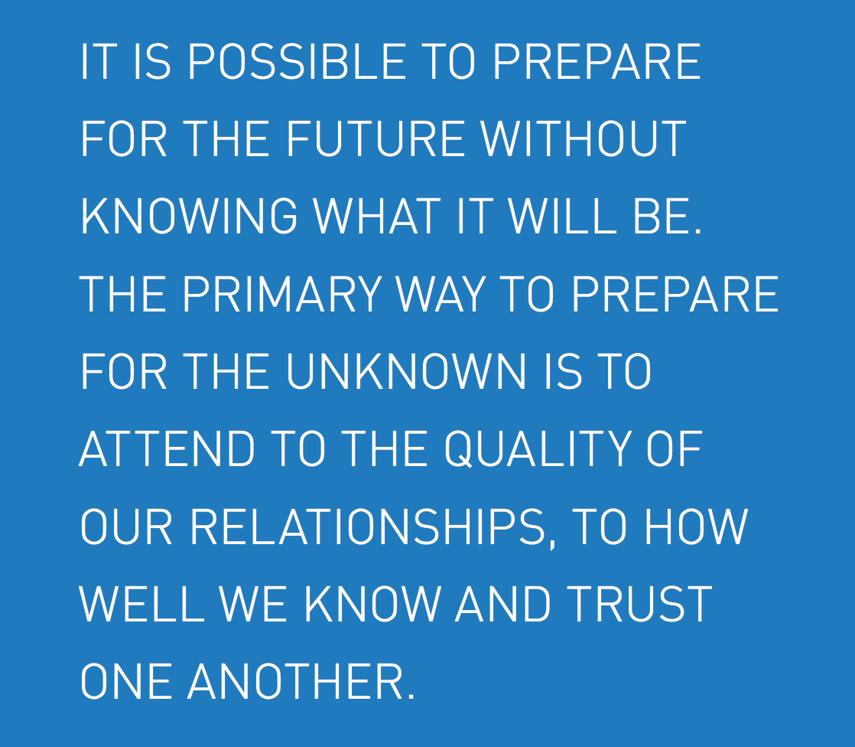
Margaret Wheatley, 2004

Slide 40
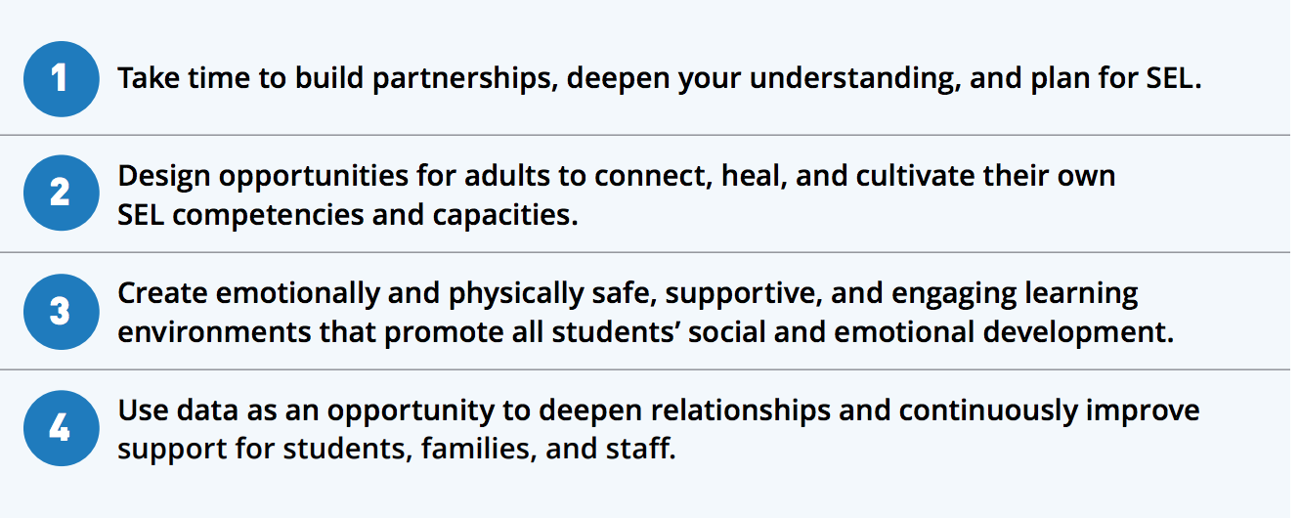
SEL is Essential Now More than EVER!

Slide 41
Some SEL Examples
Second Step
Social Cognition
Incredible Years
Check and Connect
CASEL WEBSITE
What do you use?

Slide 42
Matching Interventions to types of social skills problems:
Matching Interventions to types of social skills problems:
Most social skills studies deliver a treatment to children with an almost complete disregard for the types of social skills deficits children may have
(Gresham, 1998)
Center

Slide 43
Targeted Interventions Based on Functions of Behavior
TFI
Access Adult Attention/Support:
Check-In/Check-Out
Adult Mentoring Programs
Access Peer Attention/Support:
Social Skills Instruction
Peer Mentoring
Self-Monitoring with Peer Support (function: academic task escape)
Academic Skills Support
Organization/Homework planning support
Homework completion club
Tutoring
Notes:
Intervention is continuously available
Rapid access to intervention (72 hr.)
Very low effort by teachers
Consistent with school-wide expectations
All staff/faculty in school are involved/have access
Flexible intervention based on descriptive functional assessment
Adequate resources (admin., team)
Continuous monitoring for decision-making

Slide 44
Inventory of Existing Targeted Interventions
Notes:
Direct them to Handbook for this activity, go to next slide

Slide 45
Restorative Principles
Exploring Relationship
Agency & Choice
Meaningful Engagement
Responsibility/ Accountability

Slide 46
Continuum: Mindset Shift

Slide 47
Activity #6
Review/complete the Inventory of Targeted Supports (in workbook, page 8)
What do your practices look like along a continuum from not at all restorative to high application of the principles? What can be done to make them more aligned with restorative principles?
Notes:
In Handbook
Each team shares two most successful practices with large group

Slide 48
Check-In
Who participated in webinar?
Who completed Readiness Checklist as a Team?
Notes:
If not everyone present was part of webinar, readiness, or BAT then bring each other up to date and get additional input from one another in next activity

Slide 49
Activity #7
Review / Complete
Readiness Checklist
> In your workbook
Notes:
In Handbook
Pull up your BAT from PBIS apps website … should have completed this as part of pre-institute tasks
Review readiness checklist and BAT
THEN …
Complete Team Profile for ???both Systems Level and Individual Student Level???

Slide 50
Necessary Conversations (Teams)
TFI
Tier 1
Tier 2
Tier 3
SU/District Team
•Coordinates implementation
•Ensures access to resources
•Reviews data across schools
SU/District Team – Targeted/Intensive:
•Secures resources
•Focuses on student outcomes
•Focuses on fidelity of practices across the district/SU
SU/District
School Leadership Team
•Plans and implements 6 school components of PBIS
School Systems Level Team – Targeted/Intensive:
•Creates procedures for referral, screening & evaluation
•Communicates with staff and families
School
Student Level Team
•Matches students to interventions
•Evaluates & monitors student progress
Student Level Team
•Completes FBA/BIP
•Evaluate & monitor student progress
Facilitates wraparound
Student
Notes:
You need to figure out where you as the intensive team fit in
KEN through 78

Slide 51
Intensive Level – Three Types of Teams (or Conversations)
Systems Level
Individual Student Referral, Review
Student Specific
Some people will always be on every Individual Student Team

Slide 52
Intensive Team: Objectives
TFI
Manage teacher requests for assistance
Ensure that teachers and students receive support in a timely and meaningful manner
Provide a general forum for discussions and possible solutions for individual student behavioral concerns
Organize a collaborative effort to support the teacher (Todd et. al., 1999)

Slide 53
Role of the Administrator
Role of Intensive Team Coordinator
Notes:
This is who the parent will call if there are problems. Administrator needs to know what is happening with all student plans.
Know what the practices look like when implemented with fidelity;
Access special resources, if needed.
Support team meeting time
Be flexible around school policies/procedures.
Be committed to helping students and LRE.
Be aware of data using tracking tools; help decide what needs to change.
Attend Leadership Team Meetings
With leadership team, identify staff to facilitate individual team-based meetings.
Help team complete behavior tasks on time
Data organization and reporting
Meet with student teams weekly

Slide 54
Activity #8
Complete Team Profile and Meeting Schedule in workbook, pg. 9
1. Intensive Intervention
Team Roster -
System Level
Student Referral/Review Level
List people who will always be on
every Individual Student Team
Notes:
In Handbook
Pull up your BAT from PBIS apps website … should have completed this as part of pre-institute tasks
Review readiness checklist and BAT
THEN …
Complete Team Profile for ???both Systems Level and Individual Student Level???

Slide 55
Step 1 for Request for Assistance: Individual Student Teams
TFI
Notes:
Individual student team will look different than your intensive SYSTEMS team!
Who are the essential people to have on your individual student teams?

Slide 56
Example Request for Assistance Form
TFI
Number of ODR: __________ Number of nurses visits: ____________

Slide 57
Activity #9
Develop a Request for Assistance Process to refer a student for development of intensive level supports
Record this in your workbook, page 11
Notes:
In Handbook
Pull up your BAT from PBIS apps website … should have completed this as part of pre-institute tasks
Review readiness checklist and BAT
THEN …
Complete Team Profile for ???both Systems Level and Individual Student Level???

Slide 58
1 Teaming
2 Goals
3 Assessment (FBA)
4 Intervention (BSP)
5 Evaluation (BSP)
Vermont’s Planning Process for Students
Adapted from: Dunlap et al. (2010). Prevent, Teach, Reinforce
Inserst this as transition slide for each section
Notes:
We’ve focused today on systems.
We’re going to move for the rest of the week to focusing on intensive supports for students
Hand out books

Slide 59
1. Teaming

Slide 60
Recommended Team Members
TFI
Teacher
Parent
Behavior expert
Resource expert
Student
Others?
People who are actively involved with the student and invested in the student’s success + Input from student as appropriate!
Notes:
Emphasize ACTIVELY INVOLVED and INVESTED
This is exactly how the Behavior Support Plan is organized

Slide 61
Responsibilities of Individual Student Teams
TFI
Meet weekly at first, then less frequently per need
Set up meeting schedule at the beginning
Agree on initial behavioral goals for student
Participate in completing FBA for the F-BSP
Develop BSP (and, if needed, Crisis Plan)
Train additional staff to implement BSP
Oversee implementation of BSP
Collect and review data to evaluate effectiveness and fidelity of BSP
Revise BSP as needed

Slide 62
Engaging Team Members
TFI
Dedicated time
Creative problem solving
Organized team process
Handling conflict
Notes:
Not necessarily an easy thing to do; need to invest more effort to make them run well

Slide 63
Example: Team Meeting Structure
Start with positives!
Review all relevant data
Brainstorm ideas based on data
Discuss, prioritize, make data-based decisions
Gain consensus and implement agreed upon steps
STICK WITH YOUR AGENDA
Notes:
All the most successful individual interventions are built on student’s strengths, not on remediating their weaknesses
Don’t just mention the positives, but truly celebrate them
Hold up Bx Support Plan and direct their attention to where this sample agenda is built in

Slide 64
Family Permission Example

Slide 65
VT Family Support Resources
www.vermontfamilynetwork.org
www.vffcmh.org
Notes:
Do activity two: Power Imbalances today
Do activity one tomorrow: Positions and Interests

Slide 66
Activity #10
Heart of the Matter,
Part 2
(in workbook, pg. 12)

Slide 67
Activity #11
Review/complete/plan steps from Family Engagement Checklist in workbook (pgs. 13-14)
Develop Family Awareness and Consent & Student Awareness sections of your in your workbook
Notes:
In Handbook
Should have done this as part of pre-institute task, after having watched the 13-minute webinar

