Slide 1
F-BSP Activity
For your student who needs intensive supports, complete Stage 1: Teaming section of the Intensive Level F-BSP (p.2)
For the same student, complete Clarifying Roles and Goals of Team Members in F-BSP Appendix (1) & discuss the questions at the bottom
Notes:
In Workbook

Slide 2
2. Goals

Slide 3

Step 2: Setting Goals
TFI
Goals abide by the “fair-pair” rule
  Include relevant behavior(s) to increase and/or behavior(s) identified for decrease
Team has conversation to reach consensus
Notes:
Who are the essential people to have on your individual student teams?
Goals to support child AS WELL AS the adults providing primary interventions with child.

Slide 4
Outlining Behavior Goals
Increase the number of appropriate responses to adult directions
Decrease the number of times he runs away from adults following a direction

Slide 5
Collecting Baseline Data for F-BSP
For each behavior, the team must:
Define the behavior in measurable and observable terms
Determine best method for measuring
Choose a plan for assessing the data
Baseline data are critical for assessing the effectiveness of the interventions

Slide 6
Collecting Baseline Data
  Direct Observation:
  Time sampling = Instances of the behavior within a certain time period (e.g., blurting out)
  Total counts = Every occurrence of the behavior (e.g., following directions, running away after directions given)
  Duration = Length of each occurrence of the behavior (e.g., tantrums)
  Scatterplot = Time of the day/week in which the behavior(s) occurred
  Antecedent-Behavior-Consequence Charts = For low frequency, high severity behavior
  Existing school-based data sources/screeners/self-reports

Slide 7
F-BSP Activity
Complete Stage 2: Goals from p. 2 of F-BSP for your student
Discuss if observations might be needed to gather baseline data
Choose a method for collecting baseline data
Notes:
Emphasize that they’re thinking about a real student but this is just practice bc you don’t have all the proper team members with you today

Slide 8
3. Assessment (FBA)
4. Intervention (BSP)

Slide 9
Steps 3 & 4 Assessment & Intervention
TFI
Assessment=Functional Behavior Assessment (FBA)
Intervention = Behavior Support Plan (BSP)
School should have personnel ready to provide simple & complex FBA / BSP
Antecedent
Behavior
Consequence
Function
Notes:
Do you have people identified?
Do they feel competent and confident?
And are they doing them?

Slide 10
Only Two Basic Functions
Look to add
something desirable
Look to remove
Something aversive
from Horner & Sugai at www.pbis.org

Slide 11
F-BSP Template and Tool
An interview tool for collecting relevant information
Information comes from staff, parents, and students
Information gathered through the F-BSP template informs the behavior support plan

Slide 12
Simple vs. Complex FBA
 | SIMPLE | COMPLEX
FOR | Students with high frequency behaviors (not dangerous), received interventions that did not improve behavior, show behaviors in only 1-2 settings | Students that demonstrate dangerous behaviors or show behaviors that occur in 3 or more school settings
WHAT | Relatively simple and efficient process to guide behavior support planning | Time-intensive process involves emergency planning, family-centered planning, & collaboration outside agencies
WHO | Team of school-based personnel (ex: teachers, special educator, counselor, administrator, behavior support personnel) | School-based team with professionals trained to implement interventions for students with severe problem behaviors (ex: behavior specialist or school psychologist)
Notes:
You should have in-house capacity for simple FBAs
This looks like a dichotomy, but is really on a continuum
Know when to call in an “expert” or outside consultant

Slide 13
Activity #12
Discuss – What has been your experience with FBA/BSPs?
Complete Activity #12 – Develop FBA/BSP Capacity that Demonstrate RP Principles of:
    Agency and Choice
    Exploring Relationships
    Meaningful Engagement
    Participatory Decision-Making
Notes:
In Handbook
Should have done this as part of pre-institute task, after having watched the 13-minute webinar

Slide 14
These student FBAs, plans, & strategies are for practice only.
You will need to further refine them at school, involving the whole student team.
Notes:
Jesse

Slide 15
Behavior Pathway
TFI
Setting
Antecedent
Behavior
Consequence
Typically on days when he has worked alone for 30 min…
when given math work sheets & other assignments…
he doesn’t do his work and uses profanity.
His work doesn’t get completed and he avoids teacher requests.

Slide 16
Hypothesis Summary
When given math worksheets & other assignments, Caesar does not do his work, uses profanity, & disrupts lessons, especially when he has worked alone for 30 minutes without peer contact. His work does not get the completed, and he avoids teachers’ requests.
Therefore, the hypothesized function of the behavior is escape/avoidance.

Slide 17
F-BSP Activity
Complete Stage 3: Assessment
(the FBA portion of your Behavior Support Plan):
Choose ONE behavior for your student, complete Description of Behavior on page 3 of F-BSP
Review, discuss, & complete questions in Teacher Interview section of F-BSP (p. 3-4)
Write the results of your discussion in the Propose a Testable Explanation table (p. 4)
Develop hypothesis for function of the behavior – write this under Function of Behavior (p. 4)
Notes:
Jesse 15 minutes 10:35-10:50
NOW BREAK

Slide 18
Competing Behavior Pathway
Routine:
Desired Behavior
Consequence/Function
Desi
Setting Event
Antecedent
Challenging Behavior
Consequence/Function
Alternative Behavior
Notes:
Cortney

Slide 19
Essential Characteristics of Alternative Behaviors
Serves the same function as the behavior identified for reduction
Is easier to do and more efficient than the identified behavior
Socially acceptable
Ecologically appropriate
Provides an efficient pathway to further growth
Notes:
Cortney
Requires less physical effort and provide quicker, more reliable access to the pay-off than the problem behavior did
Replacement Behaviors
an immediate attempt to reduce disruption and potentially dangerous behavior in the classroom
(take some of the pressure off the teacher)
actively begin breaking down student’s habit of using problem behavior to meet their needs, by replacing it with a more acceptable replacement behavior

Slide 20
Why the Alternative Behavior?
3. Look how different this is from what’s happening now
Why not go straight to the Desired Behavior?
4. The student is going to need to gain numeracy skills before being able to do this like peers
Routine: Math Class
1. This is what we’re asking the student to do.
Complete math assignment
Success, teacher acknowledgment
Poor grades in math class
Given double-digit addition problems
Crying, pushing papers off desk
Sent to hall to ‘calm down’ Function: escape task
Raise hand & ask for break
5. So… in the meantime we use the Alternative behavior
2. This is what the student is currently obtaining.
Notes:
Cortney
20

Slide 21
F-BSP Activity
Complete Step 6: Build a Competing Behavior Pathway on p. 8 of your Intensive Level F-BSP
Notes:
Jean

Slide 22
The Power of Relationships
The effectiveness of an intervention often hinges on the quality of the relationship with the helping adult
“People don’t care what you know, until they know that you care.”

Slide 23
When engaged in an emotionally charged event…
…two critical skills
Validating:
Acknowledging feelings
You must deal with the feelings first before you can focus on the behavior
Active Listening:
Children who are heard listen. Kids want to tell their story

Slide 24


Abuse
Community violence
Fear of adults
Substance abuse
Sexual abuse
Neglect
Poor sleep hygiene
Hunger
Incarcerated parent
Difficulty in school
© NFI Vermont 2018

Slide 25

What is Trauma?
Trauma is a sudden, unpredictable, physiological experience that overwhelms a person’s ability to cope. It is not just an event itself, but rather a response to a stressful experience in which a person’s ability to cope is dramatically undermined.
Direct, secondary, vicarious
Event(s)
Helplessness, isolation/loneliness, mistrust and shame
Experience
Functioning in multiple domains
Effects
NFI Vermont 2018
Notes:
Direct – abuse, natural disaster
Secondary – witnessing community or domestic violence
Vicarious – hearing stories of trauma (teacher, social worker, etc.)
Experience == helplessness, isolation/loneliness, mistrust and shame

Slide 26
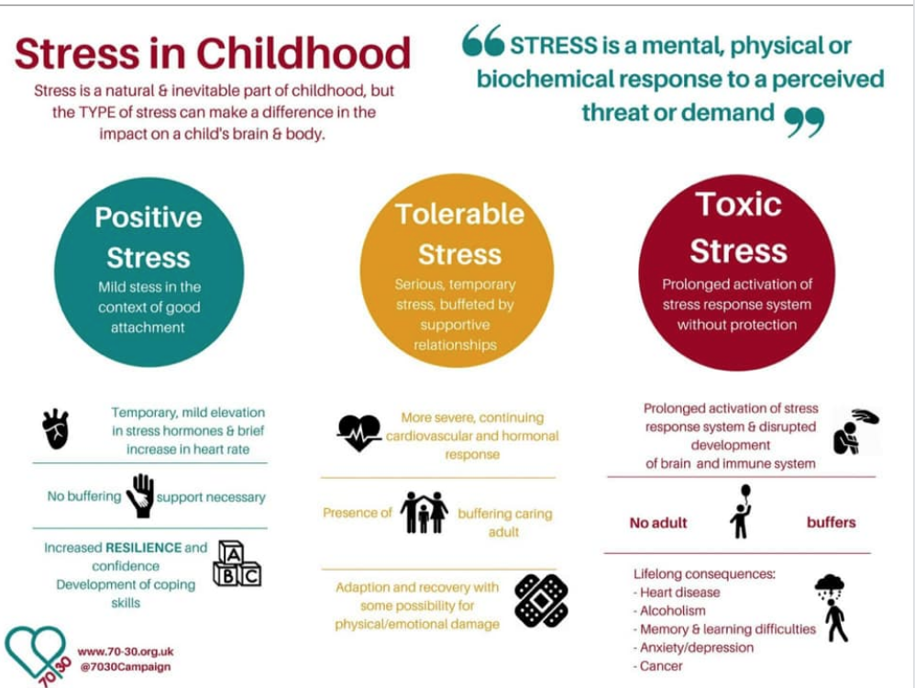

Slide 27

General Strategies
Relationships
Routines
Warn before changes
Choices
Clear limits
Safe spaces
Answer questions about trauma
Understand link
Anticipate triggers
b/w trauma &
behavior
Center
on Di and Com
sability munity

Slide 28
BSP Strategies Based on FBA
TFI
Setting Event Strategies
understanding and addressing precipitating factors (if possible)
Antecedent Strategies
redesigning the learning and environments to prevent problem behaviors
Behavior Teaching Strategies
defining, modeling, practicing new behaviors
Consequence Strategies
implementing specific to generalizable reinforcement
Ce on Disab
nter
teaching
ility
and Community

Slide 29


F-BSP Strategy Types
Setting Antecedent
Behavior
Consequence
Strengthening relationships
Home-school communication
Home-to-school reinforcement
Engaging families
Coordination with community providers
Providing choices
Transition
supports
Environmental
supports
Curricular
modification
Adult verbal behavior
Classroom management
Increase
noncontingent reinforcement
Peer support
Academic skills
Problem-solving
Coping
Social skills
Learning skills
Self-management
Independent
responding
Increased engaged time
Discontinue reinforcement of problem behavior
Group
contingencies
Increase ratio of
+ to – responses
School-to-home reinforcement
Delayed gratification
ü✓
Functionally equivalent
Cente on Disabilit and Communit
Inclusio
r y y
Peer modeling
ü✓
Behaviorally incompatible
n

Slide 30
Setting Event Strategies
WHAT WE CAN CONTROL
WHAT WE CANNOT
Engaging families
Structure / schedule
Classroom accommodations and modifications
Home/school communication
History of trauma
Medical / physical conditions
Temperament
Sensory profile
Carry-in issues

Slide 31
Setting Events can influence the function of behavior
Understanding setting events is critical to understanding the function of behavior
FBA process can reveal critical setting events that influence the function of behavior
Life Space Crisis Intervention interview process can help identify these setting events
Trauma can influence behavior in very broad ways—ability to cope; resilience

Slide 32
F-BSP Activity
Use the Setting Events Interventions Brainstorming Tool in your Intensive Level F-BSP Appendix page 15
List some setting event strategies for your student in the BSP (pg. 9)
Notes:
Jean

Slide 33
Antecedent Strategies
Antecedents are the events that immediately precede a behavior.
Antecedent strategies are created to discourage challenging behaviors and to promote efficiency of replacement behaviors
This is where the power of a behavior plan truly resides
Notes:
Teri

Slide 34
Antecedent Strategies
Examples
Eliminate the antecedent altogether
Modify task to incorporate student interests
Make task more meaningful
Reduce task difficulty level
Break task down, given first part only
Prompt alternative or replacement behavior
Take a proactive break
Change the routine
Give a choice
Change language & tone used in giving the direction
Notes:
Change routine – example of student resisting coming to Circle starting with sitting and listening – change first Circle activity to singing a song

Slide 35
F-BSP Activity
Use Antecedent Interventions Brainstorming Tool in your F-BSP Appendix pg. 16
List some antecedent strategies for your student in the BSP (pg.9)

Slide 36
Behavior Teaching Strategies
Acquisition Challenges
Absence of knowledge for executing skill or failure to discriminate which social behaviors are appropriate in specific situations (can’t do)
Performance Challenges
Skill is present in repertoire, but student fails to perform at acceptable levels (won’t do)
Fluency Challenges
Lack of exposure to sufficient or skilled models of social behavior, insufficient rehearsal/practice or low rates or inconsistent delivery of reinforcement of skilled performance
Center

Slide 37
Behavior Teaching – Adapt your social skills curricula
Social skills curriculum must match the specific need.
An ideal curriculum does not exist.
Basic set of “Preferred Teaching Practices” exists.
Initially, learning how to teach social skills takes time and energy.
And there must be a plan to prompt and reinforce social skills in the natural context.

Slide 38
Behavioral Skills Instruction at the
Intensive Level
Link with functional assessment and behavior planning
Create individualized plans within the context of the Universal (school-wide) social skills instruction
Pre-teach, pre-correct, re-teach
Integrate what the student does well
Evidence of generalization should include school, home, and community

Slide 39
F-BSP Activity
Take one of your targeted interventions from your inventory and plan how you can adapt it to teach one of the replacement behaviors in your F-BSP for your student
Use the Behavior Teaching Interventions Brainstorming
Tool, pg. 17 in F-BSP Appendix
List some Behavior
Strategies in your
student’s F-BSP

Slide 40
Consequence Strategies
Minimize reinforcement for behavior targeted for decrease
Redirect and reinforce alternative behavior
Increase reinforcement for desirable behavior
Note: consequence-based interventions should be designed in combination with teaching strategies
Center

Slide 41
Consequence Strategies
Examples:
Reinforcement (positive or negative) to increase alternative or desirable behaviors
Extinction
‘Punishment’ to decrease problem behaviors – e.g., ‘time out’ is designed to be punishment
Non-contingent reinforcement to reduce the value of current reinforcers for problem behavior (i.e. provide sensory input all the time to reduce value of disruptive sensory-seeking behavior)
Redirection
Center

Slide 42
F-BSP Activity
Use the Consequence Intervention Brainstorming Tool, F-BSP Appendix, page 18
List some consequence strategies for your student in the BSP (page 9)

Slide 43


Resources for Interventions
www.pbisworld.com
http://www.cccoe.net/social/skillslist.htm
Center on Disability and Community
Inclusion

Slide 44
5 Evaluation (BSP)

Slide 45

Step 5: Evaluation
TFI
Referring to measurable goals
Fidelity of implementation
Progress toward goals
Making data-based decisions
Center on Disability

Slide 46
F-BSP Activity
Refer to the Stage 2 Goals on p. 2 of your BSP
Further refine these goals in light of your BSP interventions
Record your newly refined goals on the Long & Short-Term Behavioral Goals of the Evaluation section of your
F-BSP (p.11)

Slide 47

Evaluation: SWIS-ISIS Demo
www.pbisapps.org

Slide 48
Activity #13
Decide what data system you will use to track your intensive-level data. Record this in the Create a System for Managing the Daily Data section of your Intensive Level Roll-Out Plan

Slide 49
Measuring Fidelity
TFI
Adherence Are minimum components of intervention strategies being implemented?
(e.g., teacher providing praise when replacement behavior occurs)
Quality
How well is the plan being implemented? (e.g., staff gave student reminder sheet, but didn’t review it)
Center

Slide 50
F-BSP Activity
For your student, determine how you will evaluate fidelity of implementation of your BSP plan. Record this in the Evaluation Procedures section of your student’s BSP.

Slide 51
Behavior is improving
Positive behavior change
Behavior progress & Good fidelity
Extension
Shaping
Fading
Self- Management
New settings
Delayed gratification
New people
Intermittent schedule
Center on Disability and Community

Slide 52
Behavior is NOT improving
Data indicate behavior not improving
Interventions implemented with fidelity
Interventions not implemented w/ fidelity
Focus on Relationships
Hypothesis incorrect
Strategies too difficult or time consuming
Interventions are insufficient
BSP does not match teacher context
Teacher experiencing intervention drift

Slide 53
When Starting New
Interventions…
Things may need to be tweaked right away – or not!
Things often get worse before they get better
  Why?
  How can we be proactive?

Slide 54
CRISIS PLAN
Desired Behaviors
Consequences
Setting Events
Problem Behaviors
Antecedents
Consequences
Alternative Behaviors

Slide 55
School-wide Crisis Plan
Starts with prevention:
Consistent Tier 1 strategies are in place
Safety Plan posted and practiced
All staff trained in de-escalation and personal safety

Slide 56
Crisis Response
Crisis Team: Small group of 3-5 trained staff available to respond to crises
Does your school have a team?
Who needs training?
School-wide procedure established for calling crisis team in
Does your school have a procedure?

Slide 57
Crisis Prevention/Intervention Plan
Situation (triggers/stressors)
Coping Strategies
What is needed to feel safe in crisis
Key support people to contact
What to do to manage a crisis
What not to do
Conditions for emergency room, police, hospital
Coordinated
Services Plan
Proactive Crisis
format

Slide 58
Taking Care of Yourself
Recognize signs
Irritability
Difficulty planning & concentrating
Numb
Intensive feeling
Don’t go it alone
Teams
Administrators
Colleagues
Recognize as occupational hazard
“cost of caring”
NOT weakness
Seek help with own trauma
Education
Talk to professional
Attend to self care
Eat well
Exercise
Sleep
Laugh & Cry

Slide 59
F-BSP Activity
Complete the Proactive Crisis Plan for your student in the BSP, p. 10
If your student is not at-risk for crisis, identify a student who is and complete the plan with respect to that student
Identify who needs to be part
of a planning meeting to
finalize the Proactive Crisis
Plan after you get back

Slide 60
What is a mental health crisis?
What is a mental health crisis?
Any situation in which the child’s behaviors puts them at risk of hurting themselves or others and/or when the adults aren’t able to resolve the situation with the skills and resources available.

Slide 61
When should you refer?
Physical symptoms
Self-regulation difficulties
Inconsistent academic performance
Over or under-reacting to events
Severe reactions
Long duration (more than 1 month)

Slide 62
Effective Mental Health Interventions for Trauma
Effective Mental Health Interventions for Trauma
Education about trauma
Helping re-establish a sense of safety
Teaching techniques for dealing with overwhelming emotional reactions
An opportunity to talk about and make sense of the traumatic experience in a safe, accepting environment
Involvement, when possible, of primary caregivers in the healing process

Slide 63




Consider an Interconnected Systems Framework
TFI
School
DCF
Family
Services
Families
Mental Health

Slide 64
Did we achieve what we set out to do?
Increased fluency in VTPBIS – systems, data and practices
Used data to guide action planning
Practiced the use of the VTPBIS Behavior Support Plan
Begun the development of an Intensive Implementation Plan and roll-out activities
Planned and scheduled year-long meetings
Had a good time together!

Slide 65
Get Ready for Next Year
Recommended Steps:
  Set aside a time to finish/revise your Workbook and Action Plan - schedule this now
  Obtain your SWIS License (optional)
  Consider BEST/Act 230 funding (training and coaching)
  Plan your professional development for next year
    VTPBIS Professional Learning Calendar

Slide 66
Vermont PBIS System of Support
SUPPORT LOOPS
School Level:
School
Coordinators
SU/SD Level:
SU/SD Coordinators
State Level:
TAs
Trainers
Coaches
Leadership Teams at ALL Levels of Support
FEEDBACK LOOPS
Notes:
We’ve learned the importance of identifying a contact at each level of the cascade.
We’ve learned that the beauty of a healthy cascade is that it will continue to sustain if one piece is missing….

Slide 67



VTPBIS State TAs
Three types of TA to VTPBIS schools and SU/SDs:
1. SYSTEMS: Specific supports include:
Determining readiness for VTPBIS training at all tiers;
Identifying other VTPBIS Professional Learning opportunities;
Seeking resources to support VTPBIS implementation; and
Understanding how to access VTPBIS Coaches/Trainers
2. DATA: Specific supports include:
Understanding and using the VTPBIS data tools (School-wide Evaluation Tool; Tiered Fidelity Inventory; Self-Assessment Survey; SWIS, etc.);
Assistance with problem solving using data; and
Assistance with developing and sharing data with stakeholders
3. PRACTICES: Specific supports include:
Implementing PBIS with fidelity at all tiers;
Identifying evidence-based practices; and
Consultation about implementation dips

Slide 68
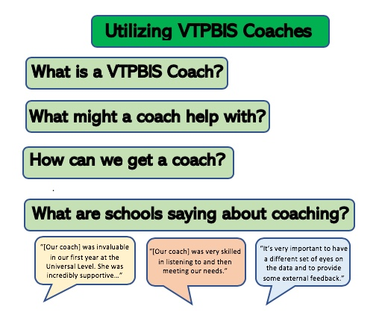

Slide 69


Stay Connected
https://www.facebook.com/groups/PBISVermont/
https://twitter.com/vtpbis
Please share all of the awesome things you are doing by using #VTPBIS or @VTPBIS

Slide 70
THANK YOU!

