Slide 1
PBIS
Targeted & Intensive
Supports
Dothan Brook School

Slide 2
It’s a Process!
(be patient)

Slide 3
2009-10 Tier 1 - Universal
2010-11 Continued Universal
2011-12 Tier 2 - Targeted
Reinvigorated Universal
2012-13 Expanded Targeted
Added to Universal (screening)

Slide 4
2013-14 Tier 3 - Intensive (mostly Wraparound)
Second Step school-wide
Tweaked Universal
Deepened Targeted
2014-15 Firing on All Cylinders!
Tweaked Universal
Adapted & developed K-1 Targeted supports
Individual goals on CICO forms
Expanded FBA/BSP
ISIS
Wraparound

Slide 5
2015-16 Continuous Improvement
All new staff on a PBIS team
Tweaked Universal
Improved K-1 Targeted supports
New Targeted review format
Standardized BSP development process
Year-long staff training - BSP process
Group “FBA” and “BSP”
Continued work toward Trauma-Informed

Slide 6
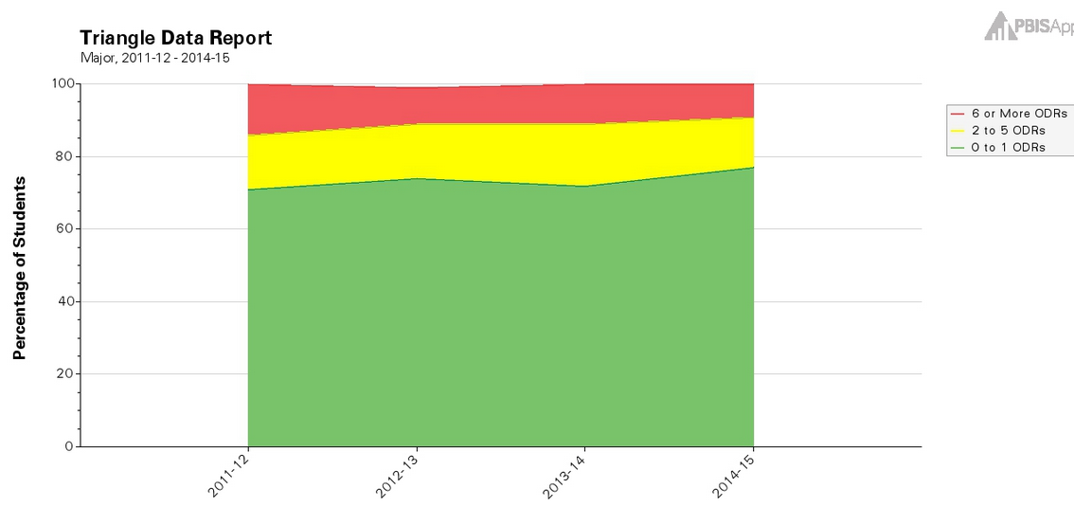

Slide 7
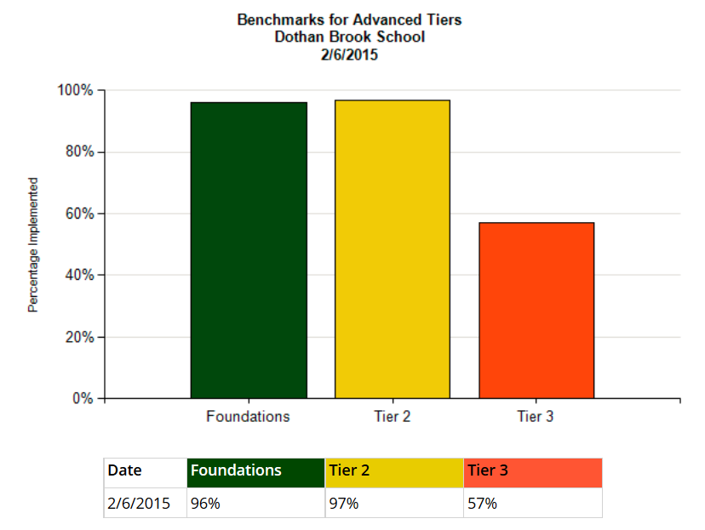

Slide 8
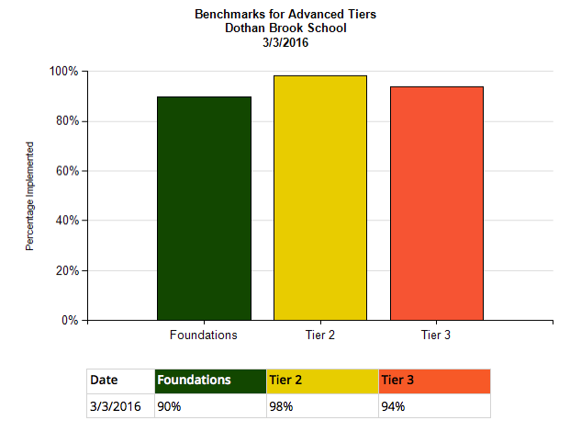

Slide 9
Menu of Targeted Supports
Otter Club
CICO
Structured Breaks
Processing Breaks
Recess Planning
Teacher Check, Connect, and Expect
Academic Support
Gear Up
Social Skills Groups
Internalizers Groups
Mentoring
Behavior Plans
FBA

Slide 10
Otter Club
Behavior Supports
CICO
Structured Breaks
Processing Breaks
Recess Planning
Supported Lunch
Academic Supports
Work “Breaks”
AM Homework Club
Reading/homework time during check out (all CICO students)

Slide 11
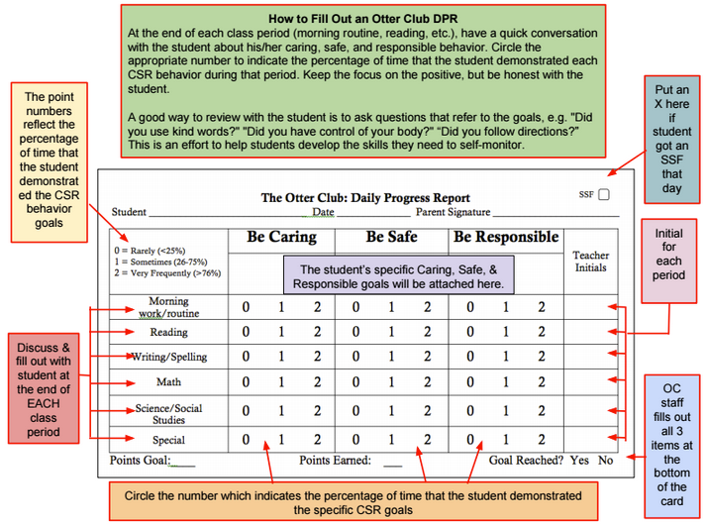

Slide 12
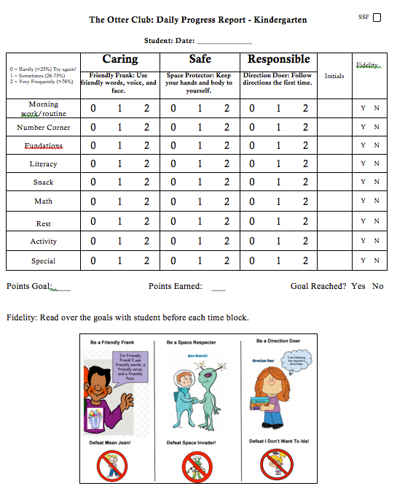

Slide 13
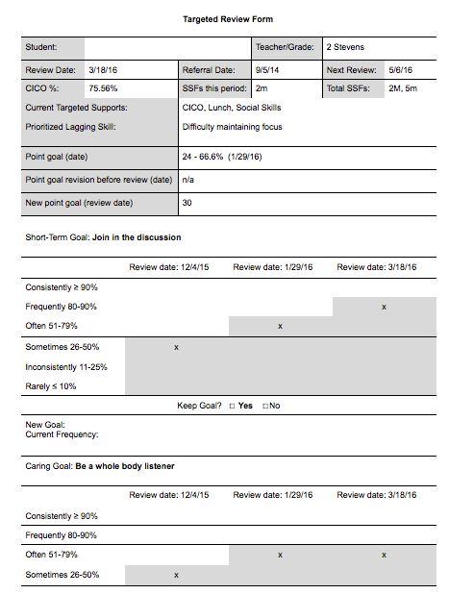
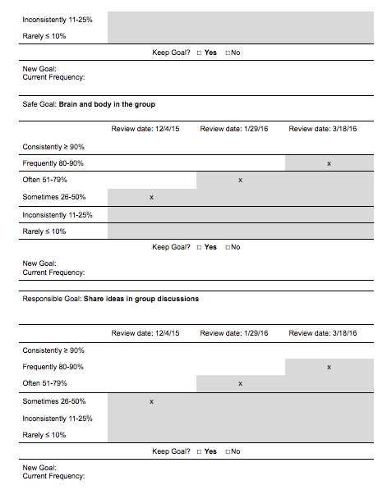

Slide 14
Targeted Supports Provided 2014-15
20 CICO
18 Structured Breaks
9 Processing Breaks
15 Lunch in OC
2 Recess Planning
9 Teacher Check & Connect
5 Gear Up
13 Social Skills Groups
16 Confidence Boosters Groups
2 Mentoring

Slide 15
Targeted Supports Provided 2014-15
50 Students*
6 - Kindergarten
17 - 1st Grade
6 - 2nd Grade
10 - 3rd Grade
7 - 4th Grade
4 - 5th Grade
* includes some Intensive level students who utilize Targeted supports

Slide 16
Intensive Supports
Wraparound
Coordinated Service Plan (CSP)
Family Safety Plan (FSP)
FBAs
BSPs
Special Ed/504 Services

Slide 17
Intensive Supports Provided 2014-15
19 Wraparound
includes Coordinated Service Plans, Family Safety Plans, DCF Treatment Team
17 Behavior Support Plans

Slide 18
Intensive Supports Provided 2014-15
27 Students
8 - Kindergarten
3 - 1st Grade
2 - 2nd Grade
5 - 3rd Grade
3 - 4th Grade
6 - 5th Grade

Slide 19
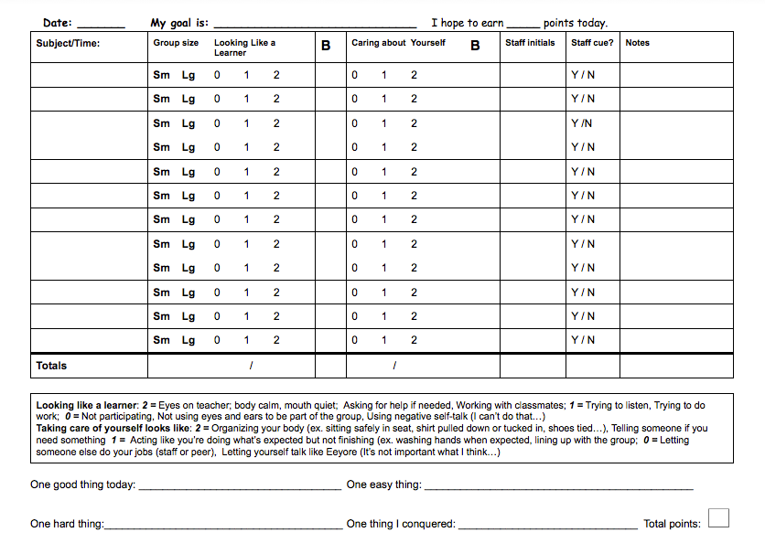

Slide 20
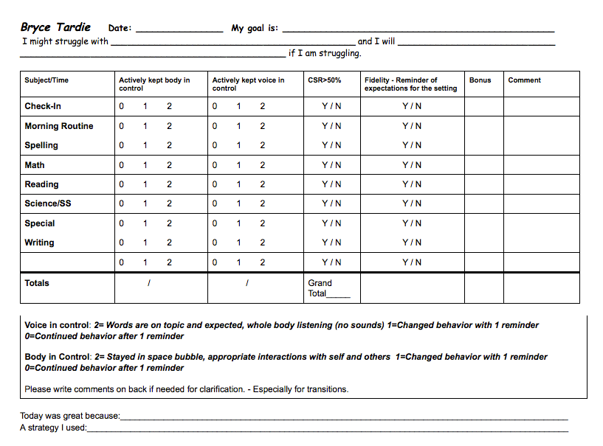

Slide 21
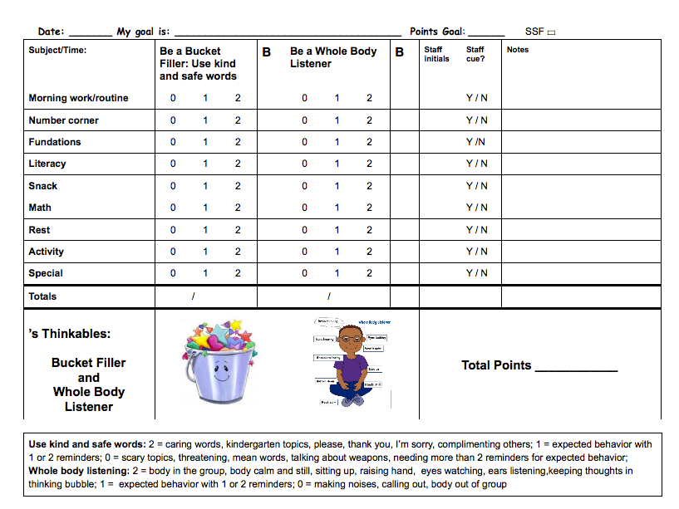

Slide 22
Behavioral Improvements 2014-15
 | 2014-15 | 2013-14 | 2012-13
# major ODRs (exclude top 5) | 290 | 443 | 399 (fidelity issues)
# students with major ODRs | 79 | 108 | 98 (fidelity issues)
# students with ≧6 ODRs | 14 (8.55%) | 18 (10.83%) | 17 (10.81%) (fidelity issues)

Slide 23
Academic Improvements 2014-15
Science NECAP
2013-14 67% at or above standard
2012-13 57% at or above standard
Reading
2014-15 & 2013-14
all 2nd graders at or above grade level

Slide 24
Goals for 2015-16
Universal
Increase frequency of universal team meetings
Create a process to orient new staff and students to PBIS
Targeted
Develop/implement data markers for non-CICO supports
Utilize nursing visit data to identify student need

Slide 25
Goals for 2015-16
Intensive
strengthen Wraparound by increasing parent engagement
develop process for monitoring FBAs
teaching & coaching student
supporting students’ teams to increase fidelity
increase and expand use of ISIS
train all special educators & paras to develop, implement with fidelity, track, & monitor BSPs through ISIS

Slide 26
Behavioral Improvements 2013-14
26% decrease in major ODRs
2012-13 487 majors (grades 1-5)
2013-14 362 majors (grades 1-5)
47% decrease in rate of major ODRs for “intensive” students (continuously at DBS) from 2010-11 to 2013-14

Slide 27
Academic Improvements 2013-14
85% of grades 1-5 students reading at or above the standard
80% above the standard
2013-14 NECAP writing results 12% increase over 2012-13
68% met or exceeded the standard (highest score ever)

Slide 28
Benefits
Improved
student behavior
student learning
student feelings of belonging
reduced student shame
student responsibility & willingness to try

Slide 29
staff understanding of behavior
staff responses to behavior
student/staff/parent understanding of expectations
family engagement
staff morale
sense of community

Slide 30
Management
Principal as chief cheerleader & problem-solver
Universal coordinator & Universal team
Targeted/Intensive coordinator
Targeted paraprofessional
Targeted team
Intensive team/Wraparound teams

Slide 31
Exploring/Implementing
Create a strong team of natural leaders!
Provide clear, engaging, ongoing information
Principal MUST be an actively involved supporter/encourager/good-cop enforcer
Build in staff rewards too
Just Do It!!!! (and have fun!)

