Slide 1

Facilitating Data Days
Presented by the VTPBIS State Team
October 2020
Notes:
Sherry

Slide 2
Welcome!
You will be muted during this session. Please use the chat box or raise your hand.
You can show or hide your video.
This session is being recorded
All materials can be found here: https://www.pbisvermont.org/evaluations/data-days-materials/

Slide 3

Always Start with Data
Attending today’s Data Day Session:
18
participants
8
SU/SDs
Notes:
Sherry

Slide 4

What is data-based decision making?
Still learning and growing
We know how to do it, now we’re working to sustain it
Very fluent
and very effective
Becoming Data Based
How are you currently embracing a data-based decision-making process that leads to results?
Pick a color that matches your experience.
Type into the chat box about what might help you get to the next color.
Notes:
Sherry

Slide 5

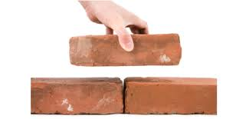
Purpose
To build competence and confidence in your role as facilitators of data review
To help School/SU Leadership Teams plan PBIS improvements based on a review of data and the use of a problem-solving/decision-making process
To develop internal capacity for continuous PBIS problem solving and planning
Notes:
Sherry

Slide 6
Objectives:
By the end of this training, you will have:
  Identified specific outcomes you would like to achieve
  Understood how PBIS data can help you measure progress toward outcomes
  Consider the use of PBIS fidelity data to prioritize focus areas
  Considered Team Initiated Problem Solving (TIPS) model as a process for data-based decision making
  Used “Big 7” behavior data to identify problems and develop solutions
  Developed a plan for continuous data review and problem solving
  Discussed strategies for sharing data with stakeholders
Notes:
Sherry

Slide 7
Supporting
Staff Behavior
Supporting
Decision Making
OUTCOMES
Systems
Data
Practices
Supporting Student Behavior
Notes:
3
DATA

Slide 8
Big Ideas About Data
All data should serve a purpose
Collect data with fidelity
Be prompt about looking at data and acting upon it
Use multiple sources of data to confirm what you see
Use data to support, not punish
Notes:
Sherry

Slide 9

Start with Outcomes
How will you know if PBIS is working if you are not sure where it should be taking you?
Notes:
Amy

Slide 10

What Are Your Outcomes?
Outcomes should be:
  Locally determined
  Contextually and culturally relevant
  Observable and measurable
  Summarized in goal statements
Consider using a “SMART Goal Format”
Notes:
Amy

Slide 11
Sample Outcomes
Reduce problem behaviors
Increase engagement
Reduce bullying
Increase attendance
Decrease referrals for Special Education
Increase school morale
Improve academic scores
Notes:
Amy

Slide 12
Sample Outcome Statements
“Given school-wide implementation of PBIS with fidelity, we will decrease the number of student suspensions and expulsions by 10% by the end of the school year.”
“During times of remote learning, 80% of students will be engaged in synchronous instruction.”
Notes:
Amy

Slide 13
1a. Outcomes Breakout Group Activity
Think about the main reason your school is implementing a social/emotional/behavioral framework (i.e. PBIS).
Draft an outcome statement that is specific, (observable and) measurable, achievable, realistic, and timely (SMART).
How will you ensure that all students will experience the same results?
    Use the PBIS Smart Goal Template to record your outcome statement. We’ll hear a sampling of responses.
Notes:
10 min

Slide 14
Type into the chat box:
What data do you collect/use to assess the social/emotional/behavioral strengths and challenges at your school?
How do you use this data for decision-making?
Notes:
sherry

Slide 15
Types of Data to Consider
Intensive:
TFI
I-SWIS
EST
FBA/BSP
Targeted:
TFI
SWIS-CICO
EST
FBA/BSP
Universal Screening
Universal:
TFI
SAS
SWIS
Attendance
Grades
School Climate
Family Engagement
Weekly Check-In
Notes:
Sherry
What else?

Slide 16
Data help us ask the right questions.
They do not provide the answers.
Notes:
Assess current status and fidelity of implementation (school-wide)
Assess impact on students
Prioritize areas for change
Acknowledge incremental success along the way
Show staff you value and use their input to make changes (SAS)
Reward staff and student performance
Determine breaks between “roll-outs”
Share results with stakeholders

Slide 17
1b. Outcomes Breakout Group Activity Revisited
Review your Outcomes Statement. What data will you use to measure progress?
Notes:
5 min

Slide 18
The Tiered Fidelity Inventory (TFI) Will Help you Get to Outcomes
Notes:
Amy

Slide 19
TFI
What? An efficient and effective validated measure to assess fidelity of core PBIS features at all 3 tiers – Teams, Implementation, and Evaluation
Why? To guide and sustain effective implementation of PBIS
When? Expectation is once a year for all schools
  Window open January 1st - March 31st (for TFI and SAS)
  Consider completing TFI more than once to monitor/assess progress
  Contact Anne Dubie if you would like your window opened
  Teams should anticipate 30 minutes to complete each tier’s assessment the first time
Upcoming TFI Webinar: January 27th
  Registration: https://redcap.med.uvm.edu/surveys/?s=P9XLWME9NR
Notes:
Amy

Slide 20
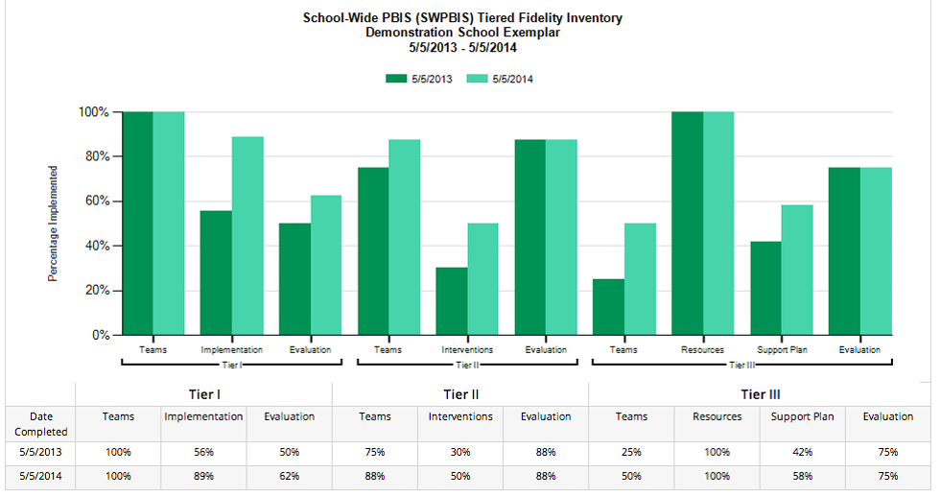
Example Subscale Report
Notes:
Amy

Slide 21
After Assessment
Analyze data:
  Total score report
  Subscale report (broken down by tier)
  Sub-sub scale report (broken down by components)
  Individual items report
    Celebrate your 2’s, examine your 0’s and 1’s
    Select a small number of items (1-3) for implementation action planning
    Ask: “What are the smallest changes we can make in the next three months to improve implementation?”
    Problem solve any challenges
    Record the strategies you like on TFI Action Plan template
Notes:
Amy

Slide 22
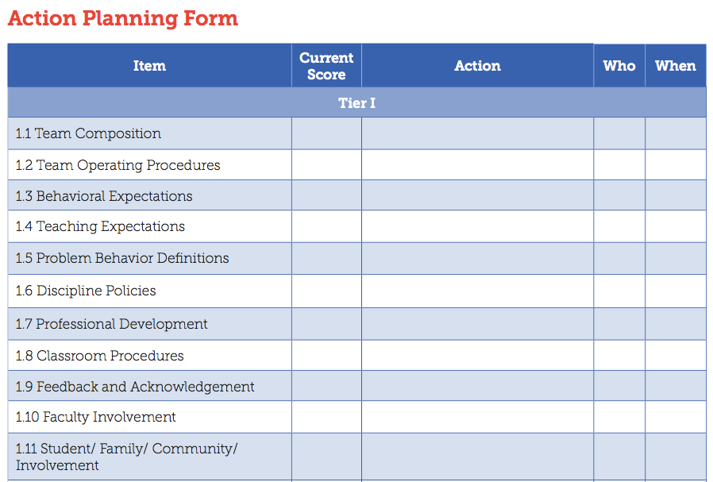
Action Planning Form
Notes:
Amy

Slide 23
Having a Strong Team Will Help You Get to Outcomes
Supporting
Staff Behavior
Supporting
Decision Making
OUTCOMES
Systems
Data
Practices
Supporting Student Behavior
Notes:
3
SYSTEMS

Slide 24
Team Meeting Systems Foundations
Why do we meet?
When do we meet?
What decisions do we make?
What data do we use to make those decisions?
How will we document our decisions?
Notes:
The leadership team plays a critical role in developing systems to support universal and targeted practices
Create procedures for all universal and targeted interventions.
Communicate to staff and families
Create links between universal and targeted systems

Slide 25
2. Team Meeting Activity
List 3-4 team meeting behaviors that you dislike the most
Identify 3-4 strategies that might help prevent these undesirable team meeting behaviors
Notes:
Mixed groups

Slide 26
What Makes a Dream Team?
Think of a successful team experience.
Accountability
Predictability
Participation
Communication

Slide 27

Characteristics of an Effective
Data Team
Notes:
Sherry

Slide 28
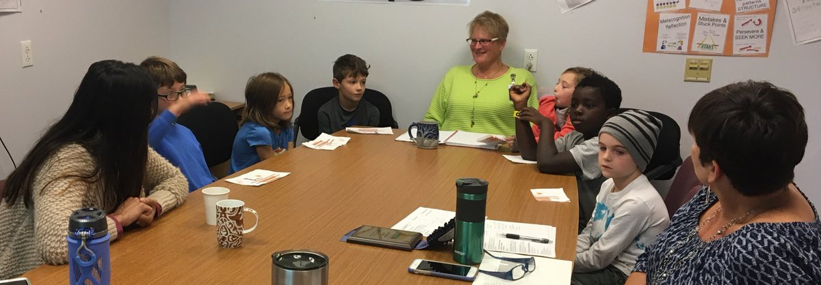
Characteristics of an Effective
Data Team

Slide 29
TFI Teaming Elements:
Teams need people with multiple skills and perspectives to implement PBIS well.
  Coordinator, behavioral expertise, administrative authority, knowledge about academic/behavior outcomes, knowledge about school operations, family/student perspective included
Specific features are necessary to ensure meetings are effective for action planning and tracking progress. Explicit features:
  Regular, monthly meetings
  Consistently followed meeting format
  Minutes taken during and disseminated after each meeting
  Participant roles are clearly defined
  Action plan current to the school year

Slide 30

“Critical to success is the administrator’s active role in supporting the school-based team process.”
– Tim Lewis
THANK YOU
Administrators!
Complete PBIS Administrator Self-Assessment for continuous improvement!
Notes:
Self-assessment (optional for Admins to complete)

Slide 31
Next steps following this webinar:
  As a leadership team:
    Review the Team Features from the TFI and create an action plan;
    and/or
    2. Complete the Leadership Team Meeting Self-Assessment tool
    Identify and celebrate 2-3 team strengths and 2-3 action steps your team will take. Be prepared to report out.
Notes:
Approximately 15-20 minutes

Slide 32
TIPS Offers:
Formal roles (facilitator, recorder, data analyst)
Specific expectations (before, during & after meetings)
Access and use of data
Use of electronic and projected meeting minutes
A structured meeting process
Notes:
Sherry
Do you sit on teams or committees?
What makes a dream team?

Slide 33
Effective meetings extend before and after the actual meeting time.
Other key roles are necessary!
BEFORE:
Set agenda and send to team
Collect data, review, and prepare summary statements
DURING:
Follow agenda & time frames
Review data
Make precision problem statements
Develop solutions
Take notes and set action items
AFTER:
Complete action items
Follow-up on action item status
Notes:
Sherry

Slide 34
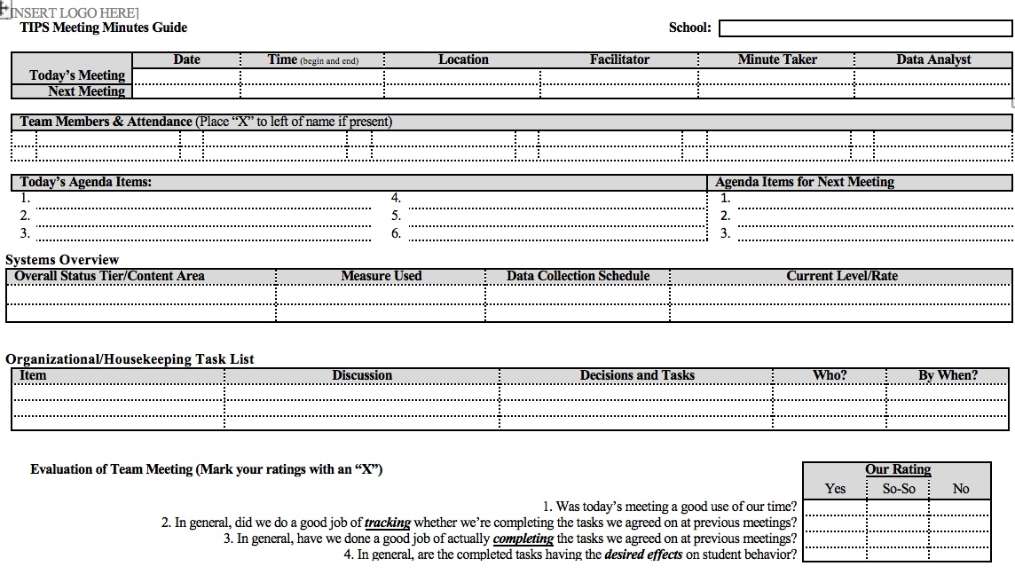
Notes:
hand out

Slide 35

Data Analyst: Role & Responsibilities
Establish the role of a data analyst (and backup person)
Use the data sources needed for problem solving and decision making (DIBELS, SWIS, etc.)
Create written data summaries in advance to assist for efficient problem solving
Launch meeting with a data summary to help define the problem with precision
Refine precision of problem statement through inferences and hypothesis
Notes:
Sherry
determining if there are problems;
jump starting a problem solving discussion; and
evaluating the impact of solutions and fidelity of implementation

Slide 36
Poll: To what extent does someone serve as data analyst in your PBIS planning meetings?
1. Data has not been used in our meetings so there has been no need for a data analyst
2. There is no one in particular serving in this role. The Team reviews and analyzes the data together at the meetings.
3. One person on the team brings data to the meeting for the team to review.
4. There is a person identified in this role who prepares data for review and points out trends in advance for discussion and problem solving at meetings.
Notes:
amy

Slide 37
Data-Based Decision-Making Can Occur at Many Levels
Whole school
Small groups or school areas
Individual student
Same basic process
Notes:
Sherry

Slide 38
One Way to Organize Data
Student | GPA | Course Failures | Days Absent | ODRs
Josh | 3.1 | 0 | 2 | 0
Mary | 4.1 | 0 | 0 | 0
Kelly | 2.8 | 1 | 0 | 1
Jacob | 1.4 | 3 | 11 | 12
Susan | 3.5 | 0 | 3 | 0
Mark | 1.9 | 1 | 5 | 7

Slide 39
Creating Your Own Data System
Student | ODRs | Be Safe | Be Kind | Be Responsible
Josh | 0 | 3 | 3 | 2
Mary | 0 | 3 | 2 | 3
Kelly | 1 | 3 | 3 | 3
Jacob | 12 | 1 | 3 | 2
Susan | 0 | 3 | 2 | 3
Mark | 7 | 2 | 3 | 1
Notes:
School created simple 3-point scale for each of the school-wide expectations
Teachers given instructions for rating students and they provide overall rating to each expectation
How would this work in your school?

Slide 40
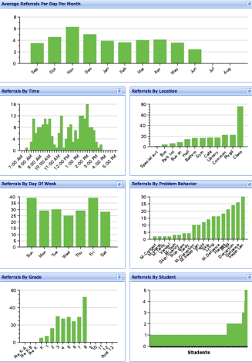
SWIS Big 7: Core Reports
Avg. Referrals Per Day Per Month
Time
Location
Day of Week
Problem
Behavior
Grade
Student
Notes:
Sherry

Slide 41
Organizing SWIS Data for Decision-Making
Universal Screening Tool
  Proportion of students with
    0-1 Office Discipline Referrals (ODRs)
    2-5 ODRs
    6+ ODRs
Progress Monitoring Tool
Compare data across time
  Prevent previous problem patterns
Define problems with precision that lead to solvable problems
Notes:
Use SWIS data to determine problems within the three tier framework. SWIS was developed to be a progress monitoring tool and is used as a universal screening tool, a progress monitoring tool, and formatted to define problems with precision

Slide 42
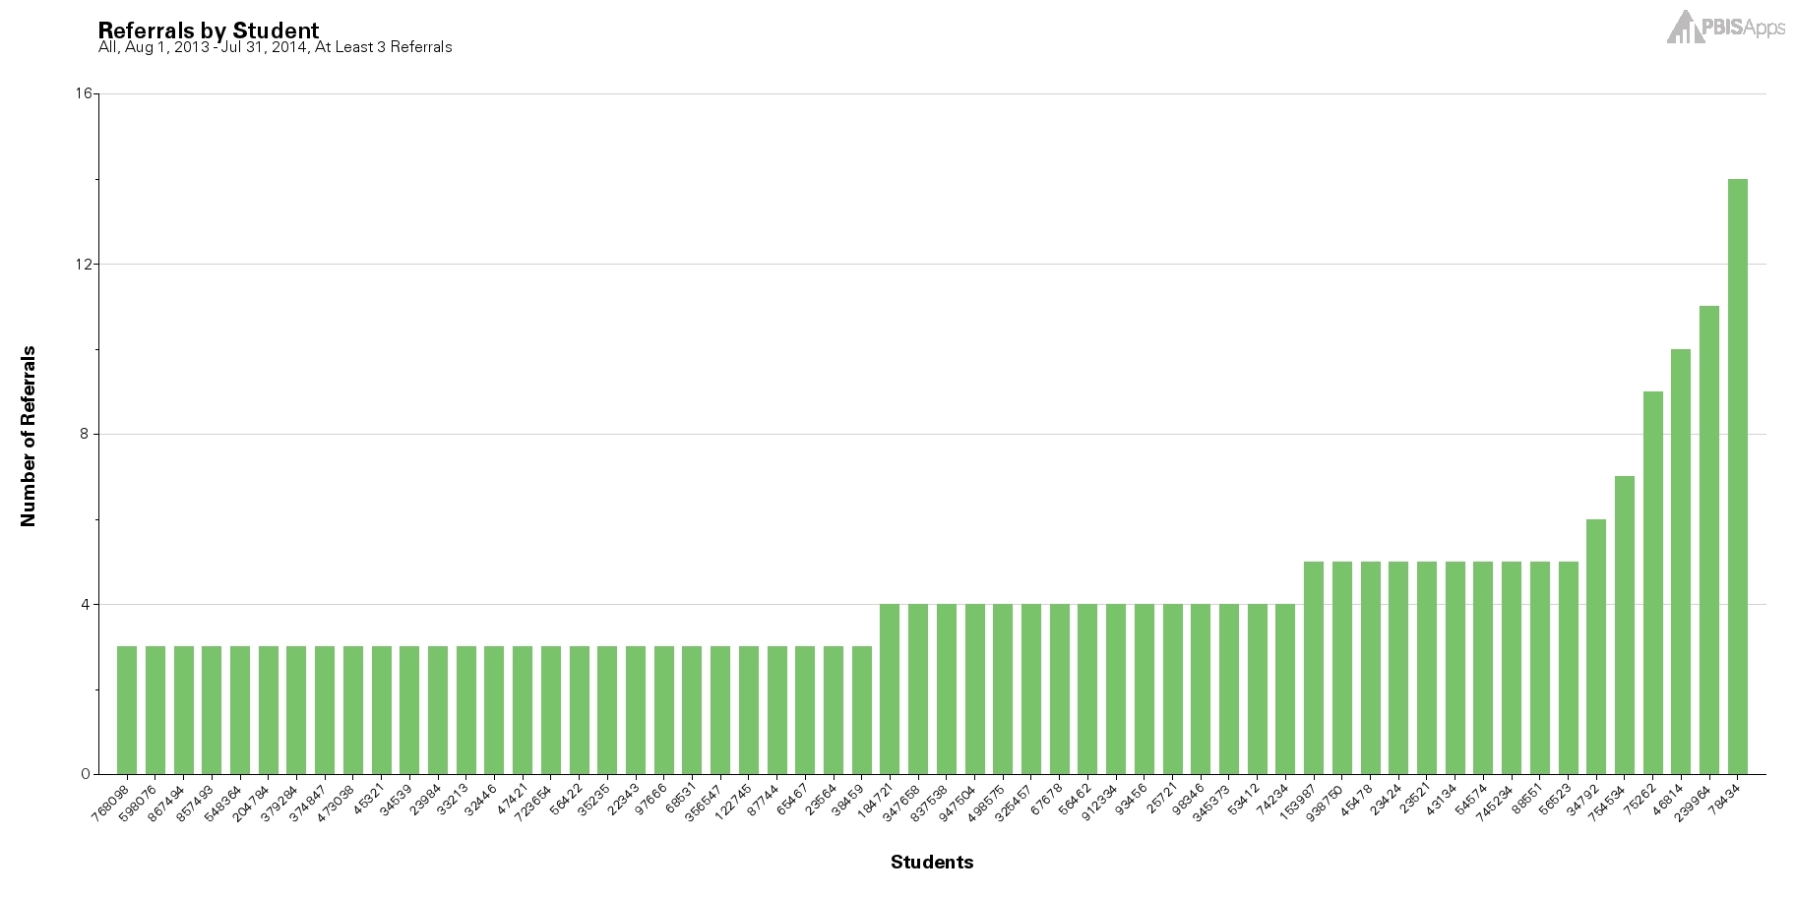

Using the Referrals by Student Report as a Universal Screening Tool
Notes:
Student with 2-5 are candidates for more support in behavior, academic, or both areas.

Slide 43
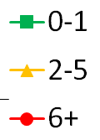
Discipline Data for Universal Screening?
Cumulative Mean ODRs Per Month for Elementary Schools
Differences become clear in October
McIntosh et al (2010)
Notes:
Based on research using SWIS data across hundreds of U.S. schools, we know that screening should start in or around October so that by November we are providing students with the level or tiers of support they need to be successful.

Slide 44
The “October Catch” Possibilities
30%
In a school of 500 students this could mean
150 less referrals
25-75 hours staff time
per school year!
20%
Notes:
In actively screening we are trying to reduce the number of total referrals, , the number of minutes a student is out of their instructional environment, the number of referrals individual students receive, and staff time spent on addressing problem behavior across the school.
PBISApps recommends screening about 6 weeks after each major break.. The October Catch, (click) the February Catch, (click) and the April Catch for example.
If we hypothesize a 20% decrease for students who would have ended the year with 2-5 referrals and a 30% decrease for students who were on target to receive 6+ referrals then some simple math tells us that a school with 500 students can reduce overall referrals by 150 and regain approximately 25-75 hours of staff time.

Slide 45

Great Article on the “October Catch”: https://www.pbisapps.org/community/Pages/The-October-Catch.aspx
Notes:
Sherry
https://www.pbisapps.org/community/Pages/The-October-Catch.aspx

Slide 46
Indicators of Possible Problems
Identify problems based on your school’s:
  Desirable and undesirable trends
  Average Referrals Per Day Per Month for this year and for corresponding months of the previous year
  Average Referrals Per Day Per Month compared to the national median
  Faculty, parent, and student opinions regarding acceptable or not acceptable levels of ODRs
Notes:
Sherry

Slide 47
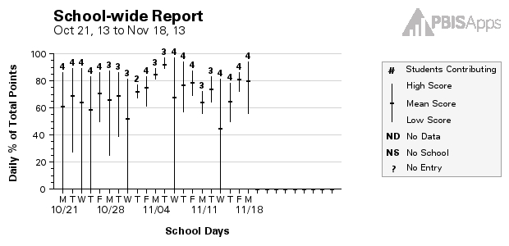
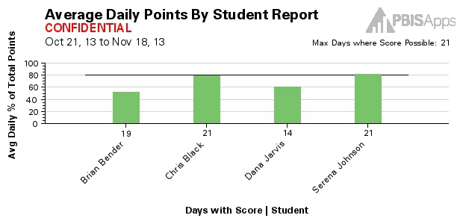
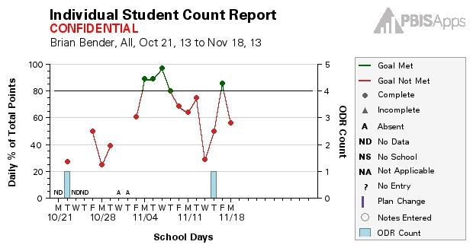
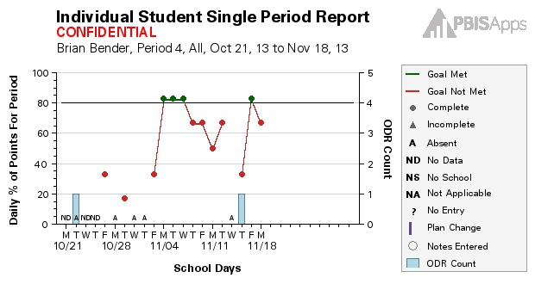
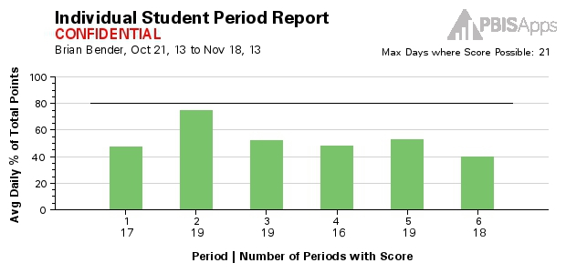
CICO - Reports:
School-wide Report
Average Daily Points
Student Count
Student Period
Student Single Period
Notes:
Sherry

Slide 48
Do you have decision rules for CICO?
Consider referring students for additional supports when:
You see failure for 2-6 weeks
Student receives 6th ODR
Five absences in 30 days
Problem behaviors become dangerous
There is a mental health concern
The family requests additional supports
Fade students from CICO who:
Consistently meet their goals for at least four weeks. This is an average across days.
Haven’t received an ODR for at least four weeks.

Slide 49
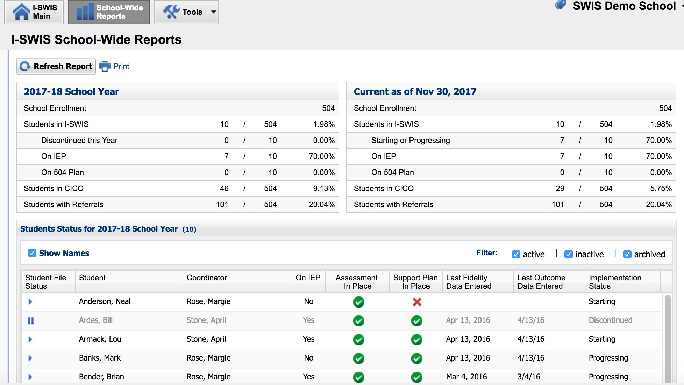
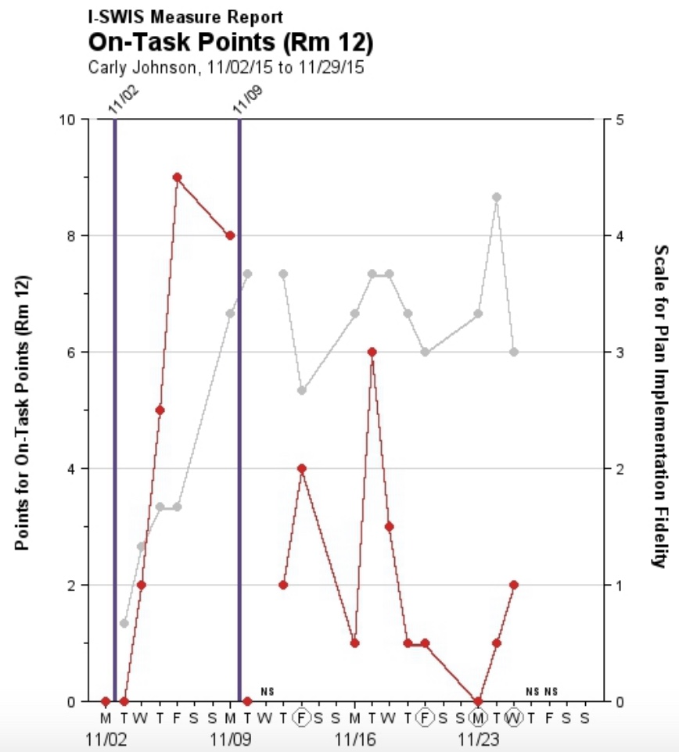
I-SWIS Reports:
Notes:
Sherry

Slide 50
Improving Decision Making
Problem
Solution
Problem
Problem Solving
Solution
Action Planning
What data tools do you use to move through data review, problem solving, and action planning?
Notes:
Sherry
Compare that to the old model of identifying a problem and then jumping right to solutions.
Instead, we’ll use our decision-making model to more clearly define the context of problems before moving into solution development.
Then those solutions are put into an action plan so that our solutions are really implemented with integrity.

Slide 51
TIPS Offers:
A process for using data to make decisions:
Formal problem solving steps that a group can use to build and implement solutions.
Access to the right information at the right time in the right format
Innovation Neutral: Use for Reading, Behavior, Math, School Improvement
Notes:
Sherry

Slide 52
TIPS Problem-Solving “Mantra”
REMEMBER to use…..
Do we have a problem? If so, what is the precise nature of our problem? (identify, define, clarify, confirm/disconfirm inferences)
What is our goal? How will we know we’ve met our goal? (what data will we use?)
Why does the problem exist, & what can we do about it? (hypothesis & solution)
What are the actual elements of our plan? (action plan)
Is our plan being implemented with fidelity & is it working? (evaluate & revise plan)
What next steps are needed?
Notes:
Sherry
Update

Slide 53
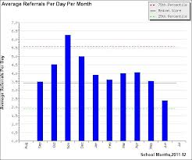


1. Do we have a problem? If so, what is the precise nature of our problem?
Notes:
What data to monitor
ODR per day per month
OSS, ISS, Attendance, Teacher report
Team Checklist/ SET (are we doing what we planned to do?)
What question to answer
Do we have a problem?
What questions to ask of Level, Trend, Peaks
How do our data compare with last year?
How do our data compare with national/regional norms?
How do our data compare with our preferred/expected status?
If a problem is identified, then ask
What are the data we need to make a good decision?

Slide 54
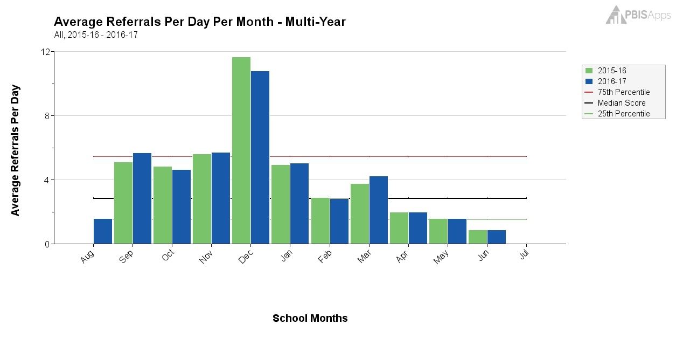
What Does this Graph Tell You?
Notes:
Sherry

Slide 55
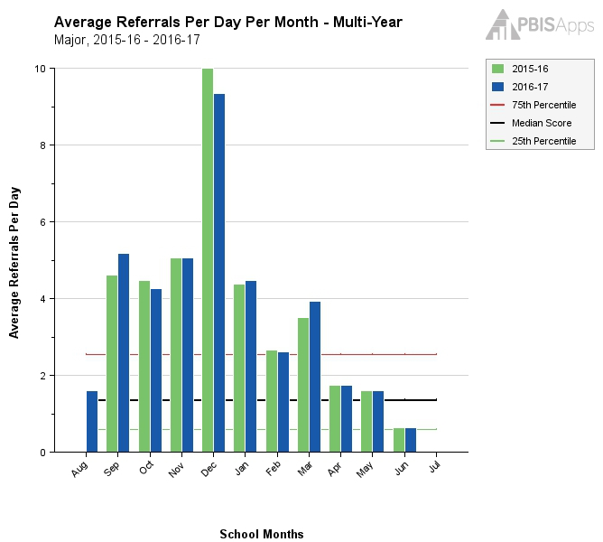
Same Graph Looking at Majors Only
Notes:
Sherry

Slide 56
What Does this Graph Tell You?
Notes:
Sherry

Slide 57
1. Do we have a problem? If so, what is the precise nature of our problem?
Question | SWIS Table/Graph
What problem behaviors are occurring? | Referrals by problem behavior
When are problem behaviors occurring? | Referrals by time
Where are problem behaviors occurring? | Referrals by location
Who is engaging in problem behaviors? | Referrals by student
Why do problem behaviors keep happening? | Referrals by motivation
What is the data we need for a decision?

Slide 58
Example: Primary to Precise
Precise Problem Statements include information about the what, when, where, who, when, and why
Inappropriate behavior is increasing
Disrespect is increasing on the playground during 3rd-6th grade recess times. This behavior seems to be motivated by desiring access to items/activities.

Slide 59
2. What is our Goal? How will we know we’ve met our goal?
Set a goal that defines levels at which the problem is no longer a problem
Set goals that are specific, (observable and) measurable, achievable, realistic, and timely
What data will you use to know that you’ve met your goal?

Slide 60
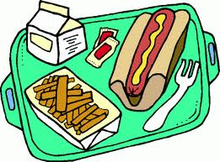
3. Why does the problem exist & what can we do about it?
(hypothesis & solution)
Problem Statement: The sixth grade boys are showing disrespectful behavior toward one another during recess.
Hypothesis: We believe they are looking for access to items/ activities.
Notes:
Sherry

Slide 61
Solution Development for Disrespect on the Playground
Prevention: Remove/alter “trigger” for problem behavior
Teaching: Define, instruct & model expected behavior
Reward: Expected/alternative behavior when it occurs; prompt as necessary
Extinction: Increase acknowledgement of presence of desired behavior
Corrective Consequence: Use non-rewarding/non-reinforcing responses when problem behavior occurs
Data Collection: Indicate how you know when you have a solution
Notes:
Sherry

Slide 62
Solution Development for Disrespect on the Playground
Prevention: Remove/alter “trigger” for problem behavior | Maintain current recess schedule but shift classes to balance numbers; add more playground activity options
Teaching: Define, instruct & model expected behavior | Reteach behavioral expectations on the playground; model resolving conflict respectfully; teach new recess games
Reward: Expected/alternative behavior when it occurs; prompt as necessary | Establish “Friday Five”: Extra 5 min of recess on Friday for five respectful days.
Extinction: Increase acknowledgement of presence of desired behavior | Encourage all students to work for“Friday Five”… make problem behavior less rewarding than desired behavior
Corrective Consequence: Use non-rewarding/non-reinforcing responses when problem behavior occurs | Active supervision and continued early consequence
Data Collection: Indicate how you know when you have a solution | Maintain ODR record and supervisor weekly report
Notes:
Sherry

Slide 63
Solution Development for CICO
Prevention: Remove/alter “trigger” for problem behavior | Review with teachers the brief protocol for checking in positively with students
Teaching: Define, instruct & model expected behavior | Teach and model to students what expectations look like in action
Reward: Expected/alternative behavior when it occurs; prompt as necessary | Pair positive feedback with points; Provide additional reinforcer at end of day for meeting goal
Extinction: Increase acknowledgement of presence of desired behavior | Acknowledge other students for demonstrating the expectations in action and why
Corrective Consequence: Use non-rewarding/non-reinforcing responses when problem behavior occurs | State expectation without responding to problem behavior
Data Collection: Indicate how you know when you have a solution | 60% of students meet CICO goal for 2 weeks
Notes:
Sherry

Slide 64

…include logistics:
Notes:
Sherry
Action Plan Elements:
Who?
By When?
Goal with Timeline
Fidelity of Implementation Measure
Effectiveness of Implementation Measure

Slide 65
Date of Initial Meeting: |  |  |  |  | Date(s) of Review Meetings
Brief Problem Description (e.g., student name, group identifier, brief item description):
Precise Problem è Statement What? When? Where? Who? Why? How Often? | Goal and è Timeline What? By When? | Solution è Actions By Who? By When? | Identify Fidelity è and Outcome Data What? When? Who? | I M P L E M E N T S O L U T I O N S | Did it work? (Review current levels and compare to goal) ê
 |  |  | What fidelity data will we collect? What? When? Who? |  | Fidelity Data: Level of Implementation Not started Partial implementation Implemented with fidelity Stopped Notes: | Outcome Data (Current Levels): Comparison to Goal Worse No Change Improved but not to goal Goal met Notes:
 |  |  | What outcome data will we collect? What? When? Who?
Current Levels: |  |  |  |  | Next Steps
 |  |  |  |  | Continue current plan Modify plan Discontinue plan Other Notes:

Slide 66

5. Is our plan being implemented with fidelity & is it working? (evaluate & revise plan)
**Report data back to staff (i.e. when you implemented this plan, ODRs on the playground dropped by 20%!)
Notes:
Sherry
Define how you will know that the solutions were implemented as planned (with fidelity)?
How often will you conduct a status review?
Define how you will know that the solutions had a positive effect on student achievement, social competence, and/or safety?
How often will you monitor student progress?
What will the data tell you when the problem is solved?
Base on team-established standard
Easier to monitor if quantifiable (“countable”)
Record on meeting minute form for progress monitoring at future meeting(s)

Slide 67
6. What next steps are needed?
Continue
Modify
Stop plan
Continue through problem solving process again
Big Idea:
Improved problem solving has a positive impact on student outcomes
(Horner, Algozzine, Todd, Algozzine, Cusumano, and Preston (in preparation))

Slide 68
Decision Making for Quality Improvement
Team assessments
Self assessments
Walkthrough reports
PBIS Assessments
  SET
  SAS
  TFI
Outcome Data
Fidelity Data
Office Discipline Referrals
Minor (staff managed) referrals
Absences
Tardiness
Climate/Culture
Academic Assessments
What else?
Notes:
Sherry
Disaggregation simply means separating something into its component parts, or break apart.
Only by evaluating both outcome and fidelity data (cause and effect) can leaders and teachers understand the complexities of student achievement (academic or behavior) and the value of our systems and practices.
We cannot begin to truly understand what it will take to achieve our intended outcomes until we understand the relation between cause and effect, how our fidelity and outcome data intersect.
Instead of segmenting data reviews (looking just at outcome or just at fidelity data) looking at the shaded section (where the data intersects) we can get a more comprehensive view of reality and can make higher quality decisions.

Slide 69
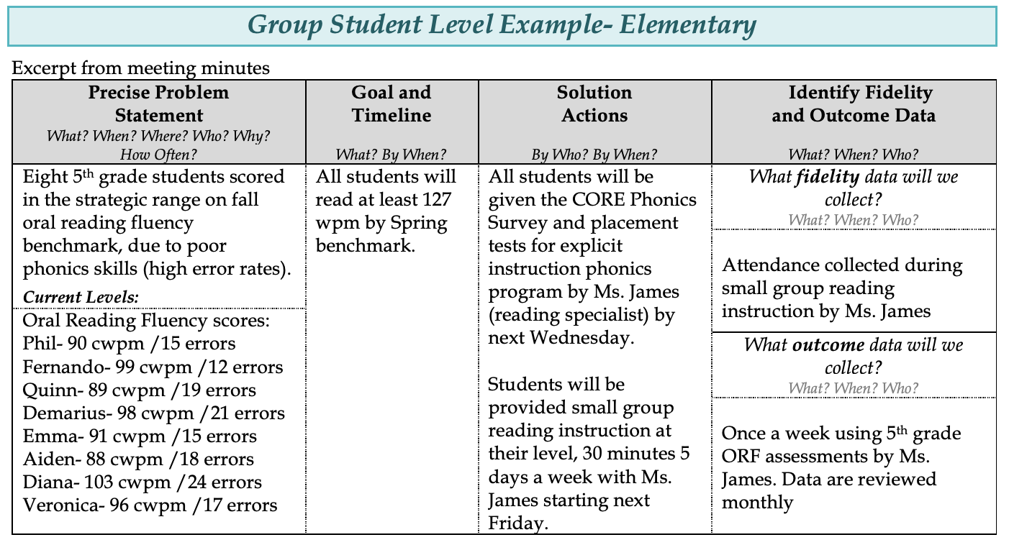
TIPS for Academics

Slide 70
Reframe and Rename ODRs!
From
Office Discipline Referral Forms
to…
Behavior Observation and Data Forms

Slide 71
Why?
  Our goal is to better reflect its intention:
  to record the behavior.
  We hope to guide schools away from it being seen as a “write up” and more toward a recorded observation of what happened (something you “write down”)

Slide 73
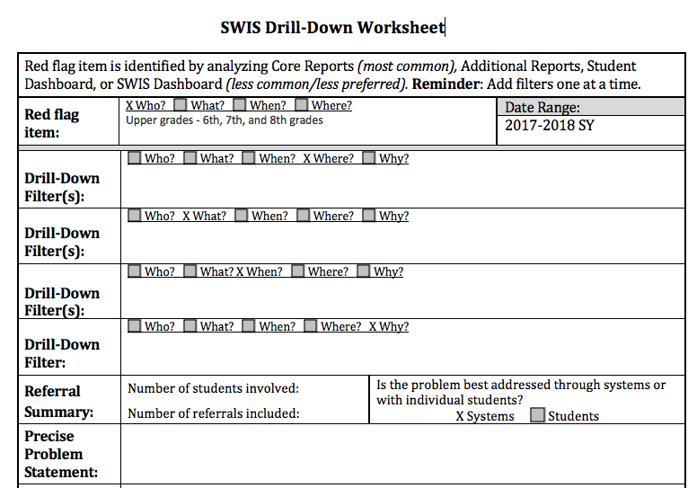
3. Activity: Let’s Practice!
www.pbisapps.org > App Demos > SWIS Demo

Slide 74
4. Activity Using your Data:
Using your TFI or Student Outcome data, answer the following questions using the TIPS Meeting Minute Form:
    Do we have a problem? If so, what is the precise nature of our problem? (identify, define, clarify, confirm/disconfirm inferences)
    What is our goal? How will we know we’ve met our goal? (what data will we use?)
    Why does the problem exist, & what can we do about it? (hypothesis & solution)
    What are the actual elements of our plan? (Use Solution Development Form)
    Is our plan being implemented with fidelity & is it working? (evaluate & revise plan)
    What next steps are needed?

Slide 75
Sharing Data
How often the leadership team shares data with all school staff has the most significant impact on whether the school sustained implementation (McIntosh, Kim, Mercer, Strickland-Cohen, & Horner​, 2015)
Builds understanding of goals, progress, outcomes – leads to buy-in
The best way to share data is the way that feels most natural, leads to effective decisions, and offers opportunities for everyone to engage in planning
https://www.pbisapps.org/community/Pages/Sustaining-Implementation-Together.aspx

Slide 76
Disseminating Data: Use Data as a Story-Telling Device
What data are you collecting?
What questions can you answer with this data?
Which of those questions tell a compelling story?
OR Which questions get to the heart of your work?
Who is your targeted audience for your story?
How could you display the data to convey the story of PBIS?
REMEMBER!
Before we can measure success, we must define success!
Notes:
Amy

Slide 77
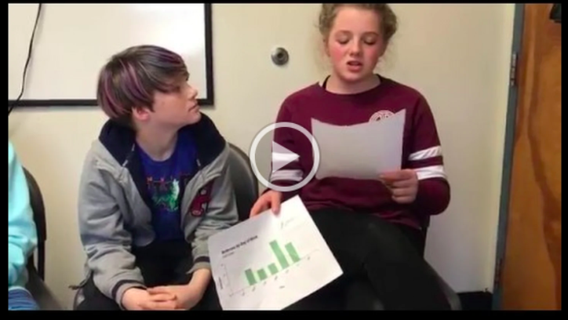
Disseminating Data: With Students!
Notes:
https://drive.google.com/file/d/1IOy3wB8OZhG41hqF3xyq8p4OannoDbVN/view

Slide 78
Activity 5. How Will You Share Data?
With a partner or team, choose 1-2 things you/your team will do to share data with others and begin planning next steps. Consider the following:
Email monthly report: give context, provide connections, suggest next steps
Create a data wall focusing on data related to school-wide goals
Invite students to reflect and plan around data
Create a PowerPoint presentation on your fidelity data (see VTPBIS Presentation Template at https://www.pbisvermont.org/wp-content/uploads/2017/12/StaffDataPresentationTemplateTFISAS2018.pptx
Share student outcome data at a monthly staff meeting. Invite all staff to participate in finding ways to improve outcomes
Present to parents, school boards, community
Utilize social media/the web (i.e. Twitter, Facebook, blog, school website)
  Examples: FWSU’s blog, Chamberlin’s Twitter, JFK’s Facebook, Newbrook’s website
Notes:
Amy
It is always a good time remember the positive impact sharing data with staff can have on achieving the valued outcomes in your building. When the whole school understands the goals and sees progress from the efforts, everyone is more likely to embrace the interventions iimplemented to meet those goals. The best way to share data is the way that feels most natural, leads to effective decisions, and offers opportunities for everyone to engage in planning.

Slide 79
Building Internal Capacity for Data-Based Decision-Making: Data Days Back at School

Slide 80
Responsibilities for Facilitating Data Review and Improvement Planning:
Schedule Data Days – Fall, Winter, Spring
Identify/enhance the role of the Data Analyst
Complete the TFI + SAS
Plan professional development around priorities identified through assessments
  TIPS/SWIS learning module
  Universal Screening
  Training in classroom management, FBA/BSP, crisis prevention and intervention, other
Notes:
Amy
The leadership team plays a critical role in developing systems to support universal and targeted practices
Create procedures for all universal and targeted interventions.
Communicate to staff and families
Create links between universal and targeted systems

Slide 81
General Recommendations for PBIS Decision-Making
Never stop doing what is already working
Always look for the smallest change that will produce the largest effect
    Avoid defining a large number of goals
    Do a small number of things well
Do not add something new without also defining what you will stop doing to make the addition possible.
Notes:
Amy
Use data in “decision layers”
Don’t drown in the data
It’s “OK” to be doing well
Decisions are more likely to be effective and efficient when they are based on data.
The quality of decision-making depends most on the first step (defining the problem to be solved)
Define problems with precision and clarity

Slide 82
Activity 6: Plan Next Steps:
Schedule Data Days – Winter, Spring
Identify/enhance the role of the Data Analyst
Plan professional development around priorities identified today. Go to: https://www.pbisvermont.org/professional-development-calendar/
Schedule date for leadership team to complete TFI
Schedule dates and process for all-staff completion of the SAS

Slide 83
Resources
TIPS Meeting Minutes Template (Google Doc version)
Drill Down Video
TIPS Resources
TIPS Meeting Videos Including Academics
VT AOE Comprehensive Needs Assessment Toolkit

