Slide 1
VTPBIS Intensive Level Training
Ken Kramberg and Jeremy Tretiak
All materials can be found here:
bit.ly/VTBEST2021

Slide 2
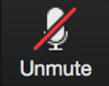
Zoom 101
Post your questions in the chat and keep an eye out for posted links or files.
Open the Participants panel to see who’s here and update your name:
* Hover over your name in the list and click “More”
* Then click “rename” to change your display name
Turn your microphone and webcam on and off
(Please stay muted when presenter is speaking)
Use the “Reactions” to raise your hand, give a thumbs up, and other interactive reactions.
You can raise your hand if you have a questions or post your question in the chat.
Notes:
Please change your name so it indicates which school you are in.

Slide 3
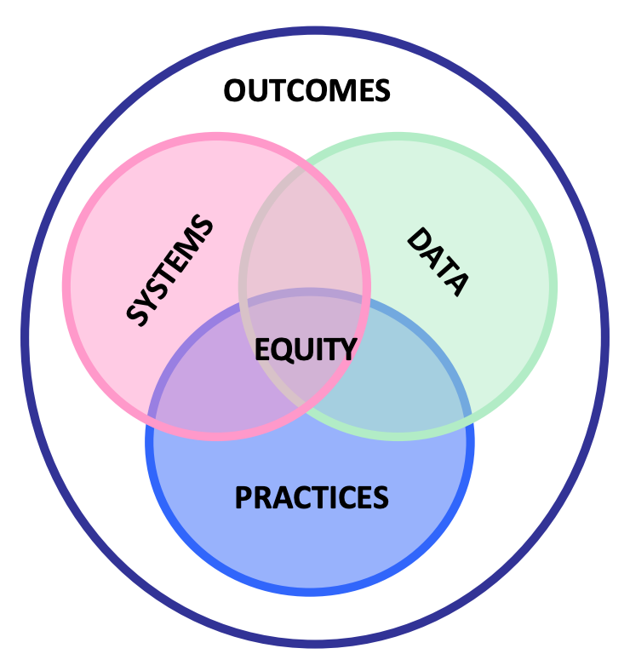
“The fundamental purpose of PBIS is to make schools more effective and equitable learning environments.”
Rob Horner, OSEP Technical Assistance Center for PBIS
PBIS is not fully implemented until it is culturally responsive.
Notes:
Unlike many initiatives or training for educators, PBIS has best shot at sustainability because it is focused on having systems (a team, administrator support, presentations to staff, assessing level of staff buy-in, procedures – things that support staff to implement practices); Data – to help make decisions; and Practices that are evidenced based reviewed by the team through looking at data.
means that EVERY CHILD receives whatever she/he/they need to develop to her/his/their full academic and social potential and to thrive academically and social-emotionally. Every child, every day. Period.
(Aguilar, 2020)

Slide 4
(Payno-Simmons, 2021)

Slide 5
Restorative Principles
Exploring Relationship
Agency & Choice
Meaningful Engagement
Responsibility/ Accountability

Slide 6
Continuum: Mindset Shift
Meaningful Participation

Slide 7
Resources for Interventions
www.pbisworld.com
http://www.cccoe.net/social/skillslist.htm
Center on Disability and Community
Inclusion

Slide 8
The Power of Relationships
The effectiveness of an intervention often hinges on the quality of the relationship with the helping adult
“People don’t care what you know, until they know that you care.”

Slide 9
The Power of Relationships
Meaningful Participation
Representation
The Effectiveness Of An Intervention Often Hinges On The Quality Of The Relationship With The Helping Adult
Well Designed and Informed Behavior Support Plans Often Fail Because The Helping Adult Fails To Establish A Positive Helping Relationship With the Child and Family
Sometimes A Poorly Designed Or Marginal Plan Is Successful Because Of The Quality Of The Relationships

Slide 10
Two Things:
Learning and Installing the Intensive Level of PBIS cannot be accomplished in a four day training/ session. We will provide follow up implementation training/coaching upon request.
This is different from other VTPBIS training!

Slide 11
Learning Outcomes
By the end of our time together, your team will have:
Increased fluency in VTPBIS – systems, data and practices
Strengthened Tier II
Used data to guide action planning
Practiced the use of the VTPBIS Behavior Support Plan
Begun the development of an Intensive Implementation Plan and roll-out activities
Planned and scheduled year-long meetings
Had a good time together!
Notes:
Talk about pace and differentiation activities

Slide 12
When you see this star…
It indicates that the information/activities on that slide correlate with an item on the TFI (Tiered Fidelity Inventory)
TFI

Slide 13
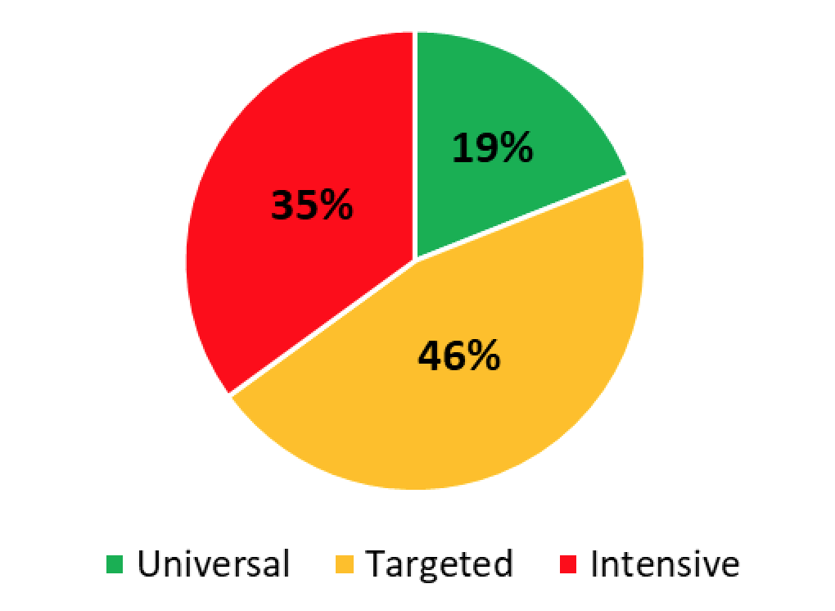
Implementation Levels (N=165)
SY 2020
165 Schools
48 SUs/SDs

Slide 14
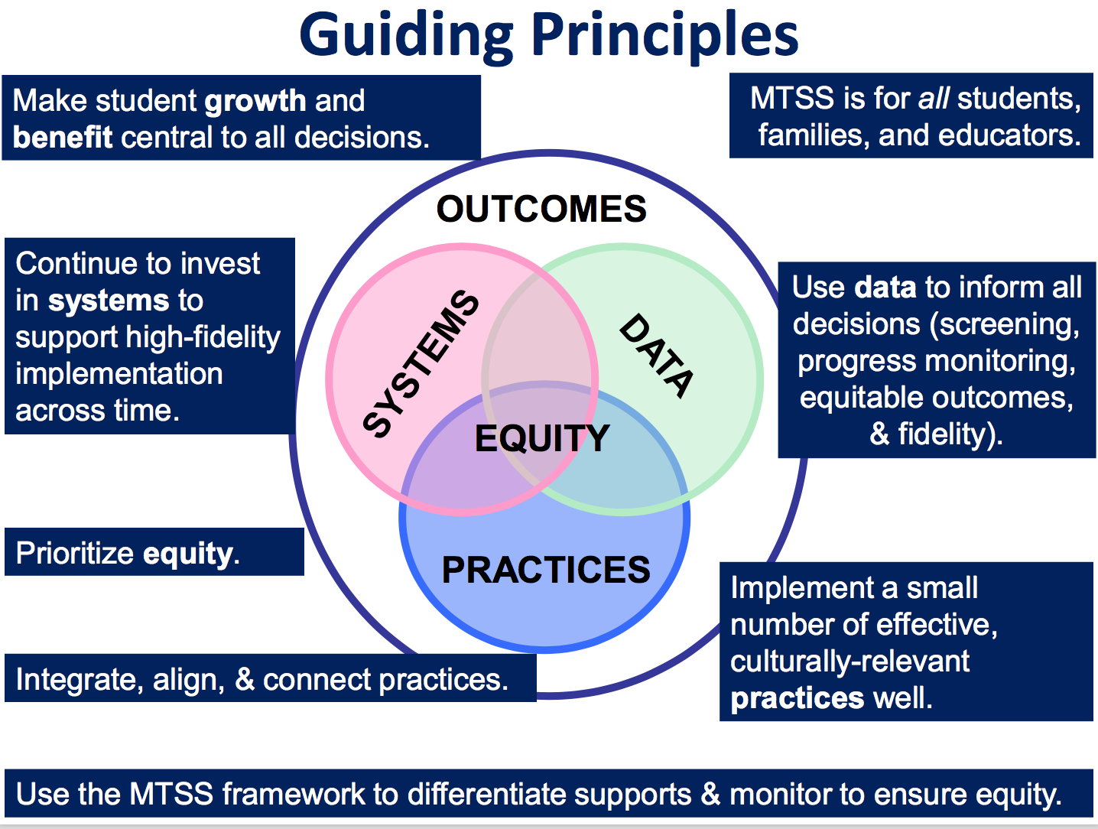
“The fundamental purpose of PBIS is to make schools more effective and equitable learning environments.”
Rob Horner, Co-Director of the OSEP Technical Assistance Center for PBIS
Notes:
Talk about MTSS
Systems: Importance of a teaming infrastructure – how are you connecting with other teams doing SEL work?
Agree that it’s a priority and communicate widely
Work with community partners Staff Handbook
Action plan
Practices: Have an understanding of SEL
Have an inventory of what already exists
Bring in community resources/interventions
Data: Formal/Informal surveys and screeners
Use data to prioritize making the smallest change for the greatest impact
Do you look at your SWIS data by ethnicity? If not, could you?

Slide 15
Setting up for Success

Slide 16
Opening Activity
Notes:
First item in workbooks

Slide 17
BEST Expectations
Be Respectful
Engage
Strengths-based
Team Solutions
Activity:
BREAK-OUT GROUPS by B, E, S,T
Talk about how you want to be together to promote these expectations in action.

Slide 18
Activity #1
In your workbook:
Create your norms and roles for your team this week
Notes:
First item in workbooks

Slide 19
Let’s Get Grounded

Slide 20
Implementation Challenge
Risk Factors
Protective Factors
Antisocial behavior
Substance Use
Disability
Mental illness
Self-management skills
Interpersonal skills
Healthy habits
Academic competence
School connectedness
Notes:
Every day we are working with students, families and colleagues who come into our schools with precipitating factors that we may or may not know about – such as mental illness, substance abuse, or disability. These risk factors can be balanced by such things as being successful at learning, being physically active and having strong social or daily living skills.
Schools that engage students in rigorous and relevant academic opportunities while promoting the development of healthy social, emotional, and behavioral routines and habits can help balance out these risk factors to overcome struggles.

Slide 21
Implementation Challenge
Protective Factors
INEFFECTIVE RESPONSE
Reactive management
Exclusion, segregation, isolation
Train & hope
Non-evidence-based practices
Subjective decision making
Low quality implementation of evidence-based practices
Risk Enhancers
Trauma
Negative modelling
Family, school, community disruption
Discrimination
School connectedness
Academic competence
Healthy habits
Interpersonal skills
Self-management skills
Notes:
Amy
However, balancing the boat becomes harder when risk factors are heavier than the protective factors due to trauma, outside influences such as negative peer modeling, family disruption, bullying, and explicit and implicit bias.
Keeping our boat afloat requires a balancing of the effects of life’s challenges with supports
As educators, we need to explicitly focus on both learning about these risk factors and the things that influence them while avoiding some of the responses that WE KNOW DO NOT WORK!

Slide 22
Implementation Challenge
EFFECTIVE RESPONSE
Trauma-informed decision making
Prevention-based behavioral sciences
Tiered support systems
Data-based decision-making teaming
Continuous coached professional development
High fidelity implementation
Proactive, competent, informed leadership
Risk Enhancers
Trauma
Negative modelling
Family, school, community disruption
Discrimination
Protective Factors
INEFFECTIVE RESPONSE
Reactive management
Exclusion, segregation, isolation
Train & hope
Non-evidence-based practices
Subjective decision making
Low quality implementation of evidence-based practices
School Connectedness
Academic competence
Healthy habits
Interpersonal skills
Self-management skills
Intentionally creating connections and relationships
Notes:
We can play a DELIBERATE role in promoting protective factors for so many of our students through carefully selecting effective responses.
This institute provide some of the gems for your treasure chest that can help you even the keel for our learners and our schools;
Offerings have a focus on charting a course of prevention within a system that provides access to learning for students.
Several strands delve into how to use data to make the most effective and efficient decisions to help navigate the waters.
There are many topic-based consultants here that can help you take your team’s learning to a higher level beyond just training with the goal of high fidelity implementation.
It is hero’s work, daunting, exhilarating and rewarding.

Slide 23
Implementation Science
Exploration
Installation
Initial Implementation
Full Implementation
Innovation
Sustainability
2-4 years

Slide 24
What does this mean to you and how can you promote this way of thinking?
“Instructional supports, practices, and interventions can be tiered – students can not! There are no “tier 2 students” (or tier 3 or tier 1). By assigning this type of label to students we make their current status permanent. That is the antithesis of the concepts underlying a multi-tiered system of supports.”
VTmtss Field Guide 2019

Slide 25
Continuum of Support for “Dylan” within MTSS-B/PBIS & MTSS-A
Universal
Targeted
Intensive
Anger Mgt.
Math
Label Behavior, Not Students!
Science
Adult relationships
Attendance
Reading
Peer Interaction
Notes:
Every student has competencies. Label behavior not STUDENTS. Everyone at one point or another needs targeted or intensive supports. Dylan is doing great in reading but may need more support in Math and with anger management.

Slide 26
Activities #2a and 2b
2a. In your Workbook: Draw a triangle and jot down some traits of your student corresponding to levels of support needed.
2b. In your Workbook: Read the Heart of the Matter and answer the questions about your student.
In the Behavior Support Plan, top of p. 3, write the student’s strengths in the Student Profile.
Notes:
Not in workbook

Slide 27
Solidifying Tier II

Slide 28
SW-PBIS Supports for All Students
Intensive Supports – Individualized interventions provided to students with most complex emotional and behavioral needs.
Wraparound
1-5%
5-15%
80-90%
Complex FBA/BSP
Simple FBA/BSP
Individualized CICO
Targeted Supports – Provided to students determined to be “at-risk” of emotional and behavioral challenges.
Social/Academic
Instructional Groups
Check-in/Check-out
Universal Supports – Supports provided to all students. Expectations are taught, reinforced, and monitored in all settings.
School & Class-wide expectations & supports
Notes:
Need to have a system that builds from the base…
VT had schools with really good individualized systems and schools that do a great job with Universal supports. It’s building the supports in between that has been the challenge. It doesn’t come naturally.
Ken

Slide 29
Ensure Check-In/Check-Out (CICO) supports are in place
TFI
Default targeted intervention. WHY?
Most students receive multiple BODRs for peer or adult attention.
Evidence indicates CICO is effective practice for reducing acting out behavior related to attention seeking.
Schools must have strong CICO in place!
Notes:
Jean

Slide 30
Big Ideas about Check-in/Check-out (CICO)
It works!
Provides prompts for positive feedback (5:1)
Provides structure for corrective feedback
Easily embedded into classroom routines
If 70% of students not responding to CICO, need to examine systems features
Circling numbers is not an intervention
Can be expanded to additional behaviors once Basic CICO is in place

Slide 31
All Check In-Check Out programs have:
a positive caring adult
daily positive interactions with teachers & other adults
supervision and monitoring of students
more performance feedback
Notes:
Jean

Slide 32
Statistically Speaking …
Receiving CICO (from SWIS)
Up to 12% of students with chronic behavior challenges act out for adult or peer attention
Why?
Notes:
0 TO 4%

Slide 33
Activity #3
Do the Math:
Given your enrollment, how many students would benefit from CICO?
> Write this in your workbook, top of Pg. 6
Notes:
First item in workbooks

Slide 34
Daily Progress Report (DPR) Sample
NAME:______________________ DATE:__________________
Teachers please indicate YES (2), SO-SO (1), or NO (0) regarding the student’s achievement in relation to the following sets of expectations/behaviors.
“Individualized Student Card linked to Tier 3 FBA/BIP"
EXPECTATIONS | 1 st block | 2 nd block | 3 rd block | 4 th block
Be Safe | 2 1 0 | 2 1 0 | 2 1 0 | 2 1 0
Be Respectful | 2 1 0 | 2 1 0 | 2 1 0 | 2 1 0
Be Responsible | 2 1 0 | 2 1 0 | 2 1 0 | 2 1 0
Total Points
Teacher Initials
Use your words
Use deep breathing
Keep arm’s distance
Use #2 voice level when upset
Ask for breaks
Self-monitor with DPR
Adapted from Grant Middle School STAR CLUB
Adapted from Responding to Problem Behavior in Schools: The Behavior Education Program by Crone, Horner, and Hawken
Notes:
34
Remember to review this in slide show so you can see that it is animated.

Slide 35
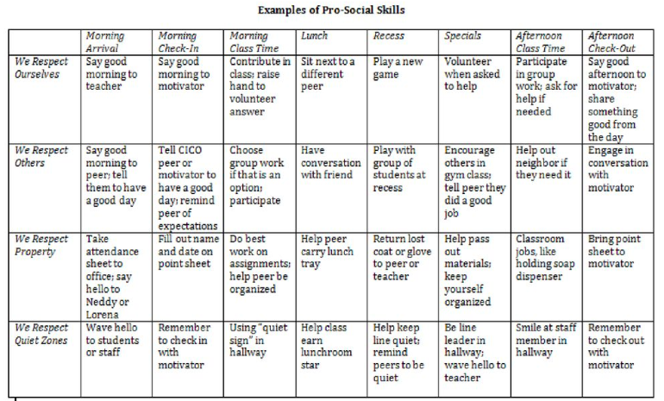
Adding Internalizing Characteristics to Teaching Matrix
Notes:
Just an example of how to apply PBIS teaching matrix to internalizing. Can be for a student in particular.

Slide 37
Individualizing CICO: Video
https://www.youtube.com/watch?v=btFC13oz9mM
Notes:
This video is a little over 9 minutes. While it talks about referral to the targeted team, this school did much more individualizing at the targeted team level. I think it’s a good example of individualizing targeted interventions.

Slide 38
Activity #4
n
Consider what modifications to CICO could be made to meet the needs of some of your students.
How could modifications to CICO support your selected student/s?
Meaningful Participation
Notes:
In Handbook

Slide 39
Activity #5 (optional)
Complete the CICO Self-Assessment in your workbook pg. 6
Notes:
In Handbook

Slide 40
Other Targeted Level Interventions

Slide 41
PBIS, SEL, RP, and Trauma-Informed Practices - Commonalities:
Whole-school
Positive, strengths-based
Proactive/prevention-focused
Contribute to and depend on an equitable learning environment
Same end goals in mind
To build a safe, respectful, and productive learning environment
To establish a positive school climate where students and adults have strong, positive relationships and students understand what is expected of them as learners at school

Slide 42
Targeted Level Interventions for
TFI
Social Emotional Learning

Slide 43
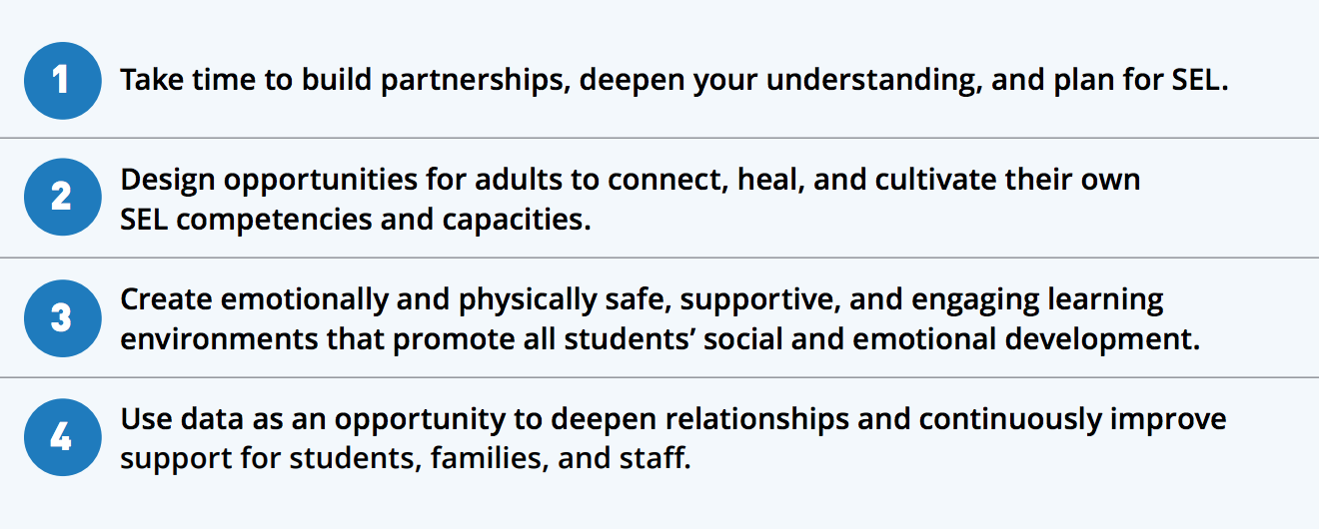
SEL is Essential Now More than EVER!

Slide 44
Some SEL Examples
Second Step
Social Cognition
Incredible Years
Check and Connect
CASEL WEBSITE
REP ( Resiliency Ed. Program)
What do you use?

Slide 45
Targeted Interventions Based on Functions of Behavior
TFI
Access Adult Attention/Support:
Check-In/Check-Out
Adult Mentoring Programs
Access Peer Attention/Support:
Social Skills Instruction
Peer Mentoring
Self-Monitoring with Peer Support (function: academic task escape)
Academic Skills Support
Organization/Homework planning support
Homework completion club
Tutoring
Notes:
Intervention is continuously available
Rapid access to intervention (72 hr.)
Very low effort by teachers
Consistent with school-wide expectations
All staff/faculty in school are involved/have access
Flexible intervention based on descriptive functional assessment
Adequate resources (admin., team)
Continuous monitoring for decision-making

Slide 46
Inventory of Existing Targeted Interventions
Notes:
Direct them to Handbook for this activity, go to next slide

Slide 47
Restorative Principles
Exploring Relationship
Agency & Choice
Meaningful Engagement
Responsibility/ Accountability

Slide 48
Continuum: Mindset Shift

Slide 49
Activity #6
Review/complete the Inventory of Targeted Supports (in workbook, page 8)
What do your practices look like along a continuum from not at all restorative to high application of the principles? What can be done to make them more aligned with restorative principles?
Notes:
In Handbook
Each team shares two most successful practices with large group

Slide 50
Check-In
Who participated in webinar?
Who completed Readiness Checklist as a Team?
Notes:
If not everyone present was part of webinar, readiness, or BAT then bring each other up to date and get additional input from one another in next activity

Slide 51
Activity #7
Review / Complete
Readiness Checklist
> In your workbook
Notes:
In Handbook
Pull up your BAT from PBIS apps website … should have completed this as part of pre-institute tasks
Review readiness checklist and BAT
THEN …
Complete Team Profile for ???both Systems Level and Individual Student Level???

Slide 52
Necessary Conversations (Teams)
TFI
Tier 1
Tier 2
Tier 3
SU/District Team
•Coordinates implementation
•Ensures access to resources
•Reviews data across schools
SU/District Team – Targeted/Intensive:
•Secures resources
•Focuses on student outcomes
•Focuses on fidelity of practices across the district/SU
SU/District
School Leadership Team
•Plans and implements 6 school components of PBIS
School Systems Level Team – Targeted/Intensive:
•Creates procedures for referral, screening & evaluation
•Communicates with staff and families
School
Student Level Team
•Matches students to interventions
•Evaluates & monitors student progress
Student Level Team
•Completes FBA/BIP
•Evaluate & monitor student progress
Facilitates wraparound
Student
Notes:
You need to figure out where you as the intensive team fit in
KEN through 78

Slide 53
Intensive Level – Three Types of Teams (or Conversations)
Systems Level
Individual Student Referral, Review
Student Specific
Some people will always be on every Individual Student Team

Slide 54
Intensive Team: Objectives
TFI
Manage teacher requests for assistance
Ensure that teachers and students receive support in a timely and meaningful manner
Provide a general forum for discussions and possible solutions for individual student behavioral concerns
Organize a collaborative effort to support the teacher (Todd et. al., 1999)

Slide 55
Role of the Administrator
Role of Intensive Team Coordinator
Notes:
This is who the parent will call if there are problems. Administrator needs to know what is happening with all student plans.
Know what the practices look like when implemented with fidelity;
Access special resources, if needed.
Support team meeting time
Be flexible around school policies/procedures.
Be committed to helping students and LRE.
Be aware of data using tracking tools; help decide what needs to change.
Attend Leadership Team Meetings
With leadership team, identify staff to facilitate individual team-based meetings.
Help team complete behavior tasks on time
Data organization and reporting
Meet with student teams weekly

Slide 56
Activity #8
Representation
Complete Team Profile and Meeting Schedule in workbook, pg. 9
1. Intensive Intervention
Team Roster -
System Level
Student Referral/Review Level
List people who will always be on
every Individual Student Team
Notes:
In Handbook
Pull up your BAT from PBIS apps website … should have completed this as part of pre-institute tasks
Review readiness checklist and BAT
THEN …
Complete Team Profile for ???both Systems Level and Individual Student Level???

Slide 57
Step 1 for Request for Assistance: Individual Student Teams
TFI
Notes:
Individual student team will look different than your intensive SYSTEMS team!
Who are the essential people to have on your individual student teams?

Slide 58
Example Request for Assistance Form
TFI
Number of ODR: __________ Number of nurses visits: ____________

Slide 59
Activity #9
Develop a Request for Assistance Process to refer a student for development of intensive level supports
Record this in your workbook, page 11
Notes:
In Handbook
Pull up your BAT from PBIS apps website … should have completed this as part of pre-institute tasks
Review readiness checklist and BAT
THEN …
Complete Team Profile for ???both Systems Level and Individual Student Level???

Slide 60
1 Teaming
2 Goals
3 Assessment (FBA)
4 Intervention (BSP)
5 Evaluation (BSP)
Vermont’s Planning Process for Students
Adapted from: Dunlap et al. (2010). Prevent, Teach, Reinforce
Inserst this as transition slide for each section
Notes:
We’ve focused today on systems.
We’re going to move for the rest of the week to focusing on intensive supports for students
Hand out books

Slide 61
1. Teaming

Slide 62
Recommended Team Members
TFI
Teacher
Parent
Behavior expert
Resource expert
Student
Others?
People who are actively involved with the student and invested in the student’s success + Input from student as appropriate!
Notes:
Emphasize ACTIVELY INVOLVED and INVESTED
This is exactly how the Behavior Support Plan is organized

Slide 63
Responsibilities of Individual Student Teams
TFI
Meet weekly at first, then less frequently per need
Set up meeting schedule at the beginning
Agree on initial behavioral goals for student
Participate in completing FBA for the F-BSP
Develop BSP (and, if needed, Crisis Plan)
Train additional staff to implement BSP
Oversee implementation of BSP
Collect and review data to evaluate effectiveness and fidelity of BSP
Revise BSP as needed

Slide 64
Engaging Team Members
TFI
Dedicated time
Creative problem solving
Organized team process
Handling conflict
Notes:
Not necessarily an easy thing to do; need to invest more effort to make them run well

Slide 65
Example: Team Meeting Structure
Start with positives!
Review all relevant data
Brainstorm ideas based on data
Discuss, prioritize, make data-based decisions
Gain consensus and implement agreed upon steps
STICK WITH YOUR AGENDA
Notes:
All the most successful individual interventions are built on student’s strengths, not on remediating their weaknesses
Don’t just mention the positives, but truly celebrate them
Hold up Bx Support Plan and direct their attention to where this sample agenda is built in

Slide 66
Family Permission Example

Slide 67
VT Family Support Resources
www.vermontfamilynetwork.org
www.vffcmh.org
Notes:
Do activity two: Power Imbalances today
Do activity one tomorrow: Positions and Interests

Slide 68
Activity #10
Heart of the Matter,
Part 2
(in workbook, pg. 12)

Slide 69
Activity #11
Representation
Meaningful Participation
Review/complete/plan steps from Family Engagement Checklist in workbook (pgs. 13-14)
Develop Family Awareness and Consent & Student Awareness sections of your in your workbook
Notes:
In Handbook
Should have done this as part of pre-institute task, after having watched the 13-minute webinar

Slide 70
F-BSP Template and Tool
An interview tool for collecting relevant information
Information comes from staff, parents, and students
Information gathered through the F-BSP template informs the behavior support plan

Slide 71
F-BSP Activity
For your student who needs intensive supports, complete Stage 1: Teaming section of the Intensive Level F-BSP (p.2)
For the same student, complete Clarifying Roles and Goals of Team Members in F-BSP Appendix (1) & discuss the questions at the bottom
Meaningful participation
Notes:
In Workbook

Slide 72
2. Goals

Slide 73
Step 2: Setting Goals
TFI
Goals abide by the “fair-pair” rule
Include relevant behavior(s) to increase and/or behavior(s) identified for decrease
Team has conversation to reach consensus
Notes:
Who are the essential people to have on your individual student teams?
Goals to support child AS WELL AS the adults providing primary interventions with child.

Slide 74
Fair-pair rule example
Increase the number of appropriate responses to adult directions
Decrease the number of times he runs away from adults following a direction

Slide 75
Collecting Data for F-BSP
For each behavior, the team must:
Define the behavior in measurable and observable terms
Determine best method for measuring
Choose a plan for assessing the data
Baseline data are critical for assessing the effectiveness of the interventions

Slide 76
Collecting Data
Direct Observation:
Frequency = Instances of the behavior within a certain time period Total counts = Every occurrence of the behavior (e.g., call outs)
Duration = Length of each occurrence of the behavior (e.g., tantrums)
Antecedent-Behavior-Consequence Charts = For low-frequency, but usually high-severity behavior
Existing school-based data sources/screeners/self-reports

Slide 77
F-BSP Activity
Complete Stage 2: Goals from p. 2 of F-BSP for your student
Discuss if observations might be needed to gather baseline data
Choose a method for collecting baseline data
Representation
High Outcomes
Notes:
Emphasize that they’re thinking about a real student but this is just practice bc you don’t have all the proper team members with you today

Slide 78
3. Assessment (FBA)
4. Intervention (BSP)

Slide 79
Steps 3 & 4 Assessment & Intervention
TFI
Assessment=Functional Behavior Assessment (FBA)
Intervention = Behavior Support Plan (BSP)
School should have personnel ready to provide simple FBA/BSP
Antecedent
Behavior
Consequence
Function
Notes:
Do you have people identified?
Do they feel competent and confident?
And are they doing them?

Slide 80
Simple vs. Complex FBA
 | SIMPLE | COMPLEX
FOR | Students with high frequency behaviors (not dangerous), received interventions that did not improve behavior, show behaviors in only 1-2 settings | Students that demonstrate dangerous behaviors or show behaviors that occur in 3 or more school settings
WHAT | Relatively simple and efficient process to guide behavior support planning | Time-intensive process involves emergency planning, family-centered planning, & collaboration outside agencies
WHO | Team of school-based personnel (ex: teachers, special educator, counselor, administrator, behavior support personnel) | School-based team with professionals trained to implement interventions for students with severe problem behaviors (ex: behavior specialist or school psychologist)
Notes:
You should have in-house capacity for simple FBAs
This looks like a dichotomy, but is really on a continuum
Know when to call in an “expert” or outside consultant

Slide 81
Activity #12
Discuss – What has been your experience with FBA/BSPs?
Complete Activity #12 – Develop FBA/BSP Capacity that Demonstrate RP Principles of:
Agency and Choice
Exploring Relationships
Meaningful Engagement
Participatory Decision-Making
Access
Representation
Meaningful Participation
High Outcomes
Notes:
In Handbook
Should have done this as part of pre-institute task, after having watched the 13-minute webinar

Slide 82
Behavior Pathway
TFI
Setting
Antecedent
Behavior
Consequence
Typically on days when he has worked alone for 30 min…
when given math work sheets & other assignments…
he doesn’t do his work and uses profanity.
His work doesn’t get completed and he avoids teacher requests.

Slide 83
Hypothesis Summary
When given math worksheets & other assignments, James does not do his work, uses profanity, & disrupts lessons, especially when he has worked alone for 30 minutes without peer contact. His work does not get the completed, and he avoids teachers’ requests.
Therefore, the hypothesized function of the behavior is escape/avoidance.

Slide 84
F-BSP Activity
Complete Stage 3: Assessment
(the FBA portion of your Behavior Support Plan):
Choose ONE behavior for your student, complete Description of Behavior on page 3 of F-BSP
Review, discuss, & complete questions in Teacher Interview section of F-BSP (p. 3-4)
Write the results of your discussion in the Propose a Testable Explanation table (p. 4)
Develop hypothesis for function of the behavior – write this under Function of Behavior (p. 4)
Representation
Meaningful Participation
Notes:
Jesse 15 minutes 10:35-10:50
NOW BREAK

Slide 85
Competing Behavior Pathway
Routine:
Desired Behavior
Consequence/Function
Desi
Setting Event
Antecedent
Challenging Behavior
Consequence/Function
Alternative Behavior
Notes:
Cortney

Slide 86
Essential Characteristics of Alternative Behaviors
Serves the same function as the behavior identified for reduction
Is easier to do and more efficient than the identified behavior
Socially acceptable/valid
Ecologically appropriate
Provides an efficient pathway to further growth
Notes:
Cortney
Requires less physical effort and provide quicker, more reliable access to the pay-off than the problem behavior did
Replacement Behaviors
an immediate attempt to reduce disruption and potentially dangerous behavior in the classroom
(take some of the pressure off the teacher)
actively begin breaking down student’s habit of using problem behavior to meet their needs, by replacing it with a more acceptable replacement behavior

Slide 87
Competing Behavior Pathway
4. The student is going to need to gain numeracy skills before being able to do this like peers
3. Look how different this is from what’s happening now
Desi
1. This is what we’re asking the student to do.
Routine:
Desired Behavior
Complete math assignment
Consequence/Function
Success, teacher acknowledgment
Setting Event
Poor grades in math class
Antecedent
double-digit addition problems
Challenging Behavior
Crying, pushing papers off desk
Consequence/Function
Sent to hall to ‘calm down’ Function: escape task
Alternative Behavior
Raise hand & ask for break
2. This is what the student is currently obtaining.
5. So… in the meantime we use the Alternative behavior
Notes:
Cortney

Slide 88
Competing Behavior Pathway Integrating Restorative Questions
Setting Event
Poor grades in math class
Antecedent
double-digit addition problems
Challenging Behavior
Crying, pushing papers off desk
Consequence/Function
Sent to hall to ‘calm down’ Function: escape task
Restorative Questions
What happened?
What led up to this?
What were you thinking/feeling at the time?
4. What were you hoping for at the time?
5. Who was affected? How?
6. What support do you need in order to do things differently in the future?
Unintended Consequence
Disrupt class
Alternative Behavior
Raise hand & ask for break
Desired Behavior
Complete math assignment
The student is going to need to gain numeracy skills before being able to do this like peers
Consequence/Function
Success, teacher acknowledgment
Agency, choice, self-determination
Notes:
Cortney

Slide 89
F-BSP Activity
Complete Step 6: Build a Competing Behavior Pathway on p. 8 of your Intensive Level F-BSP
High Outcomes
Notes:
Jean

Slide 90
The Power of Relationships
Access
Representation
The effectiveness of an intervention often hinges on the quality of the child’s relationship with the helping adults
The quality of the relationship with family
“People don’t care what you know, until they know that you care.”

Slide 91
When engaged in an emotionally charged event…
Validating:
Acknowledge feelings
You must deal with the feelings first before you can focus on the behavior
Active Listening:
Children who are heard, listen. Kids want to tell their story.

Slide 92
What is Trauma?
Trauma is a sudden, unpredictable, physiological experience that overwhelms a person’s ability to cope. It is not just an event itself, but rather a response to a stressful experience in which a person’s ability to cope is dramatically undermined.
Direct, secondary, vicarious
Event(s)
Helplessness, isolation/loneliness, mistrust and shame
Experience
Functioning in multiple domains
Effects
NFI Vermont 2018
Notes:
Direct – abuse, natural disaster
Secondary – witnessing community or domestic violence
Vicarious – hearing stories of trauma (teacher, social worker, etc.)
Experience == helplessness, isolation/loneliness, mistrust and shame

Slide 93
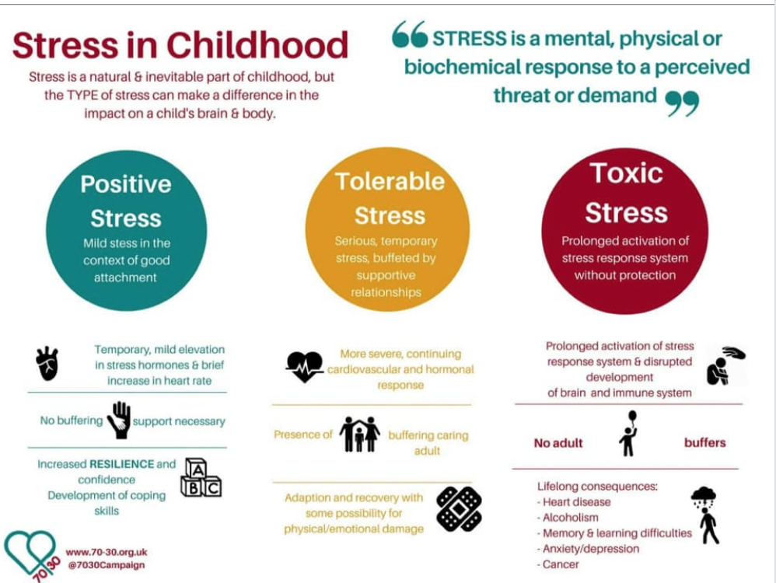

Slide 94
Abuse
Community violence
Fear of adults
Substance abuse
Sexual abuse
Neglect
Poor sleep hygiene
Hunger
Incarcerated parent
Difficulty in school
© NFI Vermont 2018

Slide 95
General Strategies
Relationships
Routines
Warn before changes
Choices
Clear limits
Safe spaces
Answer questions about trauma
Understand link
Anticipate triggers
b/w trauma &
behavior
Center
on Di and Com
sability munity

Slide 96
Effective Mental Health Interventions for Trauma
Effective Mental Health Interventions for Trauma
Education about trauma
Helping re-establish a sense of safety
Teaching techniques for dealing with overwhelming emotional reactions
An opportunity to talk about and make sense of the traumatic experience in a safe, accepting environment
Involvement, when possible, of primary caregivers in the healing process

Slide 97
BSP Strategies Based on FBA
TFI
Setting Event Strategies
understanding and addressing precipitating factors (if possible)
Antecedent Strategies
redesigning the learning and environments to prevent problem behaviors
Behavior Teaching Strategies
defining, modeling, practicing new behaviors
Consequence Strategies
implementing specific to generalizable reinforcement
Ce on Disab
nter
teaching
ility
and Community

Slide 98
Resources for Interventions
www.pbisworld.com
http://www.cccoe.net/social/skillslist.htm
Center on Disability and Community
Inclusion

Slide 99
F-BSP Strategy Types
Setting Antecedent
Behavior
Consequence
Strengthening relationships
Home-school communication
Home-to-school reinforcement
Engaging families
Coordination with community providers
Providing choices
Transition
supports
Environmental
supports
Curricular
modification
Adult verbal behavior
Classroom management
Increase
noncontingent reinforcement
Peer support
Academic skills
Problem-solving
Coping
Social skills
Learning skills
Self-management
Independent
responding
Increased engaged time
Discontinue reinforcement of problem behavior
Group
contingencies
Increase ratio of
+ to – responses
School-to-home reinforcement
Delayed gratification
ü✓
Functionally equivalent
ü✓
Behaviorally incompatible
Peer modeling
Cente on Disabilit and Communit
Inclusio
r y y
n

Slide 100
Setting Event Strategies
WHAT WE CAN CONTROL
WHAT WE CANNOT
Engaging families
Structure / schedule
Classroom accommodations and modifications
Home/school communication
History of trauma
Medical / physical conditions
Temperament
Sensory profile
Carry-in issues

Slide 101
F-BSP Activity
Use the Setting Events Interventions Brainstorming Tool in your Intensive Level F-BSP Appendix page 15
List some setting event strategies for your student in the BSP (pg. 9)
Access
Representation
Notes:
Jean

Slide 102
Antecedent Strategies
Antecedents are the events that immediately precede a behavior.
Antecedent strategies are environmental changes that reduce effectiveness of challenging behaviors and promote efficiency of replacement behaviors
Notes:
Teri

Slide 103
Antecedent Strategies
Examples
Eliminate the antecedent altogether
Modify task to incorporate student interests
Make task more meaningful
Reduce task difficulty level
Break task down, given first part only
Prompt alternative or replacement behavior
Take a proactive break
Change the routine
Give a choice
Change language & tone used in giving the direction
Notes:
Change routine – example of student resisting coming to Circle starting with sitting and listening – change first Circle activity to singing a song

Slide 104
F-BSP Activity
Use Antecedent Interventions Brainstorming Tool in your F-BSP Appendix pg. 16
List some antecedent strategies for your student in the BSP (pg.9)
Access

Slide 105
Behavior Teaching Strategies
Acquisition Challenges
Absence of knowledge for executing skill or failure to discriminate which social behaviors are appropriate in specific situations (can’t do)
Performance Challenges
Skill is present in repertoire, but student fails to perform at acceptable levels (won’t do)
Fluency Challenges
Lack of exposure to sufficient or skilled models of social behavior, insufficient rehearsal/practice or low rates or inconsistent delivery of reinforcement of skilled performance
Center

Slide 106
Behavior Teaching – Adapt your social skills curricula
Social skills curriculum must match the specific need.
An ideal curriculum does not exist.
Basic set of “Preferred Teaching Practices” exists.
Initially, learning how to teach social skills takes time and energy.
And there must be a plan to prompt and reinforce social skills in the natural context.

Slide 107
Behavioral Skills Instruction at the Intensive Level
Link with functional assessment and behavior planning
Create individualized plans within the context of the Universal (school-wide) social skills instruction
Pre-teach, pre-correct, re-teach
Integrate what the student does well
Evidence of generalization should include school, home, and community

Slide 108
F-BSP Activity
Take one of your targeted interventions from your inventory and plan how you can adapt it to teach one of the replacement behaviors in your F-BSP for your student
Use the Behavior Teaching Interventions Brainstorming
Tool, pg. 17 in F-BSP Appendix
List some Behavior
Strategies in your
student’s F-BSP
Representation
Meaningful participation

Slide 109
Consequence Strategies
Minimize reinforcement for behavior targeted for decrease
Redirect to and reinforce occurrence of alternative behavior
Consequence-based interventions are designed in combination with teaching strategies for replacement behaviors
Center

Slide 110
Consequence Strategies
Examples:
Reinforcement (positive or negative) to increase alternative or desirable behaviors
Extinction
Strategies to decrease problem behaviors – e.g., ‘time out’
Redirection to alternative behaviors
Center

Slide 111
F-BSP Activity
Use the Consequence Intervention Brainstorming Tool, F-BSP Appendix, page 18
List some consequence strategies for your student in the BSP (page 9)
Meaningful participation
High Outcomes

Slide 112
5 Evaluation (BSP)

Slide 113
Step 5: Evaluation
TFI
Progress towards identified, measurable goals
Fidelity of implementation
Data-based decisions
Center on Disability

Slide 114
F-BSP Activity
Refer to the Stage 2 Goals on p. 2 of your BSP
Further refine these goals in light of your BSP interventions
Record your newly refined goals on the Long & Short-Term Behavioral Goals of the Evaluation section of your
F-BSP (p.11)
Representation
Meaningful Participation

Slide 115
Evaluation: SWIS-ISIS Demo
www.pbisapps.org

Slide 116
Activity #13
Decide what data system you will use to track your intensive-level data. Record this in the Create a System for Managing the Daily Data section of your Intensive Level Roll-Out Plan
Representation

Slide 117
Measuring Fidelity
TFI
Adherence Are minimum components of intervention strategies being implemented?
(e.g., teacher providing praise when replacement behavior occurs)
Quality
How well is the plan being implemented? (e.g., staff gave student reminder sheet, but didn’t review it)
Center

Slide 118
F-BSP Activity
For your student, determine how you will evaluate fidelity of implementation of your BSP plan. Record this in the Evaluation Procedures section of your student’s BSP.
Representation

Slide 119
Behavior is improving
Positive behavior change
Behavior progress & Good fidelity
Extension
Shaping
Fading
Self- Management
New settings
Delayed gratification
New people
Intermittent schedule
Center on Disability and Community

Slide 120
Behavior is NOT improving
Data indicate behavior not improving
Interventions implemented with fidelity
Interventions not implemented w/ fidelity
Focus on Relationships
Hypothesis incorrect
Strategies too difficult or time consuming
Interventions are insufficient
BSP does not match teacher context
Teacher experiencing intervention drift

Slide 121
Crisis Response
Crisis Team: Small group of 3-5 trained staff available to respond to crises
Does your school have a team?
Who needs training?
School-wide procedure established for calling crisis team in
Does your school have a procedure?

Slide 122
What is a safety crisis?
What is a mental health crisis?
Any situation in which the child’s behaviors puts them at risk of hurting themselves or others and the adults are not able to resolve the situation with the skills and resources available.

Slide 123
Crisis Prevention/Intervention Plan
Situation (triggers/stressors)
Coping Strategies
What is needed to feel safe in crisis
Key support people to contact
What to do to manage a crisis
What not to do
Conditions for emergency room, police, hospital
Coordinated
Services Plan
Proactive Crisis
format

Slide 124
F-BSP Activity
Complete the Proactive Crisis Plan for your student in the BSP, p. 10
If your student is not at-risk for crisis, identify a student who is and complete the plan with respect to that student
Identify who needs to be part
of a planning meeting to
finalize the Proactive Crisis
Plan after you get back

Slide 125
Consider an Interconnected Systems Framework
TFI
School
DCF
Family
Services
Families
Mental Health

Slide 126
Taking Care of Yourself
Recognize signs
Irritability
Difficulty planning & concentrating
Numb
Intensive feeling
Don’t go it alone
Teams
Administrators
Colleagues
Recognize as occupational hazard
“cost of caring”
NOT weakness
Seek help with own trauma
Education
Talk to professional
Attend to self care
Eat well
Exercise
Sleep
Laugh & Cry

Slide 127
Where do we go from here… thoughts and/or questions…
Notes:
SWIS Trainings
Post Implementation SET
Support Available

Slide 128
Did we achieve what we set out to do?
Increased fluency in VTPBIS – systems, data and practices
Used data to guide action planning
Practiced the use of the VTPBIS Behavior Support Plan
Begun the development of an Intensive Implementation Plan and roll-out activities
Planned and scheduled year-long meetings
Had a good time together!

Slide 129
Get Ready for Next Year
Recommended Steps:
Set aside a time to finish/revise your Workbook and Action Plan - schedule this now
Obtain your SWIS License (optional)
Consider BEST/Act 230 funding (training and coaching)
Plan your professional development for next year
VTPBIS Professional Learning Calendar

Slide 130
Vermont PBIS Cascade of Support
SUPPORT LOOPS
School Level:
School
Coordinators
SU/SD Level:
SU/SD Coordinators
State Level:
TAs
Trainers
Coaches
Leadership Teams at ALL Levels of Support
FEEDBACK LOOPS
Notes:
We’ve learned the importance of identifying a contact at each level of the cascade.
We’ve learned that the beauty of a healthy cascade is that it will continue to sustain if one piece is missing….

Slide 131
Coaching Support
What?
Support for PBIS implementation & fidelity
Create school/SU/SD capacity for internal coaching
Why?
Brings experience, expertise, & external perspective
How?
SU/SD apply for BEST/Act 230 funds
Contract with state-approved VTPBIS Coaches directly
“It’s very important to have a different set of eyes on the data and to provide external feedback.”
“Our coach was invaluable in our first year at the Universal level. She was incredibly supportive.”
“[Our coach] was very skilled in listening and then meeting our needs.”

Slide 133
Stay Connected
https://www.facebook.com/groups/PBISVermont/
https://twitter.com/vtpbis
Please share all of the awesome things you are doing by using #VTPBIS or @VTPBIS

Slide 134
THANK YOU!

