Slide 1
VTPBIS Leadership Team Training
Within a Multi-Tiered System of Supports
Intensive Level
Presented by:
Ken Kramberg and Sherry Schoenberg
June, 2020
If you’re tweeting, use #VTPBIS or @VTPBIS
Find all materials at:
http://bit.ly/2019BSI
www.pbisvermont.org

Slide 2
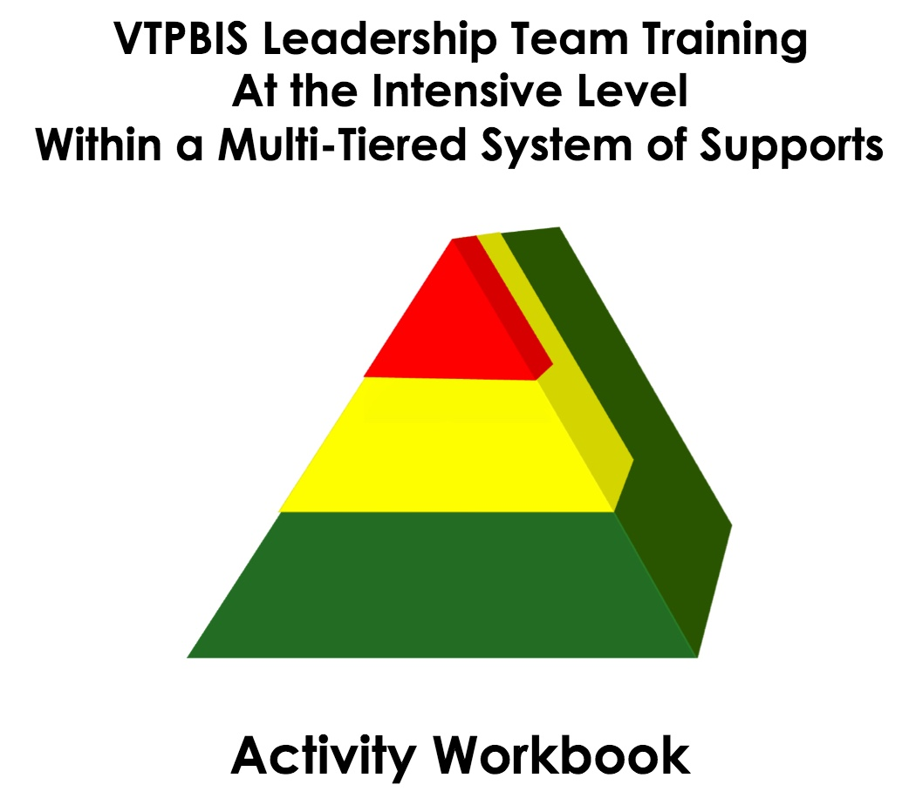
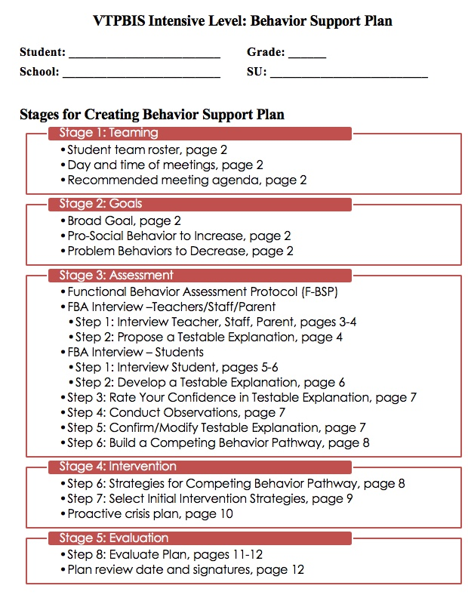
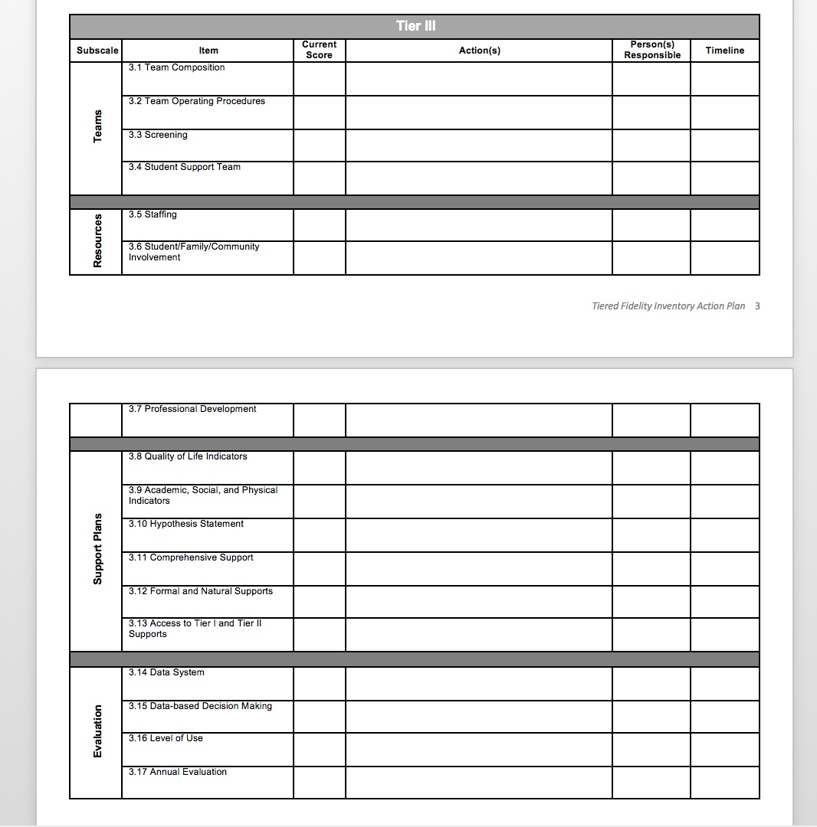
VTPBIS Intensive
Materials on Website
www.pbisvermont.org
Workbook:
https://drive.google.com/open?id=1Sg8NRZ0D2910jioQc8_joV_Evln04J7t2aOkgRmjZWk
Go to “File”, then “Make a Copy” and give it a name and share it with the team
Notes:
Explain what’s on the site and where to find the materials
PowerPoint
Staff Handbook Template
Workbook
*point out TFI Action Planning Form

Slide 3
Two Things:
Learning and Installing the Intensive Level of PBIS cannot be accomplished in an 8-hour strand. We will provide follow up implementation training/coaching in the fall FOR FREE!
This is different from other VTPBIS training!

Slide 4
Learning Outcomes
By the end of our time together, your team will have:
Increased fluency in VTPBIS – systems, data and practices
Strengthened Tier II
Used data to guide action planning
Practiced the use of the VTPBIS Behavior Support Plan
Begun the development of an Intensive Implementation Plan and roll-out activities
Planned and scheduled year-long meetings
Had a really great time together!
Notes:
Talk about pace and differentiation activities

Slide 5
When you see this star…
It indicates that the information/activities on that slide correlate with an item on the TFI (Tiered Fidelity Inventory)
TFI

Slide 6
Setting up for Success

Slide 7


BEST Expectations
Be Respectful
Engage
Strengths-based
Team Solutions
Activity:
BREAK-OUT GROUPS by B, E, S,T
Talk about how you want to be together to promote these expectations in action.

Slide 8
Let’s Get Grounded

Slide 9
What are your team norms and roles?
Norms:
  Make collaboration more effective by guiding team behavior
  Enable team members to hold each other accountable
  Promotes efficiency
Roles
  Facilitator
  Time keeper
  Note taker
  Etc.
Notes:
Have audience call out examples of team norms.
Examples:
Begin and end the meeting on time
Follow the agenda
Having a parking lot
What else?
As we come together as learners and team members, it’s really important that we use our time during this training wisely so that we are most efficient. Setting up norms and roles during this training is critically important because…Read SLIDE. In a few… as leadership teams, you will spend some time creating your meeting norms and roles…that will be used throughout the training…
Roles and responsibilities help team build internal capacity for holding effective and focused meetings
http://www.schoolimprovementcoach.org/manual/7%20Norms%20and%20Roles.pdf

Slide 10
Implementation Challenge
Risk Factors
Protective Factors
Antisocial behavior
Substance Use
Disability
Mental illness
Self-management skills
Interpersonal skills
Healthy habits
Academic competence
Notes:
Every day we are working with students, families and colleagues who come into our schools with precipitating factors that we may or may not know about – such as mental illness, substance abuse, or disability. These risk factors can be balanced by such things as being successful at learning, being physically active and having strong social or daily living skills.
Schools that engage students in rigorous and relevant academic opportunities while promoting the development of healthy social, emotional, and behavioral routines and habits can help balance out these risk factors to overcome struggles.

Slide 11
Implementation Challenge
INEFFECTIVE RESPONSE
Reactive management
Exclusion, segregation, isolation
Train & hope
Non-evidence-based practices
Subjective decision making
Low quality implementation of evidence-based practices
Risk Enhancers
Trauma
Negative modelling
Family, school, community disruption
Discrimination
Protective Factors
Academic competence
Healthy habits
Interpersonal skills
Self-management skills
Notes:
Amy
However, balancing the boat becomes harder when risk factors are heavier than the protective factors due to trauma, outside influences such as negative peer modeling, family disruption, bullying, and explicit and implicit bias.
Keeping our boat afloat requires a balancing of the effects of life’s challenges with supports
As educators, we need to explicitly focus on both learning about these risk factors and the things that influence them while avoiding some of the responses that WE KNOW DO NOT WORK!

Slide 12
Implementation Challenge
EFFECTIVE RESPONSE
Trauma-informed decision making
Prevention-based behavioral sciences
Tiered support systems
Data-based decision-making teaming
Continuous coached professional development
High fidelity implementation
Proactive, competent, informed leadership
Risk Enhancers
Trauma
Negative modelling
Family, school, community disruption
Discrimination
INEFFECTIVE RESPONSE
Reactive management
Exclusion, segregation, isolation
Train & hope
Non-evidence-based practices
Subjective decision making
Low quality implementation of evidence-based practices
Protective Factors
Academic competence
Healthy habits
Interpersonal skills
Self-management skills
Notes:
We can play a DELIBERATE role in promoting protective factors for so many of our students through carefully selecting effective responses.
This institute provide some of the gems for your treasure chest that can help you even the keel for our learners and our schools;
Offerings have a focus on charting a course of prevention within a system that provides access to learning for students.
Several strands delve into how to use data to make the most effective and efficient decisions to help navigate the waters.
There are many topic-based consultants here that can help you take your team’s learning to a higher level beyond just training with the goal of high fidelity implementation.
It is hero’s work, daunting, exhilarating and rewarding.

Slide 13

VTmtss Framework

Slide 14
Implementation Science
Exploration
Installation
Initial Implementation
Full Implementation
Innovation
Sustainability
2-4 years

Slide 15
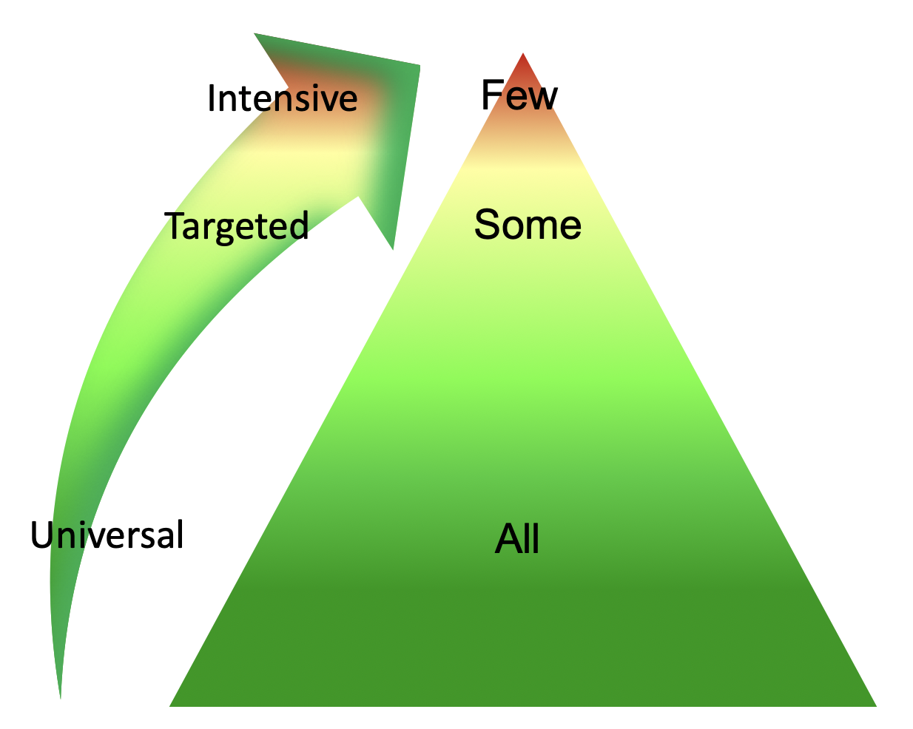
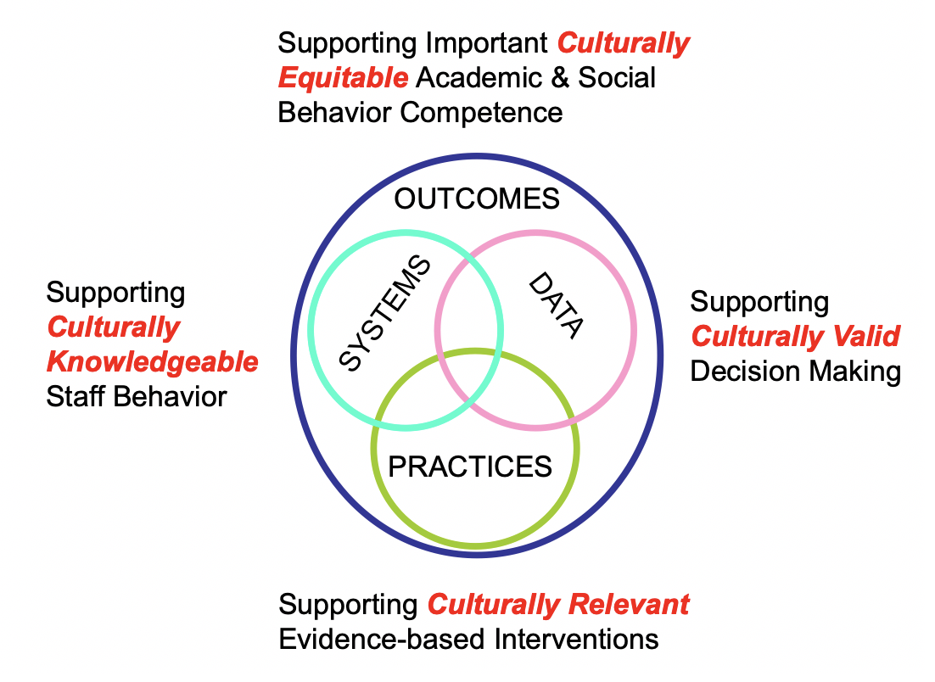
TWO ESSENTIAL OUTCOME CONSIDERATIONS
1. Continuum of Support for ALL
2. Outcomes x Data x Practices x Systems
If you remember nothing else….
Notes:
Tiered logic. You’ve seen this before and have considered the importance of a continuum no matter what you do. Example of COVID.
On the right, these four elements interact with each other in problem solving and in team action planning. Not just a focus on practices. (Describe elements.)
The continuum is important for guiding us and we have four important tools to guid

Slide 16
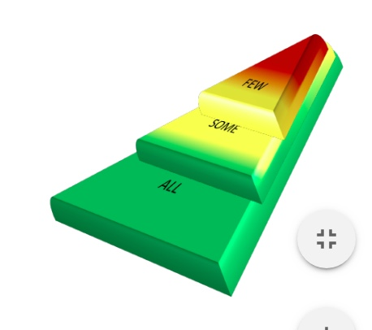
What does this mean to you and how can you promote this way of thinking?
“Instructional supports, practices, and interventions can be tiered – students can not! There are no “tier 2 students” (or tier 3 or tier 1). By assigning this type of label to students we make their current status permanent. That is the antithesis of the concepts underlying a multi-tiered system of supports.”
VTmtss Field Guide 2019

Slide 17
Continuum of Support for “Dylan” within MTSS-B/PBIS & MTSS-A
Universal
Targeted
Intensive
Anger Mgt.
Math
Label Behavior, Not Students!
Science
Adult relationships
Attendance
Reading
Peer Interaction
Notes:
Every student has competencies. Label behavior not STUDENTS. Everyone at one point or another needs targeted or intensive supports. Dylan is doing great in reading but may need more support in Math and with anger management.

Slide 18
Activity #1
In your workbook:
Create your norms and roles for your team this week
Notes:
First item in workbooks

Slide 19
Activities #2a and 2b
2a. In your Workbook: Draw a triangle and jot down some traits of your student corresponding to levels of support needed.
2b. In your Workbook: Read the Heart of the Matter and answer the questions about your student.
In the Behavior Support Plan, top of p. 3, write the student’s strengths in the Student Profile.
Notes:
Not in workbook

Slide 20
SYSTEMS
supporting staff behavior
Replace with blow up
OUTCOMES
supporting student behavior
PRACTICES
DATA
supporting decision making
Notes:
Systems, Practices, Data
Start with systems

Slide 21
Solidifying Tier II

Slide 22
SW-PBIS Supports for All Students
Intensive Supports – Individualized interventions provided to students with most complex emotional and behavioral needs.
Wraparound
1-5%
5-15%
80-90%
Complex FBA/BSP
Simple FBA/BSP
Individualized CICO
Targeted Supports – Provided to students determined to be “at-risk” of emotional and behavioral challenges.
Social/Academic
Instructional Groups
Check-in/Check-out
Universal Supports – Supports provided to all students. Expectations are taught, reinforced, and monitored in all settings.
School & Class-wide expectations & supports
Notes:
Need to have a system that builds from the base…
VT had schools with really good individualized systems and schools that do a great job with Universal supports. It’s building the supports in between that has been the challenge. It doesn’t come naturally.
Ken

Slide 23
Ensure Check-In/Check-Out (CICO) supports are in place
TFI
Default targeted intervention. WHY?
Most students receive multiple ODRs for peer or adult attention.
Evidence indicates CICO is effective practice for reducing acting out behavior related to attention seeking.
Schools must have strong CICO in place!
Notes:
Jean

Slide 24
Big Ideas about Check-in/Check-out (CICO)
It works!
Provides prompts for positive feedback (5:1)
Provides structure for corrective feedback
Easily embedded into classroom routines
If 70% of students not responding to CICO, need to examine systems features
Circling numbers is not an intervention
Can be expanded to additional problem behaviors once Basic CICO is in place

Slide 25
All Check In-Check Out programs have:
a positive caring adult
daily positive interactions with teachers & other adults
supervision and monitoring of students
more performance feedback
Notes:
Jean

Slide 26
Statistically Speaking …
Receiving CICO (from SWIS)
Up to 12% of students with chronic problem behaviors act out for adult or peer attention
Why?
Notes:
0 TO 4%

Slide 27
Activity #3
Do the Math:
Given your enrollment, how many students would benefit from CICO?
> Write this in your workbook, top of Pg. 6
Notes:
First item in workbooks

Slide 28
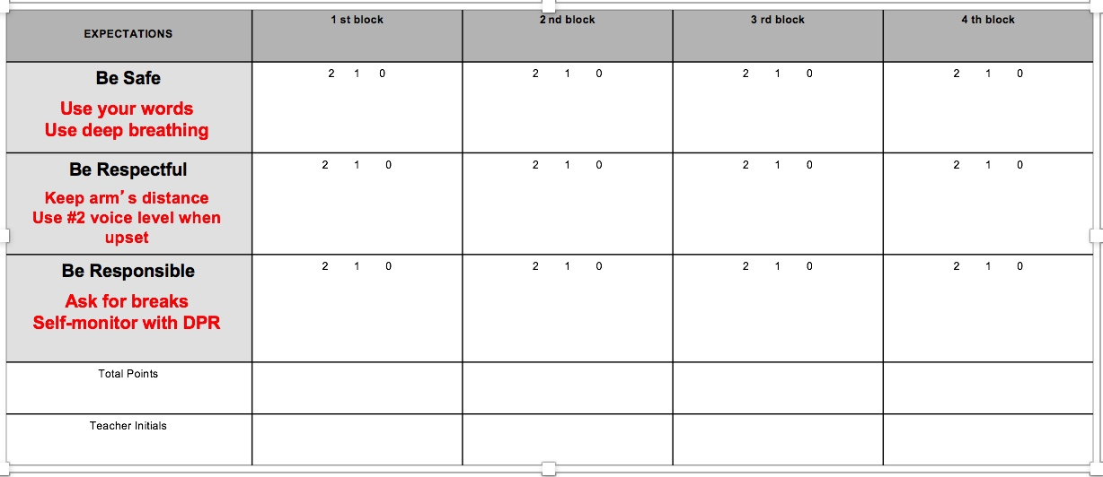
DPR Individualized

Slide 29
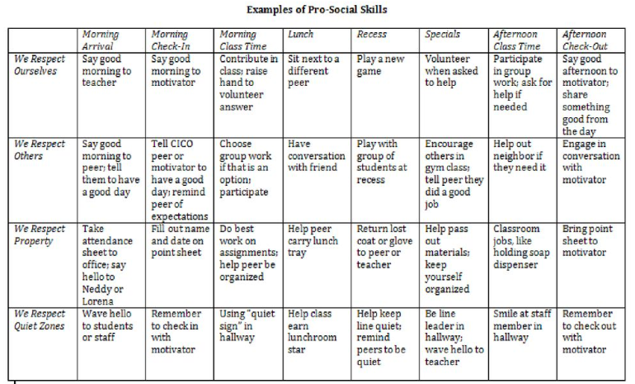
Adding Internalizing Characteristics to Teaching Matrix

Slide 30


Slide 31
Individualizing CICO: Video
https://www.youtube.com/watch?v=btFC13oz9mM

Slide 32
Activity #4
Consider what modifications to CICO could be made to meet the needs of some of your students.
How could modifications to CICO support your selected student/s?

Slide 33
Activity #5 (optional)
Complete the CICO Self-Assessment in your workbook pg. 6
Notes:
In Handbook

Slide 34
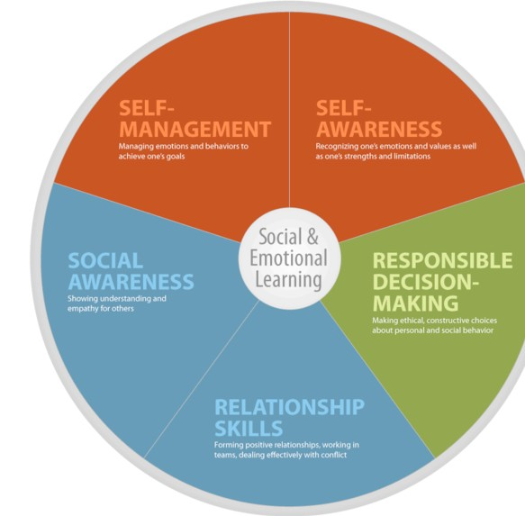
Other Targeted Level Interventions for
TFI
Social Emotional Learning

Slide 35
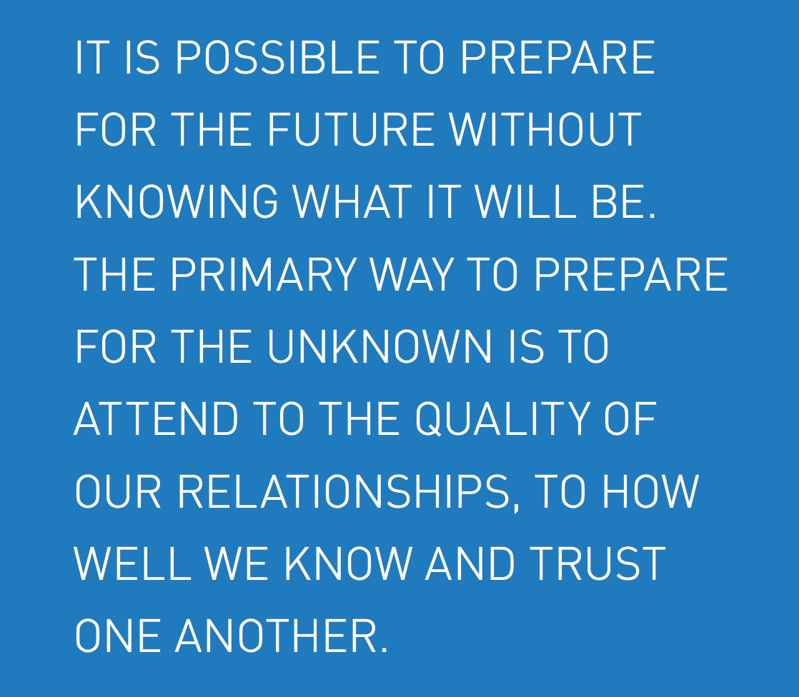
Margaret Wheatley, 2004

Slide 36
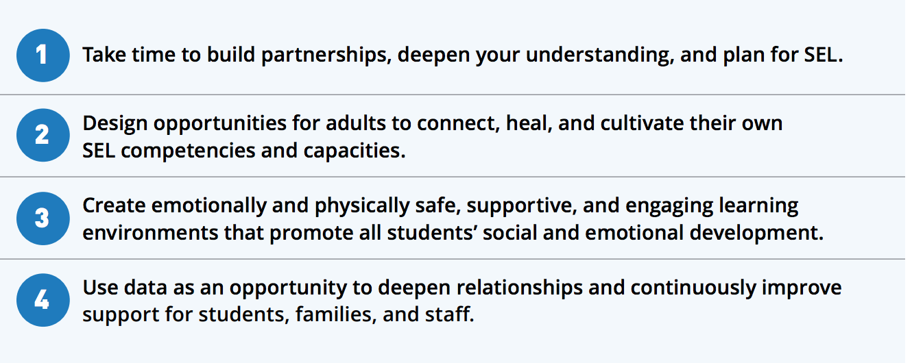
SEL is Essential Now More than EVER!

Slide 37
Some SEL Examples
Second Step
Social Cognition
Incredible Years
Check and Connect
CASEL WEBSITE
What do you use?

Slide 38
Matching Interventions to types of social skills problems:
Matching Interventions to types of social skills problems:
Most social skills studies deliver a treatment to children with an almost complete disregard for the types of social skills deficits children may have
(Gresham, 1998)
Center

Slide 39
Targeted Interventions Based on Functions of Behavior
TFI
Access Adult Attention/Support:
Check-In/Check-Out
Adult Mentoring Programs
Access Peer Attention/Support:
Social Skills Instruction
Peer Mentoring
Self-Monitoring with Peer Support (function: academic task escape)
Academic Skills Support
Organization/Homework planning support
Homework completion club
Tutoring
Notes:
Intervention is continuously available
Rapid access to intervention (72 hr.)
Very low effort by teachers
Consistent with school-wide expectations
All staff/faculty in school are involved/have access
Flexible intervention based on descriptive functional assessment
Adequate resources (admin., team)
Continuous monitoring for decision-making

Slide 40
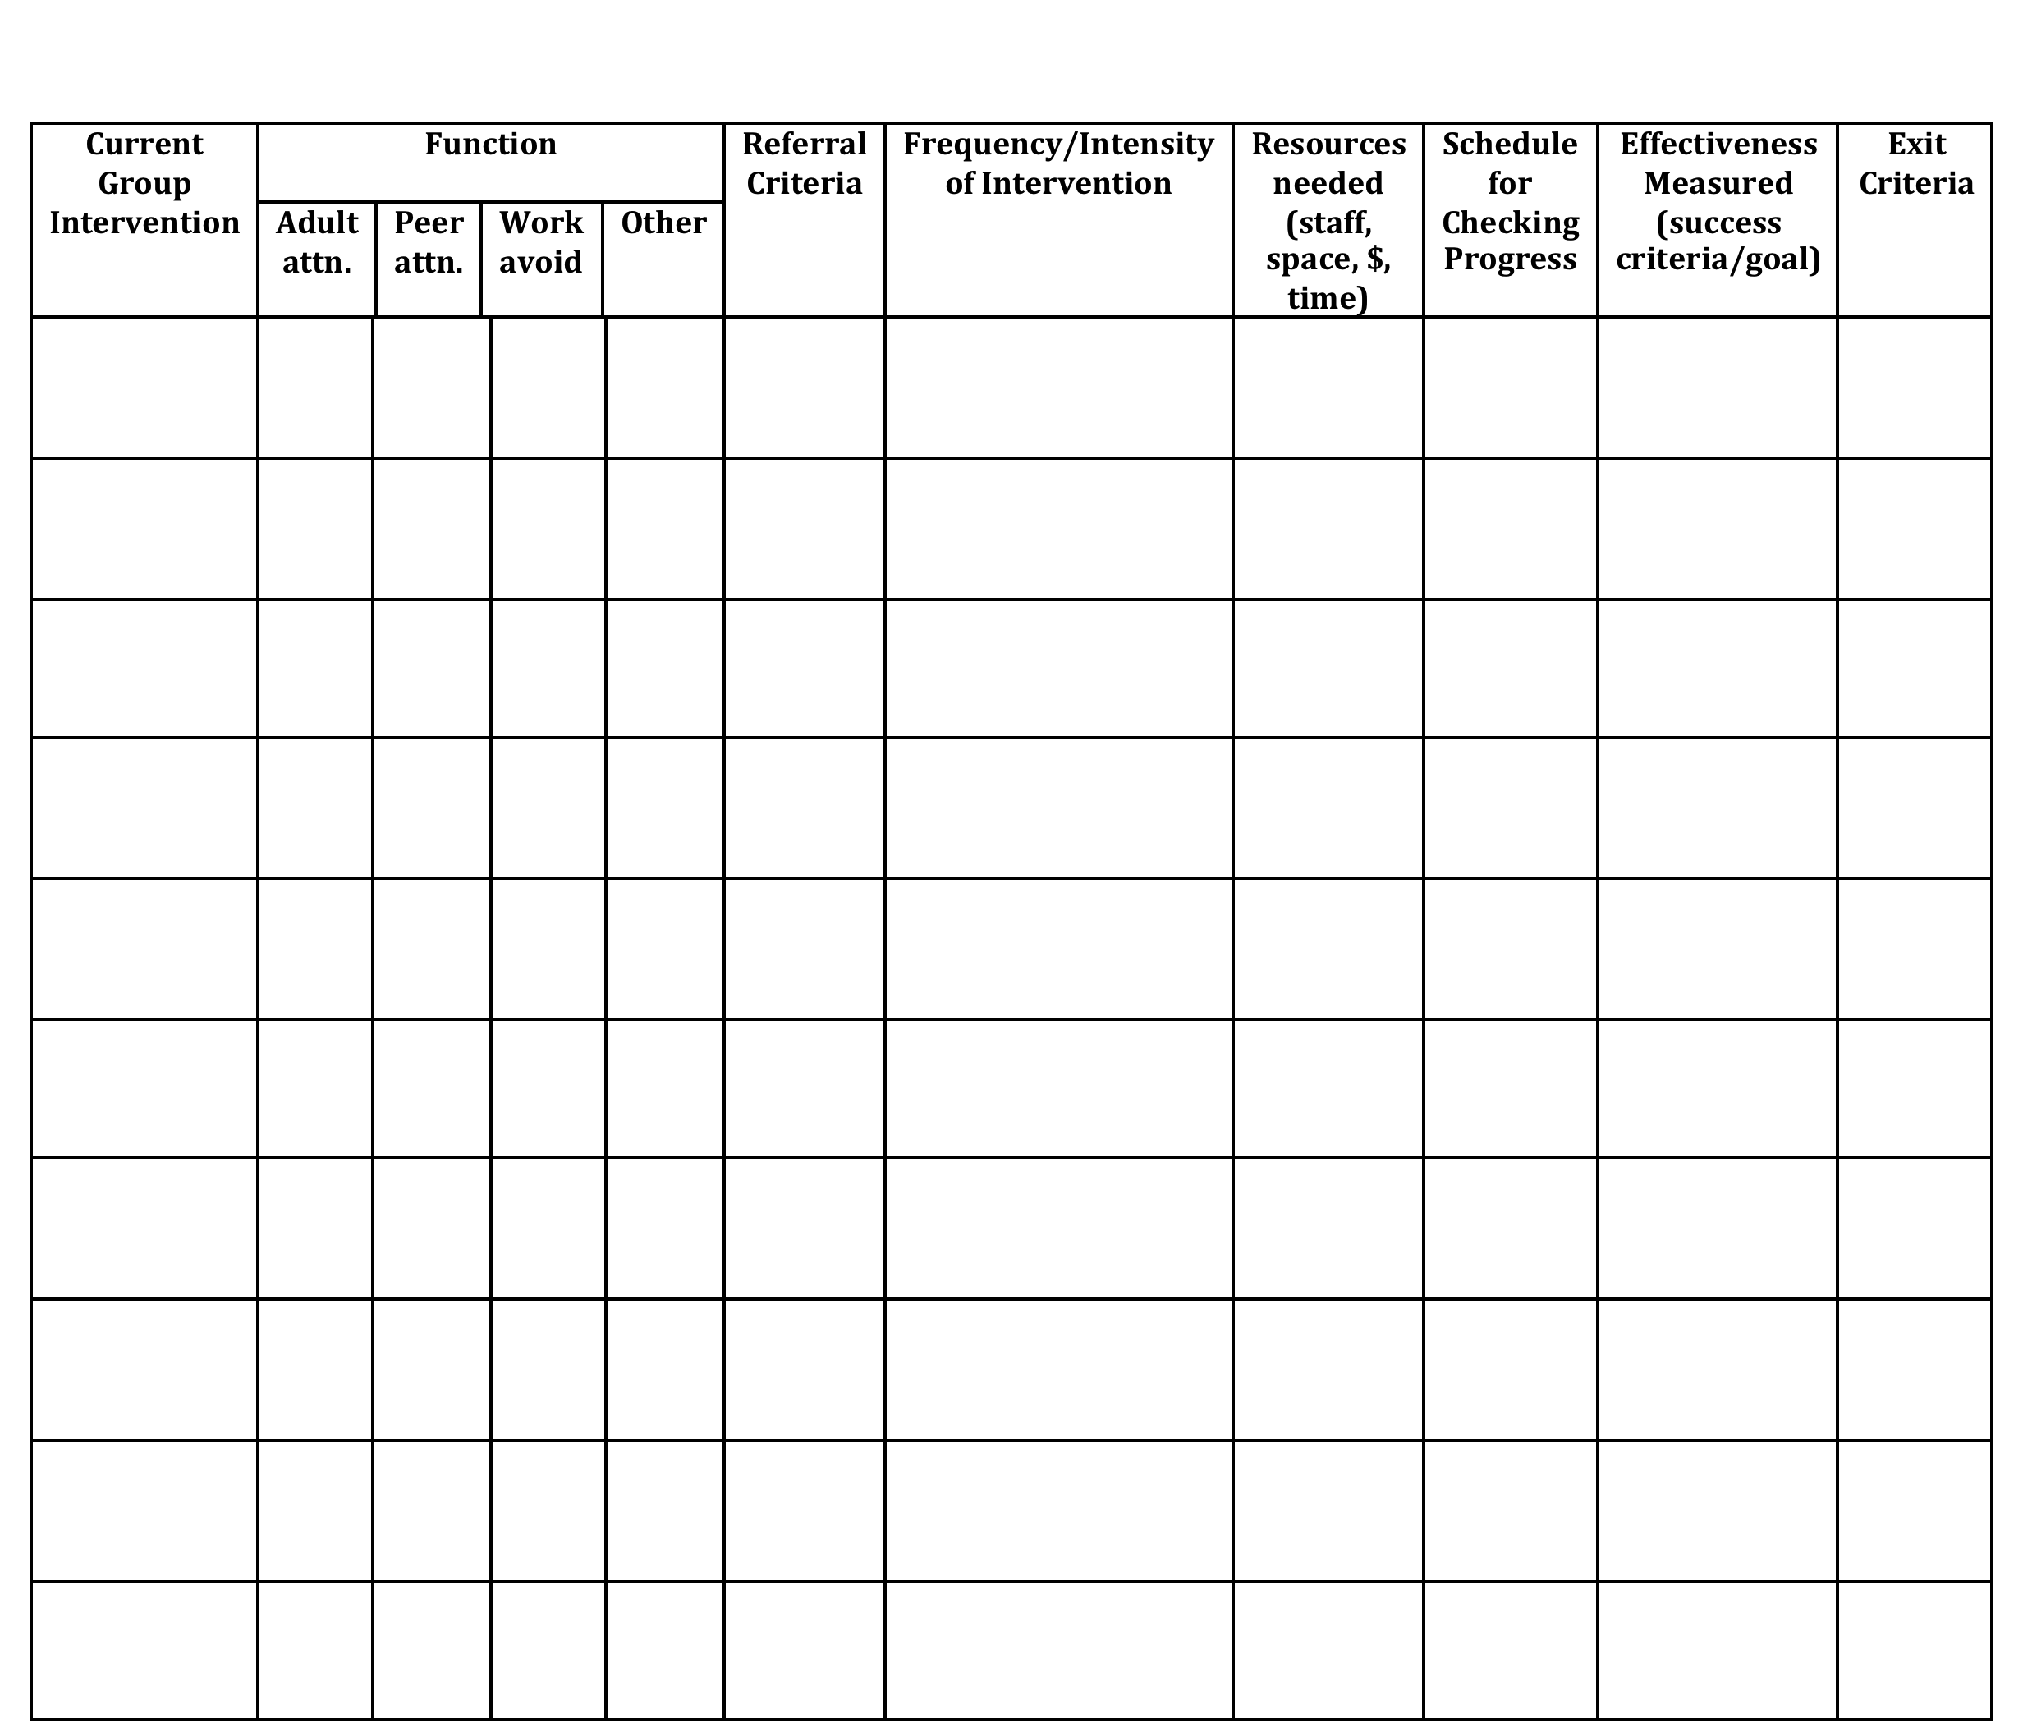
Inventory of Existing Targeted Interventions
Notes:
Direct them to Handbook for this activity, go to next slide

Slide 41
Consider the Restorative Mindset
The Restorative Approach is about:
    Voluntary Participation
    Exploring Relationships
    Meaningful Engagement
    Participatory Decision-Making

Slide 42
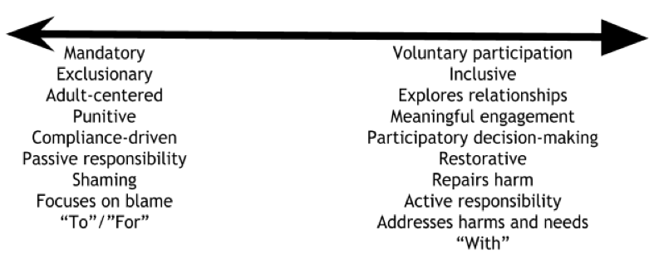
Continuum: Mindset Shift

Slide 43
Activity #6
Review/complete the Inventory of Targeted Supports (in workbook, page 8)
What do your practices look like along a continuum from not at all restorative to high application of the principles? What can be done to make them more aligned with restorative principles?
Notes:
In Handbook
Each team shares two most successful practices with large group

Slide 44

Check-In
Who participated in webinar?
Who completed Readiness Checklist as a Team?
Notes:
If not everyone present was part of webinar, readiness, or BAT then bring each other up to date and get additional input from one another in next activity

Slide 45
Activity #7
Review / Complete
Readiness Checklist
> In your workbook
Notes:
In Handbook
Pull up your BAT from PBIS apps website … should have completed this as part of pre-institute tasks
Review readiness checklist and BAT
THEN …
Complete Team Profile for ???both Systems Level and Individual Student Level???

Slide 46
Necessary Conversations (Teams)
TFI
Tier 1
Tier 2
Tier 3
SU/District Team
•Coordinates implementation
•Ensures access to resources
•Reviews data across schools
SU/District Team – Targeted/Intensive:
•Secures resources
•Focuses on student outcomes
•Focuses on fidelity of practices across the district/SU
SU/District
School Leadership Team
•Plans and implements 6 school components of PBIS
School Systems Level Team – Targeted/Intensive:
•Creates procedures for referral, screening & evaluation
•Communicates with staff and families
School
Student Level Team
•Matches students to interventions
•Evaluates & monitors student progress
Student Level Team
•Completes FBA/BIP
•Evaluate & monitor student progress
Facilitates wraparound
Student
Notes:
You need to figure out where you as the intensive team fit in
KEN through 78

Slide 47
Intensive Level –
Three Types of Teams
(or Conversations)
Systems Level
Individual Student Referral, Review
Student Specific
Some people will always be on every Individual Student Team

Slide 48
Intensive Team: Objectives
TFI
Manage teacher requests for assistance
Ensure that teachers and students receive support in a timely and meaningful manner
Provide a general forum for discussions and possible solutions for individual student behavioral concerns
Organize a collaborative effort to support the teacher (Todd et. al., 1999)

Slide 49
What is the Role of the Administrator?
What is the Role of Intensive Team Coordinator?
Notes:
This is who the parent will call if there are problems. Administrator needs to know what is happening with all student plans.
Know what the practices look like when implemented with fidelity;
Access special resources, if needed.
Support team meeting time
Be flexible around school policies/procedures.
Be committed to helping students and LRE.
Be aware of data using tracking tools; help decide what needs to change.
Attend Leadership Team Meetings
With leadership team, identify staff to facilitate individual team-based meetings.
Help team complete behavior tasks on time
Data organization and reporting
Meet with student teams weekly

Slide 50
Activity #8
Complete Team Profile and Meeting Schedule in workbook, pg. 9
1. Intensive Intervention
Team Roster -
System Level
Student Referral/Review Level
List people who will always be on
every Individual Student Team
Notes:
In Handbook
Pull up your BAT from PBIS apps website … should have completed this as part of pre-institute tasks
Review readiness checklist and BAT
THEN …
Complete Team Profile for ???both Systems Level and Individual Student Level???

Slide 51

Step 1 for Referral to Intensive: Individual Student Teams
TFI
Notes:
Individual student team will look different than your intensive SYSTEMS team!
Who are the essential people to have on your individual student teams?

Slide 52
Example Request for Assistance Form
TFI
Number of ODR: __________ Number of nurses visits: ____________

Slide 53
Activity #9
Develop a Request for Assistance Process to refer a student for development of intensive level supports
Record this in your workbook, page 11
Notes:
In Handbook
Pull up your BAT from PBIS apps website … should have completed this as part of pre-institute tasks
Review readiness checklist and BAT
THEN …
Complete Team Profile for ???both Systems Level and Individual Student Level???

Slide 54

1 Teaming
2 Goals
3 Assessment (FBA)
4 Intervention (BSP)
5 Evaluation (BSP)
Vermont’s Planning Process for Students
Adapted from: Dunlap et al. (2010). Prevent, Teach, Reinforce
Inserst this as transition slide for each section
Notes:
We’ve focused today on systems.
We’re going to move for the rest of the week to focusing on intensive supports for students
Hand out books

Slide 55
1. Teaming

Slide 56
Recommended Team Members
Teacher
Parent
Behavior expert
Resource expert
Student
Others?
TFI
People who are actively involved with the student and invested in the student’s success + Input from student as appropriate!
Notes:
Emphasize ACTIVELY INVOLVED and INVESTED
This is exactly how the Behavior Support Plan is organized

Slide 57
Responsibilities of Individual Student Teams
TFI
Meet weekly at first, then less frequently per need
Set up meeting schedule at the beginning
Agree on initial behavioral goals for student
Participate in completing FBA for the F-BSP
Develop BSP (and, if needed, Crisis Plan)
Train additional staff to implement BSP
Oversee implementation of BSP
Collect and review data to evaluate effectiveness and fidelity of BSP
Revise BSP as needed

Slide 58
Engaging Team Members
TFI
Dedicated time
Creative problem solving
Organized team process
Handling conflict
Notes:
Not necessarily an easy thing to do; need to invest more effort to make them run well

Slide 59
Example: Team Meeting Structure
Start with positives!
Review all relevant data
Brainstorm ideas based on data
Discuss, prioritize, make data-based decisions
Gain consensus and implement agreed upon steps
STICK WITH YOUR AGENDA
Notes:
All the most successful individual interventions are built on student’s strengths, not on remediating their weaknesses
Don’t just mention the positives, but truly celebrate them
Hold up Bx Support Plan and direct their attention to where this sample agenda is built in

Slide 60
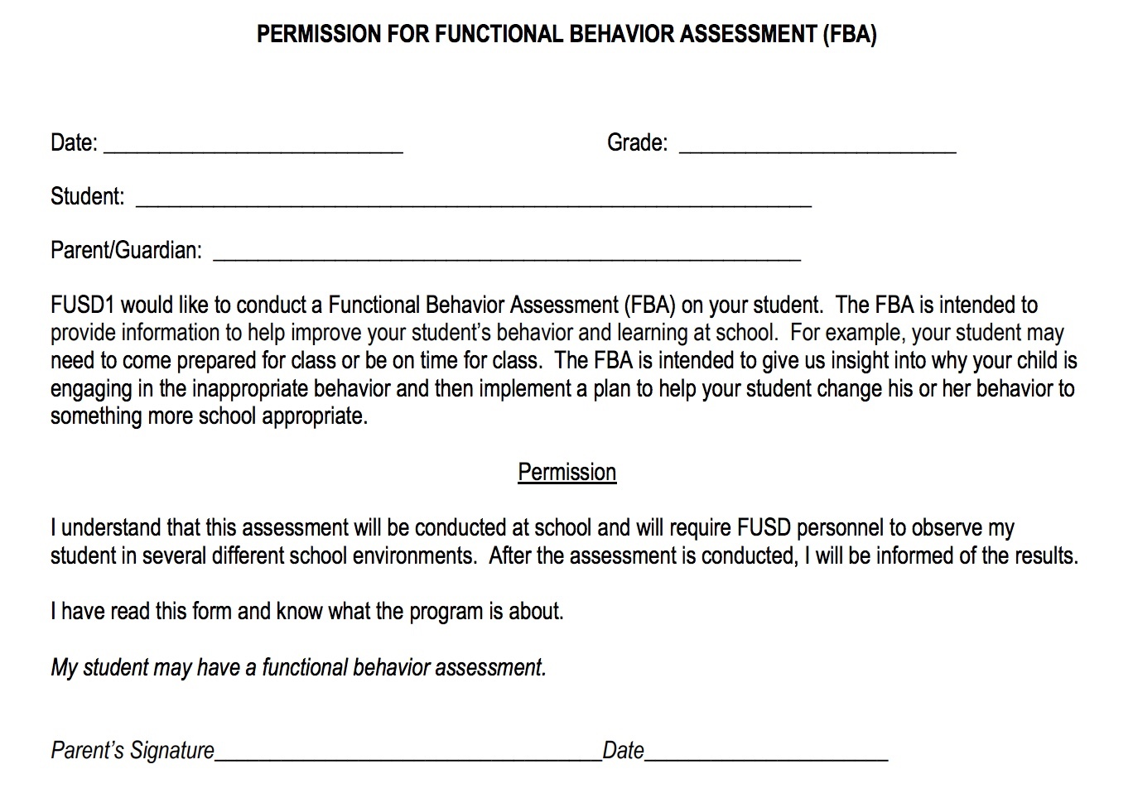
Parental Permission Example

Slide 61


VT Family Support Resources
www.vermontfamilynetwork.org
www.vffcmh.org
Notes:
Do activity two: Power Imbalances today
Do activity one tomorrow: Positions and Interests

Slide 62
Activity #10
Heart of the Matter,
Part 2
(in workbook, pg. 12)

Slide 63
Activity #11
Review/complete/plan steps from Family Engagement Checklist in workbook (pgs. 13-14)
Complete Develop Parent Awareness and Consent & Student Awareness sections of your in your workbook
Notes:
In Handbook
Should have done this as part of pre-institute task, after having watched the 13-minute webinar

Slide 64
F-BSP Activity
For your student who needs intensive supports, complete Stage 1: Teaming section of the Intensive Level F-BSP (p.2)
For the same student, complete Clarifying Roles and Goals of Team Members in F-BSP Appendix (1) & discuss the questions at the bottom
Notes:
In Workbook

Slide 65
2. Goals

Slide 66

Step 2: Setting Goals
TFI
Broad goals identified by team at the start
Includes positive behaviors to increase and problem behaviors to decrease
Team has conversation to reach consensus
Notes:
Who are the essential people to have on your individual student teams?
Goals to support child AS WELL AS the adults providing primary interventions with child.

Slide 67
Broad Goal Example
Jesse will follow instructions by teachers, staff, and other adults.

Slide 68
Collecting Baseline Data for F-BSP
For each behavior, the team must:
Define the behavior in measurable and observable terms
Determine best method for measuring
Choose anchor points for recording change
Baseline data is used to inform the FBA and later on to assess effectiveness of the BSP

Slide 69
Positive & Problem Behaviors
Increase the number of times he responds appropriately by responding to adult requests quickly and respectfully
Decrease number of times he runs away from adults following adult requests.

Slide 70
Collecting Baseline Data
  Direct Observation:
  Time sampling = Instances of the behavior within a certain time period (e.g. blurting out)
  Frequency counts = Every occurrence of the behavior (e.g. following directions, running away after directions given)
  Duration = Length of each occurrence of the behavior (e.g. tantrums)
  Scatterplot = Time the behavior(s) occurred
  Set-backs
  Antecedent-Behavior-Consequence Charts = For low frequency, high severity behavior

Slide 71
Collecting Baseline Data
  Indirect Data:
  Subjective rating scale (e.g. amount of work completed, general level of cooperation)
  CICO Daily Report Cards

Slide 72
F-BSP Activity
Complete Stage 2: Goals from p. 2 of F-BSP for your student
Discuss if observations might be needed to gather baseline data
Choose a method for collecting baseline data
Notes:
Emphasize that they’re thinking about a real student but this is just practice bc you don’t have all the proper team members with you today

Slide 73
3. Assessment (FBA)
4. Intervention (BSP)

Slide 74
Steps 3 & 4 Assessment & Intervention
TFI
Assessment=Functional Behavior Assessment (FBA)
Intervention = Behavior Support Plan (BSP)
School should have personnel ready to provide simple & complex FBA / BSP
Trigger
Behavior
Consequence
Function
Notes:
Do you have people identified?
Do they feel competent and confident?
And are they doing them?

Slide 75
Functional Behavior Support Plan
An interview tool for collecting information about problem behaviors
For staff, parents, and students
The F-BSP then leads the team to create a competing behavior pathway and behavior support plan

Slide 76
Simple vs. Complex FBA
 | SIMPLE | COMPLEX
FOR | Students with high frequency behaviors (not dangerous), received interventions that did not improve behavior, show behaviors in only 1-2 settings | Students that demonstrate dangerous behaviors or show behaviors that occur in 3 or more school settings
WHAT | Relatively simple and efficient process to guide behavior support planning | Time-intensive process involves emergency planning, family-centered planning, & collaboration outside agencies
WHO | Team of school-based personnel (ex: teachers, special educator, counselor, administrator, behavior support personnel) | School-based team with professionals trained to implement interventions for students with severe problem behaviors (ex: behavior specialist or school psychologist)
Notes:
You should have in-house capacity for simple FBAs
This looks like a dichotomy, but is really on a continuum
Know when to call in an “expert” or outside consultant

Slide 77
FBA = D.A.S.H. (Loman Training)
Define behavior in observable and measurable terms
Ask about behavior by interviewing staff and student
specify routines where & when behavior occurs
summarize where, when, and why behavior occurs
See the behavior
observe the behavior during routines specified
observe to verify summary from interviews
Hypothesize
a final summary of where, when, and why behaviors occur

Slide 78
Behavior Pathway
TFI
Setting
Antecedent
Behavior
Consequence
Typically on days when he has worked alone for 30 min…
when given math work sheets & other assignments…
he doesn’t do his work and uses profanity.
His work doesn’t get completed and he avoids teacher requests.

Slide 79
Hypothesis Summary
When given math worksheets & other assignments, Caesar does not do his work, uses profanity, & disrupts lessons, especially, when he has worked alone for 30 minutes without peer contact. His work does not get completed, & he avoids teachers requests.

Slide 80
These student FBAs, plans, & strategies are for practice only.
You will need to further refine them at school, involving the whole student team.
Notes:
Jesse

Slide 81
F-BSP Activity
Complete Stage 3: Assessment
(the FBA portion of your Behavior Support Plan):
Choose ONE behavior for your student, complete Description of Behavior on page 3 of F-BSP
Review, discuss, & complete questions in Teacher Interview section of F-BSP (p. 3-4)
Write the results of your discussion in the Propose a Testable Explanation table (p. 4)
Develop hypothesis for function of the behavior – write this under Function of Behavior (p. 4)
Notes:
Jesse 15 minutes 10:35-10:50
NOW BREAK

Slide 82
Competing Behavior Pathway
Routine:
Desired Behavior
Consequence/Function
Desi
Setting Event
Antecedent
Problem Behavior
Consequence/Function
Alternative Behavior
Notes:
Cortney

Slide 83
Essential Characteristics of Alternative Behaviors
Serves the same function as the problem behavior
Is easier to do and more efficient than the problem behavior
Socially acceptable
Notes:
Cortney
Requires less physical effort and provide quicker, more reliable access to the pay-off than the problem behavior did
Replacement Behaviors
an immediate attempt to reduce disruption and potentially dangerous behavior in the classroom
(take some of the pressure off the teacher)
actively begin breaking down student’s habit of using problem behavior to meet their needs, by replacing it with a more acceptable replacement behavior

Slide 84
Why the Alternative Behavior?
3. Look how different this is from what’s happening now
Why not go straight to the Desired Behavior?
4. The student is going to need to gain numeracy skills before being able to do this like peers
Routine: Math Class
1. This is what we’re asking the student to do.
Complete math assignment
Success, teacher acknowledgment
Poor grades in math class
Given double-digit addition problems
Crying, pushing papers off desk
Sent to hall to ‘calm down’ Function: escape task
Raise hand & ask for break
5. So… in the meantime we use the Alternative behavior
2. This is what the student is currently obtaining.
Notes:
Cortney
84

Slide 85
F-BSP Activity
Complete Step 6: Build a Competing Behavior Pathway on p. 8 of your Intensive Level F-BSP
Notes:
Jean

Slide 86
Power of Relationships

Slide 87
The Power of Relationships
The Effectiveness Of An Intervention Often Hinges On The Quality Of The Relationship With The Helping Adult
Well Designed and Informed Behavior Support Plans Often Fail Because The Helping Adult Fails To Establish A Positive Helping Relationship With the Child
Sometimes A Poorly Designed Or Marginal Plan Is Successful Because Of The Quality Of The Relationship

Slide 88
When Engaged in an emotionally charged event…
Two Critical skills
Validating
Acknowledging Feelings
You must deal with the feelings first before you can focus on the behavior
Active Listening:
Children who are heard listen. Kids want to tell their story

Slide 89


Abuse
Community violence
Fear of adults
Substance abuse
Sexual abuse
Neglect
Poor sleep hygiene
Hunger
Incarcerated parent
Difficulty in school
© NFI Vermont 2018

Slide 90

What is Trauma?
Trauma is a sudden, unpredictable, physiological experience that overwhelms a person’s ability to cope. It is not just an event itself, but rather a response to a stressful experience in which a person’s ability to cope is dramatically undermined.
Direct, secondary, vicarious
Event(s)
Helplessness, isolation/loneliness, mistrust and shame
Experience
Functioning in multiple domains
Effects
© NFI Vermont 2018
Notes:
Direct – abuse, natural disaster
Secondary – witnessing community or domestic violence
Vicarious – hearing stories of trauma (teacher, social worker, etc.)
Experience == helplessness, isolation/loneliness, mistrust and shame

Slide 91

General Strategies
Relationships
Routines
Warn before changes
Choices
Clear limits
Safe spaces
Answer questions about trauma
Understand link
Anticipate triggers
b/w trauma &
behavior
Center
on Di and Com
sability munity

Slide 92
BSP Strategies Based on FBA
TFI
Setting Event Strategies
Understanding and addressing precipitating factors (if possible)
Antecedent Strategies
Redesigning the learning and environments to prevent problem behaviors
Behavior Teaching Strategies
defining, modeling, practicing new behaviors
Consequence Strategies
implementing specific to generalizable reinforcement
Ce on Disab
nter
teaching
ility
and Community

Slide 93


F-BSP Strategy Types
Setting Antecedent
Behavior
Consequence
Strengthening relationships
Home-school communication
Home-to-school reinforcement
Engaging families
Coordination with community providers
Providing choices
Transition
supports
Environmental
supports
Curricular
modification
Adult verbal behavior
Classroom management
Increase
noncontingent reinforcement
Peer support
Academic skills
Problem-solving
Coping
Social skills
Teacher-pleasing behavior
Learning skills
Self-management
Independent
responding
Increased engaged time
Discontinue reinforcement of problem behavior
Group
contingencies
Increase ratio of
+ to – responses
School-to-home reinforcement
Delayed gratification
Peer modeling
ü✓
Functionally equivalent
Cente on Disabilit and Communit
Inclusio
r y y
ü✓
Behaviorally incompatible
n

Slide 94
Setting Event Strategies
WHAT WE CAN CONTROL
WHAT WE CANNOT
Engaging families
Structure / schedule
Classroom accommodations and modifications
Home/school communication
History of trauma
Medical / physical conditions
Temperament
Sensory profile
Carry-in issues

Slide 95
Setting Events can influence the function of behavior
Understanding setting events is critical to understanding the function of behavior
FBA process can reveal critical setting events that influence the function of behavior
Life Space Crisis Intervention interview process can help identify these setting events
“Trauma” can influence behavior in very broad ways

Slide 96
F-BSP Activity
Use the Setting Events Interventions Brainstorming Tool in your Intensive Level F-BSP Appendix page 15
List some setting event strategies for your student in the BSP (pg. 9)
Notes:
Jean

Slide 97
Antecedent Strategies
Antecedents are the events, people or things that immediately precede the problem behavior.
Antecedent strategies are created to prevent problem behaviors/increase replacement behaviors
Notes:
Teri

Slide 98
Antecedent Strategies
Examples
Eliminate the trigger
Modify task to incorporate student interests
Make task more meaningful
Reduce task difficulty level
Break task down, given first part only
Prompt alternative or replacement behavior
Take a break
Change the routine
Give a choice
Change language & tone used in giving the direction
Notes:
Change routine – example of student resisting coming to Circle starting with sitting and listening – change first Circle activity to singing a song

Slide 99
F-BSP Activity
Use Antecedent Interventions Brainstorming Tool in your F-BSP Appendix pg. 16
List some antecedent strategies for your student in the BSP (pg.9)

Slide 100
Behavior Teaching Strategies
Acquisition Challenges
Absence of knowledge for executing skill or failure to discriminate which social behaviors are appropriate in specific situations (can’t do)
Performance Challenges
Skill is present in repertoire, but student fails to perform at acceptable levels (won’t do)
Fluency Challenges
Lack of exposure to sufficient or skilled models of social behavior, insufficient rehearsal/practice or low rates or inconsistent delivery of reinforcement of skilled performance
Center

Slide 101
Behavior Teaching – Adapt your social skills curricula
Social skills curriculum must match the specific need.
An ideal curriculum does not exist.
Basic set of “Preferred Teaching Practices” exists.
Initially, learning how to teach social skills takes time and energy.

Slide 102
Behavioral Skills Instruction at the
Intensive Level
Link with functional assessment and behavior planning
Create individualized plans within the context of the Universal (school-wide) social skills instruction
Pre-teach, pre-correct, re-teach
Integrate what the student does well
Evidence of generalization should include school, home and community

Slide 103
F-BSP Activity
Activity
Take one of your targeted interventions from your inventory and plan how you can adapt it to teach one of the replacement behaviors in your F-BSP for your student
Use the Behavior Teaching Interventions Brainstorming
Tool, pg. 17 in F-BSP Appendix
List some Behavior
Strategies in your
student’s F-BSP

Slide 104
Consequence Strategies
Minimize reinforcement for problem behavior
Redirect and reinforce alternative behavior
Increase reinforcement for desirable behavior
Note: Strategies should be designed in combination with teaching strategies
Center

Slide 105
Consequence Strategies
Examples:
Reinforcement (positive or negative) to increase alternative or desirable behaviors
Extinction
‘Punishment’ to decrease problem behaviors
Non-contingent reinforcement to reduce the value of current reinforcers for problem behavior (i.e. provide sensory input all the time to reduce value of disruptive sensory-seeking behavior)
Re-direction
Center

Slide 106
F-BSP Activity
Use the Consequence Intervention Brainstorming Tool, F-BSP Appendix, page 18
List some consequence strategies for your student in the BSP (page 9)

Slide 107


Resources for Interventions
www.pbisworld.com
http://www.cccoe.net/social/skillslist.htm
Center on Disability and Community
Inclusion

Slide 108
5 Evaluation (BSP)

Slide 109

Step 5: Evaluation
TFI
Creating measurable goals
Fidelity of implementation
Progress toward goals
Making data-based decisions
Center on Disability

Slide 110
Short Term Goals
Increase the number of times he responds appropriately by walking directly to the room, taking a seat in the back of that class, and sitting quietly for one minute
Decrease number of times he runs away from adults following adult requests.
Decrease the amount of time it takes to respond to adult requests
Ce on Disab and Commu

Slide 111
Measuring Goals
TFI
Use baseline data collected as part of the FBA process to assess effectiveness of your BSP:
  Frequency
  Duration
  Intensity
  Likert-type scale
  Perception
        + Fidelity of implementation

Slide 112
Examples
Task Engagement: amount of time Johnny remains in his seat with eyes focused on the teacher and/or work materials during independent academic work.
Tantrums: number of times Johnny engages in screaming, kicking furniture and/or people, and throwing objects (all 3 behaviors must be present).

Slide 113
Example: Tracking Behaviors
5
4
Task engagement Tantrums
3
2
1
28-Jan
29-Jan
30-Jan
31-Jan

Slide 114
F-BSP Activity
Refer to the Stage 2 Goals on p. 2 of your BSP
Further refine these goals in light of your BSP interventions
Record your newly refined goals on the Long & Short-Term Behavioral Goals of the Evaluation section of your
F-BSP (p.11)

Slide 115

Evaluation: SWIS-ISIS Demo
www.pbisapps.org

Slide 116
Activity #12
Decide what data system you will use to track your intensive-level data. Record this in the Create a System for Managing the Daily Data section of your Intensive Level Roll-Out Plan

Slide 117
Measuring Fidelity
TFI
Adherence Are minimum components of intervention strategies being implemented?
(e.g., teacher providing praise when replacement behavior offered)
Quality
How well is the plan being implemented? (e.g., staff gave student reminder sheet, but didn’t review it)
Center

Slide 118
F-BSP Activity
For your student, determine how you will evaluate fidelity of implementation of your BSP plan. Record this in the Evaluation Procedures section of your student’s BSP.

Slide 119
Behavior is improving
Positive behavior change
Behavior progress & Good fidelity
Extension
Shaping
Fading
Self- Management
New settings
Delayed gratification
New people
Intermittent schedule
Center on Disability and Community

Slide 120
Behavior is NOT improving
Data indicate behavior not improving
Interventions implemented with fidelity
Interventions not implemented w/ fidelity
Focus on Relationships
Hypothesis incorrect
Strategies too difficult or time consuming
Interventions are insufficient
BSP does not match teacher context
Teacher experiencing intervention drift

Slide 121
When Starting New
Interventions…
Things may need to be tweaked right away – or not!
Things often get worse before they get better
Why?
How can we be proactive?

Slide 122
CRISIS PLAN
Desired Behaviors
Consequences
Setting Events
Problem Behaviors
Antecedents
Consequences
Alternative Behaviors

Slide 123
School-wide Crisis Plan
Starts with prevention:
Consistent Tier 1 strategies are in place
Safety Plan posted and practiced
All staff trained in de-escalation and personal safety

Slide 124
Crisis Response
Crisis Team: Small group of 3-5 trained staff available to respond to crises
Does your school have a team?
Who needs training?
School-wide procedure established for calling crisis team in
Does your school have a procedure?

Slide 125
Crisis Response
Individualized Crisis Plan should be developed for students at risk
- Who is called
- Where they go
- What they do or say to child
- Do key support people need training?
Restraint is used as a last resort following Rule 4500 protocol – other options should be explored pro-actively & in the moment

Slide 126
Crisis Prevention/Intervention Plan
Situation (triggers/stressors)
Coping Strategies
What is needed to feel safe in crisis
Key support people to contact
What to do to manage a crisis
What not to do
Conditions for emergency room, police, hospital
Coordinated
Services Plan
Proactive Crisis
format

Slide 127
Using the CPI Crisis Development
Model
Anxiety →
Defensive → Directives
Risk Behaviors → Management
Tension Reduction →
Supports
Directives
Disengagement or Safe Physical Management
Therapeutic Rapport
Notes:
Consider using this CPI framework for planning and designing Crisis Plan. Most VT schools use CPI training . Supportive and Directive strategies offer proactive preventative supports.

Slide 128
Taking Care of Yourself
Recognize signs
Irritability
Difficulty planning & concentrating
Numb
Intensive feeling
Don’t go it alone
Teams
Administrators
Colleagues
Recognize as occupational hazard
“cost of caring”
NOT weakness
Seek help with own trauma
Education
Talk to professional
Attend to self care
Eat well
Exercise
Sleep
Laugh & Cry

Slide 129
F-BSP Activity
Complete the Proactive Crisis Plan for your student in the BSP, p. 10
If your student is not at-risk for crisis, identify a student who is and complete the plan with respect to that student
Identify who needs to be part
of a planning meeting to
finalize the Proactive Crisis
Plan after you get back

Slide 130
What is a mental health crisis?
What is a mental health crisis?
Any situation in which the child’s behaviors puts them at risk of hurting themselves or others and/or when the adults aren’t able to resolve the situation with the skills and resources available.

Slide 131
When should you refer?
Physical symptoms
Self-regulation difficulties
Inconsistent academic performance
Over or under-reacting to events
Severe reactions
Long duration (more than 1 month)

Slide 132
Effective Mental Health Interventions for Trauma
Effective Mental Health Interventions for Trauma
Education about trauma
Helping re-establish a sense of safety
Teaching techniques for dealing with overwhelming emotional reactions
An opportunity to talk about and make sense of the traumatic experience in a safe, accepting environment
Involvement, when possible, of primary caregivers in the healing process

Slide 133




Consider an Interconnected Systems Framework
TFI
School
DCF
Family
Services
Families
Mental Health

Slide 134
https://vimeo.com/130836807

Slide 135

Where do we go from here… thoughts and/or questions…
Notes:
SWIS Trainings
Post Implementation SET
Support Available
Grad Course

Slide 136
Did we achieve what we set out to do?
Increased fluency in VTPBIS – systems, data and practices
Used data to guide action planning
Practiced the use of the VTPBIS Behavior Support Plan
Begun the development of an Intensive Implementation Plan and roll-out activities
Planned and scheduled year-long meetings
Had a really great time together!

Slide 137
Get Ready for Next Year
Recommended Steps:
  Set aside a time to finish/revise your Workbook and Action Plan - schedule this now
  Obtain your SWIS License (optional)
  Consider BEST/Act 230 funding (training and coaching)
  Plan your professional development for next year
    VTPBIS Professional Learning Calendar

Slide 138
Coaching Supports
What?
  Support for schools/SUs/SDs in fidelity of PBIS evidence-based practices and development of local implementation capacity
  Create school/SU/SD capacity for internal coaching
Why?
  Someone with expertise who can bring experience, expertise, and an external perspective
How?
  Contract with State Approved VTPBiS Coaches directly
  SU/SD apply for BEST/Act 230 funds
  More information at: http://www.pbisvermont.org/resources/coaches-a-coordinators/coaches

Slide 139
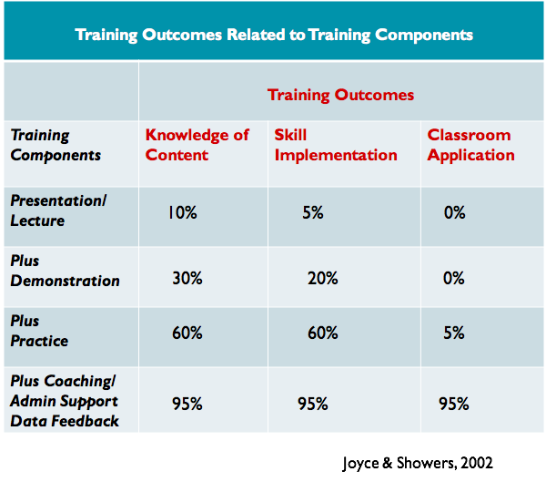

Slide 140


Stay Connected
https://www.facebook.com/groups/PBISVermont/
https://twitter.com/vtpbis
Please share all of the awesome things you are doing by using #VTPBIS or @VTPBIS

Slide 141
Questions? Contact a VTPBIS TA
When in doubt, contact Anne Dubie!
(802) 656-5775 or Anne.Dubie@uvm.edu

Slide 142
THANK YOU!

