Slide 1
VTPBIS Leadership Team Training
Within a Multi-Tiered System of Supports
Intensive Level
Presented by:
Ken Kramberg and Sherry Schoenberg
March 2019
If you’re tweeting, use #VTPBIS or @VTPBIS
Wifi Information:
LMRguest
Find all materials at:
https://www.pbisvermont.org/training-resources/intensive-training/
www.pbisvermont.org

Slide 2
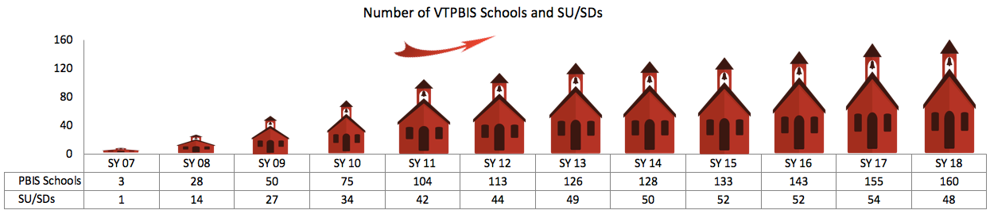
Welcome & Introductions

Slide 3
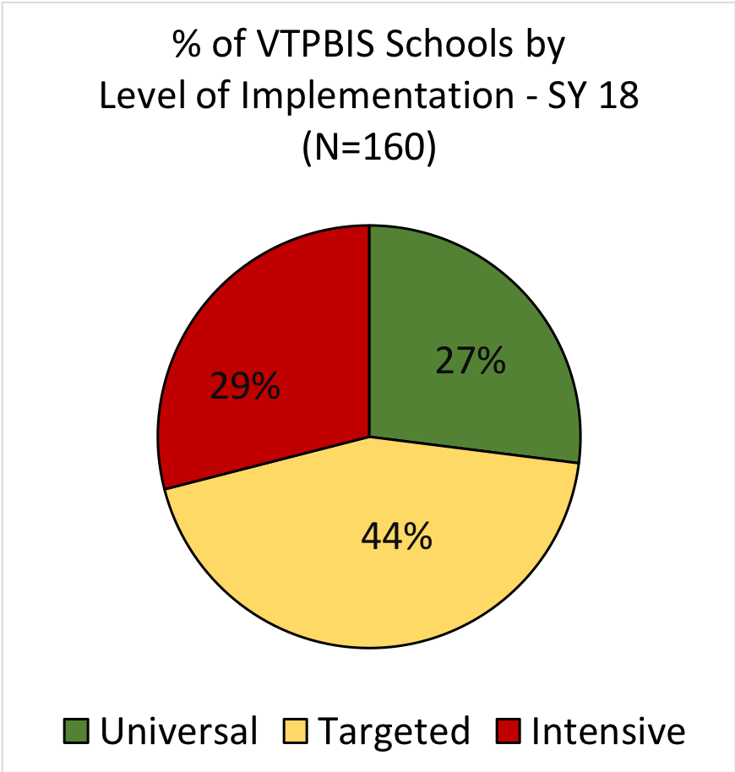
More VT Schools Implementing at Higher Levels

Slide 4


About Us
Ken Kramberg
Sherry Schoenberg

Slide 5
Learning Outcomes
By the end of our time together, your team will have:
Increased fluency in VTPBIS – systems, data and practices
Used data to guide action planning
Begun the development of an Intensive Implementation Plan
Begun planning roll-out activities
Planned and scheduled year-long meetings
Had a really great time together!
Notes:
Talk about pace and differentiation activities

Slide 6
When you see this star…
It indicates that the information/activities on that slide correlate with an item on the TFI (Tiered Fidelity Inventory)
TFI

Slide 7
Setting up for Success

Slide 8

BEST Expectations:
Teaching Matrix
BEST Expectation | All Settings
Be Respectful | Empathic responses to presenters and colleagues Silence cell phones Be present and wait for breaks
Engage | Take a Team role Ask clarifying questions
Strengths-based | Use positive statements and re-statements Remember, four positives to one negative
Team Solutions | Establish and follow team roles and norms Consider all ideas of team members

Slide 9

VTPBIS Intensive
Materials on Website
www.pbisvermont.org
Workbook:
https://drive.google.com/open?id=1Sg8NRZ0D2910jioQc8_joV_Evln04J7t2aOkgRmjZWk
Go to “File”, then “Make a Copy” and give it a name and share it with the team
Notes:
Explain what’s on the site and where to find the materials
PowerPoint
Staff Handbook Template
Workbook
*point out TFI Action Planning Form

Slide 10
Opening Activity
Find someone you don’t know
Introduce yourselves and what school you are from
Share your successes and challenges with PBIS this year so far
Share what you are hoping to achieve at this training

Slide 11

How are we going to be together?
As a Team, Discuss:
What will make this learning environment respectful and safe for all?
We’ll ask for a sampling of responses
Notes:
Sherry

Slide 12
Whenever you see this…
TFI

Slide 13
What are your team norms and roles?
Norms:
  Make collaboration more effective by guiding team behavior
  Enable team members to hold each other accountable
  Promotes efficiency
Roles
  Facilitator
  Time keeper
  Note taker
  Etc.
Notes:
Have audience call out examples of team norms.
Examples:
Begin and end the meeting on time
Follow the agenda
Having a parking lot
What else?
As we come together as learners and team members, it’s really important that we use our time during this training wisely so that we are most efficient. Setting up norms and roles during this training is critically important because…Read SLIDE. In a few… as leadership teams, you will spend some time creating your meeting norms and roles…that will be used throughout the training…
Roles and responsibilities help team build internal capacity for holding effective and focused meetings
http://www.schoolimprovementcoach.org/manual/7%20Norms%20and%20Roles.pdf

Slide 14
Team Activity
TFI
Think about your current team
Discuss your team’s strengths
As a team, develop your matrix of team roles and norms (see workbook)
Select one person on your team to introduce your team to the group and describe one strength your team brings to this process
Timer
Notes:
Have team do norm matrix

Slide 15
What is the Vermont Multi-Tiered System of Supports (VT MTSS)?
Meet students where they are at
and help them get to where they need to go
Notes:
Comprehensive, evidence-based, and systemic approach to teaching and learning that unifies general and special education in a deliberate, intentional, ongoing collaboration designed to meet academic and non-academic needs and improve learning for all students through increasingly differentiated and intensified assessment, instruction, and intervention provided by qualified professionals with appropriate expertise.

Slide 16
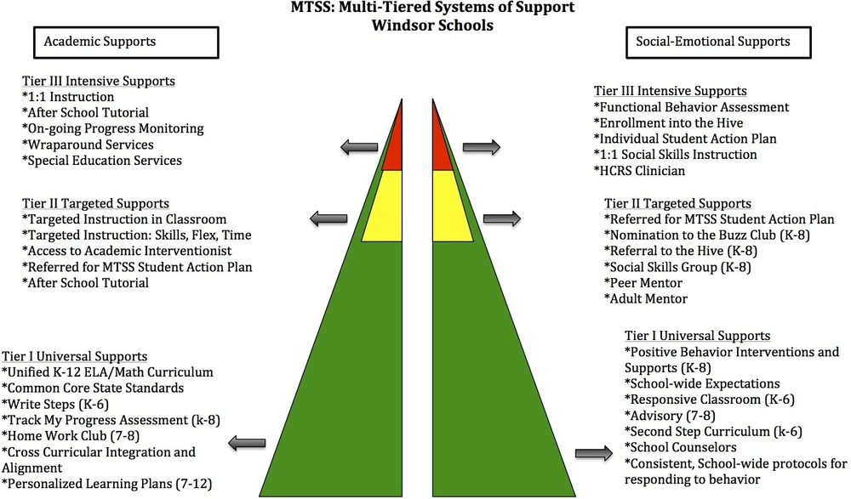

Slide 17
Sustaining PBIS
Supporting
Staff Behavior
Supporting
Decision
Making
SYSTEMS
DATA
PRACTICES
Smallest effort
Evidence-based
Biggest, durable effect
Supporting
Student Behavior
Notes:
5 Components of MTSS cuts across Data, Systems and Practices

Slide 18
Who Benefits from PBIS/MTSS-B? Everyone!
1-5% of Students may need Intensive Supports
Few
10-15% of Students may need Targeted Supports
Some
ALL Students!
Universal Practices in place for 100% of students
80% of Students should be successful when accessing Universal Supports
Notes:
Why – consistent response for students and staff
Clearly articulated plan and framework
Review of data to demonstrate success and challenges

Slide 19
Continuum of Support for “Dylan” within MTSS-B/PBIS & MTSS-A
Universal
Targeted
Intensive
Anger Mgt.
Math
Label Behavior, Not Students!
Science
Adult relationships
Attendance
Reading
Peer Interaction
Notes:
Every student has competencies. Label behavior not STUDENTS. Everyone at one point or another needs targeted or intensive supports. Dylan is doing great in reading but may need more support in Math and with anger management.

Slide 20
Activity
Continuum of Strengths
Draw a triangle and jot down the strengths and challenges for your student corresponding to each Tier
Notes:
Not in workbook

Slide 21
Person-First Language
Do say…
“students receiving intensive supports”
“students needing targeted interventions”
“student with autism”
“student receiving specialize instruction”
“children with disabilities”
Don’t say…
“red zone kids”
“targeted kids”
“the autistics”
“sped students”
“disabled kids or handicapped kids”

Slide 22
Implementation Science
Exploration
Installation
Initial Implementation
Full Implementation
Innovation
Sustainability
2-4 years

Slide 23
Parallel Processes
Across all Tiers & Problem Behaviors
Action steps to improve problem behavior across school-wide settings, at-risk groups, and individual students follow the same parallel process:
  Prevention by changing setting events
  Teaching replacement skills
  Rewarding replacement skills
  Extinction of problem behavior by eliminating reinforcement
  Corrective Consequence(s) for problem behavior
  Data Collection to see if it’s working!

Slide 24

https://vimeo.com/73172036
Notes:
Focus on this student’s strengths

Slide 25
Activity
Heart of the Matter, Part 1
> In your workbook
List student strengths
> In Student Profile Section
of F-BSP (pg. 3)
Notes:
Not in workbook

Slide 26
SYSTEMS
supporting staff behavior
OUTCOMES
supporting student behavior
PRACTICES
DATA
supporting decision making
Notes:
Systems, Practices, Data
Start with systems

Slide 27
SW-PBIS Supports for All Students
Intensive Supports – Individualized interventions provided to students with most complex emotional and behavioral needs.
Wraparound
1-5%
5-15%
80-90%
Complex FBA/BIP
Simple FBA/BIP
Individualized CICO
Targeted Supports – Provided to students determined to be “at-risk” of emotional and behavioral challenges.
Social/Academic
Instructional Groups
Check-in/Check-out
Universal Supports – Supports provided to all students. Expectations are taught, reinforced, and monitored in all settings.
School & Class-wide expectations & supports
Notes:
Need to have a system that builds from the base…
VT had schools with really good individualized systems and schools that do a great job with Universal supports. It’s building the supports in between that has been the challenge. It doesn’t come naturally.
Ken

Slide 28
Ensure Check-In/Check-Out (CICO) supports are in place
TFI
Default targeted intervention. WHY?
Most students receive multiple ODRs for peer or adult attention.
Evidence indicates CICO is effective practice for reducing acting out behavior related to attention seeking.
Schools must have strong CICO in place!
Notes:
Jean

Slide 29
All Check In-Check Out programs have:
a positive caring adult
daily positive interactions with teachers & other adults
supervision and monitoring of students
more performance feedback
Notes:
Jean

Slide 30
Statistically Speaking …
Up to 12% of students with chronic problem behaviors act out for adult or peer attention
Why?
Notes:
0 TO 4%

Slide 31
Activity
Do the Math:
Given your enrollment, how many students would benefit from CICO?
> Write this in your workbook
Plan to Sustain the Targeted Level
Notes:
First item in workbooks

Slide 32
Keys to Sustainability for CICO
TFI
Ongoing professional development
Checking for fidelity
Focus on relationships
What else?
Notes:
32
What successes have you found at targeted level?
Share with each other

Slide 33
Activity
Complete the CICO Self-Assessment in your workbook
Notes:
In Handbook

Slide 34
Barriers to Implementation of CICO
Tendency to individualize
Faculty not marking DPRs
Wanting to continue after goal has been met
Goals set too high
Desire for behavior to change quicker
Inadequate professional development
New staff
Parent buy-in
What else?
Notes:
Action Plan for Completion of Start-Up Activities appears here in workbook – is there an activity around this?

Slide 35
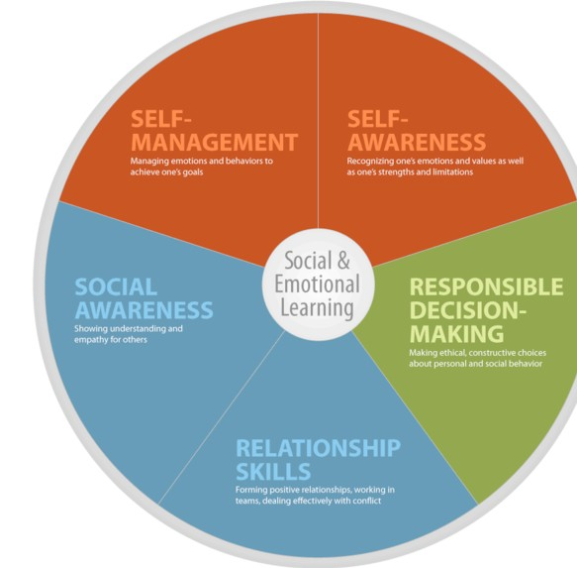
Other Targeted Level Interventions for
TFI
Social Emotional Learning

Slide 36
Some SEL Examples
Second Step
Social Cognition
Incredible Years
Check and Connect
CASEL WEBSITE
What do you use?

Slide 37
Matching Interventions to types of social skills problems:
Matching Interventions to types of social skills problems:
Most social skills studies deliver a treatment to children with an almost complete disregard for the types of social skills deficits children may have
(Gresham, 1998)
Center

Slide 38
Targeted Interventions Based on Functions of Behavior
TFI
Access Adult Attention/Support:
Check-In/Check-Out
Adult Mentoring Programs
Access Peer Attention/Support:
Social Skills Instruction
Peer Mentoring
Self-Monitoring with Peer Support (function: academic task escape)
Academic Skills Support
Organization/Homework planning support
Homework completion club
Tutoring
Notes:
Intervention is continuously available
Rapid access to intervention (72 hr.)
Very low effort by teachers
Consistent with school-wide expectations
All staff/faculty in school are involved/have access
Flexible intervention based on descriptive functional assessment
Adequate resources (admin., team)
Continuous monitoring for decision-making

Slide 39
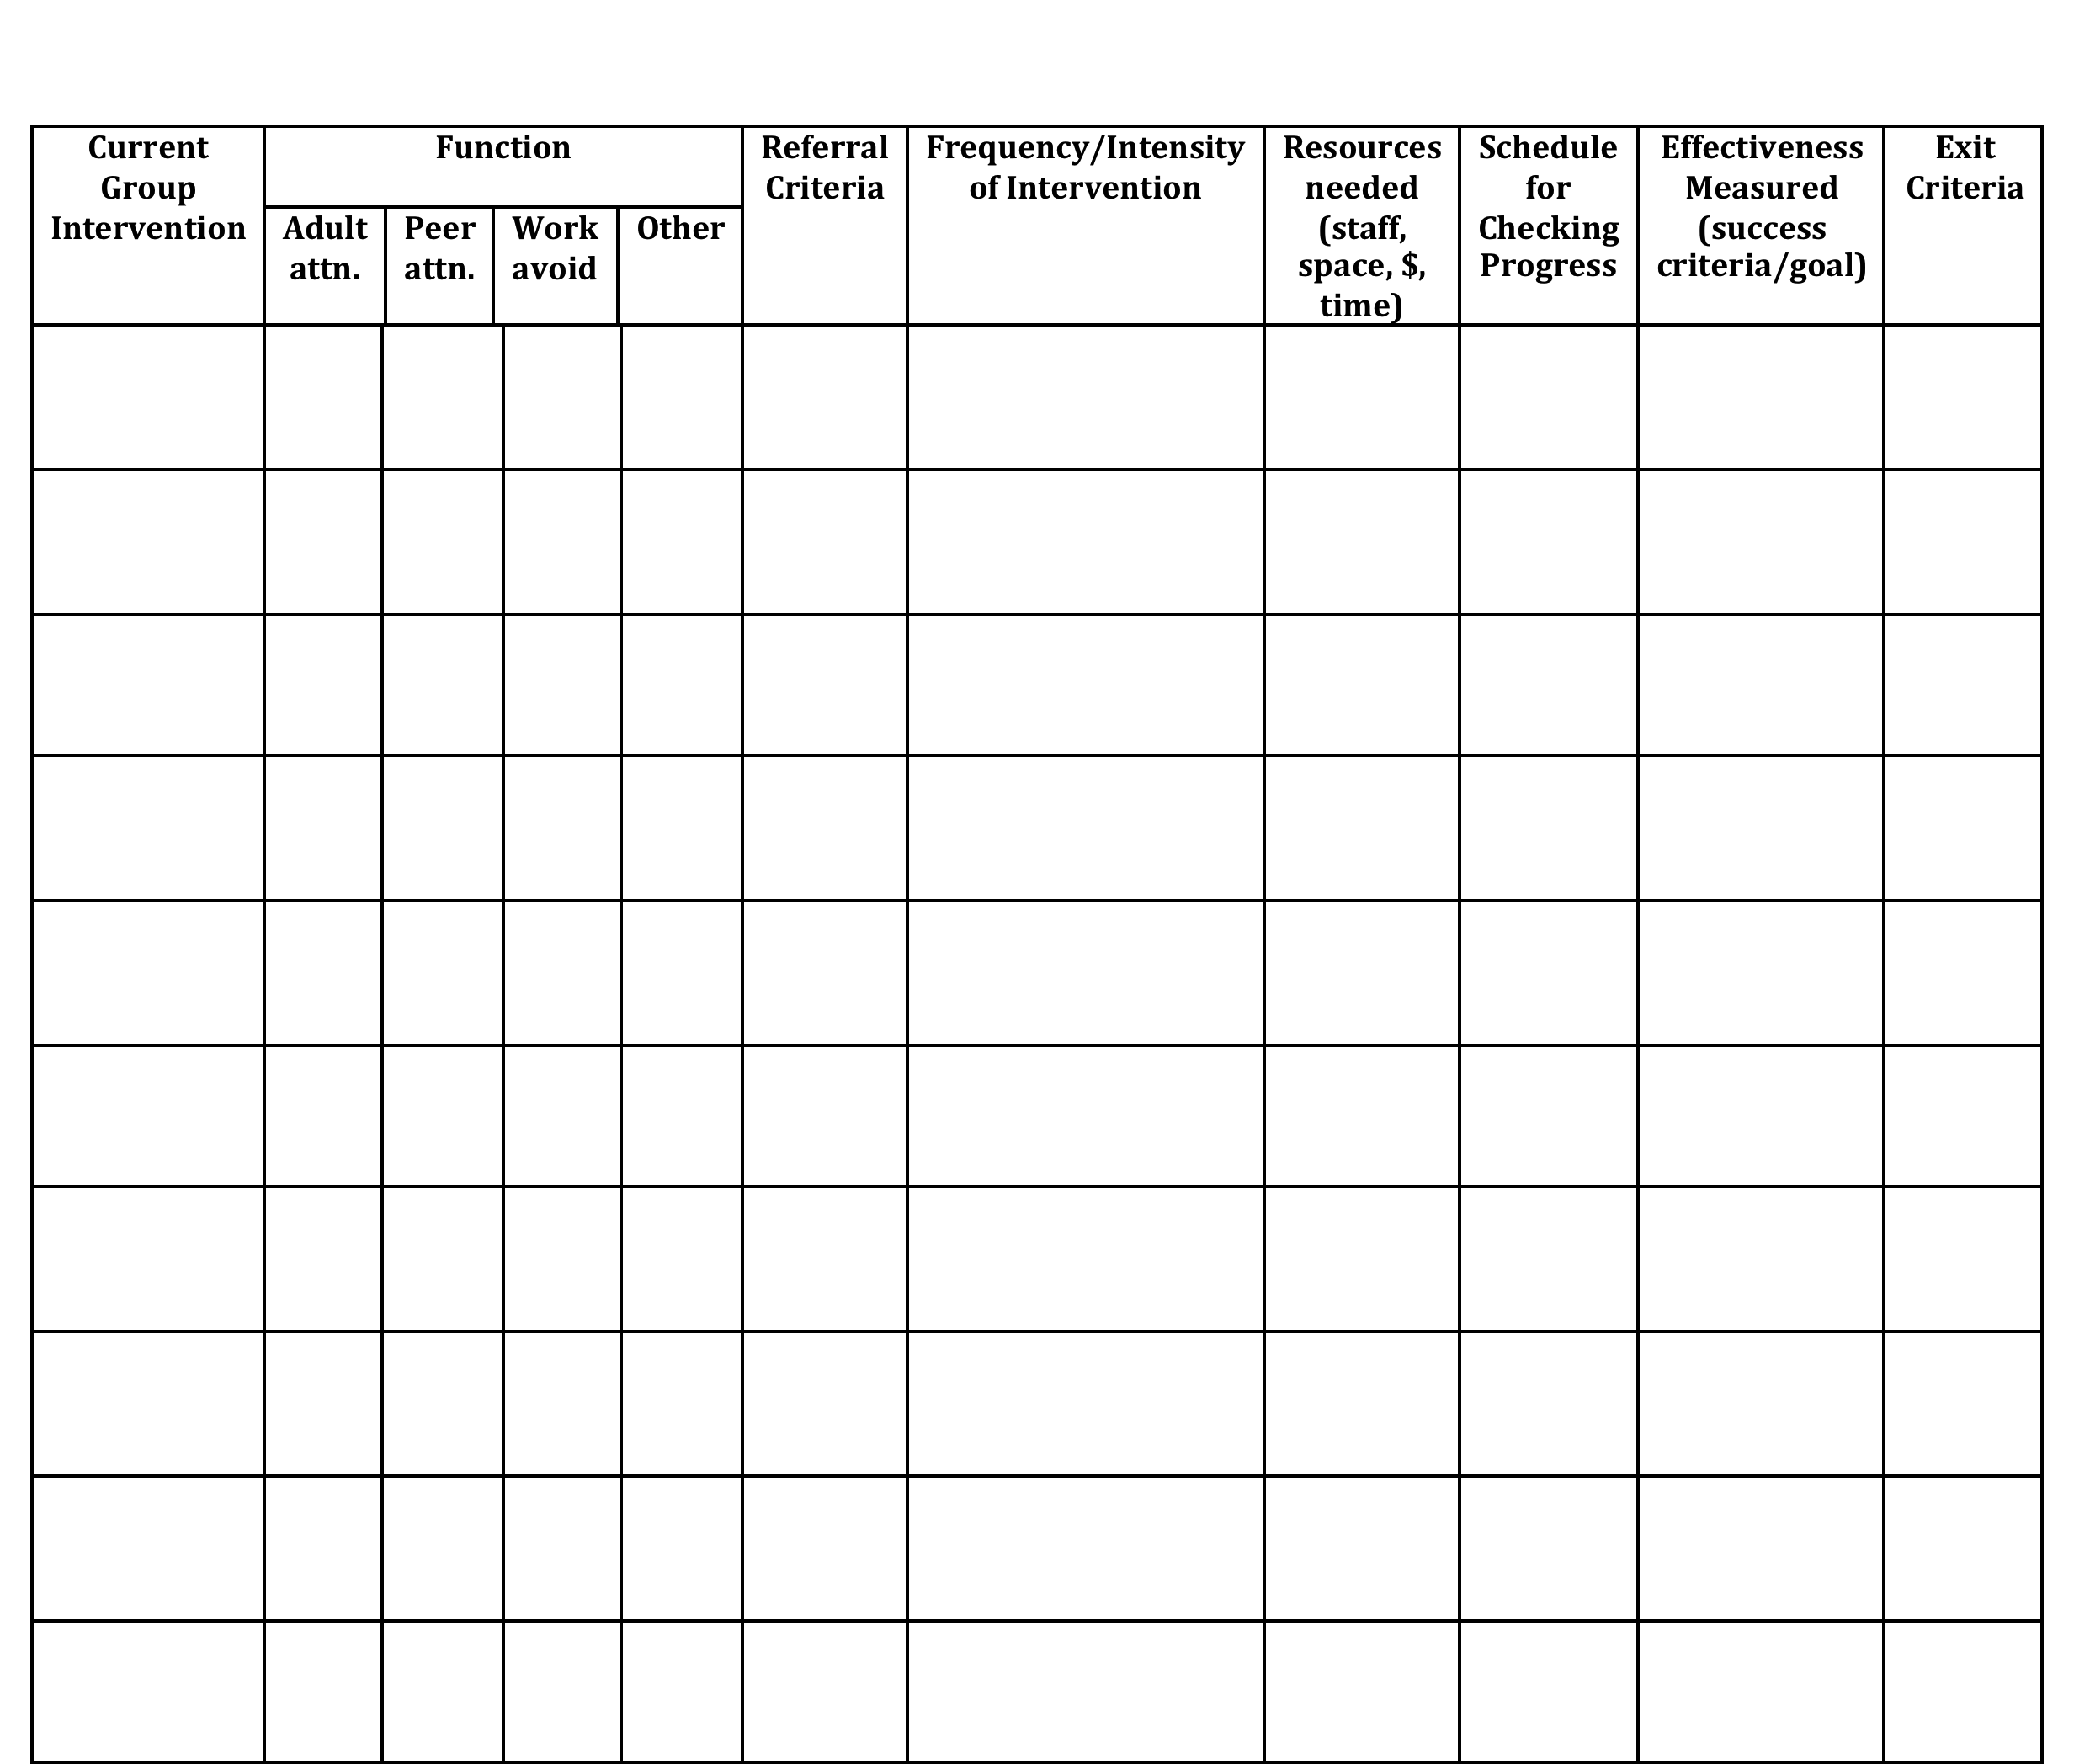
Inventory of Existing Targeted Interventions
Notes:
Direct them to Handbook for this activity, go to next slide

Slide 40
Targeted Team Video
https://www.youtube.com/watch?v=btFC13oz9mM

Slide 41
Activity
In school teams, review your targeted supports by beginning to complete the Inventory of Targeted Supports (in workbook)
Share two most successful supports or practices with large group
Notes:
In Handbook
Each team shares two most successful practices with large group

Slide 42

Check-In
Who participated in webinar?
Who completed Readiness Checklist as a Team?
Notes:
If not everyone present was part of webinar, readiness, or BAT then bring each other up to date and get additional input from one another in next activity

Slide 43
Activity
Review / Complete
Readiness Checklist
> In your workbook
Notes:
In Handbook
Pull up your BAT from PBIS apps website … should have completed this as part of pre-institute tasks
Review readiness checklist and BAT
THEN …
Complete Team Profile for ???both Systems Level and Individual Student Level???

Slide 44
Necessary Conversations (Teams)
TFI
Tier 1
Tier 2
Tier 3
SU/District Team
•Coordinates implementation
•Ensures access to resources
•Reviews data across schools
SU/District Team – Targeted/Intensive:
•Secures resources
•Focuses on student outcomes
•Focuses on fidelity of practices across the district/SU
SU/District
School Leadership Team
•Plans and implements 6 school components of PBIS
School Systems Level Team – Targeted/Intensive:
•Creates procedures for referral, screening & evaluation
•Communicates with staff and families
School
Student Level Team
•Matches students to interventions
•Evaluates & monitors student progress
Student Level Team
•Completes FBA/BIP
•Evaluate & monitor student progress
Facilitates wraparound
Student
Notes:
You need to figure out where you as the intensive team fit in
KEN through 78

Slide 45
Intensive Team: Critical Features
TFI
Possess specialized behavioral skills within their membership
Allow and encourage contributions from all their members
Have predictable and efficient procedures for doing business and solving problems
Have regular opportunities to access building staff, families, and community agencies to communicate and solicit information

Slide 46
Intensive Team: Objectives
TFI
Manage teacher requests for assistance
Ensure that teachers and students receive support in a timely and meaningful manner
Provide a general forum for discussions and possible solutions for individual student behavioral concerns
Organize a collaborative effort to support the teacher (Todd et. al., 1999)

Slide 47
Role of Administrator
Know what the practices look like when implemented with fidelity;
Access special resources, if needed.
Support team meeting time
Be flexible around school policies/procedures.
Be committed to helping students and LRE.
Be aware of data using tracking tools; help decide what needs to change.
Notes:
This is who the parent will call if there are problems. Administrator needs to know what is happening with all student plans.

Slide 48
Role of Intensive Team Coordinator
Attend Leadership Team Meetings
With leadership team, identify staff to facilitate individual team-based meetings.
Help team complete behavior tasks on time
Data organization and reporting
Meet with student teams weekly
Notes:
Active knowledge of school’s PBIS efforts
Skilled in function-based assessment, behavior support planning & implementation
Member of the school’s Leadership Team and EST
Role formally endorsed by school principal
Flexibility to complete tasks during the day
Positive rapport with other school staff

Slide 49
Activity
Complete Team Profile and Meeting Schedule in workbook
1. Intensive Intervention
Team Roster
2. Intensive Team –
Individual Student Level
List people who will always be on
every Individual Student Team
Notes:
In Handbook
Pull up your BAT from PBIS apps website … should have completed this as part of pre-institute tasks
Review readiness checklist and BAT
THEN …
Complete Team Profile for ???both Systems Level and Individual Student Level???

Slide 50

Step 1 for Referral to Intensive: Individual Student Teams
TFI
Notes:
Individual student team will look different than your intensive SYSTEMS team!
Who are the essential people to have on your individual student teams?

Slide 51
Example Request for Assistance Form
TFI
Number of ODR: __________ Number of nurses visits: ____________

Slide 52
Activity
Develop a Request for Assistance Process to refer a student for development of an individualized Behavior Support Plan
Record this in the Intensive Level Roll-Out Plan of your workbook (pages 15-17)
Notes:
In Handbook
Pull up your BAT from PBIS apps website … should have completed this as part of pre-institute tasks
Review readiness checklist and BAT
THEN …
Complete Team Profile for ???both Systems Level and Individual Student Level???

Slide 53

1 Teaming
2 Goals
3 Assessment (FBA)
4 Intervention (BSP)
5 Evaluation (BSP)
Vermont’s Planning Process for Students
Adapted from: Dunlap et al. (2010). Prevent, Teach, Reinforce
Notes:
We’ve focused today on systems.
We’re going to move for the rest of the week to focusing on intensive supports for students
Hand out books

Slide 54
Engaging Team Members
TFI
Dedicated time
Creative problem solving
Organized team process
Handling conflict
Notes:
Not necessarily an easy thing to do; need to invest more effort to make them run well

Slide 55
Recommended Team Members
Teacher
Parent
Behavior expert
Resource expert
Student
Others?
TFI
People who are actively involved with the student and invested in the student’s success. + Input from student as appropriate!
Notes:
Emphasize ACTIVELY INVOLVED and INVESTED
This is exactly how the Behavior Support Plan is organized

Slide 56
Activity
Heart of the Matter,
Part 2 (in workbook)

Slide 57
Activity
Review/complete Family Engagement Checklist in workbook
Complete Develop Parent Awareness and Consent & Student Awareness sections of your Intensive Level Roll-Out Plan in your workbook (pages 15-17)
Notes:
In Handbook
Should have done this as part of pre-institute task, after having watched the 13-minute webinar

Slide 58


VT Family Support Resources
www.vermontfamilynetwork.org
www.vffcmh.org
Notes:
Do activity two: Power Imbalances today
Do activity one tomorrow: Positions and Interests

Slide 59
Responsibilities of Individual Student Teams
TFI
Meet weekly at first, then less frequently per need
Set up meeting schedule at the beginning
Agree on initial behavioral goals for student
Participate in completing FBA for the F-BSP
Develop BSP (and, if needed, Crisis Plan)
Train additional staff to implement BSP
Oversee implementation of BSP
Collect and review data to evaluate effectiveness and fidelity of BSP
Revise BSP as needed

Slide 60
Example: Team Meeting Structure
Start with positives!
Review all relevant data
Brainstorm ideas based on data
Discuss, prioritize, make data-based decisions
Gain consensus and implement agreed upon steps
STICK WITH YOUR AGENDA
Notes:
All the most successful individual interventions are built on student’s strengths, not on remediating their weaknesses
Don’t just mention the positives, but truly celebrate them
Hold up Bx Support Plan and direct their attention to where this sample agenda is built in

Slide 61
ONSU Team
http://www.wcax.com/story/28128871/vt-school-tackles-behavior-intervention-strategies

Slide 62
Activity
For your student who needs intensive supports, complete Stage 1: Teaming section of the Intensive Level F-BSP (p.2)
For the same student, complete Clarifying Roles and Goals of Team Members in your workbook & discuss the questions at the bottom
Notes:
In Workbook

Slide 63

Step 2: Setting Goals
TFI
Broad goals identified by team at the start
Includes positive behaviors to increase and problem behaviors to decrease
Team has conversation to reach consensus
Notes:
Who are the essential people to have on your individual student teams?
Goals to support child AS WELL AS the adults providing primary interventions with child.

Slide 64
Broad Goal Example
Jesse will follow instructions by teachers, staff, and other adults.

Slide 65
Collecting Baseline Data for F-BSP
For each behavior, the team must:
Define the behavior in measurable and observable terms
Determine best method for measuring
Choose anchor points for recording change
Baseline data is used to inform the FBA and later on to assess effectiveness of the BSP

Slide 66
Positive & Problem Behaviors
Increase the number of times he responds appropriately by responding to adult requests quickly and respectfully
Decrease number of times he runs away from adults following adult requests.

Slide 67
Collecting Baseline Data
  Direct Observation:
  Time sampling = Instances of the behavior within a certain time period (e.g. blurting out)
  Frequency counts = Every occurrence of the behavior (e.g. following directions, running away after directions given)
  Duration = Length of each occurrence of the behavior (e.g. tantrums)
  Scatterplot = Time the behavior(s) occurred
  Set-backs
  Antecedent-Behavior-Consequence Charts = For low frequency, high severity behavior

Slide 68
Collecting Baseline Data
  Indirect Data:
  Subjective rating scale (e.g. amount of work completed, general level of cooperation)
  CICO Daily Report Cards

Slide 69
Activity
Complete Stage 2: Goals from p. 2 of Intensive Level Behavior Support Plan (F-BSP) for your student
Discuss if observations might be needed to gather baseline data
Choose a method for collecting baseline data
Notes:
Emphasize that they’re thinking about a real student but this is just practice bc you don’t have all the proper team members with you today

Slide 70
Steps 3 & 4 Assessment & Intervention
TFI
Assessment=Functional Behavior Assessment (FBA)
Intervention = Behavior Support Plan (BSP)
School should have personnel ready to provide simple & complex FBA / BSP
Trigger
Behavior
Consequence
Function
Notes:
Do you have people identified?
Do they feel competent and confident?
And are they doing them?

Slide 71
Functional Behavior Support Plan
An interview tool for collecting information about problem behaviors
For staff, parents, and students
The F-BSP then leads the team to create a competing behavior pathway and behavior support plan

Slide 72
Simple vs. Complex FBA
 | SIMPLE | COMPLEX
FOR | Students with high frequency behaviors (not dangerous), received interventions that did not improve behavior, show behaviors in only 1-2 settings | Students that demonstrate dangerous behaviors or show behaviors that occur in 3 or more school settings
WHAT | Relatively simple and efficient process to guide behavior support planning | Time-intensive process involves emergency planning, family-centered planning, & collaboration outside agencies
WHO | Team of school-based personnel (ex: teachers, special educator, counselor, administrator, behavior support personnel) | School-based team with professionals trained to implement interventions for students with severe problem behaviors (ex: behavior specialist or school psychologist)
Notes:
You should have in-house capacity for simple FBAs
This looks like a dichotomy, but is really on a continuum
Know when to call in an “expert” or outside consultant

Slide 73
FBA = D.A.S.H. (Loman Training)
Define behavior in observable and measurable terms
Ask about behavior by interviewing staff and student
specify routines where & when behavior occurs
summarize where, when, and why behavior occurs
See the behavior
observe the behavior during routines specified
observe to verify summary from interviews
Hypothesize
a final summary of where, when, and why behaviors occur

Slide 74
Competing Behavior Pathway
Desired Behavior
MaintainingConsequence
Setting Condition
Antecedent Trigger
Problem Behavior
Maintaining Consequence
Function
Replacement Behavior
Notes:
74

Slide 75
FBA Hypothesis
Setting
Antecedent
Behavior
Consequence
TFI
Typically on days when he has worked alone for 30 min…
when given math work sheets & other assignments…
he doesn’t do his work and uses profanity.
His work doesn’t get completed and he avoids teacher requests.

Slide 76
Hypothesis Summary
When given math worksheets & other assignments, Caesar does not do his work, uses profanity, & disrupts lessons, especially, when he has worked alone for 30 minutes without peer contact. His work does not get completed, & he avoids teachers requests.

Slide 77
These student FBAs, plans, & strategies are for practice only.
You will need to further refine them at school, involving the whole student team.
Notes:
Jesse

Slide 78
Activity
Complete Stage 3: Assessment
(the FBA portion of your Intensive Level BSP):
Choose ONE behavior for your student, complete Description of Behavior on page 3 of F-BSP
Review, discuss, & complete questions in Teacher Interview section of F-BSP (p. 3-4)
Write the results of your discussion in the Propose a Testable Explanation table (p. 4)
Develop hypothesis for function of the behavior – write this under Function of Behavior (p. 4)
Notes:
Jesse 15 minutes 10:35-10:50
NOW BREAK

Slide 79
End of Day One
Homework/Team Time
1. Review all of the work you did today and put items that you did not get a chance to finish on your To Do list.
2. Determine what else you need from us to get your intensive team ready on a systems level.
3. Begin completing the Intensive Level Roll-Out Plan in your workbook.
4. Give feedback to trainers about your needs for Day 2.

