Slide 1
VTPBIS Leadership Team Training
Within a Multi-Tiered System of Supports
Intensive Level
Presented by:
Ken Kramberg and Sherry Schoenberg
March 2019
If you’re tweeting, use #VTPBIS or @VTPBIS
www.pbisvermont.org
Find all materials at:
https://www.pbisvermont.org/training-resources/intensive-training/
Wifi Information:
LMRguest

Slide 2
Agenda
Focus on Strengths
Targeted Review
Teaming
Engaging Families
Setting Goals
FBA
Day 1
Day 2
    BSP Interventions
    Evaluation
    Crisis Plan
    Roll Out Plan
    Follow Up

Slide 3
The Power of Relationships
The Effectiveness Of An Intervention Often Hinges On The Quality Of The Relationship With The Helping Adult
Well Designed and Informed Behavior Support Plans Often Fail Because The Helping Adult Fails To Establish A Positive Helping Relationship With the Child
Sometimes A Poorly Designed Or Marginal Plan Is Successful Because Of The Quality Of The Relationship

Slide 4
Life Space Crisis Intervention
Establishing effective positive helping relationships with children
Diagnosing and correcting self-defeating patterns of behavior

Slide 5
De-Escalation and Relationship Building Skills
Consider training In Life Space Crisis Intervention or similar content to build capacity in these skill areas

Slide 6
WHEN ENGAGED IN AN EMOTIONALLY CHARGED EVENT…
YOU MUST DEAL WITH THE FEELINGS FIRST BEFORE YOU CAN DEAL WITH THE BEHAVIOR
FEELINGS , THOUGHTS , BEHAVIOR

Slide 7
CHILDREN WHO ARE HEARD
LISTEN
Kids want to tell their story

Slide 8

General Strategies
Relationships
Routines
Warn before changes
Choices
Clear limits
Safe spaces
Answer questions about trauma
Understand link
Anticipate triggers
b/w trauma &
behavior
Center
on Di and Com
sability munity

Slide 9
BSP Strategies Based on FBA
TFI
Setting Event Strategies
Understanding and addressing precipitating factors (if possible)
Antecedent Strategies
Redesigning the learning and environments to prevent problem behaviors
Behavior Teaching Strategies
defining, modeling, practicing new behaviors
Consequence Strategies
implementing specific to generalizable reinforcement
Ce on Disab
nter
teaching
ility
and Community

Slide 10
Activity
Complete Step 6: Build a Competing Behavior Pathway on p. 8 of your Intensive Level F-BSP
Notes:
Jean

Slide 11


F-BSP Strategy Types
Setting Antecedent
Behavior
Consequence
Strengthening relationships
Home-school communication
Home-to-school reinforcement
Engaging families
Coordination with community providers
Providing choices
Transition
supports
Environmental
supports
Curricular
modification
Adult verbal behavior
Classroom management
Increase
noncontingent reinforcement
Peer support
Academic skills
Problem-solving
Coping
Social skills
Teacher-pleasing behavior
Learning skills
Self-management
Independent
responding
Increased engaged time
Discontinue reinforcement of problem behavior
Group
contingencies
Increase ratio of
+ to – responses
School-to-home reinforcement
Delayed gratification
Peer modeling
ü✓
Functionally equivalent
Cente on Disabilit and Communit
Inclusio
r y y
ü✓
Behaviorally incompatible
n

Slide 12
Selecting Strategies
As you identify unique strategies, use the sticky notes to post strategies on the laminated charts posted around the room:
Setting Event Strategies
Antecedent Strategies
Teaching Strategies
Consequence
Strategies
C
on Disa and Comm
enter
bility
Notes:
Setting = Prevention
Antecedent =Cue

Slide 13
Setting Event Strategies
WHAT WE CAN CONTROL
WHAT WE CANNOT
Engaging families
Structure / schedule
Classroom accommodations and modifications
Home/school communication
History of trauma
Medical / physical conditions
Temperament
Sensory profile
Carry-in issues

Slide 14

At the Intensive Level, the children we are working with are often victims of trauma.
Notes:
As we go through the day, we will be working through all of the challenges of supporting these children. Let’s remember the broader context of their lives.

Slide 15
What setting events impacted the function of her behavior when she broke the doll? If you hadn’t seen this part of the clip, would you have assumed she broke the doll on purpose?

Slide 16
Setting Events can influence the function of behavior
Understanding setting events is critical to understanding the function of behavior
FBA process can reveal critical setting events that influence the function of behavior
Life Space Crisis Intervention interview process can help identify these setting events
“Trauma” can influence behavior in very broad ways

Slide 17


What is trauma?
Unpredictable
Threatening
Trauma is NOT Trauma is how the stressful you experience
event the event
Center on Disability and Community
Inclusion
Overwhelming
Meaningless

Slide 18
The importance of knowing about trauma:
Many children with intensive behavior support needs have been victims of trauma and neglect
When staff understand the effects of trauma they often find it easier to manage their own feelings when challenged
Adults who understand the effects of trauma can provide support to help children respond
Center on Disability and Community
Inclusion

Slide 19
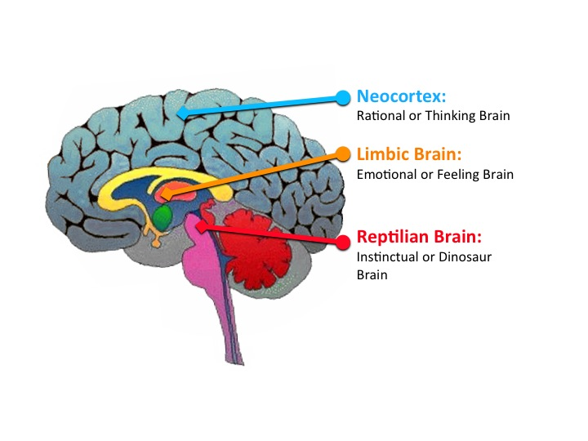
Notes:
Trauma effects how we think . Staff working with children who are vicitims ( probably all staff) of trauma and neglect need a basic understanding of how trauma effects ability to cope, problem solve and access language.

Slide 20
Resources
https://traumasensitiveschools.org/
NCTSN Child Trauma Toolkit for Educators (2008)
National Council for Adoption Children of Trauma: What Educators Need to Know (2013)

Slide 21
Activity
Use the Setting Events Interventions Brainstorming Tool in your Intensive Level F-BSP p. 9
List some setting event strategies for your student in the F-BSP protocol
Notes:
Jean

Slide 22
Antecedent Strategies
Antecedents are the events, people or things that immediately precede the problem behavior.
Antecedent strategies are created to prevent problem behaviors/increase replacement behaviors
Notes:
Teri

Slide 23
Antecedent Strategies
Examples
Eliminate the trigger
Modify task to incorporate student interests
Make task more meaningful
Reduce task difficulty level
Break task down, given first part only
Prompt alternative or replacement behavior
Take a break
Change the routine
Give a choice
Change language & tone used in giving the direction
Notes:
Change routine – example of student resisting coming to Circle starting with sitting and listening – change first Circle activity to singing a song

Slide 24
Activity
Use Antecedent Interventions Brainstorming Tool in your F-BSP p. 10
List some antecedent strategies for your student in the F-BSP

Slide 25
Behavior Teaching Strategies
Acquisition Challenges
Absence of knowledge for executing skill or failure to discriminate which social behaviors are appropriate in specific situations (can’t do)
Performance Challenges
Skill is present in repertoire, but student fails to perform at acceptable levels (won’t do)
Fluency Challenges
Lack of exposure to sufficient or skilled models of social behavior, insufficient rehearsal/practice or low rates or inconsistent delivery of reinforcement of skilled performance
Center

Slide 26
Behavior Teaching – Adapt your social skills curricula
Social skills curriculum must match the specific need.
An ideal curriculum does not exist.
Basic set of “Preferred Teaching Practices” exists.
Initially, learning how to teach social skills takes time and energy.

Slide 27
Instructional Approach to
Behavioral Skills Teaching (BST)
Tell (coaching)
Show (modeling)
Do (role play)
Practice (behavioral rehearsal)
Monitor Progress (feedback)
Generalize (apply in multiple settings)

Slide 28
Behavioral Skills Instruction at the
Intensive Level
Link with functional assessment and behavior planning
Create individualized plans within the context of the Universal (school-wide) social skills instruction
Pre-teach, pre-correct, re-teach
Integrate what the student does well
Evidence of generalization should include school, home and community

Slide 29
Activity
Activity
Take one of your targeted interventions from your inventory and plan how you can adapt it to teach one of the replacement behaviors in your F-BSP for your student
Use the Behavior Teaching Interventions Brainstorming
Tool p. 11
List some Behavior
Strategies in your
student’s F-BSP

Slide 30
Consequence Strategies
Minimize reinforcement for problem behavior
Redirect and reinforce alternative behavior
Increase reinforcement for desirable behavior
Note: Strategies should be designed in combination with teaching strategies
Center

Slide 31
Consequence Strategies
Examples:
Reinforcement (positive or negative) to increase alternative or desirable behaviors
Extinction
‘Punishment’ to decrease problem behaviors
Non-contingent reinforcement to reduce the value of current reinforcers for problem behavior (i.e. provide sensory input all the time to reduce value of disruptive sensory-seeking behavior)
Re-direction
Center

Slide 32
Activity
Use the Consequence Intervention Brainstorming Tool p. 12
List some consequence strategies for your student in the F-BSP protocol

Slide 33
Supports and Practices
Trauma informed Care
De-escalation and Relationship Building Skills
LSCI trainings
  Breaking The Conflict Cycle (all Staff)
  Turning Down The Heat ( some staff)
  Full LSCI training
Check and Connect

Slide 34
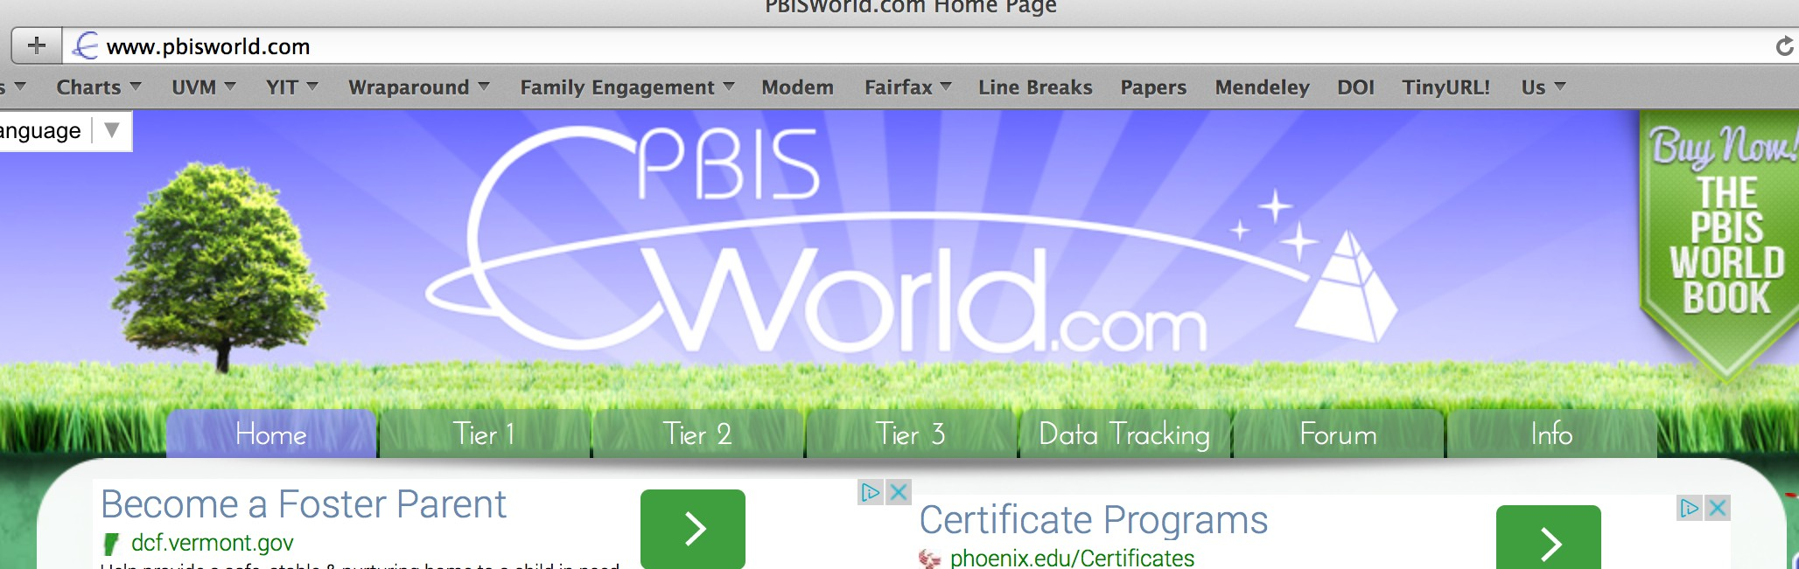

Resources for Interventions
www.pbisworld.com
http://www.cccoe.net/social/skillslist.htm
Center on Disability and Community
Inclusion

Slide 35
Activity
Explore these resources & add three additional strategies or modifications to your BSP for your student.
Notes:
Ken finishes here

Slide 36

Step 5: Evaluation
TFI
Creating measurable goals
Fidelity of implementation
Progress toward goals
Making data-based decisions
Center on Disability

Slide 37
Short Term Goals
Increase the number of times he responds appropriately by walking directly to the room, taking a seat in the back of that class, and sitting quietly for one minute
Decrease number of times he runs away from adults following adult requests.
Decrease the amount of time it takes to respond to adult requests
Ce on Disab and Commu

Slide 38
Activity
Refer to the Stage 2 Goals on p. 2 of your F-BSP
Further refine these goals in light of your BSP interventions
Record your newly refined goals on the Long & Short-Term Behavioral Goals of the Evaluation section of your
F-BSP (p.13)

Slide 39
Measuring Goals
TFI
Use baseline data collected as part of the FBA process to assess effectiveness of your BSP:
  Frequency
  Duration
  Intensity
  Likert-type scale
  Perception
        + Fidelity of implementation

Slide 40
Examples
Task Engagement: amount of time Johnny remains in his seat with eyes focused on the teacher and/or work materials during independent academic work.
Tantrums: number of times Johnny engages in screaming, kicking furniture and/or people, and throwing objects (all 3 behaviors must be present).

Slide 41
Example: Tracking Behaviors
5
4
Task engagement Tantrums
3
2
1
28-Jan
29-Jan
30-Jan
31-Jan

Slide 42
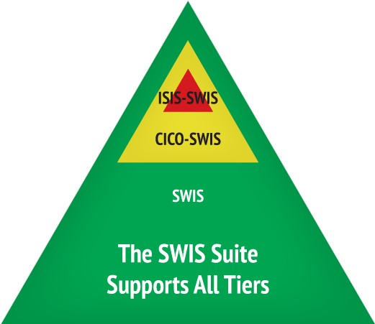
Evaluation: SWIS-ISIS Demo
www.pbisapps.org

Slide 43
Activity
Decide what data system you will use to track your intensive-level data. Record this in the Create a System for Managing the Daily Data section of your Intensive Level Roll-Out Plan

Slide 44
Activity
Decide what data you will collect to find out if your BSP is working.
Record this in the Evaluation Procedures section of your student’s BSP, p. 16

Slide 45
Measuring Fidelity
TFI
Adherence Are minimum components of intervention strategies being implemented?
(e.g., teacher providing praise when replacement behavior offered)
Quality
How well is the plan being implemented? (e.g., staff gave student reminder sheet, but didn’t review it)
Center

Slide 46
Activity
For your student, determine how you will evaluate fidelity of implementation of your BSP plan. Record this in the Evaluation Procedures section of your student’s BSP.

Slide 47
Behavior is improving
Positive behavior change
Behavior progress & Good fidelity
Extension
Shaping
Fading
Self- Management
New settings
Delayed gratification
New people
Intermittent schedule
Center on Disability and Community

Slide 48
Behavior is NOT improving
Data indicate behavior not improving
Interventions implemented with fidelity
Interventions not implemented w/ fidelity
Hypothesis incorrect
Strategies too difficult or time consuming
Interventions are insufficient
BSP does not match teacher context
Teacher experiencing intervention drift

Slide 49
When Starting New
Interventions…
Things may need to be tweaked right away – or not!
Things often get worse before they get better
Why?
How can we be proactive?

Slide 50
CRISIS PLAN
Desired Behaviors
Consequences
Setting Events
Problem Behaviors
Antecedents
Consequences
Alternative Behaviors

Slide 51
https://vimeo.com/130836807

Slide 52
Taking Care of Yourself
Recognize signs
Irritability
Difficulty planning & concentrating
Numb
Intensive feeling
Don’t go it alone
Teams
Administrators
Colleagues
Recognize as occupational hazard
“cost of caring”
NOT weakness
Seek help with own trauma
Education
Talk to professional
Attend to self care
Eat well
Exercise
Sleep
Laugh & Cry

Slide 53
School-wide Crisis Plan
Starts with prevention:
Consistent Tier 1 strategies are in place
Safety Plan posted and practiced
All staff trained in de-escalation and personal safety

Slide 54
Crisis Response
Crisis Team: Small group of 3-5 trained staff available to respond to crises
Does your school have a team?
Who needs training?
School-wide procedure established for calling crisis team in
Does your school have a procedure?

Slide 55
Crisis Response
Individualized Crisis Plan should be developed for students at risk
- Who is called
- Where they go
- What they do or say to child
- Do key support people need training?
Restraint is used as a last resort following Rule 4500 protocol – other options should be explored pro-actively & in the moment

Slide 56
Crisis Prevention/Intervention Plan
Situation (triggers/stressors)
Coping Strategies
What is needed to feel safe in crisis
Key support people to contact
What to do to manage a crisis
What not to do
Conditions for emergency room, police, hospital
Coordinated
Services Plan
Proactive Crisis
format

Slide 57
Activity
Complete the Proactive Crisis Plan for your student in the F-BSP, p. 12
If your F-BSP student is not at-risk for crisis, identify a student who is and complete the plan with respect to that student
Identify who needs to be part
of a planning meeting to
finalize the Proactive Crisis
Plan after you get back

Slide 58
What is a mental health crisis?
What is a mental health crisis?
Any situation in which the child’s behaviors puts them at risk of hurting themselves or others and/or when the adults aren’t able to resolve the situation with the skills and resources available.

Slide 59
When should you refer?
Physical symptoms
Self-regulation difficulties
Inconsistent academic performance
Over or under-reacting to events
Severe reactions
Long duration (more than 1 month)

Slide 60
Effective Mental Health Interventions for Trauma
Effective Mental Health Interventions for Trauma
Education about trauma
Helping re-establish a sense of safety
Teaching techniques for dealing with overwhelming emotional reactions
An opportunity to talk about and make sense of the traumatic experience in a safe, accepting environment
Involvement, when possible, of primary caregivers in the healing process

Slide 61




Relationships with Partners
TFI
School
DCF
Family
Services
Families
Mental Health

Slide 62

Where do we go from here… thoughts and/or questions…
Notes:
SWIS Trainings
Post Implementation SET
Support Available
Grad Course

Slide 63

You are not alone!
Notes:
SWIS Trainings
Post Implementation SET
Support Available
Grad Course

Slide 64
Vermont PBIS System of Support
SUPPORT LOOPS
School Level:
School
Coordinators
SU/SD Level:
SU/SD Coordinators
State Level:
TAs
Trainers
Coaches
Leadership Teams at ALL Levels of Support
FEEDBACK LOOPS
Notes:
We’ve learned the importance of identifying a contact at each level of the cascade.
We’ve learned that the beauty of a healthy cascade is that it will continue to sustain if one piece is missing….

Slide 65
Getting ready for next year….
Recommended Steps:
  Set aside a time to finish/revise your Staff Roll-out and Action Plan - schedule this time now
  Obtain your I- SWIS License (optional)
    http://www.pbisvermont.org/resources/evaluation-tools/swis
  Consider securing resources for coaching support
  Plan your professional development for next year
    Keep an eye out for the VTPBIS Professional Learning Calendar in June

Slide 66
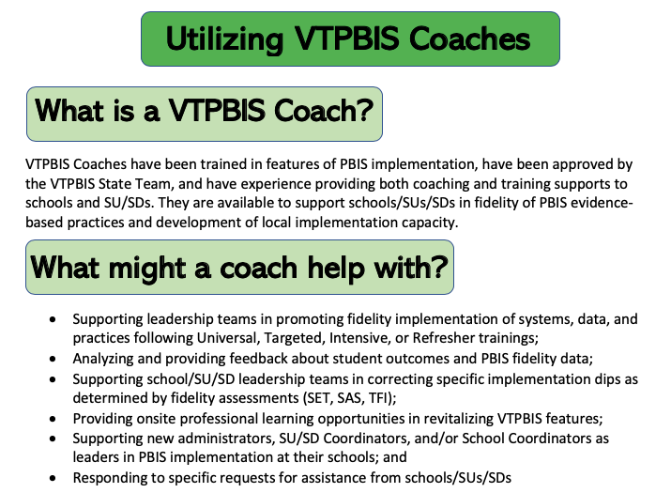

Slide 67




The elements necessary to sustain PBIS include:
Data
Communication
Sharing Information
Participation
Notes:
1) Data: The school completes annual assessments (SAS and Annual TFI). The school also collects discipline data and uses it to problem solve and maintains an annual PBIS action plan.
2) Communication: A school initiates at least bi- monthly contact with their Implementation Coach or their State TA. The schools communicates regularly with its Supervisory Union/District Coordinator and/or sends progress reports to the Superintendent at least twice a year.
3) Participation: A school participates in at least three of the four Regional Coordinators Meetings and provides opportunities for all staff to participate in progress updates and problem solving at least three times a year.
4) Training/Information Sharing The school actively works toward fidelity of implementation at all tiers.

Slide 68



Stay Connected
https://www.facebook.com/groups/PBiSVermont/
https://twitter.com/vtpbis
https://www.pinterest.com/vtpbis/

Slide 69
Questions? Contact a VTPBiS TA
When in doubt, contact Anne Dubie!
(802) 656-5775 or Anne.Dubie@uvm.edu

Slide 70
THANK YOU!
Safe Travels!

