Slide 1
Disseminating Data: Use Data as a Story-Telling Device
What data are you collecting?
What questions can you answer with this data?
Which of those questions tell a compelling story?
OR Which questions get to the heart of your work?
Who is your targeted audience for your story?
How could you display the data to convey the story of PBIS?
REMEMBER!
Before we can measure success, we must define success!
Notes:
Amy

Slide 2
Create an Infographic or Brief Power Point Presentation!
Simple is better!
Start with one graph or table and some descriptive text
Infographic templates: https://www.visme.co/
Notes:
Amy

Slide 3
Notes:
Amy

Slide 4
Notes:
Amy

Slide 5
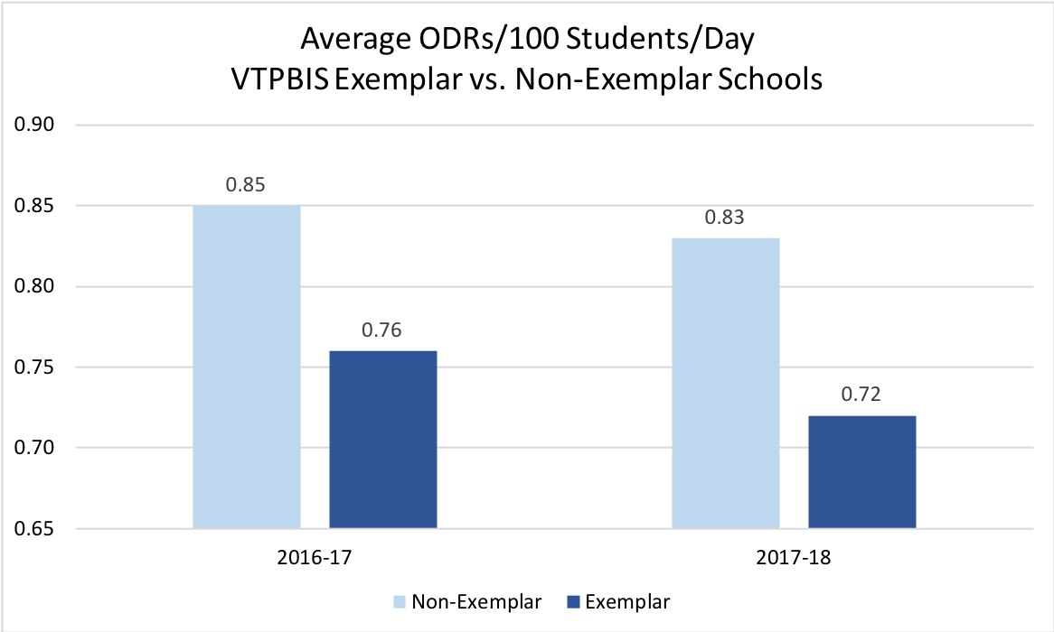
Notes:
Amy

Slide 6
Optional Activity
With a partner, help each other create a simple Infographic
Notes:
Amy

Slide 7
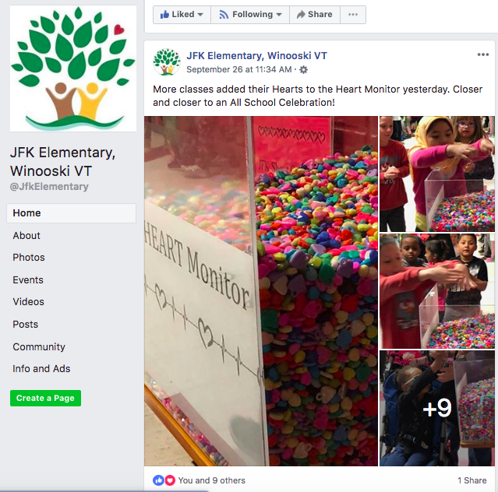
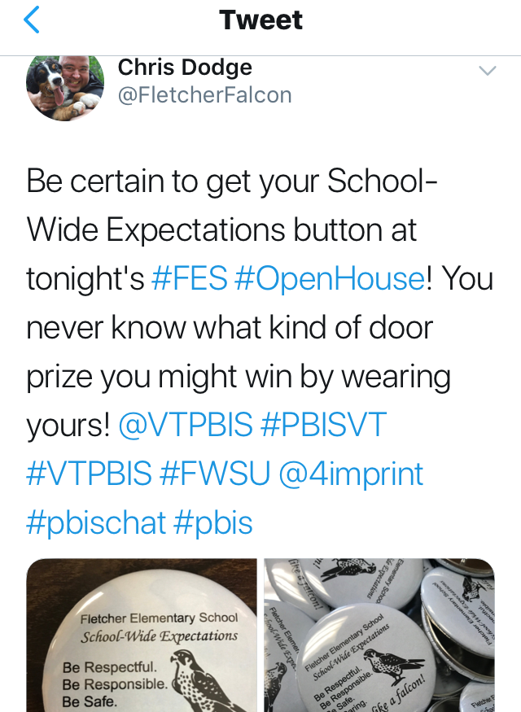
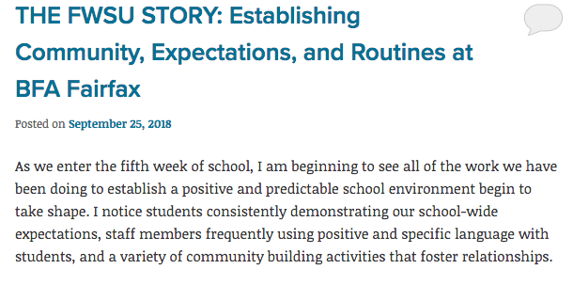
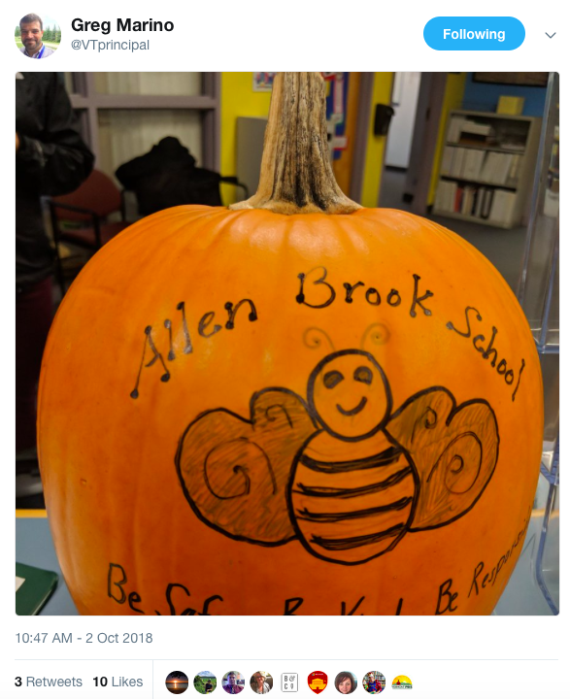
Modes of Dissemination
Twitter
Facebook
Blog
School Website
Notes:
Amy

Slide 8
Sharing Data with Your Staff
Introduce team members
Acknowledge staff support for the process
Identify data trends using graphs
Be specific about areas for improvement and areas of growth (i.e. violation system, consistency in responses)
Elicit feedback on ways to improve
Review data regularly (quarterly, monthly, etc.)
Identify the team’s response based on feedback
End by identifying who staff can go to if they have questions/comments
Notes:
Consider: Turning this into a checklist for the PBIS team.

Slide 9
Annual Evaluation (TFI item)
Document fidelity and effectiveness (including on academic outcomes) of Tier I practices at least annually (including year-by-year comparisons) that are shared with stakeholders (staff, families, community, district)
Use this evaluation to inform action plan

Slide 10
Optional Activity
Using the template that follows, create a presentation of your SAS and TFI results, including action steps.
Alternatively:
Create a presentation of your student outcomes results
Create a presentation to use when training new staff in PBIS
Notes:
The staff presentation ppt will be posted at www.pbisvermont.org. Handouts will also be available.

Slide 11
INSERT School Name PBIS Update!
Insert School Mascot/Logo and Expectations
HERE

Slide 12
PBIS Data Update!
THANK YOU ALL!
(INSERT # of Staff or %) of Staff Members Completed
the Self-Assessment Survey!

Slide 13
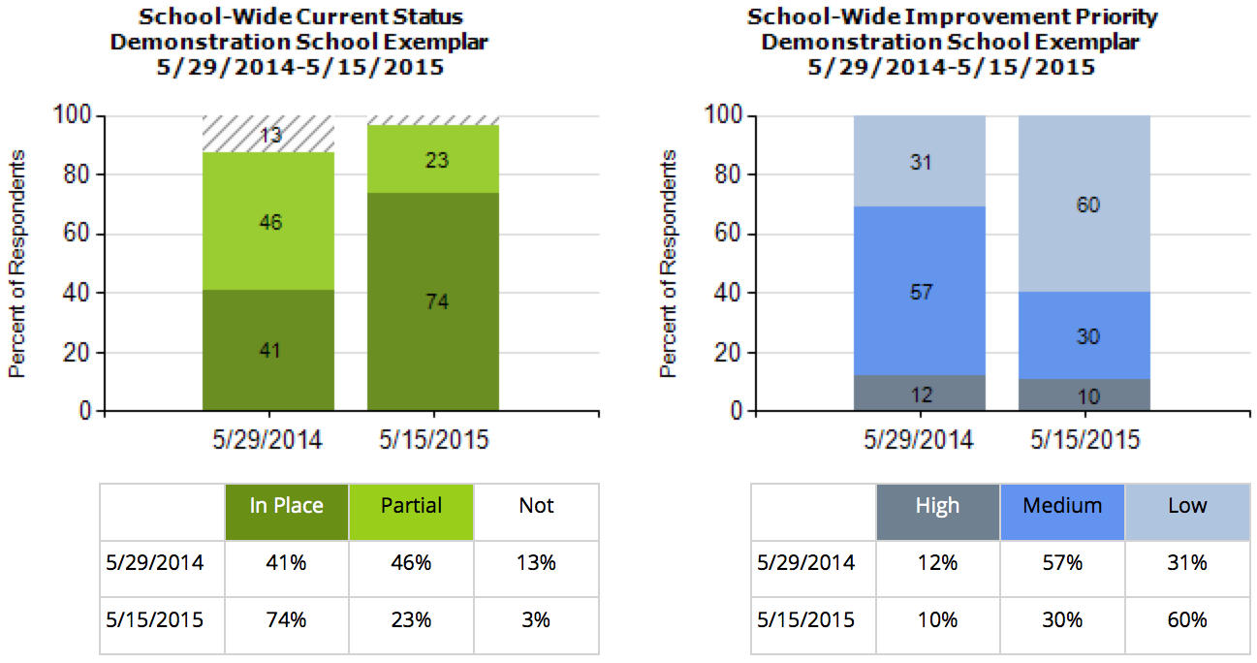
This year --% of our staff completed the SAS. --% indicated that they think school-wide system is in place compared to --% last year. --% of staff still say this is a medium or high priority for improvement.
INSERT your SAS Graph

Slide 14
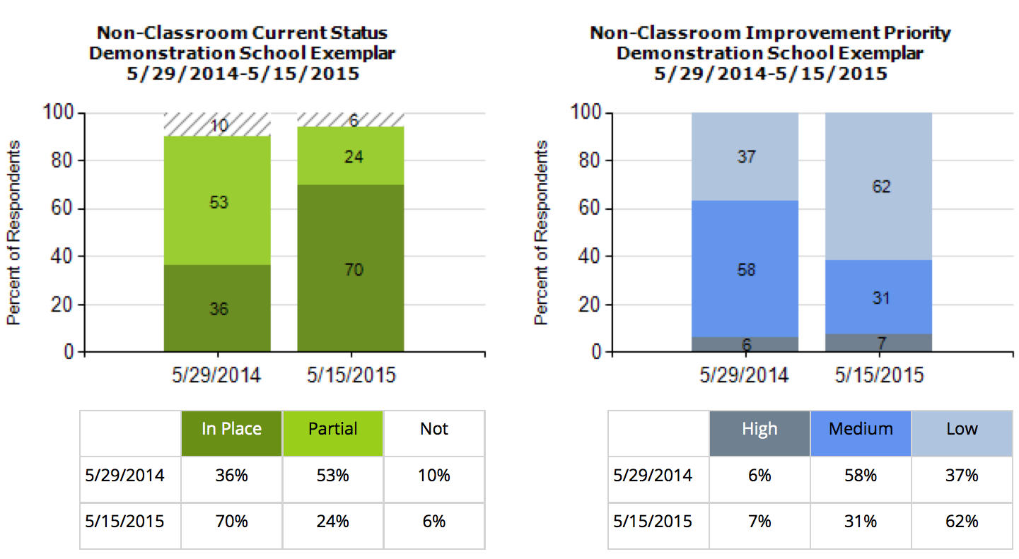
--% of staff think that non-classroom settings are in place, an increase of --% since last year. Only --% say this is still a high priority for improvement.
INSERT your SAS Graph

Slide 15
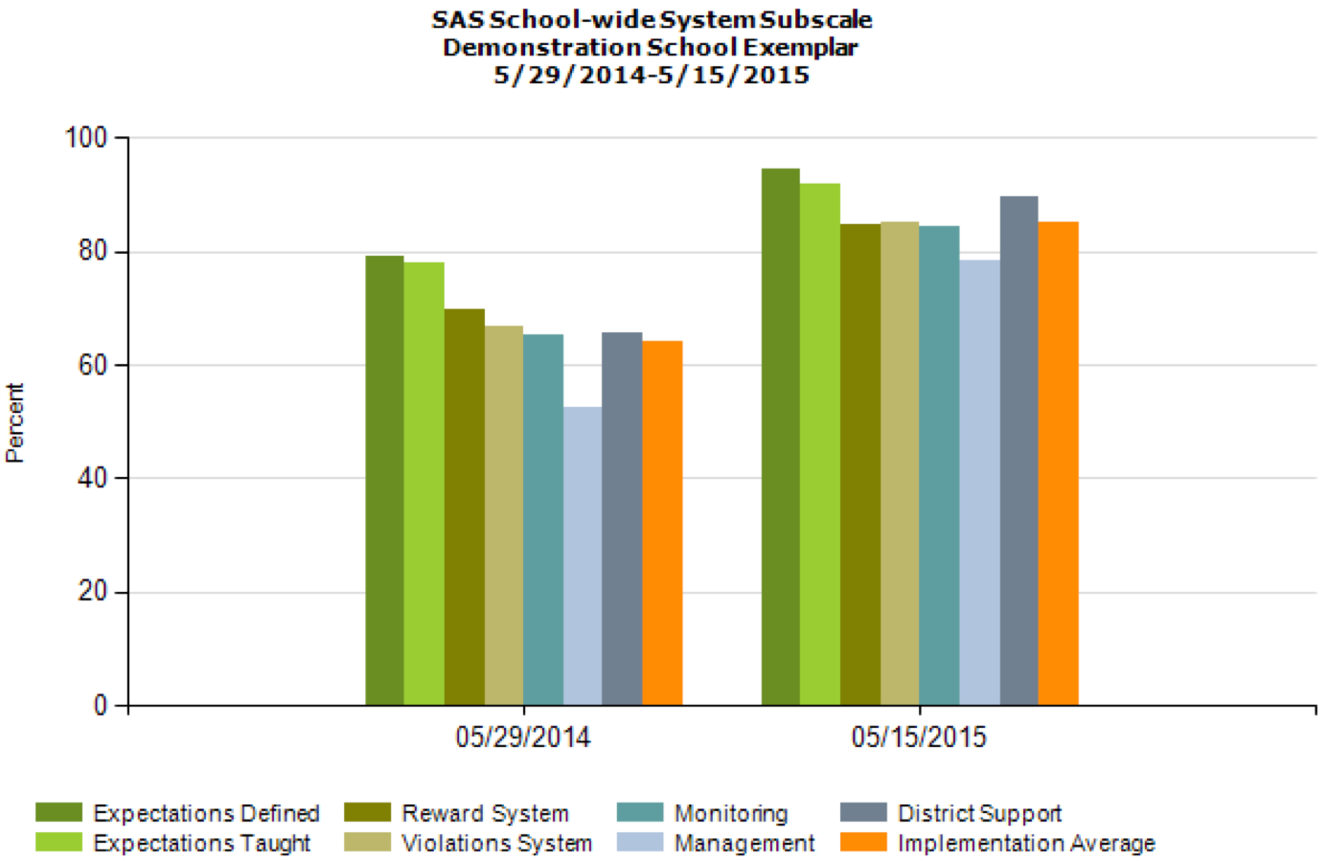
Overall, staff perception of implementation has improved across all categories!
INSERT your SAS Multi-year by Element Graph

Slide 16
This year our PBIS team took the TFI to assess PBIS fidelity of PBIS at the Universal level. This year --% of PBIS features are in Place. Compared to Last year’s BoQ, only --% of features were in place.
INSERT your TFI Universal Score Graph

Slide 17
Based on your feedback our team has determined the following areas for improvement:
INSERT GOAL
INSERT GOAL
INSERT GOAL
(USE the SAS and TFI Summary to help articulate these)

Slide 18
Thanks!
Questions about PBIS?
Contact one of the team members:
Jane Principal
Tom Coordinator
Physical Ed
Sharon Teacher
Johnny Naysayer
INSERT Team Members HERE

