Slide 1
Looking for a Data Protocol? Consider Using TIPS:
A process for using data to make decisions:
Formal problem solving steps that a group can use to build and implement solutions
Access to the right information at the right time in the right format
A structured meeting process
Formal roles (facilitator, recorder, data analyst)
Specific expectations (before, during & after meetings)
Access and use of data
Use of electronic and projected meeting minutes

Slide 3
What, Who, When, Where, and Why?
Team-Initiated Problem Solving (TIPS II) Model
Identify Problem
with
Precision
How do we want the problem to change?
What next?
Make Summative
Evaluation
Decision
Identify
Goal for Change
Collect and Use Data
Has the problem been solved?
Monitor Impact
of Solution and
Compare against Goal
Identify
Solution and
Create
Implementation
Plan with
Contextual Fit
Implement
Solution with
High Integrity
What are we going to do to bring about desired change?
Did we implement with fidelity?
Meeting
Foundations
Notes:
The outer circle ( Problem Solving Meeting Foundations) refer to the process and procedures and team uses to function. Roles are determined and defined, meetings are scheduled for the year, electronic equipment and internet access are available, and an agenda is established.
The inner circles and arrows define a problem-solving model designed to improve the decision-making and problem solving of PBIS Team. This model is called “TIPS,” which stands for “Team-Initiated Problem Solving.” The model uses data for during problem solving and decision making, during meetings. We will also apply a metric for determining if rates of problem behavior at a school or below, at, or above the national average to determine if there is a problem or not. TIPS teaches teams to use their SWIS data to define precision problem statements. Once the problem statement is precise, a variety of solutions are discussed based on prevention, teaching, reward, correction and extinction and teams will determine which solution(s) they want to implement. The TIPS model then moves the team to action planning ,evaluation and measurement determination.

Slide 4
TIPS Problem-Solving “Mantra”
REMEMBER to use…..
Do we have a problem? If so, what is the precise nature of our problem? (identify, define, clarify, confirm/disconfirm inferences)
What is our goal? How will we know we’ve met our goal? (what data will we use?)
Why does the problem exist, & what can we do about it? (hypothesis & solution)
What are the actual elements of our plan? (action plan)
Is our plan being implemented with fidelity & is it working? (evaluate & revise plan)
What next steps are needed?
Notes:
Sherry
Update

Slide 5
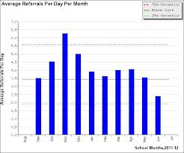
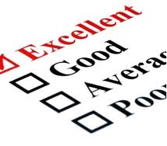
1. Do we have a problem? If so, what is the precise nature of our problem?
Notes:
What data to monitor
ODR per day per month
OSS, ISS, Attendance, Teacher report
Team Checklist/ SET (are we doing what we planned to do?)
What question to answer
Do we have a problem?
What questions to ask of Level, Trend, Peaks
How do our data compare with last year?
How do our data compare with national/regional norms?
How do our data compare with our preferred/expected status?
If a problem is identified, then ask
What are the data we need to make a good decision?

Slide 6
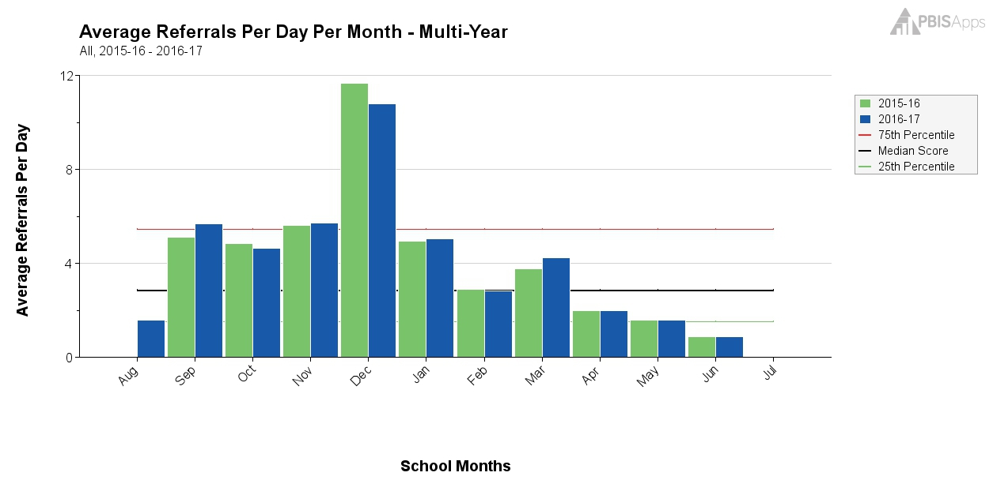
What Does this Graph Tell You?
Notes:
Sherry

Slide 7
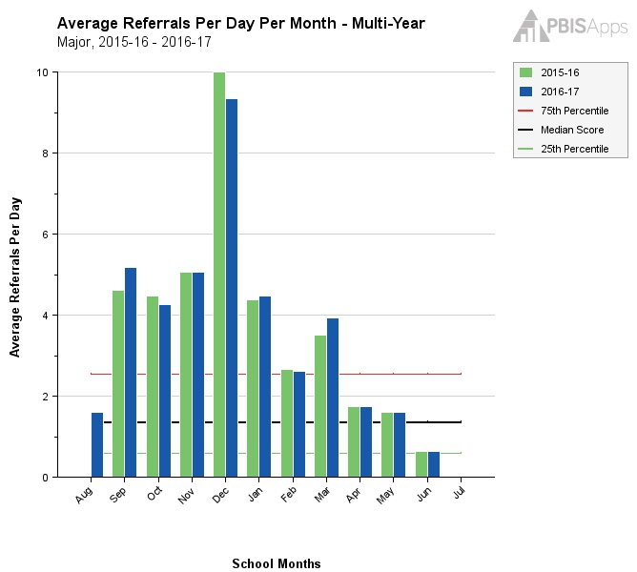
Same Graph Looking at Majors Only
Notes:
Sherry

Slide 8
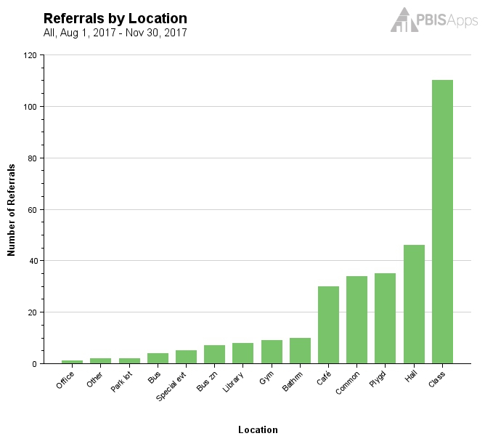
What Does this Graph Tell You?
Notes:
Sherry

Slide 9
What Does this Graph Tell You?
Notes:
Sherry

Slide 10
1. Do we have a problem? If so, what is the precise nature of our problem?
Question | SWIS Table/Graph
What problem behaviors are occurring? | Referrals by problem behavior
When are problem behaviors occurring? | Referrals by time
Where are problem behaviors occurring? | Referrals by location
Who is engaging in problem behaviors? | Referrals by student
Why do problem behaviors keep happening? | Referrals by motivation
What is the data we need for a decision?

Slide 11
Example: Primary to Precise
Precise Problem Statements include information about the what, when, where, who, when, and why
Inappropriate behavior is increasing
Inappropriate language and disruptive behavior is increasing in the cafeteria during first lunch period, is being done mostly by 6th grade boys, and seems to be maintained by social praise from the bystander peer group.

Slide 12
2. What is our Goal? How will we know we’ve met our goal?
Set a goal that defines levels at which the problem is no longer a problem
Set goals that are specific, (observable and) measurable, achievable, realistic, and timely
What data will you use to know that you’ve met your goal?

Slide 13
3. Why does the problem exist & what can we do about it? (hypothesis & solution)
Problem Statement: The sixth graders are disruptive & use inappropriate language in the cafeteria between 11:30 AM and 12:00 PM
Hypothesis: We believe they are trying to get attention from their peers.
Notes:
Sherry

Slide 14
Solution Development for Disruption in Cafeteria
Prevention: Remove/alter “trigger” for problem behavior
Teaching: Define, instruct & model expected behavior
Reward: Expected/alternative behavior when it occurs; prompt as necessary
Extinction: Increase acknowledgement of presence of desired behavior
Corrective Consequence: Use non-rewarding/non-reinforcing responses when problem behavior occurs
Data Collection: Indicate how you know when you have a solution
Notes:
Sherry

Slide 15
Solution Development for Disruption in Cafeteria
Prevention: Remove/alter “trigger” for problem behavior | Maintain current lunch schedule, but shift classes to balance numbers.
Teaching: Define, instruct & model expected behavior | Teach behavioral expectations in cafeteria
Reward: Expected/alternative behavior when it occurs; prompt as necessary | Establish “Friday Five”: Extra 5 min of lunch on Friday for five good days.
Extinction: Increase acknowledgement of presence of desired behavior | Encourage all students to work for “Friday Five”… make problem behavior less rewarding than desired behavior
Corrective Consequence: Use non-rewarding/non-reinforcing responses when problem behavior occurs | Active supervision and continued early consequence
Data Collection: Indicate how you know when you have a solution | Maintain ODR record and supervisor weekly report
Notes:
Sherry

Slide 16
…include logistics:
Notes:
Sherry
Action Plan Elements:
Who?
By When?
Goal with Timeline
Fidelity of Implementation Measure
Effectiveness of Implementation Measure

Slide 17
Date of Initial Meeting: |  |  |  |  | Date(s) of Review Meetings
Brief Problem Description (e.g., student name, group identifier, brief item description):
Precise Problem è Statement What? When? Where? Who? Why? How Often? | Goal and è Timeline What? By When? | Solution è Actions By Who? By When? | Identify Fidelity è and Outcome Data What? When? Who? | I M P L E M E N T S O L U T I O N S | Did it work? (Review current levels and compare to goal) ê
 |  |  | What fidelity data will we collect? What? When? Who? |  | Fidelity Data: Level of Implementation Not started Partial implementation Implemented with fidelity Stopped Notes: | Outcome Data (Current Levels): Comparison to Goal Worse No Change Improved but not to goal Goal met Notes:
 |  |  | What outcome data will we collect? What? When? Who?
Current Levels: |  |  |  |  | Next Steps
 |  |  |  |  | Continue current plan Modify plan Discontinue plan Other Notes:

Slide 18
5. Is our plan being implemented with fidelity & is it working? (evaluate & revise plan)
**Report data back to staff (i.e. when you implemented this plan, ODRs in the cafeteria dropped by 20%!)
Notes:
Sherry
Define how you will know that the solutions were implemented as planned (with fidelity)?
How often will you conduct a status review?
Define how you will know that the solutions had a positive effect on student achievement, social competence, and/or safety?
How often will you monitor student progress?
What will the data tell you when the problem is solved?
Base on team-established standard
Easier to monitor if quantifiable (“countable”)
Record on meeting minute form for progress monitoring at future meeting(s)

Slide 19
6. What next steps are needed?
Continue
Modify
Stop plan
Continue through problem solving process again
Big Idea:
Improved problem solving has a positive impact on student outcomes
(Horner, Algozzine, Todd, Algozzine, Cusumano, and Preston (in preparation))

Slide 20
Your Turn! What is the precise nature of our problem?
Question: | Fill in the information below:
What problem behaviors are occurring?
When are problem behaviors occurring?
Where are problem behaviors occurring?
Who is engaging in problem behaviors?
Why do problem behaviors keep happening?
Notes:
As a team, we need to develop a precise problem statement! This Slide is a handout and we will use this to explore the data is SWIS.

Slide 21
What are the actual elements of our plan?
Precise Problem Statement:
Prevention: Remove/alter “trigger” for problem behavior
Teaching: Define, instruct & model expected behavior
Reward: Expected/alternative behavior when it occurs; prompt as necessary
Extinction: Increase acknowledgement of presence of desired behavior
Corrective Consequence: Use non-rewarding/non-reinforcing responses when problem behavior occurs
Data Collection: Indicate how you know when you have a solution
Notes:
Prevention: *Maintain current lunch schedule, but shift classes to balance numbers.
Teaching: *Teach behavioral expectations in cafeteria
Reward: Establish “Friday Five”: Extra 5 min of lunch on Friday for five good days.
Extinction: Establish “Friday Five”: Extra 5 min of lunch on Friday for five good days.
Corrective Consequence: Active supervision, and continued early consequence (ODR)
Data Collection: Maintain ODR record and supervisor weekly report
Prevention
: How can we avoid the problem context?

Who, When, Where

Schedule change, curriculum change, etc

Teaching:
How can we define, teach, and monitor what we want?

Teach appropriate behavior

Use problem behavior as negative example

Recognition
: How can we build in systematic reward for desired behavior?

Extinction
: How can we prevent problem behavior from being rewarded?

Consequences
: What are efficient, consistent consequences for problem
behavior?

How will we collect and use data to evaluate (a) implementation fidelity, and
(b) impact on student outcomes?

Slide 22
Activity
Using the TIPS Problem Solving Process (handout) as a guide:
Identify the precise nature of the problem
What are the elements of your plan?
Consider: Is there a benefit to sharing data with students?

