Slide 1
Integrating Mental Health Into Public Schools
A continuum of integrated, family- and child-centered care to support the education of Vermont’s most vulnerable children and youth

Slide 2
SBBC Team Leader
Amy Irish MA, BCBA, LBA- VT
NCSS

Slide 3
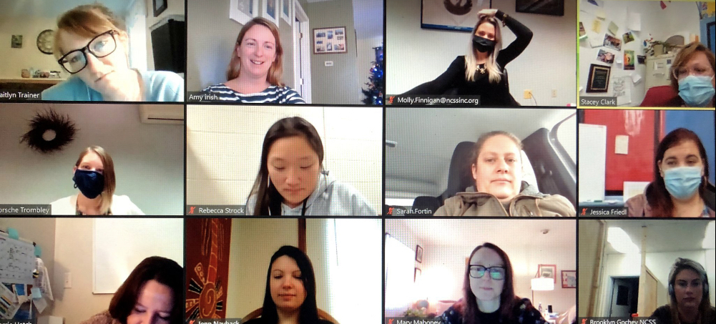
Scope of School-Based Mental Health Services
STATEWIDE REACH
All 10 designated agencies provide school-based services
We partner with 91% of Vermont supervisory unions to offer school-based services
HIGH DEMAND FROM SCHOOLS
3662 students served in FY20
Waitlists in many areas
COST EFFECTIVE
Leverages Medicaid match
V
March through June 1071 students via telehealth
Providing over 11,000 telehealth services during COVID-19
Notes:
penetration rates differ
There are other agencies providing these services – but they do not have Medicaid match
Behavior Intervention programs reached 269 kids in FY16, 318 in FY17, and 327 in FY18 – an increase of 21% in two years
364 kids total in therapuetic schools –approximately 300 in DA therapeutic schools (as reported by VISA)
Medicaid match means roughly 55% of cost is covered by Medicaid, with schools paying approx 45% of total cost.

Slide 4
Collaboration Between AOE and AHS for Mental Health Services in Schools as an Outcome of ACT 264.
1992: Success Beyond Six was created as a fiscal mechanism to allow local schools to contract with Designated Agencies for mental health services for children as described in ACT 264.
1993: Home School Coordinators. HSC provided service coordination, case management and therapy to identified youth within their local school.
1995: Behavioral Interventionist (BI). Mental Health Behavioral Interventionist positions (1 to 1) were created to support the needs of those students who require intensive individualized services beyond what HSC could offer (based on the “wraparound” model).
2009: Statewide Behavior Interventionist Standards developed. These standards were created to create consistent quality of BI services across the state.
2012: Positive Behavior Intervention Supports ( PBIS) Behavior Consultants. 1–to-10 model of providing mental health and behavioral supports to youth in public schools. This model was created with the intention of providing more services to more students in a cost effective manner and to assist schools in their school wide behavior management system.
2018: Behavior Interventionist “Pod” Model: providing schools with an identified set of staff which allow them to create flexible and tailored supports to school systems beyond the 1-to-1 model.

Slide 5
Continuum of Care
Integrated mental health supports are a necessary part of the MTSS/PBiS system of supports and intervention
A continuum of supports that are least restrictive and most effective
Shift focus from Reactionary to Preventative (when possible)
Help schools improve school-wide systems that impact all students
Build capacity of all adults to work with students with challenging behaviors/mental health needs/trauma
Therapeutic Schools
Behavior Interventionist Programs
School Based Clinicians
School Based PBiS Analysts
School Based PBiS Behavior Analysts.
Notes:
Just under 400 in BI programs
Around 300 in therapuetic schools

Slide 6
Levels of Intervention
A mid-tier of services provided to students who require an individualized level of support but not at the level of a 1:1 staff. Often provided by a master’s-level clinician working with a small group or caseload of students on low-intensity behavior plans implemented in conjunction with school staff, as well as those receiving more traditional clinical support. Funding and structure allow for clinician time to be spread across more students. PBIS Consultant and School-Based Clinician models fit in this tier. In terms of numbers of identified students served, the majority are in this tier.
Many services are more widely available to the school as a whole. Flexibility of case-rate funding, as in PBIS Consultant, allows for clinician to spend time helping develop and support school-wide systems and build school capacity, impacting students at the early intervention and prevention levels. Facilitates interventions impacting students who are not identified clients.
Highly individualized, intensive BI programming. Often provided by a Behavior Interventionist working with one student in the classroom across the school day. Programs serve a range of students including those classified as EBD, diagnosed with Autism, and a range of other diagnosis and needs.
Designated Agencies provide a wide range of levels and types of intervention to meet the needs of schools, students, and families while maximizing resources both in terms of staffing and funding.
DA’s continue to work with schools to identify and adapt to changing needs, along with state partners to use available funding in creative and different ways to serve more students with less dollars and focus increasingly on early intervention and prevention.
Notes:
penetration rates differ
– 44% have home-school coordinators and 40% have behavioral interventionist services
Second bullet as reported by DAs on schools in their catchment areas
There are other agencies providing these services – but they do not have Medicaid match
Behavior Intervention programs reached 269 kids in FY16, 318 in FY17, and 327 in FY18 – an increase of 21% in two years
364 kids total in therapuetic schools –approximately 300 in DA therapeutic schools (as reported by VISA)
Medicaid match means roughly 55% of cost is covered by Medicaid, with schools paying approx 45% of total cost.

Slide 7
Presenting Behaviors
Social isolation
Kicking holes in walls
Threats of harm towards the school
Self harm
Throwing chairs through windows
Refusal
Throwing chairs, desks, etc.
Swearing
Racist
acts
Hitting adults
Destruction of Property
Physical aggression
towards peers
Physical aggression
With weapons
Disrobing
bullying
Possession of weapons
Interrupting
Fire setting
Disrespectful Language
Fecal smearing
Long transition times
Running off school grounds
Throwing items
Grooming
peers
Immature/Silly Behaviors
Drug/alcohol use
Head banging
Sexual
assault
Harassment
Peer conflicts
Calling out
Suicidal behaviors
Behaviors that require the school to go on lockdown
Harming animals
Leaving Class

Slide 8
How Do Students Get the Support They Need?
Students can access all three tiers while staying in their public school
Step down supports are available and more seamless as student’s behaviors improve
Students can be referred for higher levels of supports if interventions are not showing improvements

Slide 9
A Story: Andy
Case management as part of his services supported his family in accessing resources including stable housing, food and transportation.
As data reflected a decrease in challenging behaviors, Andy was transitioned back to the PBiS Analyst caseload and eventually was able to access his classroom with only PBiS Supports
Andy’s home stressors increased following a transition into DCF custody and he began to require 1:1 support to manage his aggressive behaviors– A referral was made for an Intensive Behavior Interventionist Services.
Andy was a 9 year old student with a history of early childhood trauma. In 1st grade he began making self defeating comments- he was struggling academically and socially
The PBiS Analyst reviewed the ODR data with the school and identified that he continued to show increasingly challenging behaviors (including throwing chairs across the classroom and running away from the building) and formally referred him to the Analyst caseload where an FBA was completed in order to develop a plan that the school could implement.
He also participated in the school PBiS System and the PBiS Analyst consulted with his teacher on classroom supports --The PBiS Analyst referred him to access the School Based Clinician

Slide 10
School-Based Behavior Consultants
Systems Development
Fidelity of Universal Implementation
Behavior Response System Development
Facilitating Data Review & Resource Allocation
Tier II Intervention Development
SBBC Tier II Caseload– consultation focus
Small Group Reteach
Consultation
Integration into current structures
Share Data
Notes:
Fidelity- How do we promote behaviors
Staff training
Development of Consistent Bx Response Protocols
Bx Response- how do we respond to bxs
Staff Training
Data Systems
Major Behavior Response Protocols
Tier II– second instruction
Consultation
- Integrate into MTSS, PLC, EST

Slide 11
Many Facets to Effective Treatment in Schools
Child Centered Care
Evidenced Based Practices: Trauma Informed Care, Applied Behavior Analysis, Mindfulness, PBIS, Cognitive Processing
Connection with other services and access to full range of DA supports. Case management and service coordination as key components of treatment
Building capacity within schools and empowering school staff to manage difficult behaviors and student needs with less support
Fostering and growing key partnerships with schools, family, and community – Focus on Social Determinants of Health

Slide 12
Beyond Collaboration
Integration
Building Staff Capacity
Partners in Education
Embedded
Relationship Building
Visibility
Healthy Conflict
Notes:
Not just working with school staff…
Teaching Staff and increasing their skill set
We are at the table where big decisions are being made, providing another perspective and insight to other available supports
The work is far reaching and is creating higher quality behavioral instruction for all students
Creating natural relationships within the buildings that are increasing the understanding of the system of care and providing access to care for more students
We are seen openly as partners in supporting all students rather than someone who comes in and “takes over” a kid--- “their kid”

Slide 13
SBBC Challenges
School Staff Buy-In
Building Understanding of Behavior & Adult Roles
Staff understanding SBBC Role
Prevention & Consultation vs Crisis Responses
Notes:
Importance of administration
the extinction burst

Slide 14
Challenges Facing SX6 Programs
Hiring and maintaining qualified staff
Student need vs. staff availability
Staff injury
Competitive wages with other agencies and professions
Staff turnover makes it a challenge to serve kids with intense behavioral needs (need high level of training and ongoing supervision and support)
Staff coverage due to illness, injury, maternity leave, etc
Notes:
Not enough psychiatric providers to meet the current need
Accessing a therapist in an appropriate amount of time

Slide 15
Importance of School Based Mental Health Services Without these services the state and community would be at risk of the following:
Educational Implications
Increase in out-of-school placements (in and out of state)
Including residential and alternative schools
More restrictive and higher cost placements
Increase in school disciplinary referrals as well as strain on behavioral support resources
Increase in truancy
Increase in school suspension and expulsions
Exhausting school (personnel and financial) resources
Increase in reactionary access to local LEO (law enforcement officer)
Increased need for SRO ( school resource officer)
Increased stressors in school environment to staff, students, etc
Accessing Community Mental Health Implications
Increase strain on mental health system and reduced capacity to serve underrepresented community members
Without SB6 programs there would be an inability to access a higher level of care that is currently being provided by school based programs
Decreased protective factors for individuals with high ACE scores
Family access to needed services, resources and supports, ie therapy, healthcare, Medicaid, food banks, economic services, etc
Breakdown in communication amongst school, DCF, other providers
Limited ability to access psychiatry, community skills supports or family managed respite, case management
Fragmented community supports ( siloes of supports)
Notes:
• Increased screener calls=possible increased inpatient placements
• Lack in CM in the homes=less support for families accessing resources for housing, food, medical and mental health services

Slide 16
Continued Growth…
Enhanced Training Opportunities
Integrated Care
Increased Classroom Consultation
Fidelity of Implementation
Classroom Managed Behaviors
Notes:
“Academic Meeting” vs “Bx Meeting” vs “MH Meeting” vs “DCF Meeting”

Slide 17
NCSS SBBC Outcomes

Slide 18
School-Based Services are Evolving to Meet VT’s Needs
WHAT LIES AHEAD:
Census funding on the horizon with emphasis on MTSS
Statewide cap on Medicaid in All-Payer Model
Schools will still be the mostly likely place where kids
who struggle can access behavioral and family support
WE ARE READY:
Experimenting with different/ new delivery models
Working with special education community to
prepare for census funding future
Piloting innovative integrated models of family-centered care
Notes:
DA school-based services have often evolved to meet the needs of Vermont students and the education community. We will

