Slide 1

Universal Screening for Behavior and Implications for Interventions
Presented by
Kym Asam, LICSW and the MAUSD SEL Team
Notes:
Please make sure you have copies of the materials so you and your team can familiarize yourself with them. We are going to discuss how we can use data to develop and utilize informal and formal screening tools.

Slide 2
Welcome!
You will be muted during this session, except during breakouts.
Need help?
Type into the chat box
You
can show or hide your video.
Materials can be found at: https://www.pbisvermont.org/training-resources/vtpbis-annual-forum/.
Notes:
Please post this in the chat box at the beginning of the session and again about 10 minutes in: “All materials for the VTPBIS Forum sessions can be found at:https://www.pbisvermont.org/training-resources/vtpbis-annual-forum/.

Slide 3
Learning Objectives
Participants will:
Understand the context and rationale for identifying students at risk of social/emotional/behavioral challenges
Consider several informal and formal screening tools
Identify the systems needed to implement Universal Screening
Discuss the process of matching results with proactive and preventative practices.
Examine the systems in place to collect, analyze and act upon data
Explore next steps and…
Notes:
Participants will hear from representatives of the Mount Abe Union Supervisory District VTPBIS about their use of Universal Screening tools and implications for using these tools to support students in their schools and district-wide.
Recovery plan has indicated universal screener as a method to integrate students back into school. Social emotional functioning, engagement and academic success. Universal screeners can help facilitate all of these – also staff wellbeing. Equity and inclusion

Slide 4
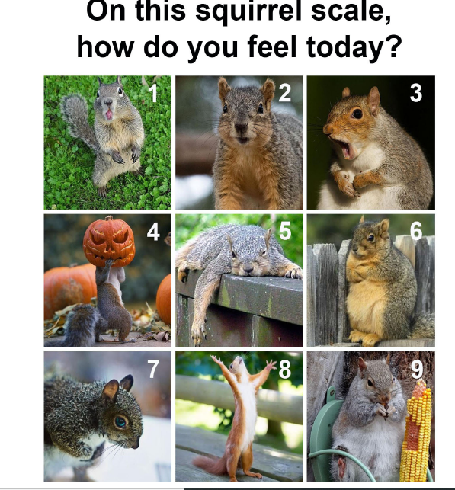
Check your battery:
Poll
Notes:
Type in the chat

Slide 5
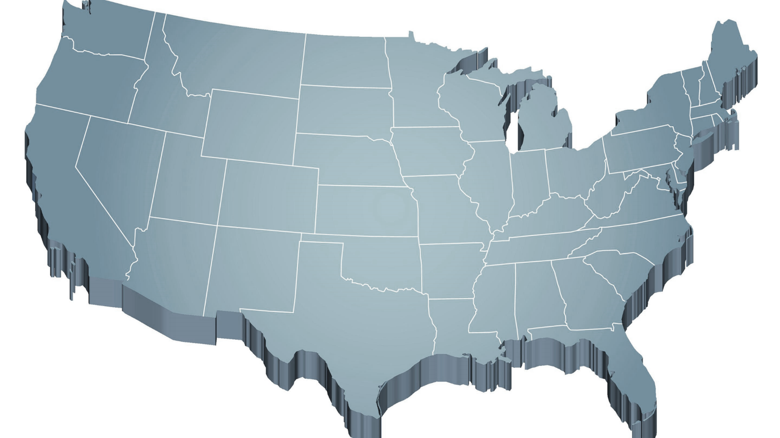
Shift to a systems level perspective
Internalizing
Externalizing
ED <1%
EBD 12-20%
Source: Forness, S.R., Freeman, S.F., Paparella, T., Kauffman, J.M., & Walker, H.M. (2012). Special education implications of point and cumulative prevalence for children with emotional or behavioral disorders. Journal of Emotional and Behavioral Disorders, 20, 4-18.
Notes:
12% of all school age kids have some kind of internalizing issues (shy, withdrawn) or acting out behaviors (aggressions, non-compliance – or both. White dominant culture – cultural context. Look at behaviors through white lens – national experts examining current screeners to evaluate whether or not they define internalizing and externalizing behavior through a white dominant cultural lens.
20% mild to severe. This is a concern for all educators because less than 1% go on to receive special ed. Commitment to tiered systems so important.
This is everyone’s problems. Won't be addressed by referrals. That's why tiered systems of support are so important. This is also an issue of equity.

Slide 6
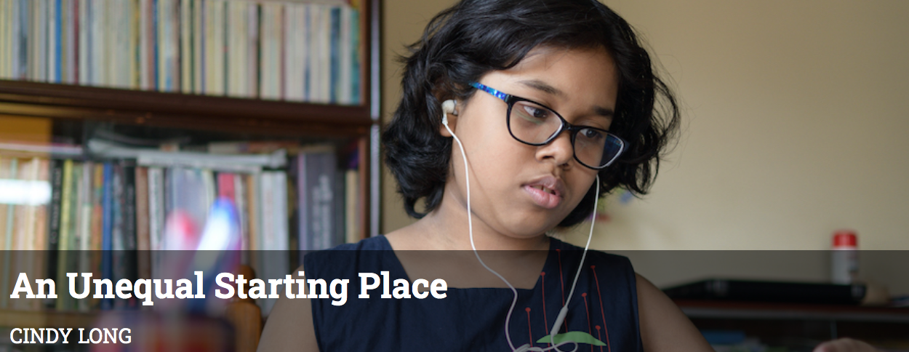

Context: Challenges and Opportunities
Notes:
It is clear that we have the biggest challenges in education right now. Between the predictions about our ability to catch up academically, the loss of many connections over the last year, the tension about racism in education after the murders of George Floyd and others. Universal screening can allow us to have an objective lens of how students are doing and also validate the successes of students.
We are beyond the normalcy bias which means that we expect things will continue in the future the way they typically occurred in the past – continue to be “normal”).

Slide 7
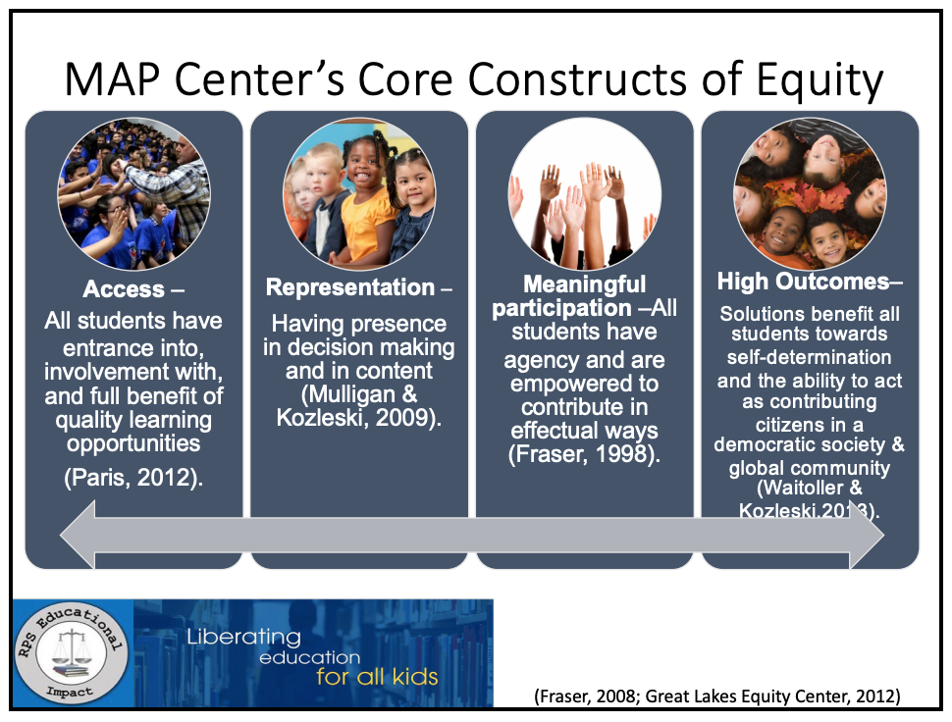
Notes:
exists when educational policies, practices, interactions, and resources are representative of, constructed by, and responsive to all people so that
EACH INDIVIDUAL has access to, meaningfully participates in, AND has positive outcomes from high-quality learning experiences, regardless of individual characteristics and group memberships.
(Fraser, 2008; Great Lakes Equity Center, 2012)
…means that EVERY CHILD receives whatever she/he/they need to develop to her/his/their full academic and social potential and to thrive academically and social-emotionally. Every child, every day. Period.
(Aguilar, 2020)

Slide 8
Educational Equity . . .
…exists when educational policies, practices, interactions, and resources are representative of, constructed by, and responsive to all people so that
EACH INDIVIDUAL has access to, meaningfully participates in, AND has positive outcomes from high-quality learning experiences, regardless of individual characteristics and group memberships.
(Fraser, 2008; Great Lakes Equity Center, 2012)
…means that EVERY CHILD receives whatever she/he/they need to develop to her/his/their full academic and social potential and to thrive academically and social-emotionally. Every child, every day. Period.
(Aguilar, 2020)

Slide 9
Access and Equity for All!
1-5% of Students may need Intensive Supports
Few
10-15% of Students may need Targeted Supports
Some
ALL Students!
Universal Practices in place for 100% of students
80% of Students should be successful when accessing Universal Supports
Notes:
Why – consistent response for students and staff which contributes to equity
Clearly articulated plan and framework. Regardless of the level of intervention that a student needs, they continue to have access to universal supports.
Review of data to demonstrate success and challenges. Looking at data through the lens of equity and inclusion.

Slide 10
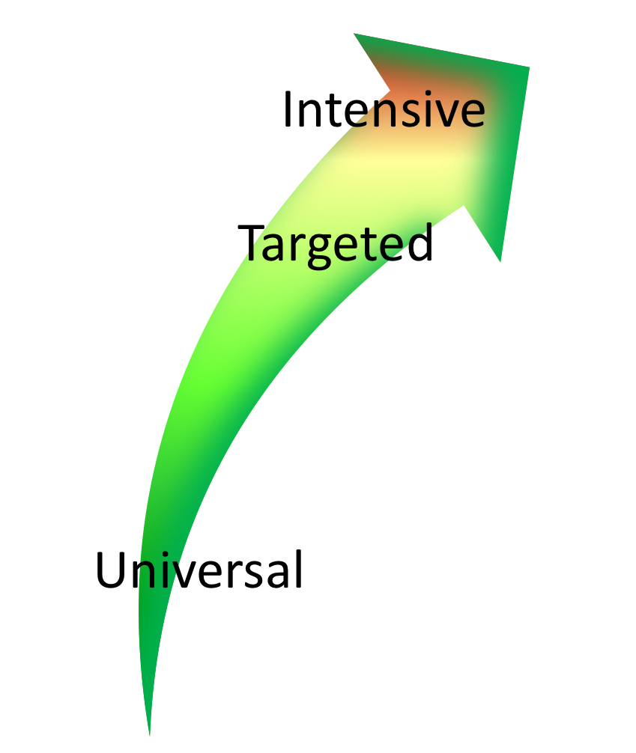

Continuum of Support Within
MTSS for Behavior and MTSS for Academics
Affect Mgt.
Math
Label Behavior, Not Students!
Science
Adult relationships
Attendance
Reading
Peer Interaction
Notes:
Every student has competencies. Label behavior not STUDENTS. Everyone at one point or another needs targeted or intensive supports. Dylan is doing great in reading but may need more support in Math and with anger management.
We never say “those universal kids” so why say “those tier 2” or “tier 3 kids.” we also should avoid saying internalizers or externalizers. don’t lose the child to the diagnosis. Be aware of how your implicit bias might be activated. This is also an issue of equity.

Slide 11
Type into the chat box:
What data do you collect/use to assess the social/emotional/behavioral strengths and challenges at your school?
How do you use this data for decision-making?
Notes:
What data will you use to measure progress on your SMART goals?

Slide 12
Types of Data to Consider
Consider Community Data – MH, Substance Abuse, Homelessness, Placement, etc.
Intensive:
TFI
I-SWIS
EST
FBA/BSP
Targeted:
TFI
SWIS-CICO
EST
FBA/BSP
Universal Screening
Universal:
TFI
SAS
SWIS
Attendance
Grades
School Climate
Family Engagement
Weekly Check-In
Notes:
Sherry
What else? IEP across the tiers
Targeted – SWIS or some other School information System like PowerSchool
The more data you have, the more questions you will ask and the better rounded and comprehensive picture you will have.
It is also important to disaggregate data to be sure it is representative of your student body. I.e., if 47% of your students are male, 41% female and 2% non binary – look at the percentage of students in either demographic that is receiving intensive supports or getting significant BODF’s.

Slide 13
Screening data helps us ask the right questions.
They do not provide the answers.
Notes:
Data based decision making can occur at many levels.
Macro – whole school
Mezzo – certain classrooms or identified groups
Micro – individual student concerns
Start with outcome, create statement with goal summary, gather data, etc.

Slide 14
What is social/emotional/behavioral screening?
Assessment of early signs of social risk or behavior problems, as well as the presence of resilience factors and indicators of wellbeing.
Mechanism for supporting students who need additional supports after receiving evidenced-based universal social/emotional/behavioral supports (i.e. PBIS)
Notes:
SEB screening differs from other assessments of attitudes and feelings such as within school climate surveys in that SEB screening focuses on an individual student’s level of SEB health.
School climate surveys typically yield data that are aggregated across groups to indicate a given school’s safety and SEB health as perceived by a variety of stakeholders (student, staff, parents) and can provide another source of important data especially in regard to environmental and contextual factors.
Consider what you can discover about the strengths of your school culture through screeners as well.
“At risk of” is a big category. We would like to know if there are any warning signs that we can easily address by matching student need with interventions.

Slide 15
Two methods of Screeners and Surveys
Informal Screeners
Formal SEBL Screeners
Ways to check-in with students frequently and with staff and families regularly to identify support needs as they emerge
Ways to get input from students, families, and staff about well-being and/or climate at the school
Validated instruments that focus on social/emotional/behavioral risks and strengths.
A reliable method for determining students with elevated levels of risk.
https://assets-global.website-files.com/5d3725188825e071f1670246/5eb435206705b2123f3c6b82_Universal%20Screening%202019%20RDQ%20Brief2.pdf
Notes:
Can provide valuable data for getting important feedback as well as assessing connections and engagement. Also increases opportunities for school faculty and staff to be observers of behavior and can move a “hunch” to a data point.
The use of screening data is well established as a valid and reliable method for determining students with elevated levels of risk (Kamphaus & Distephano, 2007; Romer & McIntosh, 2005; Elliott & Gresham, 2008).
Recognize typical base rates and norm comparison data may be skewed.
Reference screening doc

Slide 16
Informal Screeners – why and what
Students must feel physically and psychologically safe in order to actively engage in learning
Invite voice, choice, and ownership
Help identify students or staff perhaps at higher risk for significant stress or trauma from COVID-19
Establish most efficient and effective use of MH providers, school psychologists, school counselors, community partners
Notes:
those experiencing death or loss of someone close to them; those with significant disruption to lifestyle such as food insecurity, financial insecurity; those with a history of trauma and chronic stress or other pre-existing mental health problems; those with exposure to abuse or neglect; nothing about us without us – not do to them but do with them
Using SEBL folks at which level? Using them at the universal, targeted and intensive level. Pushing in more to utilize informal screening processes to see the challenges in the context where they exist.

Slide 17
Methods of Screening
Surveys
Circles
Phone calls
Drive-by visits
Advisories
Video-chat/face-time
Using existing data
What else?
Notes:
Demiystify what informal screening is

Slide 18
Screening Using Existing Data
Student | GPA | Course Failures | Days Absent | Concerning Behaviors
Josh | 3.1 | 0 | 2 | 0
Mary | 4.1 | 0 | 0 | 0
Kelly | 2.8 | 1 | 0 | 1
Jacob | 1.4 | 3 | 11 | 12
Susan | 3.5 | 0 | 3 | 0
Mark | 1.9 | 1 | 5 | 7
Notes:
This is the what you can use. Jacob – 12 behaviors that have risen above classroom management

Slide 19
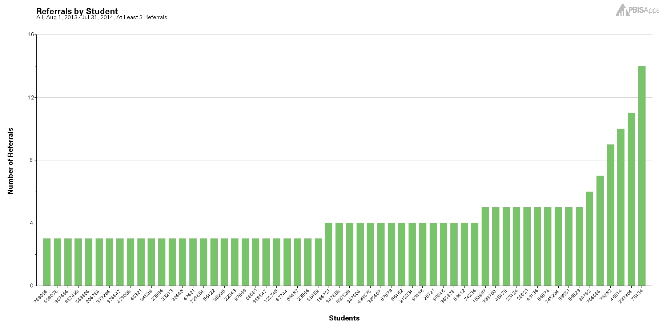

Using the Concerning Behaviors (Referrals) by Student Report as a Universal Screening Tool
Notes:
Student with 2-5 are candidates for more support in behavior, academic, or both areas. SWIS or some other student information system

Slide 20
Survey Resources
Closegap – wellness check
Making Caring Common – Relationship Mapping, Check-in Surveys for Middle/HS
PBIS Center – Check-in/Check-out Survey, Input and Satisfaction Surveys
WestEd – Learning from Home Survey
Panorama – Question bank of surveys for students, educators, and parents
See document here.
Notes:
Learning from home survey has relevant questions to building based learning

Slide 21
Please Type Into Chatbox:
What other data might your “team” look at to determine supports needed?

Slide 22
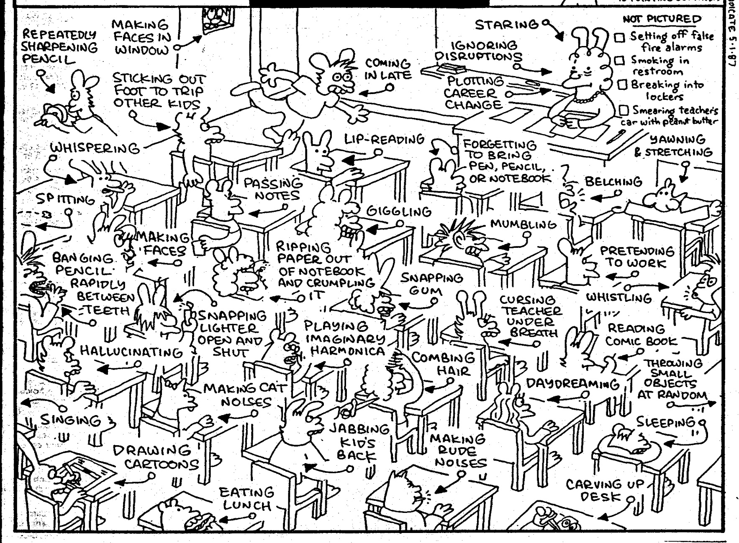
How do we formulate an accurate measure of risk?
Notes:
With the number of behaviors that occur in the classroom on a daily basis, it can sometimes be difficult to formulate an accurate measure of the real challenges and needs if we rely solely on anecdotal, gut reactions. It can also sometimes be a challenge to figure out where to start when there can be so many variations in the types of behaviors.
Role of educator challenging to meet differentiated needs of students.

Slide 23
Why (Formal) Universal Screening?
To find students whose problems are not immediately obvious.
To identify problems with a high degree of accuracy.
Early identification leads to early intervention.
To select interventions based on results of rating scales on the screening tools. This is most effective and efficient.
Notes:
Validated instruments that focus on social/emotional/behavioral risks and strengths.
A reliable method for determining students with elevated levels of risk.
As we already said, we’re doing a multitude of screenings in schools anyway. Just like with our other screenings, early identification leads to early intervention. Using formalized screening measures allows schools to select interventions that are based on results of rating scales rather than guesses.
Screening allows us to be objective.
We know that students who are untreated or do not get early intervention, are at risk for poor grades, impaired personal relationships, high school drop out, incarceration, substance abuse and suicide.
Matching interventions to what is going on with the student. A simplistic example would be supporting a shy, withdrawn student with a standard CICO intervention
It is also important to remember that students with internalizing behaviors maybe missed because their behaviors are not obvious.

Slide 24
Please Type Into Chatbox:
Is your school implementing a Social/Emotional/Behavioral Screener? If so, what tool are you using?

Slide 25
When to Screen?
At least 6-8 weeks into the school year and 2-3 times/year (Oct and Feb)
  Need enough time for observation, interaction, and experience with a student so ratings are reliable and valid. You need to KNOW THE STUDENT!
  If done too early and too quickly, the results will largely be invalid, the needed treatment directions will be unclear (or incorrectly focused)
Review process and tools with all staff prior to screening
Notes:
Teachers (or others) complete a standardized questionnaire, behavior rating scale, or clinical assessment tool on every student (equity) to determine if they are experiencing or at-risk for some social, emotional, or behavioral problem (for example, trauma, stress, anxiety, depression, anger, or aggression).
Second bullet – relationship mapping. Think about equity and inclusion, implicit bias, subjective behaviors, etc.
If such “Screening” is done too early and too quickly, the results will largely be invalid, the needed treatment directions will be unclear (or incorrectly focused), the time will be wasted. . . . and worse, some students may be harmed by not getting or getting the wrong therapeutic services.
If a school is doing screening for several years and this year is elevated, consider the pandemic as a source of increased symptoms of internalizing and/or externalizing behaviors. National group of people working on ensuring screeners are normed to the pandemic, race and ethnicity validity, etc. (Kathleen Lane). Under normal (pre-pandemic) circumstances, a psychometrically-sound screening-to-services process requires the use of (a) multiple assessment approaches or tools; (b) completed by multiple raters (including the student him or herself); (c) evaluating student behavior across multiple settings; (d) where the ratings, observations, and data are reliable and the results are valid; and all completed (e) within a multiple-gated process.
When students return to school this Fall, we are fully expecting a social, emotional, and behavioral transition or re-entry process that is somewhat different than “normal.” While we can’t exactly predict how individual students will re-enter (hence the screening process outlined later in this Blog), we do expect different levels of social, emotional, and behavioral variability across students as a “normal” response. . . both to the medical, economic, educational, social, and/or other life condition effects of the pandemic, and to the racial bias and equity events triggered by the murder of George Floyd and others.

Slide 26
Screening can help identify:
Students with externalizing problems?
Students with internalizing problems?
Notes:
Students exhibiting anxiety, depression or other internalizing behaviors are not as easily recognizable. Although BODFs give descriptions of behavior incidents that occurred, they do not assess the motivating factors behind behavior and often times miss the a student who has less visible externalizing behaviors who dont typically “Act Out.”

Slide 27
Multi-Stage & Multi-Gate Approach to Screening
Universal Screen
Elevated? Screen #2
Elevated? Request for assistance
Not elevated? Done.
Not elevated? Done.
Stage 1
Stage 2
Stage 3
Notes:
Stage 1: screen all kids; stage 2: teacher rating. Higher than average internalizing and externalizing behavior (combined frequency index and critical behavior index (SSBD) – kids that most approximate bx for internalizing or externalizing behavior, Stage 3: intervention or request for assistance. Rank order students (screening systems) and for those who you rank higher, and some kids you will do a deeper assessment as a result of elevated scores. Think of hearing screening, if concern, might do a second screen and then maybe get referred to audiologist.

Slide 28
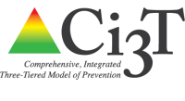
What Screening Tools are out There?
https://www.ci3t.org/screening
Notes:
Reference document, videos are on this website as well as multiple screeners, age groups, etc.

Slide 29
Systems Considerations
Identified as priority
Resources secured
Team in place
SEB curriculum in place
Families informed
Ethical/legal –
Policies/procedures
Process for selecting screener
Tier 1 interventions with fidelity
EST ready to act on data
Interventions implemented
Roll-out
Commitment to continued inquiry
Screening Systems Considerations Assessment
Notes:
Reference screening systems considerations assessment. Screen you need to intervene

Slide 30

Another amazing resource!
https://smhcollaborative.org/wp-content/uploads/2019/11/universalscreening.pdf
_
Notes:
Also listed on the hand-out of resources.
Talks about need for screeners, procedural considerations, how to select a screener and ethical and legal considerations. Even if you are using a screener, this can be a helpful tool.

Slide 31
Connecting Results from Screenings to Interventions
Intervention: | Target Population: | Evidenced to Address:
Second Step | Grades K-6 | Prosocial skills Violence prevention
Botvin Life Skills | Grades 7-12 | Prosocial skills Substance use prevention
Support for Students Exposed to Trauma | Grades 4-9 | Address impact of trauma
Check In, Check Out | Grades K-12 | Reteach expectations, increased adult attention
Small group instruction of needed skills (social, coping, problem solving) | Grades K-12 | Reteach lessons from curriculum available at T1
MATCH-ADTC (anxiety, depression, trauma, conduct) | Grades K-12 | Modular approach to address less intense presenting problems
Coping Cat | Grades 2-8 | Address impact of anxiety
Bounce Back | Grades K-5 | Address impact of trauma
SPARCS | Grades 6-12 | Address impact of trauma
Aggression Replacement Training | Grades 6-12 | Address physical aggression
TF-CBT | Grades K-12 | Address impact of trauma
Notes:
Inventory mapping

Slide 32
What’s Next?
Review Screening Systems Considerations Assessment
Determine where is your school in this process
Review and select tools

Slide 33
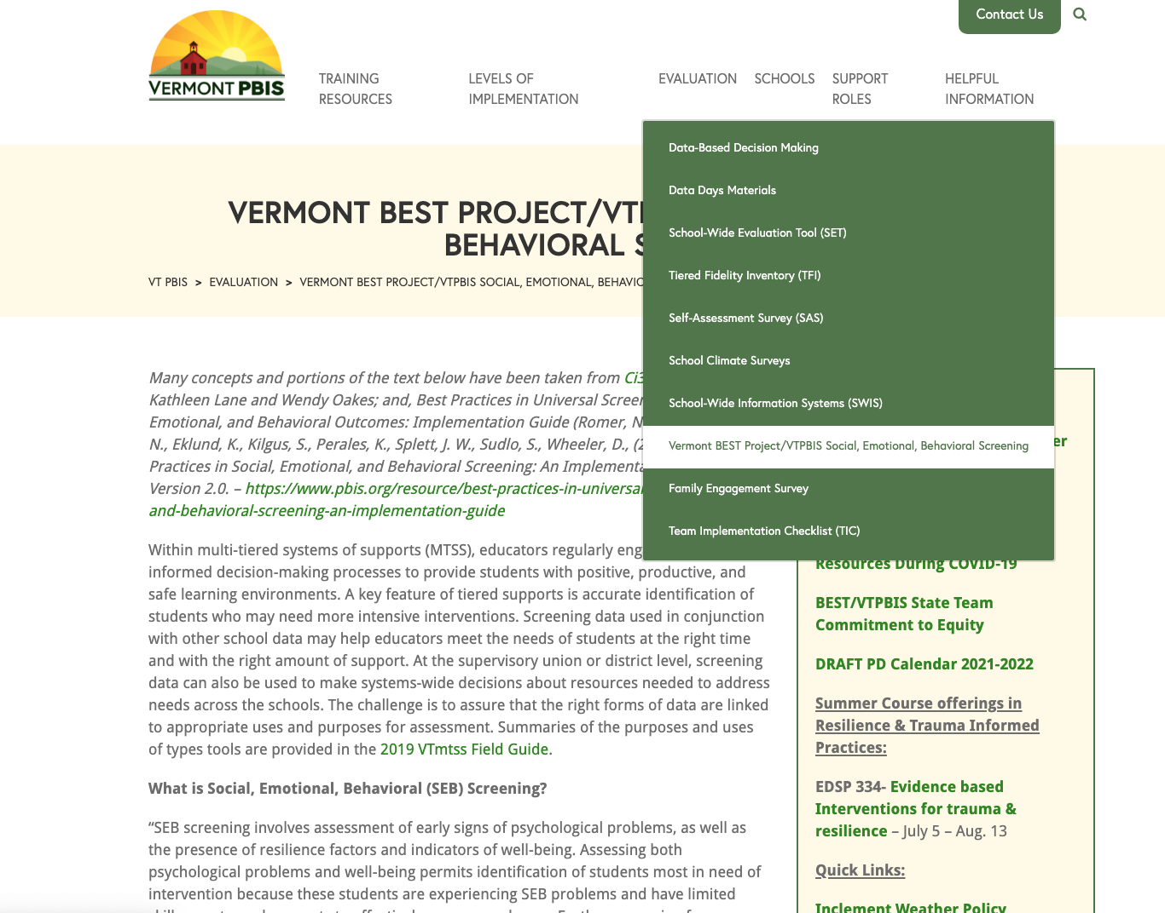

Slide 34


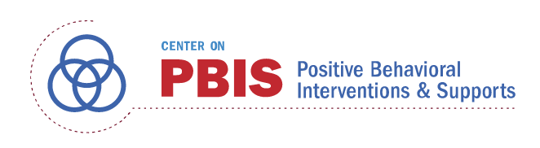




Acknowledgements
Notes:
Also:
WestEd
Kym Asam
AIR
Harvard

Slide 35

Welcome Mt. Abe SEL team!

