Slide 1
Building Better Behavior Support Plans
Jeremy Tretiak, M.Ed., BCBA, LBA-VT
e-mail: jeremytretiakgmbc@gmail.com
Cortney Keene, M.Ed., C.A.S., BCBA, LBA-VT
email: cortney.keene@uvm.edu
WiFi: Grand Guest
Notes:
Introduce ourselves

Slide 2
Maximizing Your Session Participation
Consider these questions:
Where are we in our implementation?
What do I hope to learn?
What did I learn?
What will I do with what I learned?
By when?
Use the Learning Reflection Sheet

Slide 3
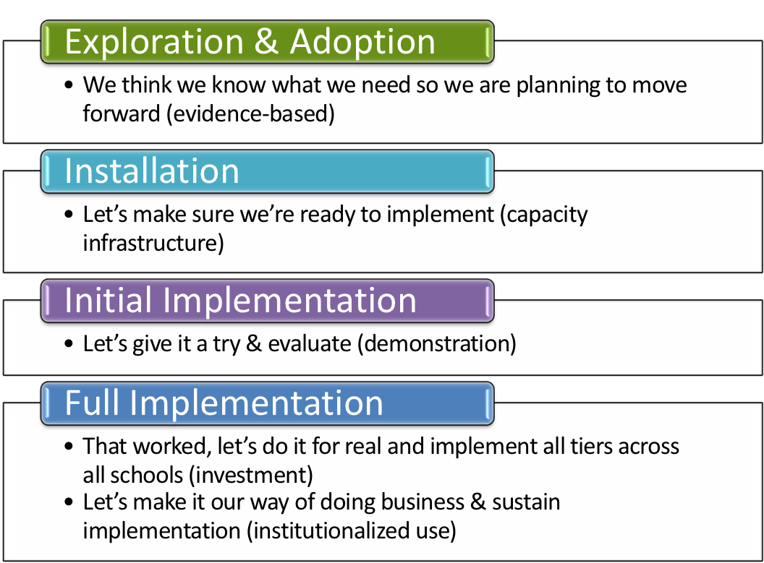
Where is your school in the implementation process?
Adapted from Fixsen & Blase, 2005
Notes:
Emphasis is that you have identified that you have a need. How did you identify it? Is it climate, behavioral challenges, both? Why do you want to explore an evidence based practice?

Slide 4
BEST Expectations
Be present
Engage with others
Strengths-based
Team solutions
Notes:
Sherry
Remind of our expectations –
Be present – cell phones off, throw out task list, etc.
Engage – show respect by listening and using effect team skills
Use rule of brainstorming= no idea is a bad idea
Team solutions – work together toward consensus

Slide 5
Objectives
By the end of this session, you will:
Have problem-solved with presenters and colleagues about ways to improve one of your own BSP’s
Be able to identify some common errors in implementing BSP’s
Be able to offer some solutions to try when a BSP isn’t working
Notes:
Cortney

Slide 6
Activity
On your own or with members of your school team who are here, write down the specific problems you are having with your BSP and to which you would like to get some solutions in today’s session.
Notes:
Cortney
padlet.com
login in: cortney.keene@uvm.edu
password: pbisuvm
refresh every once in a while

Slide 7
Behavior Pathway
Use this for your FBA Hypothesis Statement and include it in your BSP
Setting Events /
Conditions
Antecedent Trigger
Problem Behavior
Maintaining
Consequence
Function
Notes:
7
Teri

Slide 8
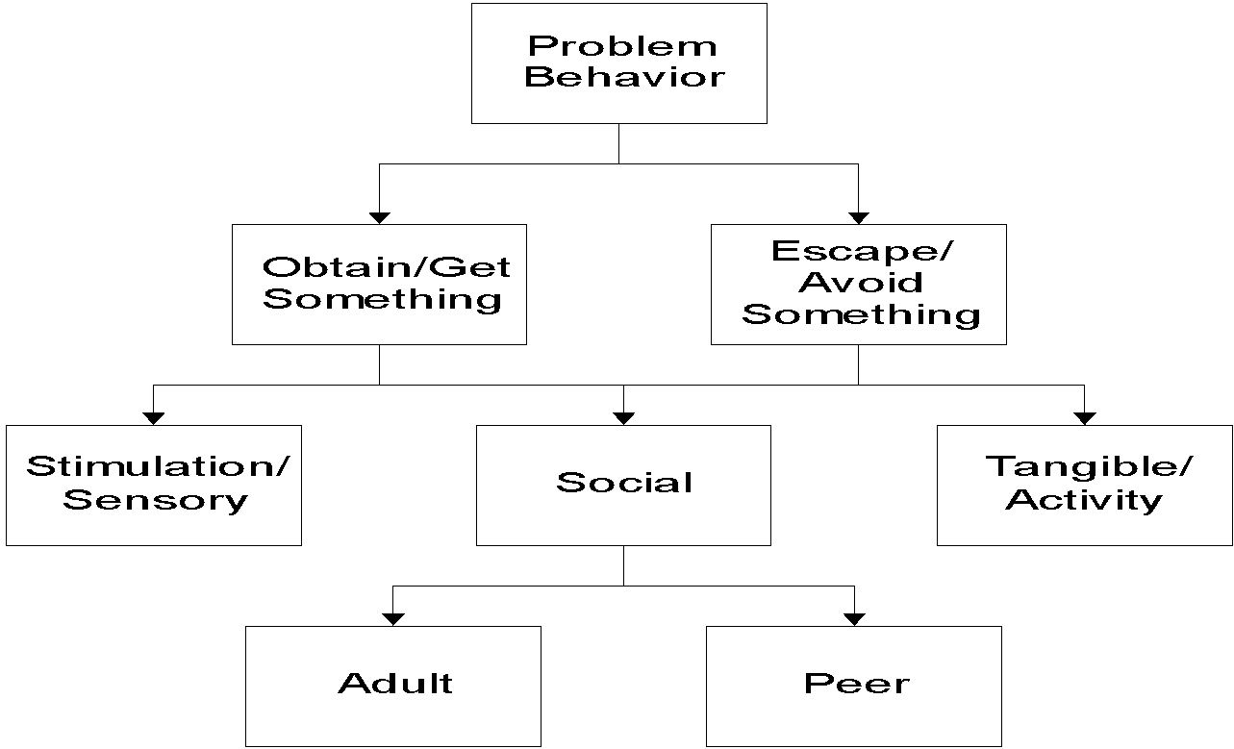
Identify Functions of Behavior
Notes:
8
Teri

Slide 9
Competing Behavior Pathway
Desired Behavior
Maintaining
Consequence
Setting Events /
Conditions
Problem Behavior
Antecedent Trigger
Maintaining
Consequence
Function
Replacement Behavior
Notes:
9
Cortney

Slide 10
Case Study Pathway: Sarah
Complete math task
Maintaining
Consequence
Routine: Math Class
Function
Student didn’t get much sleep last night
Avoids math task
Asked to do a math task
Gets sent out of class
Sits silently
Write name on paper
Notes:
10
Cortney

Slide 11
Checklist of BSP Elements
Interventions in your BSP address each stage of the Competing Behavior Pathway:
Setting Events
Antecedents
Replacement Behavior
Teaching, if needed
Consequences
Rewards for replacement behaviors
Extinguishing rewards for problem behaviors
Punishment for problem behavior
Notes:
Cortney

Slide 12
How Good Is Your BSP?
TFI (Tiered Fidelity Inventory) Tier III Support Plan Worksheet:
Individualized Team
External Supports/Agencies
Goals/Strengths Identified by Student &/or Family
Relevant medical, academic behavioral assessment data
FBA Hypothesis Statement
7 types of interventions per Competing Behavior Pathway
Action steps
Access to Tier I and Tier II supports
Monthly meetings to review outcome and fidelity data
Online at Vermont PBIS Website->Resources->Evaluation Tools
Notes:
Teri
Provide TFI Tier III Support Plan Worksheet as a resource

Slide 13
Activity
On your own or with members of your school team who are here, review the Tier III Support Plan Worksheet and identify strengths and areas in need of improvement in your BSP.
Notes:
Cortney
padlet.com
login in: cortney.keene@uvm.edu
password: pbisuvm
refresh every once in a while

Slide 14
Individualized Case Consultation
1. Introduce us to your student’s most challenging behaviors
2. What interventions have you tried?
3. What has worked? What isn’t working?
4. How did you do on the Tier III Support
Plan Worksheet?
Let’s Problem-Solve!
Notes:
Assign 15-20 minutes per case. Assign a time-keeper? Stop 20 minutes before the end of the session in order to cover the rest of the slides.

Slide 15
Behavior is NOT improving
Data indicate behavior not improving
Interventions implemented with fidelity
Interventions not implemented w/ fidelity
Hypothesis incorrect
Strategies too difficult or time consuming
Interventions are insufficient
BSP does not fit with ecology of the classroom
Reinforcement for the behavior is insufficient
Teacher experiencing intervention drift
Notes:
Teri
Interventions are insufficient = BSP plan does not address all stages of the Competing Behavior Pathway

Slide 16
Types of Implementation Errors
Developing an effective BSP that is not informed by behavior theory (i.e. functional behavior assessment)
Failure to ensure staff buy-in and commitment
Failure to address staff time and availability
Lack of follow through with tasks
i.e. Ordering sensory materials, communicating with staff not present at meetings, finalizing scheduling changes, writing social stories
Notes:
Teri

Slide 17
Types of Implementation Errors
Lack of communication of the plan to involved staff
Lack of adequate training provided to staff
Failing to collect and review data
Failing to set a follow-up meeting date
Failing to use data
Data isn’t collected
Data isn’t summarized
Data isn’t reviewed by the team
Notes:
Teri

Slide 18
Replacement Behaviors
Does the replacement behavior fulfill the same function?
Does the replacement behavior need to be taught?
How will the replacement behavior be reinforced?
Is your planned reinforcement of the replacement behavior powerful enough to make it a more desirable choice than the problem behavior?
Notes:
Cortney

Slide 19
Whole Group Discussion
What seem to be the most common roadblocks to successful BSPs?
What seem to be the most important elements to
success?
Notes:
Cortney
open up padlet again and look at the notes of roadblocks.

Slide 20
Training Available
Available through the Vermont PBIS Team:
Basic FBA to BSP
Building Better Behavior Support Plans (B3SP)
VTPBiS Leadership Team Training at the Intensive Level
See Vermont PBIS website for current trainings offered, or contact a coach for more options
Notes:
Teri

Slide 21
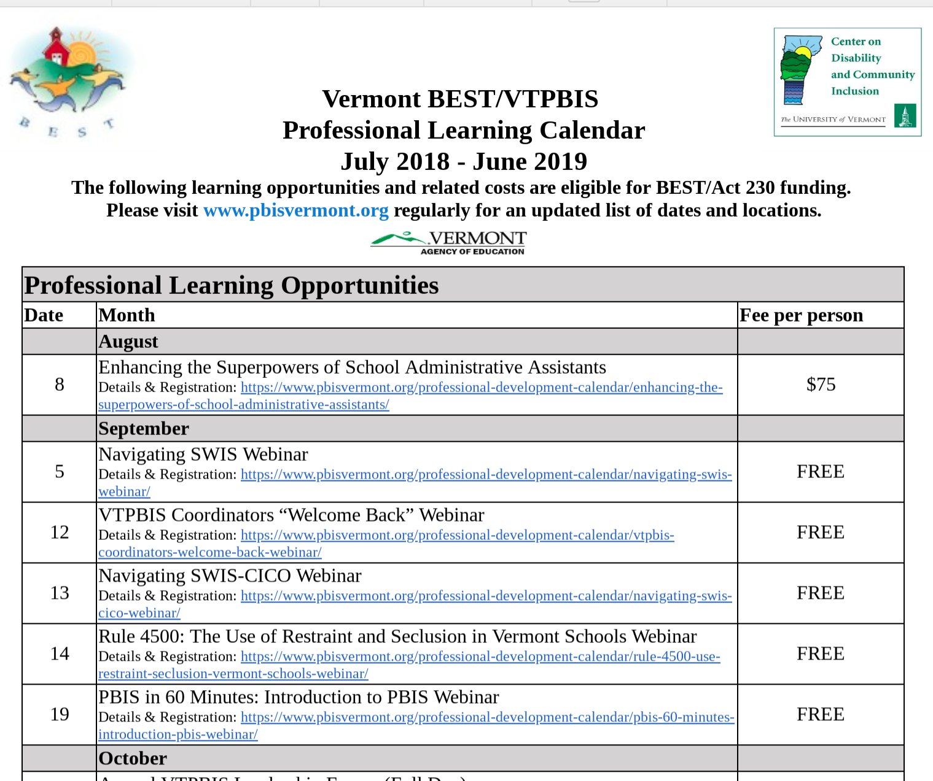
Explore the PD Calendar

Slide 22
To get a VTPBIS State-Approved Coach:
Contact your VTPBIS State TA to review the needs of your SU/SD/School
Review the VTPBIS Coach Fees: $62.50/hour, $250/half day or $500/day plus mileage
Coordinate with your central office Grants Coordinator to use local funds or to apply for BEST/Act 230 funds: http://education.vermont.gov/sites/aoe/files/documents/edu-integrated-frameworks-best-act-230-innovation-grant-instructions.pdf.
Contact a VTPBIS State-Approved Coach: http://www.pbisvermont.org/resources/coaches-a-coordinators/coaches.

Slide 23
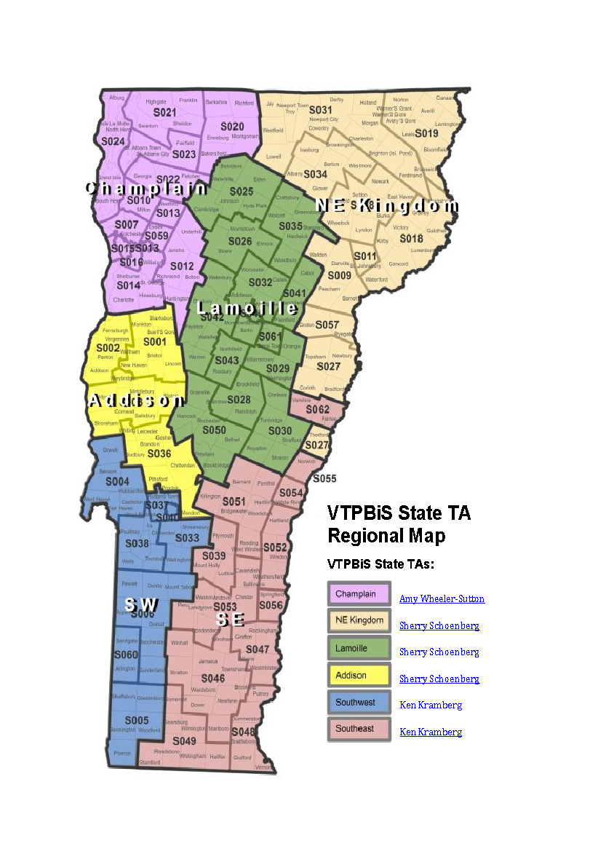
VTPBIS TA’s are a great resource
When in doubt, contact Anne Dubie!
at
(802) 656-5775 or
Anne.Dubie@uvm.edu

Slide 24
Stay Connected
https://www.facebook.com/groups/PBISVermont/
https://twitter.com/vtpbis
Please share all of the awesome things you are doing by using #VTPBIS or @VTPBIS

Slide 25
Wrap-Up
Contact us with any questions!
Cortney Keene, M.Ed., C.A.S., BCBA, LBA-VT
email: cortney.keene@uvm.edu
Jeremy Tretiak, M.Ed., BCBA, LBA-VT
e-mail: jeremytretiakgmbc@gmail.com
Notes:
Cortney

