Slide 1
Welcome!
You will be muted during this session. Please use the chat box or raise your hand.
You can show or hide your video.
This session is being recorded.
All materials can be found here: https://www.pbisvermont.org/training-resources/vtpbis-annual-forum/
Questions? Contact Anne Dubie at anne.dubie@uvm.edu

Slide 2
Welcome to the 2020 VTPBIS Forum!
Notes:
Good morning everyone. I am Sherry Schoenberg and I’m here with Amy Wheeler-Sutton, Anne Dubie, and the rest of the VTPBIS State Team and we’d like to welcome you to the 2020 VTPBIS Virtual Forum.
To start the Forum today, we want acknowledge that we do our work on Abenaki land. We realize the importance of understanding the long history of hardship faced by all First Nations Peoples. We recognize that inequities and injustices must be reconciled and healed, and there is much work to be done.
We hope that today’s Forum will be a place where we can intentionally focus on our commitment on do this work.

Slide 3
Who’s Here?
40
School and SU Coordinators
65 Team Members/
Educators
18 Admins
19 Project AWARE Grantees
24 State Partners

Slide 4
Schedule and Materials
8:30 – 9:45: Opening Remarks and Keynote
10:15 – 11:45: Workshop Sessions
LUNCH ON YOUR OWN
12:30 – 1:15: (Optional) Ignite Sessions or Team Time
1:30 – 3:00: Featured Sessions
Materials at:
https://www.pbisvermont.org/training-resources/vtpbis-annual-forum/

Slide 5
Guiding Principles for Today’s Learning
Prioritize equity
Make student growth and benefit central to all decisions
Prioritize the most effective and efficient practices
Use data
Invest in systems

Slide 6
Lean On Your Framework
PBIS has meant the world to us as we have made the transition back to in-person learning. I have said a million times over the past 3 months that PBIS provides a perfect framework for us to articulate, teach, practice, and reinforce all of these new routines in our buildings.
Matt Young, Principal,
Peoples Academy Middle School

Slide 7
How is VTPBIS Doing?

Slide 8
Number of VTPBIS Schools

Slide 9
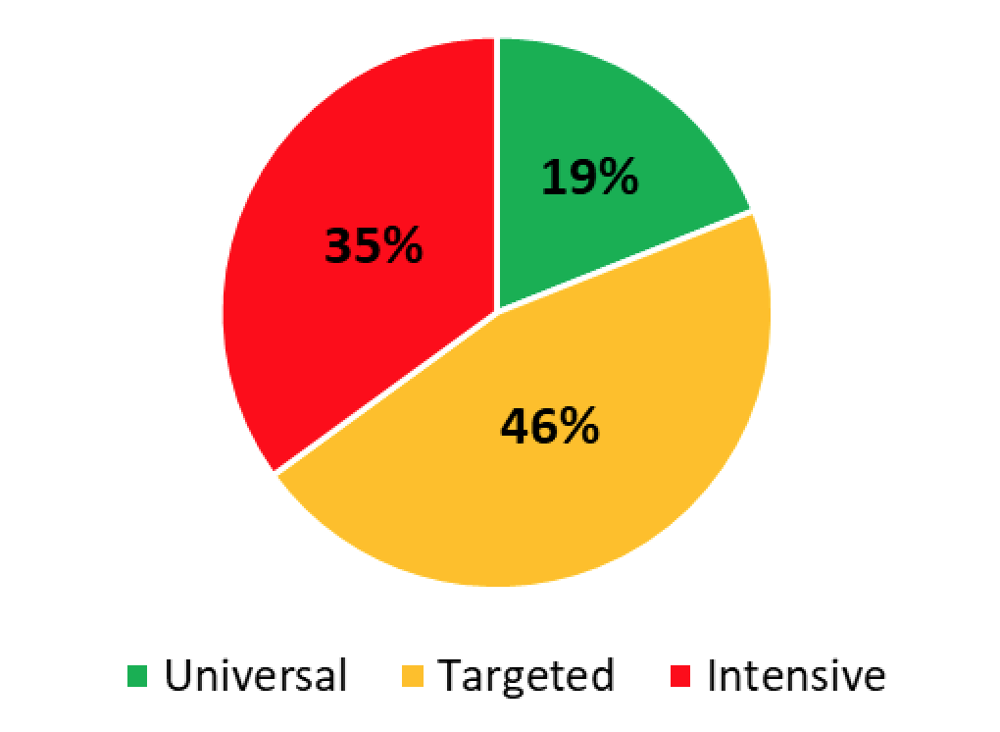
Implementation Levels (N=165)

Slide 10
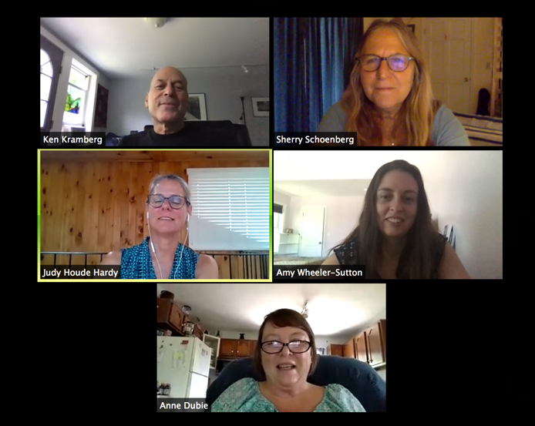
SY 20 Professional Learning Opportunities
32 In-Person and Web-Based Trainings
97.73% Highly Satisfied/ Satisfied
1,221 Participants

Slide 11
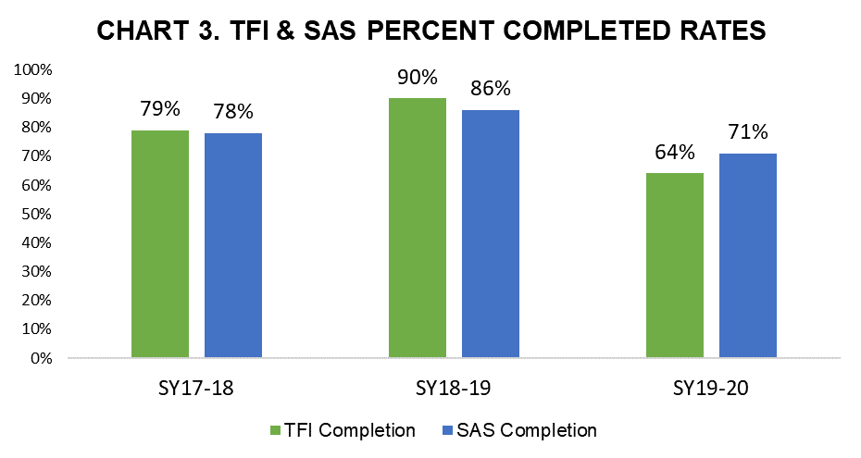

Slide 12
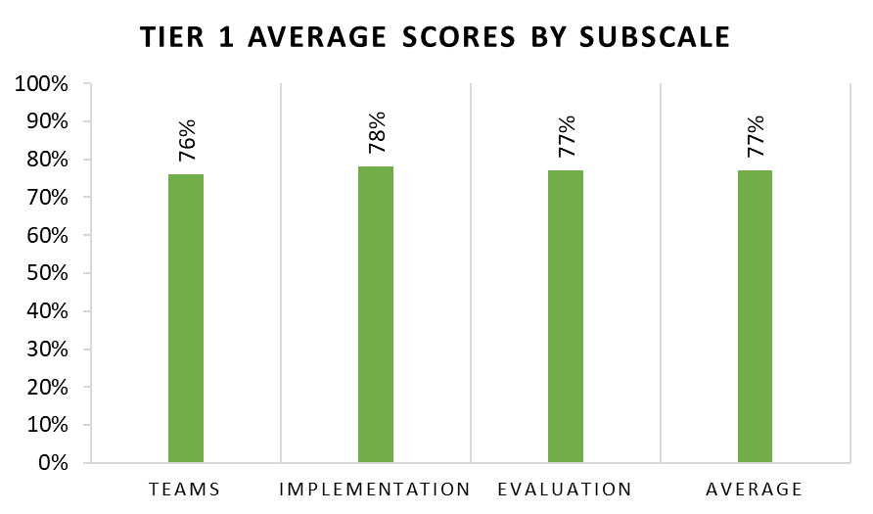

Slide 13
VTPBIS Acknowledgements
19 VTPBIS schools recognized
Notes:
additional narrative evidence of positive student outcomes, adapting PBIS, and partnering with families during remote learning

Slide 14
Status of 2019-20 Action Plan
2020 Goals
Build and support SU/SD-level capacity
Build connections between PBIS implementation fidelity and student outcomes
Improve student and family voice in PBIS

Slide 15
VTPBIS Action Plan for 2020-21
VTPBIS State Team Commitment to Equity:
Raise our own level of awareness and sensitivity
Embed equity and cultural responsiveness in all PD and coaching
Promote PD grounded in equity and that includes voice, choice, and ownership of all students, families, and staff
Collect, analyze, problem-solve, and act on fidelity and student outcome data
https://www.pbisvermont.org/best-vtpbis-state-team-commitment-to-equity/

Slide 16
VTPBIS Action Plan for 2020-21
VTPBIS State Team Commitment to Equity:
Raise our own level of awareness and sensitivity
Embed equity and cultural responsiveness in all PD and coaching
Promote PD grounded in equity and that includes voice, choice, and ownership of all students, families, and staff
Collect, analyze, problem-solve, and act on fidelity and student outcome data
https://www.pbisvermont.org/best-vtpbis-state-team-commitment-to-equity/

Slide 17
VTPBIS Action Plan for 2020-21 – cont’d
Provide real-time professional development, resources, and support that promote effective social/emotional/behavioral learning and wellness at home, school, or through hybrid education

Slide 18
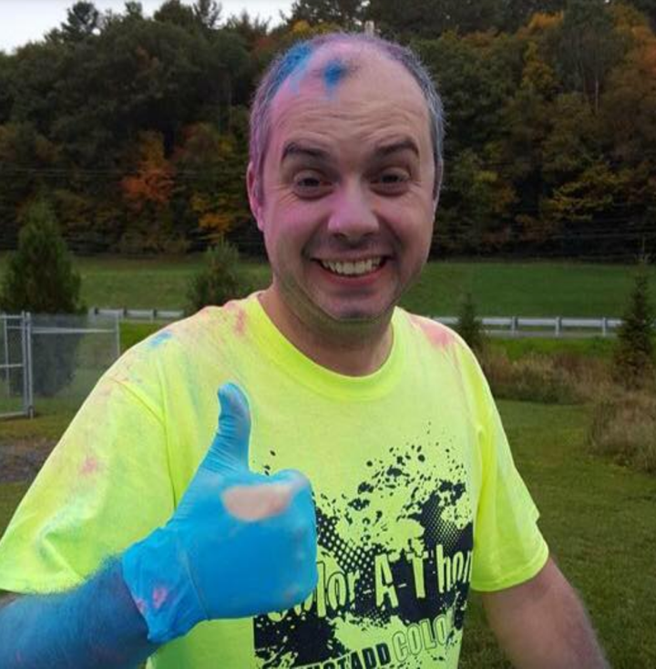
Welcome
Rick Dustin-Eichler

