Slide 1
Welcome!
You will be muted during this session. Please use the chat box or raise your hand.
You can show or hide your video.
This session is being recorded.
All materials can be found here: https://www.pbisvermont.org/training-resources/vtpbis-annual-forum/
Questions? Contact Anne Dubie at anne.dubie@uvm.edu

Slide 2


Welcome to the
2021 Virtual VTPBIS Forum!
Notes:
Good morning, everyone. I am Amy Wheeler-Sutton, and I’m here today with Sherry Schoenberg, Anne Dubie, and the rest of the VTPBIS State Team and we’d like to welcome you to the 2021 VTPBIS Virtual Forum.
To start the Forum today, we want acknowledge that we do our work on Abenaki land.

Slide 3

Notes:
We gather virtually today as teams of educators, school counselors, principals, behavior interventionists, paraeducators, and other support staff from across the state of Vermont who all contribute to the inspiration of children and students in this world. We want to honor the legacy of Vermont’s Indigenous people, the Abenaki People of the Dawn, who have cared for this land for generations and continue to do so. We recognize that colonialism and the oppression of Native peoples is a current and ongoing process, and we commit to building our awareness of our present participation. We pay our respects to the elders past and present. We honor with deep gratitude this land and all it gives us.
We also honor the histories of BIPOC people and acknowledge both the painful history of enslavement and that this country was built on the backs of Black and Brown people.
In the words of Chief Don Stevens of the Nulhegan tribe, please learn more about Abenaki culture and history, support the Abenaki people, stay engaged, be kind and caring to and accepting of the Abenaki people, and honor the fact that they have always had, and continue to have, a lot to offer.

Slide 4
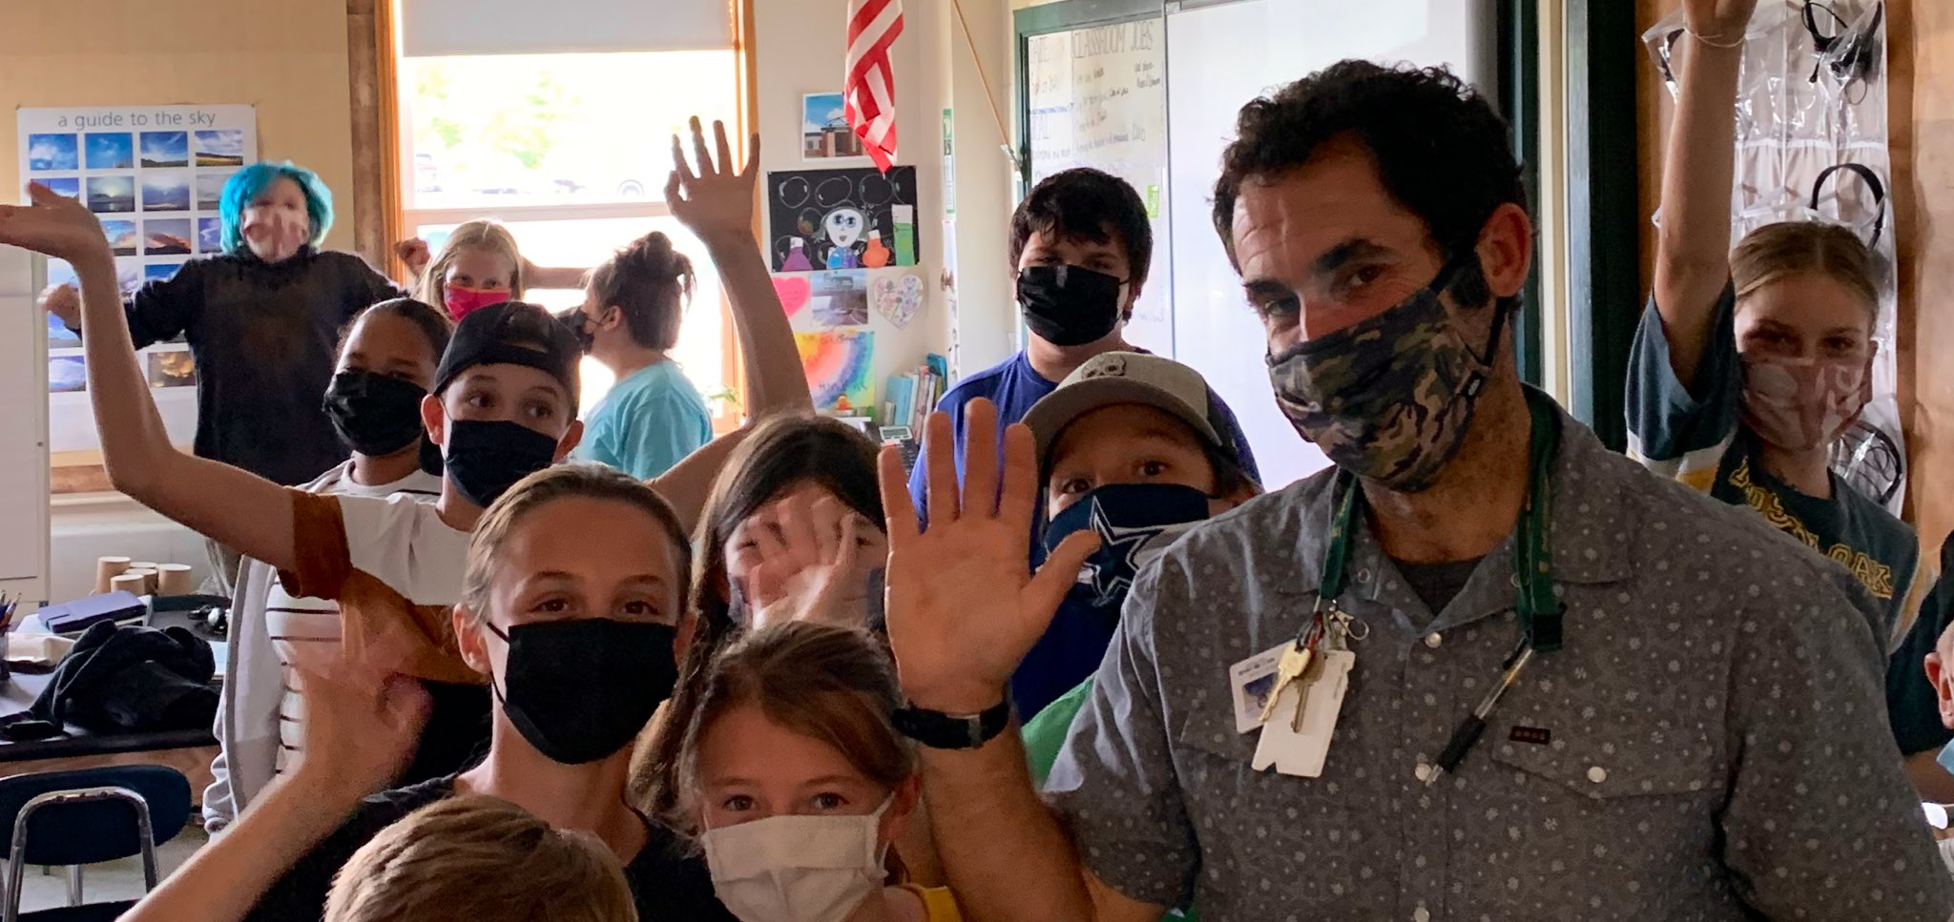
Thank you for your time!

Slide 5


Who’s Here?
42
Team Members/
Educators
41
School and SU Coordinators
21
Administrators
19
State Partners

Slide 6
Schedule and Materials
9:00 – 10:15: Opening Remarks and Keynote
10:30 – 12:00: Workshop Sessions
LUNCH ON YOUR OWN
12:45 – 1:15: (Optional) Ignite Sessions or Team Time
1:30 – 3:00: Workshop Sessions
Materials at:
https://www.pbisvermont.org/training-resources/vtpbis-annual-forum/

Slide 7
Centering Equity in PBIS - Core Constructs
Access: How do all students have entrance into, involvement with, and full benefit of quality learning opportunities offered and supported by PBIS implementation?
Representation: How do PBIS-related decision-making and content incorporate student, caregiver/parent, and staff voices, particularly those that are currently or historically underrepresented?
Meaningful Participation: How do all students have agency and how are they empowered to contribute to PBIS implementation in effectual ways?
High Outcomes: How do solutions provided by PBIS implementation benefit all students towards self-determination and the ability to act as contributing citizens in a democratic society and global community?

Slide 8
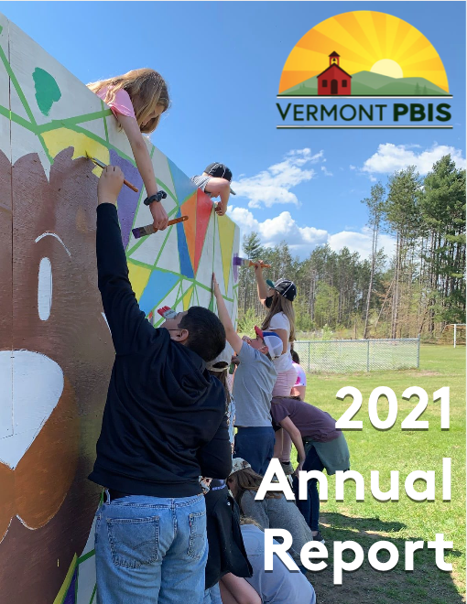
How is VTPBIS Doing?

Slide 9
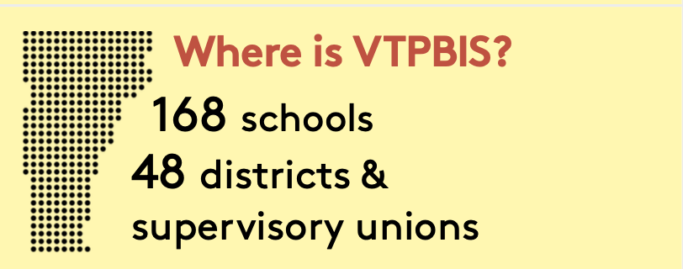

Slide 10
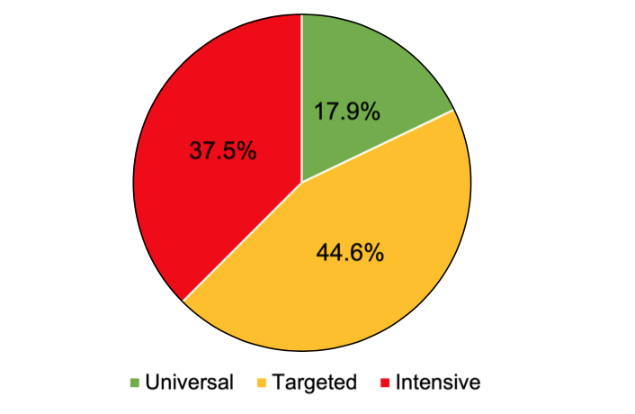
Implementation Levels (n=168)

Slide 11
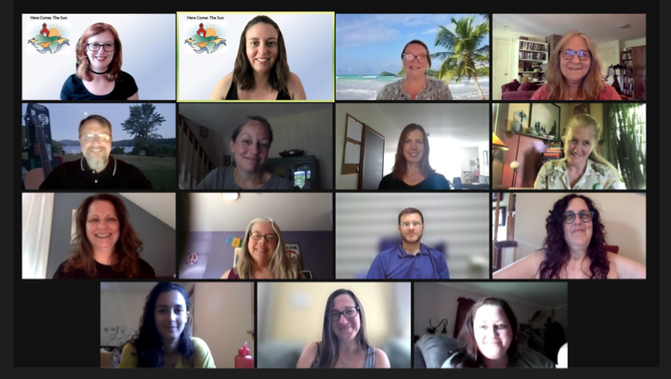
SY 21 Professional Learning Opportunities
31
Web-Based Trainings
97.96% Highly Satisfied/ Satisfied
1,241 Participants

Slide 12
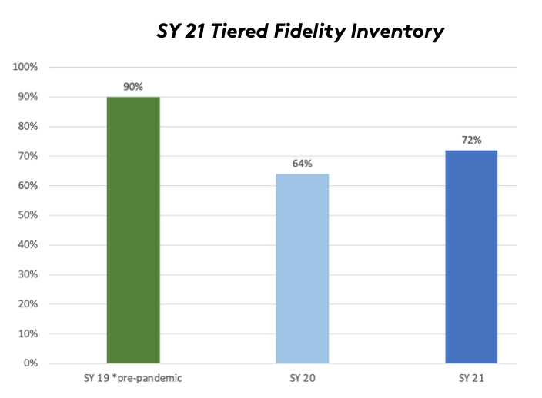

Slide 13
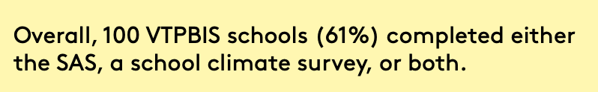
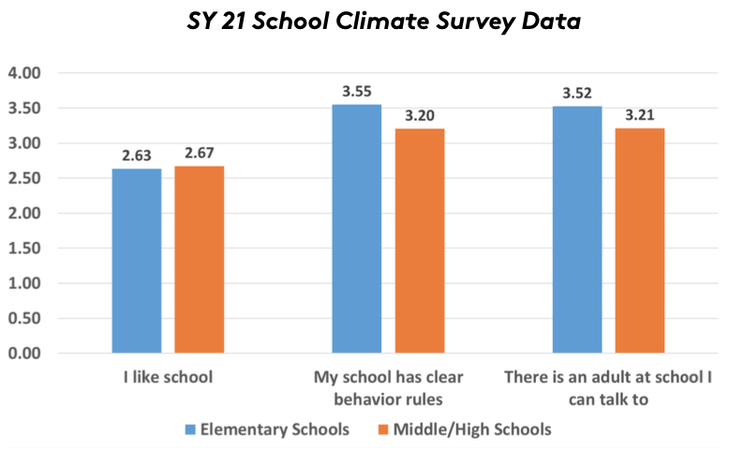

Slide 14
New Schools!
Barre City
Tunbridge
Chelsea
WRVMS

Slide 15
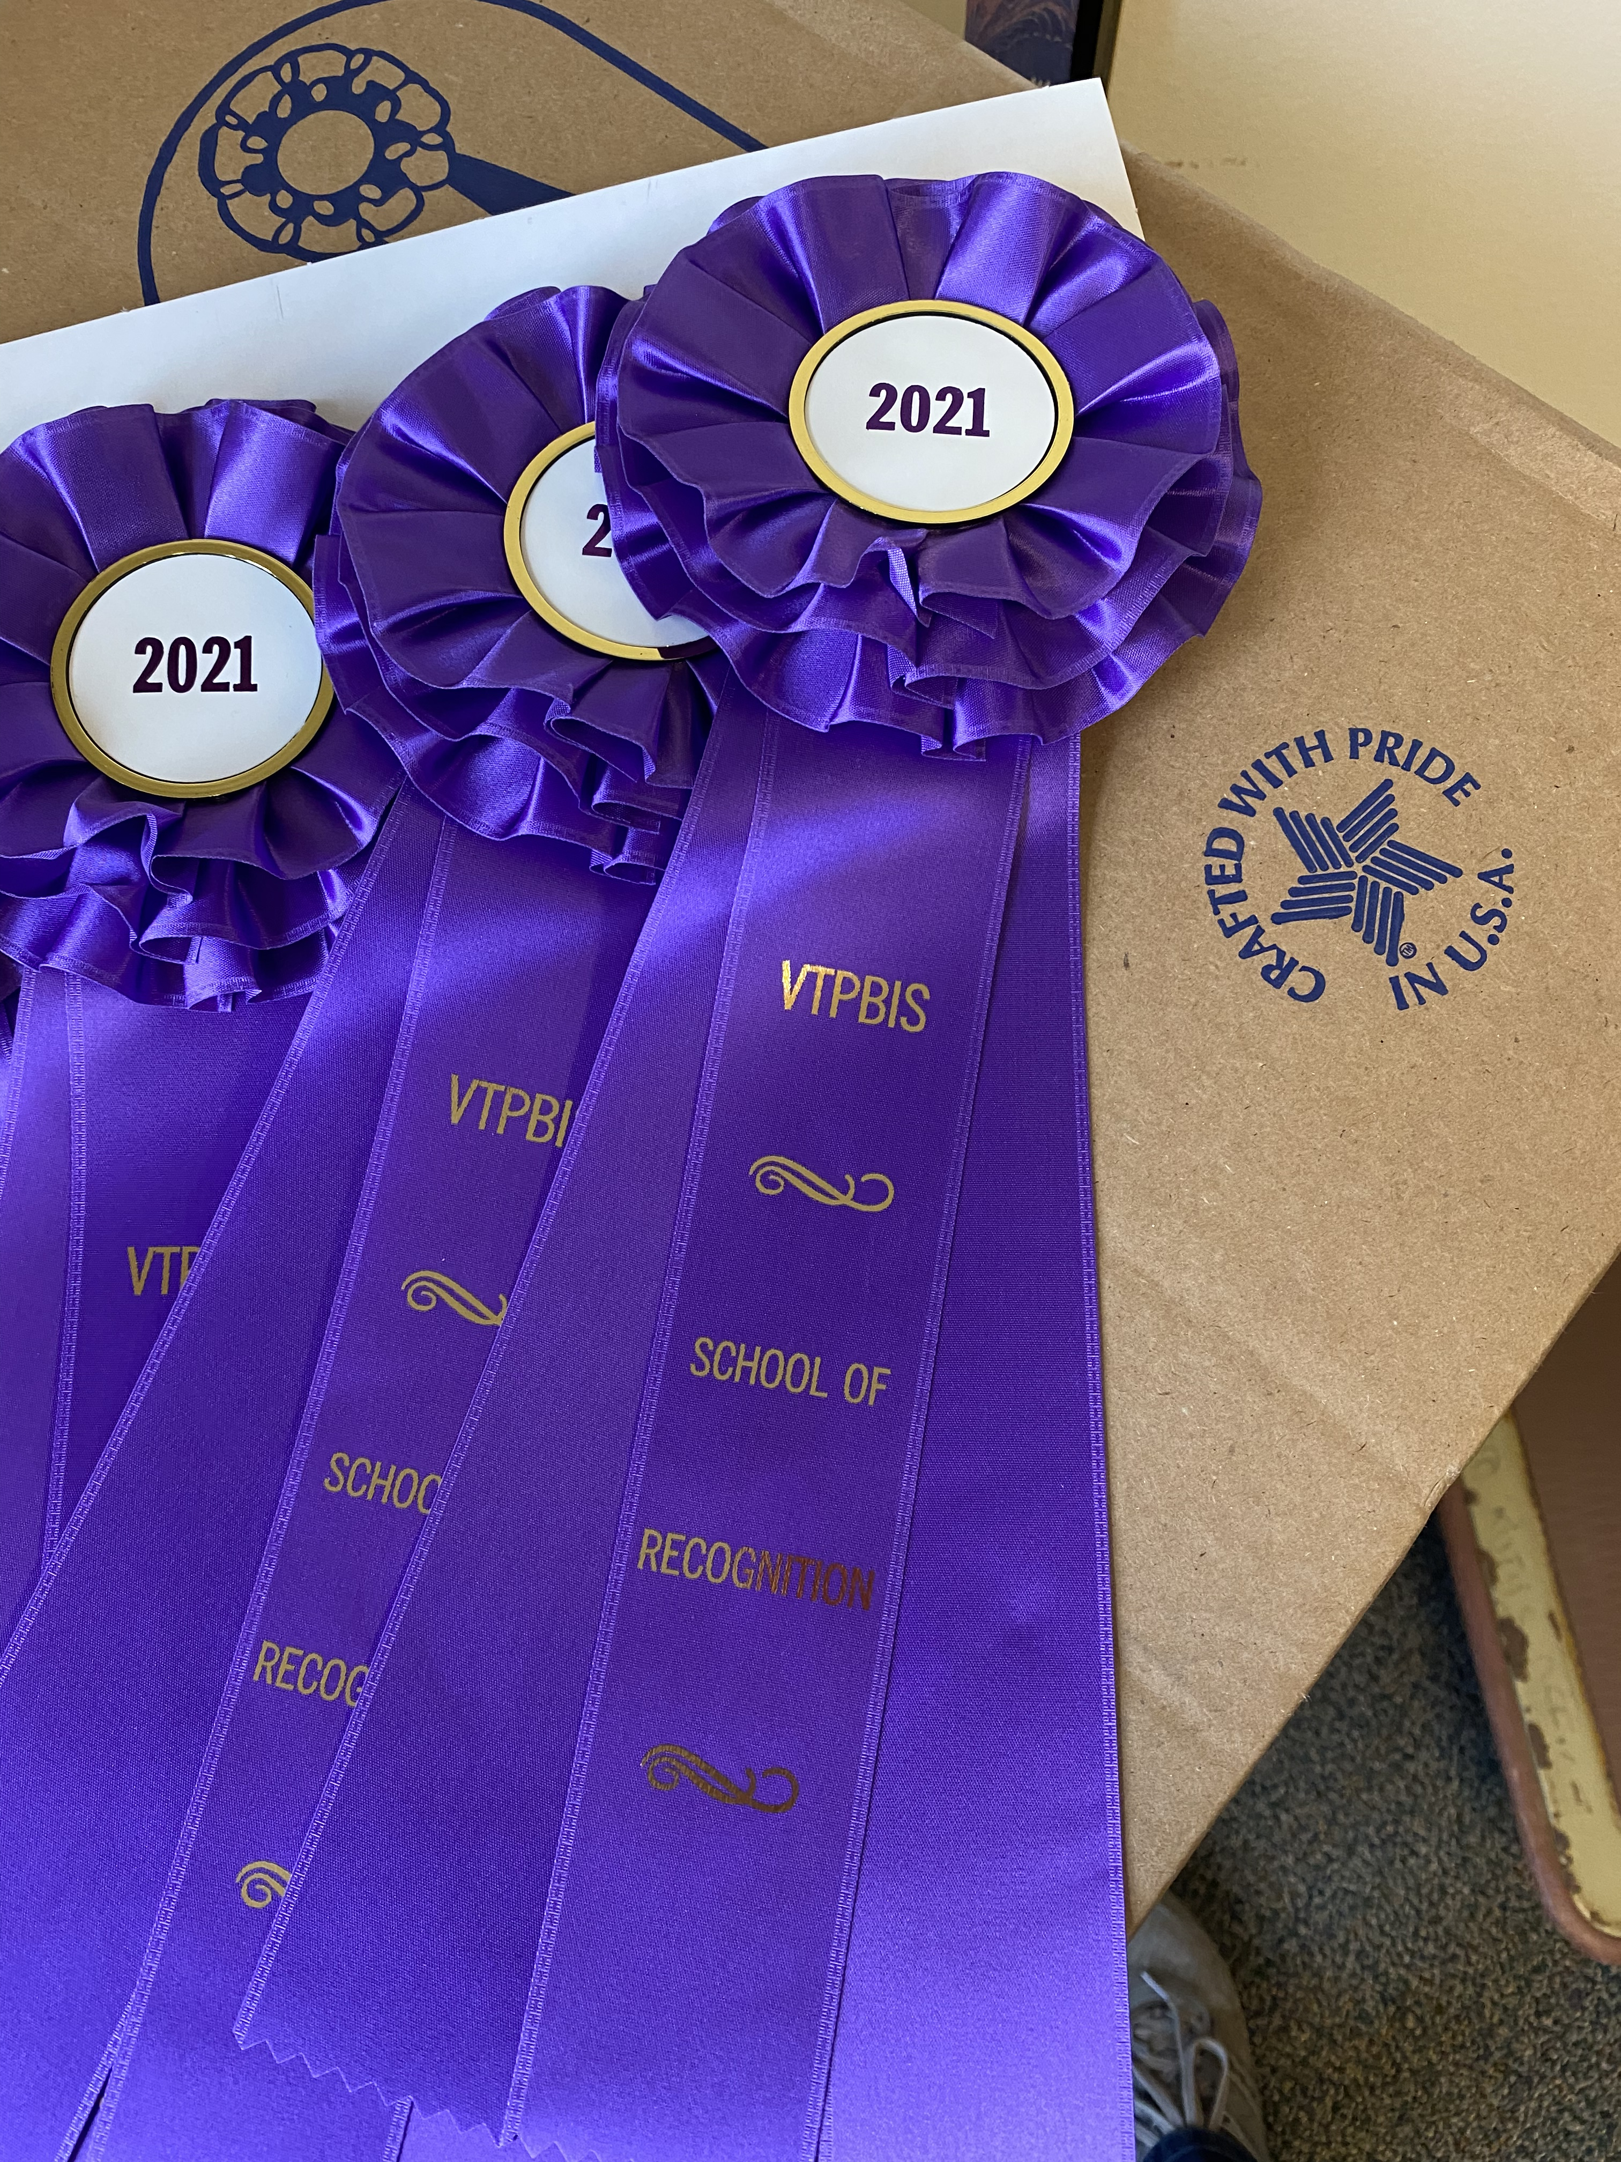
VTPBIS Acknowledgements
43 VTPBIS schools recognized

Slide 16
VTPBIS Acknowledgements
Allen Brook
Barnet
Benson Village
Blue Mountain Union
Brownington Central
Cabot
Castleton Elementary
Castleton Village
Concord
Derby
Dothan Brook
Gertrude Chamberlin
Grand Isle
Green Street
Guilford
Hartland Elementary
Hyde Park Elementary
Killington Elementary
Kurn Hattin
Lakeview Elementary
Middletown Springs
Miller's Run School
Monkton
Newport Town
Orchard
Orwell Village
Ottauquechee
Peoples Academy Middle Level
Porters Point
Poultney Elementary
Rutland Intermediate
Shelburne
Sheldon Elementary
Stowe Elementary
Summit Street
Sunderland
Vergennes Union Elementary
Walden
Waterville Elementary
Wells Village
White River Valley
Windsor Schools
Wolcott Elementary

Slide 17
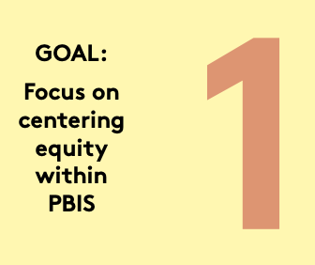
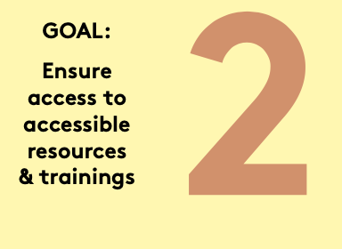
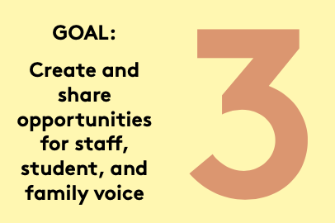
2021-22 VTPBIS Action Plan

Slide 18
Upcoming Events
Crisis Prevention and Intervention (CPI) – Oct. 19
Data Day Webinar – Oct. 20
Relationship Building & De-escalation Skills – Oct. 22 – now virtual
Intro to Restorative Practices within MTSS – Oct. 29 – now virtual
Understanding + Practicing Function-Based Thinking Webinar - Nov. 3
For all events, see our PD Calendar

Slide 19
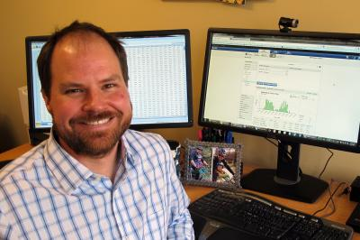
Welcome Kent McIntosh

