Slide 1
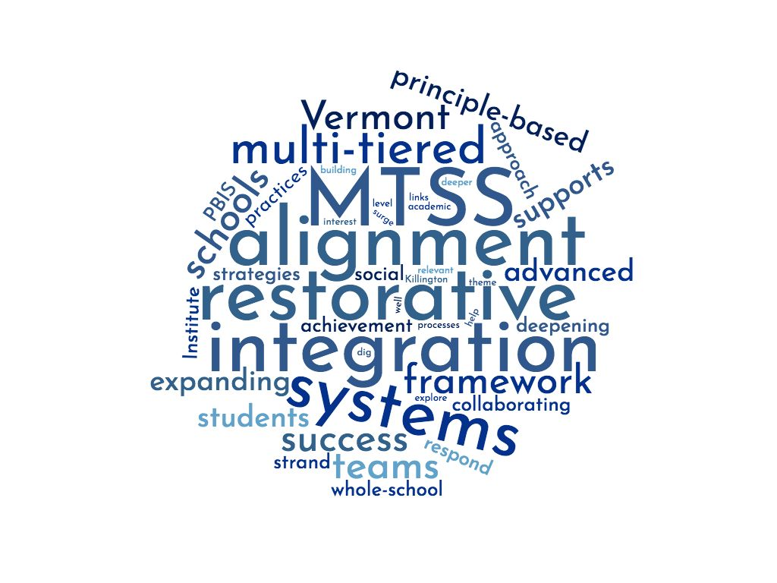
Restorative Practices within a PBIS Framework
Amy Wheeler-Sutton, BEST/PBIS State Team
Shawn Gonyaw, Barnet School
Angel Roy, Barnet School
Notes:
Restorative practices can be implemented as a whole-school, multi-tiered approach, guided by principles that emphasize positive relationships. These principles provide a lens to examine school climate and culture, as well as a school community’s response to when things go wrong. This foundation-level workshop will interactively introduce the restorative principles and what it looks like when they are applied in a PBIS school.

Slide 2
Agenda
Introductions
Quick Review of PBIS
Alignment of PBIS and Restorative Practices
PBIS + RP at Barnet School
Tier I Restorative Circle Video (if time)

Slide 3
Introductions
Please get up and introduce yourself to someone you don’t know
Discuss any experiences you have had with PBIS and/or Restorative Practices. If you don’t have any, share why you chose this session.
Share Out
Notes:
Raise your hand if you work in a school that is implementing PBIS? RP? With fidelity?

Slide 4
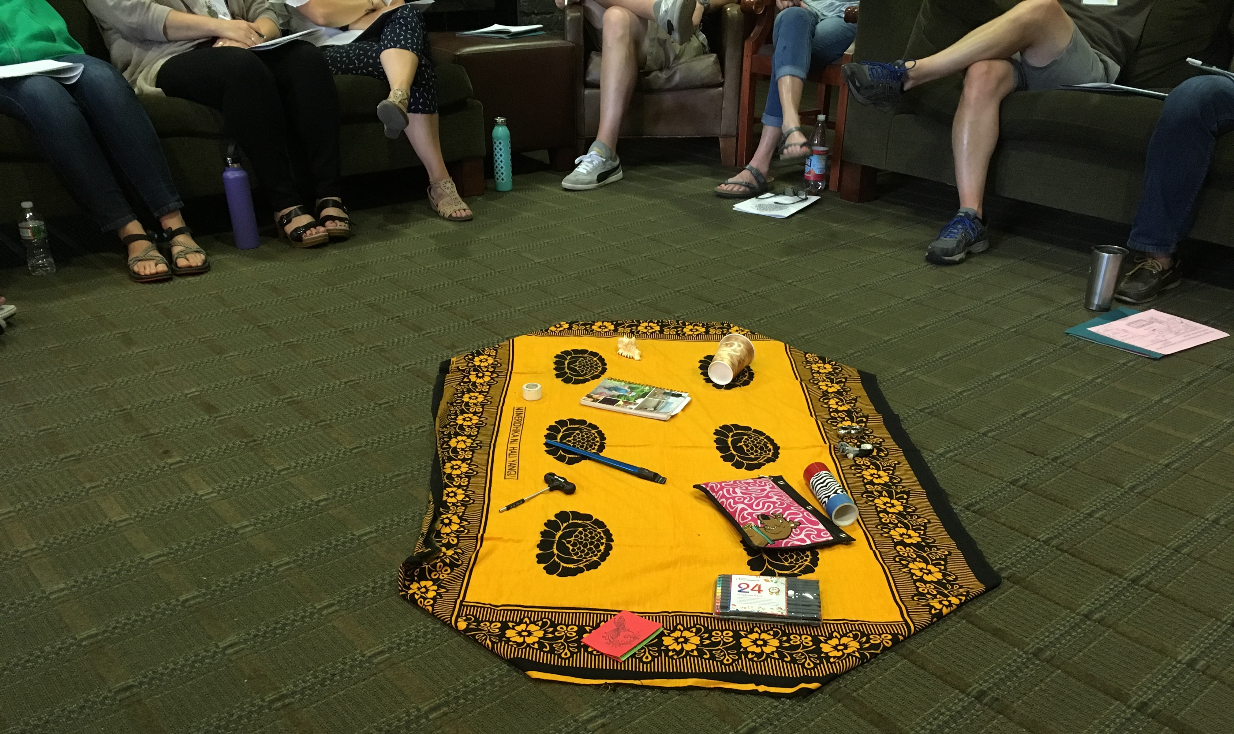
Acknowledgements
Jon Kidde, Green Omega, L3C

Slide 6
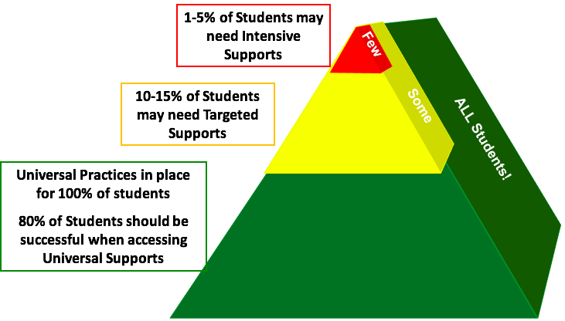
Who Benefits from PBIS?

Slide 7
PBIS Sustainability
Supporting
Staff Behavior
Supporting
Decision
Making
SYSTEMS
DATA
PRACTICES
Smallest effort
Evidence-based
Biggest, durable effect
Supporting
Student Behavior

Slide 8
Core Features of Universal PBIS
Leadership team
Common purpose statement
3-5 positively-stated behavioral expectations
Systems for teaching behavioral expectations
Systems for acknowledging and rewarding behavioral expectations
Systems for discouraging problem behaviors
Data management systems
Improve consistency and predictability
Notes:
Increase consistency and predictability
Assumption that skills need to be taught, they are not innate

Slide 9
What are Restorative Practices?
Proactively build healthy school climates by creating space for people to understand one another and develop relationships
Meaningful opportunities for social engagement that foster empathy and mutual responsibility for the well-being of individuals and community
When things go wrong, engaging those affected and creating space so that individuals and communities can identify, understand, and address harms and needs in order for all to heal
Whole School Restorative Approaches Resource Guide
Notes:
No singular universally agreed-upon definition for whole-school restorative approaches (Fronius et al., 2016)
Intentional relationship/culture building - when you feel connected, less likely to harm, more likely to want to repair harm when it happens
Trust
A philosophy, way of being; something we are, not something we do
Not new
Not a program

Slide 10
Big Idea:
Restorative Practices at Tier I involve
intentional relationship and culture building.
Those who feel connected to their community are less likely to harm, more likely to want to
repair harm when it happens,
and more likely to accept consequences
All members of the community should feel that
their “presence is vital to their
learning community’s success”
Highgate's PBIS/RP Document
Whole School Restorative Approaches Resource Guide

Slide 11
Outcomes and Indicators
Reduced suspensions and expulsions
Reduced behavioral referrals
Reduced racial disparities in exclusionary discipline.
Reduced absenteeism and tardiness
Increased academic performance
Increased parental satisfaction with school response
Identified increased social emotional capacity
http://www.greenomegal3c.org/2016/restorative-justice-in-schools-outcomes-and-indicators/

Slide 12
Core Principles of RP
Voluntary participation
Exploring relationships
Meaningful engagement
Participatory decision-making (do “with” rather than “to” or “for”)
Identification of and addressing harms and needs (rather than focus on blame, rule violation, or punishment/exclusion)
Active responsibility (rather than passive and/or punitive accountability)
Restoration and repairing the harm
Whole School Restorative Approaches Resource Guide
Notes:
No singular universally agreed-upon definition for whole-school restorative approaches (Fronius et al., 2016)

Slide 13
Reflection:
What resonates with you in these core principles?
How might you incorporate these principles into Universal PBIS?
How might this apply at the staff level?

Slide 14
Reflection: What resonates with you in these core principles? How might you incorporate these principles into Universal PBIS? How might this apply at the staff level?
Voluntary participation
Exploring relationships
Meaningful engagement
Participatory decision-making (do “with” rather than “to” or “for”)
Identification of and addressing harms and needs (rather than focus on blame, rule violation, or punishment/exclusion)
Active responsibility (rather than passive and/or punitive accountability)
Restoration and repairing the harm
Share Out
Whole School Restorative Approaches Resource Guide
Notes:
No singular universally agreed-upon definition for whole-school restorative approaches (Fronius et al., 2016)

Slide 15
Core Features of Universal PBIS: What do these look like with RP lens?
Leadership team
Common purpose statement
3-5 positively-stated behavioral expectations
Systems for teaching behavioral expectations
Systems for acknowledging and rewarding behavioral expectations
Systems for discouraging problem behaviors
Data management systems
Notes:
Co-creation of norms/expectations
Engaging students in learning norms/expectations
Student voice and choice in recognition systems
Restorative approaches to responses to problem behavior

Slide 16
Shifting Practices/Policies/Procedures
Reminder: this is a mindset shift for many

Slide 17
Not Instead of, But Rather, Complementary
“Restorative Justice is not another program to be imposed on schools. It is a philosophy, a way of being and relating. It does not replace current initiatives. Promising and evidence-based programs such as: Positive Behavior Intervention and Support (PBIS), Responsive Classroom, Second Step, Too Good for Violence, Too Good for Drugs, Tribes, and other initiatives assist in building a foundation and culture of caring. These kinds of programs and initiatives complement restorative practices.”
Spotlight Practice: Restorative Justice:
A Working Guide for Our Schools

Slide 18
A CONTINUUM OF RESTORATIVE PRACTICES
A CONTINUUM OF SWPBIS PRACTICES
Intensive Intervention
Return from suspension
Administrative transfer or school crime diversion:
Victim offender meetings
Family/community group conferences
Restitution
Intensive Intervention
Function-based support
Wraparound support
~5%
~15%
Early Intervention
Alternatives to suspension:
Youth/peer court
Peer mediation
Conflict resolution training
Restitution
Responsive circles
Early Intervention
Check-in/ Check-out
Social Skills Curricula
Prevention & Skill Building
Define and teach expectations
Establish consequence system
Collection and use of data
Prevention & Skill Building
Peace-keeping/community building circles for:
Morning meetings
Social/emotional instruction
Staff meetings
~80% of Students
(Adapted from Swain-Bradway, Eber, Sprague, and Nelson, 2016)

Slide 19
Alignment of PBIS and RP
What does you notice about the overlap between PBIS and RP?
Both are:
MTSS
Whole-school
Positive
Proactive/prevention-focused
Same end goals in mind
Notes:
Both responses to Zero Tolerance
Many misconceptions associated with both
Flexibility within guiding principles
Reducing exclusionary discipline
Maximizing instructional engagement

Slide 20
Goals of PBIS and RP
To build a safe, respectful, and productive learning environment
To establish a positive school climate where students and adults have strong, positive relationships and students understand what is expected of them as learners at school
https://www.pbis.org/common/cms/files/pbisresources/TECBD_RJP%20in%20SWPBIS%20Eber,%20Swain-Bradway.pptx

Slide 21
Using PBIS Framework to Sustain RP
Supporting
Staff Behavior
Supporting
Decision
Making
SYSTEMS
DATA
Fidelity
Student Outcome
PRACTICES
Smallest effort
Evidence-based
Biggest, durable effect
Supporting
Student Behavior

Slide 22
Why a Systems Approach?
Ensures practices are implemented as intended (with fidelity)
Fidelity Tools: Portland RJ TFI; Oregon TFI-RP
Ensures consistency across the school
Ensures RP is not being used when contraindicated by function of a problem behavior
i.e. Circles can be an opportunity to get uninterrupted attention.
Eber, L. & Swain-Bradway (2015). SWPBS as a Framework for Installing Restorative Practices in Schools.

Slide 23
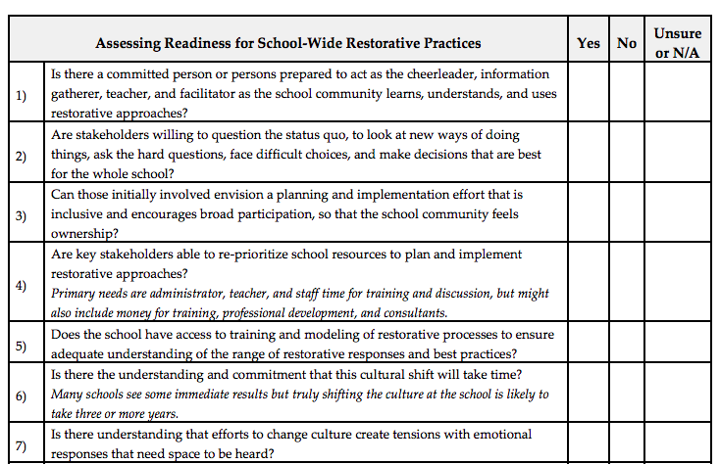
Cautions
Research is limited
Whole School Restorative Approaches Resource Guide (pg. 36-37)
Ensure readiness (of entire community)
Whole School Restorative Approaches Resource Guide (pg. 27)
Ensure alignment
Technical Guide for Alignment
Provide training
Establish clarity about core features and structure for implementation
Start small (consider starting only at the staff level for 1 year)
Establish careful measurement of fidelity and outcomes
Continually assess
Eber, L. & Swain-Bradway (2015). SWPBS as a Framework for Installing Restorative Practices in Schools.

Slide 24
Turn and Talk: 1) If your school implementing PBIS + RP, what does it look like? 2) If you aren’t implementing RP, what steps would you need to take to become more restorative? Do you have administrative/staff/family buy-in/resources/support to move in this direction? What barriers do you foresee?
Share Out

Slide 25
Highgate: Why implement PBIS and RP together? Why not choose one?
With PBIS but not RP: Some students may know and understand the expectations of the classroom and the school, but do not feel sufficiently connected to their classroom and/or the school, and so are not motivated to adhere to norms (which they feel have been forced upon them). Accordingly, these students are unmotivated to repair harm they have done to others within the scope of those norms. When they receive consequences (especially those resulting in exclusion), they view those consequences as oppressive or unfair, and their feelings of belonging are further diminished, making misbehavior more likely in the future.
These students’ skill outpaces their will.
Highgate's PBIS/RP Document
Notes:
https://docs.google.com/document/d/16B5k1DTxAkjqdHr0imSv20dpjtPpqTLrjeooKteRUxw/edit

Slide 26
Highgate: Why implement PBIS and RP together? Why not choose one?
With RP but not PBIS: Some students may desire to be a part of their learning community and to adhere to its norms, but lack the necessary executive functioning skills to do so consistently. Other students may have developed behavior response mechanisms that meet their needs in other environments but are maladaptive to school. They are not given the explicit teaching necessary to be successful within the community’s norms, and so become frustrated by their repeated need to restore and repair harm.
These students’ will outpaces their skill.
Highgate's PBIS/RP Document
Notes:
https://docs.google.com/document/d/1KHaWUzpipofy5D7iqfGdOGb6zxehwlfHlAvQ5p9xg0w/edit

Slide 27
Georgia Elementary/Middle School
Blog Post

Slide 28
Barnet School

Slide 29
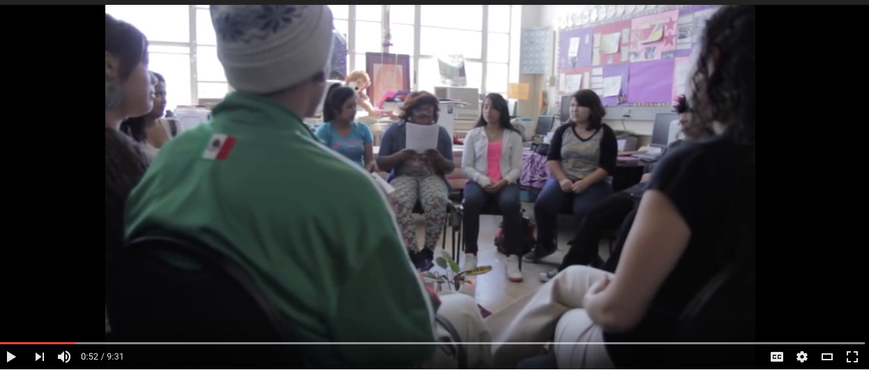
Tier I Community-Building Circle
Consider:
While you are watching this video, think about what a Tier I circle might look like in your school.
If you are already using Tier I circles,
what do you notice in this video
that you’d like to see in your circles?

Slide 30
What is your WHY?

Slide 31
Where can you learn more about this topic? - Oct. 24th – full day training with Jon Kidde - December 6th – The Restorative Classroom training with Annie O’Shaughnessy - VTPBIS Coaching with Jon Kidde - BEST/MTSS Summer Institute (likely)

Slide 32
Reflection (3, 2, 1): What are three new things you learned? What are two questions you have? What is one thing you will do differently this school year?
Share Out

Slide 33
What questions do you have?

Slide 34
Resources
VTPBIS Website
PBIS.org
Whole School Restorative Approaches Resource Guide (VT AOE)
Technical Guide for Alignment
Highgate's PBIS/RP Document
PBIS Forum in Brief: Integration of RJP within SWPBIS

