Slide 1
Team Initiated Problem Solving
Presented by the VTPBIS State Team
October 2021
Notes:
Sherry

Slide 2
Welcome!
You will be muted during this session. Use the chat box or raise your hand to talk.
You can show or hide your video.
All materials can be found here: https://www.pbisvermont.org/training-resources/vtpbis-annual-forum/

Slide 3
What is data-based decision making?
Still learning and growing
We know how to do it, now we’re working to sustain it
Very fluent
and very effective
Becoming Data Based
How are you currently embracing a data-based decision-making process that leads to results?
Pick a color that matches your experience.
Type into the chat box about what might help you get to the next color.
Notes:
Sherry

Slide 4
Big Ideas About Data
All data should serve a purpose
Collect data with fidelity
Be prompt about looking at data and acting upon it
Use multiple sources of data to confirm what you see
Use data to support, not punish
Notes:
Sherry

Slide 5
Types of Data to Consider
Consider Community Data – MH, Substance Abuse, Homelessness, Placement, etc.
Intensive:
TFI
I-SWIS
EST
FBA/BSP
Targeted:
TFI
SWIS-CICO
EST
FBA/BSP
Universal Screening
Universal:
TFI
SAS
SWIS
Attendance
Grades
School Climate
Family Engagement
Weekly Check-In
Notes:
Sherry
What else? IEP across the tiers
Targeted – SWIS or some other School information System like PowerSchool
The more data you have, the more questions you will ask and the better rounded and comprehensive picture you will have.
It is also important to disaggregate data to be sure it is representative of your student body. I.e., if 47% of your students are male, 41% female and 2% non binary – look at the percentage of students in either demographic that is receiving intensive supports or getting significant BODF’s.

Slide 6
Data help us ask the right questions. They do not provide the answers.

Slide 7
Having a Strong Team Will Help You Get to Outcomes
Supporting
Staff Behavior
Supporting
Decision Making
OUTCOMES
Systems
Data
Practices
Supporting Student Behavior
Notes:
3
SYSTEMS

Slide 8
TIPS Offers:
A process for using data to make decisions:
Formal problem-solving steps that a group can use to build and implement solutions.
Access to the right information at the right time in the right format
A structured meeting process
Formal roles (facilitator, recorder, data analyst)
Specific expectations (before, during & after meetings)
Access and use of data
Use of electronic and projected meeting minutes
Notes:
Sherry

Slide 9
TIPS Offers:
Formal roles (facilitator, recorder, data analyst)
Specific expectations (before, during & after meetings)
Access and use of data
Use of electronic and projected meeting minutes
A structured meeting process
Notes:
Sherry
Do you sit on teams or committees?
What makes a dream team?

Slide 10
What Makes a Dream Team?
A successful team experience
Accountability
Predictability
Participation
Communication

Slide 11
Characteristics of an Effective Data Team
Notes:
Sherry

Slide 12
Characteristics of an Effective Data Team

Slide 13
Effective meetings extend before and after the actual meeting time. Other key roles are necessary!
BEFORE:
Set agenda and send to team
Collect data, review, and prepare summary statements
DURING:
Follow agenda & time frames
Review data
Make precision problem statements
Develop solutions
Take notes and set action items
AFTER:
Complete action items
Follow-up on action item status
Notes:
Sherry

Slide 14
Data Analyst: Role & Responsibilities
Establish the role of a data analyst (and backup person)
Use the data sources needed for problem solving and decision making (DIBELS, SWIS, etc.)
Create written data summaries in advance to assist for efficient problem solving
Launch meeting with a data summary to help define the problem with precision
Refine precision of problem statement through inferences and hypothesis
Notes:
Sherry
determining if there are problems;
jump starting a problem solving discussion; and
evaluating the impact of solutions and fidelity of implementation

Slide 15
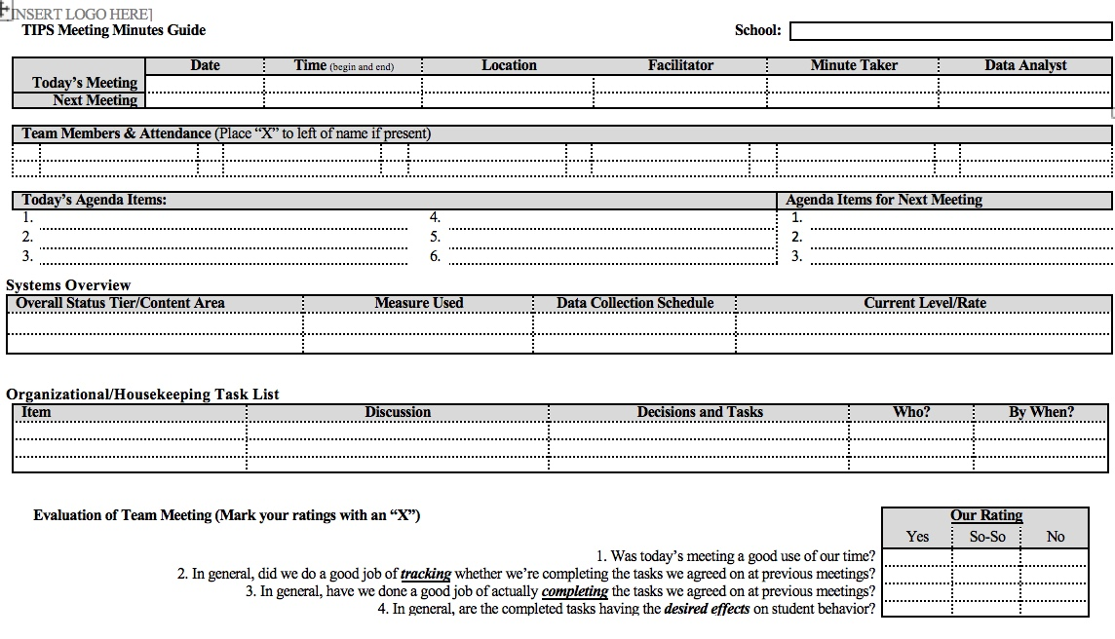
Notes:
hand out

Slide 16
TIPS Offers:
A process for using data to make decisions:
Formal problem solving steps that a group can use to build and implement solutions.
Access to the right information at the right time in the right format
Innovation Neutral: Use for Reading, Behavior, Math, School Improvement
Notes:
Sherry

Slide 17
Innovation Neutral: Use for Reading, Behavior, Math, School Improvement
Notes:
This is a microcosm of the drivers within a theory of improvement process outined in the AOE Comprehensive needs assessment toolkit.

Slide 18
Indicators of Possible Problems
Identify problems based on your school’s:
Desirable and undesirable trends
Average Referrals Per Day Per Month for this year and for corresponding months of the previous year
Average Referrals Per Day Per Month compared to the national median
Faculty, parent, and student opinions regarding acceptable or not acceptable levels of BODFs
Notes:
Sherry

Slide 19
TIPS Problem-Solving “Mantra”
REMEMBER to use…..
Do we have a problem? If so, what is the precise nature of our problem? (identify, define, clarify, confirm/disconfirm inferences)
What is our goal? How will we know we’ve met our goal? (what data will we use?)
Why does the problem exist, & what can we do about it? (hypothesis & solution)
What are the actual elements of our plan? (action plan)
Is our plan being implemented with fidelity & is it working? (evaluate & revise plan)
What next steps are needed?
Notes:
Sherry
Update

Slide 20
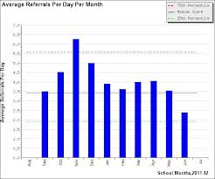
1. Do we have a problem? If so, what is the precise nature of our problem?
Notes:
What data to monitor
ODR per day per month
OSS, ISS, Attendance, Teacher report
Team Checklist/ SET (are we doing what we planned to do?)
What question to answer
Do we have a problem?
What questions to ask of Level, Trend, Peaks
How do our data compare with last year?
How do our data compare with national/regional norms?
How do our data compare with our preferred/expected status?
If a problem is identified, then ask
What are the data we need to make a good decision?

Slide 21
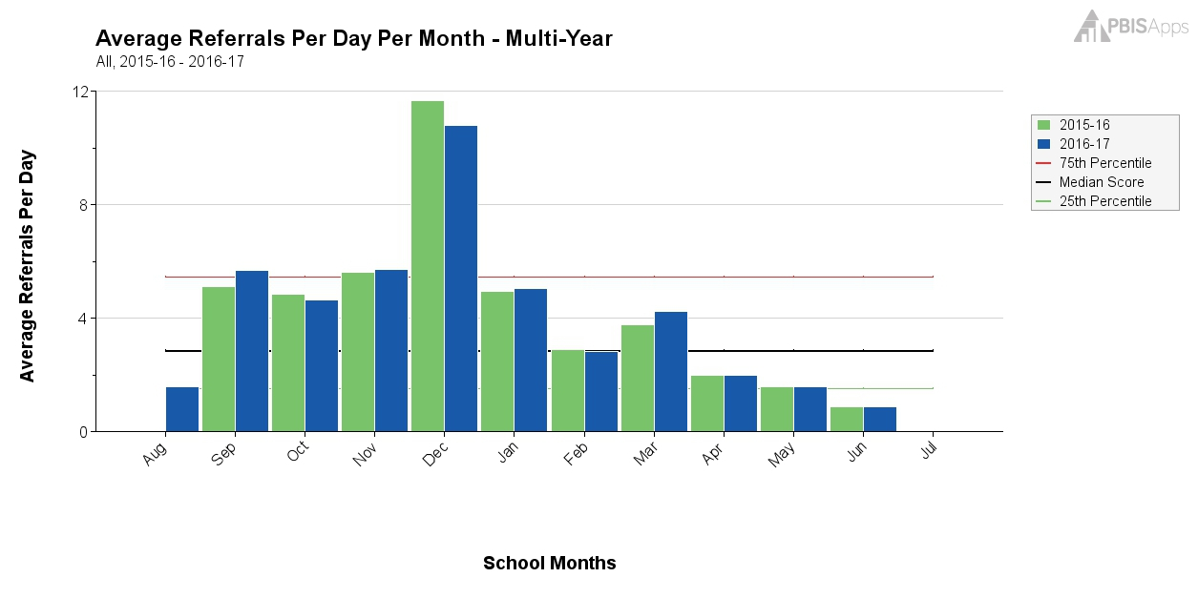
What Does this Graph Tell You?
Notes:
Sherry

Slide 22
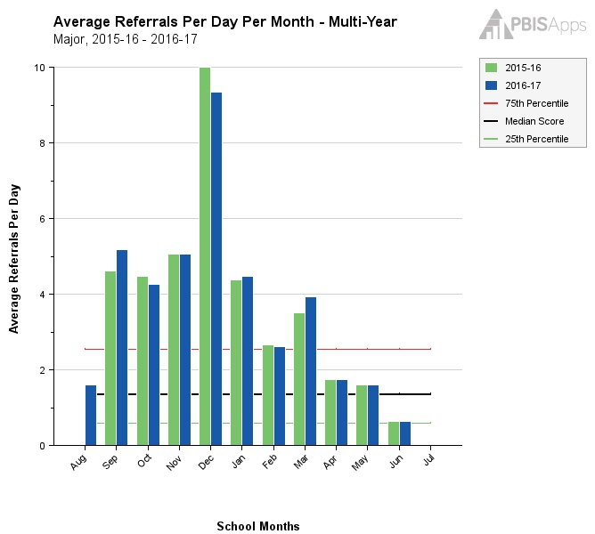
Same Graph Looking at Majors Only
Notes:
Sherry

Slide 23
What Does this Graph Tell You?
Notes:
Sherry

Slide 24
1. Do we have a problem? If so, what is the precise nature of our problem?
Question | SWIS Table/Graph
What problem behaviors are occurring? | Referrals by problem behavior
When are problem behaviors occurring? | Referrals by time
Where are problem behaviors occurring? | Referrals by location
Who is engaging in problem behaviors? | Referrals by student
Why do problem behaviors keep happening? | Referrals by motivation
What is the data we need for a decision?

Slide 25
Example: Primary to Precise
Precise Problem Statements include information about the what, when, where, who, when, and why
Inappropriate behavior is increasing
Disrespect is increasing on the playground during 3rd-6th grade recess times. This behavior seems to be motivated by desiring access to items/activities.

Slide 26
2. What is our Goal? How will we know we’ve met our goal?
Set a goal that defines levels at which the problem is no longer a problem
Set goals that are specific, (observable and) measurable, achievable, realistic, and timely
What data will you use to know that you’ve met your goal?

Slide 27
3. Why does the problem exist & what can we do about it? (hypothesis & solution)
Problem Statement: The sixth grade boys are showing disrespectful behavior toward one another during recess.
Hypothesis: We believe they are looking for access to items/ activities.
Notes:
Sherry

Slide 28
Solution Development for Disrespect on the Playground
Prevention: Remove/alter “trigger” for problem behavior
Teaching: Define, instruct & model expected behavior
Reward: Expected/alternative behavior when it occurs; prompt as necessary
Extinction: Increase acknowledgement of presence of desired behavior
Corrective Consequence: Use non-rewarding/non-reinforcing responses when problem behavior occurs
Data Collection: Indicate how you know when you have a solution
Notes:
Sherry

Slide 29
Solution Development for Disrespect on the Playground
Prevention: Remove/alter “trigger” for problem behavior | Maintain current recess schedule but shift classes to balance numbers; add more playground activity options
Teaching: Define, instruct & model expected behavior | Reteach behavioral expectations on the playground; model resolving conflict respectfully; teach new recess games
Reward: Expected/alternative behavior when it occurs; prompt as necessary | Establish “Friday Five”: Extra 5 min of recess on Friday for five respectful days.
Extinction: Increase acknowledgement of presence of desired behavior | Encourage all students to work for“Friday Five”… make problem behavior less rewarding than desired behavior
Corrective Consequence: Use non-rewarding/non-reinforcing responses when problem behavior occurs | Active supervision and continued early consequence
Data Collection: Indicate how you know when you have a solution | Maintain ODR record and supervisor weekly report
Notes:
Sherry

Slide 30
Solution Development for CICO
Prevention: Remove/alter “trigger” for problem behavior | Review with teachers the brief protocol for checking in positively with students
Teaching: Define, instruct & model expected behavior | Teach and model to students what expectations look like in action
Reward: Expected/alternative behavior when it occurs; prompt as necessary | Pair positive feedback with points; Provide additional reinforcer at end of day for meeting goal
Extinction: Increase acknowledgement of presence of desired behavior | Acknowledge other students for demonstrating the expectations in action and why
Corrective Consequence: Use non-rewarding/non-reinforcing responses when problem behavior occurs | State expectation without responding to problem behavior
Data Collection: Indicate how you know when you have a solution | 60% of students meet CICO goal for 2 weeks
Notes:
Sherry

Slide 31
…include logistics:
Notes:
Sherry
Action Plan Elements:
Who?
By When?
Goal with Timeline
Fidelity of Implementation Measure
Effectiveness of Implementation Measure

Slide 32
Date of Initial Meeting: |  |  |  |  | Date(s) of Review Meetings
Brief Problem Description (e.g., student name, group identifier, brief item description):
Precise Problem è Statement What? When? Where? Who? Why? How Often? | Goal and è Timeline What? By When? | Solution è Actions By Who? By When? | Identify Fidelity è and Outcome Data What? When? Who? | I M P L E M E N T S O L U T I O N S | Did it work? (Review current levels and compare to goal) ê
 |  |  | What fidelity data will we collect? What? When? Who? |  | Fidelity Data: Level of Implementation Not started Partial implementation Implemented with fidelity Stopped Notes: | Outcome Data (Current Levels): Comparison to Goal Worse No Change Improved but not to goal Goal met Notes:
 |  |  | What outcome data will we collect? What? When? Who?
Current Levels: |  |  |  |  | Next Steps
 |  |  |  |  | Continue current plan Modify plan Discontinue plan Other Notes:

Slide 33
5. Is our plan being implemented with fidelity & is it working? (evaluate & revise plan)
**Report data back to staff (i.e. when you implemented this plan, ODRs on the playground dropped by 20%!)
Notes:
Sherry
Define how you will know that the solutions were implemented as planned (with fidelity)?
How often will you conduct a status review?
Define how you will know that the solutions had a positive effect on student achievement, social competence, and/or safety?
How often will you monitor student progress?
What will the data tell you when the problem is solved?
Base on team-established standard
Easier to monitor if quantifiable (“countable”)
Record on meeting minute form for progress monitoring at future meeting(s)

Slide 34
6. What next steps are needed?
Continue
Modify
Stop plan
Continue through problem solving process again
Big Idea:
Improved problem solving has a positive impact on student outcomes
(Horner, Algozzine, Todd, Algozzine, Cusumano, and Preston (in preparation))

Slide 35
General Recommendations for PBIS Decision-Making
Never stop doing what is already working
Always look for the smallest change that will produce the largest effect
Avoid defining a large number of goals
Do a small number of things well
Do not add something new without also defining what you will stop doing to make the addition possible.
Notes:
Amy
Use data in “decision layers”
Don’t drown in the data
It’s “OK” to be doing well
Decisions are more likely to be effective and efficient when they are based on data.
The quality of decision-making depends most on the first step (defining the problem to be solved)
Define problems with precision and clarity

Slide 36
Resources
TIPS Meeting Minutes Template (Google Doc version)
Team Member Responsibililities
TIPS Meeting Foundation Checklist
TIPS Videos

