Slide 1
Universal Screening for Social, Emotional, Behavioral Risk
Kimberly Vannest, PhD
Professor and Chair, Department of Education, UVM
Susan Bruhl, PhD
MAUSD Director of Student Support Services

Slide 2
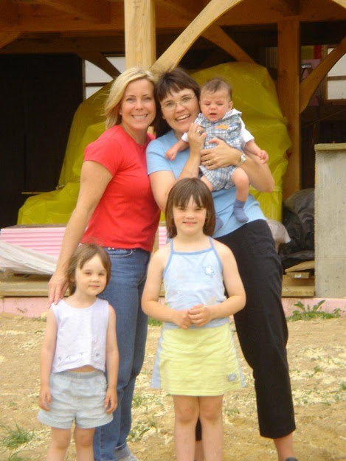
Your Presenters

Slide 3
Tell us about you and where you are on the implementation timeline.

Slide 4
Universal Screening for Social, Emotional, Behavioral Risk
This workshop will provide illustrations for three methods of engaging in universal screening for social, emotional, and behavioral risk and well-being in school settings.
We will present school-based illustrations of timelines and options for practice. We will demonstrate how to integrate screening into multi-tier systems of support for academic and behavioral needs of children and youth K-12.
Learn the science behind the methods, explore and discuss challenges to implementation, and hear our successes and lessons learned from schools in VT, Colorado, North Carolina, Texas, Louisiana, and California.

Slide 5
Speaking of screeners...
www.kahoot.it or use your kahoot app.
Kahoot Pin# 118108

Slide 6
Learning Targets
I can describe the purpose of a screener in 140 characters or less.
I can identify the characteristics of a quality screening system.
I can identify one take away from this session today and at least one potential next step.

Slide 7
Why do we need a systematic screener for SEL?

Slide 8
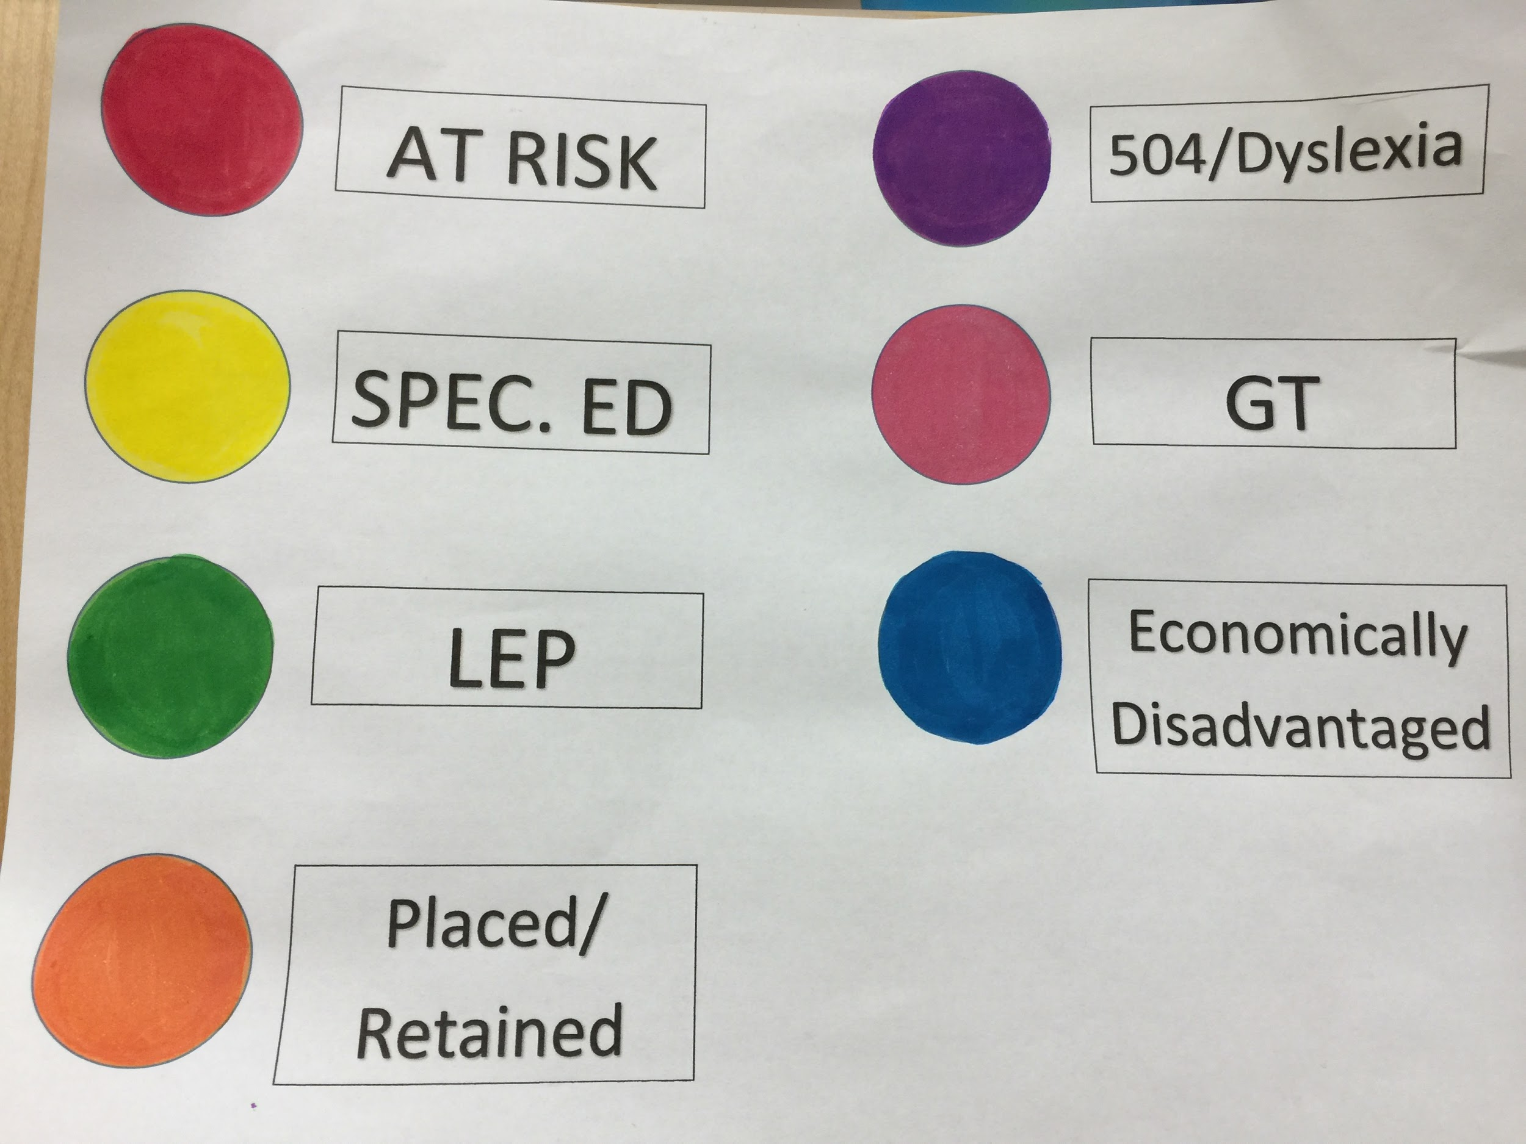
Reactive Approaches
In our current model, students who need services ONLY get them when parents and/or teachers notice a problem.
Idiosyncratic, externalizing behavior problem-focused method of either unknown or poor validity.

Slide 9
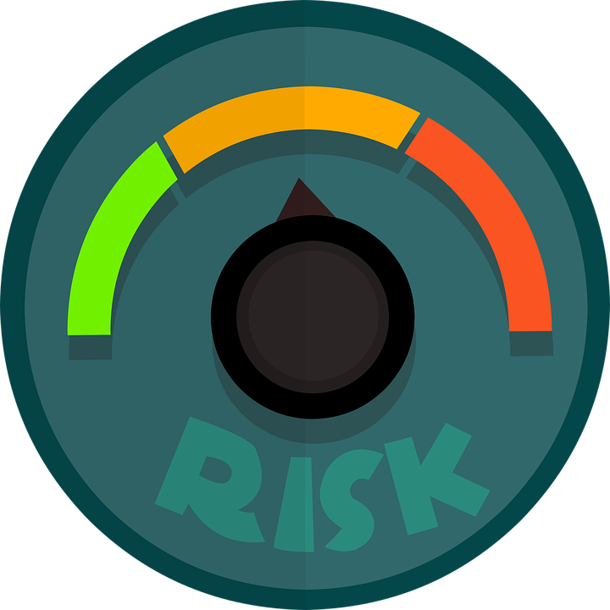
We are all working hard, are we focused on the wrong things?
Head Start staff under-identified children with behavioral or emotional problems as a group and, those children with the highest risk for poor academic readiness were MOST likely to be unidentified and untreated (Fantuzzo, Bulotsky, McDermott, Mosca, & Lutz, 2003).

Slide 10
We can spend our time on prevention or intervention
¼ of pediatric visits are related to behavior problems
Teachers leave the field at an alarming rate and cite discipline as a number one reason.
Students who progress from risk to EBD
Are 2 to 4 grade levels behind in academics
have a 46% drop out rate
Have 3.2 times the expulsion rate
Experience MORE - fatal accidents, substance abuse, divorce, unemployment, psychiatric illness, and early death
Experience MORE - punitive contacts with teachers, peer rejection, problem family interactions

Slide 11
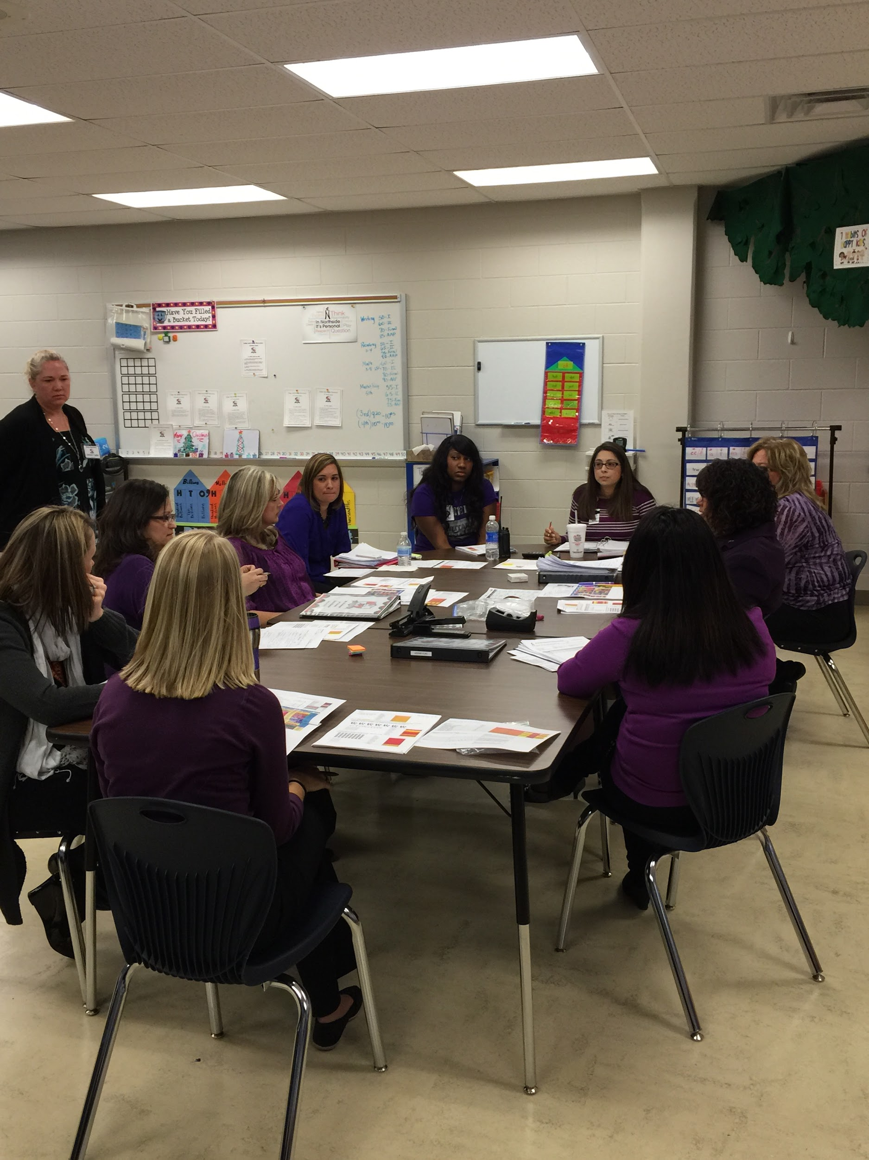
The use of screening data is well established as a valid and reliable method for determining students with elevated levels of risk (Kamphaus & Distephano, 2007; Romer & McIntosh, 2005; Elliott & Gresham, 2008).

Slide 12
A study of 3600 students indicates...
The most common problem behaviors for children and adolescents were:
careless errors
distraction
spelling
excessive movement
rushes and hurries through assignments
misunderstands directions
worries about mistakes
short attention span
lacks concentration
math
How does this relate to the context of school that Susan described earlier?

Slide 13
Are the common problems of children and adolescents different?
Most common specific for CHILDREN
is generally distracted,
does not follow directions,
has a reading deficit,
talks without permission,
has a handwriting deficit,
and demonstrates overall worry.
Most common problem behaviors of ADOLESCENTS
demonstrates self doubt,
worries about what others think,
worries about personal perfection,
requires repeated directions,
demonstrates overall worry, and acts silly or immature anner.
Harrison, Vannest, Davis & Reynolds (2012). Common Behavior Problems in Children, Journal of Emotional and Behavioral Disorders.
WHAT Do you notice about the difference between children and adolescents?

Slide 14
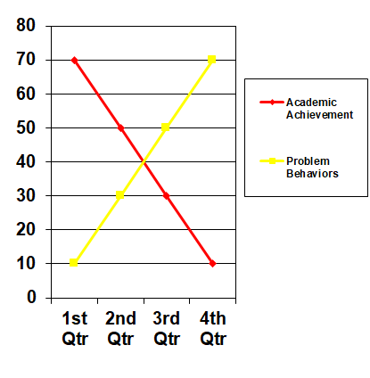
If 20% of our student population is struggling with social emotional, behavioral issues – academics will be affected.
We know a reciprocal relationship exists between achievement and behavior.
Academic performance has consistently been shown to be inversely related to problem behavior that begins early in a child’s development (Brier, 1995; McEvoy & Welker, 2000).

Slide 15
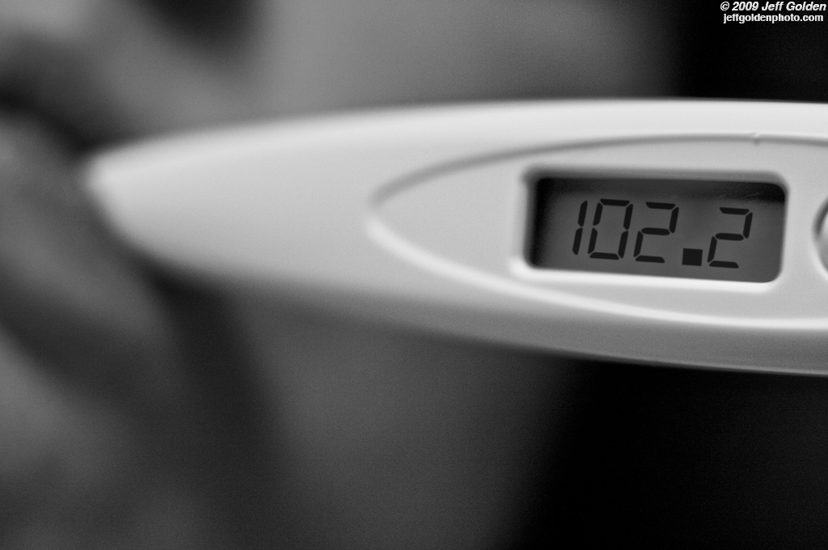
Purpose of Screening
Early identification of risk for emotional and behavioral challenges.
Provision of prevention and early intervention services.
Reduction of development of chronic problems.
Decrease in disproportionate identification of disability.

Slide 16
Learning target #1: I can describe the purpose of a screener in 140 characters or less.
Individually or in a group create a 140 character or less description.
tweet me: @KJVannest

Slide 17
Resource Allocation
If we are NOT screening, we have an inefficient reactive rather than proactive approach.
The community costs for treatment of chronic conditions, juvenile justice, adult incarceration, restorative justice, loss to family and work force contributions far exceeds the cost of screening and early intervention.
An average year of incarceration is $ 25,000 the cost for screening a student is closer to a dollar.
Schools screen for other types of problems including vision, hearing, speech, academic problems associated with specific learning disabilities, and developmental delay but not for behavior and emotional risk.

Slide 18
What is a screener?

Slide 19
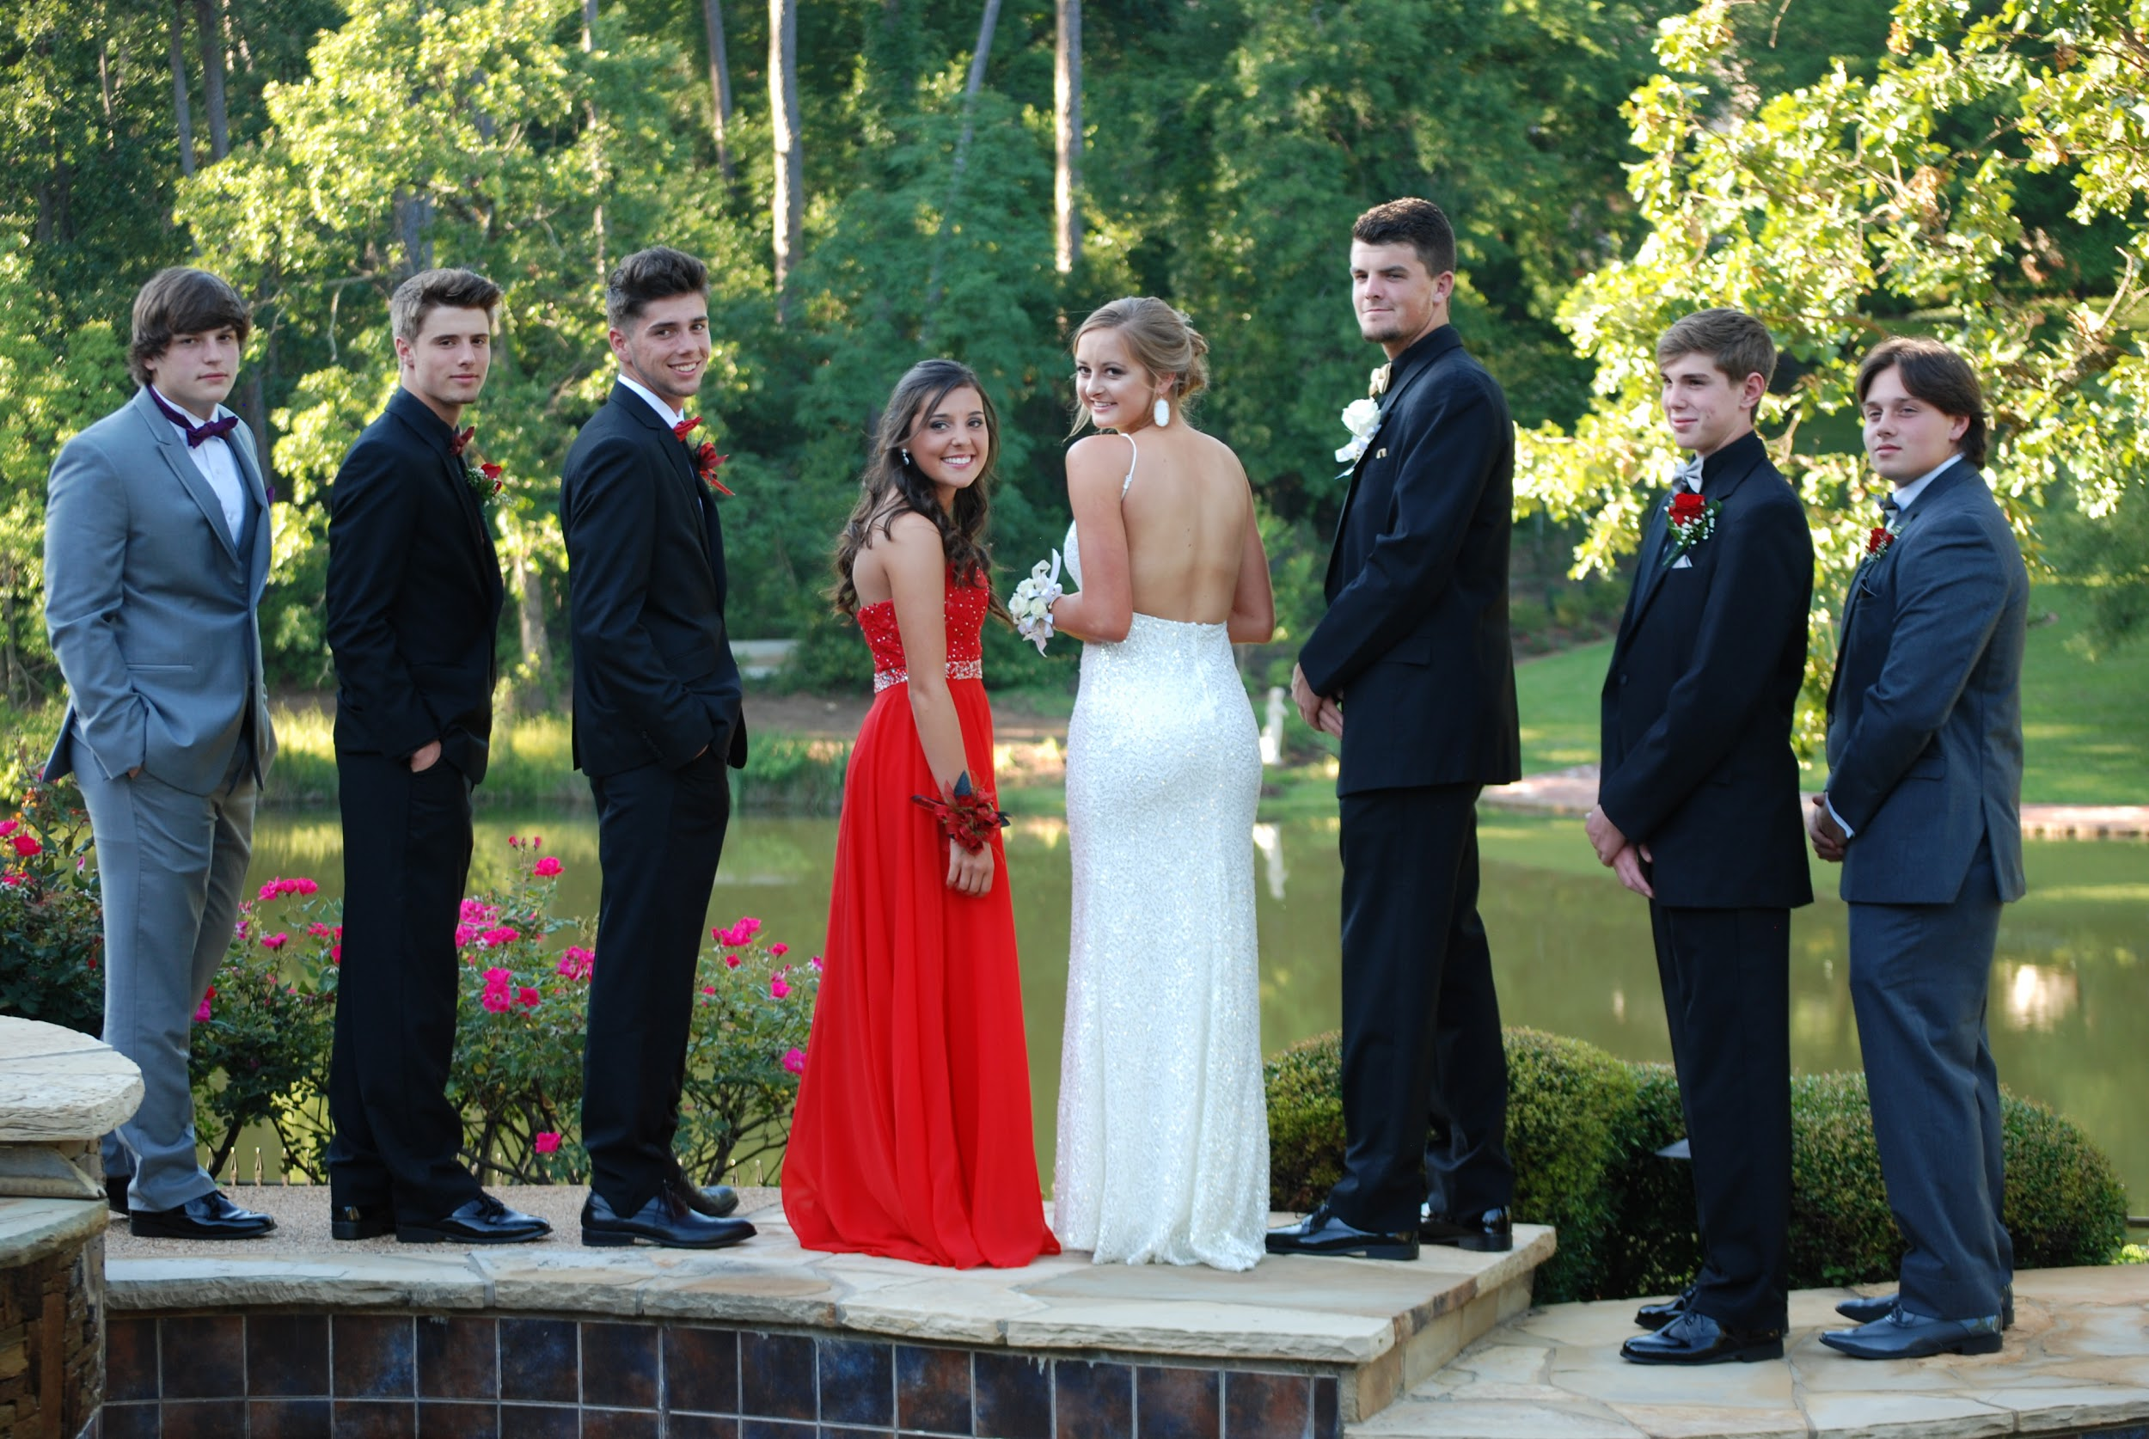
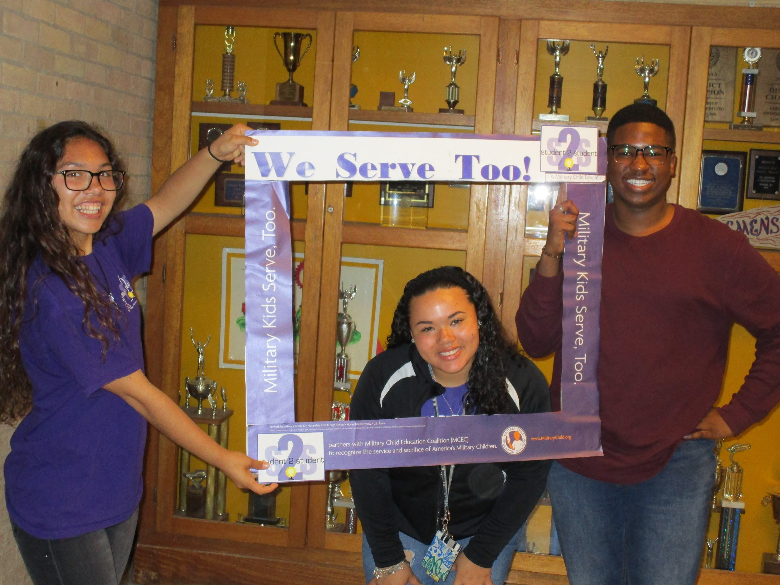
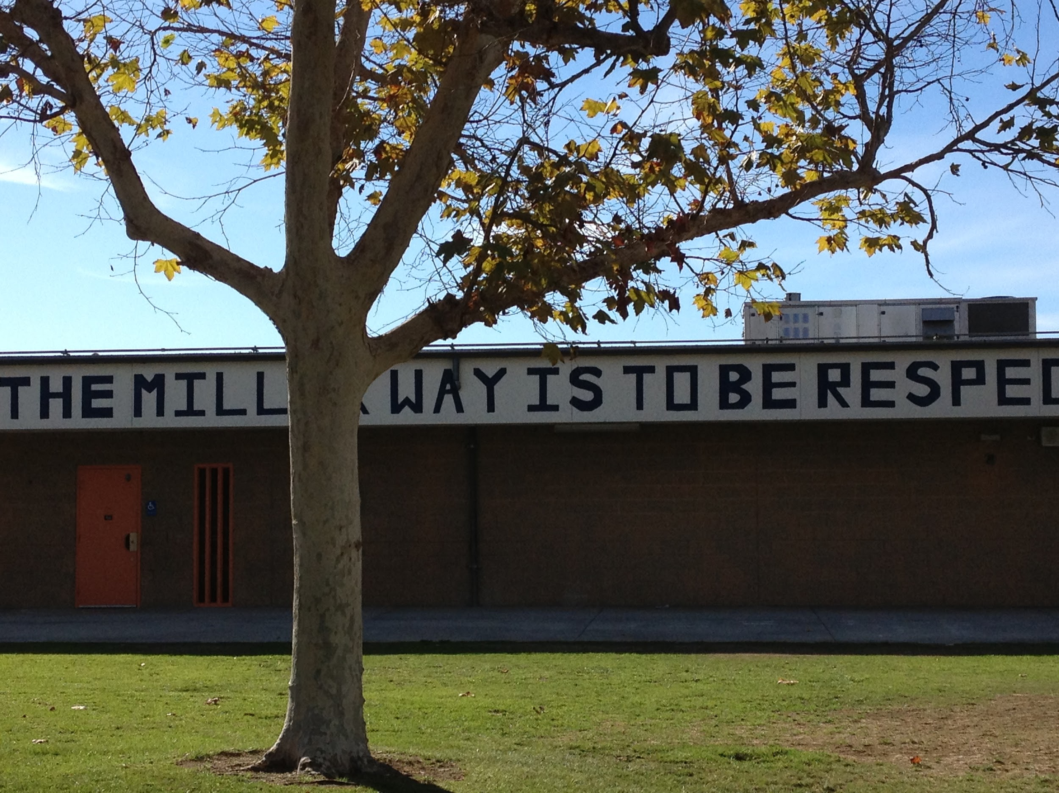
A universal assessment for elevated levels of risk in the population
NOTE: we are all at risk, we have a different levels of risk for different types of physical, social, mental, financial challenges and these things change across time.

Slide 20
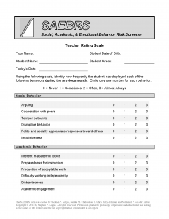
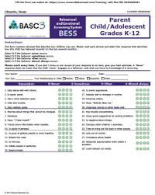
Screening Tools & Resources
Ci3T.org
PBIS.org

Slide 21
Characteristics of a Screener
needs of the school or district
needs of the student
national norms
local norms
age, grade, gender level norms
externalizing and internalizing problems
academic problems
reliability
validity

Slide 22
Learning target #2: I can identify the characteristics of a quality screening system.
Turn and talk to your partner and identify as many as you can without looking at your notes.

Slide 23
How to Screen

Slide 24
Overall Process - How to screen
Engage relevant stakeholders
parents, teachers, students,
explicit or implicit permission
conduct screening
score screeners
return scores & student lists to teachers for confirmation
share data with parents & caregivers
consent and awareness of program level changes at tiers one, two, three

Slide 25
Three ways to gather information
Parents or caregivers as informants
Students as informants
Teachers as informants

Slide 26
Three timelines for when to engage in screening
1x/year - summer or early fall
2x/ year - beginning and end
3x/ year - fall, winter, spring
like hearing and vision screening
pre-post review of programs
progress monitoring of student progress

Slide 27
Three models of who to serve
Identify ALL students who need targeted interventions (about 15%)
identify bubble students (selected students with elevated risk, based on capacity)
Identify students who should be considered for assessment & intensive interventions (most will be in the pipeline or already identified - but not all)
Illustrations from the field

Slide 28
What types of targeted programs are typical?
check in check out
breakfast club
mentoring
additional instruction & contingency contracts
social skills groups
peer work
self monitoring
mindfulness skills
positive activity planning

Slide 29
What types of programs are individualized?
Behavior Contracts
Strengths-based Approaches & Individual Pathways
Functional Behavioral Assessment

Slide 30
What are some ways to give agency and ownership to stakeholders?
Form strong, positive partnerships with stakeholders (e.g., classroom teachers, parents, students, school leaders, other potential outside agencies)
Clear collaborative vision of what you expect to achieve as a result of using a screening system and your plan for using the results to inform decision making.
Involve others in the planning, logistics of implementation (diverse perspectives are important!)
Communicate outcomes often and celebrate what’s going well!

Slide 31
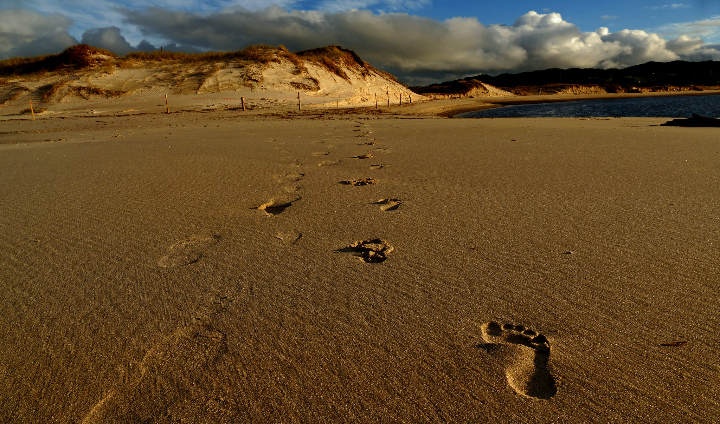
Take-aways and Potential Next Steps

Slide 32
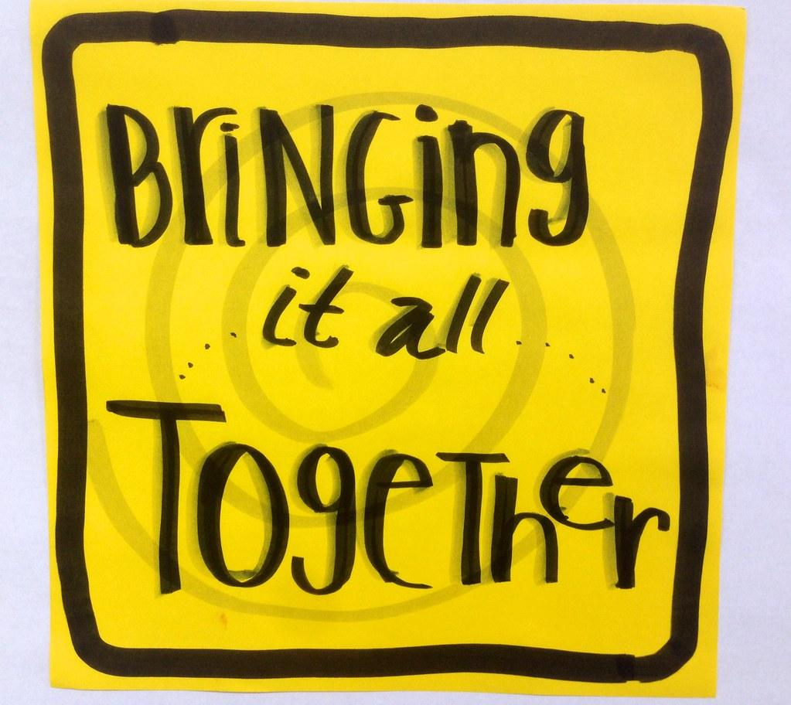
Wrap up
www.kahoot.it
Kahoot! app
with Game PIN:
200905

Slide 33
Thank You
Kimberly Vannest
kimberly.vannest@uvm.edu
Susan Bruhl
susan.bruhl@mausd.org

