Slide 1


Enhancing your PBIS Implementation through an Interconnected Systems Framework
Midwest PBIS Network
& Center on PBIS

Slide 2
During our time together we will explore how an Interconnected Systems Framework (ISF) is really your current PBIS framework with enhanced features to ensure mental health integration. You will leave with an understanding of which features will be enhanced and what an ISF looks like at both the school and district levels.
Intended audience: School/district personnel who have basic knowledge and experience with PBIS implementation.

Slide 3
Introductions and How You Got “Here”
District/School Participants:
Community MH Partner Participants:

Slide 4
Objectives
Be able to describe an Interconnected Systems Framework
Increase your knowledge of what enhanced features look like

Slide 5
A Few Notes
Language is important; you need to decide what works best in your state/district/community.
Acronyms – there are many, so we will work hard to make sure we are clear. (Please ask if we forget to clarify!)
DOTS – “Depends on the Situation” – context is important, so we will dialogue with you so we can work together to clarify

Slide 6
Context and history

Slide 7
CONTEXT
A national study completed in the journal Pediatrics (11/2016) found a 37% increase in the number of teens suffering from a major depressive episode from 2005 to 2014, but those receiving mental health counseling or treatment did not change significantly (Mojtabai, Ramin; Olfson, Mark; Han, Beth; 2016).
A 2015 report from the Child Mind Institute states that of the 74.5 million children in the United States, it is estimated that just over 17 million have or have had a psychiatric disorder. The report goes on to state that according to interviews done by professionals with a group of youth ages 13-18, “49.5% of American youth will have had a diagnosable mental illness at some point before they are 18...” and that, “22.2% of American youth will have a diagnosable mental illness with ‘serious impairment’ at some point before they are 18.”
Notes:
Review statistics of current prevalence?
Illicit what people are seeing in their schools.

Slide 8
CONTEXT
One in 5 youth have a MH “condition”
At least 50%, perhaps 80%, of those get no treatment
School is “defacto” MH provider
Juvenile Justice system is next level of system default
Suicide is 2nd leading cause of death among young adults
Factors that impact mental health occur ‘round the clock’
It is challenging for educators to address the factors beyond school
It is challenging for community providers to address the factors in school
Notes:
1. Abram, K., Teplin, L., Charles D., Longworth, S., McClelland, G., & Dulcan, M (2004). Posttraumatic stress disorder and trauma in youth in juvenile detention. Archives of General Psychiatry 61 (4): 403-410
2. Merikangas, K.R., He, J.P., Burstein, M., Swanson, S.A., Avenevoli, S., Cui, L., Benjet, C., Georgiades,K., & Swendsen, J. (2010). Lifetime prevalence of mental disorders in U.S. adolescents: results from the National Comorbidity Survey Replication—Adolescent Supplement (NCS-A). J Am Academy Child
Adolescent Psychiatry 49(10):980-9.

Slide 9
Context
33% increase in teens reporting symptoms of depression
46% of children in the US have experienced at least one Adverse Childhood Experience (ACE)
US has highest rate of opioid use in the world
The CDC reports “electronic aggression” as an emerging public health problem
  Any type of harassment or bullying that occurs through email, a chat room, instant messaging, a website or text messaging
Notes:
60 minutes – Milwaukee on trauma (Oprah)
Data from CDC and WHO

Slide 10
Big Picture Challenges:
Low intensity, low fidelity interventions for behavior/emotional needs
Habitual use of restrictive settings (and poor outcomes) for youth with disabilities
High rate of undiagnosed MH problems (stigma, lack of knowledge, etc.)
Changing the routines of ineffective practices (systems) that are “familiar” to systems
  “Referrals to a MH person” viewed as an intervention

Slide 11
Perceived Barriers
Funding
HIPPA/FERPA
”Working beyond your scope”
“ So you are here to take my job”
Implicit Bias and Stigma

Slide 12
Complication:
Initiative Overload
Popularity breeds fragmentation ?
Potential for drift? Potential for confusion?
  Systems change is complex
  Multiple Definitions
  Multiple Interpretations
  Range of experiences
    especially in low fidelity settings
  Trauma Informed
  Mental Health
  Restorative Practices
  Social Emotional Learning

Slide 13
Alignment of Initiatives Related to PBIS is Guided by the Six MTSS Features
McIntosh, K.& Goodman, S. (2016). Integrated Multi-Tiered Systems of Support: Blending RTI and PBIS. New York: Guilford Press.
Academic RTI
Schoolwide PBIS
Focus on teaming
Scientifically based
interventions
Instruction as prevention
Tiered continuum of supports with increasing intensity based on need
Regular screening for early intervention
Use of a problem-solving model and data-based decision rules
Emphasis on improving quality of implementation
Embedded into school improvement plan
Specific social behavior assessments and interventions
Use of free materials that are adapted to fit the school’s context
Use of indirect assessment of behavior
Continuous assessment of social behavior with existing data sources
Focus on schoolwide teaming
Described in IDEA as schoolwide prevention and individual intervention approach
Specific academic assessments and interventions
Use of published curricula selected by school or district
Use of direct assessment of skills
Periodic assessment through benchmarking periods
Focus on grade-level teaming
Described in IDEA as special education eligibility determination approach
Team based leadership and coordination
Evaluation of implementation fidelity
Three-Tiered Continuum of evidence-based practices
Continuous data-based progress monitoring and decision-making
Comprehensive universal screening
On-going professional development including coaching with local content expertise
Core Features of MTSS

Slide 14
Literature on why a MTSS should be used to install practices:
MTSS is essential to accurate, durable, and scalable implementation (Chafouleas, 2016)
MTSS represents a service delivery framework grounded in the public health model of prevention and consists of providing a continuum of evidence-based practices and making data-driven decisions (Cook, 2015)
MTSS provides a framework to more efficiently support students identified with needs (Splett, 2018)
Notes:
Chafouleas, S.M., Johnson, A.H., Overstreet, S., & Santos, N.M. (2016). Toward a blueprint for trauma-informed service delivery in schools. School Mental Health, 8(1), 144-162.
Cook, C.R., Frye, M., Slemrod, T., Lyon, A.R., Renshaw, T.L, & Zhang, Y. (2015). An integrated approach to universal prevention: Independent and combined effects of PBIS and SEL on youths’ mental health. School Psychology Quarterly, 30(2), 166.
Splett, J. W., Trainor, K., Raborn, A., Halliday-Boykins, C., Dongo, M., Garzona, M., & Weist, M. D. (2018). Comparison of universal mental health screening to students already receiving intervention in a multitiered system of support. Behavioral Disorders, Special Issue, 43(3), 344-356.

Slide 15
Why Use a MTSS/PBIS Framework
To integrate trauma informed approaches and SEL competencies?
Emphasizes whole system response/prevention
Provides instructional framework for teaching S/E competencies Focus on use of data to evaluate impact
Sustainability
Cook, C. R., Frye, M., Slemrod, T., Lyon, A. R., Renshaw, T. L., & Zhang, Y. (2015).
An integrated approach to universal prevention: Independent and combined effects of PBIS
and SEL on youths’ mental health. School Psychology Quarterly, 30(2), 166.
Chafouleas, S. M., Johnson, A. H., Overstreet, S., & Santos, N. M. (2016). Toward a blueprint
for trauma-informed service delivery in schools. School Mental Health, 8(1), 144-162.
Maynard, B. R., Farina, A., Dell, N. A., & Kelly, M. S. (2019).
Effects of trauma‐informed approaches in schools: A systematic review.
Campbell Systematic Reviews, 15(1-2).
Notes:
Cook, C. R., Frye, M., Slemrod, T., Lyon, A. R., Renshaw, T. L., & Zhang, Y. (2015). An integrated approach to universal prevention: Independent and combined effects of PBIS and SEL on youths’ mental health. School Psychology Quarterly, 30(2), 166.
Chafouleas, S. M., Johnson, A. H., Overstreet, S., & Santos, N. M. (2016). Toward a blueprint for trauma-informed service delivery in schools. School Mental Health, 8(1), 144-162.
Maynard, B. R., Farina, A., Dell, N. A., & Kelly, M. S. (2019). Effects of trauma‐informed approaches in schools: A systematic review. Campbell Systematic Reviews, 15(1-2).

Slide 16

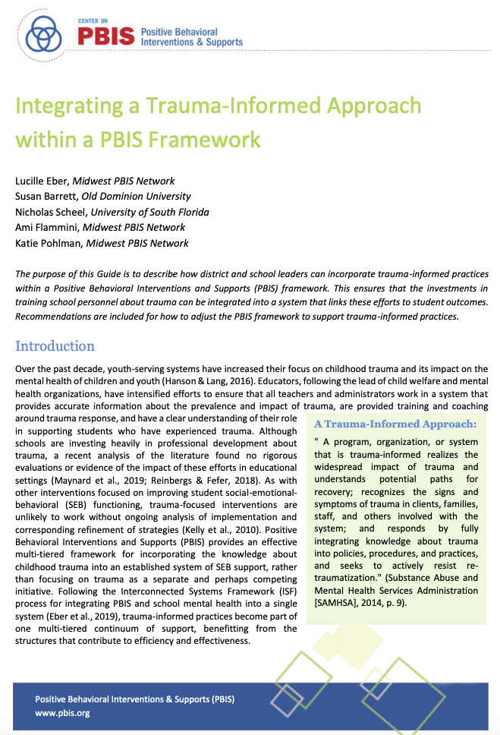


Slide 17
The PBIS Framework
a prevention-focused continuum of supports,
data-based decision-making,
regular universal screening and progress monitoring,
systems change through ongoing professional development and coaching,
team-based leadership, and
evidence-based practices for improving behavior and learning
Horner, Sugai, & Anderson, 2010

Slide 18
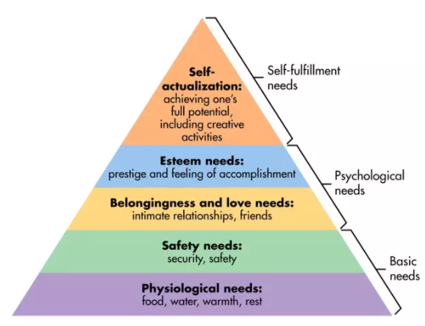
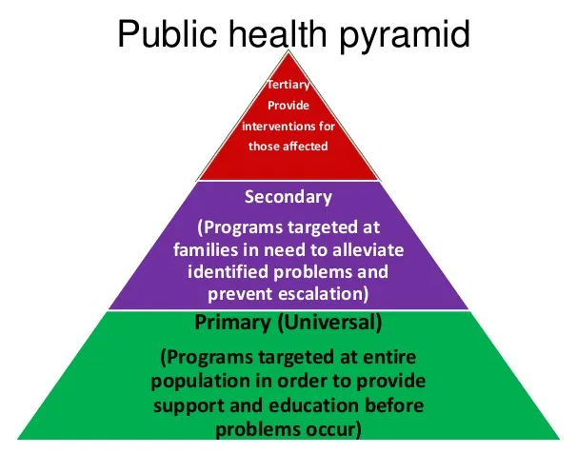
Maslow’s Hierarchy of Needs

Slide 19
Tertiary Prevention:
Specialized
Individualized
Systems for Students with High-Risk Behavior
A Multi-Tiered System of Support in Schools
~5%
Secondary Prevention:
Specialized Group
Systems for Students with At-Risk Behavior
~15%
Primary Prevention:
School-/Classroom-
Wide Systems for
All Students,
Staff, & Settings
~80% of Students

Slide 20
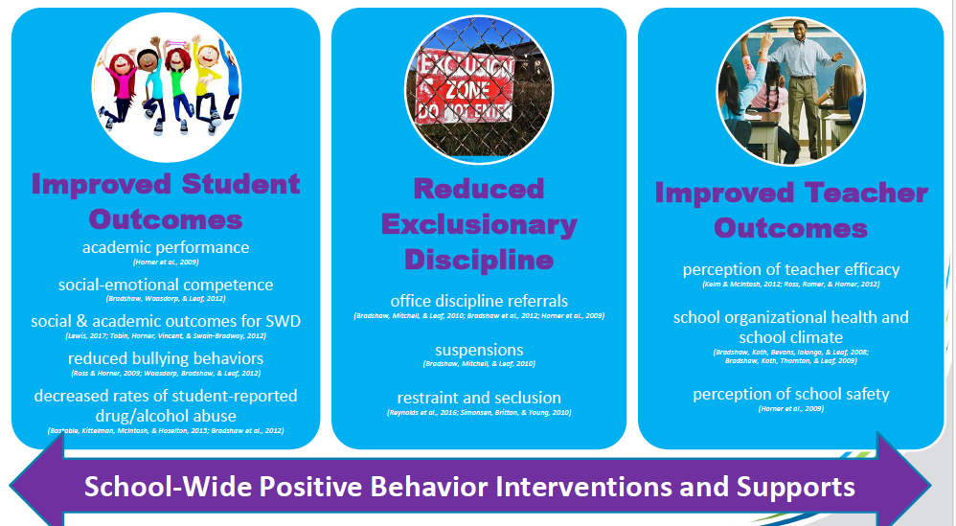
Outcomes associated with Implementation
(George, H. 2018)

Slide 21
Experimental Research on SWPBIS
SWPBIS Experimentally Related to:
Reduction in problem behavior
Increased academic performance
Increased attendance
Improved perception of safety
Reduction in bullying behaviors
Improved organizational efficiency
Reduction in staff turnover
Increased perception of teacher efficacy
Improved Social Emotional competence
Bradshaw, C.P., Koth, C.W., Thornton, L.A., & Leaf, P.J. (2009). Altering school climate through school-wide Positive Behavioral Interventions and Supports: Findings from a group-randomized effectiveness trial. Prevention Science, 10(2), 100-115
Bradshaw, C.P., Koth, C.W., Bevans, K.B., Ialongo, N., & Leaf, P.J. (2008). The impact of school-wide Positive Behavioral Interventions and Supports (PBIS) on the organizational health of elementary schools. School Psychology Quarterly, 23(4), 462-473.
Bradshaw, C. P., Mitchell, M. M., & Leaf, P. J. (2010). Examining the effects of School-Wide Positive Behavioral Interventions and Supports on student outcomes: Results from a randomized controlled effectiveness trial in elementary schools. Journal of Positive Behavior Interventions, 12, 133-148.
Bradshaw, C.P., Reinke, W. M., Brown, L. D., Bevans, K.B., & Leaf, P.J. (2008). Implementation of school-wide Positive Behavioral Interventions and Supports (PBIS) in elementary schools: Observations from a randomized trial. Education & Treatment of Children, 31, 1-26.
Bradshaw, C., Waasdorp, T., Leaf. P., (2012 )Effects of School-wide positive behavioral interventions and supports on child behavior problems and adjustment. Pediatrics, 130(5) 1136-1145.
Horner, R., Sugai, G., Smolkowski, K., Eber, L., Nakasato, J., Todd, A., & Esperanza, J., (2009). A randomized, wait-list controlled effectiveness trial assessing school-wide positive behavior support in elementary schools. Journal of Positive Behavior Interventions, 11, 133-145.
Horner, R. H., Sugai, G., & Anderson, C. M. (2010). Examining the evidence base for school-wide positive behavior support. Focus on Exceptionality, 42(8), 1-14.
Ross, S. W., Endrulat, N. R., & Horner, R. H. (2012). Adult outcomes of school-wide positive behavior support.
Journal of Positive Behavioral Interventions. 14(2) 118-128.
Waasdorp, T., Bradshaw, C., & Leaf , P., (2012) The Impact of Schoolwide Positive Behavioral Interventions and
Supports on Bullying and Peer Rejection: A Randomized Controlled Effectiveness Trial. Archive of
Pediatric Adolescent Medicine. 2012;166(2):149-156
Bradshaw, C. P., Pas, E. T., Goldweber, A., Rosenberg, M., & Leaf, P. (2012). Integrating schoolwide Positive Behavioral Interventions and
Supports with tier 2 coaching to student support teams: The PBISplus Model. Advances in School Mental Health Promotion, 5(3),
177-193. doi:10.1080/1754730x.2012.707429
Freeman, J., Simonsen, B., McCoach D.B., Sugai, G., Lombardi, A., & Horner, ( submitted) Implementation Effects of School-wide
Positive Behavior Interventions and Supports on Academic, Attendance, and Behavior Outcomes in High Schools.

Slide 22
Trauma Informed Strategies
Discipline and Safety
School Mental Health
Wraparound
Check & Connect
Function-based Support
Classroom Management
One Social Emotional Academic Framework
Restorative Practices
Wellness & Self-Regulation
Cognitive Behavior Counseling
Check In Check Out
Social Emotional Learning
Dropout Prevention
Bullying Prevention
School Climate
Literacy Instruction
Cultural Responsiveness
Social Skills Programming
Notes:
Safety, emotional safety

Slide 23
PBIS Provides a Solid Foundation…. but More is Needed…
Many schools implementing PBIS struggle to implement effective interventions at Tiers 2 and 3
Many systems struggle to align multiple initiatives
Youth with “internalizing” issues may go undetected
PBIS systems (although showing success in social climate and discipline) often do not address broader community data and mental health prevention.

Slide 24
What is an Interconnected systems framework (ISF)?

Slide 25
Alignment of PBIS & Mental Health
Moving from a co-located school mental health model to an integrated model where all S/E/B interventions are designed, delivered, and monitored through one set of teams at each school.
Community and school-based clinicians actively participate with other school staff in multi-tiered teams, reviewing data and ensuring effective system structures at the school level.
DSFI 3.4 Alignment to Initiatives: Clear description of initiative alignment (e.g., graphic organizer, organizational chart,
conceptual map) displays integrated and/or collaborative implementation of PBIS with existing initiatives having
similar goals, outcomes, systems, and practices.
Notes:
ISF Key Messages: 1) Single system of Delivery. 2) Access is Not enough. 3) Mental Health is for ALL. 4) MTSS features applied to all S/E/B learning and interventions.
DSFI 3.4 Alignment to Initiatives: Clear description of initiative alignment (e.g., graphic organizer, organizational chart,
conceptual map) displays integrated and/or collaborative implementation of PBIS with existing initiatives having
similar goals, outcomes, systems, and practices.

Slide 26
ISF History/Development:
2002-2007: Site Development with PBIS Expansion (informal and independent), Community of Practice focus on integration of PBIS & SMH)
2008: ISF White Paper: formal partnership between PBIS and SMH
2009- 2013: Monthly calls with implementation sites, national presentations (from sessions to strands)
2009-2011: Grant Submissions
June 2012-September 2013: ISF Monograph & Monograph Advisory group
2015: ISF Learning Community, SOC Webinar Series
2016: Randomized Control Trial Grant awarded
2016-2017: Targeted Work Group Webinars, knowledge development sites
2018: Continued webinars/knowledge development sites, expanded Training/TA curriculum and workbook available online
2019: Targeted Work Group (PLC) webinars

Slide 27
2019-2024
OSEP’s National PBIS Center (PBIS V - 2018- 2024)
National PBIS Center: Development of ISF Demonstration sites
  8 states represented
  15 districts
  30 schools
Volume 2 of ISF monograph: An Implementation Guide

Slide 28
The Interconnected Systems Framework (ISF)
Deliberate application of the multi-tiered PBIS Framework for all social-emotional-behavioral (SEB) interventions, (e.g. Mental Health, Social Emotional Instruction, Trauma-Informed Practices, Bully Prevention, etc.),
Aligning all SEB related initiatives through one system at the state/regional, district and school level.
Active participation of Family and Youth is a central feature of the ISF.
DSFI 3.2 Community Agency Alignment: Procedures exist to ensure that all external community agency work is
aligned to PBIS framework, evidence- based practices, and organizational goals of the district.
Notes:
ISF is defined : a) Structure and a process for education and mental health systems to interact in most effective and efficient manner; b) Guided by key stakeholders in education and mental health/community systems c) Who have authority to reallocate resources, change role and function of staff, and change policy.
DSFI 3.2 Community Agency Alignment: Procedures exist to ensure that all external community agency work is
aligned to PBIS framework, evidence- based practices, and organizational goals of the district.

Slide 29
ISF Defined
  Structure and process for education and mental health systems to interact in most effective and efficient way.
  Guided by key stakeholders in education and mental health/community systems
  Who have the authority to reallocate resources, change role and function of staff, and change policy.

Slide 30

ISF Enhances MTSS Core Features
  Effective teams that include community mental health providers
  Data-based decision making that include school data beyond ODRs and community data
  Formal processes for the selection & implementation of evidence-based practices (EBP) across tiers with team decision making
  Early access through use of comprehensive screening, which includes internalizing and externalizing needs
  Rigorous progress-monitoring for both fidelity & effectiveness of all interventions regardless of who delivers
  Ongoing coaching at both the systems & practices level for both school and community employed professionals
Notes:
Quick review
Same as PBIS RTI MTSS (labels not as important as ensuring core features needed for installing EBPs)

Slide 31
What if… ?
School Employed and Community Employed Staff use community and school data to assess the needs of young people in their school community and, together as an integrated team, select evidence based practices that match specific needs.
This means moving away from co-located model to a fully integrated system!

Slide 32

Interconnected Systems Framework
PBIS
One Integrated System of Supports
School-Based Mental Health Supports
Notes:
Often school teams and community partners still work in isolation not knowing the supports the others provide.
The Interconnected Systems Framework draws on the strengths of both systems to create one single system of delivery.

Slide 33
Interconnected Systems Framework
PBIS
School-Based Mental Health Supports
Notes:
Often school teams and community partners still work in isolation not knowing the supports the others provide.
The Interconnected Systems Framework draws on the strengths of both systems to create one single system of delivery.

Slide 34
One Integrated System of Supports
Notes:
Often school teams and community partners still work in isolation not knowing the supports the others provide.
The Interconnected Systems Framework draws on the strengths of both systems to create one single system of delivery.

Slide 35
Advantages of Implementing an ISF (What will be different)
Move from co-located to single system of delivery for all s-e-b support
Deliberate application of PBIS for all social-emotional-behavioral interventions
Aligning all related initiatives through one system at the district and school level
Active participation of Family and Youth
Moving from a co-located school mental health model to an integrated model
All social-emotional-behavioral interventions are designed, delivered, and monitored through one set of teams
Clinicians actively participate in teams, share data and are part of system problem solving
District/community leadership team and identified coaches (from both education & mental health) support efforts within the schools

Slide 36
Why an Interconnected Systems Framework?
A whole population need requires a whole population response…
We need more expertise in our schools and we need to re-position how we use our ‘experts’
We need to build capacity because…

Slide 37
1. Single System of Delivery
One set of teams
What Does it Look Like?
Invest in one set of school “behavioral health” teams organized around tiers.
Flexibility of funding to allow community employed staff to serve on teams and assist serving ALL students.
Role and function of staff are explicitly stated in MOU.
ALL Requests for Assistance managed within one set of teams.
ALL school and community employed staff take part in teaching Social/Emotional/Behavioral (SEB) necessary to navigate social situations, school, family and work environments.
Community and School MH staff serve on leadership team and make decisions as a TEAM
Symmetry of Process
  State
  County
  District
  School
A seamless system for accessing interventions
  Both school and community based supports

Slide 38
What Does it Mean to Integrate?
Change in routines and procedures?
(e.g. who needs to be available to participate in team meetings?)
Change in how interventions are selected and
monitored?
(e.g. team review of data/research vs individual clinician choice?)
Change in language we use?
(e.g. identifying specific interventions vs generic terms such as “counseling” or
“supports”?)
Changes in Roles/functions of staff?
(e.g. clinicians coordinating/overseeing some interventions that non-clinicians deliver?)

Slide 39
Example (*EARLY CHILDHOOD)
DCLT identified large percentage of behavior problems occurring in kindergarten across 11 elementary buildings
DCLT decided to train kindergarten teachers in Prevent-Teach-Reinforce (PTR)
Individual students and families were identified to received Parent Child Interactive Therapy (PCIT) from mental health clinicians
Data 1 year later indicated need for more clarity around desired outcomes
DCLT decided to provide additional coaching and technical assistance to ensure fidelity and then check outcomes again
Notes:
RDQ Brief – pg 8

Slide 40
2. Access is NOT Enough
Success is defined by student impact
What Does it Look Like?
The District and School team includes community providers, families, students and persons who have authority to make structural changes within their organizations.
Teams works collaboratively with leaders to continuously assess student needs, implement programs, and eliminate, adjust, replace programs at all tiers to increase their impact on students.
Ineffective programs or practices are eliminated.
Interventions are evidenced based and matched to presenting problem using data
Interventions are progress monitored for fidelity and impact
Teams are explicit about intervention description (what, when, how long)
Skills taught in Tier 2/3 interventions are assessed across all tiers by ALL Staff across ALL settings linked to Tier 1 Social Emotional Behavioral (SEB) instruction
-
-

Slide 41
Trauma-Informed
Tier 2 Group
Daily Progress Report (DPR) Sample
NAME:______________________ DATE:__________________
Teachers please indicate YES (2), SO-SO (1), or NO (0) regarding the student’s achievement
in relation to the following sets of expectations/behaviors.
EXPECTATIONS | 1 st block | 2 nd block | 3 rd block | 4 th block
Be Safe | 2 1 0 | 2 1 0 | 2 1 0 | 2 1 0
Be Respectful | 2 1 0 | 2 1 0 | 2 1 0 | 2 1 0
Be Responsible | 2 1 0 | 2 1 0 | 2 1 0 | 2 1 0
Total Points
Teacher Initials
Self-Check
Use calming strategy
Use your words
Use safe hands
Ask for help
Connect with safe person
Adapted from Grant Middle School STAR CLUB
Adapted from Responding to Problem Behavior in Schools: The Behavior Education Program by Crone, Horner, and Hawken
Notes:
41

Slide 42
Example
Community clinician joined Tier II team
Helped recognize that a group of students identified for support had likely experienced trauma.
Community clinician and school clinician collaborated to select an evidence-based trauma informed group.
Trauma informed group was added to school’s continuum of interventions
Community and school clinician co-facilitated the group
Students receiving intervention had improved academic and behavioral data as well as self-reporting feeling more connected to school.
Notes:
RDQ brief example – pg 5

Slide 43
3. Mental Health is FOR ALL
From Few to ALL
What Does it Look Like?
  ALL staff are trained and supported through PD plan/coaching process.
  MOU defines roles of all staff working in schools.
  Clinicians role includes support of systems and support of ALL adults as well as delivery of some interventions with students.
  Teachers provide social emotional behavior (SEB) instruction along with academic content.
  District Leadership prioritizes Staff Wellness
Integrate SEB competencies into PBIS Matrix
Vast majority of students will benefit from safe, predictable, positive nurturing environment, mentoring and academic support.
Universal Screening to identify ALL possible MH/Behavioral needs (externalizers and internalizers)
Need MH experts to triage and identify students with positive screen to determine next steps. However, not all interventions require clinical expertise
-

Slide 44
Teaching Matrix |  | INCORPORATE Coping Strategies for Managing Stress
 |  | All Settings | Halls | Playgrounds | Lunch | Library/ Computer Lab | Assembly | Bus
 | Respectful | Be on task. Give your best effort. Be prepared. | Walk. | Have a plan. |  | Study, read, compute. | Sit in one spot. | Watch for your stop.
 | Achieving & Organized | Be kind. Hands/feet to self. Help/share with others. | Use normal voice volume. Walk to right. | Share equipment. Include others. |  | Whisper. Return books. | Listen/watch. Use appropriate applause. | Use a quiet voice. Stay in your seat.
 | Responsible | Recycle. Clean up after self. | Pick up litter. Maintain physical space. | Use equipment properly. Put litter in garbage can. |  | Push in chairs. Treat books carefully. | Pick up. Treat chairs carefully. | Wipe your feet.
1. Expectations
2. NATURAL CONTEXT (Locations)
Invite those sitting alone to join in
Have a lunch plan and choose quiet or social lunch area
Invite friends to join me
Expectations
3. Rules or Specific Behaviors
Use my breathing technique
Listen to my signals
Notes:
Replacement behaviors- very important that we anchor in our teaching matrix as this is our core social emotional curriculum- the common language and script we use to teach, acknowledge, pre-correct – all staff are using same approach for teaching and supporting throughout the year across the school day. We get what we pay attention to and this helps provide the common language/consistent approach- our values for our school
When dealing with stress and anxiety became major priority in school, it would be a matter of teaching skills to students so they developed strategies and skills and incorporated into their social curriculum – the matrix is the delivery mechanism to get skills out ALL !!!

Slide 45
MS Pyramid of Interventions
Tier 3: Individualized Supports -Structured Interventions for the
few students with the greatest need
Complex Functional Behavioral Assessment (FBA) and Behavior Support
3 R (Respectful, Relevant, Realistic) Plan(s)
Individualized Family and Youth-Driven Planning and Support
Community Supports (WRAP, DCYF, Mental Health, and Child and Family Services)
Enhanced Academic Seminar
A Few Students
>5%
Tier 2: Behavioral Interventions & Supports- Supports for some students who struggle with meeting the expectations
Simple Behavior Support Plans
Simple Functional Behavioral Assessments (FBA)
Targeted Cognitive Behavioral Therapy (CBT)
Coping CAT
Academic Seminar
Check In/Check Out,
Mentoring
Some Students
>15%
Individualization and Intensity of
Interventions Increases
Tier 1 Interventions & Supports- Structured Behavior Interventions for all students
PRIDE Expectation Matrix,
PRIDE Classroom Expectations & PRIDE Classroom Lessons
Guidance Services,
Homeroom Guidance
Continuum of Discipline Responses
Student/Parent Conferences,
Before & After School Program
Project Success (Substance Use)
ALL Students
100%
Notes:
Adapted form Rundlett MS in NH

Slide 46
4. Use MTSS Framework
Need implementation science to guide the work
What Does it Look Like?
The system models a Public Health Approach
All initiatives/programs are aligned and installed with core features of MTSS
The continuum of evidence-based interventions are linked across tiers, with dosage and specificity of interventions increasing from lowest to highest tiers.
Data-based decision making is used at all tiers with type of data matched to specifics and complexity of interventions.
A formal process for selecting and implementing evidence-based practices is established.
Comprehensive screening allows for early access to interventions.
Progress monitoring for both fidelity and effectiveness;
Skills taught in Tier 2/3 interventions are supported by ALL Staff across ALL settings linked to Tier 1 SEB instruction
Ongoing professional development and coaching to ensure fluency and to guide refinement of implementation.
-
Notes:
during group and individual sessions

Slide 47
Multiple Evidence-Based Interventions of Varying Intensity
Install foundational interventions School-wide
Ensuring identification, monitoring, and selection process are in place
Identifying additional interventions that might be needed such as:
  Trauma Informed Interventions
  Coping Cat
  Check and Connect

Slide 48
MTSS: A Continuum of Evidence-Based Practices (EBP’s) linked across Tiers
A formal process for selecting and implementing evidence-based practices
  Invest in small number of EBP
  Matched to need, culture and context
  Install systems first
Team process (not individual clinicians)
Interventions linked across Tiers with dosage and specificity of interventions increasing from lower to higher tiers

Slide 49
Example: Data-Based Decision Process
a) Identification for Trauma Informed Group (IN):
  Student identified in highly elevated range for Internalizing Risk on screener
  Student has 2 or more events leading to suspension
  Student has not responded to a lower level Tier 2 intervention
b) Progress-monitoring (ON):
  DPR data is collected daily & reviewed every other week. Data is collected and reviewed for 6 weeks for and monitored for upward trend.
c) Exiting/transitioning (OUT):
  Student received a total of 80% of DPR points averaged per day/week for 6 weeks and has had no new ODRs, suspensions, or time out of class concerns. Student may be transitioned to CICO for 4 weeks.

Slide 50
Where Do Specific
“MH” Interventions Fit?
That depends on the data of the school and community
    Examples of Expanded View of data:
    Child welfare contacts,
    Violence rates
    Incarceration rates
    Deployed families,
    Homeless families,
    Unemployment spikes
    New comers

Slide 51
“Social & Academic Instructional Groups”
(sample coping skills group)
Daily Progress Report (DPR) Sample
NAME:______________________ DATE:__________________
EXPECTATIONS | 1st block | 2nd block | 3rd block | 4th block | 5th block | 6th block | 7th block
Be Safe | 2 1 0 | 2 1 0 | 2 1 0 | 2 1 0 | 2 1 0 | 2 1 0 | 2 1 0
Be Respectful | 2 1 0 | 2 1 0 | 2 1 0 | 2 1 0 | 2 1 0 | 2 1 0 | 2 1 0
Be Responsible | 2 1 0 | 2 1 0 | 2 1 0 | 2 1 0 | 2 1 0 | 2 1 0 | 2 1 0
Total Points
Teacher Initials
Label feeling
Use deep breathing
Use calm words with peers
Let teacher know feeling temperature if above yellow
Notes:
51

Slide 52
“Tier 3 Plan with Trauma-Informed Strategy”
Daily Progress Report (DPR) Sample
NAME:______________________ DATE:__________________
Teachers please indicate YES (2), SO-SO (1), or NO (0) regarding the student’s achievement
in relation to the following sets of expectations/behaviors.
EXPECTATIONS | 1 st block | 2 nd block | 3 rd block | 4 th block
Be Safe | 2 1 0 | 2 1 0 | 2 1 0 | 2 1 0
Be Respectful | 2 1 0 | 2 1 0 | 2 1 0 | 2 1 0
Be Responsible | 2 1 0 | 2 1 0 | 2 1 0 | 2 1 0
Total Points
Teacher Initials
SOS (slow down, orient, self-check)
Use mindfulness
Distract & Self-Soothe
Let ‘M Go
Make A Link
Make Meaning
Adapted from Grant Middle School STAR CLUB
Adapted from Responding to Problem Behavior in Schools: The Behavior Education Program by Crone, Horner, and Hawken
Notes:
52

Slide 53
Daily Progress Report (DPR) Sample
NAME:______________________ DATE:__________________
Teachers please indicate YES (2), SO-SO (1), or NO (0) regarding the student’s achievement
in relation to the following sets of expectations/behaviors.
Individualized Student Card (FBA/BIP)
EXPECTATIONS | 1 st block | 2 nd block | 3 rd block | 4 th block
Be Safe | 2 1 0 | 2 1 0 | 2 1 0 | 2 1 0
Be Respectful | 2 1 0 | 2 1 0 | 2 1 0 | 2 1 0
Be Responsible | 2 1 0 | 2 1 0 | 2 1 0 | 2 1 0
Total Points
Teacher Initials
Use your words
Use deep breathing
Keep arm’s distance
Use #2 voice level when upset
Ask for breaks
Self-monitor with DPR
Adapted from Grant Middle School STAR CLUB
Adapted from Responding to Problem Behavior in Schools: The Behavior Education Program by Crone, Horner, and Hawken
Notes:
53

Slide 54
STAGES of IMPLEMENTATION
(Fixsen, Blasé, 2005)
Exploration/
Adoption
Should we do this?
Installation
Put resources and systems in place
Initial Implementation
Initial pilots and assess results
Full Implementation
The practice was successful, adopt system- wide
Innovation
Adopt variations of the practice and assess results
Sustainability
Make this the way of doing business
Notes:
Were are you? What stage are you in?

Slide 55
Symmetry of Process
State Leadership Team
Regional Leadership Team
District/Community Leadership Team
District/Community Leadership Team
Regional Leadership Team
District/Community Leadership Team
School Leadership Team
School Leadership Team
School Leadership Team
School Leadership Team

Slide 56
State/Regional/District Level

Slide 57
Stakeholder Engagement
Funding and Alignment
Policy
Workforce Capacity
Executive Functions
LEADERSHIP TEAMING
Implementation Functions
Training
Coaching
Evaluation
Local Implementation Demonstrations
Notes:
Version 2017-3-8
Swaps Stakeholder Support and Funding

Slide 59
Installing ISF at State/Regional/District Leadership Level
    Establish (or enhance) Leadership Team
    Assess Current Status of PBIS and SMH
      System structures
      Current initiatives
      Staff Utilization
      Existing school/community data
    Establish Mission
    Establish Team Routines and Procedures for MTSS
      Comprehensive Universal screening process
      Single Request for Assistance process
      Routines for selecting EBPs
      Process for Fidelity
      Process for measuring outcomes
    Implementation Plan (ongoing)
      Evaluation Plan
      PD/Coaching
      Select Demo Sites
      Establish MOUs as Needed
Notes:
Agenda; is data system is working; how do we select EBP’s

Slide 60
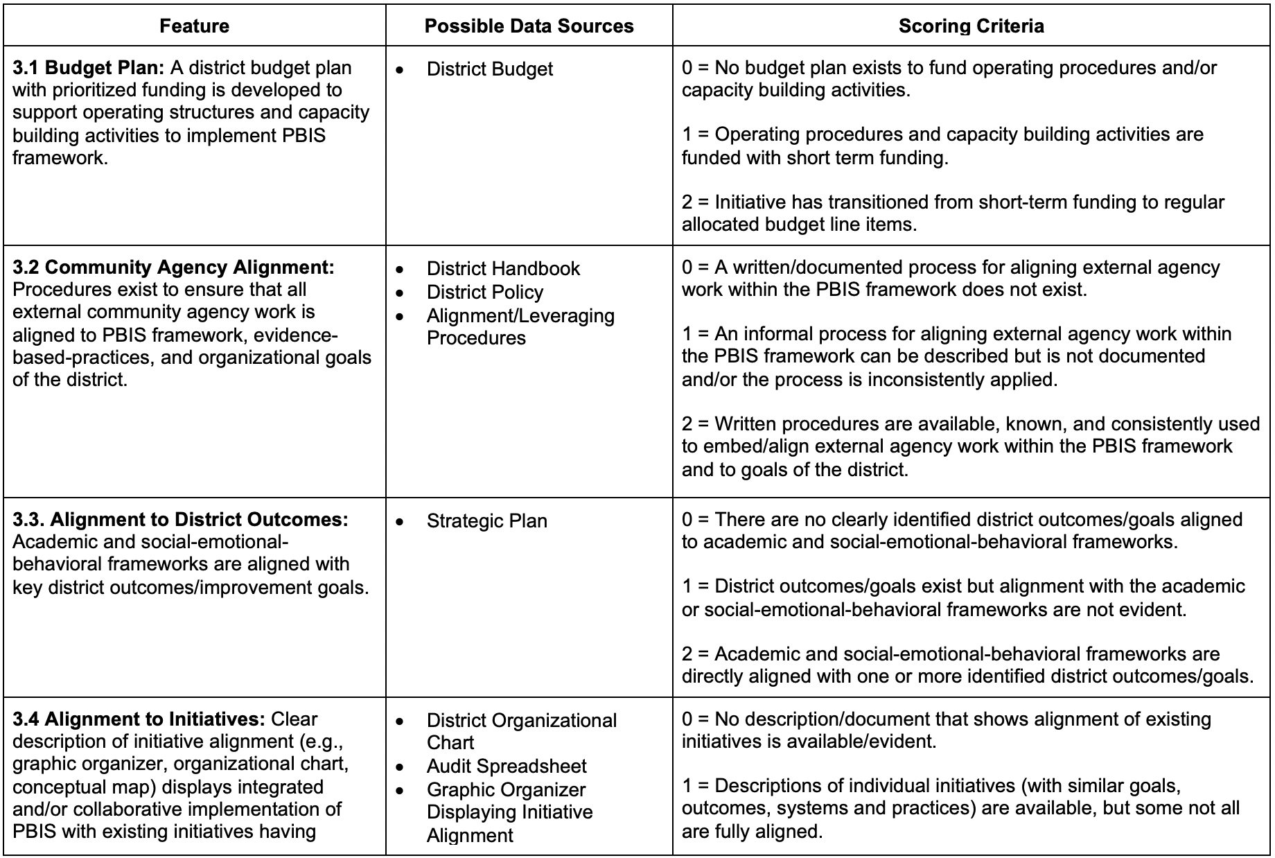
2a. Use District Systems Fidelity Inventory Emphasize SEB (think cross system, rather than only district)
Notes:
DSFI: https://www.pbis.org/resource/pbis-district-systems-fidelity-inventory-dsfi-pilot-version-v0-1

Slide 61
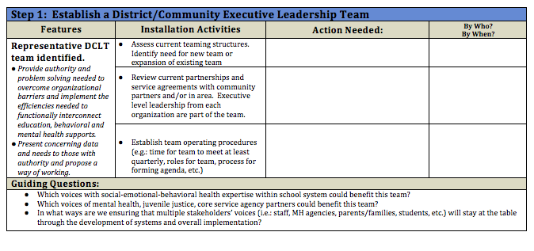
ISF DCLT Installation Guide
Purpose: This guide is intended to be used by facilitators and coaches to support District/Community Leadership Teams to install structures/systems needed to support an Interconnected System Framework (ISF). The goal is for teams to examine current system using installation activities and generate actions to move toward a more efficient and effective service delivery model.
Notes:
Link to District Installation Guide: https://drive.google.com/open?id=11bnIZ_lvj5NuviGAJmrQWdo66QgJ5Ryx

Slide 62
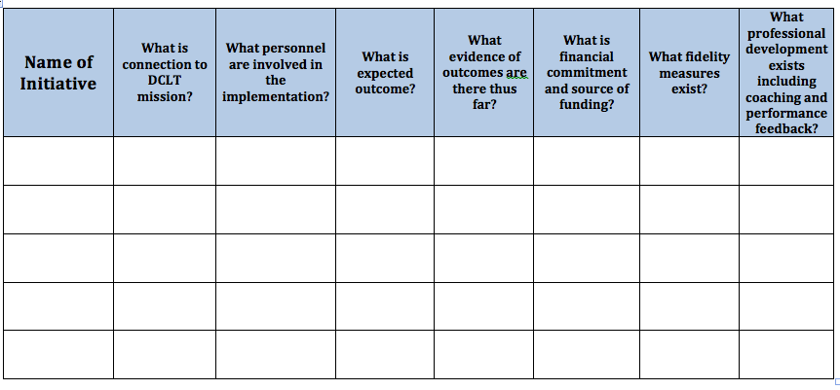
ISF Initiative Inventory
ISF V2 Ch4: State/District Level Installation Guide (in press) - Step 2b: Conduct a Review of Current Initiatives
Purpose of this tool is to (a) provide an overall picture of existing social emotional behavioral related initiatives or programs available to the larger community, (b) determine the effectiveness, relevance, and fidelity for each, (c) determine funding and resource allocation, and (d) determine areas of redundancy. This process is led by the District Community Leadership Team with representation from both education and community stakeholders.
Adapted from NIRN Initiative Inventory
Notes:
Found in District Level Installation Guide, an Appendix to Chapter 4 in Volume 2 of the ISF Monograph
Initiative Inventory: https://drive.google.com/open?id=11QrI6SJ45CGYJjnEZWYX70Qa5rgKQxM-

Slide 63
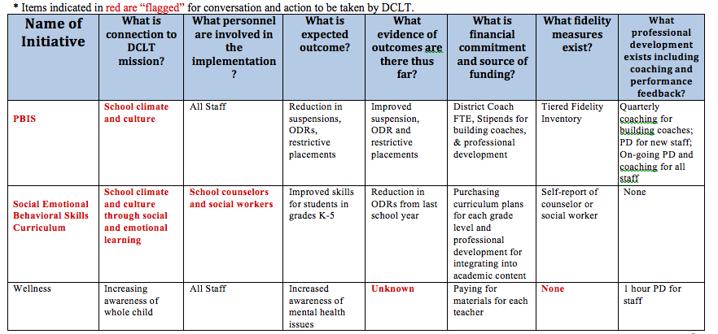
ISF Initiative Inventory
ISF V2 Ch4: State/District Level Installation Guide (in press) - Step 2b: Conduct a Review of Current Initiatives
District Example
Notes:
Initiative Inventory: https://drive.google.com/open?id=11QrI6SJ45CGYJjnEZWYX70Qa5rgKQxM-

Slide 64
Building Level Installation

Slide 65
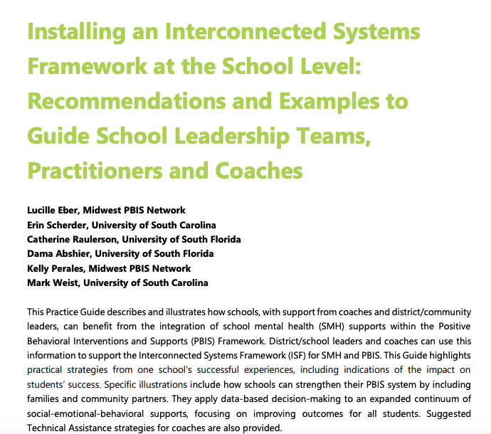
NEW!
Practice Guide –
Installing an Interconnected Systems Framework at the School Level: Recommendations and Examples to Guide School Leadership Team, Practitioners and Coaches
Notes:
https://drive.google.com/file/d/16eDEK3qSXdKTxegAnDAXeWo8WnfxCXc4/view?usp=sharing

Slide 66
Steps for Installation within Schools
All steps guided by Coaches and DCLT
Establish Single Set of Integrated Team(s)
  Identify need for merging teams with similar goals.
  Expand team membership
  Establish roles and functions of teams across tiers of support
  Roles and Functions
  Consider role changes for staff
  Establish team operating procedures and problem solving approaches (for each team)
Assess Current Status
  PBIS/SMH (Action Planning Companion Guide to TFI)
  Assess structures for identifying students who need more supports
  Conduct Intervention Inventory
  Assess data being used to identify social-emotional-behavioral needs
Notes:
Establish Single Set of Integrated Team(s)
Identify need for merging teams with similar goals.
Expand team membership
Establish roles and functions of teams across tiers of support
Roles and Functions
Consider role changes for staff
Establish team operating procedures and problem solving approaches (for each team)
Assess Current Status
PBIS/SMH (Action Planning Companion Guide to TFI)
Assess structures for identifying students who need more supports
Conduct Intervention Inventory
Assess data being used to identify social-emotional-behavioral needs

Slide 67
Steps for Installation within Schools (Cont.)
All steps guided by Coaches and DCLT
3. Enhance School level Procedures and Routines
  Develop process for implementing universal screening
  Develop request for assistance process
  Develop routines for data-based decision making
  Develop process for selecting EBPs
  Establish a process for tracking fidelity of all interventions
  Establish a process for monitoring the outcomes of all interventions
4. Develop an Integrated Action Plan
  Monitor the effectiveness of the system
  Monitor student impact
  Conduct professional development
Notes:
. Enhance School level Procedures and Routines
Develop process for implementing universal screening
Develop request for assistance process
Develop routines for data-based decision making
Develop process for selecting EBPs
Establish a process for tracking fidelity of all interventions
Establish a process for monitoring the outcomes of all interventions
4. Develop an Integrated Action Plan
Monitor the effectiveness of the system
Monitor student impact
Conduct professional development

Slide 68
Purpose of ISF Implementation Inventory
To assist school and community partners in their installation and implementation of ISF
To assess baseline and/or ongoing implementation progress of critical ISF features
To inform action planning that advances and enhances ISF implementation
To measure ISF implementation fidelity
Notes:
ISF Implementation Inventory is multi-purposed. is it was developed as a fidelity tool, but we also want to make sure it includes that action planning piece. So we specifically identified it as an implementation inventory not an implementation fidelity checklist. Fidelity was left out intentionally so that it wasn’t seen as a research tool or something that was very evaluation-heavy but more as a tool that was supportive of advancing implementation in a succinct and strategic way. So we’re really looking at it as a tool that schools who are in that installation and implementation stages of ISF can use. You can use it for a baseline and then continue using it for progress-monitoring. Really, the items on the scales are around those critical features for ISF implementation, so that’s why it is not just a fidelity check, but also training—we’re organizing training around those items and then organizing the action planning that goes with it. So its kind of a multipurpose, singular tool. And I like it, in case you can’t tell.”

Slide 69
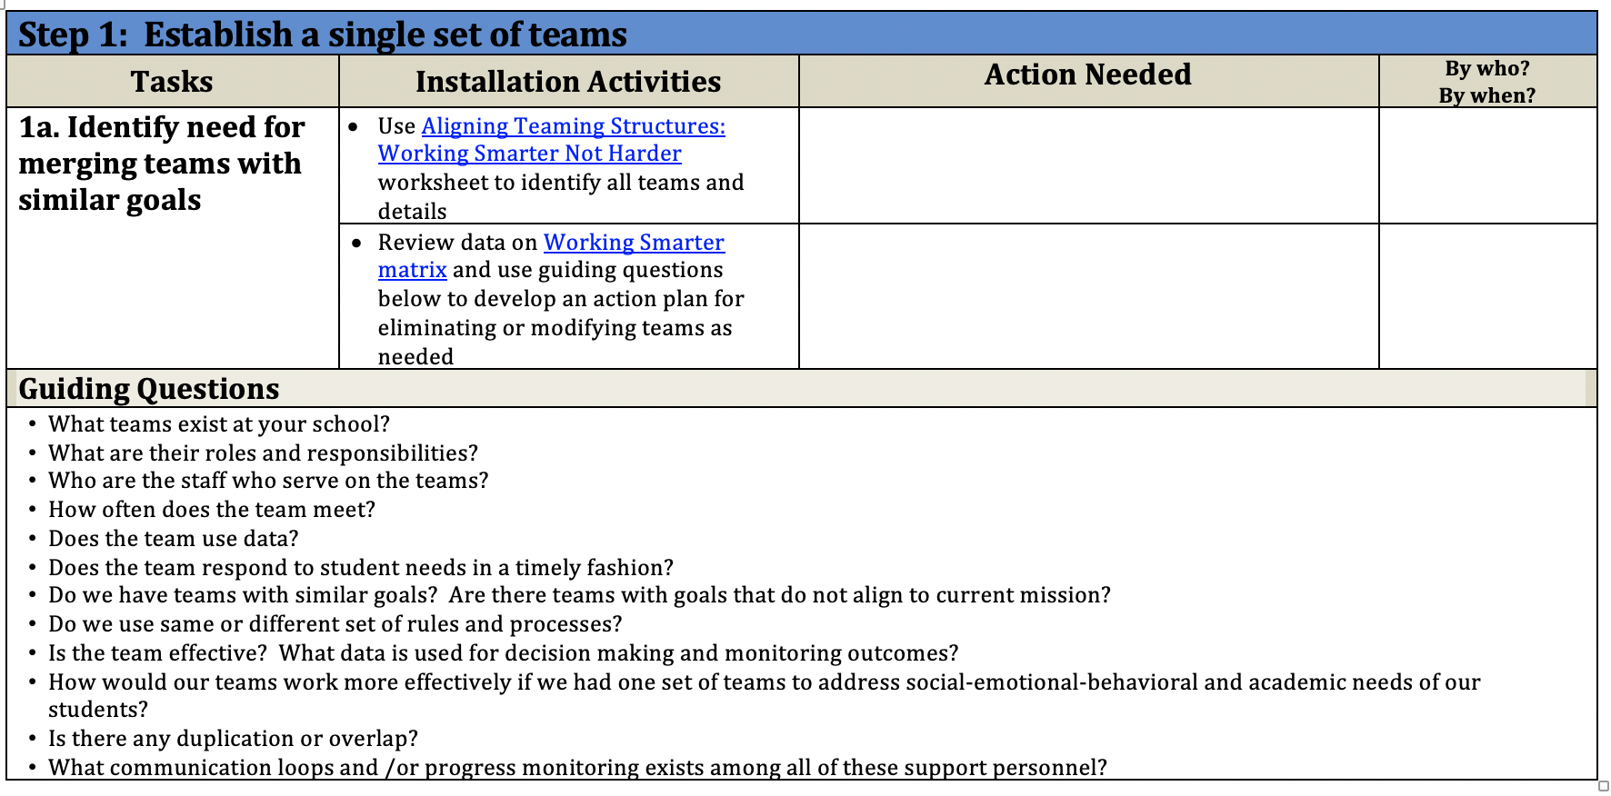
ISF School Installation Guide
ISF V2 Chapter 5 (in press)
Purpose: This guide is intended to be used by facilitators and coaches to support District/Community Leadership Teams to install structures/systems needed to support an Interconnected System Framework (ISF). The goal is for teams to examine current system using installation activities and generate actions to move toward a more efficient and effective service delivery model at the building level.
Notes:
ISF School Installation Guide: https://drive.google.com/open?id=12neA1en5rwyq_kQgdjCIYiBUHFB1sQKd&authuser=katie.pohlman@midwestpbis.org&usp=drive_fs

Slide 70
resources

Slide 71

Follow Us On Social Media
www.pbis.org
  Facebook: @CenterOnPBIS
  Twitter: @CenterOnPBIS
  Instagram: @center.on.pbis
Midwest PBIS Network

Slide 72
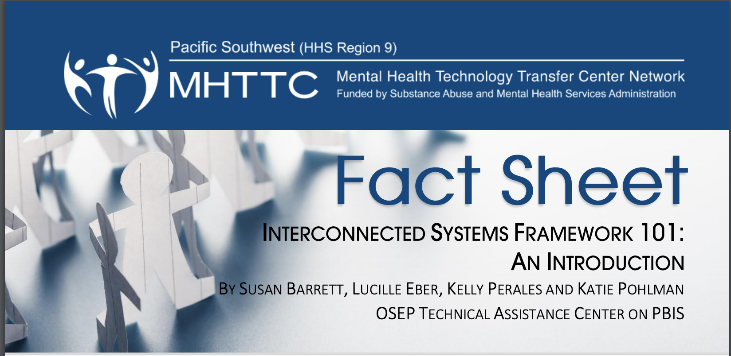
ISF Fact Sheets
101: An Introduction
201: When School Mental Health is Integrated within a MTSS: What’s Different
301: Installing an Integrated Approach
Notes:
101: https://www.pbis.org/resource/fact-sheet-interconnected-systems-framework-101-an-introduction
201: https://www.pbis.org/resource/fact-sheet-isf-201-when-school-mental-health-is-integrated-within-a-mtss-whats-different
301: https://www.pbis.org/resource/fact-sheet-isf-301-installing-an-integrated-approach

Slide 73
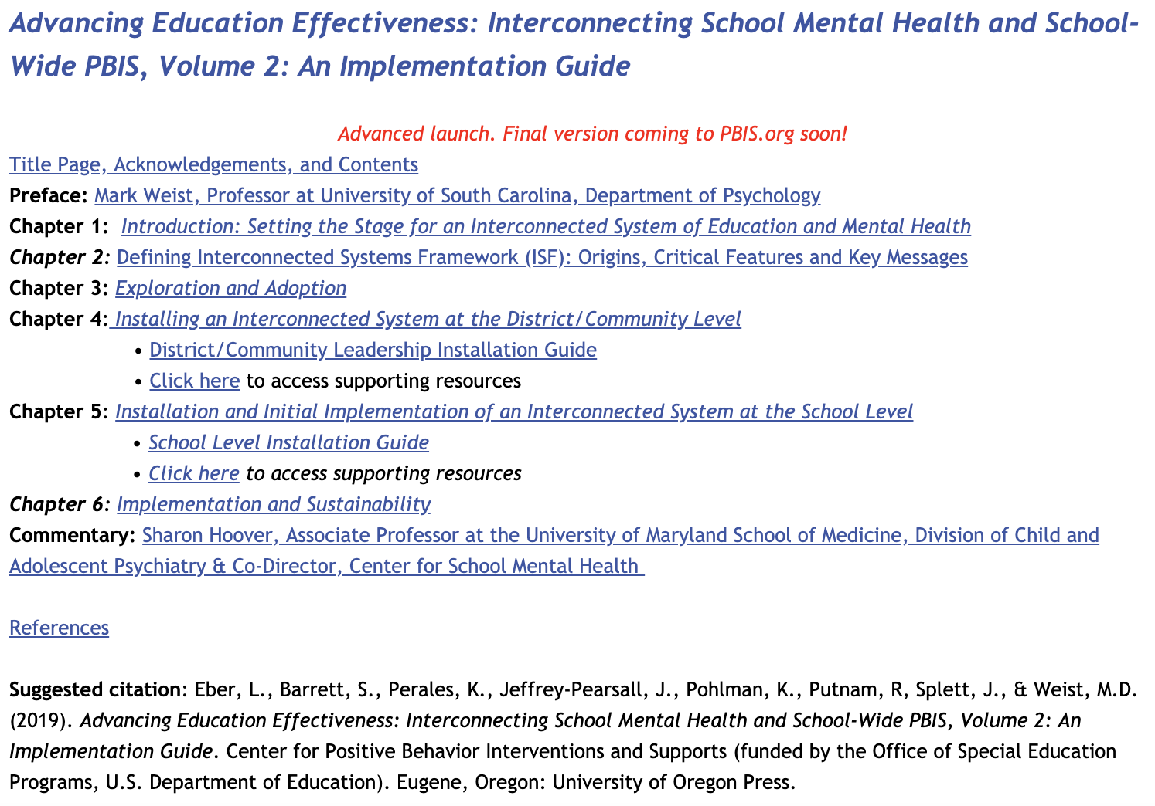
www.midwestpbis.org/interconnected-systems-framework/v2

Slide 74
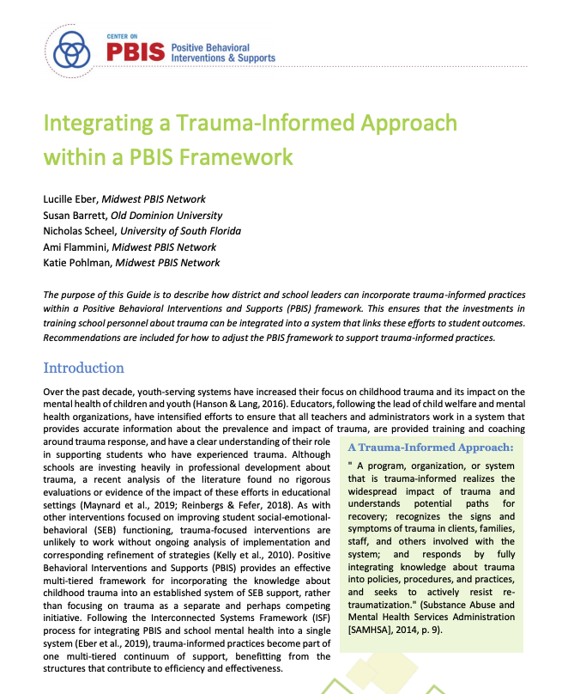
NEW!
Practice Guide –
Integrating a Trauma-informed Approach within a PBIS Framework
Notes:
https://drive.google.com/file/d/1Zz53UhEOWqUGPHA3FOwtPKdNq6SKO1hj/view?usp=sharing

Slide 75

Advancing Education Effectiveness: Interconnecting School Mental Health (ISF) and
School-Wide Positive Behavior Support (PBIS)
  Editors: Susan Barrett,
  Lucille Eber and Mark Weist
  pbis.org
  csmh.umaryland
  IDEA Partnership NASDSE

Slide 76

Monograph Volume 2
Official Publication!
Advacning Education Effectiveness: Interconnecting School Mental Health and SWPBIS, Volume 2: An Implementation Guide
Notes:
https://www.pbis.org/resource/interconnecting-school-mental-health-and-pbis-volume-2

Slide 77
Review of preliminary results of a random control trial

Slide 78




Our First RCT:
24 Participating Elementary Schools
  2 school districts in the Southeast
  Prior to study all were implementing PBIS; none were implementing SMH
Each school is randomized to one of three conditions
  PBIS Only
  PBIS + SMH (business as usual)
  Interconnected Systems Framework (ISF)
Intervention (ISF) in place for 2 academic years
All students in the building are participants unless they opt of study
Notes:
Kelly
Stratified randomizatoin taking PBIS implementation and discipline rates into account
2 years of randomized intervention implementation
Passive consent or opt out procedure for those in 4th/5th who are asked to complete survey (not just school records)
ISF = intervention condition (briefly describe)

Slide 79
Teaming (Proximal Findings)
In ISF Schools…
Greater team participation by principals, school counselors, school psychologists, and school mental health clinicians
Greater commitment to team meetings
  3.7 times more team meetings per quarter (w/more productivity!);
  25 minutes longer
ISF Teams had more Tier 1 problem-solving/discussion
  Using data to address issues discussed
Notes:
Kelly
Schools in the ISF condition reported having more meetings discussing tier 1 (3.7 more meetings per quarter) and greater attendance by school counselors compared to the PBIS-only condition. The ISF condition also had longer meeting times (~25 minutes longer) and greater attendance from principals, SMH clinicians, and school psychologists compared to both the PBIS-only and PBIS+SMH conditions.

Slide 80
Beyond Access (Proximal Findings)
In ISF Schools….
More students identified proactively and connected to Tier 2 and Tier 3 interventions Use of Universal Screener and triangulation of data
  Catching students before higher level of need arose
More Tier 2 and Tier 3 interventions were provided to students
  Continuum of interventions developed and used by integrated teams
Students of color were increasingly identified and appropriately connected to intervention for Social-Emotional-Behavioral need
When compared to other two study conditions
Notes:
Kelly
In this study, we documented proximal benefits of the ISF including more Tier 2 and Tier 3 interventions delivered, and a strong trend for more students receiving these interventions in ISF schools by the study’s second year. In addition, the ISF emphasizes genuine education-mental health system partnerships (Weist et al., 2001), with formal memoranda of agreement for community mental health clinicians to be integrated into schools and functioning as if they were school employees (Barrett et al., 2013). It is striking that by the study’s second year community clinicians were providing almost half of Tier 2 and Tier 3 interventions in ISF schools, compared to around 3% of interventions delivered in PBIS+SMH schools. This finding provides additional support for the recognition that without a structure for education-mental health system integration, as in the ISF, community clinicians will often come into schools and operate in a co-located manner, “seeing” a handful of students, but not participating on school teams, and generally not being integrated into the school delivery system (Eber et al., 2020; Splett et al., 2017; Weist et al., 2018). This is consistent with the common anecdotal observation for co-located SMH by school staff making comments like, “yes, we have a clinician, who sees students on Tuesday and Friday, but we have no idea what they are doing.”
Although this is speaking to “access”, it is the first step to improving student outcomes.

Slide 81
Outcome Findings
In ISF Schools:
Reduced in-school suspensions
Reduced office discipline referrals (ODRs)
Reduced out-of-school suspensions and ODRs for students of color
When compared to other two study conditions
Notes:
Kelly
Notably, this study also documented important distal impacts on student outcomes, with ISF schools having fewer ODRs and ISSs than PBIS only or PBIS+SMH schools. These results are encouraging given data that PBIS reduces disciplinary exclusions when compared to schools not implementing PBIS (Lee & Gage, 2020). Thus, the results of this study suggest that schools implementing ISF reduce disciplinary exclusions even more than just PBIS alone. Subsequently, adding ISF decreases school-wide discipline outcomes, increasing instructional time and creating a more positive school climate. Although more research is needed to understand the mechanisms by which ISF impacts school-wide discipline data, these results are encouraging, particularly within the context of the positive effects PBIS alone can have on disciplinary exclusions.

