Slide 1
Basic FBA to BSP
Using Functional Behavioral Assessment (FBA) to Develop Function-Based Behavior Support Plans (BSP)
Adapted from Sheldon Loman and others
Day One
Presented by Lauralee Keach and Jeremy Tretiak
Materials at:
https://www.pbisvermont.org/training-resources/functional-behavior-assessmentbehavior-support-plan-fbabsp/
Notes:
Please make sure you have copies of the materials so you and your team can familiarize yourself with them.

Slide 2
Welcome!
You will be muted during this session unless in breakout rooms.
Need help?
Type into the chat box.
You
can show or hide your video.
This session will be recorded.
If you’d like to access the recording, please email anne.dubie@uvm.edu.

Slide 3
Learning Objectives
Day One:
Consider how FBA/BSP fits within a multi-tiered system of supports
Understand the concepts of “function of behavior” and “functional behavior assessment”
Start to learn the FBA process and begin practice with selected student
Day Two:
Continue to learn the FBA process and deepen practice with selected student
Day Three:
Develop a BSP for selected student
Plan for implementing FBA/BSP within your multi-tiered system
Notes:
Amy

Slide 4
Materials https://www.pbisvermont.org/training-resources/functional-behavior-assessmentbehavior-support-plan-fbabsp/
Introduction and Practice in Functional Behavior Assessment and Behavior Support Planning (FBA/BSP)
From FBA to BSP
Planning Workbook
Notes:
Introduce workbook and share the F-BSP Protocol
Amy

Slide 5
Materials
Functional (Behavioral Assessment) Behavior Support Plan (F-BSP) Protocol
Interview tool for collecting information about problem behaviors
For staff, parents, and students
The F-BSP then leads the team to create a competing behavior pathway and behavior support plan
Notes:
See Handout
Amy

Slide 6
What’s the function of this behavior?
http://www.youtube.com/watch?v=hkKOqij_Tdw
Notes:
Amy

Slide 7
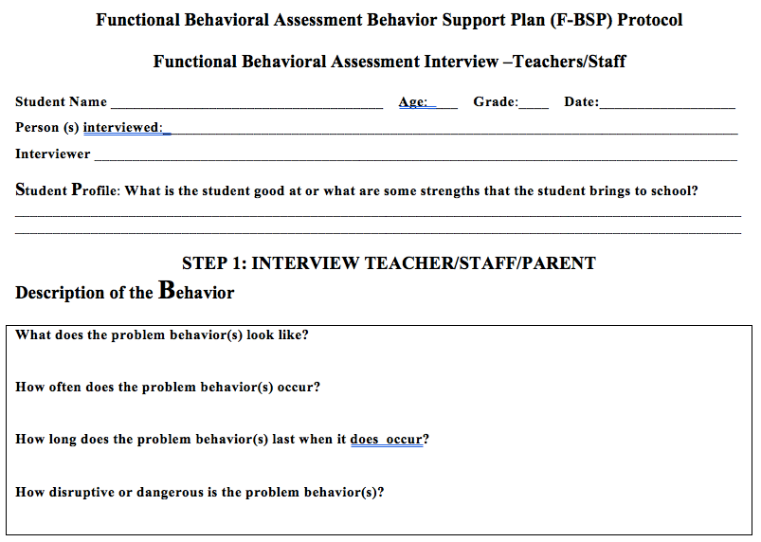
Notes:
Amy
Remind participants that it is more time efficient to use the F-BSP at a team meeting rather than having to go to each teacher individually

Slide 8
Restorative Principles
The Restorative Approach is about:
Voluntary Participation
Exploring Relationships
Meaningful Engagement
Participatory Decision-Making

Slide 9
Continuum: Mindset Shift

Slide 10
Function-Based Approach
Focuses on:
Changing environmental factors
instead of
fixing the person.
It’s about what we as adults will do differently!
Notes:
Amy

Slide 11
D.A.S.H.
Define behavior in observable and measurable terms
Ask about behavior by interviewing staff and student
specify routines where & when behavior occurs
summarize where, when, and why behavior occurs
See the behavior
observe the behavior during routines specified to verify summary from interviews
Hypothesize
a final summary of where, when, and why behaviors occur
Notes:
Amy

Slide 12
The Continuum of FBA
 | FBA Thinking | SIMPLE | COMPLEX
FOR | On the spot decision-making about effective responses (i.e. consequences) to student’s challenging behaviors | High frequency behaviors that are not dangerous or only mildly to moderately disruptive, may occur in only 1-2 settings | Dangerous behaviors or highly disruptive behaviors that persistently occur in 3 or more school settings
WHAT | A way of thinking about why a student is engaging in a challenging behavior, and how you can respond in a way that will effectively reduce the behavior | Relatively simple and efficient process to gather data to hypothesize about the function of behavior and use this information to guide behavior support planning | Time-intensive process involving gathering information from multiple sources, a written FBA and BSP, emergency planning, family-centered planning, and collaboration with outside agencies
BY WHOM | You! | Team of school-based personnel (ex: teachers, special educator, counselor, administrator, behavior support personnel) | School-based team, including professionals trained to develop and implement intensive interventions for students with severe problem behaviors (i.e. behavior specialist)
Notes:
Amy

Slide 13
How Does
the Functional Approach
Fit Into Your School’s
Multi-Tiered System of Supports?
Notes:
Amy

Slide 14
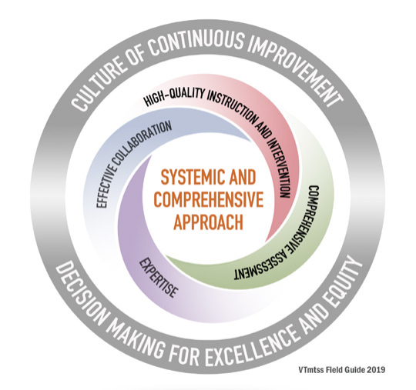
Vermont MTSS

Slide 15
Six Components of Universal
Purpose Statement
3-5 Expectations
System for Teaching Expectations
System for Acknowledging Expectations
System for Discouraging Problem Behavior
Data-based Decision Making
Think Functionally!
Universal
Notes:
Amy
Ask if ODRs have a place to ask what function of behavior may have been

Slide 16
Targeted Interventions
Implement Universal with Fidelity
Inventory Existing Targeted Practices
Develop Intervention – ie. Check-in/Check-out
Develop Data System to Support Targeted Interventions
Match interventions to the function of the behavior!
Targeted
Notes:
Amy

Slide 17
Examples: Targeted Group Interventions Based on Functions of Behavior
Access Adult Attention/Support:
Adult Mentoring Programs
Access Peer Attention/Support:
Social Skills Instruction
Peer Mentoring
Self-Monitoring with Peer Support (function: academic task escape)
Academic Skills Support:
Organization/ Homework planning support
Homework completion club
Tutoring
Power of Check-in/Check-out:
Can meet several needs/functions at once
Notes:
Amy
This further shows which types of interventions are useful based on the motivation of behavior.

Slide 18
INTENSIVE LEVEL
Establish Intensive Team
Establish SU Supports for the Intensive Level
Establish SU and interagency
Develop Capacity for Wraparound Supports
Create FBA/BSP
Intensive
Notes:
Amy
Emphasize that the only difference b/w simple & complex FBA is the depth, but both can be completed by school staff at any level of your PBIS interventions. Should be completed by school staff who have the most intimate understanding of the student, school resources, community, school culture, and the person who will be implementing the plan.

Slide 19
FBA LOGIC MODEL
Sheldon Loman, University of Oregon
“Specialist” responsible for up to 25 FBAs in school of 500
Individualized Supports
5% of
Students
Designated staff conduct proactive simple FBA/BSP to prevent intensive problem behaviors, & decrease reliance on specialist.
Secondary Group Supports
10-15% of Students
All staff estimate the function of behavior on ODR forms
School-wide Positive Behavioral Supports
80% of Students
Notes:
Amy
change language in red arrow: Ensure there is a place on the ODR to determine possible motivation of behavior

Slide 20
Break!
15-minute break

Slide 21
Who is responsible for conducting FBA/BSPs in your school?
How does someone access this FBA/BSP?
Notes:
Amy
Discuss as a group

Slide 22
Requesting an FBA
Teachers & school teams should be able to identify the system for requesting assistance
Teachers should be able to identify who to access assistance from
The targeted team/EST will determine when an FBA/BSP referral is necessary, based on data
Notes:
Amy
Focus on system again and assessment team

Slide 23
ACTIVITY 1:
Using the questions in the workbook, review/develop your school’s process for accessing an FBA/BSP
Notes:
Amy

Slide 24
D.A.S.H.
Define behavior in observable and measurable terms
Ask about behavior by interviewing staff and student
specify routines where & when behavior occurs
summarize where, when, and why behavior occurs
See the behavior
observe the behavior during routines specified to verify summary from interviews
Hypothesize
a final summary of where, when, and why behaviors occur
Notes:
Amy

Slide 25
Defining and Understanding Behavior
Notes:
Cortney

Slide 26
The ABC’s of Understanding Behavior
A = Antecedent
Find out the events that occur right before the behavior. When and Where?
B = Behavior
Define an observable problem behavior. What?
C = Consequence
Find out what happens after the behavior occurs. Why?
Notes:
Cortney

Slide 27
Always Start by Defining the Problem Behavior (ABC’s)
2
Antecedents/Triggers
When _____happens….
1
Behavior:
the student does (what)__
3
Consequence/Function
..and as a result ______
Notes:
Cortney
A = Antecedent
Find out the events that occur right before the behavior. When and Where?
B = Behavior
Find out What is the observable problem behavior
C = Consequence
Find out what happens after the behavior occurs. Why?
27

Slide 28
Defining Observable Behaviors
Definitions of behaviors need to be:
*Observable: an action that can be seen
*Measurable: can be counted or timed
*Defined so clearly that a person unfamiliar with the student could recognize the behavior without any doubts!
Notes:
Cortney

Slide 29
Examples and Non-Examples
NON-OBSERVABLE / MEASURABLE | OBSERVABLE / MEASURABLE
Disruptive behaviors | Talks when teacher is lecturing, calling out in a loud voice, singing
Off-task behaviors | Draws pictures during group work time
Angry, hostile Behaviors | Throwing objects, kicking over chairs
Inappropriate language | Calls peers names
Attention problems | Tapping/drumming on desk, looking around the classroom
Non-compliance | Saying “no” after instructions. Engaged in any other behavior than the one that is directed
Defiance | Yells “No” or “You can’t make me” when given direction
Notes:
Cortney

Slide 30
Are these observable & measurable?
Gets out of desk and hits other students
Has separation anxiety (from parent)
Spacey
Reads 120 wpm
Says she hears voices
Emotionally disturbed
Doesn’t like classmates
Notes:
Cortney

Slide 31
Defining Behavior Tips: 1) “What does the behavior look like?”
Talking out: Any verbalization made by the student that was not initiated by the teacher and/or distracts others from the assigned tasks in the classroom
2) Provide Examples and Non-Examples of the Problem Behavior
Examples of Talking Out:
Answering a question the teacher asks of a different student
Non-examples of Talking Out:
Answering a question the teacher asks of the student
Notes:
Cortney

Slide 32
ACTIVITY 2:
A) Using your workbook, provide an observable & measurable definition for each behavior
B) Using your workbook, describe your student’s behavior. Review FBSP-Protocol, Step 1: Description of Behavior
Notes:
Cortney

Slide 33
Break!
15-minute break

Slide 34
D.A.S.H.
Define behavior in observable and measurable terms
Ask about behavior by interviewing staff and student
specify routines where & when behavior occurs
summarize where, when, and why behavior occurs
See the behavior
observe the behavior during routines specified to verify summary from interviews
Hypothesize
a final summary of where, when, and why behaviors occur
Notes:
Amy

Slide 35
Asking About When, Where, and Why the Behavior Occurs
Notes:
Amy

Slide 36
Once you have defined the problem behavior… THEN: Where & When does the behavior occur?
2
Antecedents/Triggers
When _____happens….
1
Behavior:
the student does (what)__
3
Consequence/Function
..and as a result ______
Notes:
Amy
A = Antecedent
Find out the events that occur right before the behavior. When and Where?
B = Behavior
Find out What is the observable problem behavior
C = Consequence
Find out what happens after the behavior occurs. Why?
36

Slide 37
WHERE and WHEN Does the Problem Behavior Occur?
WHERE & When
Routines where the problem behavior is most likely
Examples: during math class, gym, lunch, recess
Specific events (or antecedents) within a routine that precede the problem behavior
Examples: when given double-digit addition; when given directions by a peer
Notes:
Amy

Slide 38
Identifying Antecedents
Identify the event, action, or object that occurs right before the problem behavior (When…)
A ‘signal’ to engage in a certain behavior
Makes a behavior more likely to occur
Identify the ANTECEDENT in these examples:
At the lunch table, when told to shut up by a peer, Ben hits the student
In language arts class, when asked to read aloud in class, Tracy gets up and tells jokes
During circle time, when praised, Jessie starts crying
Notes:
Amy

Slide 39
ACTIVITY 3:
Using your workbook, identify the behavior and antecedent in the scenarios.
Notes:
Amy

Slide 40
Scenario #1
During passing period in the hallway before recess, when peers tease him about his walk, A.J. calls them names and hits them.
Routine: “During __________________________”
Passing Period before Recess
Antecedent
Antecedent
Behavior
When…
When…
When…
The student...
The student...
PEERS TEASE ABOUT HIS WALK
CALLS NAMES & HITS
Notes:
Amy
40

Slide 41
Scenario #2
In math class, Bea stares off into space and does not respond to teacher directions when she is given a difficult math problem.
Routine: “During________________”
Math Class
Antecedent
Behavior
When…
When…
The student…
GIVEN A DIFFICULT MATH PROBLEM
STARES & DOES NOT RESPOND TO DIRECTIONS
Notes:
Amy
41

Slide 42
Once you have defined the behavior (the What) & know Where & When the behavior occurs…
Then: What is the CONSEQUENCE? (What happens after or as a result of the behavior?)
2
Routines/Antecedents:
When _____happens….
1
Behavior:
the student does (what)__
3
Consequence/Outcome
..and as a result ______
Notes:
Cortney
42

Slide 43
Consequence: Determine What Happens Right After the Behavior
It may help to think: “and as a result, _____________”
Example (Antecedent🡪Behavior🡪Consequence)
During recess, when peers tease him, Ben hits his peers and they leave him alone.
During reading, when asked to read aloud, Tracy tells jokes, the other students laugh, and she is sent to the office (missing the assignment)
During circle time, when praised, Jessie starts crying, the teacher stops circle time, and comforts her
Notes:
Cortney

Slide 44
ACTIVITY 4:
Using your workbook, identify the behavior, routine, antecedent, and consequence in the scenario #1 and scenario #2
Using your workbook, Identify the ABC’s of your student’s behavior. Also, review FBSP-Protocol, Step 1: Description of Antecedent and Consequences
Notes:
Cortney

Slide 45
Homework
Use the provided Structured Interview Forms to gather anecdotal information related to the ABC’s of your selected student’s target behavior.
Next session: we will look at these interview data, talk about observation strategies, and develop a hypothesis for the function of your selected student’s target behavior.
Notes:
Cortney

