Slide 1



Basic FBA to BSP
Using Functional Behavioral Assessment (FBA) to Develop Function-Based Behavior Support Plans (BSP)
Adapted from Sheldon Loman and others
Day Two

Slide 2
Welcome Back!

Slide 3
Learning Objectives
Day Two:
Review learning from last session
Continue learning the FBA process
Develop a testable hypothesis regarding the function of your selected student’s target behavior
Learn from each others’ experiences

Slide 4
Homework from Day 1
Gather more information on the student you’ve identified using the interview section of the F-BSP Protocol (ideally in a team meeting)
Practice thinking functionally!
Check in as a group with progress and process

Slide 5
Once you have identified the ABC’s
Then: You need to understand the FUNCTION or WHY the behavior occurs
2
Routines/Antecedents:
When _____happens….
1
Behavior:
the student does (what)__
3
Consequence/Outcome
…and as a result ______
Function is _________
Notes:
When understanding behavior, we want to learn what FUNCTION (or purpose) the behavior is serving for the student (what is the pay-off for the student or what maintains that behavior?)
You need to understand from the student’s perspective…
What are they getting (or trying to get) from engaging in this behavior
What is the most important thing that the student wants to gain (or avoid) by using this behavior
5

Slide 6
Functions of Behavior

Slide 7
Why Function?
There are four functions of behavior:
  Attention
  Tangibles
  Escape/Avoid
  Sensory/Automatic
Replacement behaviors must serve the same function as the target behavior
Interventions are designed to change the environment, not the function
  Behavior is conditioned by the environment

Slide 8
Functions of Behavior: Examples
To Obtain/ Get :
Peer attention
Adult attention
Desired activity
Desired object/ items
Sensory stimulation: auditory, tactile, etc.
To Avoid/ Escape:
Difficult Task
Boring Task
Easy Task
Physical demand
Non-preferred activity
Peer attention
Staff attention
Reprimands

Slide 9
Examples of Function in School
Obtain/Get Reinforcers
  I yell and others look at me.
  I fight and others listen to me.
  I wander and people talk to me.
  I hit in order to get toys from other kids.
Escape/Avoid Aversives
  I cry when work gets difficult, and the teacher tells me to take a time out.
  I throw a book during math class, and the teacher will remove me from class.
  I stand out of the way during PE, and the other game participants will avoid throwing me the ball.

Slide 10
Reminder: Examples of Targeted Group Interventions Based on Functions of Behavior
Access Adult Attention/Support:
  Adult Mentoring Programs
Access Peer Attention/Support:
  Social Skills Instruction
  Peer Mentoring
  Self-Monitoring with Peer Support (function: academic task escape)
Academic Skills Support:
  Organization/ Homework planning support
  Homework completion club
  Tutoring
Multiple Function:
  Check-in/Check-out

Slide 11
Understanding FUNCTION: WHY? What maintains the behavior?
Use information about the routine, antecedent, behavior, & consequence to determine that the function of the behavior is either to:
-Get or avoid something in the environment
Routine: During ________________
Antecedent/Trigger:
When _________
Behavior:
Student does _________
Consequence/Outcome:
and as a result… __________
Therefore, the function of the behavior is to: get/avoid ____________

Slide 12
What is the Function of Jane’s Behavior?
Jane, a fifth-grade student, was referred to the student support team by her teacher, Mrs. O’Neil.
After interviewing Mrs. O’Neil and conducting several observations of Jane in the classroom, the team determined that during transitions (from lunch, recess, dismissal) in the hallway when staff are present, she shouts profanities.
Then, adults spend time talking with her about her behavior.

Slide 13
Jane’s Summary Statement
Routine: During ________________
Transitions
Antecedent/Trigger:
When ..
Behavior:
Student..
Consequence/Outcome: and as a result...
Therefore, the function of the behavior is to:
get/avoid
Staff are present
Shouts profanities
Adults talk to her
The pattern suggests that adult attention maintains the behavior.
Attention from Adults
Notes:
13

Slide 14
ACTIVITY 5:
1. Using your workbook, identify the behavior, routine, antecedent, and consequence in scenario #1.
2. Complete this exercise for your chosen student (scenario #2).
Use this information to hypothesize the most likely FUNCTION of the behavior

Slide 15
Scenario #1
When asked to sit with to his peers in morning circle, Mike pulls the hair of the girl sitting next to him. The teacher tells Mike to go back and sit at his desk.
Routine: “During ________________”
Morning Circle
Antecedent/Trigger:
“When …
Behavior:
Student does…
Consequence/Outcome:
and as a result…
Therefore, the function of the behavior is to: get/avoid
Sent to sit at desk
Asked to sit with peers
Pulls hair of girl next to him
Sitting at morning circle

Slide 16
Break

Slide 17
After we defined the behavior (the What) & know Where, When & Why the behavior occurs…
Then we ask: Are there any events that happen outside of the routine that the make the behavior more likely to occur?
4
Setting Events
2
Antecedents
1
Behavior
3
Consequence and Function
Notes:
17

Slide 18
Setting Events
Events removed from the immediate situation, that have an impact on behavior
Things that, when an antecedent is present, increases the likelihood that the behavior will occur
Examples: lack of sleep, illness, change in routines, argument at home the night before, bullying, etc.

Slide 19
Setting Events
What about trauma?
…poverty?
…systemic racism?
…pervasive exclusionary practices (intentional or not)?

Slide 20
Antecedents vs. Setting Events
Antecedents - occur immediately before and act as a signal to engage in a behavior
Setting Events - temporarily alter the value of a consequence, changing the likelihood of engaging in a behavior
Understanding setting events help us to be proactive with our interventions

Slide 21
Common Setting Events:
Lack of sleep or food
Having a fight on the way to school
Bad grade on a test / reprimands
Forgetting to take medication
Substitute teacher / changes in routine
Non-example:
Diagnosis of autism or ADHD
NOTE:
Setting Events can be difficult to identify and are often unknown—Why?
Notes:
21
21

Slide 22
Setting Events: Example
When peers approach Victor in the hallway and say, “Hello,” he yells, “Leave me alone! Go away!” Peers say he is weird and walk away. This is most likely to happen on days that Victor has an argument with his sibling before school.
What is the antecedent?
- Peers approach and say, “hello”
What is the setting event?
- Argument with sibling before school
Notes:
22
22

Slide 23
ACTIVITY 6:
Using your workbook, identify the following in the scenarios:
* The antecedent
* The most likely FUNCTION of the problem
behavior
* The setting event

Slide 24
Scenario #1
When Jason is asked to outline a book chapter in Language Arts, he often argues, refuses to work, and uses profanity which results in being sent to the office for ‘disrespect.’ This behavior is more likely if Jason has an altercation with a peer on the bus on the way to school.
Routine:
Language Arts
Setting event
Antecedent
Behavior
Consequence
Peer altercation on bus on the way to school
Asked to outline chapter
Arguing with teacher, refusing to work, profanity
Teacher sends him
to the office
Function:
Escape Task
Notes:
24

Slide 25
D.A.S.H.
Define behavior in observable and measurable terms
Ask about behavior by interviewing staff and student
  specify routines where & when behavior occurs
  summarize where, when, and why behavior occurs
See the behavior
  observe the behavior during routines specified to verify summary from interviews
Hypothesize
  a final summary of where, when, and why behaviors occur

Slide 26
Seeing or observing the behavior to verify summary from interviews

Slide 27
ABC Observation
Observe the student in the routines identified during the interview
Confirm accuracy of summary of behavior from interview
Identify antecedents and outcomes that the team may have overlooked
Verify the hypothesis for the function of the behavior
Develop the most accurate summary statement

Slide 28
A-B-C Chart for Behavior
Student Name: _________________ Staff Name: _______________________
Date of Incident: _______________ Time of Incident: ___________________
What happened just before the behavior? | Behavior | What was student trying to get? | What did staff (incl. you) do after? | How did student respond?
 |  | __ Teacher Attention __ Peer Attention __ Escape from Demand/Task __ Sensory Input __ Preferred Object/Activity

Slide 29
Practice Scenario for A-B-C Chart
Setting Event
Antecedent
Behavior
Consequence
Typically on days when John has worked alone for 30 min…
when he’s given math worksheets & other assignments…
he doesn’t do his work and uses profanity.
The teacher gives the rest of the class a task to do then sits with John to give him support and help him do the work.
Notes:
Define these terms clearly

Slide 30
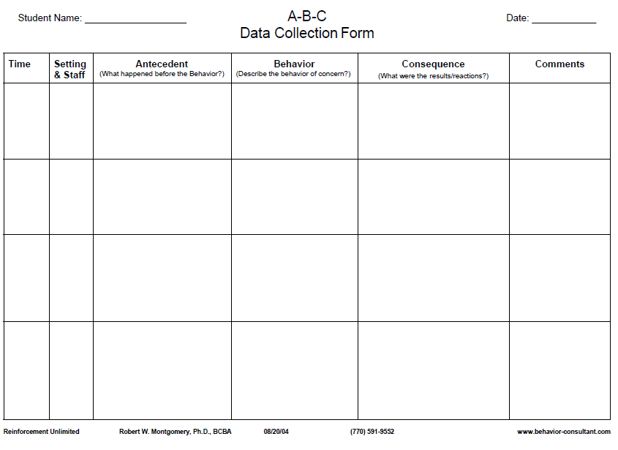
John puts his head down, then back up, then stares out window for 5 minutes before using profanity, saying he won’t do the work
Teacher hands math worksheets out and gives direction to complete silently
The teacher gives the rest of the class a task to do, then sits with John to give him support and help him do the work
The same pattern has been observed for the previous 4 math classes
John has been working alone for 30 min
Notes:
Objective, measurable and observable
Emphasize that understanding of function is a working hypothesis—data collection is ongoing

Slide 31
Practice: FBA Hypothesis
Practice Scenario for A-B-C Chart
Setting Event
Antecedent
Behavior
Consequence
Typically on days when John has worked alone for 30 min…
when given math worksheets & other assignments…
he doesn’t do his work and uses profanity.
The teacher gives the rest of the class a task to do then sits with John to give him support and help him do the work.
Function of the Behavior = (Teacher) Attention

Slide 32
Practice: FBA Hypothesis
Practice Scenario for A-B-C Chart
Setting Event
Antecedent
Behavior
Consequence
Typically on days when Sarah comes in late because she overslept…
when she’s given math worksheets & other assignments…
she doesn’t do her work and uses profanity.
Sarah is sent out of the classroom.

Slide 33
1. Sarah was given math worksheets and instructed to complete them before she could go grab a snack from the cafeteria
1. Sarah engages in side- conversation with a peer, throws an object
1. Teacher redirects Sarah to the worksheet task
The same pattern has been observed several times previously in math classes
Sarah came in to school late because she overslept
2. Sarah begins to swear at teacher and says she is not doing the worksheet
2. Sarah is sent out of the classroom (to the office) by teacher
2. Teacher redirects Sarah to the worksheet task
Notes:
Objective, measurable and observable
Emphasize that understanding of function is a working hypothesis—data collection is ongoing
ALSO CONSIDER: Adult behavior can be tracked/considered in this format too! (Probably not time for that discussion in this webinar).

Slide 34
FBA Hypothesis
Practice Scenario for A-B-C Chart
Setting Event
Antecedent
Behavior
Consequence
Typically on days when Sarah comes in late because she over-slept
when given math work sheets & other assignments…
she doesn’t do her work and uses profanity.
Sarah is sent out of the classroom.
Function of the Behavior = Avoids (work)

Slide 35
Break

Slide 36
Measuring Behavior
ABC data help us determine maintaining consequences and function
  Also need to measure relevant behavior dimensions to compare baseline data to intervention data
  Measurement is tied to the objective, operational behavior definitions
  These data will help define and inform progress towards short- and long-term goals

Slide 37
Measuring and Monitoring Goals
Evaluation Plan:
  Create goal statements based off baseline data
  Develop evaluation procedures and data sheets
    Use a data sheet with correct measurement that aligns with the language of the goal/objectives

Slide 38
Data-Based Goals
Both short- and long-term goals should:
  A. Be written in observable, measurable terms
    What specific behaviors will you increase/decrease?
  B. Include specific mastery criteria
    How will you know when the student has met the goal?

Slide 39
Examples
Task Engagement: amount of time Johnny remains at his work area with body oriented towards on the teacher and/or work materials.
Tantrums: number of times Johnny engages in screaming, kicking furniture and/or people, and throwing objects (all 3 behaviors must be present).

Slide 40
Possible Goals Language
Increase the number of minutes he remains in his work area, oriented towards the teacher or materials
Decrease the number of times he engages in tantrum behavior

Slide 41
Measurement Opportunities
Count – total number of instances
Frequency – count/time interval
Duration – total amount of time
Intensity – on a scale or through objective definitions
Likert-type scale
Perception – social validity
Fidelity of implementation
Notes:
Importance of baseline information for setting goals

Slide 42
D.A.S.H.
Define behavior in observable and measurable terms
Ask about behavior by interviewing staff and student
  specify routines where & when behavior occurs
  summarize where, when, and why behavior occurs
See the behavior
  observe the behavior during routines specified to verify summary from interviews
Hypothesize
  a final summary of where, when, and why behaviors occur

Slide 43
Hypothesizing a final summary of where, when, and why behaviors occur

Slide 44
Anatomy of an Hypothesis Statement
During ___________________________________,
(the routine or location)
When _____________________________________,
(summarize the antecedents here)
he/she will __________________________________
(summarize/define the behavior here)
in order to _____________________________.
(summarize the function here)
This behavior is more likely to occur if ___________________.
(summarize setting event here)

Slide 45
ACTIVITY 7/Homework:
Using your workbook:
Complete the behavior pathway for your student
Create your hypothesis statement
Conduct observations to verify interview data and observe environmental variables
Working with student’s team, finalize a working hypothesis statement for your student’s behavior

Slide 46
Next Session:
Competing Behavior Pathway
Routine:
Desi
Desired Behavior
Consequence/Function
Setting Event
Antecedent
Problem Behavior
Consequence/Function
Alternative Behavior

