Slide 1
INSERT School Name PBIS Update!
Insert School Mascot/Logo and Expectations
HERE

Slide 2
PBIS Data Update!
THANK YOU ALL!
(INSERT # of Staff or %) of Staff Members Completed
the Self-Assessment Survey!

Slide 3
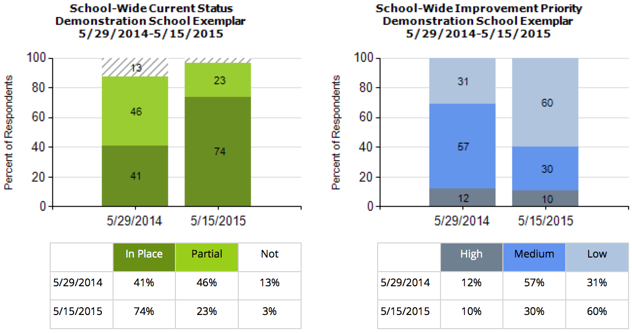
This year --% of our staff completed the SAS. --% indicated that they think school-wide system is in place compared to --% last year.
--% of staff still say this is a medium or high priority for improvement.
INSERT your SAS Graph

Slide 4
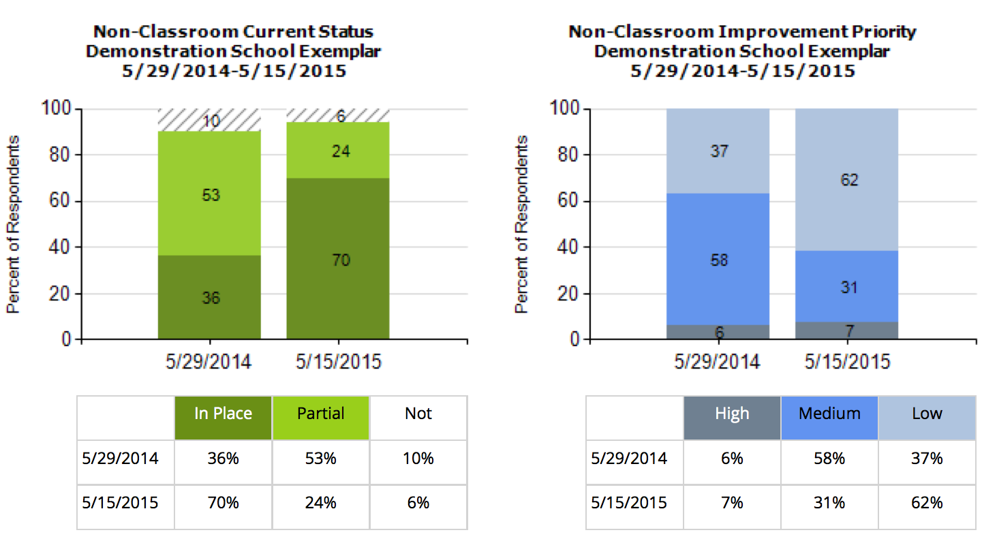
--% of staff think that non-classroom settings are in place, an increase of --% since last year. Only --% say this is still a high priority for improvement.
INSERT your SAS Graph

Slide 5
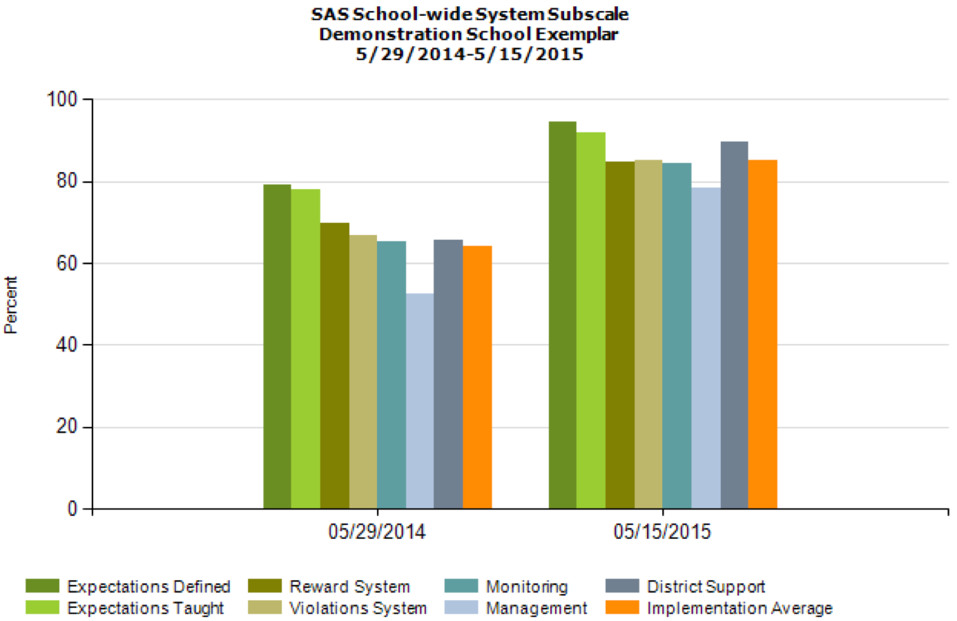
Overall, staff perception of implementation has improved across all categories!
INSERT your SAS Multi-year by Element Graph

Slide 6
This year our PBIS team took the TFI to assess PBIS fidelity of PBIS at the Universal level. This year --% of PBIS features are in Place.
Compared to Last year’s TFI, only --% of features were in place.
INSERT your TFI Universal Score Graph

Slide 7
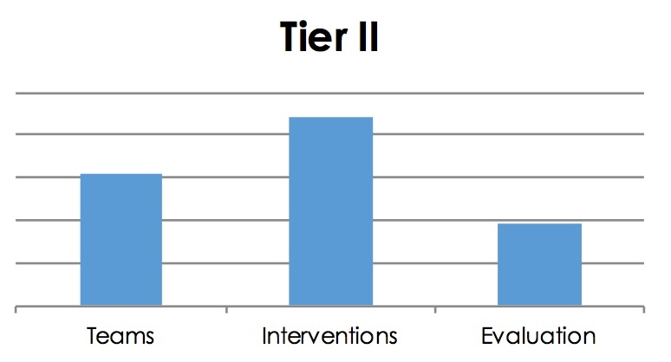
This year our PBIS team took the TFI to assess PBIS fidelity of PBIS at the Targeted level. This year --% of PBIS features are in Place.
--% of features were in place.
INSERT your TFI Targeted Score Graph

Slide 8
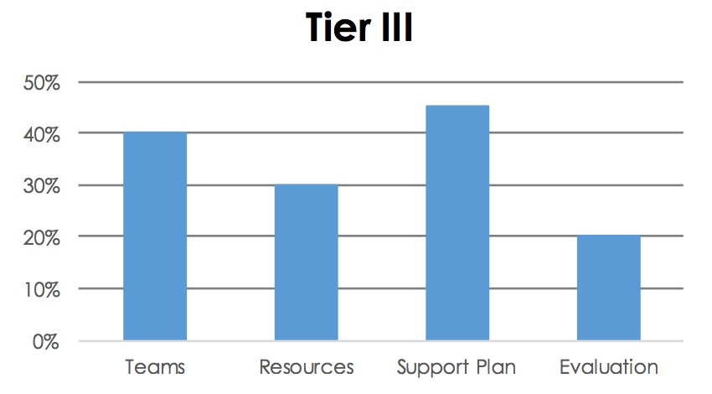
This year our PBIS team took the TFI to assess PBIS fidelity of PBIS at the Intensive level. This year --% of features are in Place.
INSERT your TFI Intensive Score Graph

Slide 9
Based on your feedback our team has determined the following areas for improvement:
INSERT GOAL
INSERT GOAL
INSERT GOAL
(USE the SAS and TFI Summary to help articulate these)

Slide 10
Thanks!
Questions about PBIS?
Contact one of the team members:
Jane Principal
Tom Coordinator
Physical Ed
Sharon Teacher
Johnny Naysayer
INSERT Team Members HERE

