Slide 1

May 2021
Coordinators
Learning and Networking Meeting
Presented by the VTPBIS State Team

Slide 2
Type in the chat which squirrel image resonates with how you are feeling today

Slide 3
Orient to Zoom:
Find your tool bar:
  Participants
  Chat
  Audio
  Video
Breakout rooms
Materials at https://www.pbisvermont.org/training-resources/coordinators-learning-networking-meetings/

Slide 4
Always Start with Data!
May VTPBIS Coordinators Meetings Attendees
45
participants
30
schools
26
SU/SDs

Slide 5
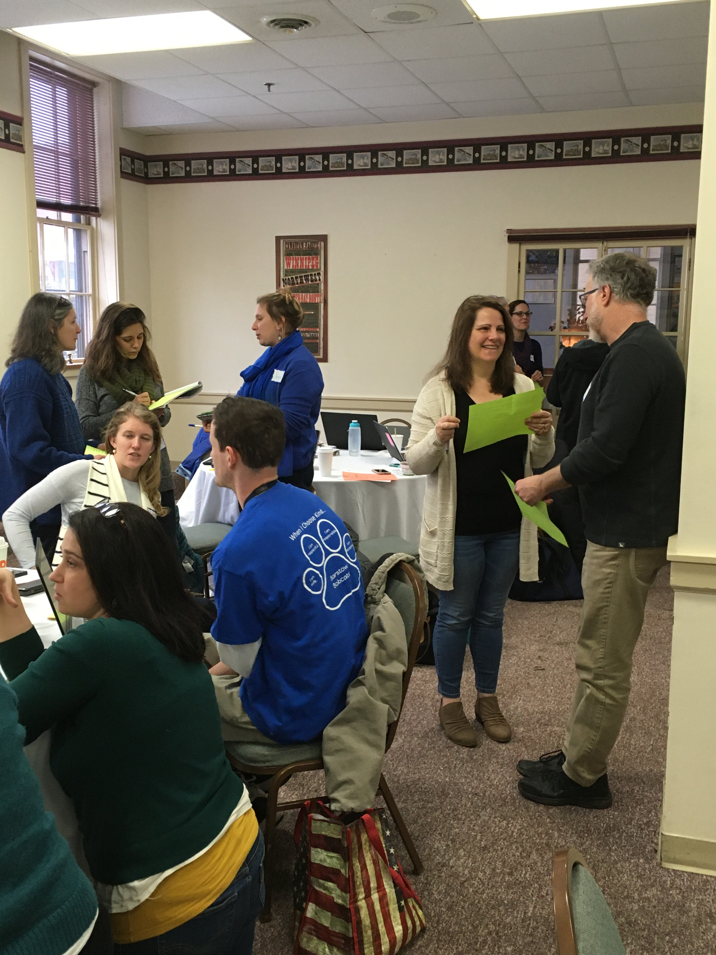
Agenda
Intro and connections
Reflect on positive highlights and practices during COVID
Topic: Build knowledge and skills to infuse equity into your recovery efforts through PBIS roll-out
VTPBIS status report
Hear about great new resources and PD events to support you in your ongoing PBIS journey
Celebrate educator resilience

Slide 6

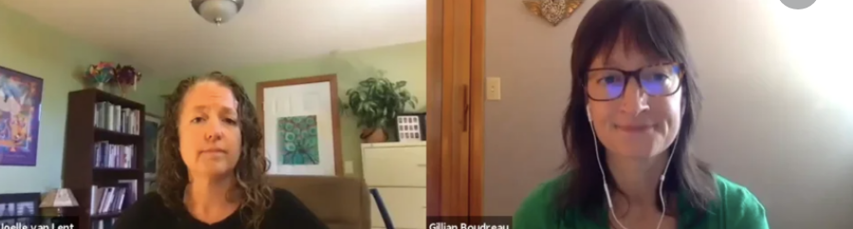


Acknowledgements
Joelle van Lent and Gillian Boudreau
VTPBIS Schools
https://www.pbisvermont.org/training-resources/coordinators-learning-networking-meetings/

Slide 7
Break-out Group Activity 1: Use Google Doc
Positive Highlights and Practices during COVID
What positive highlights have you noticed in your schools during the pandemic that you will bring into next year?
What did your schools and teachers learn from the pandemic in terms of equity and inclusion?
How might you enhance equity and inclusion next year?

Slide 8
Topic Presentation:
Infusing Equity into Recovery Efforts through PBIS Roll-out

Slide 9
“The fundamental purpose of PBIS is to make schools more effective and equitable learning environments.”
‒ Rob Horner, OSEP Technical Assistance Center for PBIS
Educational equity exists when educational policies, practices, interaction, and resources are representative of, constructed by, and responsive to all people so that each individual has access to, meaningfully participates in, and has positive outcomes from high-quality learning experiences, regardless of individual characteristics and group memberships.
(Fraser, 2008; Great Lakes Equity Center, 2012)

Slide 10
Foundations of Equity in PBIS
Collect, use, and report disaggregated discipline data
Implement a behavior framework that is preventive, multi-tiered, and culturally responsive
Use engaging instruction to reduce the opportunity (achievement) gap
Develop policies with accountability for disciplinary equity
Teach strategies for neutralizing implicit bias in discipline decisions

Slide 11
PBIS is not fully implemented . . .
. . . until it is culturally responsive!
Core components of cultural responsiveness in PBIS:
Identity
Voice
Supportive Environment
Situational Appropriateness
Data for Equity

Slide 12
Cultural Responsiveness & Systems Change
Technical Changes
Adaptations to actual practices or instruction
May not reflect deeper change
Adaptive Changes
Changes in values, beliefs, roles, relationships, & approaches to work
Involves changing mindsets as well as routines

Slide 13
Equity is a Universal/Tier 1 Issue!
Equity must be addressed at Tier 1
Providing Tier 2 and 3 supports to students from groups who receive disproportionate rates of referrals and suspensions does not address inequitable student outcomes
PBIS Equity Reflection Questions

Slide 14
Equity: Universal Team Composition
How can we actively elicit from families and the community:
  ownership?
  voice?
  broad representation?
Whose voices are missing or not heard?
  students
  families
  community
  staff
How can we support meaningful participation?
  especially by students/families from communities which have been marginalized?

Slide 15
Equity: Team Norms
How can we ensure that our team norms promote equity by:
  inviting voice?
  ensuring a supportive environment?

Slide 16
Equity: Behavior Expectations
How can we ensure that our behavior expectations:
  reflect student/family voice?
  are culturally responsive?

Slide 17
Equity: Teach Expected Behaviors
How can we ensure that we are:
  explicitly teaching any differences between expectations at school and at home/community?
  without disrespecting those differences?
How can we ensure that the matrix is accessible to:
  non-readers?
  students/families with other home languages?
  those with vision or height differences?
How can we ensure that all visuals:
  reflect diversity?
  are accessible to all?

Slide 18
Equity: Acknowledge Positive Behavior
How can we involve students & families in the development/redesign of our acknowledgement system?
How can we ensure that our acknowledgement system reflects student/family cultures?

Slide 19
Equity: Prevent & Respond to Problem Behavior
How can we actively seek input on problem behavior definitions from students, families, and staff?
How can we be especially attentive to how we define subjective behaviors such as defiance & respect?
How can we ensure that staff understand the difference between universally unacceptable & situationally inappropriate behaviors?
How can we ensure that discipline policies, procedures, & practices are inclusionary to the greatest extent possible?
How can we ensure that our practices for responding to problem behaviors maintain students’ dignity?
How can we support teachers in the consistent and equitable use of practices to prevent problem behaviors? (engaging instruction, effective classroom management, fidelity, restorative conversations, relationship-building & repair)

Slide 20
Equity: Data for Decision-Making
How can we develop systems to disaggregate data by race/ethnicity, disability status, & gender so that we can assess and monitor equity in student outcomes?
How can we ensure that students are engaged in each step of TIPS (problem & goal identification, solution identification & implementation, monitoring, evaluation)?
How can we ensure that implementation fidelity is examined specifically with regard to the equity of outcomes for all students?
How can we engage a wide and representative range of stakeholders in 2-way communication regarding goals and progress?

Slide 21
Equity: Targeted/Tier 2
How can we ensure that Targeted interventions increase instructional opportunities, feedback, and positive home communication with students’ families?
How can we ensure that access to positive, instructional Tier 2 interventions is consistent across student groups?
How can we ensure that referred students’ behavior concerns are being addressed to the fullest extent possible at Universal/Tier 1?

Slide 22
Equity: Intensive/Tier 3
How can we ensure that students and their family members are meaningfully involved in goal-setting and intervention design?
How can we establish systems for two-way communication and shared decision-making with families?
How can we avoid making inaccurate assumptions about home life or family values regarding education?
How can we ensure that referred students’ behavior concerns are being addressed to the fullest extent possible at Universal/Tier 1 and Targeted/Tier 2?

Slide 23
Break-out Group Activity 1: Use Google Doc
Equity, Cultural Responsiveness, and Systems Change within PBIS
Use the Equity Reflection Questions to consider ways that you can make your PBIS implementation and its components more equity-centered.
  What are some technical changes you could start with? (adaptations to actual practices)
  How might you go about working toward adaptive changes? (changes in values, beliefs, roles, relationships, approaches to work)

Slide 24
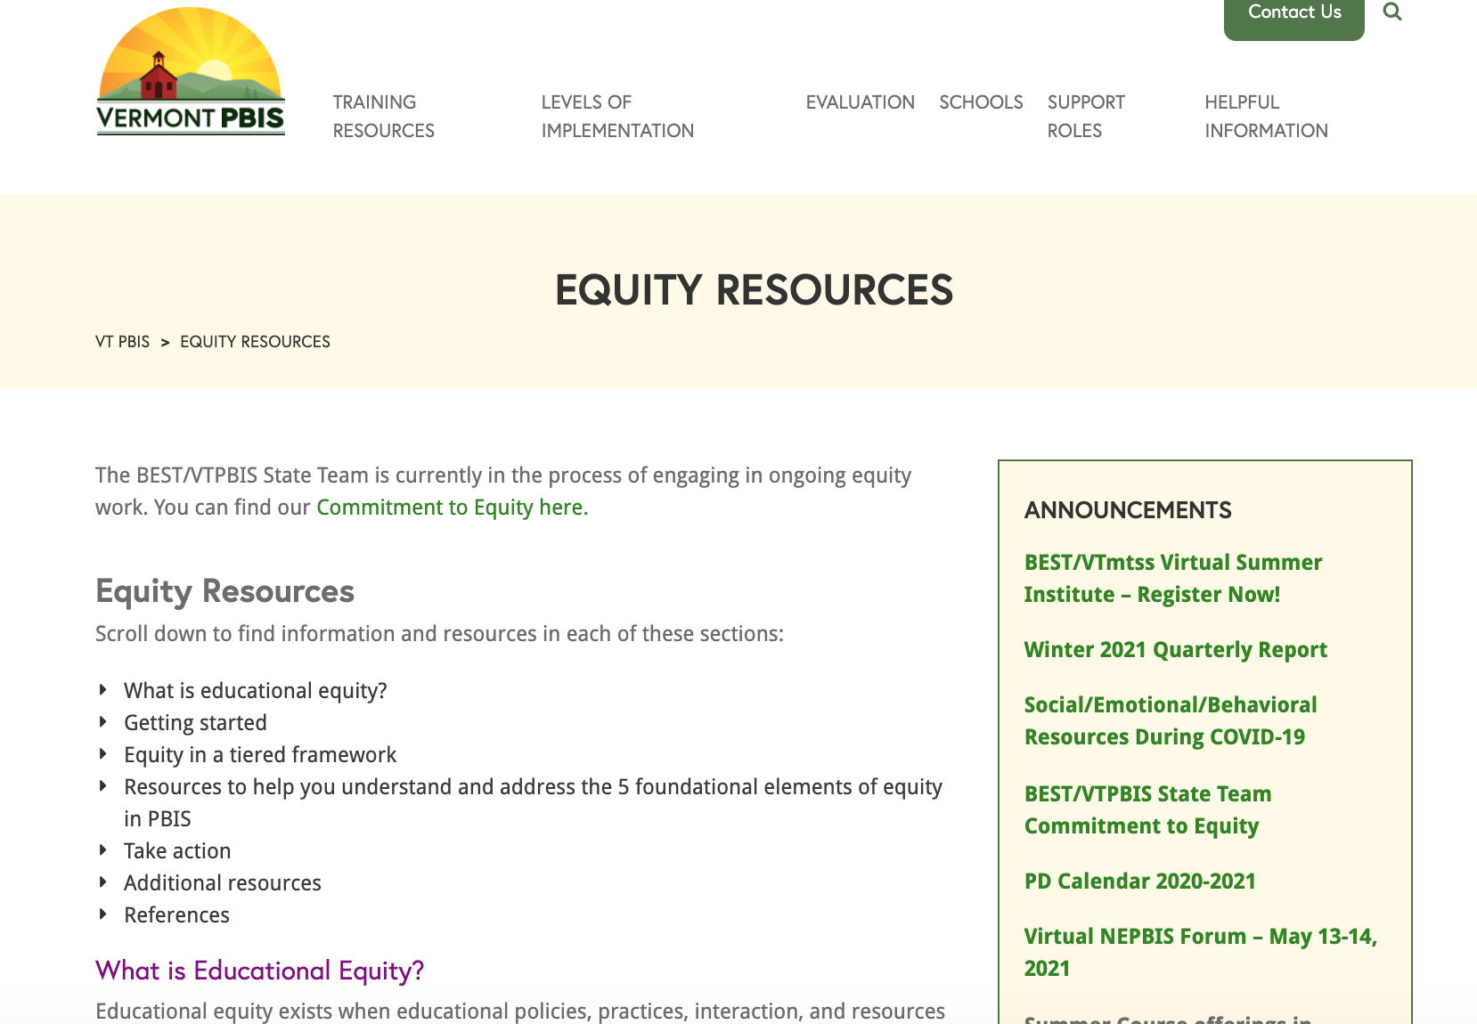
https://www.pbisvermont.org/training-resources/equity-resources/

Slide 25
Status of VTPBIS and Great New Resources
Status of VTPBIS Assessments and Action Plan
Trainings recap
New resources

Slide 26
Fidelity of Implementation - TFI
TFI Completions (59%-72%)
% of schools implementing with fidelity = ??
Notes:
97 Schools completed (59%), 21 requested an extension (would be 72%)

Slide 27
Self-Assessment and/or School Climate Survey
57% Schools Completed the SAS and/or School Climate Survey
???
If you did a School Climate Survey, type into the chat box something that excited you about it!
Notes:
Amy

Slide 28
VTPBIS Action Plan Update
Goal | Status
Build SU/SD Capacity | Increased TA data review and outreach; Project AWARE focus at SU/SD level
Strengthen Connection Between Student Outcomes and Implementation Fidelity | Introduction of School Climate Survey and informal screeners; Data Days PD
Strengthen Student and Family Voice | Restorative Approaches: Project AWARE collaboration with UP for Learning to infuse student voice; Upcoming focus groups; New resources
Provide PD for Different Learning Environments | Inserted into all PD and added new resources
Focus on Equity and Anti-Bias | State Team PD and development; Integrated into Universal training; New training evaluation questions

Slide 29
Training Numbers and Satisfaction
98%
Highly Satisfied/Satisfied
28
PD Events
876
Participants

Slide 30
New Training Evaluation Questions
This training was accessible to me. (e.g., able to access the material, able to request and receive accommodations, able to hear and/or understand the presenter.)
This training included relevant information on diversity, equity, and inclusion.
This training helped me learn more about diversity, equity, and inclusion.
Demographics

Slide 31
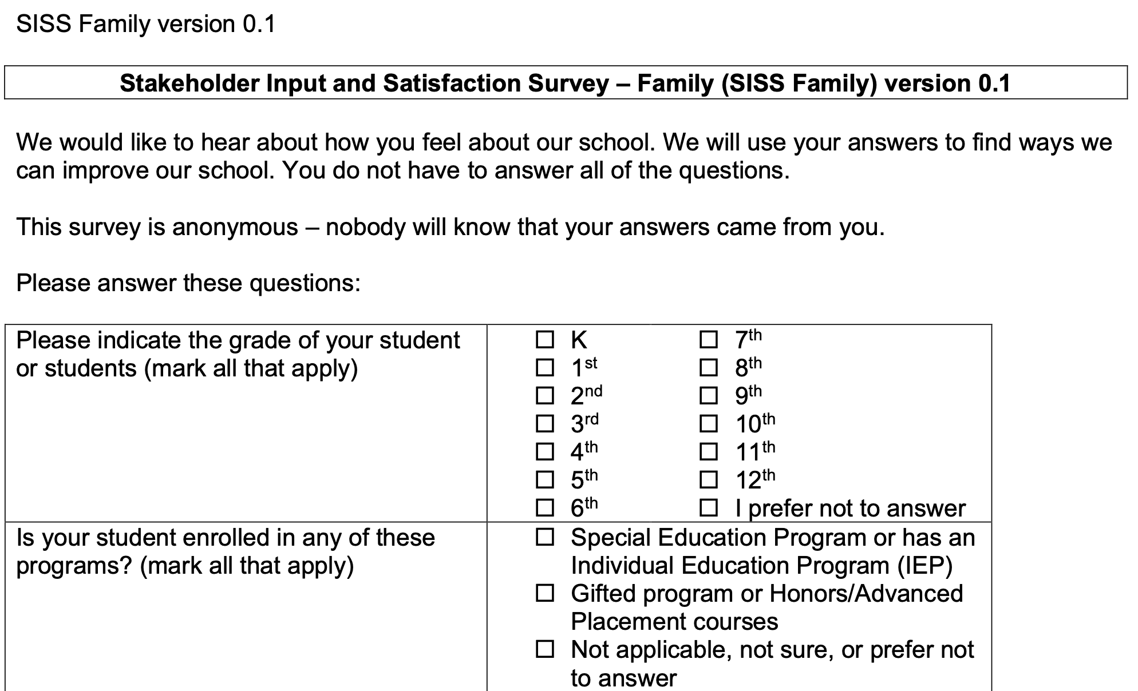
New Resource – Introducing the SISS!
Notes:
https://www.pbisvermont.org/wp-content/uploads/2017/12/SISS-Family-survey-2016-08-10.pdf

Slide 32
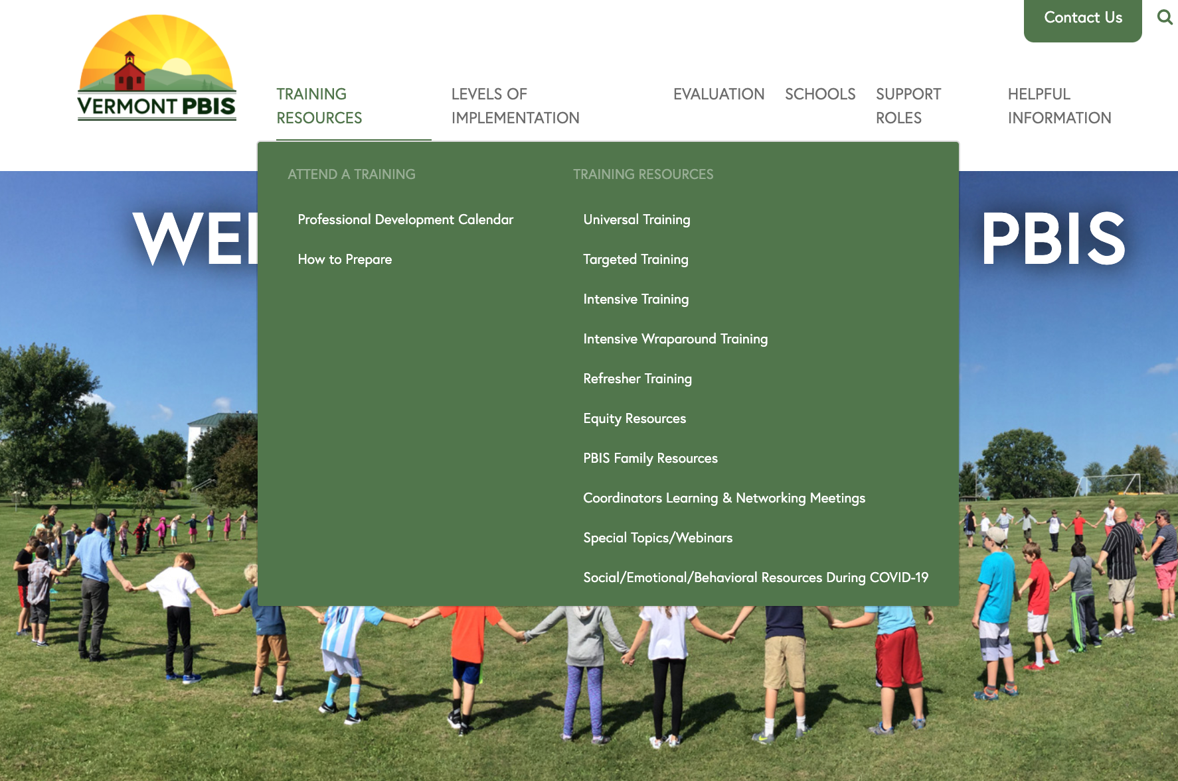
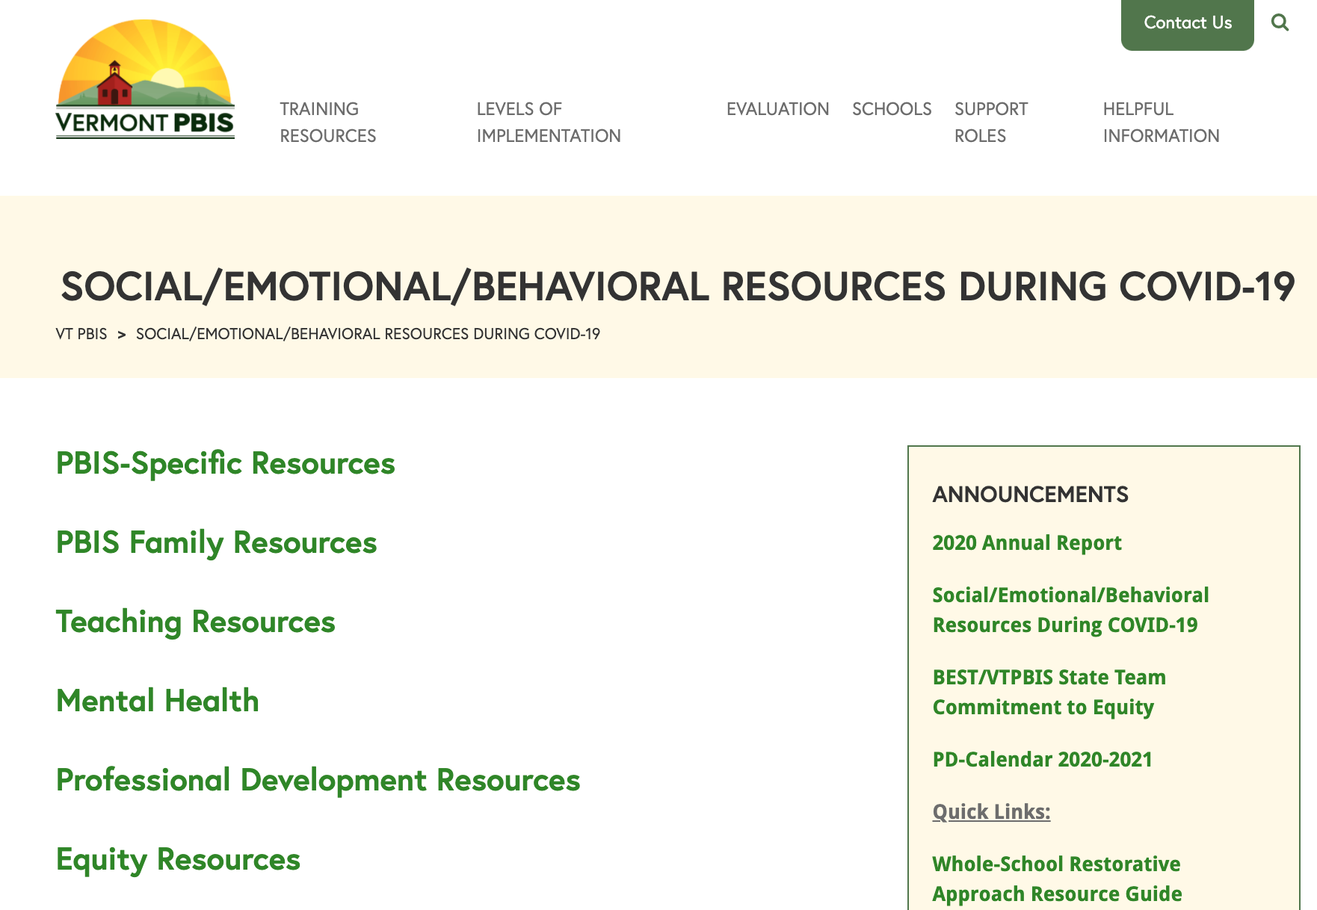
Website Changes – New Resources:

Slide 33
Upcoming Events:
BEST/VTmtss Summer Institute:
  June 21-24
BEST/VTPBIS PD Tentative Calendar for 2021-22 - What’s new?
  August webinars focused on recovery – surveys/screeners; SEL; Educator resilience
  CPI online and in person!
  Restorative Practices within MTSS
  Equity infused in all PD
VTPBIS Leadership Academy – coming soon!

Slide 34


Stay Connected
https://www.facebook.com/groups/PBISVermont/
https://twitter.com/vtpbis
Please share all of the awesome things you are doing by using #VTPBIS or @VTPBIS
Notes:
Amy

Slide 35

We Appreciate You!

Slide 36
Our gift to you: TIME!
Take 5 minutes:
  Unplug. Ban all electronics, social media, email, and phone calls for a few minutes, and instead…
  Listen to your favorite song (and dance, if you so choose!).
  Turn off the lights and lay your head down on your desk.
  Channel your biggest mentor/supporter. Imagine they write you a letter congratulating you on what you’ve done during this tough year. Write that letter.
  Do your favorite yoga stretches.
  Do a 5-minute meditation on your favorite meditation app (Headspace, Calm, Insight Timer).
  Go take a quick walk outside.
  Eat a piece of chocolate.
  Write down 5 things you’re grateful for.
  Doodle or color.
  Give yourself a hand massage.
Other 5-minute self-care ideas

