Slide 1
Consider the Restorative Mindset
The Restorative Approach is about:
    Voluntary Participation
    Exploring Relationships
    Meaningful Engagement
    Participatory Decision-Making

Slide 2
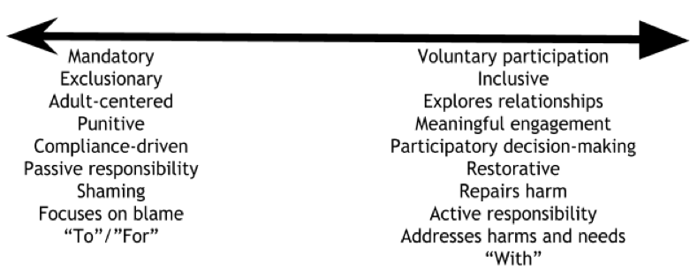
Continuum: Mindset Shift
What PBIS/SEL interventions do you have? Where are they on the continuum? How can you move more toward “doing with”?

