Slide 1
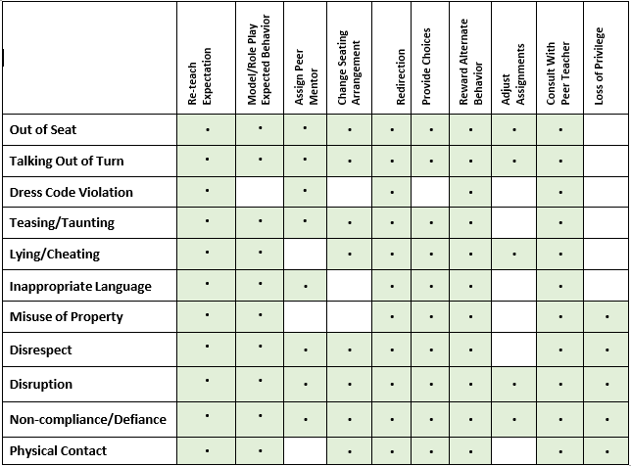
SAMPLE Response Matrix

Slide 2
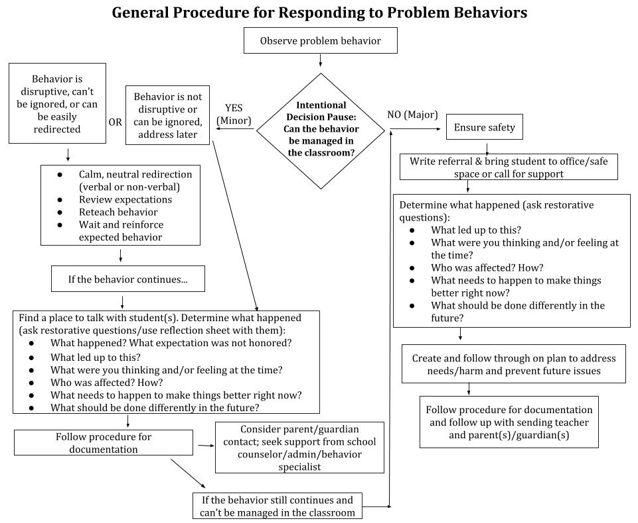
NEW Sample

