Slide 1
Creating Gender-Affirming Environments
MARA IVERSON (SHE/HER/HERS)
OUTRIGHT VERMONT
Outrightvt.org
Facebook.com/outrightvt

Slide 3
Youth Risk Behavior Survey (YRBS)
Queer & trans identified youth experience higher rates of risk factors than their cis/het peers.
VT YRBS 2019
2x more likely (31% vs 15%): bullied in the last 30 days
2.5x more likely (13% vs 5%): skipped school in the last 30 days due to feeling unsafe 2x more likely (56% to 26%): Report having a physical disability, long-term health problems, emotional problems, or a learning disability
5x more likely (19% vs 4%): attempted suicide in the last 12 months
Suicide plan: 36% and hurt self on purpose: 50%
63% of LGBT youth report feeling sad for 2 weeks or more in the last 12 months

Slide 4
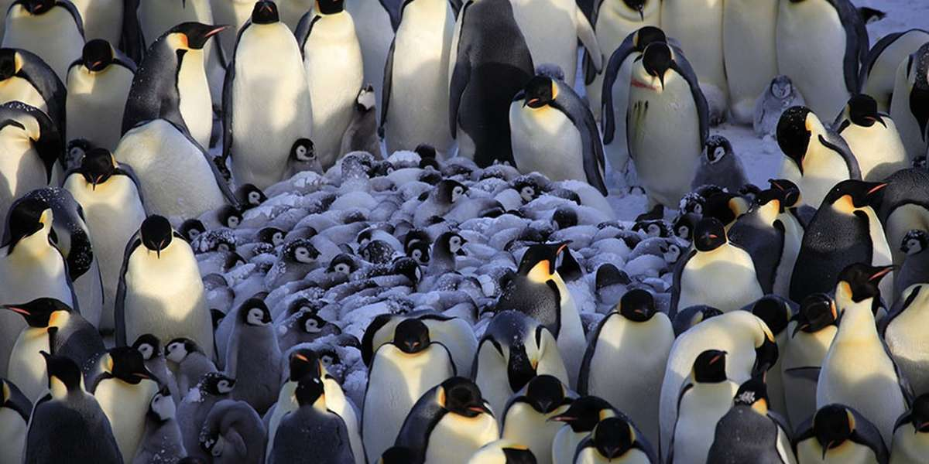
Protective Factors!
These elements reduce risk and create more support for queer & trans youth, and benefit ALL YOUTH!!
Acceptance and support from adults, especially caregivers, and peers
Visibility and inclusion in all of their surroundings starting as children (reduced suicide planning likelihood by 18%)
Availability of teachers/school adults they
could talk to if they have a problem
(reduced suicide planning likelihood by 23%)
Inclusive sexual health education
School Gender and Sexuality Alliances (GSAs)

Slide 5
Societies with Formal Recognition of More Than 2 Genders
Source: PBS Independent Lens
Notes:
Teach people realistic stuff about the world instead of perpetuating that same old material without nuance

Slide 7
Perceivable Inclusion, Support
& Celebration

Slide 8
Inclusive Physical Spaces
Look for:
Safe Zone signs and rainbows
Gender-neutral restrooms and changing spaces
Inclusive signage, decor, and even promotional posters
Now you: what else might people notice or might you scan for?

Slide 9
Celebrations and Events
Notes:
https://www.glsen.org/activity/glsen-2020-2021-school-year-calendar

Slide 10
Practice some new habits TODAY!
Notes:
Review Best Practices Guide https://docs.google.com/document/d/1nTAKF6oqrK6BE5dZsw22nSzbuQYNDIfh/edit

Slide 11
Consulting & Questions

Slide 12
bit.ly/QU33RYAE

