Slide 1
Using Data for Decision Making within a PBIS Framework
Presented by the VTPBIS State Team
Notes:
Sherry

Slide 2
What is data-based decision making?
Still learning and growing
We know how to do it, now we’re working to sustain it
Very fluent
and very effective
Becoming Data Based
How are you currently embracing a data-based decision-making process that leads to results?
Poll: Pick which color matches your experience.
Type in the chat box about what might help you get to the next color.
Notes:
Sherry

Slide 3
Purpose
To build competence and confidence to use data to make decisions
To explore a problem-solving/decision-making process
To consider strategies for sharing data with others

Slide 4
Supporting
Staff Behavior
Supporting
Decision Making
OUTCOMES
Systems
Data
Practices
Supporting Student Behavior
Notes:
3
DATA

Slide 5
Types of Data to Consider
Intensive:
TFI
I-SWIS
EST
FBA/BSP
Targeted:
TFI
SWIS-CICO
EST
FBA/BSP
Universal Screening
Universal:
TFI
SAS
SWIS
Attendance
Grades
Leadership Team Self-Assessment
School Climate
Family Engagement
Notes:
Sherry
What else?

Slide 6
Talk Amongst Yourselves…
What data do you collect/use to assess the social/emotional/behavioral strengths and challenges at your school?
How do you use this data for decision-making?
Notes:
sherry

Slide 7
How does your school use data?
To assess current status
To assess implementation fidelity
To assess impact on students
To plan for school-wide and individual student changes
To acknowledge incremental success along the way
To determine priority areas of focus
To show staff you value and use their input to make changes (SAS)
To reward staff and student performance
To determine breaks between “roll-outs”
To share results with stakeholders

Slide 8
Data help us ask the right questions.
They do not provide the answers.
Notes:
Identify a possible problem
Build a precise “problem statement”
Place the “problem” in the context rather than on the students
Select an effective and efficient solution (intervention)
Assess if a solution is (a) being implemented and (b) being effective

Slide 9
Big Ideas About Data
All data should serve a purpose
Collect data with fidelity
Be prompt about looking at data and acting upon it
Use multiple sources of data to confirm what you see
Use data to support, not punish
Notes:
Sherry

Slide 10
Start with Outcomes
How will you know if PBIS is working if you are not sure where it should be taking you?
Outcomes should be:
Locally determined
Contextually and culturally relevant
Observable and measurable
Summarized in goal statements
Sample outcomes:
Reduce ODRs
Reduce bullying
Increase attendance
Decrease referrals for SPED
Increase building morale
Improve academic scores
Notes:
Amy

Slide 11
What are your outcomes?
Think about the main reason your school is implementing PBIS.
Do you have an outcome statement that is specific, measurable (observable), achievable, realistic, and timely (SMART)?
(i.e. “Given school-wide implementation of PBIS with fidelity, we will decrease the number of student suspensions and expulsions by 10% by the end of the school year.”)
Notes:
Amy

Slide 12
The Tiered Fidelity Inventory (TFI) Will Help you Get to Outcomes
What is the TFI? An efficient and effective validated measure to assess fidelity of core PBIS features at all 3 tiers – Teams, Implementation and Evaluation
Why use the TFI? To guide and sustain effective implementation of PBIS
When? Expectation is once a year for all schools
Window open January 1st - March 31st (for TFI and SAS)
Consider completing TFI more than once to monitor/assess progress
Contact Anne Dubie if you would like your window opened
Teams should anticipate 30 minutes to complete each tier’s assessment the first time
Notes:
Amy

Slide 13
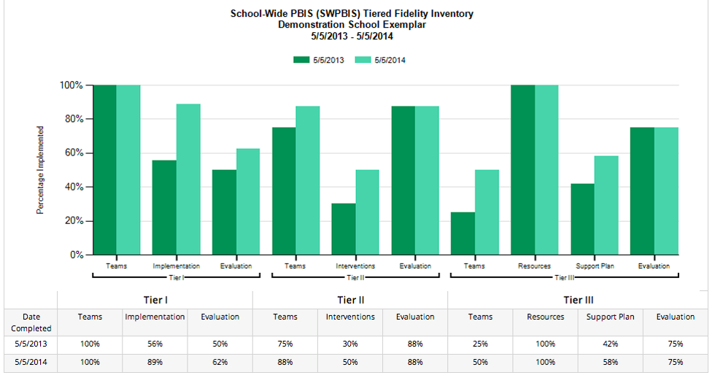
Example Subscale Report
Notes:
Amy

Slide 14
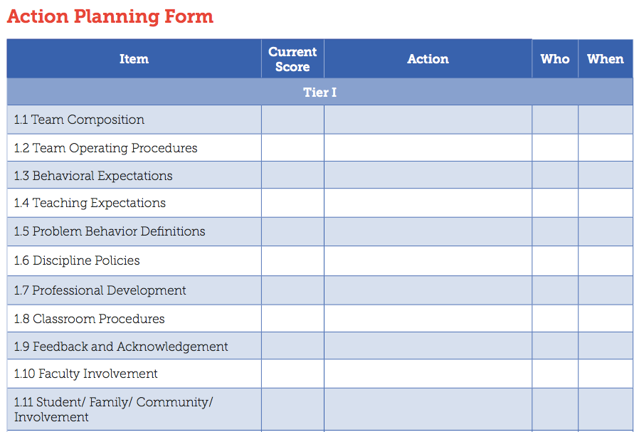
After Assessment
Analyze data:
Total score report
Subscale report (broken down by tier)
Sub-sub scale report (broken down by components)
Individual items report
Celebrate your 2’s, examine your 0’s and 1’s
Notes:
Amy

Slide 15
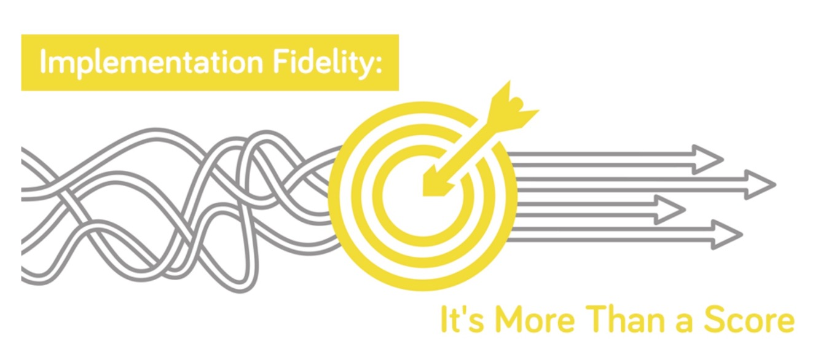
Great Article on Fidelity:
https://www.pbisapps.org/community/Pages/Fidelity.aspx
Notes:
Sherry

Slide 16
TIPS Offers:
Formal roles (facilitator, recorder, data analyst)
Specific expectations (before, during & after meetings)
Access and use of data
Use of electronic and projected meeting minutes
A structured meeting process
A process for using data to make decisions:
Formal problem solving steps that a group can use to build and implement solutions.
Access to the right information at the right time in the right format
Notes:
Sherry
Do you sit on teams or committees?
What makes a dream team?

Slide 17
What Makes a Dream Team?
Think of a successful team experience. What were some of the characteristics?
Accountability
Predictability
Participation
Communication

Slide 18
Characteristics of an Effective Data Team
Notes:
Sherry

Slide 19
Effective meetings extend before and after the actual meeting time. Other key roles are necessary!
BEFORE:
Set agenda and send to team
Collect data, review, and prepare summary statements
DURING:
Follow agenda & time frames
Review data
Make precision problem statements
Develop solutions
Take notes and set action items
AFTER:
Complete action items
Follow-up on action item status
Notes:
Sherry

Slide 20
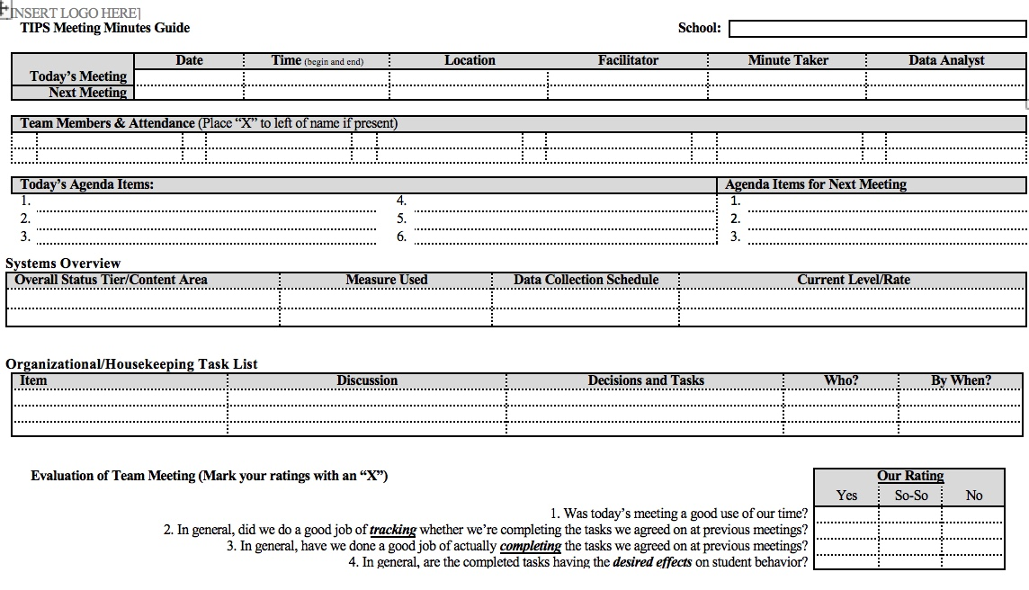
Notes:
hand out

Slide 21
Data Analyst: Role & Responsibilities
Establish the role of a data analyst (and backup person)
Use the data sources needed for problem solving and decision making (DIBELS, SWIS, etc.)
Create written data summaries in advance to assist for efficient problem solving
Launch meeting with a data summary to help define the problem with precision
Refine precision of problem statement through inferences and hypothesis
Notes:
Sherry
determining if there are problems;
jump starting a problem solving discussion; and
evaluating the impact of solutions and fidelity of implementation

Slide 22
Data-Based Decision-Making Can Occur at Many Levels
Whole school
Small groups or school areas
Individual student
Same basic process
Notes:
Sherry

Slide 23
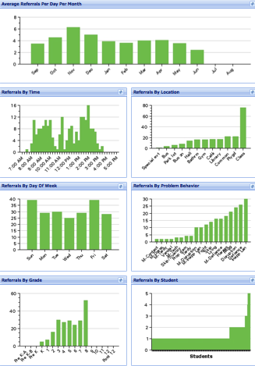
SWIS Big 7: Core Reports
Avg. Referrals Per Day Per Month
Time
Location
Day of Week
Problem
Behavior
Grade
Student
Notes:
Sherry

Slide 24
Indicators of Possible Problems
Identify problems based on your school’s:
Desirable and undesirable trends
Average Referrals Per Day Per Month for this year and for corresponding months of the previous year
Average Referrals Per Day Per Month compared to the national median
Faculty, parents, and students’ opinions regarding acceptable or not acceptable levels of ODRs
Notes:
Sherry

Slide 25
Improving Decision Making
Problem
Solution
Problem
Problem Solving
Solution
Action Planning
What data tools do you use to move through data review, problem solving, and action planning?
Notes:
Sherry
Compare that to the old model of identifying a problem and then jumping right to solutions.
Instead, we’ll use our decision-making model to more clearly define the context of problems before moving into solution development.
Then those solutions are put into an action plan so that our solutions are really implemented with integrity.

Slide 26
Innovation Neutral: Use for Reading, Behavior, Math, School Improvement
Notes:
This is a microcosm of the drivers within a theory of improvement process outined in the AOE Comprehensive needs assessment toolkit.

Slide 27
TIPS Problem-Solving “Mantra”
REMEMBER to use…..
Do we have a problem? If so, what is the precise nature of our problem? (identify, define, clarify, confirm/disconfirm inferences)
What is our goal? How will we know we’ve met our goal? (what data will we use?)
Why does the problem exist, & what can we do about it? (hypothesis & solution)
What are the actual elements of our plan? (action plan)
Is our plan being implemented with fidelity & is it working? (evaluate & revise plan)
What next steps are needed?
Notes:
Sherry
Update

Slide 28
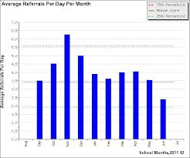
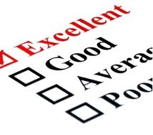
1. Do we have a problem? If so, what is the precise nature of our problem?
Notes:
What data to monitor
ODR per day per month
OSS, ISS, Attendance, Teacher report
Team Checklist/ SET (are we doing what we planned to do?)
What question to answer
Do we have a problem?
What questions to ask of Level, Trend, Peaks
How do our data compare with last year?
How do our data compare with national/regional norms?
How do our data compare with our preferred/expected status?
If a problem is identified, then ask
What are the data we need to make a good decision?

Slide 29
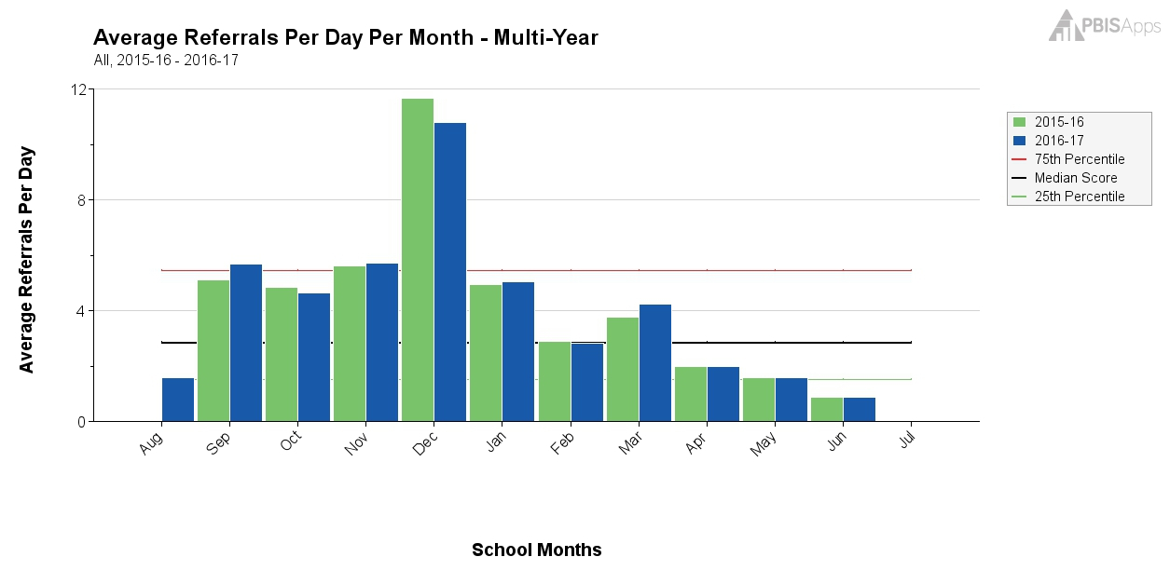
What Does this Graph Tell You?
Notes:
Sherry

Slide 30
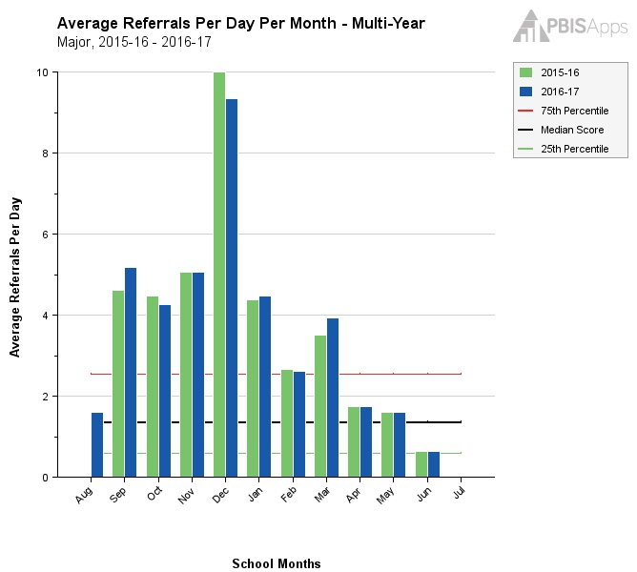
Same Graph Looking at Majors Only
Notes:
Sherry

Slide 31
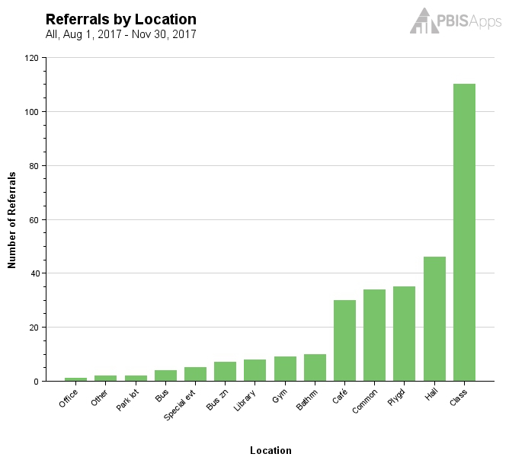
What Does this Graph Tell You?
Notes:
Sherry

Slide 32
What Does this Graph Tell You?
Notes:
Sherry

Slide 33
1. Do we have a problem? If so, what is the precise nature of our problem?
Question | SWIS Table/Graph
What problem behaviors are occurring? | Referrals by problem behavior
When are problem behaviors occurring? | Referrals by time
Where are problem behaviors occurring? | Referrals by location
Who is engaging in problem behaviors? | Referrals by student
Why do problem behaviors keep happening? | Referrals by motivation
What is the data we need for a decision?

Slide 34
Example: Primary to Precise
Precise Problem Statements include information about the what, when, where, who, when, and why
Inappropriate behavior is increasing
Inappropriate language and disruptive behavior is increasing in the cafeteria during first lunch period, is being done mostly by 6th grade boys, and seems to be maintained by social praise from the bystander peer group.

Slide 35
2. What is our Goal? How will we know we’ve met our goal?
Set a goal that defines levels at which the problem is no longer a problem
Set goals that are specific, measurable (observable), achievable, realistic, and timely
What data will you use to know that you’ve met your goal?

Slide 36
3. Why does the problem exist & what can we do about it? (hypothesis & solution)
Problem Statement: The sixth graders are disruptive & use inappropriate language in the cafeteria between 11:30 AM and 12:00 PM
Hypothesis: We believe they are trying to get attention from their peers.
Notes:
Sherry

Slide 37
Solution Development for Disruption in Cafeteria
Prevention: Remove/alter “trigger” for problem behavior
Teaching: Define, instruct & model expected behavior
Reward: Expected/alternative behavior when it occurs; prompt as necessary
Extinction: Increase acknowledgement of presence of desired behavior
Corrective Consequence: Use non-rewarding/non-reinforcing responses when problem behavior occurs
Data Collection: Indicate how you know when you have a solution
Notes:
Sherry

Slide 38
Solution Development for Disruption in Cafeteria
Prevention: Remove/alter “trigger” for problem behavior | Maintain current lunch schedule, but shift classes to balance numbers.
Teaching: Define, instruct & model expected behavior | Teach behavioral expectations in cafeteria
Reward: Expected/alternative behavior when it occurs; prompt as necessary | Establish “Friday Five”: Extra 5 min of lunch on Friday for five good days.
Extinction: Increase acknowledgement of presence of desired behavior | Encourage all students to work for “Friday Five”… make problem behavior less rewarding than desired behavior
Corrective Consequence: Use non-rewarding/non-reinforcing responses when problem behavior occurs | Active supervision and continued early consequence
Data Collection: Indicate how you know when you have a solution | Maintain ODR record and supervisor weekly report
Notes:
Sherry

Slide 39
…include logistics:
Notes:
Sherry
Action Plan Elements:
Who?
By When?
Goal with Timeline
Fidelity of Implementation Measure
Effectiveness of Implementation Measure

Slide 40
Date of Initial Meeting: |  |  |  |  | Date(s) of Review Meetings
Brief Problem Description (e.g., student name, group identifier, brief item description):
Precise Problem è Statement What? When? Where? Who? Why? How Often? | Goal and è Timeline What? By When? | Solution è Actions By Who? By When? | Identify Fidelity è and Outcome Data What? When? Who? | I M P L E M E N T S O L U T I O N S | Did it work? (Review current levels and compare to goal) ê
 |  |  | What fidelity data will we collect? What? When? Who? |  | Fidelity Data: Level of Implementation Not started Partial implementation Implemented with fidelity Stopped Notes: | Outcome Data (Current Levels): Comparison to Goal Worse No Change Improved but not to goal Goal met Notes:
 |  |  | What outcome data will we collect? What? When? Who?
Current Levels: |  |  |  |  | Next Steps
 |  |  |  |  | Continue current plan Modify plan Discontinue plan Other Notes:

Slide 41
5. Is our plan being implemented with fidelity & is it working? (evaluate & revise plan)
**Report data back to staff (i.e. when you implemented this plan, ODRs in the cafeteria dropped by 20%!)
Notes:
Sherry
Define how you will know that the solutions were implemented as planned (with fidelity)?
How often will you conduct a status review?
Define how you will know that the solutions had a positive effect on student achievement, social competence, and/or safety?
How often will you monitor student progress?
What will the data tell you when the problem is solved?
Base on team-established standard
Easier to monitor if quantifiable (“countable”)
Record on meeting minute form for progress monitoring at future meeting(s)

Slide 42
6. What next steps are needed?
Continue
Modify
Stop plan
Continue through problem solving process again
Big Idea:
Improved problem solving has a positive impact on student outcomes
(Horner, Algozzine, Todd, Algozzine, Cusumano, and Preston (in preparation))

Slide 43
Decision Making for Quality Improvement
Team assessments
Self assessments
Walkthrough reports
PBIS Assessments
SET
Self-Assessment
TFI
Outcome Data
Fidelity Data
Office Discipline Referrals
Minor (staff managed) referrals
Absences
Tardiness
Climate/Culture
Academic Assessments
What else?
Notes:
Sherry
Disaggregation simply means separating something into its component parts, or break apart.
Only by evaluating both outcome and fidelity data (cause and effect) can leaders and teachers understand the complexities of student achievement (academic or behavior) and the value of our systems and practices.
We cannot begin to truly understand what it will take to achieve our intended outcomes until we understand the relation between cause and effect, how our fidelity and outcome data intersect.
Instead of segmenting data reviews (looking just at outcome or just at fidelity data) looking at the shaded section (where the data intersects) we can get a more comprehensive view of reality and can make higher quality decisions.

Slide 44
Sharing Data
How often the leadership team shares data with all school staff has the most significant impact on whether the school sustained implementation (McIntosh, Kim, Mercer, Strickland-Cohen, & Horner​, 2015)
Builds understanding of goals, progress, outcomes – leads to buy-in
The best way to share data is the way that feels most natural, leads to effective decisions, and offers opportunities for everyone to engage in planning
https://www.pbisapps.org/community/Pages/Sustaining-Implementation-Together.aspx

Slide 45
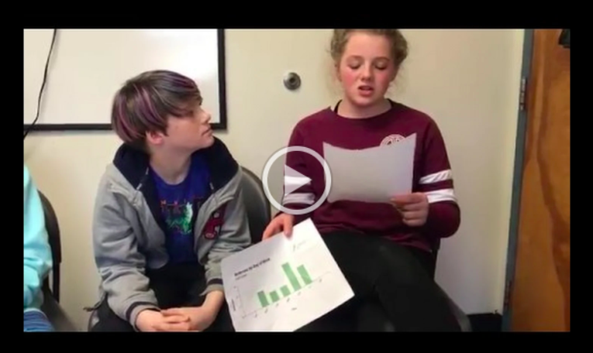
Students as Data Analysts
Notes:
https://drive.google.com/file/d/1IOy3wB8OZhG41hqF3xyq8p4OannoDbVN/view

Slide 46
Disseminating Data: Use Data as a Story-Telling Device
What data are you collecting?
What questions can you answer with this data?
Which of those questions tell a compelling story?
OR Which questions get to the heart of your work?
Who is your targeted audience for your story?
How could you display the data to convey the story of PBIS?
REMEMBER!
Before we can measure success, we must define success!
Notes:
Amy

Slide 47
Create an Infographic or Brief Power Point Presentation!
Simple is better!
Start with one graph or table and some descriptive text
Notes:
Amy

Slide 48
Notes:
Amy

Slide 49
Notes:
Amy

Slide 50
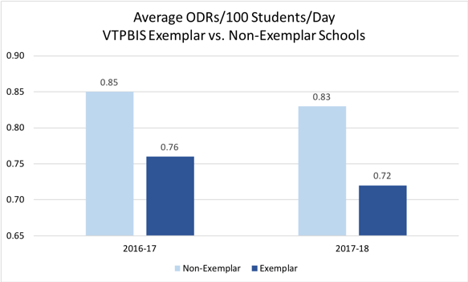
Notes:
Amy

Slide 51
Building Internal Capacity for Data-Based Decision-Making: Data Days Back at School

Slide 52
Responsibilities for Facilitating Data Review and Improvement Planning:
Schedule Data Days – Fall, Winter, Spring
Identify/enhance the role of the Data Analyst
Plan professional development around priorities identified through assessments
Consider TIPS/SWIS learning module
Consider training in Universal Screening
Consider training in classroom management, FBA/BSP, crisis prevention and intervention, other
Remember to complete and use the SAS and TFI!

Slide 53
General Recommendations for PBIS Decision-Making
Never stop doing what is already working
Always look for the smallest change that will produce the largest effect
Avoid defining a large number of goals
Do a small number of things well
Do not add something new without also defining what you will stop doing to make the addition possible.
Notes:
Amy
Use data in “decision layers”
Don’t drown in the data
It’s “OK” to be doing well
Decisions are more likely to be effective and efficient when they are based on data.
The quality of decision-making depends most on the first step (defining the problem to be solved)
Define problems with precision and clarity

Slide 54
Resources
TIPS Meeting Minutes Template (Google Doc version)
Drill Down Video
TIPS Resources
TIPS Meeting Videos Including Academics
VT AOE Comprehensive Needs Assessment Toolkit

