Slide 1
De-Escalation and Relationship Building
Applying the Foundation Skills of (LSCI) Life Space Crisis Intervention

Slide 2
The Power of Relationships
The Effectiveness Of An Intervention Often Hinges On The Quality Of The Relationship With The Helping Adult
Well Designed and Informed Behavior Support Plans Often Fail Because The Helping Adult Fails To Establish A Positive Helping Relationship With the Child
Sometimes A Poorly Designed Or Marginal Plan Is Successful Because Of The Quality Of The Relationship

Slide 3
WHEN DEALING WITH IN AN EMOTIONALLY CHARGED EVENT
YOU MUST DEAL WITH THE FEELINGS FIRST
BEFORE YOU CAN DEAL WITH THE BEHAVIOR
FEELINGS , THOUGHTS , BEHAVIOR

Slide 4
CHILDREN WHO ARE HEARD LISTEN
Kids want to tell their story

Slide 5
Self Defeating vs. Bad Behavior Cooperative Problem Solving Discipline approach
The Power Of Language

Slide 6
Most Effective Behavioral Interventions Are Based on Strengths
The ability to recognize child’s strengths positive actions and intentions is key.

Slide 7
Two Critical Skills
Validating
The ability to acknowledge the feelings the child is experiencing or expressing
Affirming
The ability to recognize positive intent , use of prosocial skills or actions

Slide 8
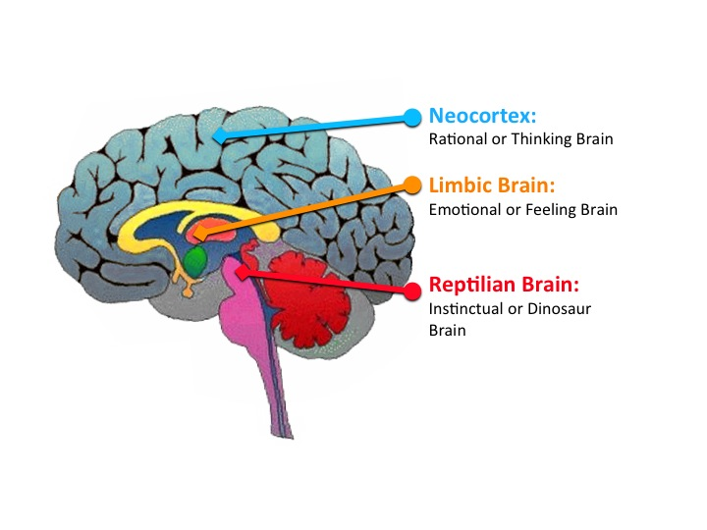

Slide 9
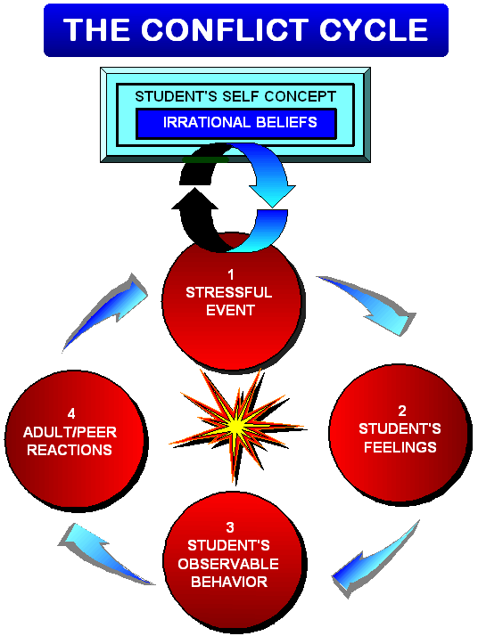
Notes:
The Conflict Cycle
Participant Manual page 24
This is simply a full page visual for participants to refer back to. Nothing new here.

Slide 10
THE CONFLICT CYCLE PARADIGM
A STRESSFUL EVENT occurs which activates a troubled student’s irrational beliefs.
These NEGATIVE THOUGHTS determine and trigger feelings.
FEELINGS, not rational forces, drive inappropriate behaviors.
Inappropriate BEHAVIORS incite adults.
Adults take on the student’s feelings and may MIRROR his behaviors.
This negative adult REACTION increases the student’s stress, escalating the conflict into a self-defeating power struggle.
The student’s SELF-FULFILLING PROPHECY (irrational beliefs) is REINFORCED; the student has no motivation to change thinking or behavior.

Slide 11
THE “SCRIPT”
Acknowledge the feelings: Make 2-3 validating statements
Affirm : Make 2-3 affirming statements
Get the child’s perspective and restate
Set limits and give choices as needed

Slide 12
1 DRAIN OFF
Drain off the student’s intense emotions by acknowledging the feelings
2 TIMELINE
Use affirming and listening skills to discover the student’s point of view
3 CENTRAL ISSUE
Identify the student’s vital interest and give them their choices

