Slide 1
School Presentation
Charlotte Central School
Grades K-8
Notes:
This is an example of a school PBIS refresher presentation- click through to show what it looks like - starting with the data (student data, fidelity data, staff perception data), introduce what’s new

Slide 2
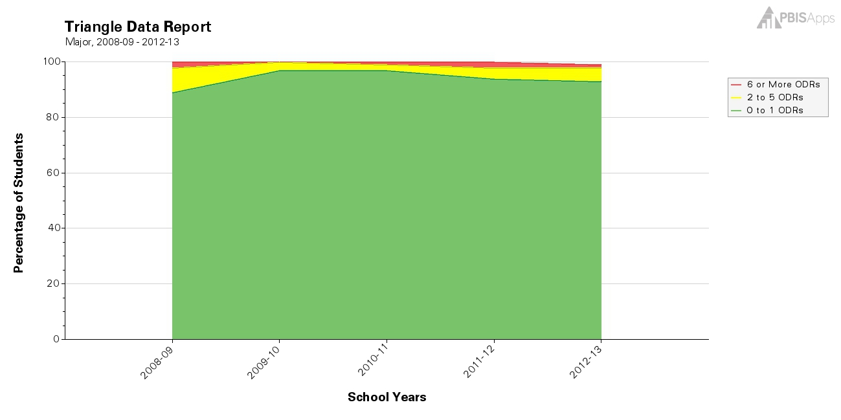
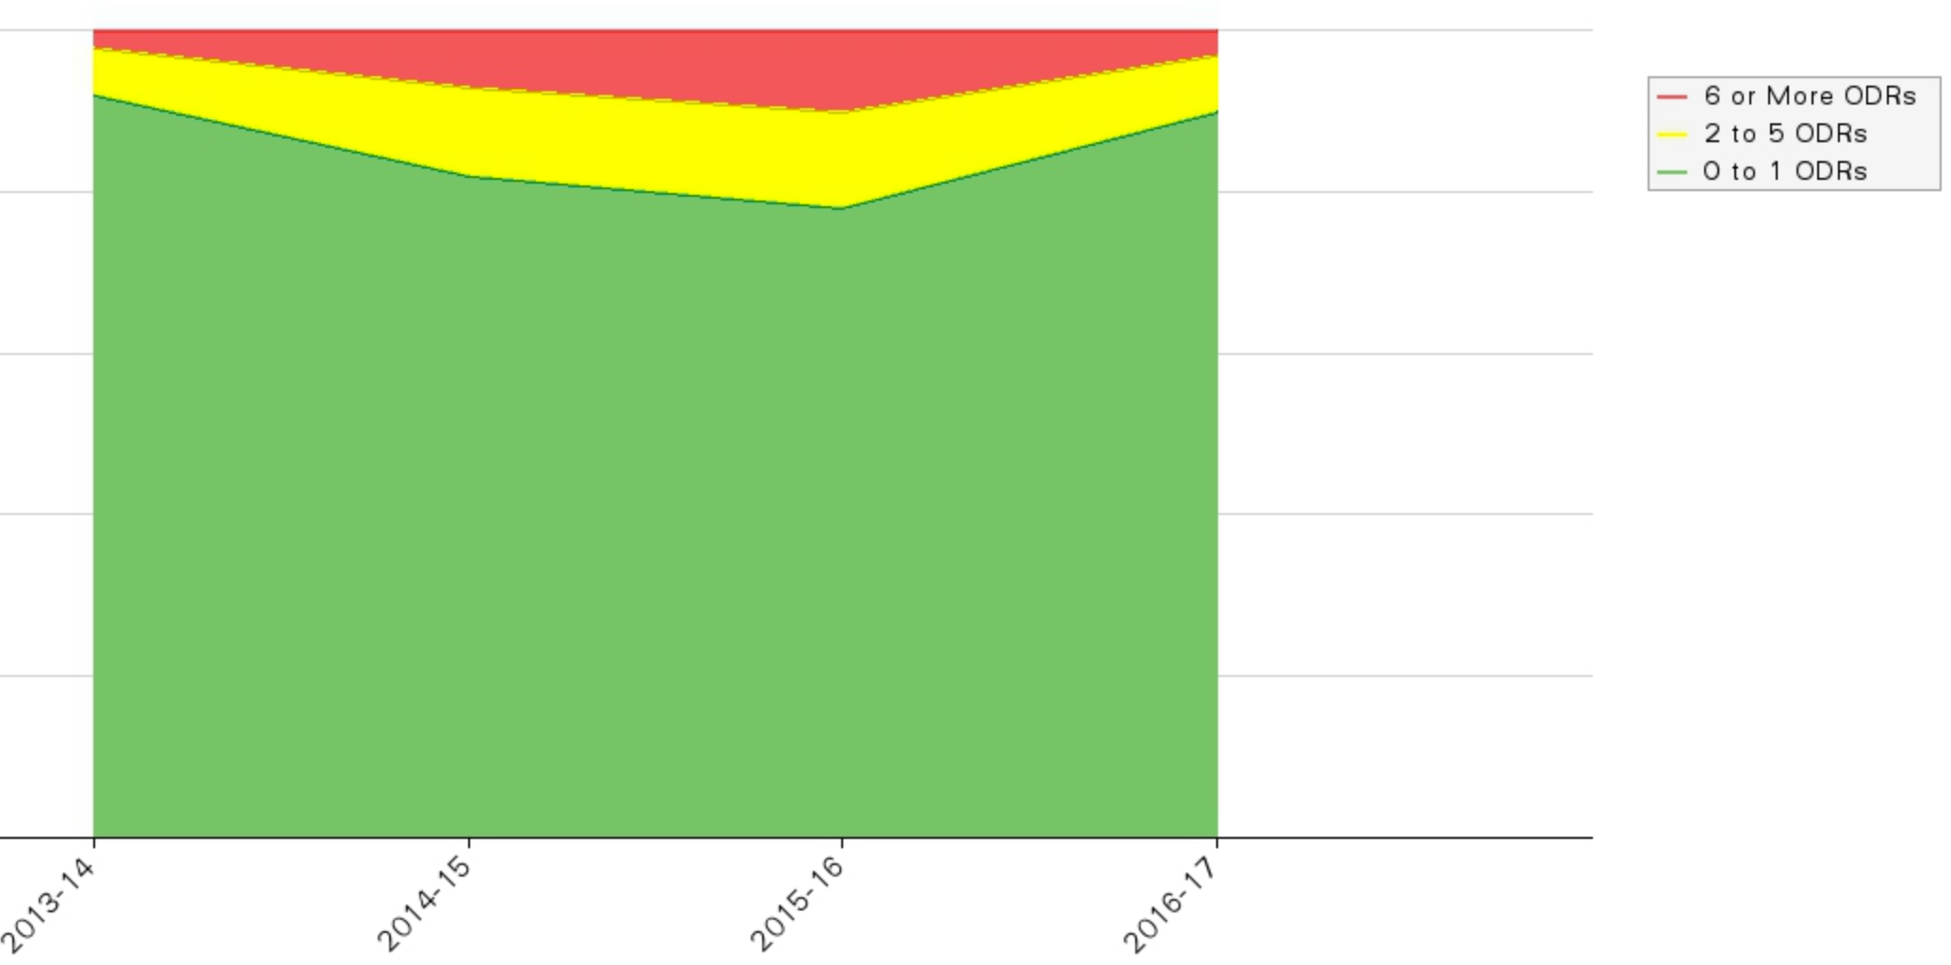
Start with the Data: What does the data tell us overtime?

Slide 3
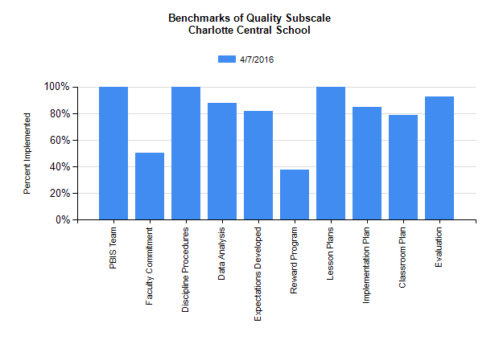
What does the PBIS Team think is in Place?

Slide 4
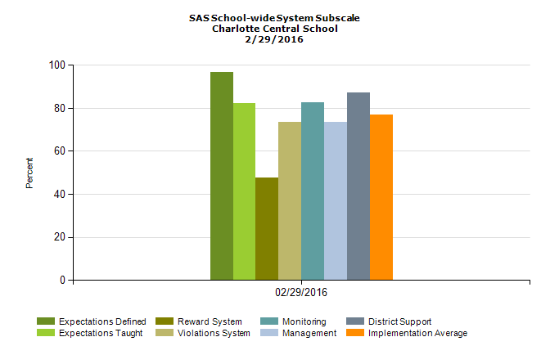
What does CCS Staff think is in Place?

Slide 5
What’s Missing?
PBIS Team
CCS Staff
Acknowledgement System!

Slide 6
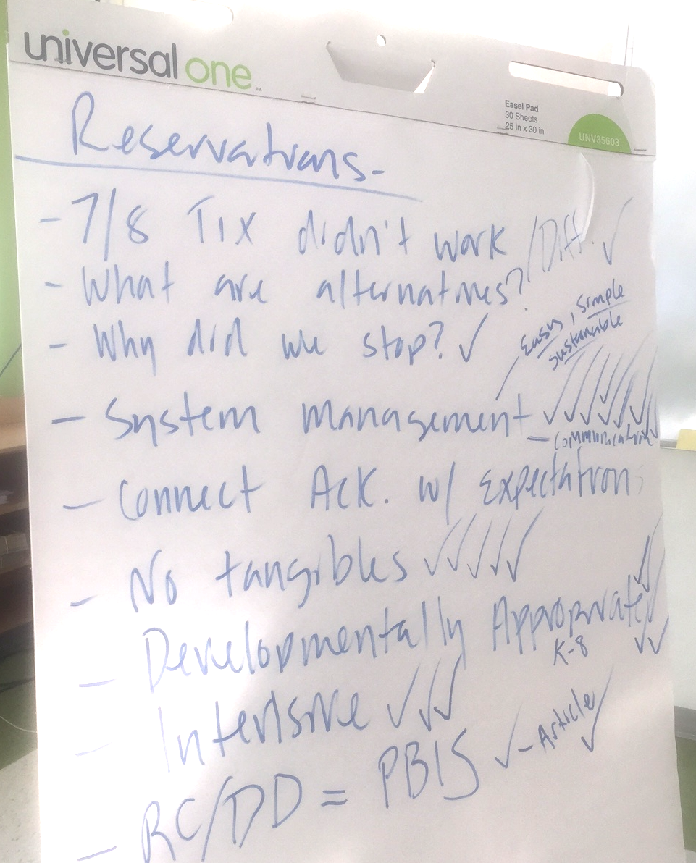
What our Staff told us?
Grades ⅞ -Tickets didn’t work
System Management - Easy, Simple, Sustainable
Connect with School-wide Expectations
No tangibles
Developmentally Appropriate
RC/DD + PBIS = CCS

Slide 7
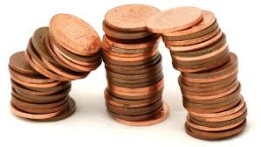
Our NEW System: What does it look like?
At CCS, Taking CARE of Ourselves, Taking CARE of Others and Taking CARE of this Place……
Just makes “cents”!

Slide 8
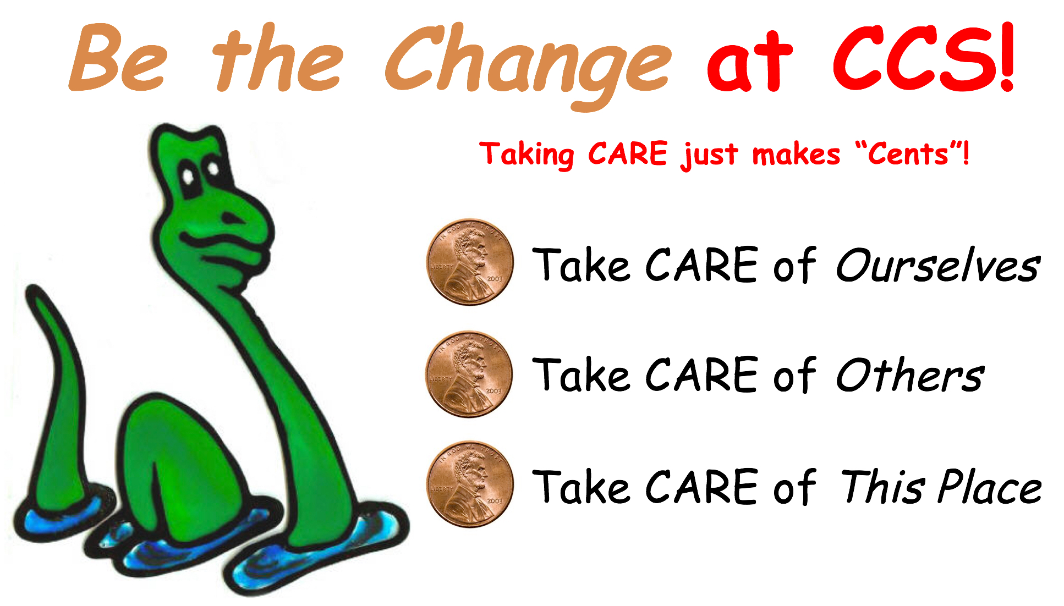
What is it called?
Be the Change!

Slide 9
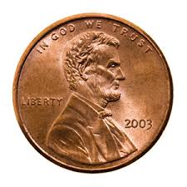
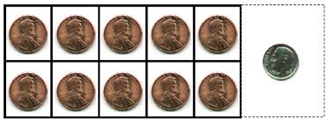
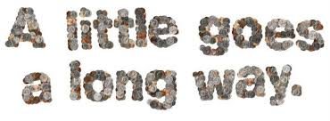
Why the Penny?
Building on CCS’s strong “cents” of community and values, the penny allows CCS to engage in…
Sustainable practices
Educational opportunities
“Paying” it forward

Slide 10
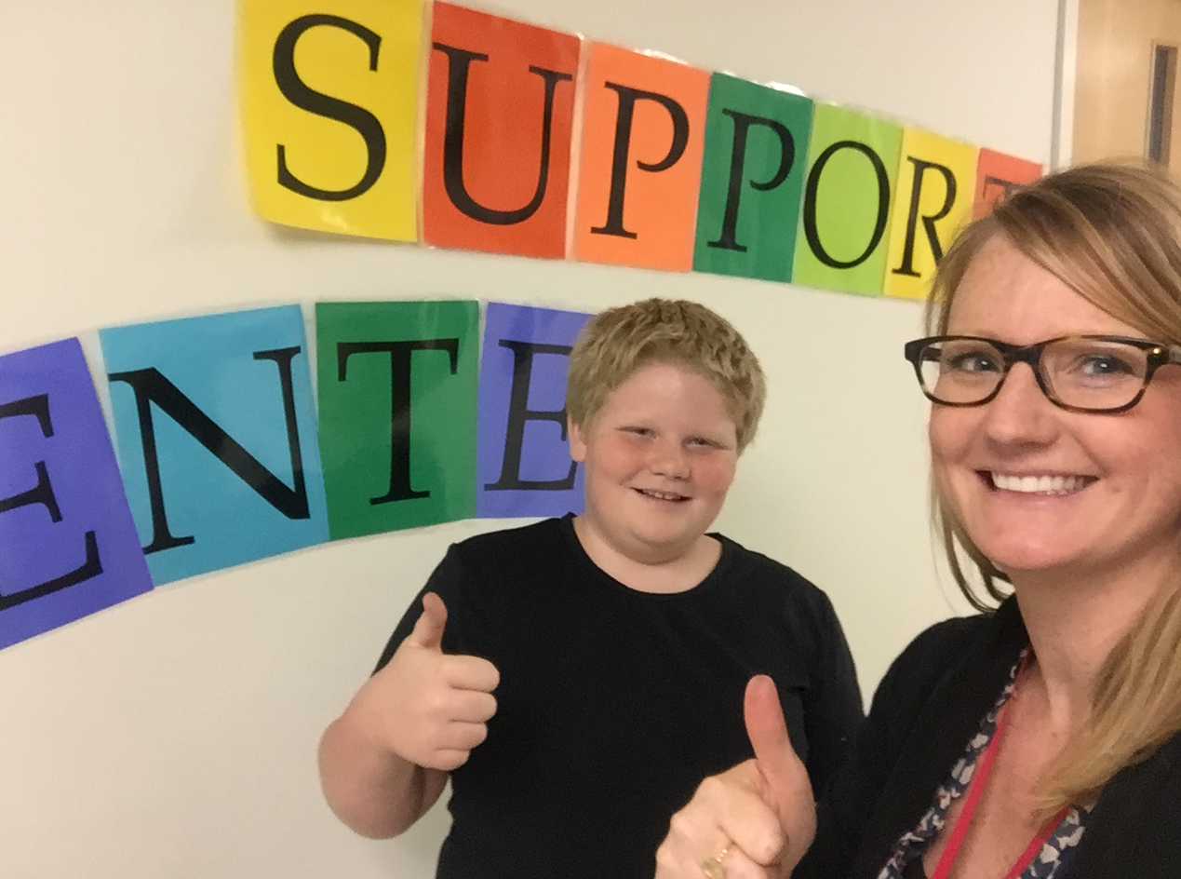
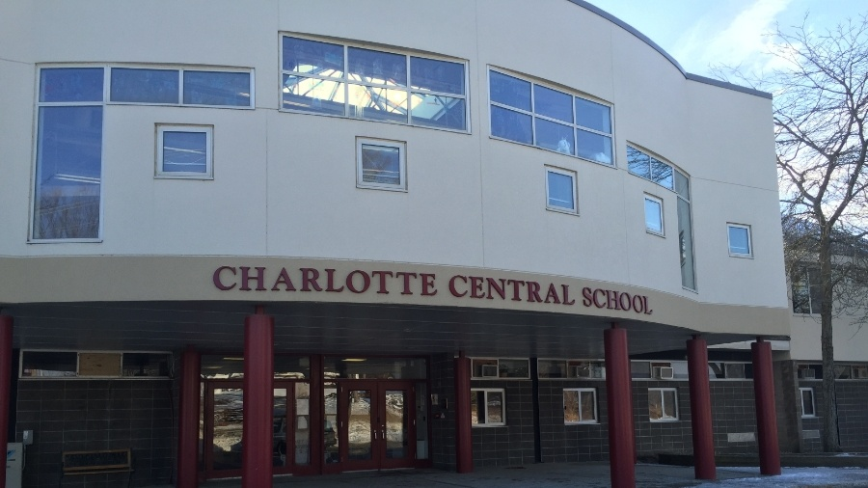
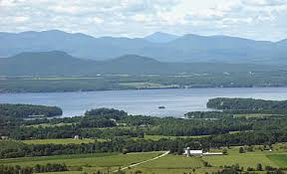
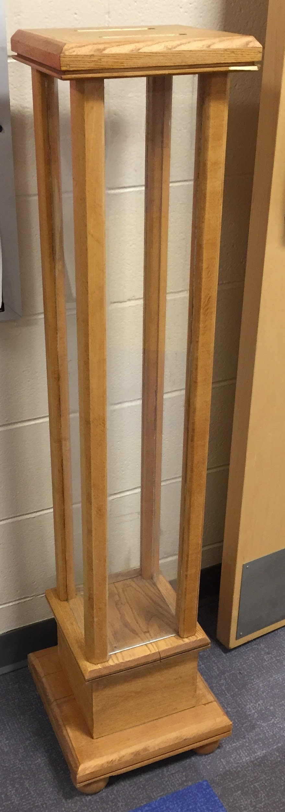
“Paying” it Forward
“Paying” it forward
Individual
School
Community
Local Organization
Lake Champlain Clean-up
Humane Society
VT Organization
Notes:
Students, staff and families will vote to determine the organization CCS will donate too.

Slide 11
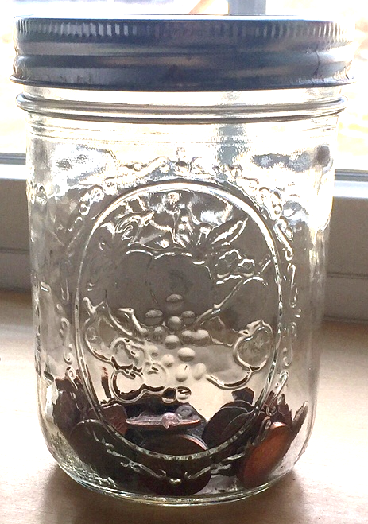
How do Students Get It?
When students demonstrate the school-wide expectations - Take care of ourselves, others and this place:
Give the student specific feedback connected to the expectation and provide them the option to put the penny directly in the school-wide jar or classroom jar

Slide 12
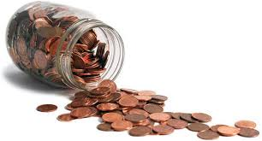
What do Students do with it?
Classroom
School-wide

Slide 13
“Be the Change” in Action!
https://drive.google.com/file/d/0B-4_Lb_IN_OON29RdEdUa1hWeW8/view

Slide 14
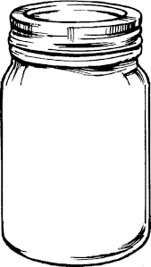
Classroom Celebrations -
Keep it Simple & Have Fun!
You and Your Students Set Goals and Determine Celebration!
PJ Day!
Extra Recess!
Play Games!

Slide 15
Classroom vs. School-wide Celebrations
Celebration should be immediate - something we can live with…
Each classroom has the autonomy to set their own “Class-wide” goal
During every School-wide Assembly, classrooms are invited to deposit their change in the school-wide tube.
Once the tube is full, CCS will donate the pennies to an organization (TBD by the entire school community)

Slide 16
Building a Positive Community….. Starts with Us!
Staff Acknowledgement:
Be (See) the Change!
Note Cards!
Located in the Staff Room & Mailroom

