Slide 1
When the Stars (Initiatives) Align, School is a Brighter Place
Lauralee Keach, VTPBIS State Team
Megan Goyet and Lisa Rundle, Chamberlin Elementary School
Notes:
One of the most challenging tasks districts and schools currently face is aligning and integrating varied evidence-based frameworks, initiatives, programs, and practices. This workshop will address how Restorative Practices (RP), Responsive Classroom (RC), Social-Emotional Learning (SEL), and Trauma-Informed Schools can all be organized within a PBIS framework, and how a school’s climate-related work can be embedded within academics to help reduce initiative fatigue. There will be opportunities for networking around challenges and solutions. A variety of examples, planning tools, and strategies will be shared that will empower and equip your school leadership team to embark upon this important work. A Vermont school district will share their alignment and integration journey.

Slide 2
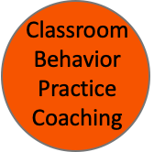
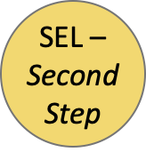
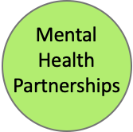
How many is your school trying to implement?
Notes:
And on top of all this, you’re trying to teach kids how to read and write?!

Slide 3
Agenda
The “What,” the “Why,” and the “When”
Overview of Evidence-Based Frameworks/Initiatives/Programs/Practices
The “How,” the “Who,” and the “Where”
PBIS/MTSS Framework
Embedding Within Academics
Chamberlin’s Alignment and Integration Journey

Slide 4
During this session, consider:
What will you be able to implement?
How will you know you’re implementing it well?
How will your most vulnerable students benefit?
How will you/your team sustain what you’re implementing?

Slide 5
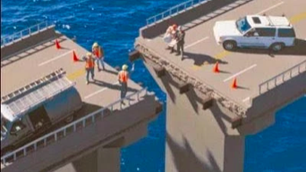
What is Alignment?
“To be in precise adjustment or correct relative position”
“The proper positioning of parts in relation to each other”
Organizational Alignment:
“The simultaneous implementation
of multiple initiatives with
efficiency and effectiveness”
From Alignment, Implementation and Educational Excellence Presentation at OSEP IDEA Conference 2015
Steve Goodman, Michigan (MiBLSi) & Rob Horner, University of Oregon

Slide 6
What is Integration?
Different parts of a system are made a functional and structural whole
Resources are leveraged to build upon each other
From Alignment, Implementation and Educational Excellence Presentation at OSEP IDEA Conference 2015
Steve Goodman, Michigan (MiBLSi) & Rob Horner, University of Oregon

Slide 7
“It is not the pace of change that is the culprit,
it is the piecemealness
and fragmentation
that wears us down.”
Fullen, 2003

Slide 8
Why Align?
Situation: Increased focus on school climate, social/behavioral health, school safety, and the impact on academic outcomes; resources are limited
Status: Various approaches to promote social-emotional competence that are not sustainable when implemented separately
Often districts have more programs/initiatives/practices than can be implemented well (Domitrovich et al., 2010; Sugai, & Horner,
Need: Schools must be organized in a manner that is highly strategic, efficient, relevant to school mission and values statement, and effective
Notes:
Consider the school CIP- include SEL goals and alignment. Good way to ensure they address school mission and value statement
Use principles of Implementation Science to provide the framework for organizing and aligning the initiatives

Slide 9
When to Align?
Start thinking about alignment while in the exploration phase
Select interventions based on actual need, contextual fit, and evidence base, with an eye toward efficiency and sustainability
PBIS Forum in Brief: Aligning and Integrating Mental Health and PBIS to Build Priority for Wellness (From PBIS Forum Round Table Discussion – December 2017)
Notes:
Exploration phase: how will the initiative connect with the others, how does it meet the same and different goals/outcomes, what does it look like fully implemented with the other initiatives

Slide 10
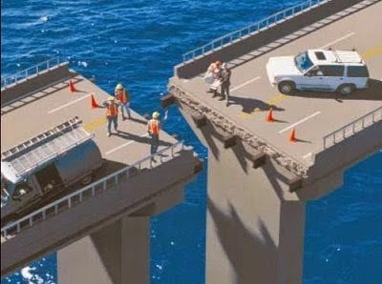
Alignment Challenge
Interventions may not always be selected based on actual need, contextual fit, evidence base, or with an eye towards efficiency and sustainability

Slide 11
How would you rate the need for alignment in your school/district?
1. High need
2. Medium need
3. Low need
What systems do you have in place to support alignment of positive school climate initiatives?

Slide 12
PBIS Components
Common purpose statement
Leadership Team
Define 3-5 positively-stated behavioral expectations
Systems for teaching behavioral expectations
Systems for acknowledging behavioral expectations
Systems for discouraging problem behaviors
Data management systems

Slide 13
What are Restorative Practices (RP)?
Proactively build healthy school climates by intentionally creating space for people to understand one another and develop relationships
Meaningful opportunities for social engagement that foster empathy and mutual responsibility for the well-being of individuals and community
When things go wrong, engaging those affected and creating space so individuals and communities can identify, understand, and address harms/needs in order for all to heal
Whole School Restorative Approaches Resource Guide

Slide 14
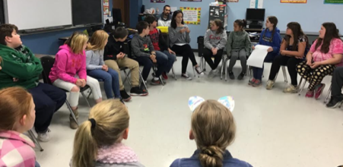
Big Ideas:
Those who feel connected to their community are less likely to harm,
more likely to want to repair harm when it happens, and more likely to accept consequences.
All members of the community should feel that their “presence is vital to their learning community’s success.”
Whole School Restorative Approaches Resource Guide
Highgate's PBIS/RP Document

Slide 15
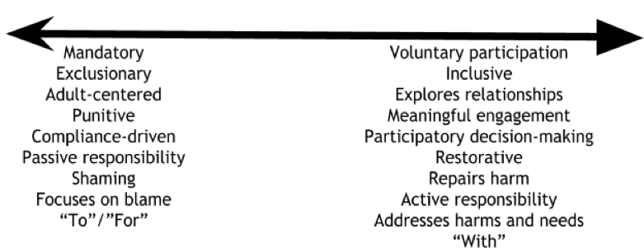
Shifting Practices/Policies/Procedures
Reminder: this is a mindset shift for many

Slide 16
Consider 1-2 social/emotional/behavioral interventions you have in place. Where do they fall along the continuum? How might you shift them to be more restorative?
Notes:
Breakout groups in school teams

Slide 17
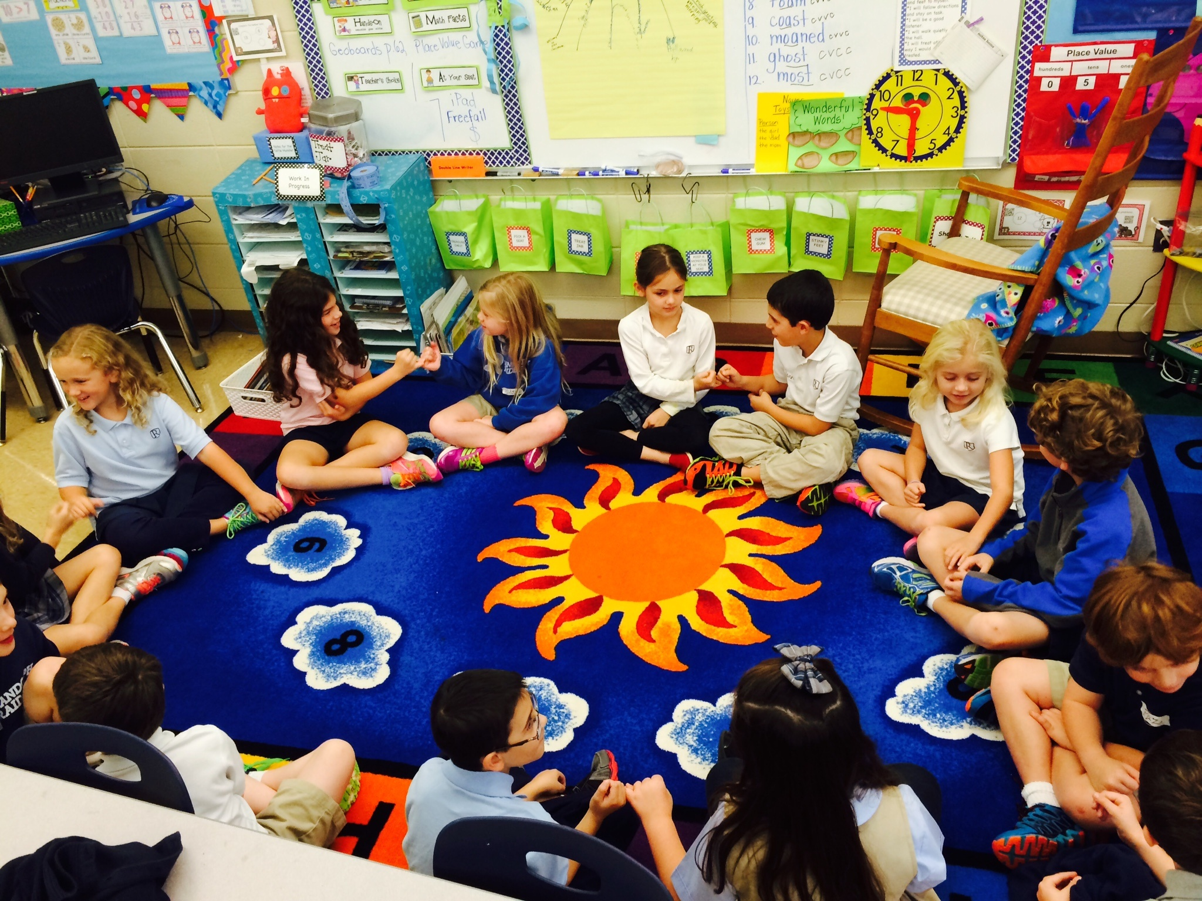
What is Responsive Classroom (RC)?
Evidence-based approach to teaching and discipline
Engaging academics
Active, interactive, meaningful choices
Positive community
Morning Meeting
Shared purpose
Effective teacher language
Effective management
Routines
Developmental awareness
What do you see listed here that links with PBIS and RP?
Notes:
All are evidence-based
All are meant to create a positive, safe community
Meeting (RP circles)
Shared: common language, goals, purpose
Teacher language: use commone language re: expectations, consequences, etc.
Management/Routines: PBIS consistent expectations, response to behavior, specific expectations in routines or locations
Developmental awareness: appropriate language, expectations (modifications based on age/grade), consequences, rewards/celebrations

Slide 18
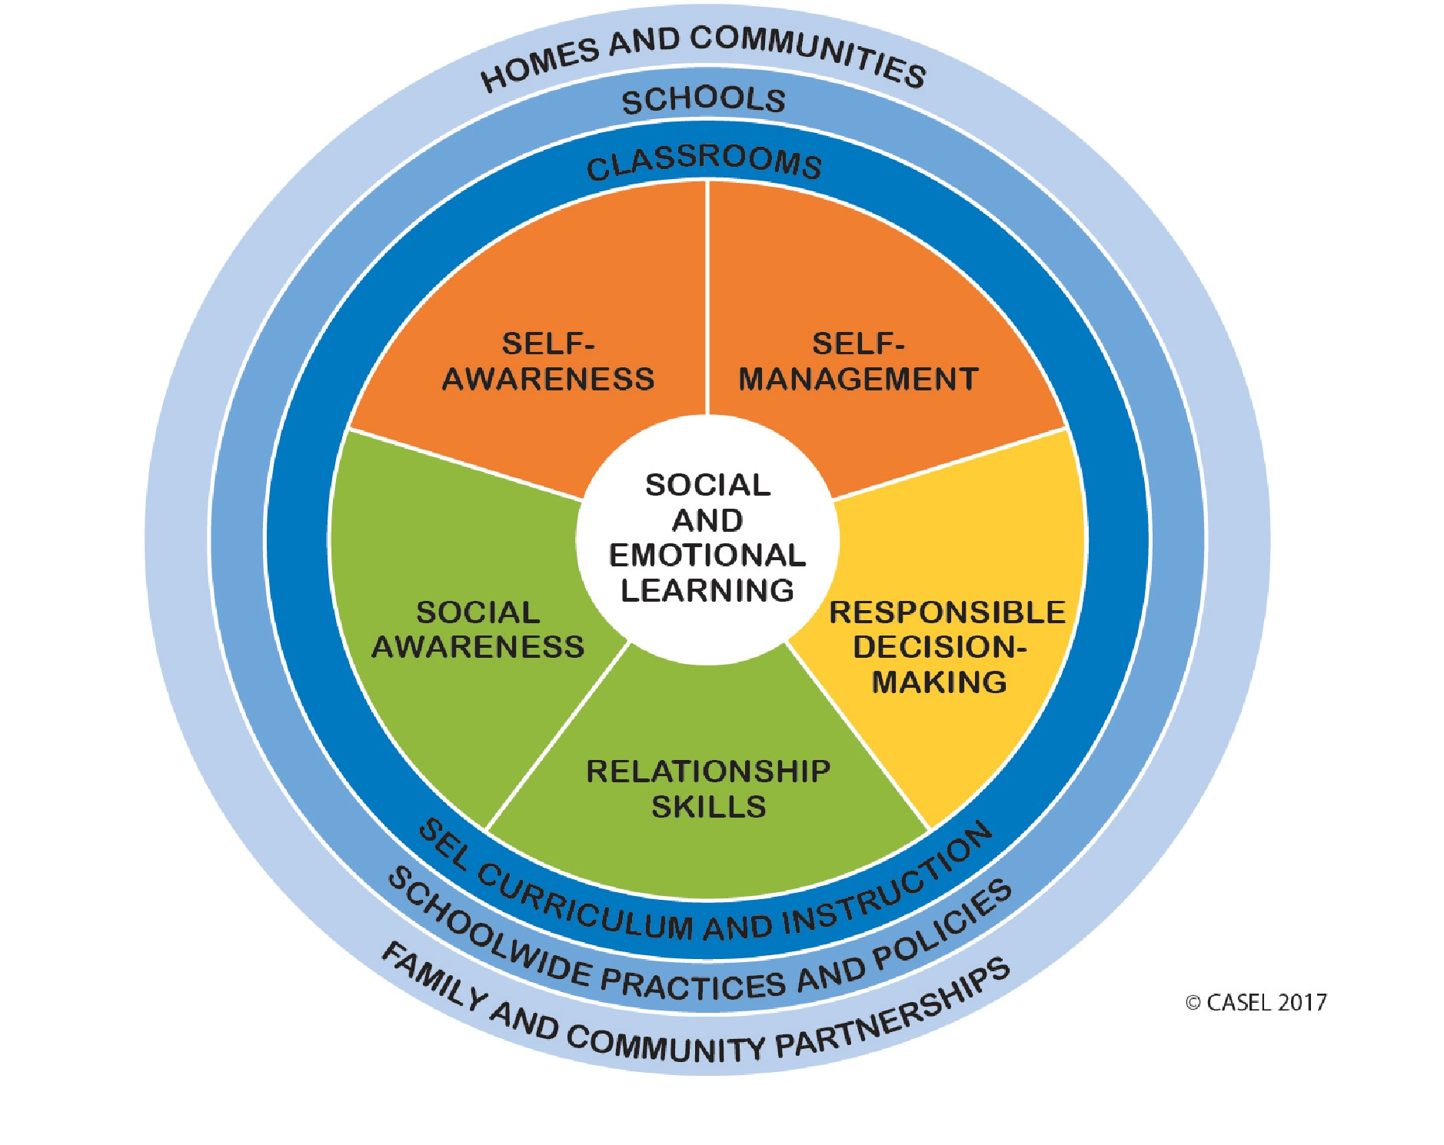
What is Social-Emotional Learning (SEL)?
Understanding and managing emotions
Setting goals
Showing empathy for others
Establishing positive relationships,
Making responsible decisions
CASEL
How does your school help students & adults develop SEL skills?
Notes:
CASEL: resource for SEL information and researech, tools, school wide resources
Break out group in school teams

Slide 19
What are Trauma-Informed Schools?
Adults in the school are prepared to recognize and respond to those who have been impacted by traumatic stress
Students are provided with clear expectations and communication strategies to guide them through stressful situations. The goal is to not only provide tools to cope with extreme situations but create an underlying culture of respect and support.
Treatment and Services Adaptation Center
What do you see here that links with PBIS, RP, RC, and SEL?

Slide 20
What do you notice about all of these?
Whole-school
Positive
Proactive/prevention-focused
Same end goals in mind
To build a safe, respectful, and productive learning environment
To establish a positive school climate where students and adults have strong, positive relationships and students understand what is expected of them as learners at school

Slide 21
How can they all be aligned/integrated?
Notes:
Implementation Science: consider the framework of implementation science and how an initiative can be successful using those principles
Continuum: MTSS principles
Outcomes- academic and behavior data and use data-based decision making

Slide 22
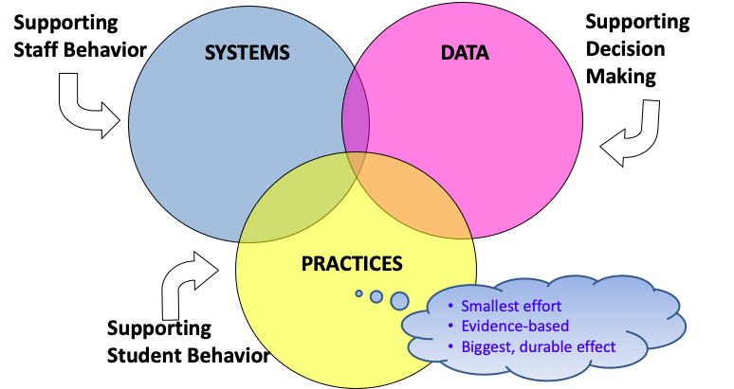
Sustainability
Notes:
Systems: Use Initiative Assessments, working smarter not harder matrix
How can data systems be aligned to provide information on the outcomes of individual initiatives as well as the combined effect of the initiatives
Practices: the more the initiatives are aligned, the more effective they will be. More likely to be implemented by adults, more likely to get accurate data

Slide 23
Why a Systems Approach?
Ensures practices are implemented as intended (with fidelity)
Ensures consistency across the school
Consider readiness, buy-in, training
Can examine outcomes
Notes:
Implementation Science (readiness and buy in)

Slide 24
How can you embed within academics?
Goal: Weave together academic + behavioral instruction/content into one seamless experience for students
Consider where natural connections exist
i.e. connect behavior expectations to related reading stories that deal with social interactions/values, facilitate a circle on topic of essay before beginning to write
Directly connect behavioral + academic expectations
i.e. describe that being responsible means engaging in class instruction (and what this looks like)
Incorporate proactive + positive behavior supports into lesson planning
i.e. planned prompts and specific praise statements for students for attending, participating and completing academic tasks
https://www.pbis.org/resource/classroom-integrated-academics-and-behavior-brief

Slide 25
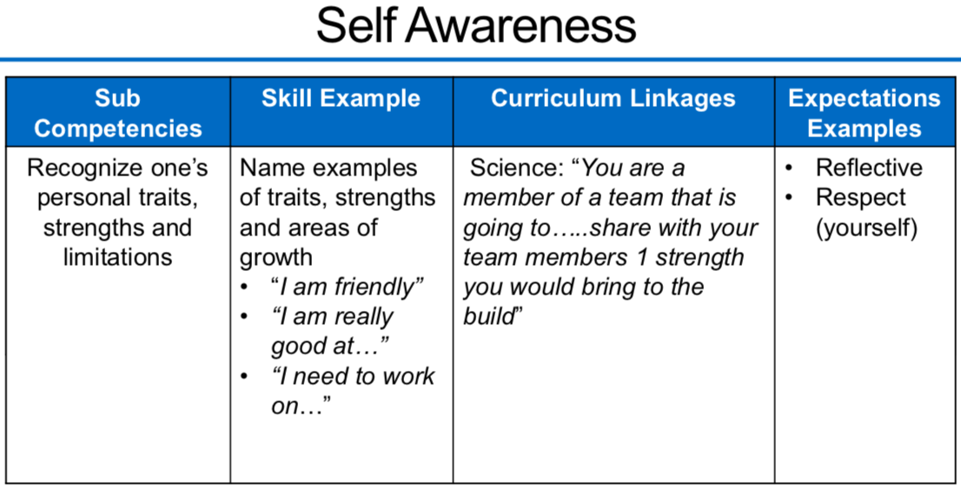
Link competencies, sub-competencies, skills, academic curriculum, and school-wide expectations
Anchoring Social-Emotional Wellness Skill Instruction Within Universal Intervention, The Boggs Center on Developmental Disabilities Rutgers, The State University of New Jersey, 2018-2019

Slide 26
Tools
Working Smarter Not Harder
Inventory
Alignment Guide
PBIS Staff Handbook (with RP infused)

Slide 27
Other Resources
VTPBIS Website
PBIS.org
PBIS and Trauma-Informed Schools

Slide 28
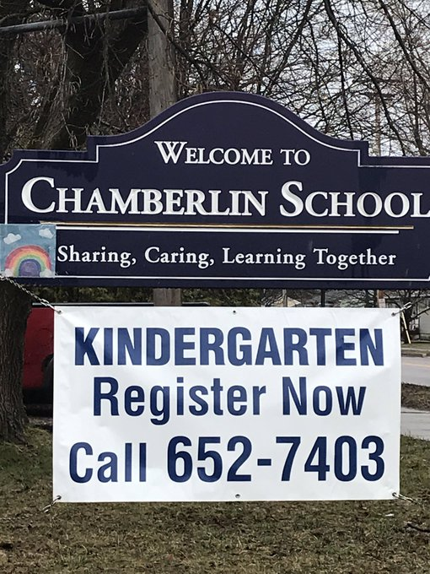

Slide 29
Initiatives
All district initiatives come from the District Continuous Improvement Plan
PBiS
Resiliency/Trauma Informed Practices
Restorative Practices
There are district level teams as well as building based teams.
Chamberlin has explored how these align and developed practices that focus on these initiatives.
In 2018 Chamberlin incorporated Second Step as a Social Emotional Curriculum Universally.
Notes:
Attend team meetings to share information with teachers re: Targeted and Intensive Interventions, problem solve, share student data, for bx support team to get information about targeted interventions
Administrative support:using PD opportunities, incorporating feedback, staff self-care
Share challenges and problem solving process

Slide 30
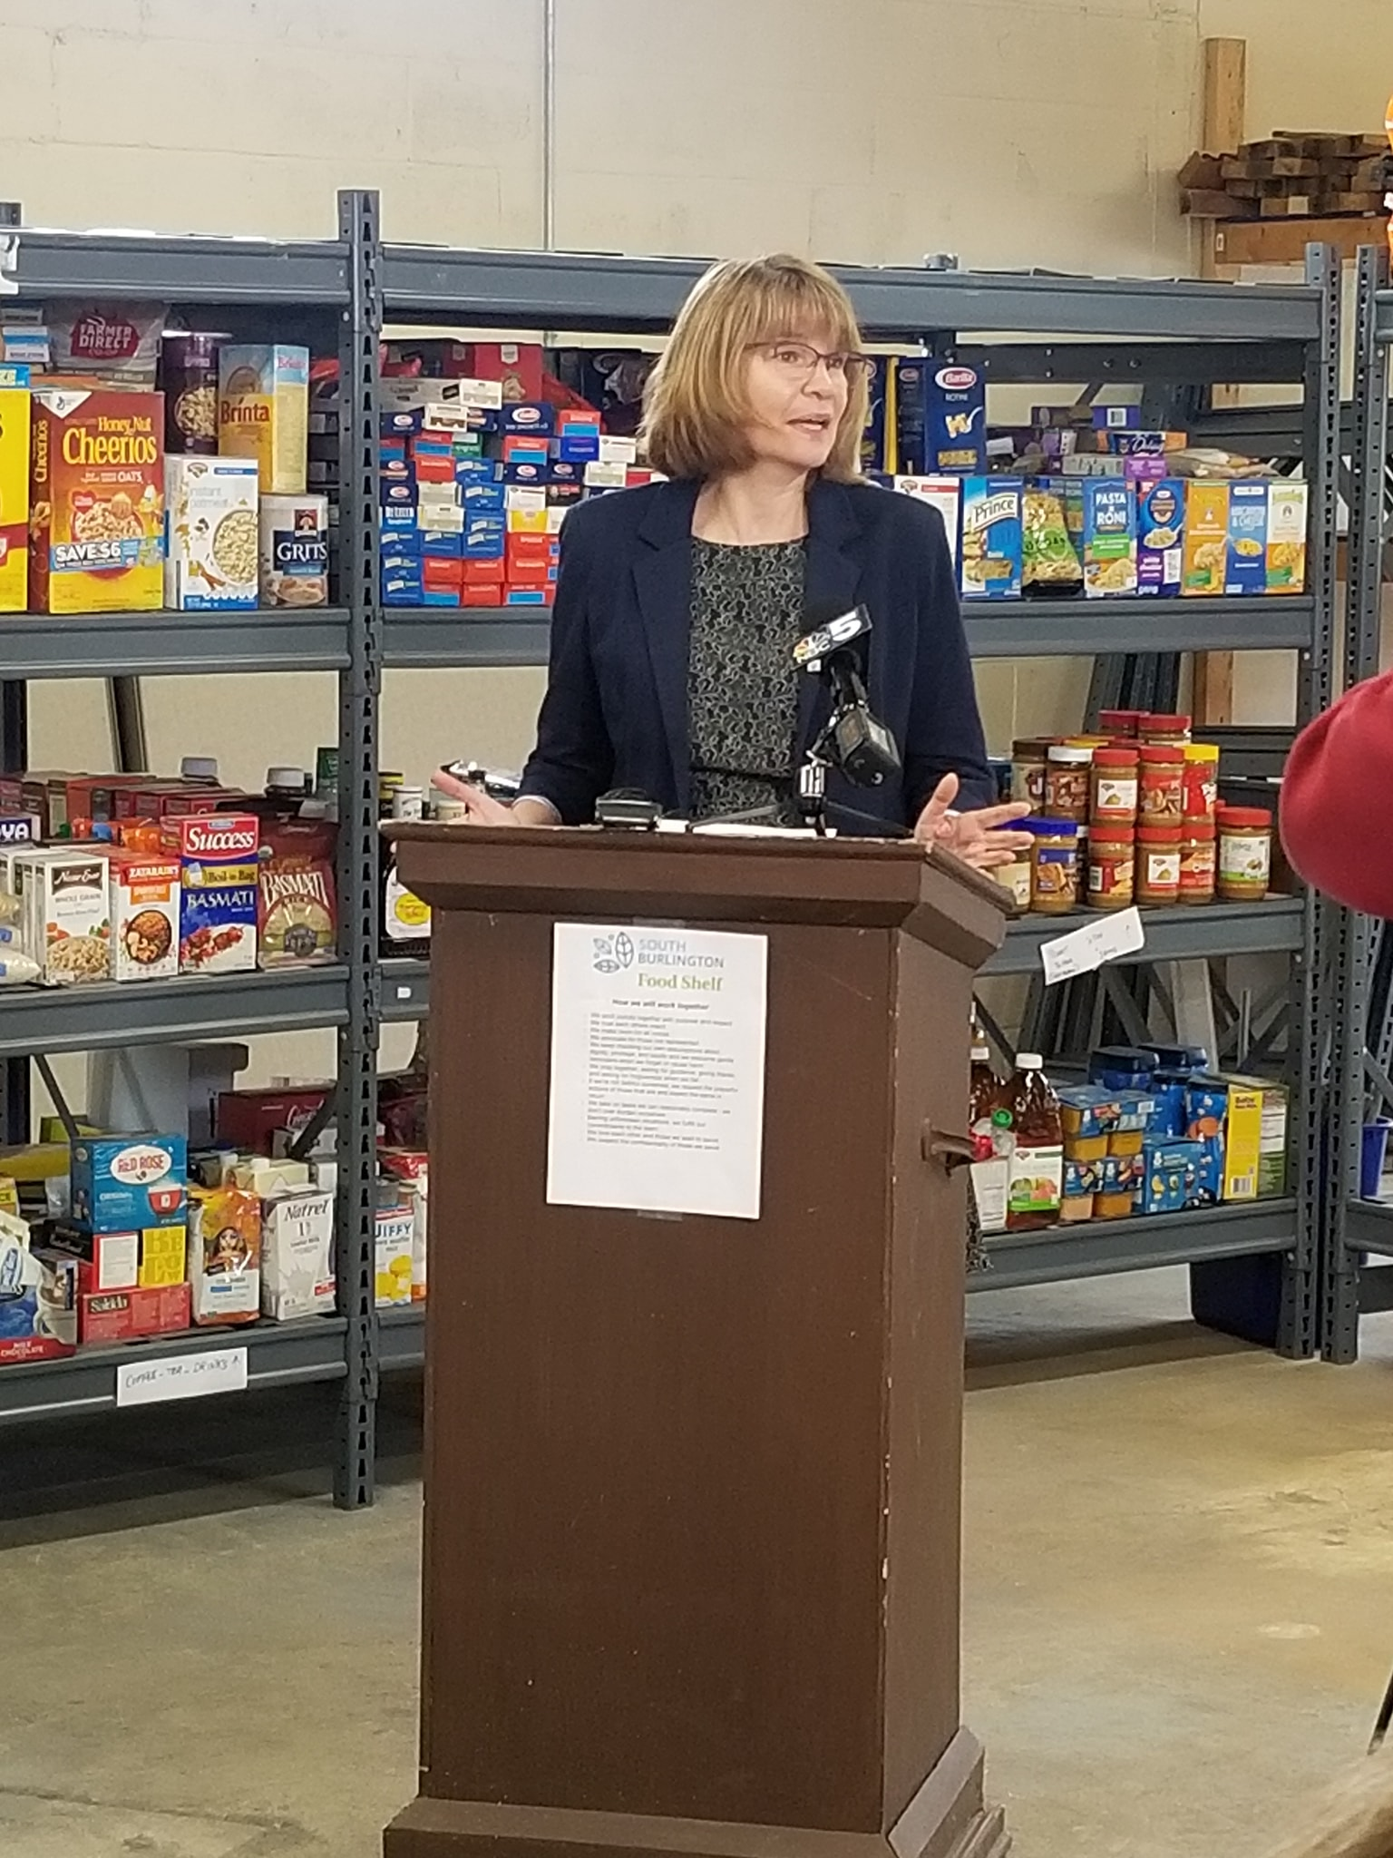
Notes:
Our Principal supports all of our initiatives in school and the community.

Slide 31
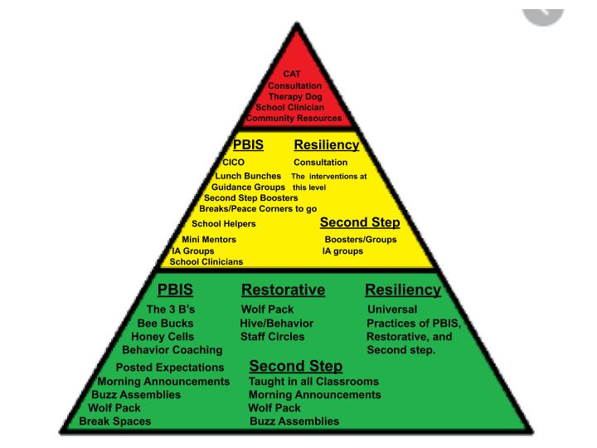
Our Practices

Slide 32
Data
We use data to guide our interventions.
TFI: Yearly
SAS: Yearly
SWIS: at least twice a month
SAEBRS (goal of 3xyear)
Second Step Assessment data (end of year)
Reflective practice data of coaching practices(coaching focus)
Layered/Targeted supports grid
Nurse visits
Attendance
Data Wall
Staff feedback
Notes:
Challenge: Including SAEBRS in data wall. A shift in thinking and practices. Having all PBIS team members at meetings. Making data collection a priority.

Slide 33
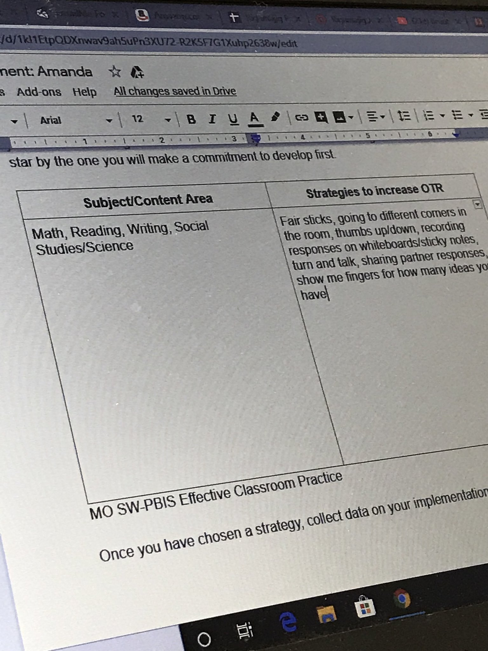
Notes:
Ongoing training. This was one of our PBIS coaching around evidence based practice.
Alignment: Aligned with SWPBIS, extends PBIS to the classroom. Resiliency: much of the coaching is around practices that promote predictability and safety for students. Restorative this particular one promotes voice.
Challenges: Staff Buy In.
How we overcome: Administrative support. Teachers seeing success in their practice.

Slide 34
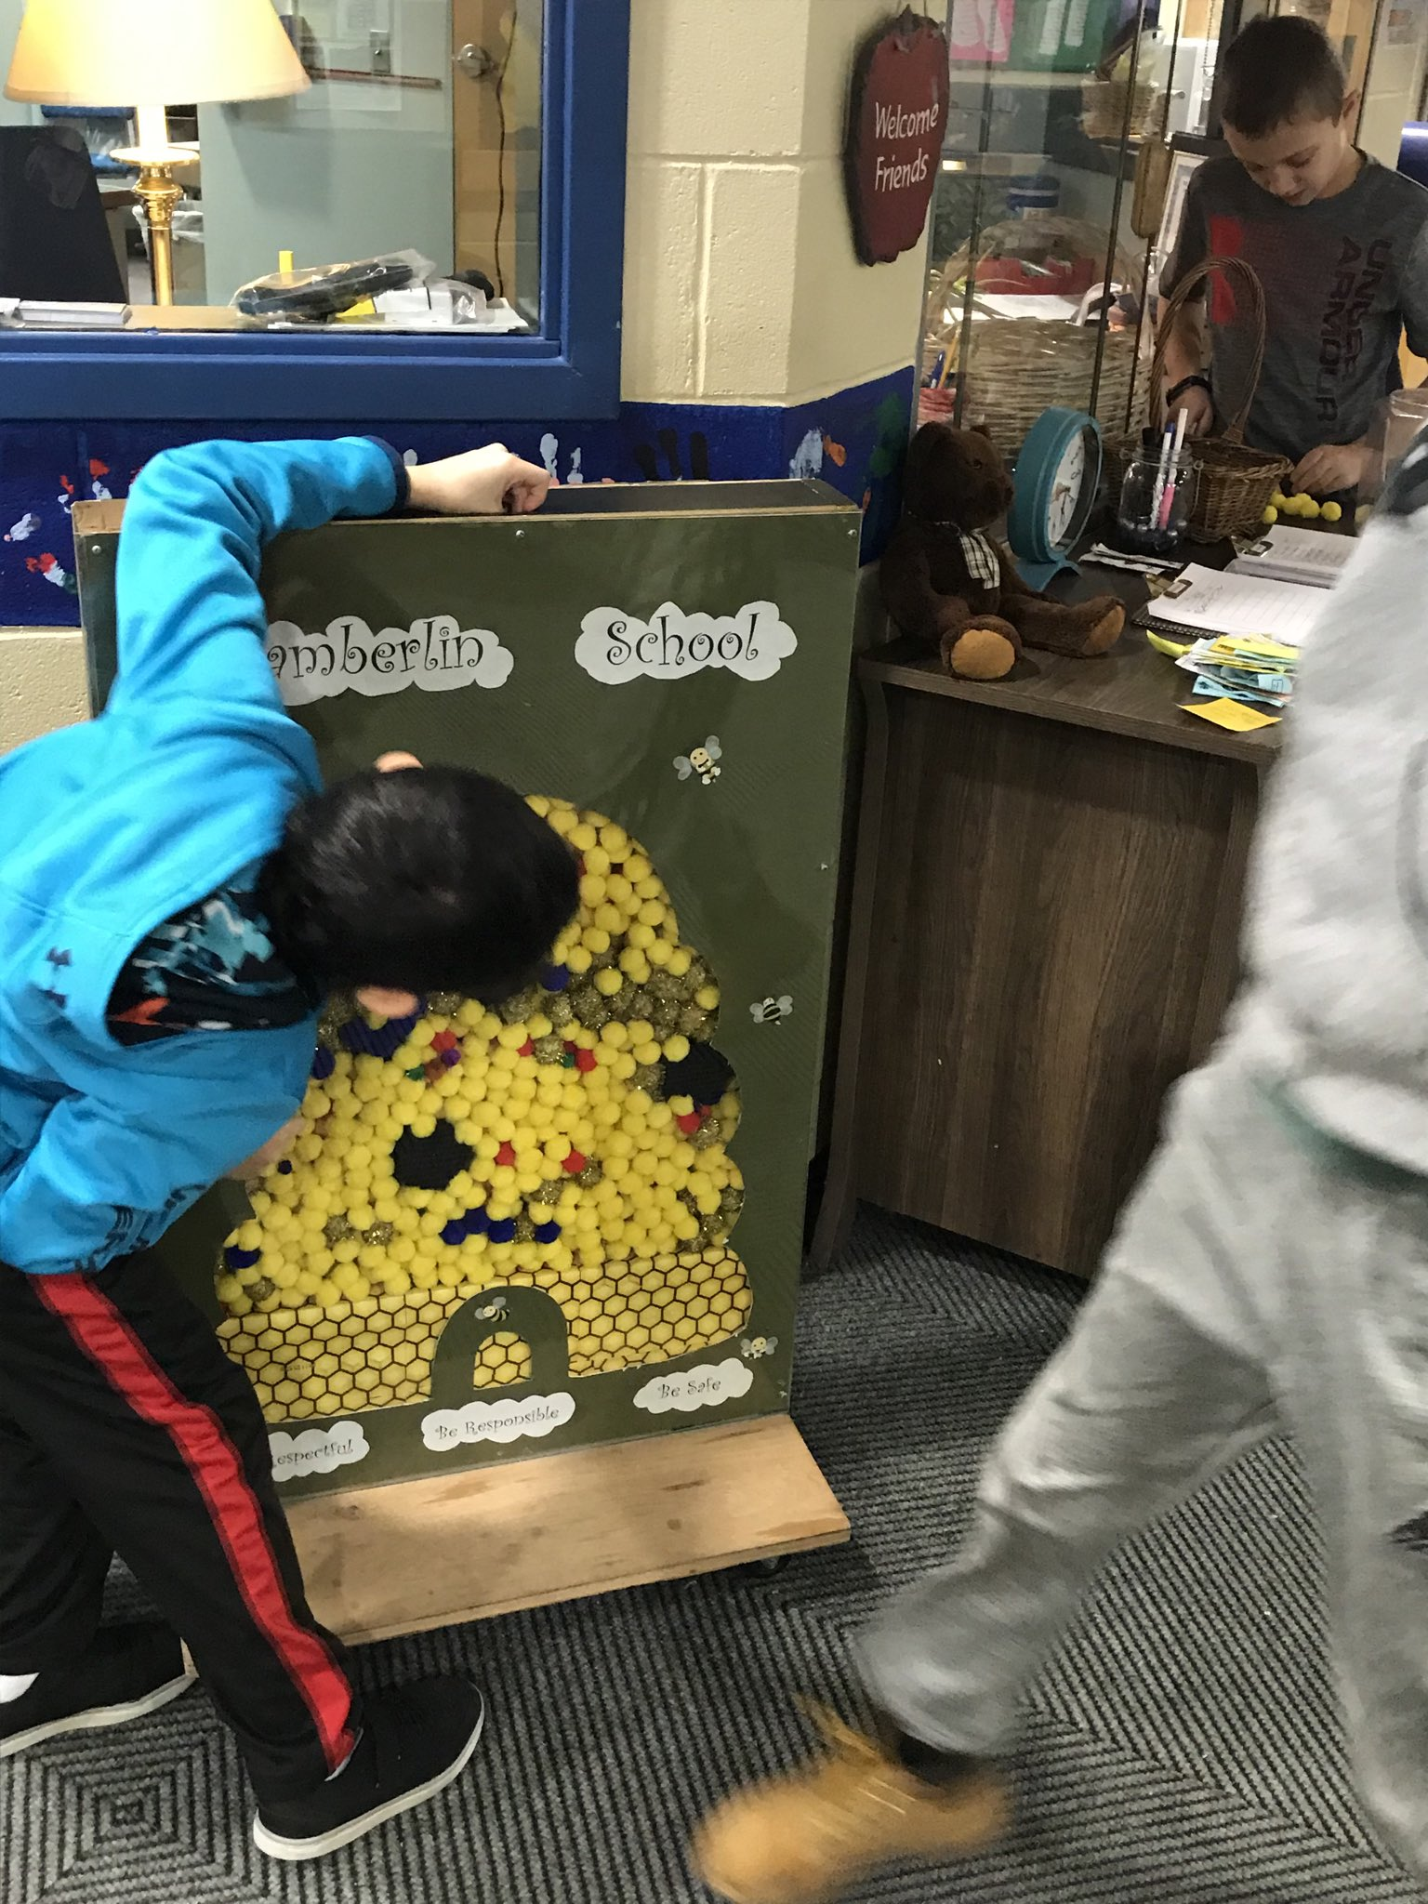
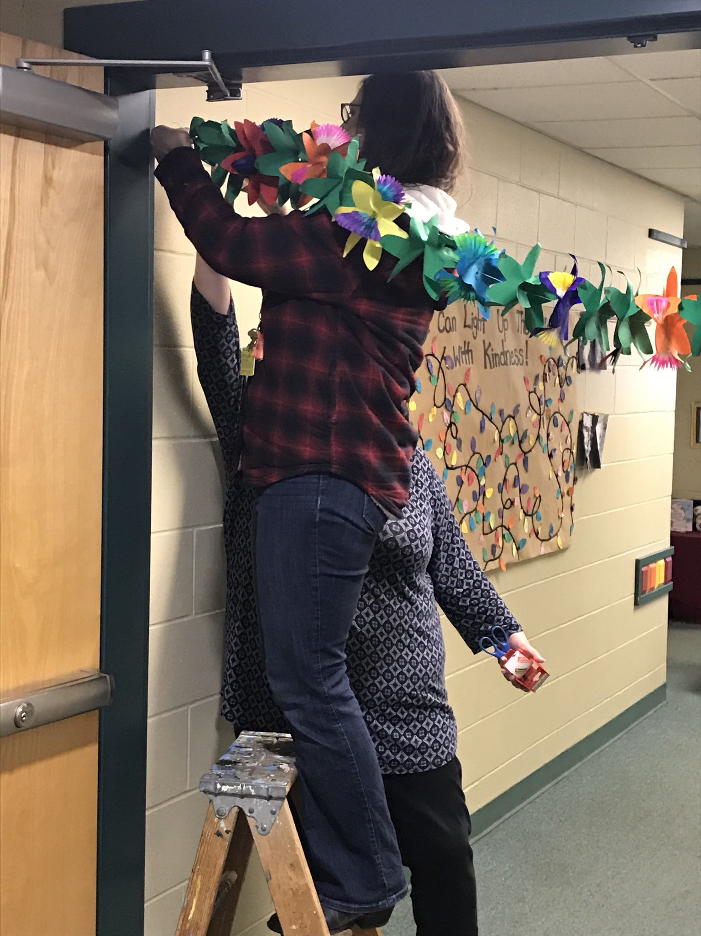
Notes:
This is our Hive. Students cash in Bee Bucks for honey cells and when the Hive is full we do an all school celebration. The next photo is of the PBIS staff decorating for the all school celebration, Tropical Day! Specific Positive Praise and acknowledgement is part of Coaching.
Alignment: Resiliency promotes safety and predictable routines. PBIS foundation
Challenges: When first started staff buy in and consistency.
What we did: support from administration. Staff successes. Teams.

Slide 35
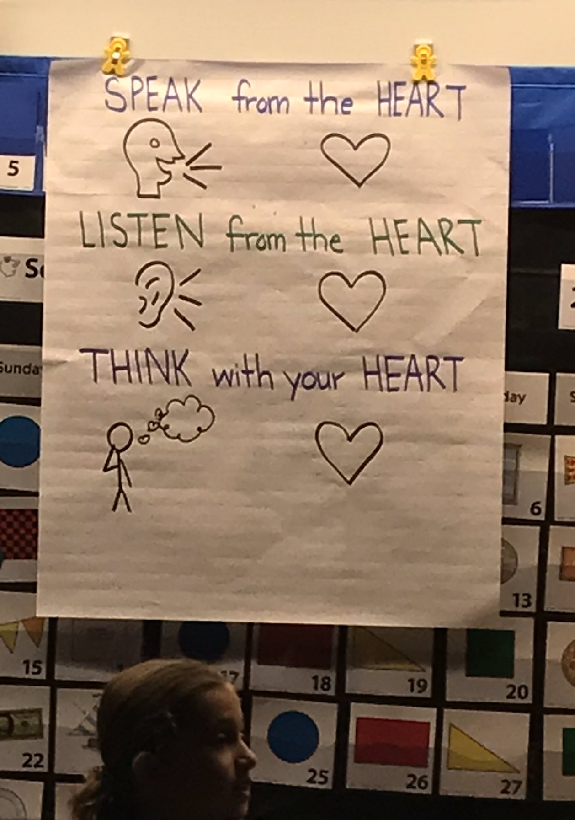
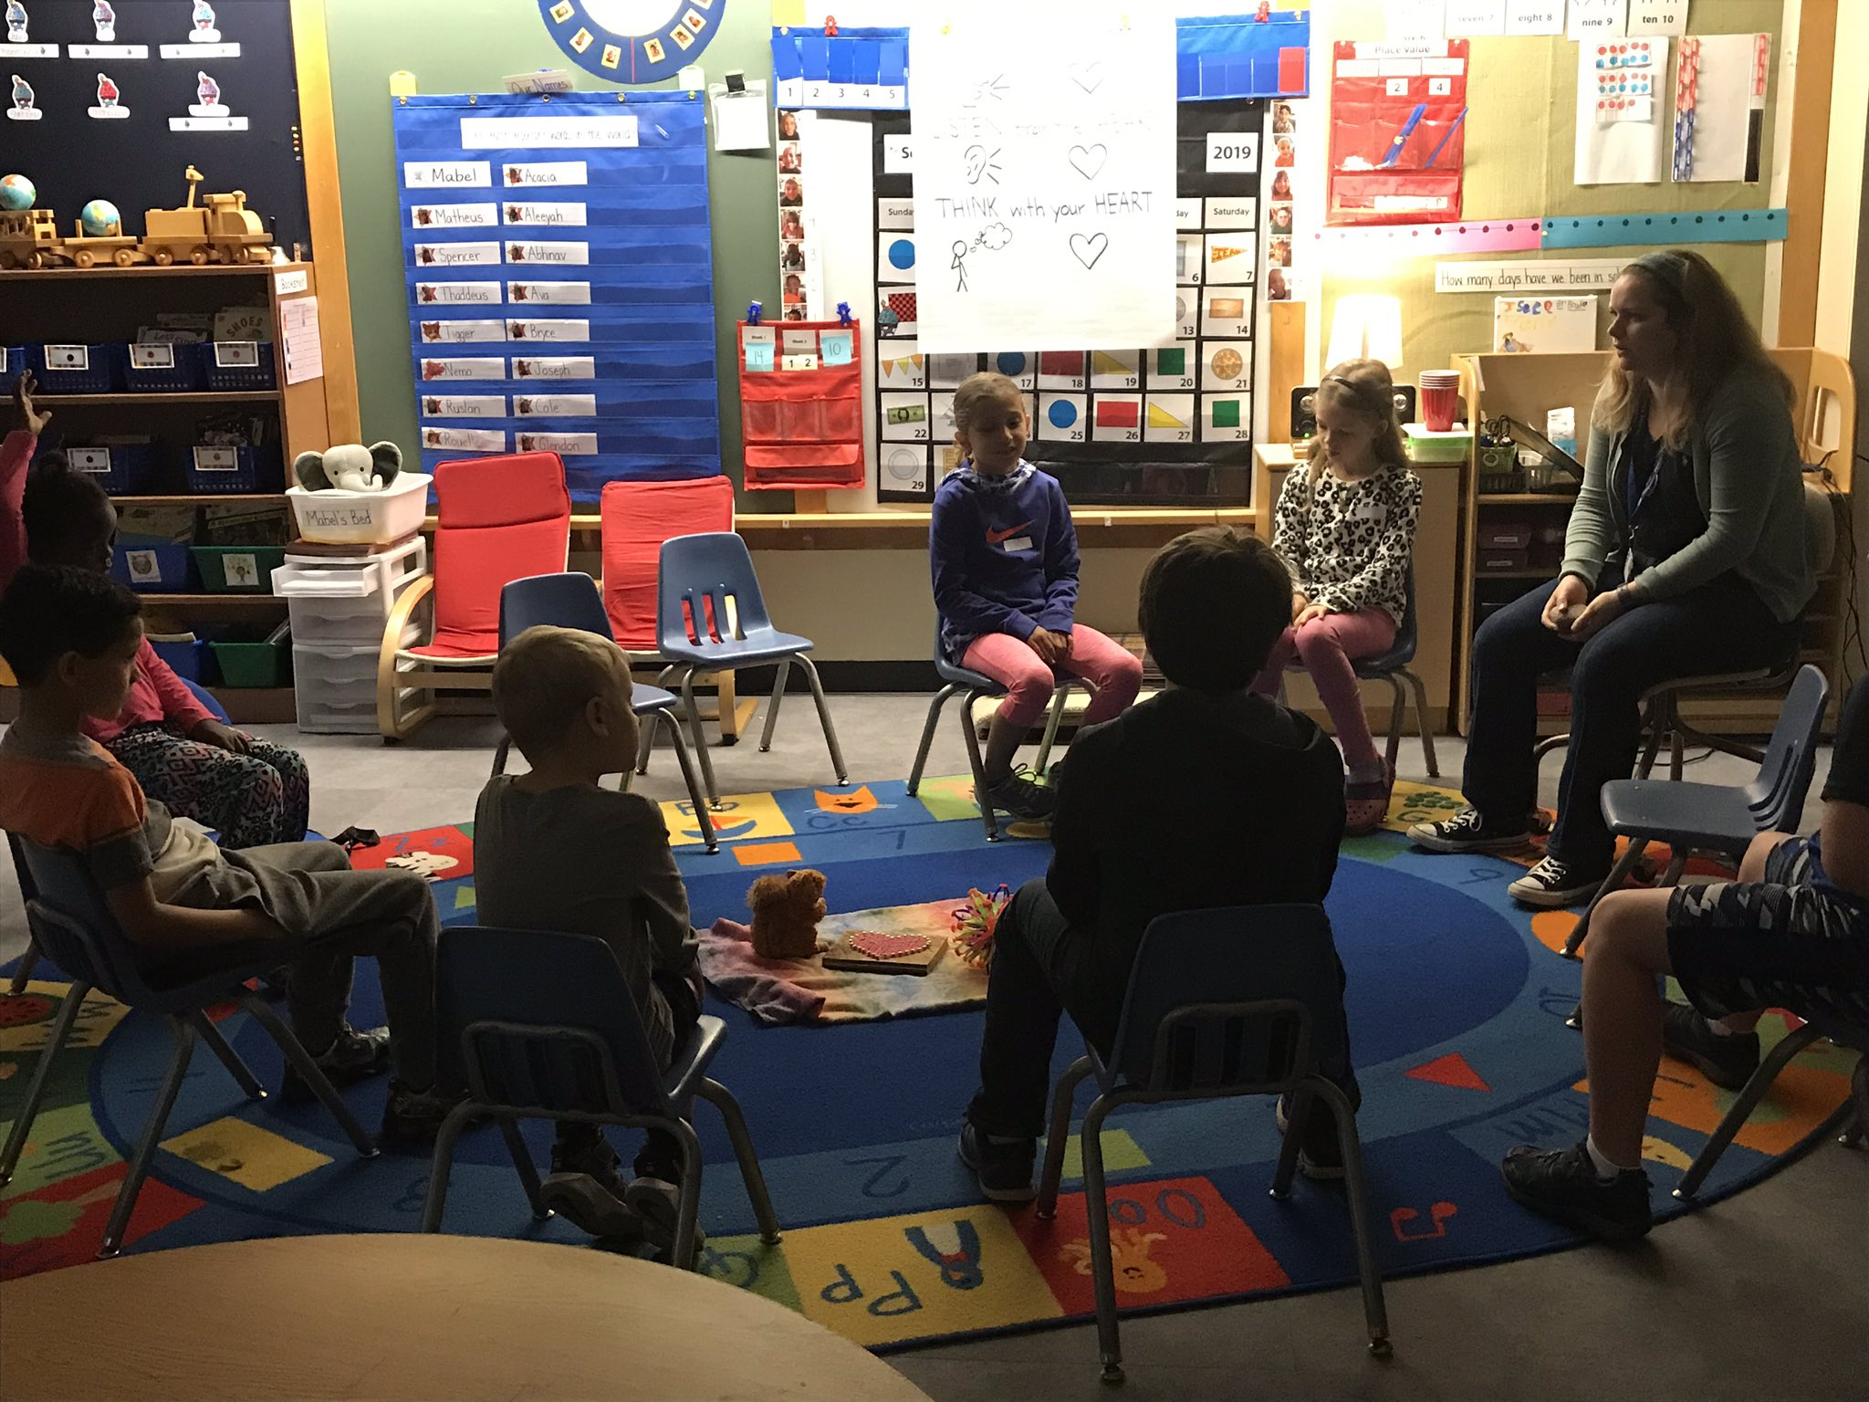
Notes:
This is a Wolf Pack group. A Universal Restorative Practice. The entire school is divided into groups of 9 students and a leader to practice circles, do a cooperative activity tied to Second Step and use PBIS language. This is a multi-age group that will stay together throughout their tenure at Chamberlin School. The hope is to develop strong relationships and trust with other adults and students. The second photo is the agreements that were made for this particular Wolf Pack. There will also be a learning intention posted for each group. The agreements may be different but the learning intention is the same school wide. Wolf Pack time happens once a month.
Alignment: PBIS language, Second Step focus of the month, Done in restorative circle format, provides connection and safety
Challenges: Staff Buy In, Carving out time, grouping students, Lessons
What we did: Support and leadership from Principal, Looking at our schedule and using an assembly time, random student assignment with some targeted grouping and not changing unless necessary, using lessons from another school as template, assigning tasks to team members.

Slide 36
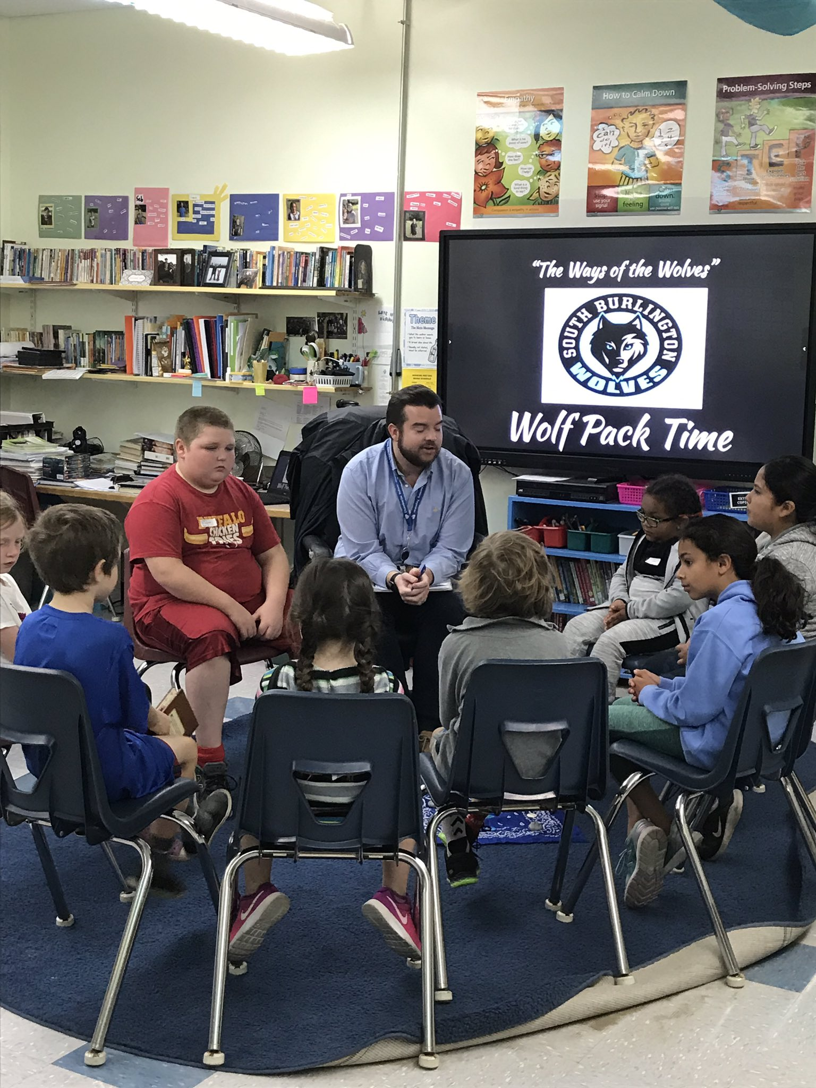
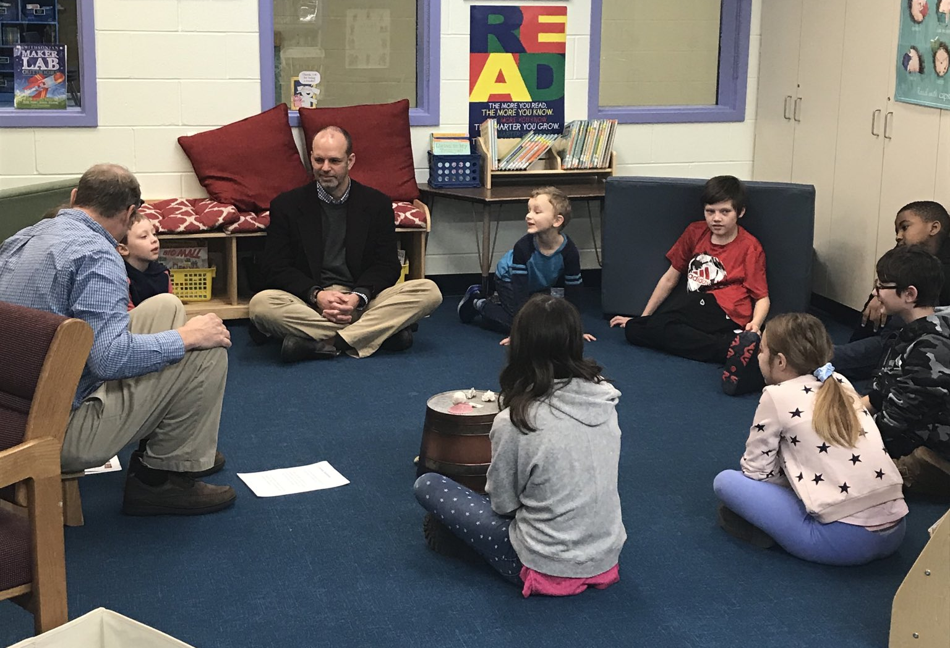

Slide 37
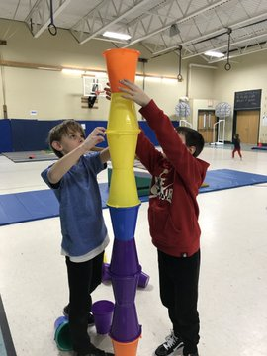
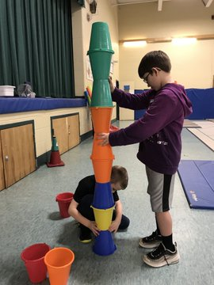
Notes:
Second Step Boosters were provided by behavior staff, clinician, and Integrated Arts Teachers.
This is one of our Second Step Booster groups in P.E. This group was focusing on cooperation, using their words and problem solving.
Targeted
Alignment: PBIS data for candidates. Restorartive: community building, providing equal voice, Resiliency: Community building and taking chances in a safe environment.
Data: Used SWIS data, nurse data, attendance and teacher input
Challenges: Teachers being asked to do something new and initial flexibility of thinking, Timing
What we did:

Slide 38
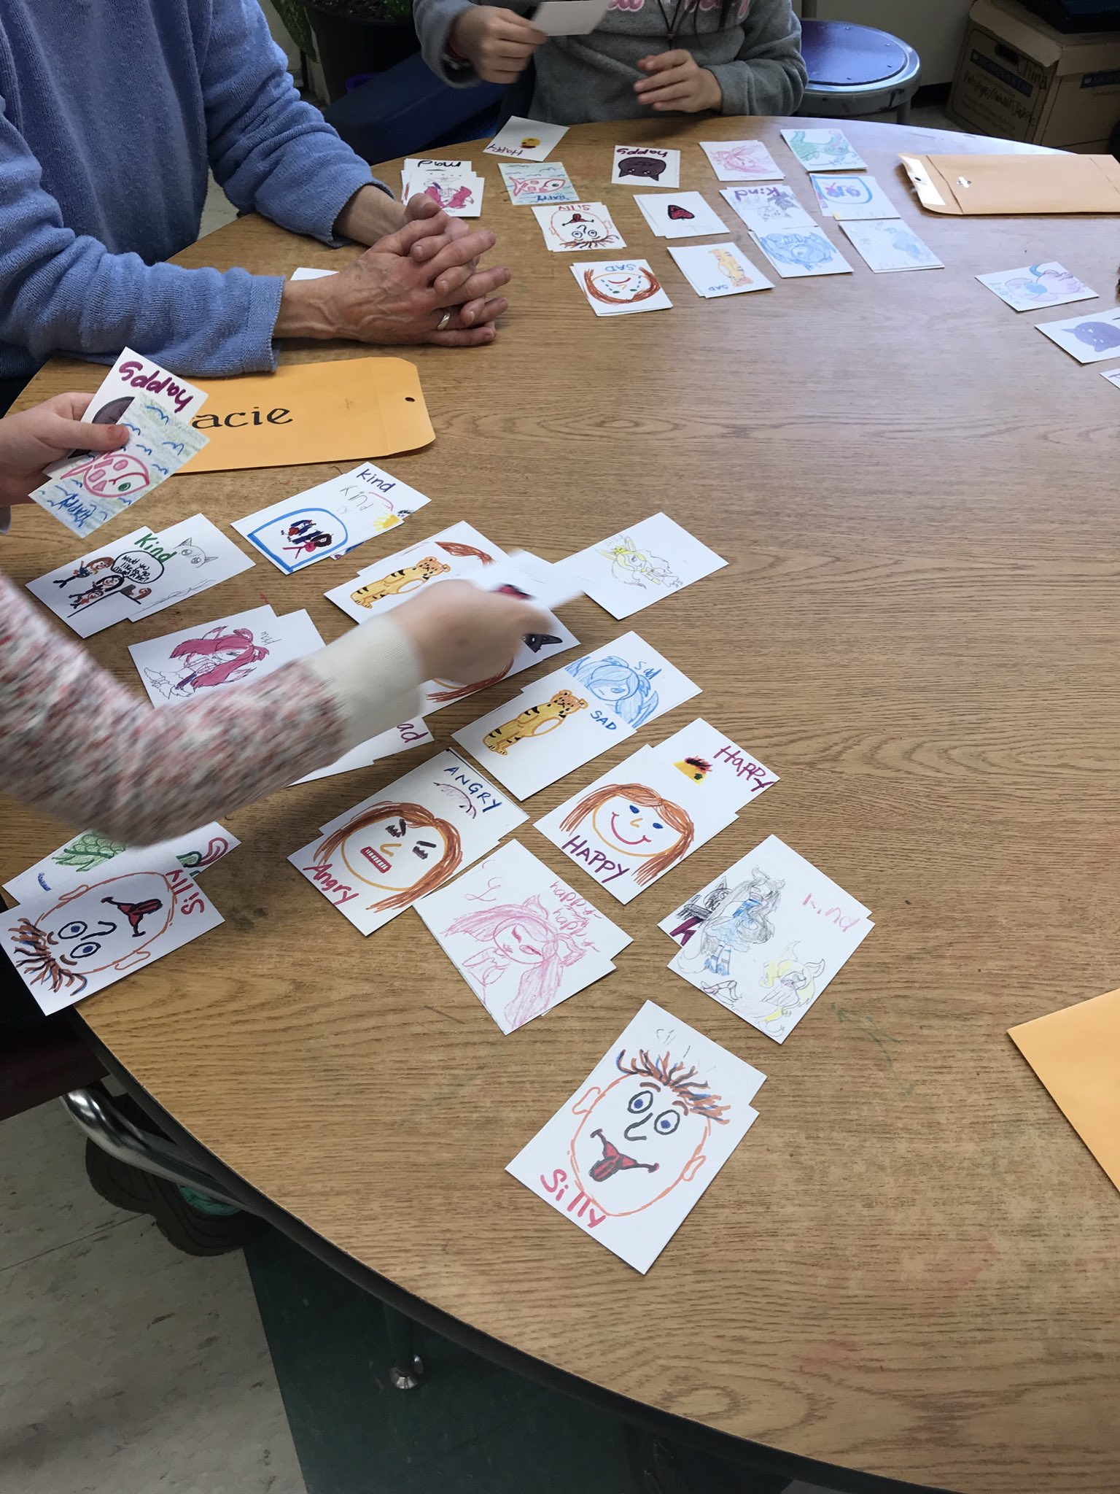
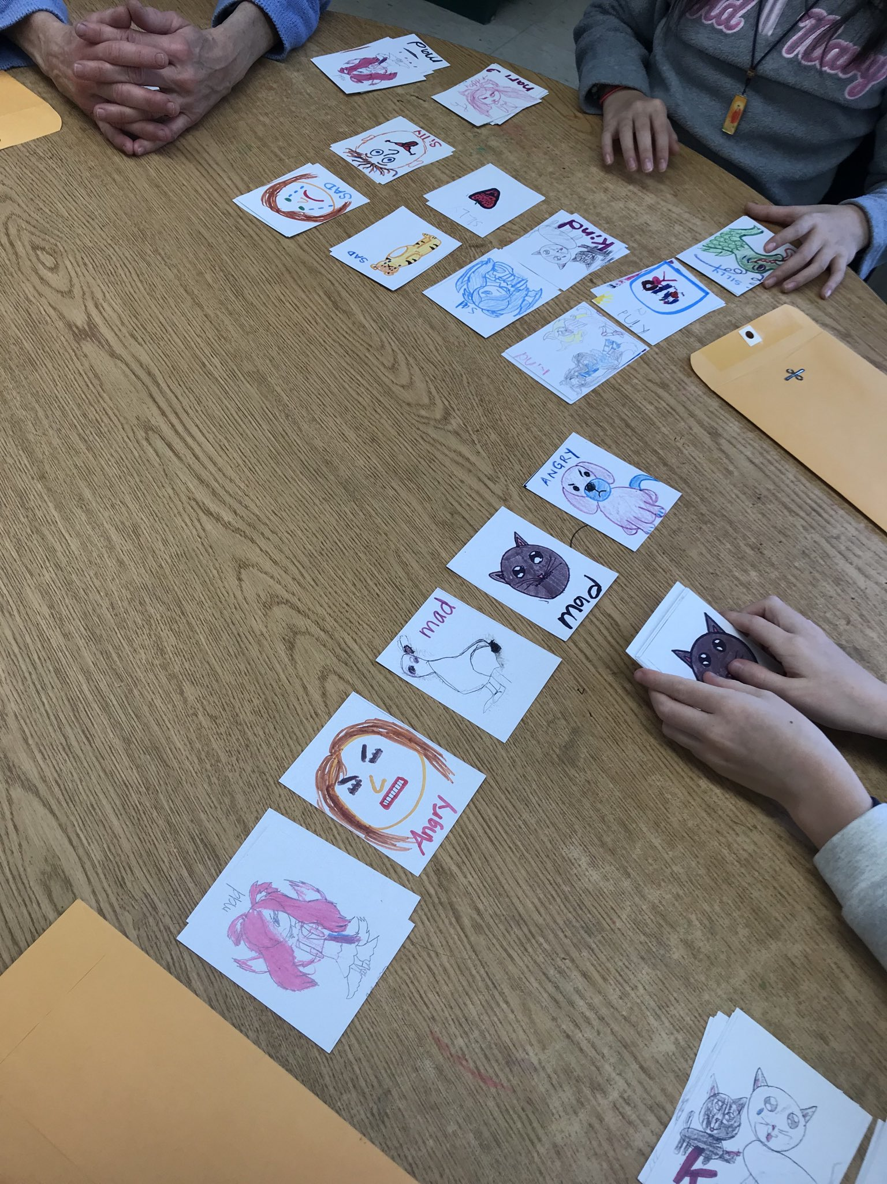
Notes:
This is one of are Art Second Step booster groups and the focus here is feelings and drawing emotions and feelings.

Slide 39
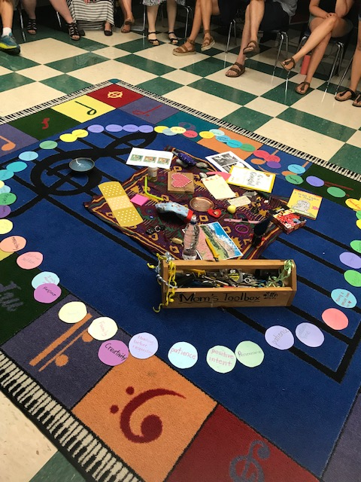
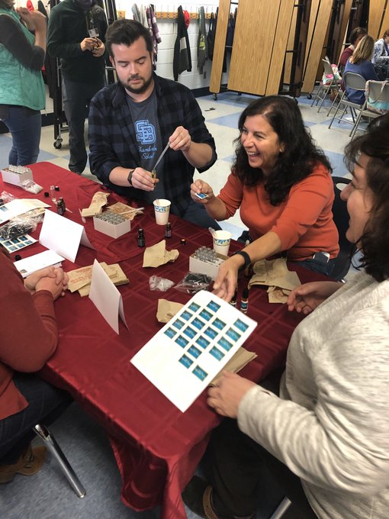
Notes:
Training is provided for restorative, resiliency and PBIS.
This welcome back start to school for staff had a focus on restorative practices and we brought meaningful items to create our centerpiece. The second picture shows staff making an essential oil roller called calm teacher. Compassion fatigue is real and we need to take care of ourselves so we can be at our best for the students in our care.

Slide 40
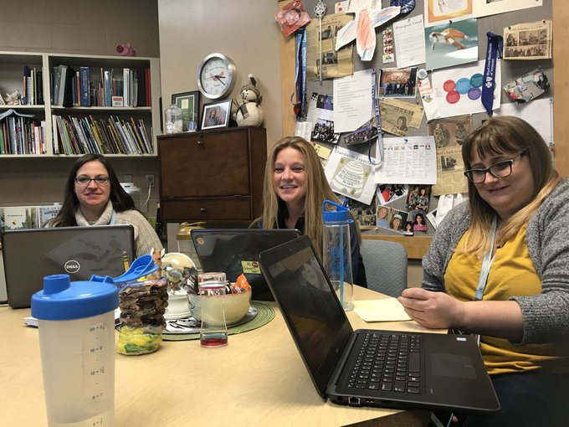
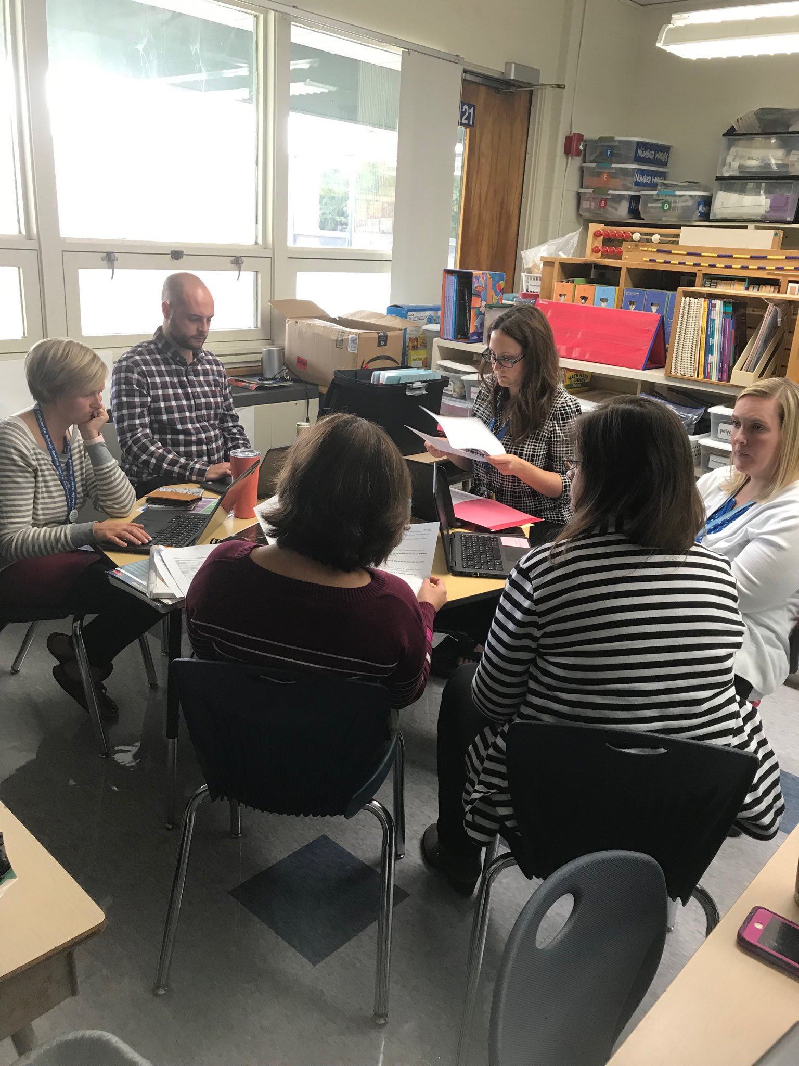
Notes:
Teams looking over data to make informed data driven decisions.
Targeted Team: looking at data recognizing successes and determining need.
Challenge: People are not aware of what targeted supports we have in the school.
What we did: Team meetings providing data and information about students that are getting support.
Data wall: Uses academic data to support students at each grade level. This year we have started to incorporate SAEBRS (behavior screener) into our data wall process.
Challenge: Before SAEBRS there was a lot of subjective discussions around behavior and less time to focus on academics. Focus has been more on targeted supports rather than the universal needs which is what we tried to focus SAEBRS on.

Slide 41
Key Points
Administrative support and participation is key to the success
Training
Make sure there is a team/s that understand the alignment and can share this to increase knowledge and follow through.
Develop practices that weave into the fabric of your day, not just during a specific time of day.
Get feedback from staff and respond to their feedback.
Look at the data:
Are the majority following through with the initiative?
Those that aren’t explore the why. What do they need?
Team meetings: data, communication, problem-solving

Slide 42
Now that you’ve learned about this topic...
What will you be able to implement?
How will you know you’re implementing it well?
How will your most vulnerable students benefit?
How will you/your team sustain what you’re implementing?

Slide 43
Questions?

