Slide 1
Workshop F – SEL and Special Education: Integrating Inclusive Practices at All Tiers
Dr. Kristabel Stark
June 26th, 2024

Slide 2
Agenda
8:00-8:10 Goals & Orientation
8:10-8:30 Introducing Inclusion
8:30-8:50 Identifying [Facilitators & Barriers to] Inclusion
8:50-9:15 Imagining Inclusion
9:15-9:30 Setting New Goals + Resource Deep Dive

Slide 3
My Goals
Celebrate the ways you walk the walk: build community & enjoy each other.
Give space for the tension within “inclusive” models & acknowledge different sources of tension.
Explore types of data/strategies that may help triage resources to better include both students and staff.
Brainstorm ideas to navigate the messiness in sustainable ways.

Slide 4
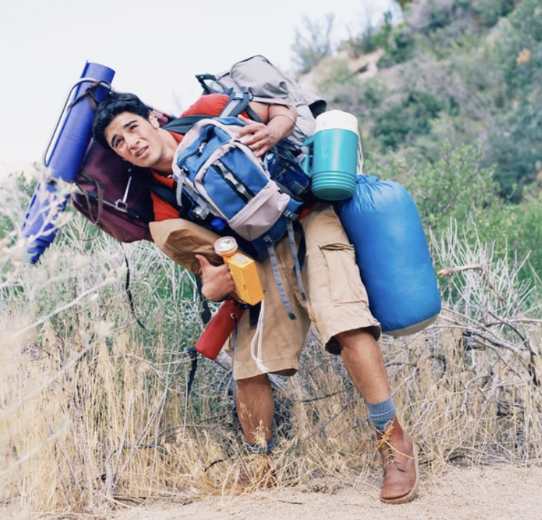
This topic may feel heavy, due to…
Experiences with our own inclusion in school
Watching loved ones deal with inclusion
Mixed beliefs about the nature of inclusion
Pressures to include students in particular ways
Also…WEDNESDAYS!
So just as we are here for our students, and we are also here for each other.

Slide 5
My Positionality
Notes:
As I reflected I recognized that my inability to navigate the complex affective demands of my job was in part because I hadn’t invested in critical reflection my own motivations and identity as a white, non-disabled woman teaching predominantly Black and Hispanic students with disabilities, prior to entering the classroom.
But, I also recognized that the working conditions in which I and other special educators had been put into were inequitable and unsustainable. So I began to think a lot about how teachers’ sociocultural and professional identities interacted with the school organizational cultures and structures to shape teacher outcomes. I wanted to understand both how special educators could develop critical awareness of their positionalities within the classroom, and how organizational systems informed special educators’ health and sustainability.
As I tried to figure out what to do with my burnout, I came across an article that my future advisor had written on teachers’ emotions, and I reached out to talk about the possibility of formally pursuing my questions via research. I transitioned into graduate school, I continued to work in schools as a sub, special education administrator intern, GED teacher, and community college adjunct, expanding my understanding of school systems. Then, I moved to the DC area and worked in different schools there.
I’ve been able to continue to explore how special educators’ professional outcomes are shaped both by things that go on within the teacher and external to the teacher. I want to talk about this both-and. In my work as a special education researcher, I aim to critically explore how teachers’ emotions can function as both a liability and a support, and how these emotions exist within organizational conditions.
--illuminate the true nature of the job to policy makers AND support future & current teachers in their work
--you can make them better teachers by understanding how they feel

Slide 6
Part 1: Introducing Inclusion

Slide 7
Introductions
Make
a representation of an inclusive practice (and sign it, obviously)
Exchange
your image with someone you haven’t met before
Negotiate
a title for each others’ masterpieces

Slide 8
What do our pictures tell us about inclusion?
WHO are we including?
WHAT are we including them in?
WHEN are folks being included?
WHERE are folks being included?
WHY are we engaging in inclusive practices?

Slide 9
Inclusion of who?
Students
Did specific types of students come to mind?
Why?
Adults: Staff & Families
What do inclusive practices mean for staff?
What do inclusive practices mean for families?

Slide 10
Inclusion—where + when?
What parts of the building come to mind?
What are the “hot spots” both physically and temporally?
Imagine both its absence & presence! What time of day/year are you doing this practice well?

Slide 11
Inclusion—what + how?
Tier 1 policies & practices
Tier 2 policies & practices
Tier 3 policies & practices
Today’s workshop is intended to help you brainstorm…
Are these policies & practices actually moving us toward inclusion?
How do we implement in systematic & sustainable ways?
Inclusion

Slide 12
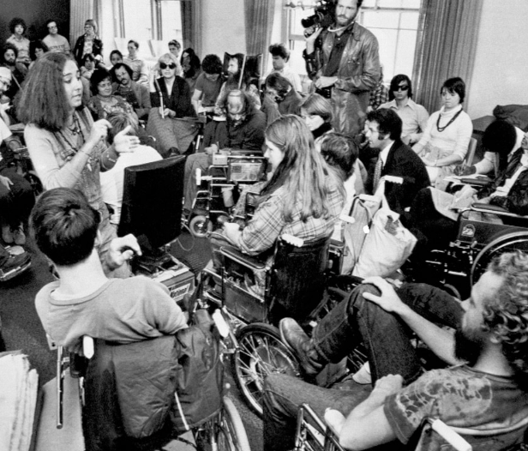
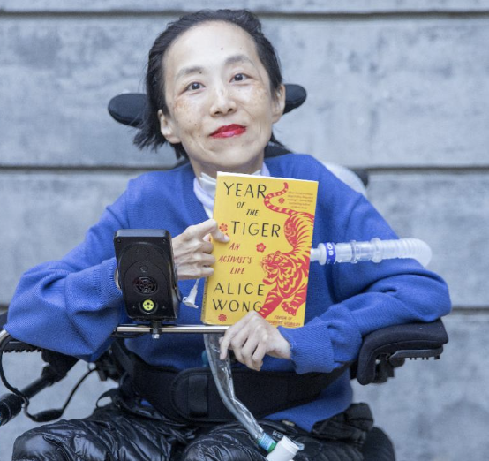
Inclusion—the WHY
We all have a deep desire to be our authentic selves. We want that for our loved ones, too.
And…
Sense of belonging → better outcomes
It is a sacred responsibility we have been gifted!

Slide 13
Part 2: Identifying Inclusion

Slide 14
Okay: so if inclusion is our mutual goal, why are inclusive practices so hard to enact?
Inclusion means so many different things!
Our communities constantly evolve.
We are juggling a LOT!

Slide 15
Common Definitions
PBIS: what brought you here this week
SEL initiatives: anything you are doing within your school to foster the social-emotional development of your students (hopefully, your PBIS system is part of this)
Special education: specially designed instruction to meet the needs of students with disabilities whose disabilities cause an adverse effect on their educational performance (e.g., the O.G. MTSS)

Slide 16
What’s going on at your school(s)?
PBIS
Special Education
Which adults are involved?
Which kids are involved?
What are the tools/resources?
Which adults are involved?
SEL Initiatives
Which adults are involved?
Which kids are involved?
What are the tools/resources?
Which kids are involved?
What are the tools/resources?

Slide 17
Debrief
Did you see overlap where you expected?
How does this overlap (or lack thereof) relate to the idea of inclusive policies and practices?

Slide 18
All of these systems serve to foster inclusion of students with disabilities. How can we facilitate cohesive, inclusive practices across systems?
PBIS
Special Education
Which adults are involved?
Which kids are involved?
What are the tools/resources?
Which adults are involved?
SEL Initiatives
Which adults are involved?
Which kids are involved?
What are the tools/resources?
Which kids are involved?
What are the tools/resources?

Slide 19
“Doing inclusion” across systems begins with our beliefs & emotions.
Thoughts
Behavior
Feelings
(CBT-Triangle; Sensemaking Theory)

Slide 20
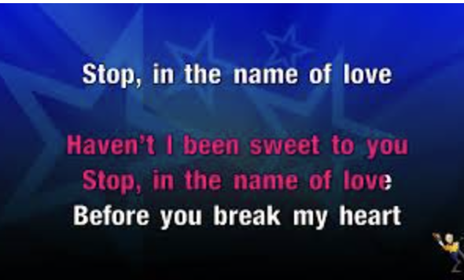
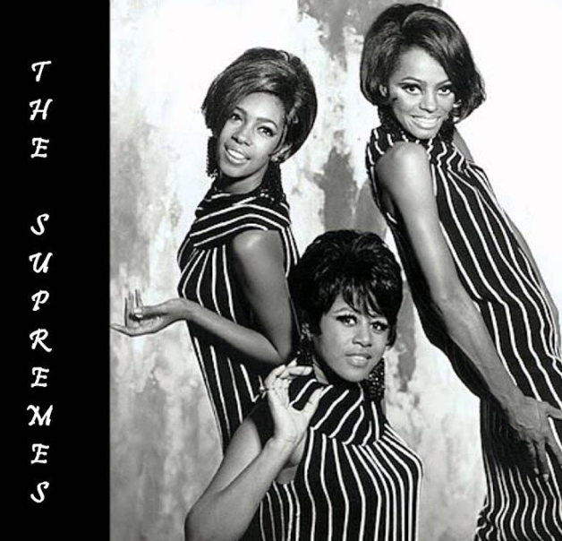
We can have a whole list of policies & procedures & evidence-based “inclusive practices”…
But if we have unresolved feelings toward them,
Or if we have beliefs that contradict them?

Slide 21
What are the inclusive behaviors (practices) you want to see from your staff/colleagues?
Teachers greet all students with love when they enter the classroom.
Teachers provide graphic organizers on a regular basis.
Teachers consistently complete behavior charts.
Teachers model concepts before providing practice opportunities.
Thoughts
Behavior
Feelings

Slide 22
Write down one inclusive practice you want to see more of in your school.

Slide 23
Now, let’s break down the triangle.
Teachers provide graphic organizers on a regular basis.
What are the thoughts that facilitate this behavior?
What are the thoughts that block this behavior?
What are the feelings that facilitate this behavior?
What are the feelings that block this behaviors?

Slide 24
Here’s some common barriers of inclusive practices …
Thoughts/Beliefs | Feelings/Emotions
Special education is a tier. | No one sees how hard I am working, so…F*** IT
At this point, I’ve taught every type of kid under the sun. | It will be embarrassing if I try something different and it doesn’t work.
Kids with disabilities get away with everything. | I feel tired of being the adult.
No matter what we do in school, the kid will go…home. | I feel NOTHING.

Slide 25
Here’s some common facilitators of inclusive practices:
Thoughts/Beliefs | Feelings/Emotions
All students are our students. | I’m proud of the help I can provide my colleagues.
Disability is a form of diversity. | People see the real me in this school.
Good teachers constantly evolve their practices. | We are grieving the same things.
Special educators need the same amount of sleep as general educators. | My colleagues are hilarious.

Slide 26
Your turn!
What are the thoughts that facilitate this behavior?
What are the thoughts that block this behavior?
What are the feelings that facilitate this behavior?
What are the feelings that block this behavior?

Slide 27
How do we connect thoughts-feelings-behaviors?
When we start/change systems, we can’t jump right to the practices. We must consider the beliefs + feelings that impact our implementation.
Cognitive behavioral theory
Sensemaking theory
How do we do this?
We practice catching it within ourselves.
We talk about it with each other!
Emotions are a source of data, not a byproduct.

Slide 28
Part 3: Imagining/Innovating Inclusion

Slide 29
Visualizing is science!

Slide 30
Laying the Groundwork: Tier 1
What are your current practices to support the social-emotional inclusion of students with disabilities in Tier 1?
What tensions do you see within these practices?
What are the beliefs/feelings that might need to be addressed more directly, in order to address these tensions?

Slide 31
3 Innovations to Consider for Tier 1
Taking a fresh look at UDL
1
Flipping special education: Integrating lessons about disability into gen ed curriculum
2
Inviting staff to engage in mini role-reversals
3

Slide 32
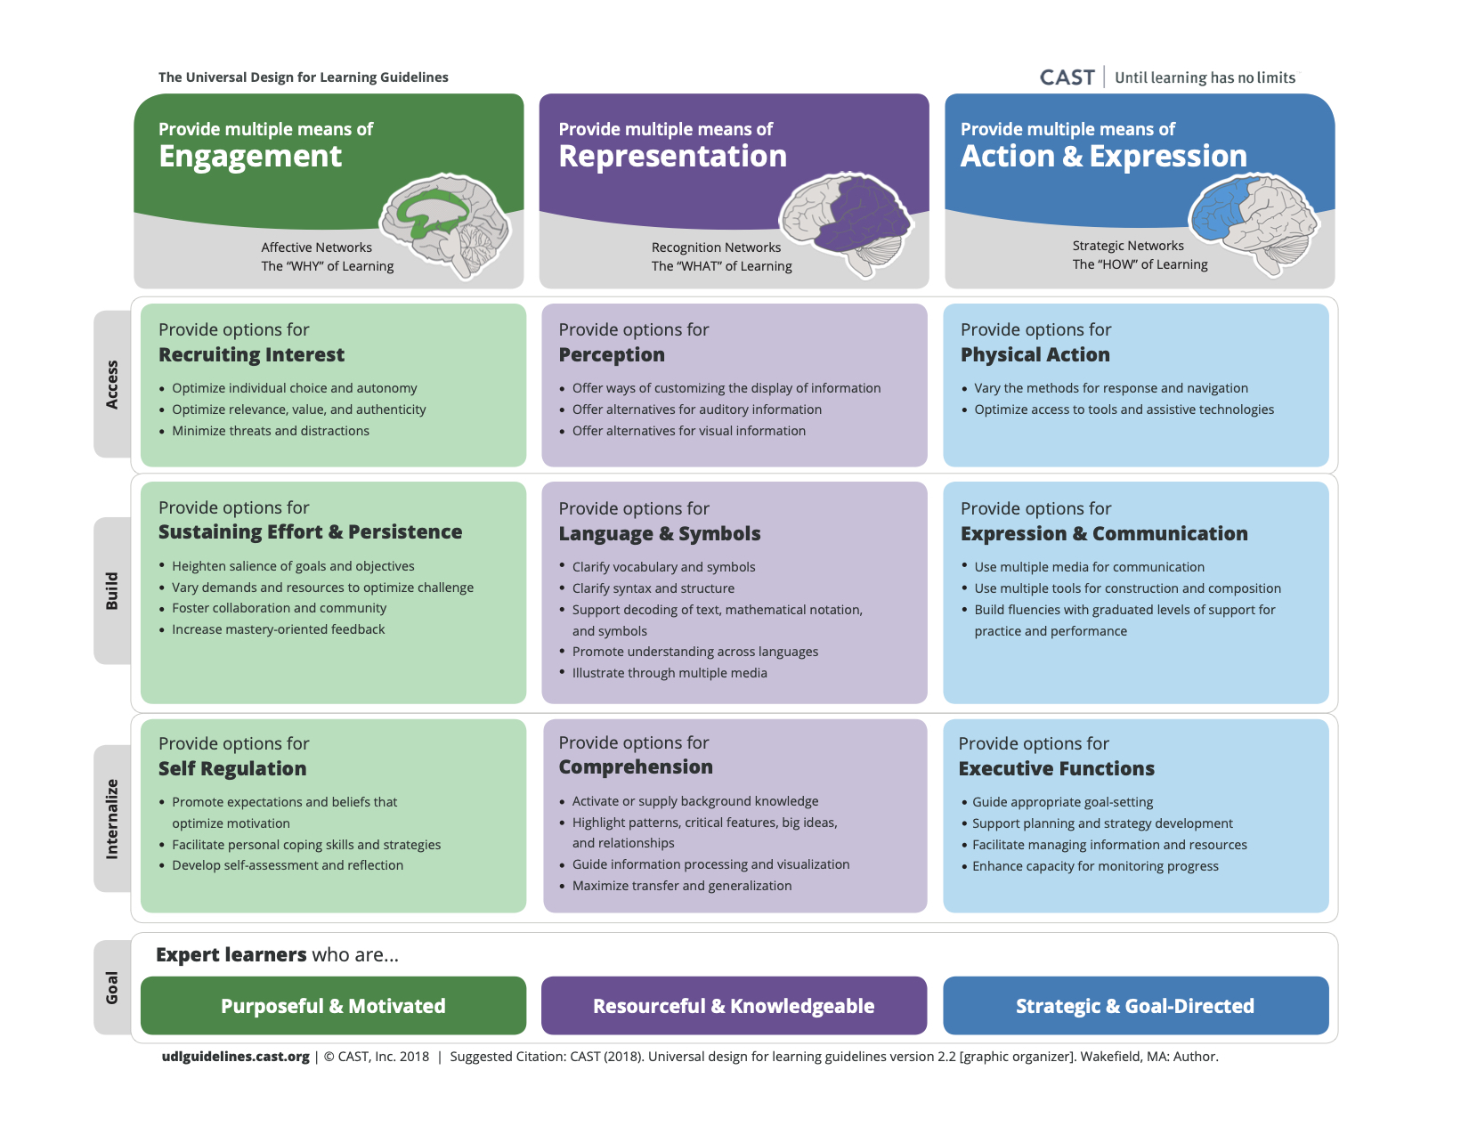
Wild Idea #1: Take a fresh look at UDL

Slide 33
Wild Idea #2: Integrate lessons about disability

Slide 34
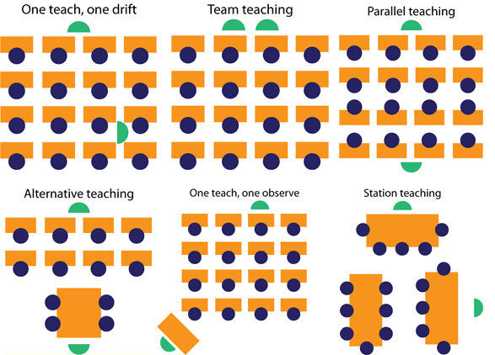
Wild Idea #3: Inviting staff to engage in role reversals

Slide 35
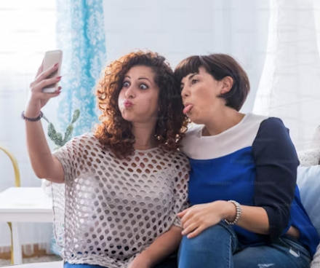
Wild Idea #4: Double-down on loving own authentic self.

Slide 36
Close-Out: Goal Setting

Slide 37
Ideas for goals
Part 1: Introducing inclusion: what new ideas/aspects of inclusion are you thinking about?
Part 2: Identifying inclusion: what beliefs/thoughts are you interested in addressing? How?
Part 3: Imagining Inclusion: What is your dream? Do any of the “wild ideas” resonate with you?

Slide 38
What can you do to be able to continue seeing the community of support you have walking beside you in this work?
Disability Visibility
The Future is Disabled/Care Work
#AccessIsLove
#CripTheVote
Vermont BEST/PBIS Trainings
Get people’s digits!!
Email researchers we love it!

Slide 39
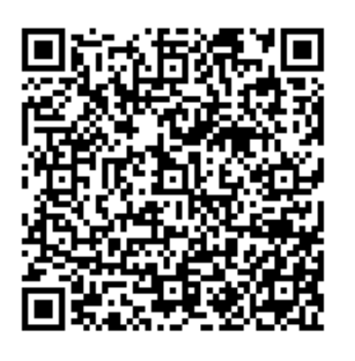
Resource Deep Dive
Scan the QR code for a variety of articles about inclusion, SEL, students with disabilities, and sensemaking theory!

Slide 40
Thank you!
THANK YOU!
Contact:
Kristabel.Stark@uvm.edu
https://www.uvm.edu/cess/profile/kristabel-stark

