Slide 1
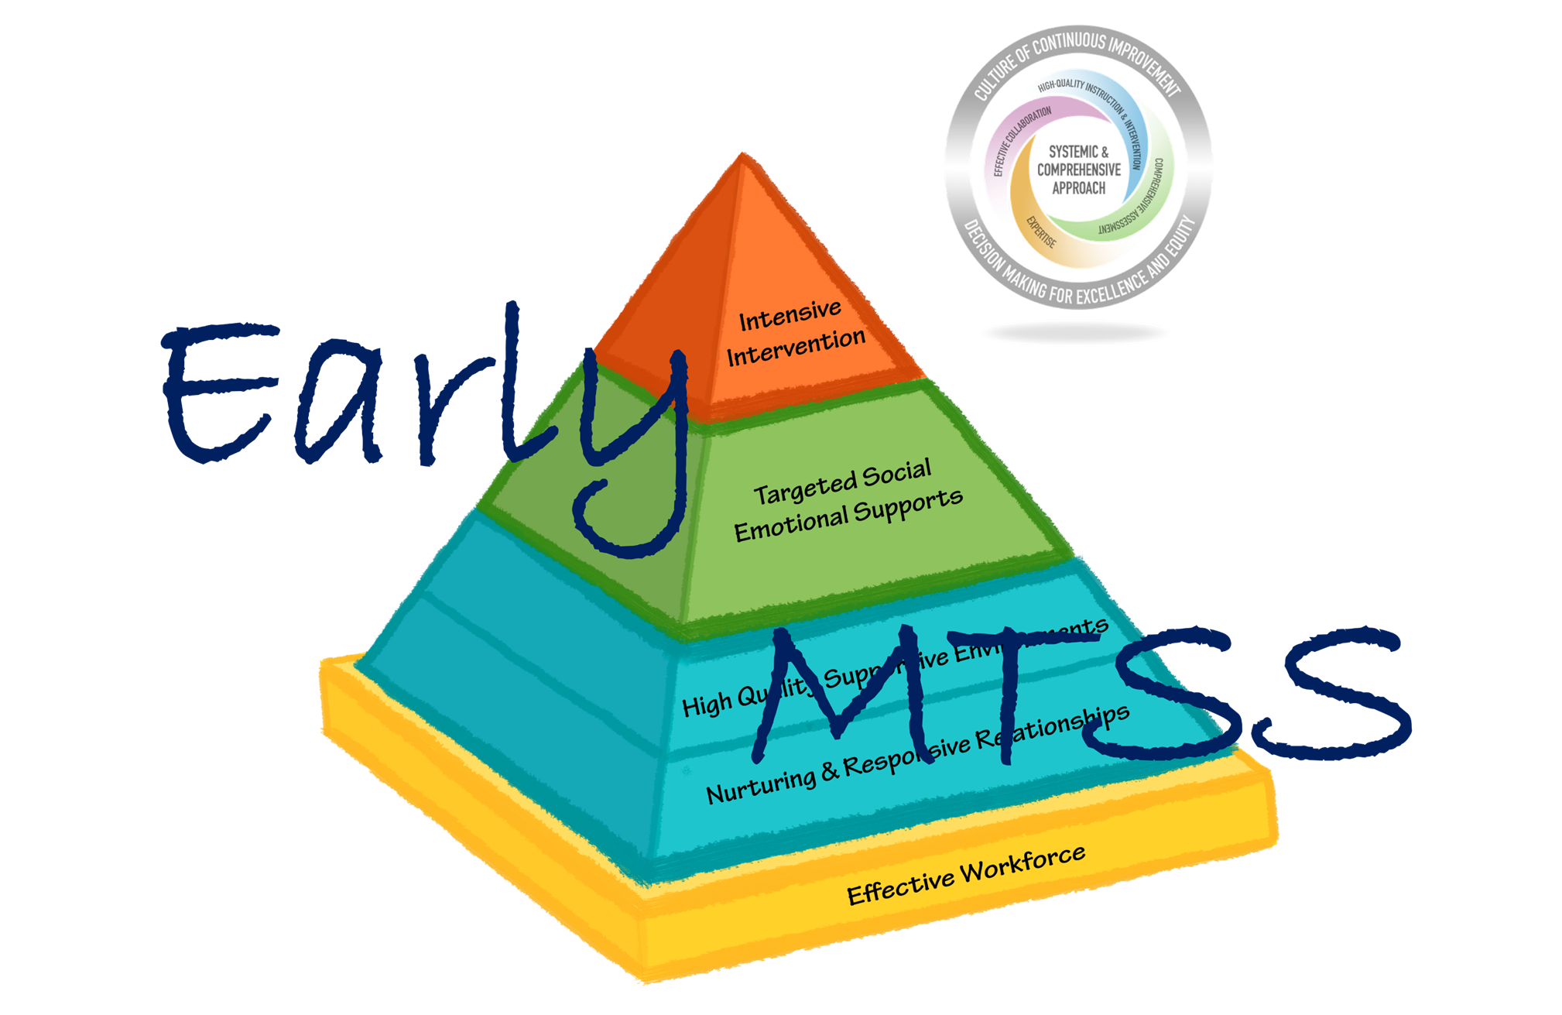
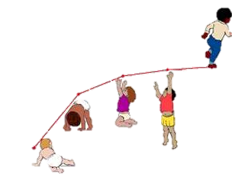
An Introduction to Vermont’s
Dr. Lori Meyer, Julie Lavine, & Stephanie Ripley
BEST/VTmtss Institute
6/23/21

Slide 3
This Photo by Unknown Author is licensed under CC BY

Slide 4
Objectives
By the end of today’s session, you will be able to:
State the importance of Vermont Early MTSS for families and young children;
Understand the alignment between Early MTSS, VTmtss & VTPBIS;
Recognize assets already present for implementing Early MTSS;
Locate implementation resources for Early MTSS; and
Identify next steps for exploring implementation of Early MTSS in your classrooms, schools, and communities.

Slide 5
Overview of Our Time Together
Overview of the Pyramid Model
Review the Strengthening Families Approach
Hear from Vermont Early MTSS Demonstration Program Leaders
Dedicated times to pause and answer questions after each part
Please feel free to put your questions in the chat box
Close with Reflections for Next Steps

Slide 6
Rate Your Familiarity with the Pyramid Model
1
2
3
4
5

Slide 7
See-Think-Wonder

Slide 8
See-Think-Wonder

Slide 9
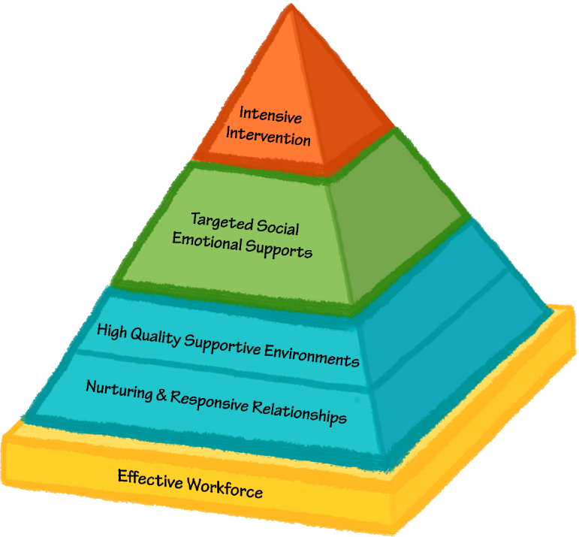
Pyramid Model for Promoting the Social and Emotional Competence of Young Children
Tertiary Intervention
Few
Secondary Prevention Some
Universal Promotion
All
A Framework of Evidence-Based Practices

Slide 10
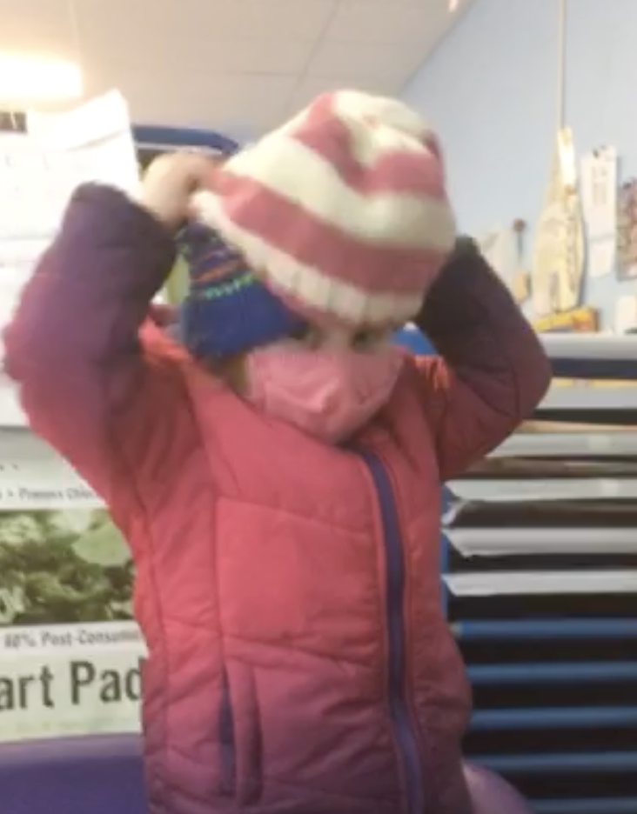
Results of Successful Implementation – For Children
Reduction of child challenging behavior for children with challenging behavior
Improvement of observed social interaction skills for children with challenging behavior
Improvement in ratings of social-emotional skills for children with challenging behavior
Improvement in ratings of social-emotional skills for all children in the classroom
Adapted from L. Fox 2/9/21

Slide 11
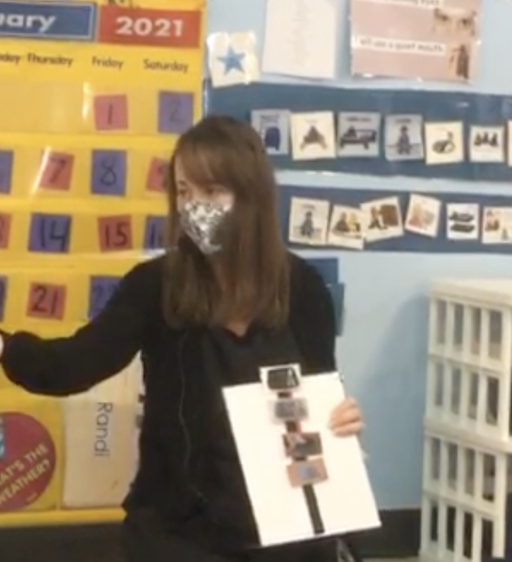
Results of Successful Implementation – For Teachers
PD on the Pyramid Model was effective for supporting teachers’ implementation.
Teachers’ use of the practices was related to children’s social and behavioral outcomes.
Teachers continued to use the practices after coaching ended.
Teachers reported high levels of satisfaction with PD and report improved child behaviors.
Hemmeter, Ostrosky, & Fox, 2021

Slide 12
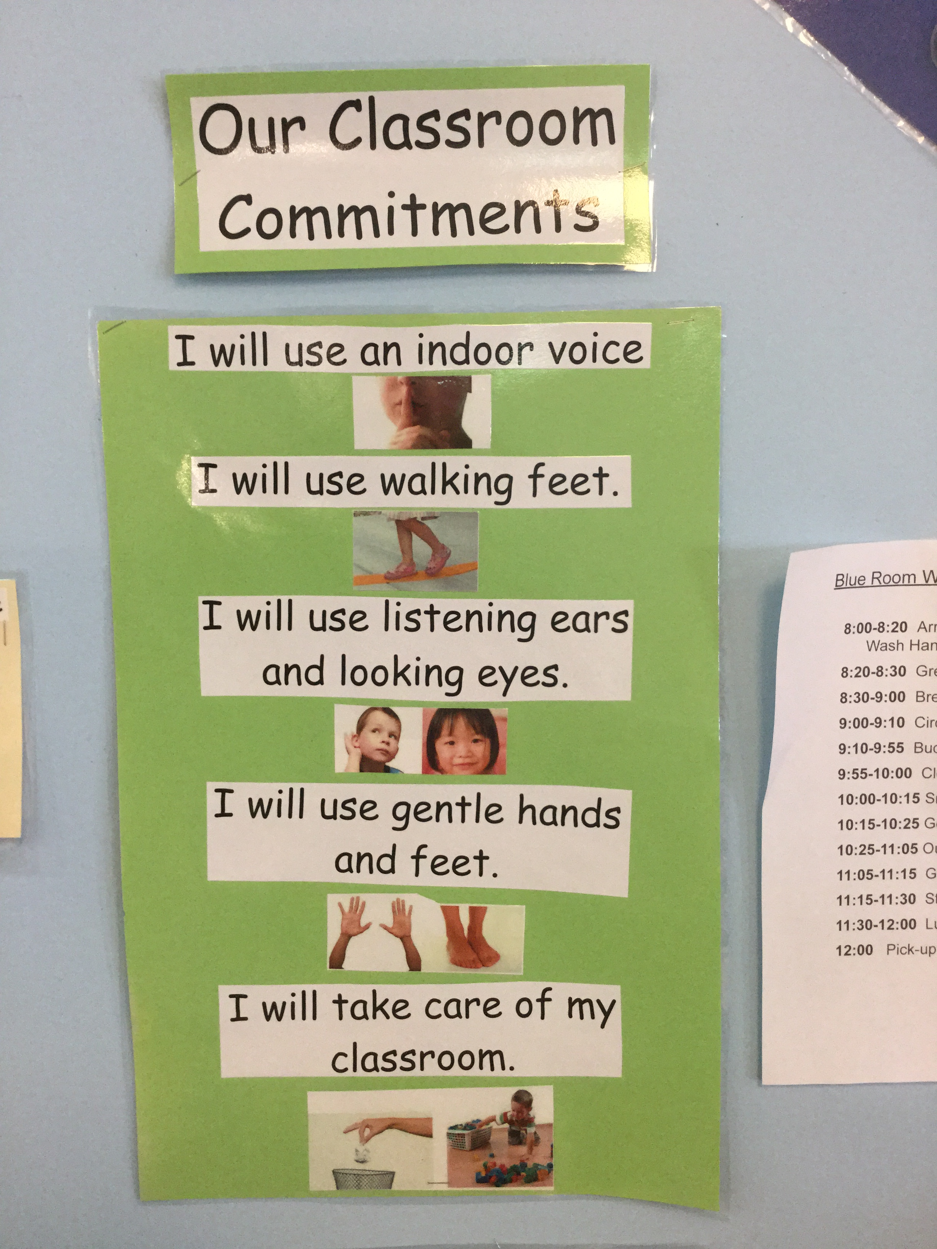
Program Reported Outcomes
Improvements in classroom quality
More intentional instruction around social skills and emotional competencies
Improved capacity to address challenging behaviors
Better relationships with families
Decrease in problem behaviors, increase in social skills, and decrease in overall disruptive behaviors
Elimination of the use of exclusionary discipline
Increases in child engagement in learning opportunities
From L. Fox 2/9/21

Slide 13
Pyramid Model Inventory of Practices
This Photo by Unknown Author is licensed under CC BY-SA

Slide 14
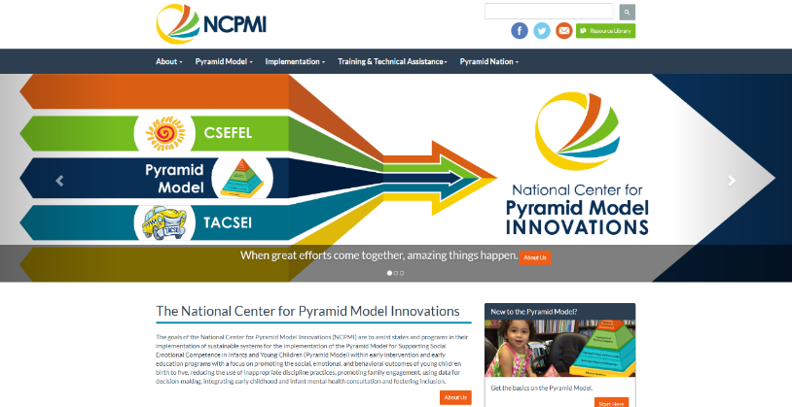
Implementation Supports
Comprehensive training materials
Fidelity of implementation tools
The Teaching Pyramid Observation Tool (TPOT)
The Teaching Pyramid Infant Toddler Observation System (TPITOS)
Practical tools and materials for teachers
Program-wide leadership guides and tools
Materials for families

Slide 15
This Photo by Unknown Author is licensed under CC BY-SA

Slide 16
Family Protective Factors
Parental resilience
Social connections
Knowledge of parenting and child development
Concrete support in times of need
Social and emotional competence of children

Slide 17
Family Protective Factors

Slide 18
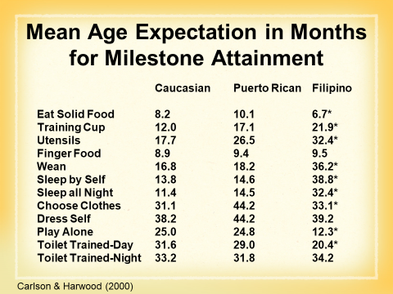
Family Protective Factors

Slide 19
This Photo by Unknown Author is licensed under CC BY-SA

Slide 20
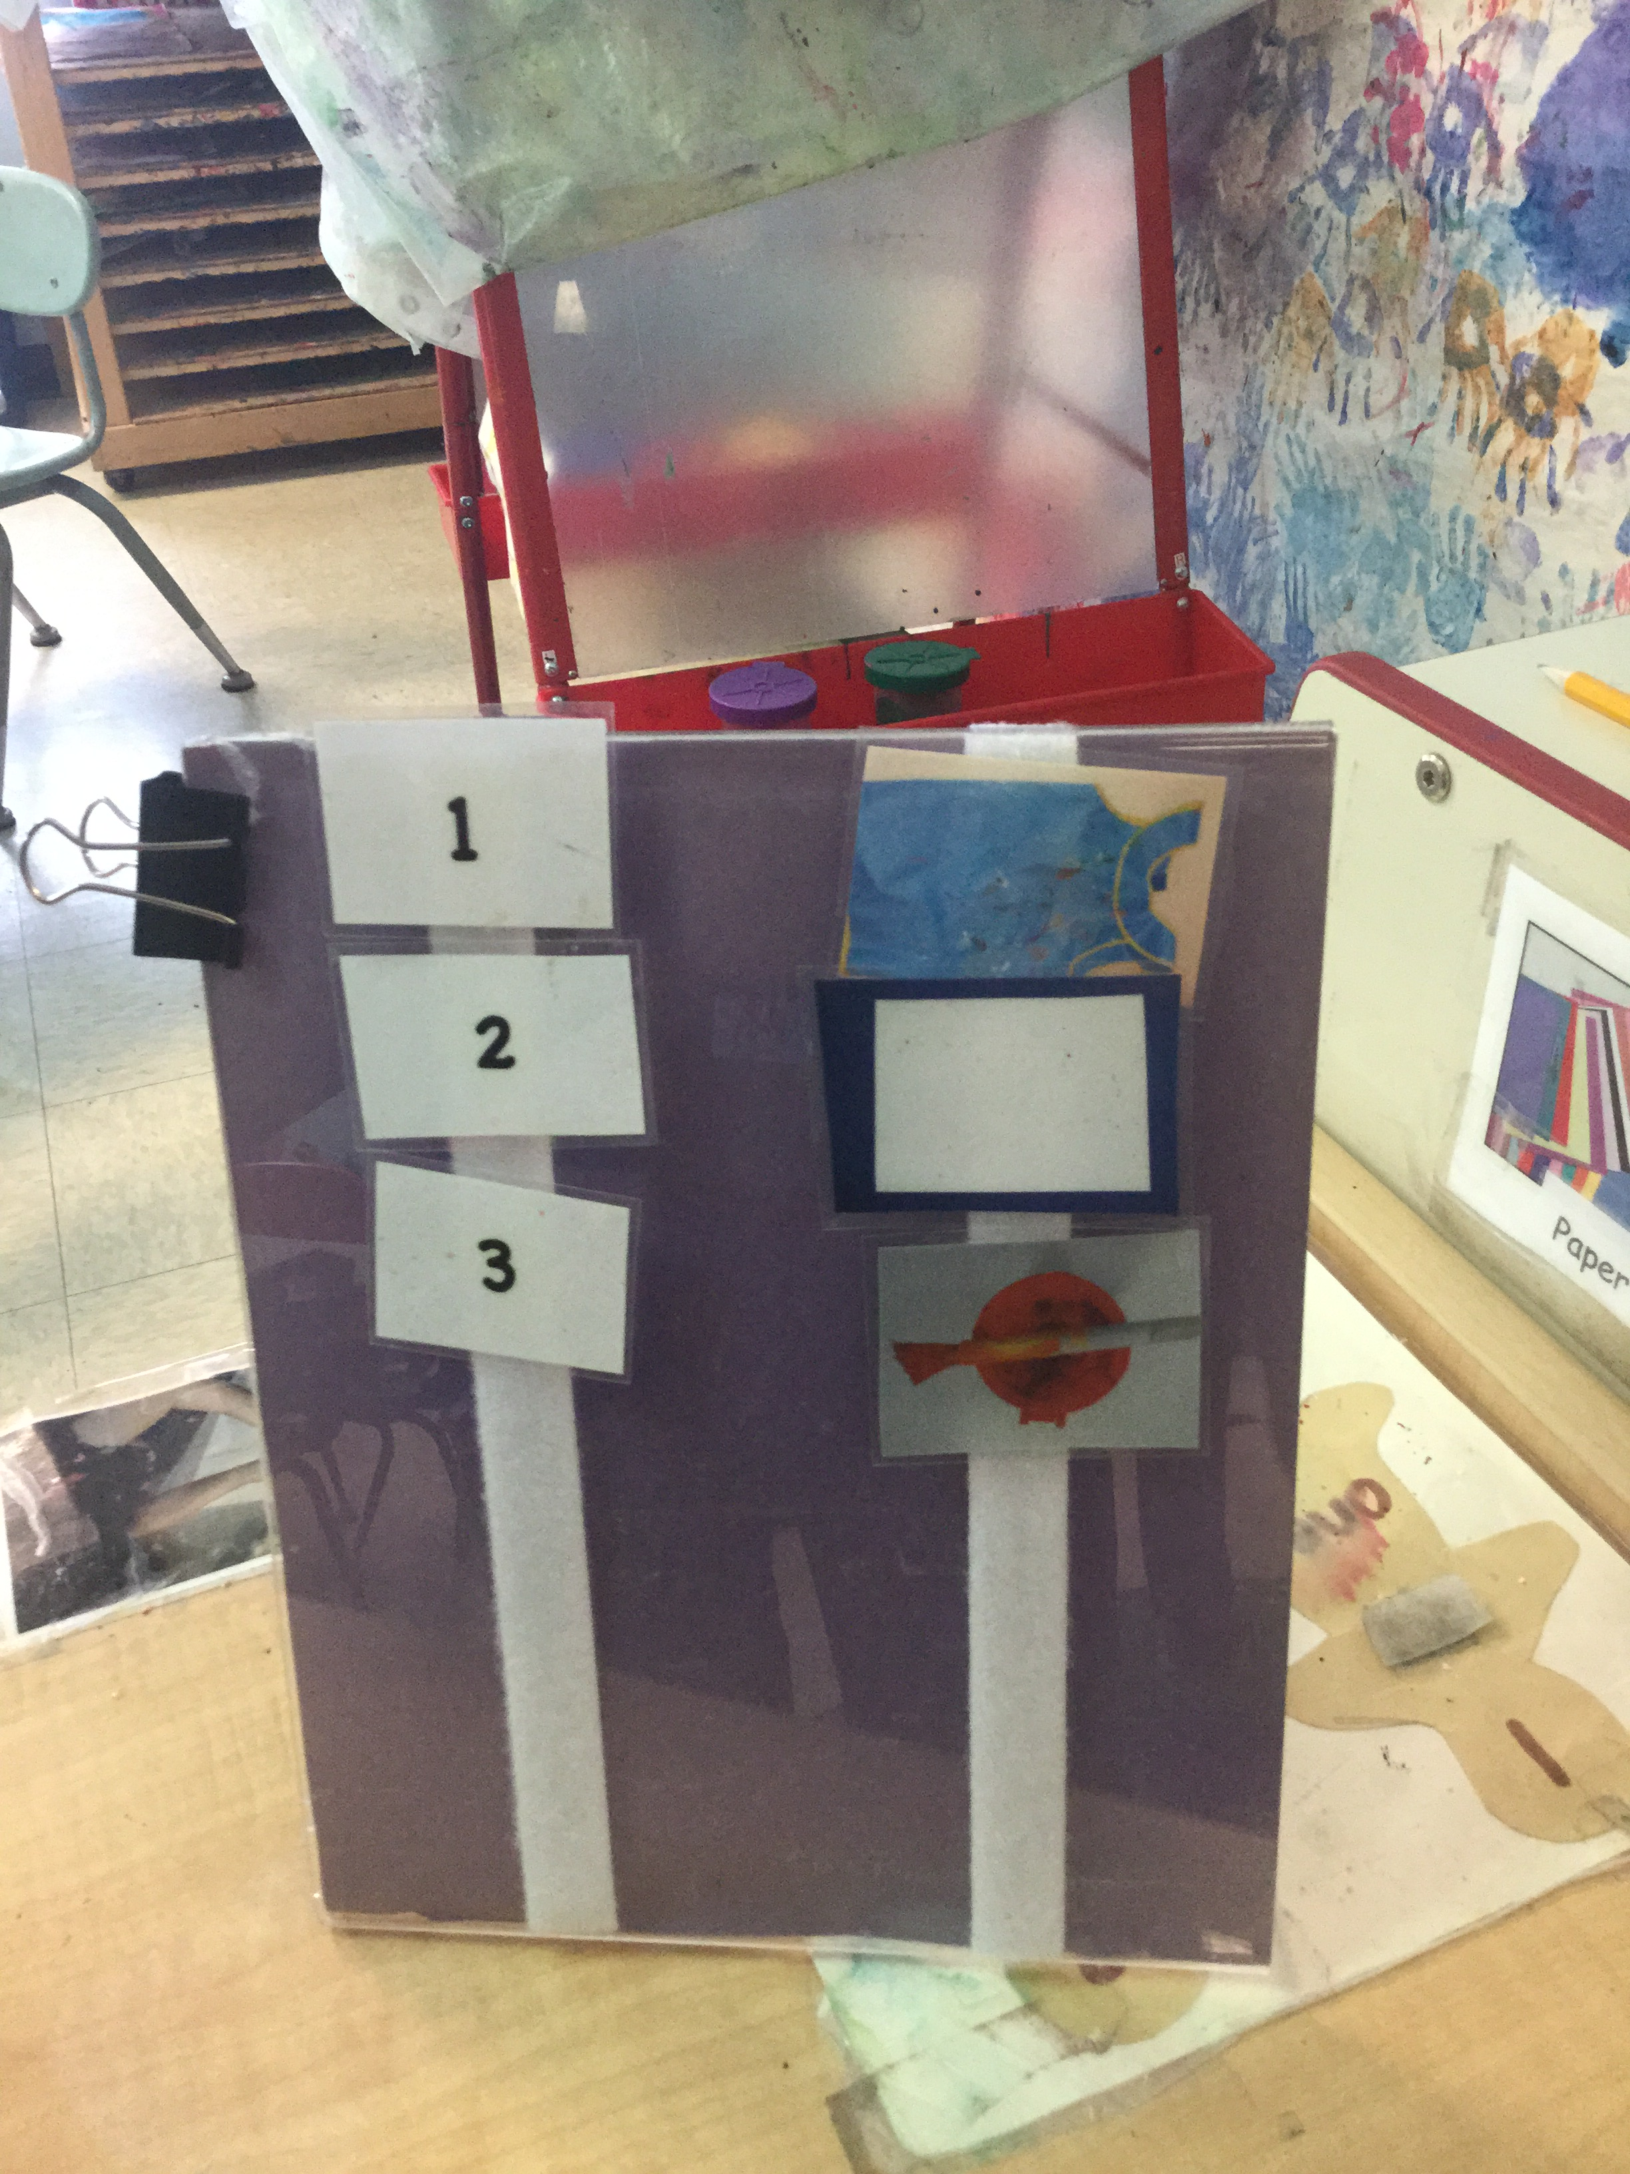
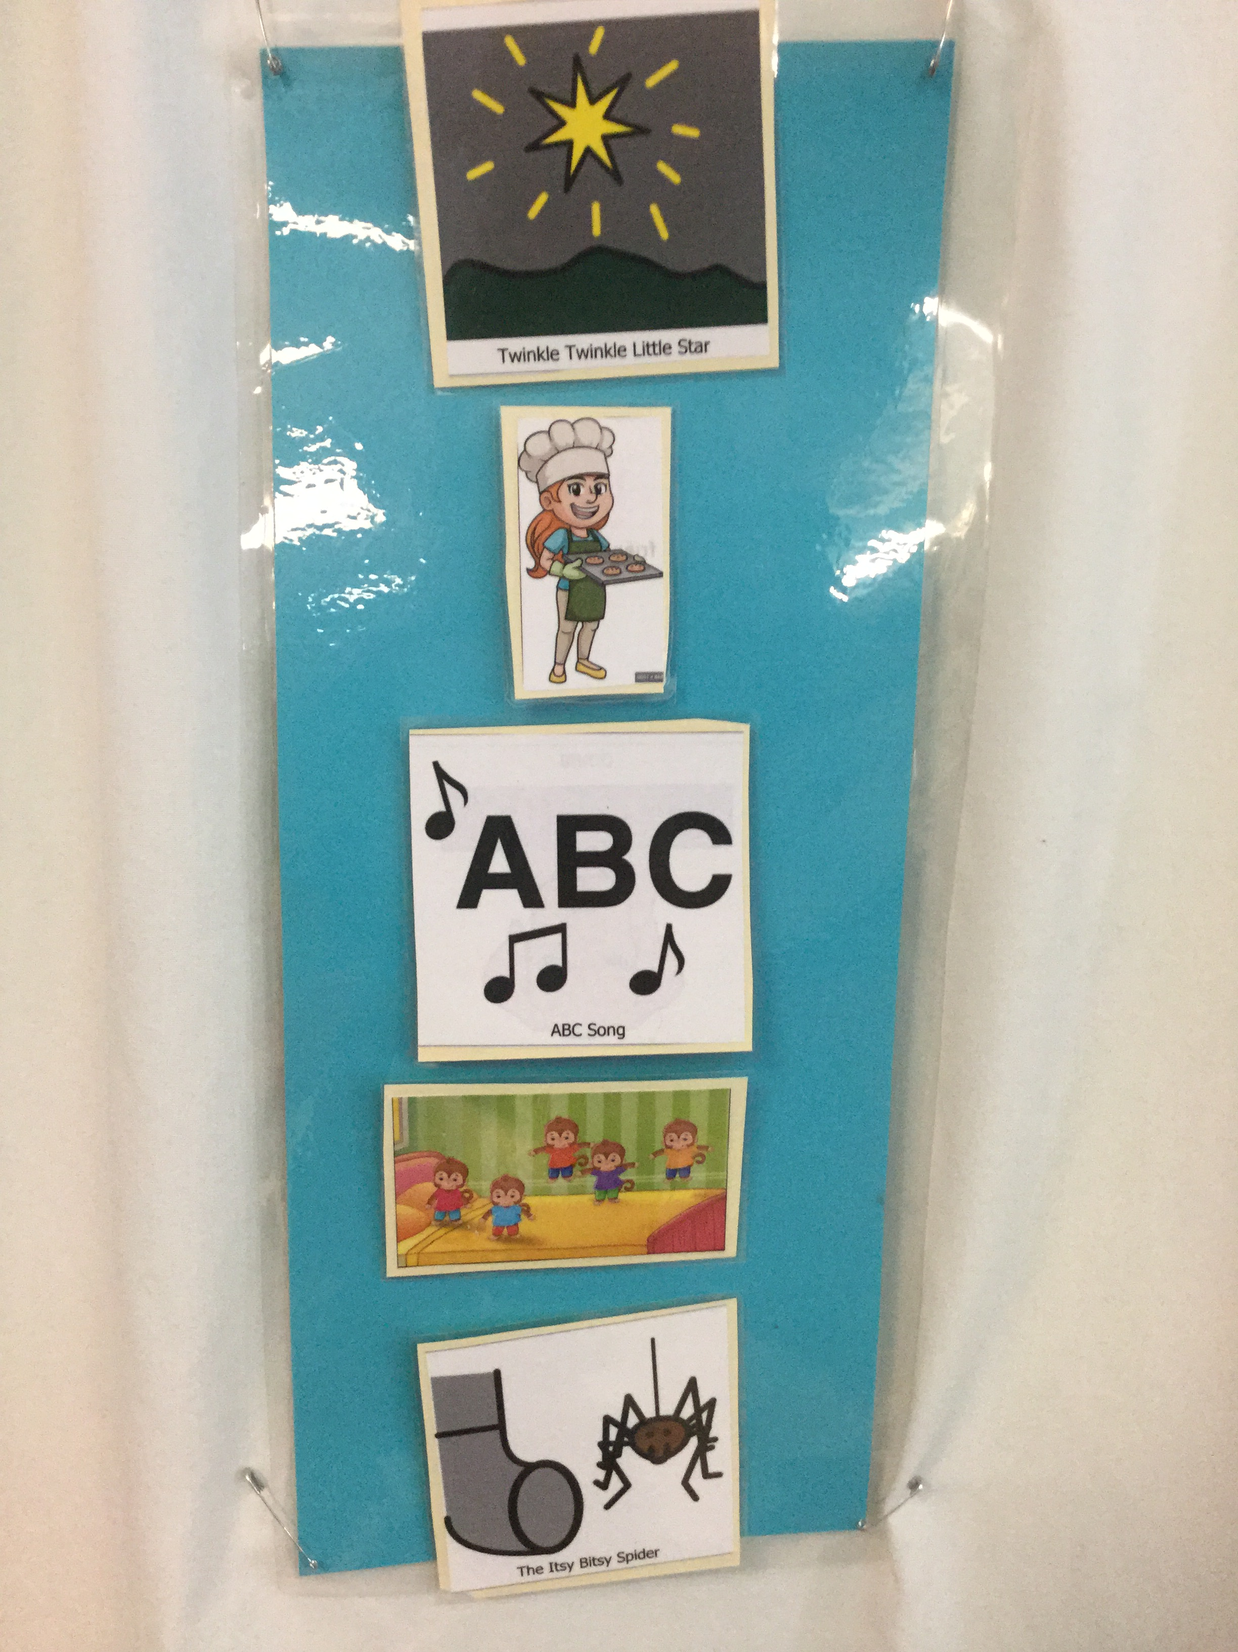
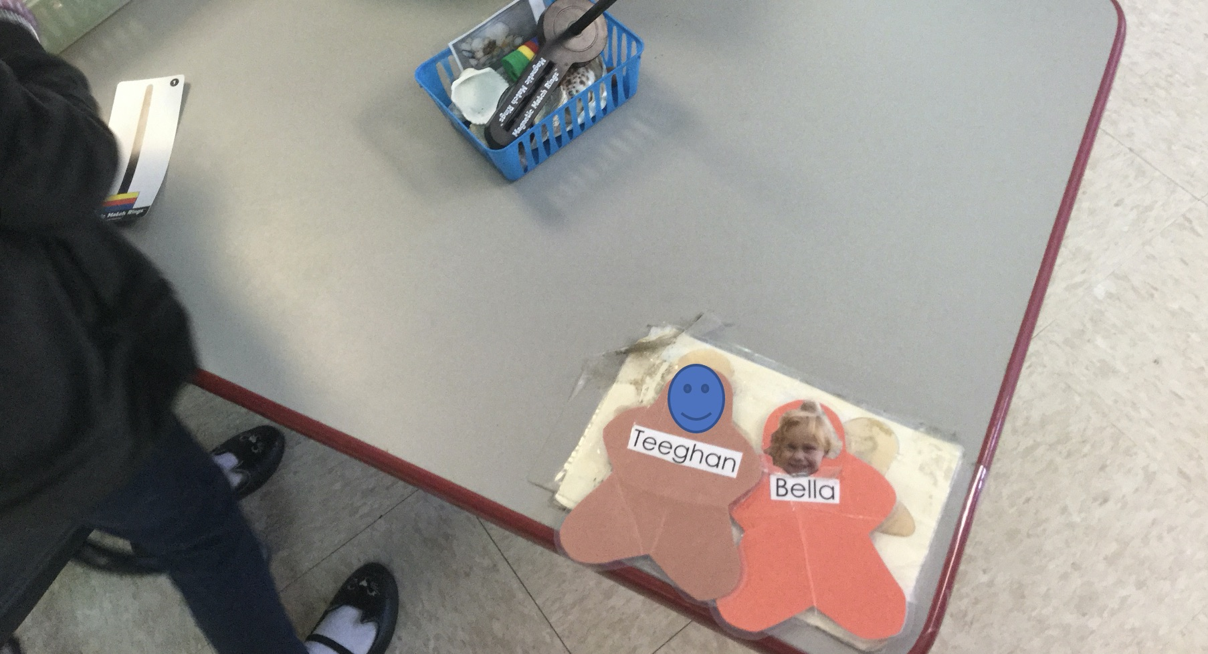
Vermont Early MTSS Assets!
Julie Lavine, Director
Orleans Central Supervisory Union (OCSU) Early Childhood Program
Stephanie Ripley, Director
Maple Run Early Childhood Programs

Slide 21
This Photo by Unknown Author is licensed under CC BY-SA

Slide 22
This Photo by Unknown Author is licensed under CC BY

Slide 23
This Photo by Unknown Author is licensed under CC BY-SA-NC

