Slide 1

Expanding our Data Systems to Identify Social/Emotional/Behavioral Learning Needs and Strengths of Students
Presented by Kym Asam with Sherry Schoenberg
Notes:
Please make sure you have copies of the materials so you and your team can familiarize yourself with them. We are going to discuss how we can use data to develop and utilize informal and formal screening tools.

Slide 2
Welcome!
You will be muted during this session, except during breakouts.
Need help?
Type into the chat box
You
can show or hide your video.
Materials can be found at: bit.ly/VTBEST2021

Slide 3


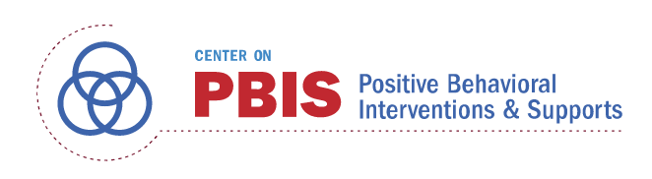





Acknowledgements
Notes:
Also:
WestEd
Kym Asam
AIR
Harvard

Slide 4
Learning Objectives
Participants will:
Understand the context and rationale for identifying students at risk of social/emotional/behavioral challenges
Consider several informal and formal tools
Discuss matching findings to interventions
Examine the systems in place to collect, analyze and act upon data
Explore next steps
Notes:
Recovery plan has indicated universal screener as a method to integrate students back into school. Social emotional functioning, engagement and academic success. Universal screeners can help facilitate all of these – also staff wellbeing. Equity and inclusion

Slide 5
Check your battery:
Poll

Slide 6
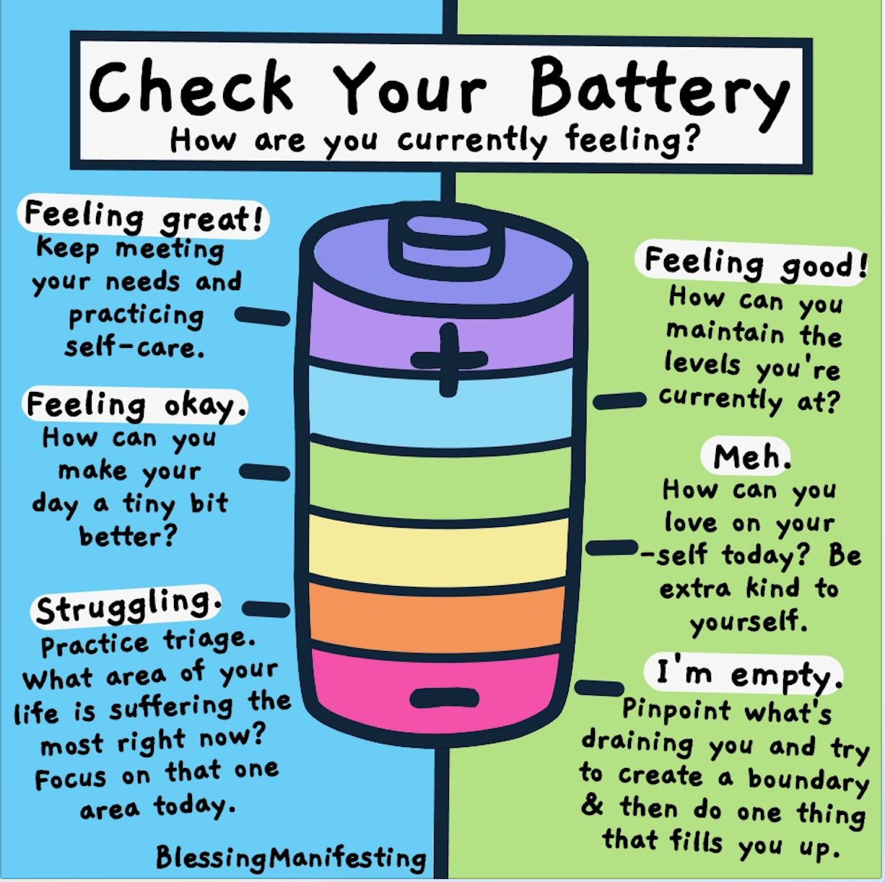
Poll

Slide 7
Thank you for your commitment!

Slide 8
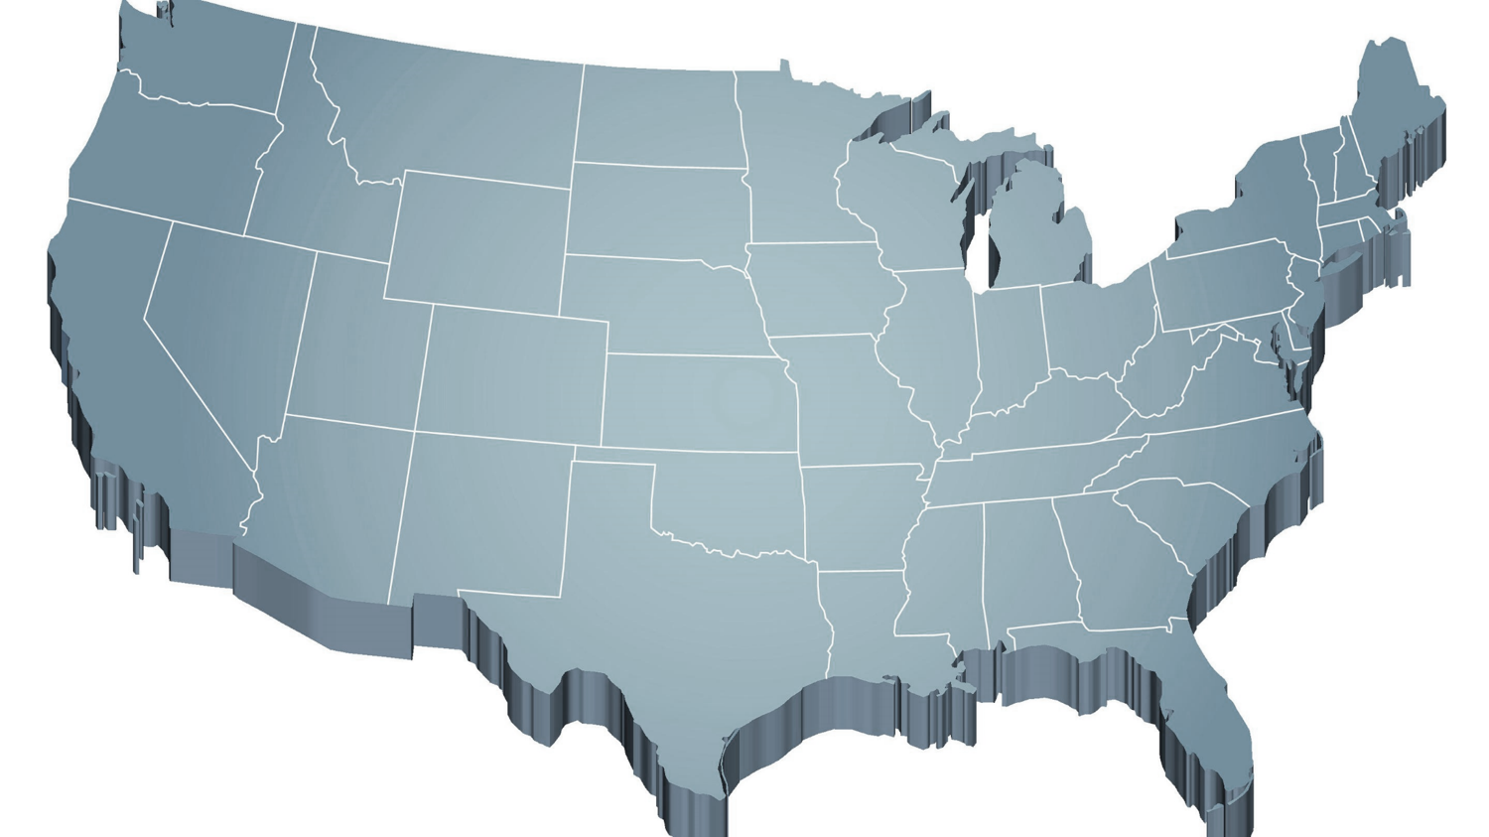
Shift to a systems level perspective
Internalizing
Externalizing
ED <1%
EBD 12-20%
Source: Forness, S.R., Freeman, S.F., Paparella, T., Kauffman, J.M., & Walker, H.M. (2012). Special education implications of point and cumulative prevalence for children with emotional or behavioral disorders. Journal of Emotional and Behavioral Disorders, 20, 4-18.
Notes:
12% of all school age kids have some kind of internalizing issues (shy, withdrawn) or acting out behaviors (aggressions, non-compliance – or both. White dominant culture – cultural context.
20% mild to severe. This is a concern for all educators because less than 1% go on to receive special ed. Commitment to tiered systems so important.
This is everyone’s problems. Won't be addressed by referrals. That's why tiered systems of support are so important.

Slide 9


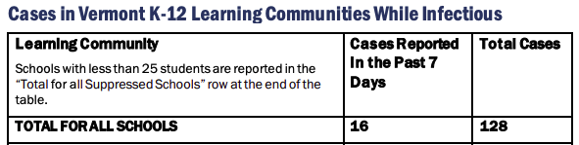
Context: Challenges
Notes:
It is clear that we have the biggest challenges in education right now. Between the predictions about our ability to catch up academically, the loss of many connections over the last year, the tension about racism in education after the murders of George Floyd and others.
We are beyond the normalcy bias which means that we expect things will continue in the future the way they typically occurred in the past – continue to be “normal”).

Slide 10
Access and Equity for All!
1-5% of Students may need Intensive Supports
Few
10-15% of Students may need Targeted Supports
Some
ALL Students!
Universal Practices in place for 100% of students
80% of Students should be successful when accessing Universal Supports
Notes:
Why – consistent response for students and staff which contributes to equity
Clearly articulated plan and framework. Regardless of the level of intervention that a student needs, they continue to have access to universal supports.
Review of data to demonstrate success and challenges. Looking at data through the lens of equity and inclusion.

Slide 11
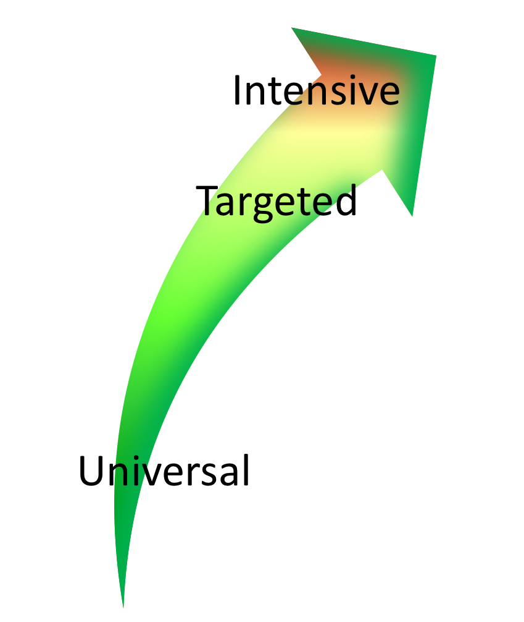

Continuum of Support Within
MTSS for Behavior and MTSS for Academics
Anger Mgt.
Math
Label Behavior, Not Students!
Science
Adult relationships
Attendance
Reading
Peer Interaction
Notes:
Every student has competencies. Label behavior not STUDENTS. Everyone at one point or another needs targeted or intensive supports. Dylan is doing great in reading but may need more support in Math and with anger management.
We never say “those universal kids” so why say “those tier 2” or “tier 3 kids.” don’t lose the child to the diagnosis

Slide 12
Big Ideas About Data
All data should serve a purpose
Collect data with fidelity
Be prompt about looking at data and acting upon it
Use multiple sources of data to confirm what you see
Use data to support, not punish
Notes:
Quick response increases belief that the systems work. When we see school-wide, classroom trends or individual student concern, we want to respond quickly.
To write down, not write up. Data tells us a need exists and we need to figure out what intervention strategy we are going to use to meet that need. Universal instruction? Targeted interventions, etc.

Slide 13

Start with Outcomes
How will you know if your efforts are working if you are not sure where it should be taking you?
Notes:
This just introduces the idea that you might want to have broad goals based on the data you already have and that you shouldn't start drilling into data without a goal in mind

Slide 14

What Are Your Outcomes?
Outcomes should be:
  Locally determined
  Contextually and culturally relevant
  Observable and measurable
  Summarized in goal statements
Consider using a “SMART Goal Format”
Notes:
Specific, Measurable, Attainable, Relevant, and Time-Bound
This just introduces the idea that you might want to have broad goals based on the data you already have and that you shouldn't start drilling into data without a goal in mind
Create a precise problem statement and precision goal statement

Slide 15
Sample Outcomes
Reduce problem behaviors
Increase access to Tier 1 interventions for all students
Increase engagement
Increase meaningful representation
Reduce bullying
Increase attendance
Decrease referrals for Special Education
Increase school morale
Improve academic scores
Notes:
Amy

Slide 16
Sample Outcome Statements
”Given the implementation of relationship mapping and school-wide implementation of “positive greetings at the door”, school climate surveys will average 3 or above after the first two months of school.”
“Given school-wide implementation of PBIS with fidelity, we will decrease the number of student suspensions and expulsions by 10% by the end of the school year.”
Notes:
Amy – the goal summary is to improve the school climate through a student engagement intervention.

Slide 17
Type into the chat box:
What data do you collect/use to assess the social/emotional/behavioral strengths and challenges at your school?
How do you use this data for decision-making?
Notes:
What data will you use to measure progress on your SMART goals?

Slide 18
Types of Data to Consider
Consider Community Data – MH, Substance Abuse, Homelessness, Placement, etc.
Intensive:
TFI
I-SWIS
EST
FBA/BSP
Targeted:
TFI
SWIS-CICO
EST
FBA/BSP
Universal Screening
Universal:
TFI
SAS
SWIS
Attendance
Grades
School Climate
Family Engagement
Weekly Check-In
Notes:
Sherry
What else? IEP across the tiers
Targeted – SWIS or some other School information System like PowerSchool
The more data you have, the more questions you will ask and the better rounded and comprehensive picture you will have.

Slide 19
Data help us ask the right questions.
They do not provide the answers.
Notes:
Not sure if these notes are for this slide.
Assess current status and fidelity of implementation (school-wide)
Assess impact on students
Prioritize areas for change
Acknowledge incremental success along the way
Show staff you value and use their input to make changes (SAS)
Reward staff and student performance
Determine breaks between “roll-outs”
Share results with stakeholders

Slide 20
Data-Based Decision-Making Can Occur at Many Levels
Whole school
Small groups or school areas
Individual student
Same basic process
Notes:
Macro – whole school
Mezzo – certain classrooms or identified groups
Micro – individual student concerns
Start with outcome, create statement with goal summary, gather data, etc.

Slide 21
One Way to Organize Data
Student | GPA | Course Failures | Days Absent | Concerning Behaviors
Josh | 3.1 | 0 | 2 | 0
Mary | 4.1 | 0 | 0 | 0
Kelly | 2.8 | 1 | 0 | 1
Jacob | 1.4 | 3 | 11 | 12
Susan | 3.5 | 0 | 3 | 0
Mark | 1.9 | 1 | 5 | 7
Notes:
Jacob – 12 behaviors that have risen above classroom management

Slide 22
Creating Your Own Data System
Student | Concerning Behaviors | Be Safe | Be Kind | Be Responsible
Josh | 0 | 3 | 3 | 2
Mary | 0 | 3 | 2 | 3
Kelly | 1 | 3 | 3 | 3
Jacob | 12 | 1 | 3 | 2
Susan | 0 | 3 | 2 | 3
Mark | 7 | 2 | 3 | 1
Notes:
School created simple 3-point scale for each of the school-wide expectations
Teachers given instructions for rating students and they provide overall rating to each expectation
Jacob – more questions about where he is doing well and where he is struggling.
How would this work in your school?

Slide 23
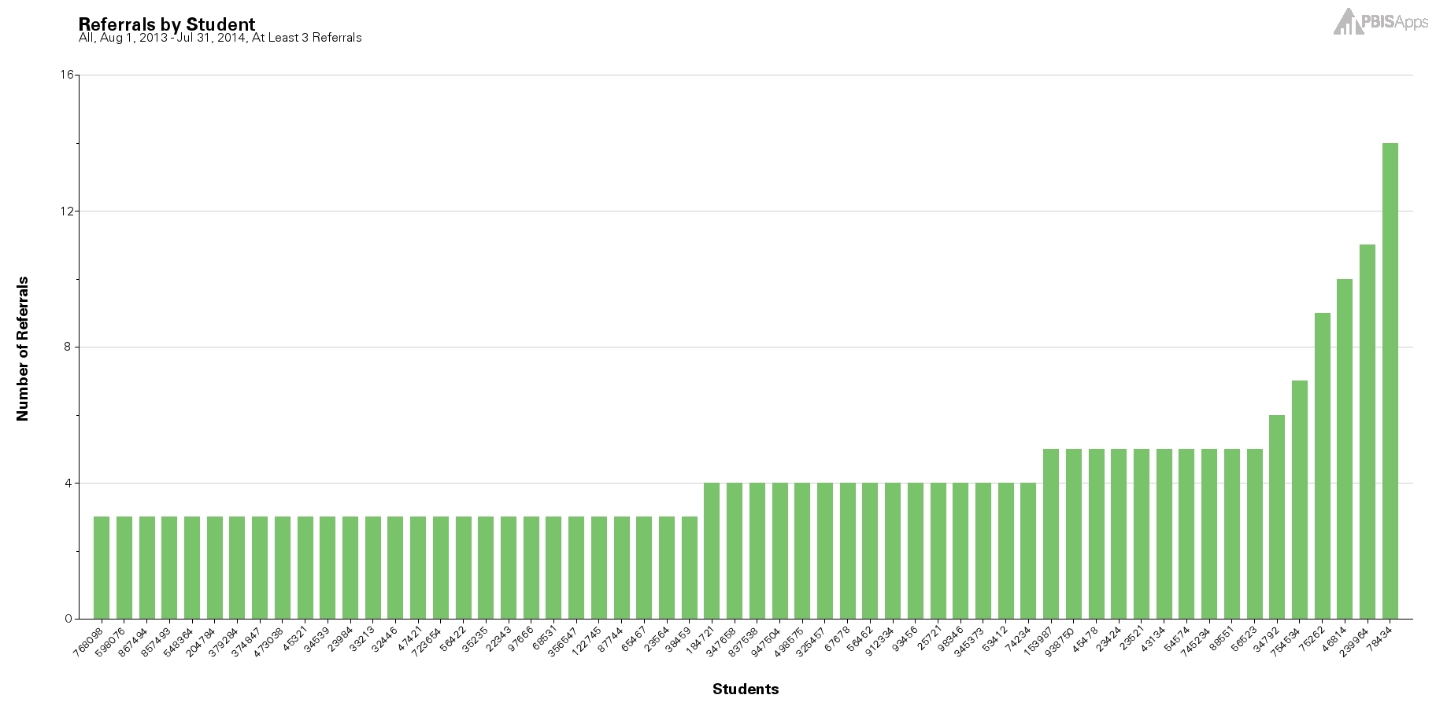

Using the Concerning Behaviors (Referrals) by Student Report as a Universal Screening Tool
Notes:
Student with 2-5 are candidates for more support in behavior, academic, or both areas.

Slide 24
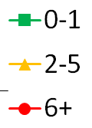
Behavior Data for Universal Screening?
Cumulative Mean BODF Per Month for Elementary Schools
Differences become clear in October
McIntosh et al (2010)
Notes:
Based on research using SWIS data across hundreds of U.S. schools, we know that screening should start in or around October so that by November we are providing students with the level or tiers of support they need to be successful.

Slide 25
The “October Catch” Possibilities
October is also a good time to review race/ethnicity data
30%
20%
In a school of 500 students this could mean
150 less referrals
25-75 hours staff time
per school year!
Notes:
Projected if we intervene we will have lower projected office disciplinary referrals. In actively screening we are trying to reduce the number of total referrals, , the number of minutes a student is out of their instructional environment, the number of referrals individual students receive, and staff time spent on addressing problem behavior across the school.
PBISApps recommends screening about 6 weeks after each major break.. The October Catch, (click) the February Catch, (click) and the April Catch for example.
If we hypothesize a 20% decrease for students who would have ended the year with 2-5 referrals and a 30% decrease for students who were on target to receive 6+ referrals then some simple math tells us that a school with 500 students can reduce overall referrals by 150 and regain approximately 25-75 hours of staff time.

Slide 26
What is social/emotional/behavioral screening?
Assessment of early signs of social risk or behavior problems, as well as the presence of resilience factors and indicators of wellbeing.
Mechanism for supporting students who need additional supports after receiving evidenced-based universal social/emotional/behavioral supports (i.e. PBIS)
Notes:
SEB screening differs from other assessments of attitudes and feelings such as within school climate surveys in that SEB screening focuses on an individual student’s level of SEB health.
School climate surveys typically yield data that are aggregated across groups to indicate a given school’s safety and SEB health as perceived by a variety of stakeholders (student, staff, parents) and can provide another source of important data especially in regard to environmental and contextual factors.
“At risk of” is a big category. We would like to know if there are any warning signs that we can easily address by matching student need with interventions.

Slide 27
Two Types of Screeners
Informal screeners and surveys
Formal SEBL Universal Screeners
Notes:
Screeners with a little s and screeners with a capital S. SEBL – Social Emotional Behavior Learning

Slide 28
1. Informal Screeners and Surveys
Ways to check-in with students frequently and with staff and families regularly to identify support needs as they emerge
Ways to get input from students, families, and staff about well-being and/or climate at the school
Notes:
Can provide valuable data for getting important feedback as well as assessing connections and engagement. Also increases opportunities for school faculty and staff to be observers of behavior and can move a “hunch” to a data point.

Slide 29
2. Formal Universal Screeners for SEBL
Validated instruments that focus on social/emotional/behavioral risks and strengths.
A reliable method for determining students with elevated levels of risk.
Notes:
The use of screening data is well established as a valid and reliable method for determining students with elevated levels of risk (Kamphaus & Distephano, 2007; Romer & McIntosh, 2005; Elliott & Gresham, 2008).
Recognize typical base rates and norm comparison data may be skewed.

Slide 30
Informal Screeners and Surveys
Notes:
Screen. Formally or informally screen to efficiently identify students who need more support (related to health, safety, SEB needs, academic concerns). Lets talk a little bit about the why

Slide 31
Why Conduct Informal Screening?
Students must feel physically and psychologically safe in order to actively engage in learning
Invite voice, choice, and ownership
Help identify students or staff perhaps at higher risk for significant stress or trauma from COVID-19
Establish most efficient and effective use of MH providers, school psychologists, school counselors, community partners
Notes:
those experiencing death or loss of someone close to them; those with significant disruption to lifestyle such as food insecurity, financial insecurity; those with a history of trauma and chronic stress or other pre-existing mental health problems; those with exposure to abuse or neglect;
Using SEBL folks at which level? Using them at the universal, targeted and intensive level. Pushing in more to utilize informal screening processes to see the challenges in the context where they exist.

Slide 32
Methods of Screening
Surveys
Circles
Phone calls
Drive-by visits
Advisories
Video-chat/face-time
Using existing data
What else?

Slide 33
Please Type Into Chatbox
Do you have an informal screening or survey at your school to assess for social/emotional/behavioral concerns? If so, what are you doing?

Slide 34
Informal Screeners and Surveys - Examples
Notes:
asking questions, listening empathically, and reaching out to let others know we care —can make a big difference in the lives of our students.
Reference list in hand-outs/materials calls social/emotional/behavioral surveys and screeners.

Slide 35
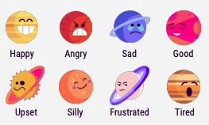
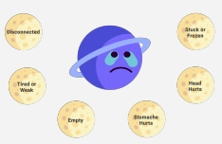
Closegap https://www.closegap.org/
How are you feeling?
How does that feel in your body?
What else is going on?
Which activity would you like to complete?
Notes:
Closegap was one of the recommendations provided by the AOE in the SEL Covid-guidance. It was also recommended by VT School Counselor Association and the VT SEL Taskforce. it is free and user friendly. Can be completed on both remote learning days and in-person days. You can also create something like this that is physical vs virtual
Strengths – easy to implement. No pushback from staff. Younger students like the “select to speak option. Can do pencil and paper version.
Barriers – initial concern that middle schoolers wouldn’t like it but they do.
They are doing it twice a week. School counselor has access to all the data. Helps prevent kids from falling through the cracks when they select that they want to speak to someone.
How are you feeling? Closegap uses planets to describe our feelings. You may be feeling one way right now, but feelings are temporary— they aren’t who you are and they will pass. You can move from feeling to feeling, from planet to planet, all day long.
How does that feel in your body? From here you check in with your physical feelings, or the sensations happening in your body. These are our moon
What else is going on? Then we ask about your energy levels, and follow up with some additional questions: Did you sleep well last night? Is everything OK at home? Are you hurt or sick? Do you want to talk to someone?
What activity would you like to complete? We then offer a library of activities to choose from, varying from calming to energizing, from discreet to things you can do with others.

Slide 36
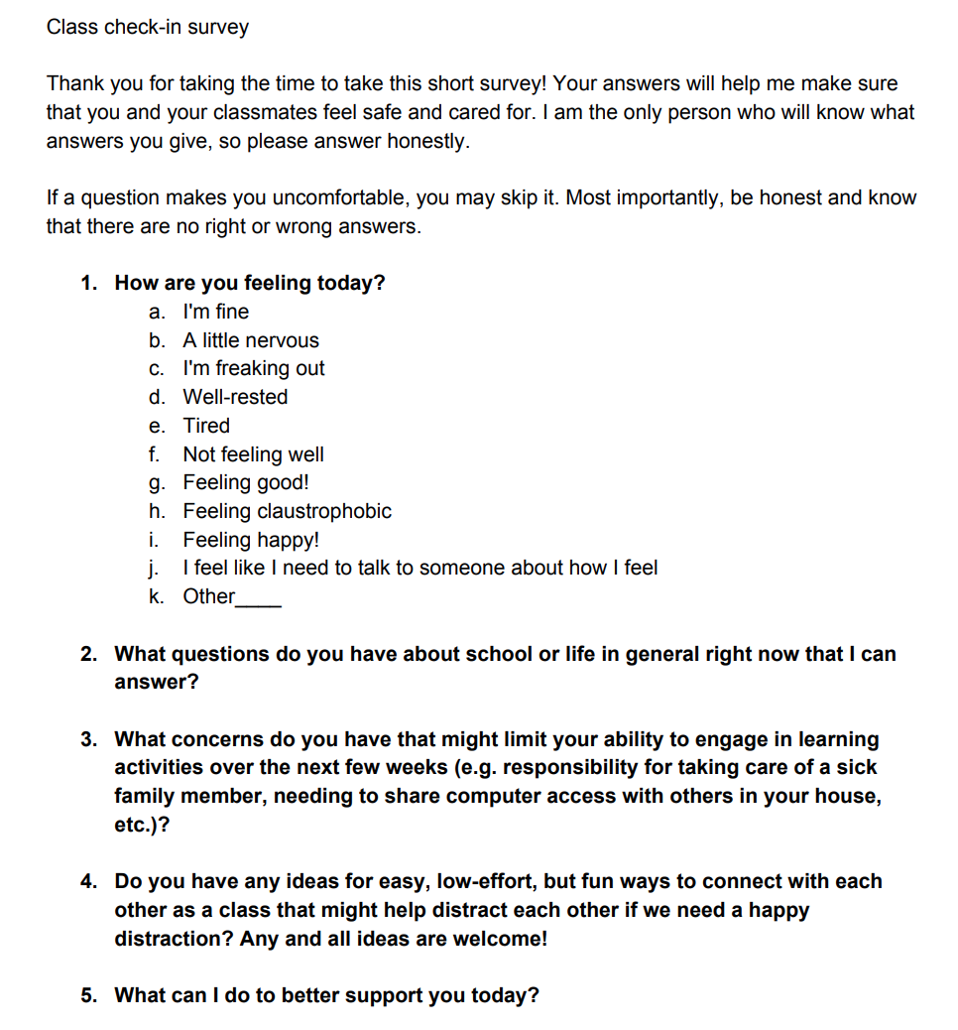
Harvard Graduate School of Education – Making Caring Common Project:
https://mcc.gse.harvard.edu/resources-for-educators/covid-check-in-survey

Slide 37
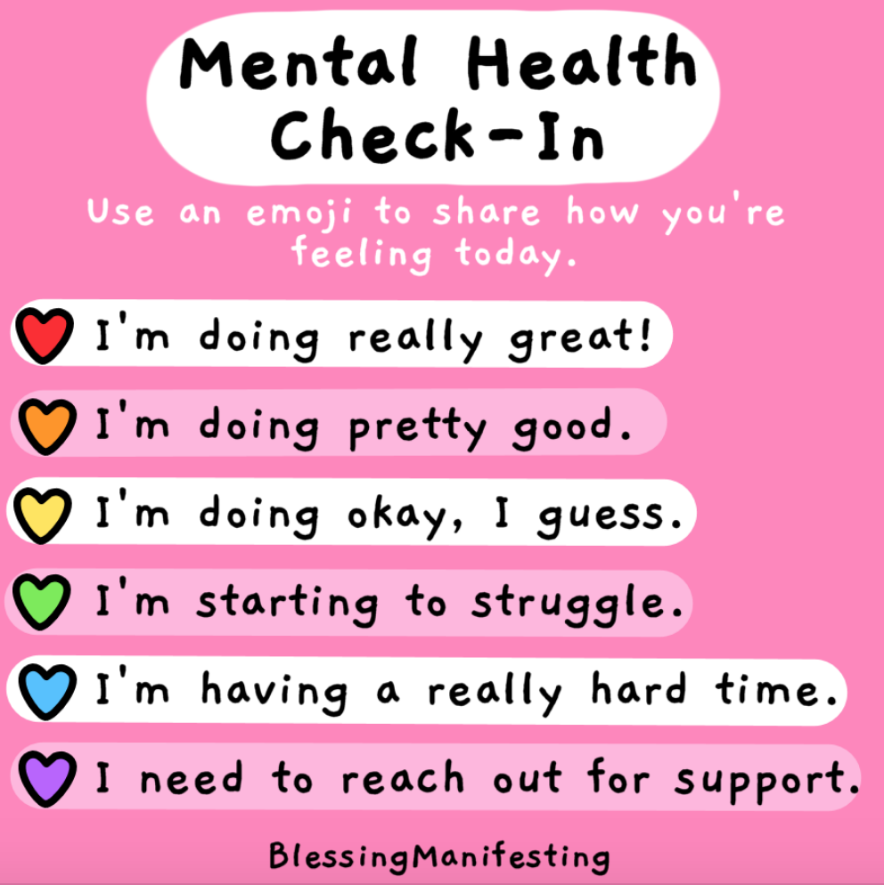
Notes:
Check box and do it anymously on their desk
Emoji in receptacle and get your finger on the pulse of the classroom community

Slide 38
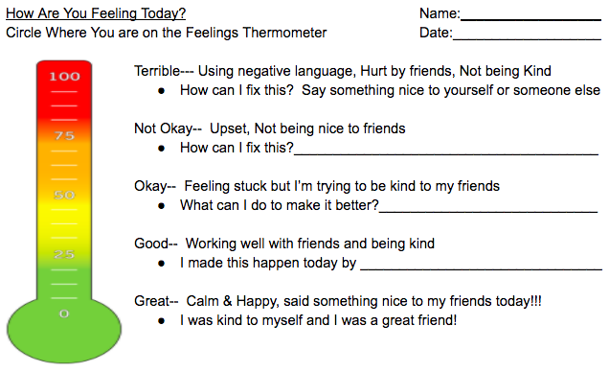
Youth Self-Report

Slide 39
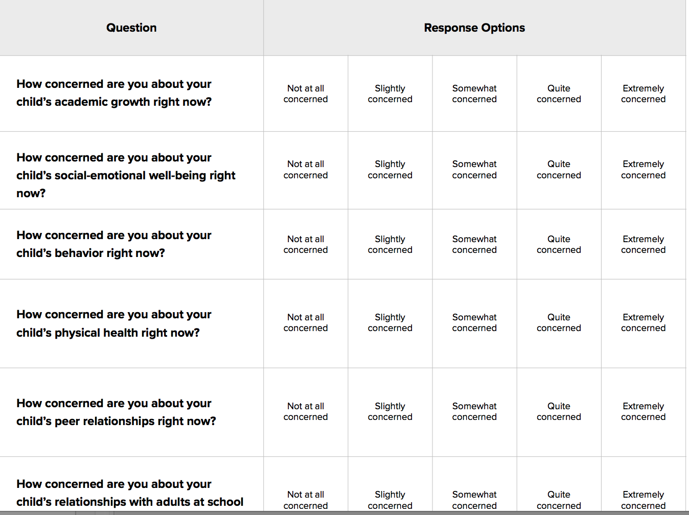
Family Surveys:
Panorama Education

Slide 40
Educator Survey Questions
During the past week, how often did you feel engaged at work?
How connected do you feel to other adults at your school?
When you face challenges at work, how supportive are your school leaders?
How confident are you that you can help your school's most challenging students to learn?
What is the most effective thing that you do to model social-emotional learning for your students?
Panorama Education
Notes:
Well-being, belonging, ed leadership relationships, efficacy, self-reflection

Slide 41
Want to create your own surveys?
Check out the Panorama Question Bank at https://go.panoramaed.com/thanks/question-bank-student-check-ins?submissionGuid=cf5405fd-0c3f-4559-9ccc-4b2feda9612c

Slide 42
Other SEBL Data to Consider
Behavior Data and Observation Form Referrals (Office Discipline Referrals, or ODRs)
Nurses visits
Suspension/expulsion
Student level of engagement in distance learning
Referrals (from staff, parents, other)
MH caseloads
Community Partners’ data
Notes:
Earlier we looked at data across the tiers. This is just a reminder of what to look for with your informal universal screener.
PCP’s, crisis visits, hospital diversion, substance abuse, etc.

Slide 43
Relationship Mapping
To identify students who do (or do not) have positive and stable relationships with adults in school
To connect at least one adult in school to every student who does not currently have a positive and trusting relationship with an adult
https://mcc.gse.harvard.edu/resources-for-educators/relationship-mapping-strategy
Notes:
Equity and inclusion for students. Do they have someone they can trust that looks like them and understands their culture.

Slide 44
Input and Satisfaction Surveys
Stakeholder Satisfaction and Input Surveys (SSIS) are available for students, staff, and families. Developed for PBIS schools, these surveys are tools to get voice and agency among stakeholders about their extent of satisfaction with communication, respect, and behavioral supports at the school.
For families, go here; for students, go here; for staff, go here
Notes:
Satisfaction about school culture is another way to informally survey what experiences families, students and staff are having. You can use that information to design interventions.

Slide 45
Please Type Into Chatbox:
What other data might your “team” look at to determine supports needed?

Slide 46
Informal Screening:
Key Systems Considerations
MOST IMPORTANT: If you screen, you must have a plan to intervene
MTSS work in progress
  Strong teaming infrastructure is needed
  Request for assistance process is understood by all
Prioritize SEBL and communicate importance
Have common understanding of SEBL
Identify supports and interventions up front
  Inventory
  Ensure capacity to respond
Use community partners
https://www.pbisvermont.org/evaluations/social-emotional-behavioral-screening/
Notes:
One of the unintended positive consequences of COVID was that prioritization to SEB well-being for staff and students was named in a way that it has not been before so there is more acceptance about ensuring that occurs and it not as competitive with academics as it used to be.
Understand that utilizing informal and formal screening tools may uncover needs about which you were not aware. So, be prepared to find tools to address those needs. Harm can be done if you uncover a need and do not address it. However, this should not paralyze the process. Just be ready to mobilize to meet the need.
When students return to school, they need to immediately know what social, emotional, and behavioral resources are available. While staff can encourage students to use those services, staff are still responsible to refer students with clear or suspected needs to the EST/Targeted Team/ even in the absence of a student self-report or self-referral.
What functions do your interventions address? It may be helpful to connect with local service agencies and community partners to help identify these needs and provide additional support. Build a broad coalition to integrate SEL and academic supports into transition plans, and create and maintain a caring, safe, and supportive environment for all students and adults.

Slide 47
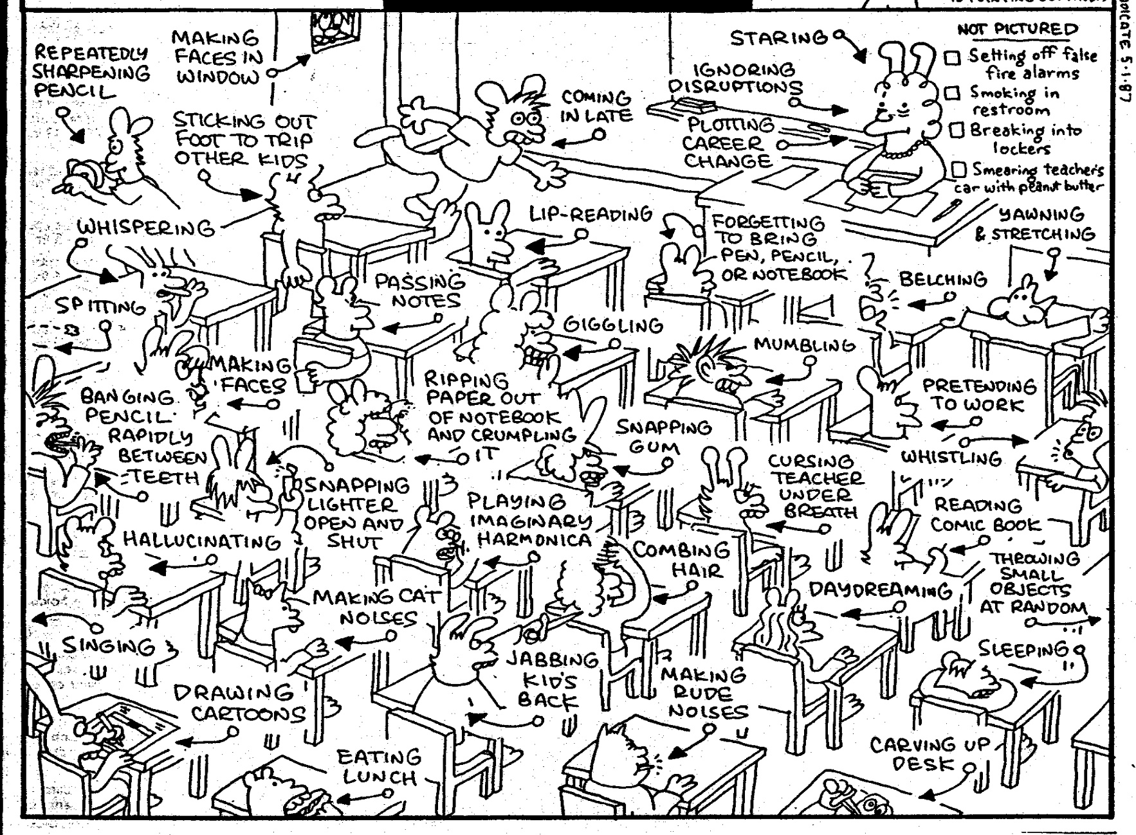
How do we formulate an accurate measure of risk?
Notes:
With the number of behaviors that occur in the classroom on a daily basis, it can sometimes be difficult to formulate an accurate measure of the real challenges and needs if we rely solely on anecdotal, gut reactions. It can also sometimes be a challenge to figure out where to start when there can be so many variations in the types of behaviors.
Role of educator challenging to meet differentiated needs of students.

Slide 48
Why (Formal) Universal Screening?
To find students whose problems are not immediately obvious.
To identify problems with a high degree of accuracy.
Early identification leads to early intervention.
To select interventions based on results of rating scales on the screening tools. This is most effective and efficient.
Notes:
Validated instruments that focus on social/emotional/behavioral risks and strengths.
A reliable method for determining students with elevated levels of risk.
As we already said, we’re doing a multitude of screenings in schools anyway. Just like with our other screenings, early identification leads to early intervention. Using formalized screening measures allows schools to select interventions that are based on results of rating scales rather than guesses.
Screening allows us to be objective.
Matching interventions to what is going on with the student. A simplistic example would be supporting a shy, withdrawn student with a standard CICO intervention
It is also important to remember that students with internalizing behaviors maybe missed because their behaviors are not obvious.

Slide 49
Poor Outcomes for Unidentified and Untreated Youth
Poor grades
Impaired personal relationships
High school dropout
Unemployment
Incarceration
Substance abuse
Suicide
Notes:
WHAT DO WE KNOW!
Academic Success is linked with social and behavioral skills
Early identification with intervention can decrease the likelihood of academic failure
Preventive supports reduce the need for more intensive supports later
.

Slide 50
What does Universal SEBL Screening Look Like?
Teachers (or others) complete a standardized questionnaire, behavior rating scale, or clinical assessment tool on every student to determine if they are experiencing or at-risk for some social, emotional, or behavioral problem (for example, trauma, stress, anxiety, depression, anger, or aggression).
Notes:
Under normal (pre-pandemic) circumstances, a psychometrically-sound screening-to-services process requires the use of (a) multiple assessment approaches or tools; (b) completed by multiple raters (including the student him or herself); (c) evaluating student behavior across multiple settings; (d) where the ratings, observations, and data are reliable and the results are valid; and all completed (e) within a multiple-gated process.

Slide 51
Please Type Into Chatbox:
Is your school implementing a Social/Emotional/Behavioral Screener? If so, what tool are you using?

Slide 52
Interventions with an Evidence Base
Advance organizers
Anger Management Skills Training
Behavioral Interventions
Choice
Class Wide Peer Tutoring
Cognitive organizers
Cognitive Restructuring
Cognitive-Behavioral Therapy
Computer-Assisted Instruction
Contingency Management
Daily Behavior Report Cards
Exposure-Based Techniques
Family Therapy
Functional Assessment
Functional Communication Training
Integrated Cognitive-Behavioral Therapy
Interdependent Group-Oriented Contingency Management
Interpersonal Therapy for Adolescents
Milieu Language Teaching
Mnemonics
Modeling
Modified Task Presentation Strategies
Multimodal Interventions
Multisystemic Therapy
Opportunities to respond
Pacing
Parent Training
Peer Mediated Interventions
Peer tutoring
Peer-Mediated Conflict Resolution and Negotiation
Picture Exchange Communication System
Pivotal Response Training
Pre-correction
Presentation Strategies
Problem Solving
Procedural prompts and behavioral momentum
Replacement Behavior Training
Self instruction
Self mediated strategies
Self monitoring
Self-Management
Social Skills Training
Task Modification
Task Selection Strategies
Token Economy System
Verbal Mediation
Video Modeling
SEB INTERVENTIONS
Vannest K, Reynolds CR, Kamphaus RW. BASC-2 intervention guide for emotional and behavioral problems. Bloomington, MN: Pearson Assessments; 2009.
Notes:
How do we know which intervention to use for each child? We need to have a formalized way to determine what type of intervention is most appropriate for each student. Just like in an RTI model where we use Universal academic assessments to identify students at risk and to provide early intervention. We need to do the same behaviorally and ensure that we are being more intentional with our intervention selection.

Slide 53
When to Screen?
At least 6-8 weeks into the school year
  Need enough time for observation, interaction, and experience with a student so ratings are reliable and valid
You need to KNOW THE STUDENT!
If done too early and too quickly, the results will largely be invalid, the needed treatment directions will be unclear (or incorrectly focused),
Notes:
Second bullet – relationship mapping. Think about equity and inclusion, implicit bias, subjective behaviors, etc.
If such “Screening” is done too early and too quickly, the results will largely be invalid, the needed treatment directions will be unclear (or incorrectly focused), the time will be wasted. . . . and worse, some students may be harmed by not getting or getting the wrong therapeutic services.
When students return to school this Fall, we are fully expecting a social, emotional, and behavioral transition or re-entry process that is somewhat different than “normal.” While we can’t exactly predict how individual students will re-enter (hence the screening process outlined later in this Blog), we do expect different levels of social, emotional, and behavioral variability across students as a “normal” response. . . both to the medical, economic, educational, social, and/or other life condition effects of the pandemic, and to the racial bias and equity events triggered by the murder of George Floyd and others.

Slide 54
Screening can help identify:
Students with externalizing problems?
Students with internalizing problems?
Notes:
Students exhibiting anxiety, depression or other internalizing behaviors are not as easily recognizable. Although ODRs give descriptions of behavior incidents that occurred, they do not assess the motivating factors behind behavior and often times miss the less externalizing student who don’t typically “Act Out.”
Bristol: someone may rank order high in the screening but may not receive referrals which means you just need to ask more questions.

Slide 55
Multi-Stage & Multi-Gate Approach to Screening
Universal Screen
Elevated? Screen #2
Elevated? Request for assistance
Not elevated? Done.
Not elevated? Done.
Stage 1
Stage 2
Stage 3
Notes:
Stage 1: screen all kids; stage 2: teacher rating. Higher than average internalizing and externalizing behavior (combined frequency index and critical behavior index (SSBD) – kids that most approximate bx for internalizing or externalizing behavior, Stage 3: intervention or request for assistance. Rank order students (screening systems) and for those who you rank higher, and some kids you will do a deeper assessment as a result of elevated scores. Think of hearing screening, if concern, might do a second screen and then maybe get referred to audiologist.

Slide 56
Features of Good
Universal Screening
Accurate
Cost efficient
Acceptable
Useful
Notes:
As far as accuracy, whenever using any screening or assessment tool you want to make sure it is normed based on the student population that you work with. So you’ll want to select an evidence based, norm-referenced screening tool in order to get the most accurate results.
Reference steps to readiness document
Efficiency, Effectiveness.

Slide 57
What Screening Tools are out There?
https://www.ci3t.org/screening
Notes:
Reference document

Slide 58
List of Screeners
Student Risk Screening Scale http://miblsi.cenmi.org/MiBLSiModel/Evaluation/Measures/StudentRiskScreeningScale.aspx
Social Skills Improvement System http://www.pearsonclinical.com/education/products/100000322/social-skills-improvement-system-ssis-rating-scales.html
Strengths and Difficulties Questionnaire www.sdqinfo.org
Systematic Screening for Behavior Disorders http://store.cambiumlearning.com
BASC™-2 Behavioral and Emotional Screening System (BASC-2 BESS) http://www.pearsonassessments.com
Social, Academic & Emotional Behavior Risks Screener http://ebi.missouri.edu/?p=1116
_
_
_
_
_
_
Notes:
Systematic Screening Tools: Universal Behavior Screeners document

Slide 59
Systematic Screening: Systems Considerations
Recommended 2-3 times/year
  October & February
Group administration of Stage 1
Teachers should have known students for at least one month (longer this year)
Review process and tools with all staff

Slide 60
Systematic Screening:
Systems Considerations
Teaming infrastructure
Referral process
Universal foundation in place
Equity issues
SEBL is a stated priority
Policies and Procedures
Capacity for MH lens on this work
Time for training and coaching
Screening Systems Considerations Assessment

Slide 61
Systems Considerations for Readiness
Identified as priority
Resources secured
Team in place
SEB curriculum in place
Families informed
Ethical/legal –
Policies/procedures
Process for selecting screener
Tier 1 interventions with fidelity
EST ready to act on data
Interventions implemented
Roll-out
Commitment to continued inquiry
See Screening Systems Considerations Assessment
Notes:
Reference screening systems considerations assessment.

Slide 62

Improving Decision Making
Problem
Solution
Problem
Problem Solving
Solution
Action Planning
What data tools do you use to move through data review, problem solving, and action planning?
Notes:
Sherry
Compare that to the old model of identifying a problem and then jumping right to solutions.
Instead, we’ll use our decision-making model to more clearly define the context of problems before moving into solution development.
Then those solutions are put into an action plan so that our solutions are really implemented with integrity.

Slide 63
Problem Solving Mantra…..
Do we have a problem? If so, what is the precise nature of our problem? (identify, define, clarify, confirm/disconfirm inferences)
What is our goal? How will we know we’ve met our goal? (what data will we use?)
Why does the problem exist, & what can we do about it? (hypothesis & solution)
What are the actual elements of our plan? (action plan)
Is our plan being implemented with fidelity & is it working? (evaluate & revise plan)
What next steps are needed?
Notes:
Sherry
Update

Slide 64
Connecting Results from Screenings to Interventions
Intervention: | Target Population: | Evidenced to Address:
Second Step | Grades K-6 | Prosocial skills Violence prevention
Botvin Life Skills | Grades 7-12 | Prosocial skills Substance use prevention
Support for Students Exposed to Trauma | Grades 4-9 | Address impact of trauma
Check In, Check Out | Grades K-12 | Reteach expectations, increased adult attention
Small group instruction of needed skills (social, coping, problem solving) | Grades K-12 | Reteach lessons from curriculum available at T1
MATCH-ADTC (anxiety, depression, trauma, conduct) | Grades K-12 | Modular approach to address less intense presenting problems
Coping Cat | Grades 2-8 | Address impact of anxiety
Bounce Back | Grades K-5 | Address impact of trauma
SPARCS | Grades 6-12 | Address impact of trauma
Aggression Replacement Training | Grades 6-12 | Address physical aggression
TF-CBT | Grades K-12 | Address impact of trauma

Slide 65
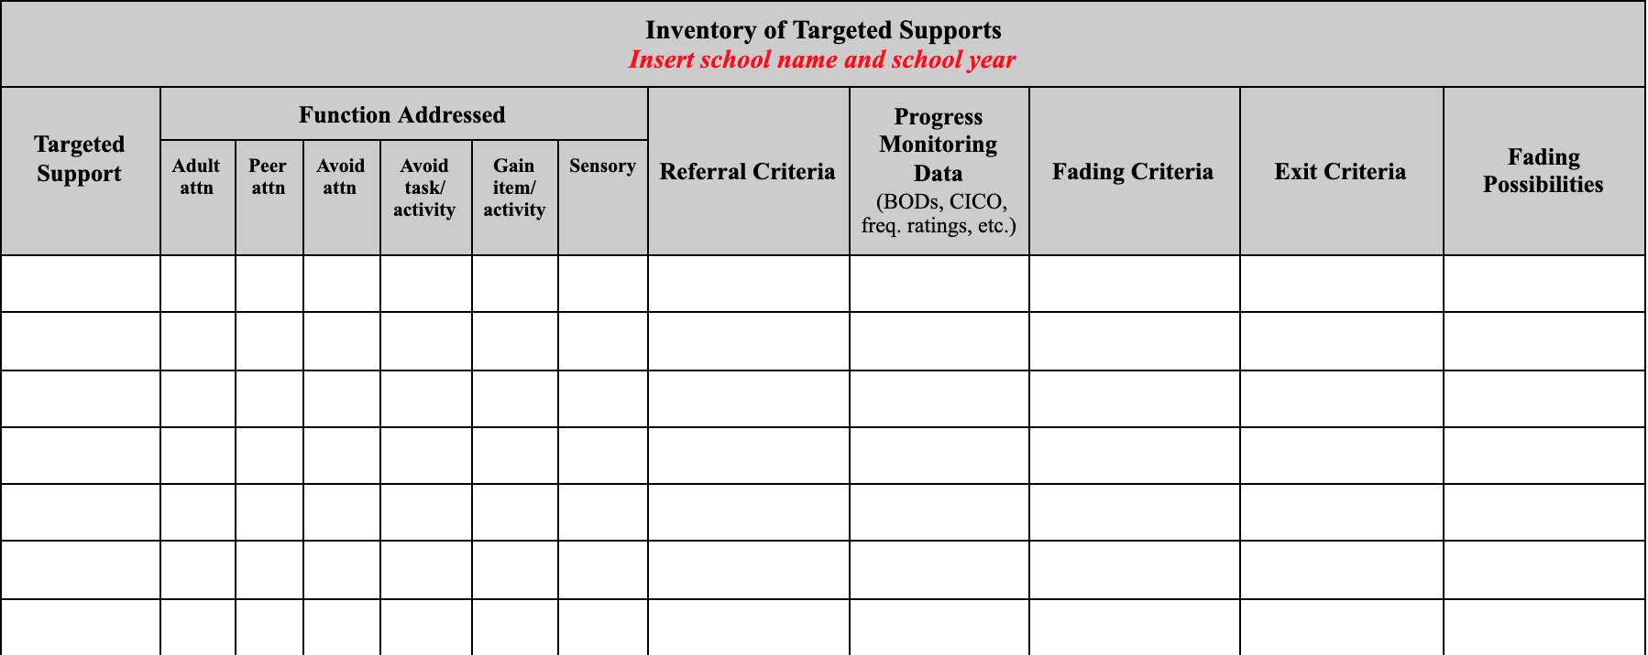
Inventory of Targeted Supports
https://docs.google.com/document/d/1IJMrgr_UKqYhmiMm_L9lMgKX1F6gIt8FFYRg0aLQyyg/copy
Notes:
Reference intervention mapping

Slide 66
What’s Next?
Review Screening Systems Considerations Assessment
Determine where is your school in this process
Review and select tools

Slide 67
http://www.ci3t.org/screening
_

Slide 68

Another amazing resource!
https://smhcollaborative.org/wp-content/uploads/2019/11/universalscreening.pdf
_
Notes:
Nate (940-945)

Slide 69
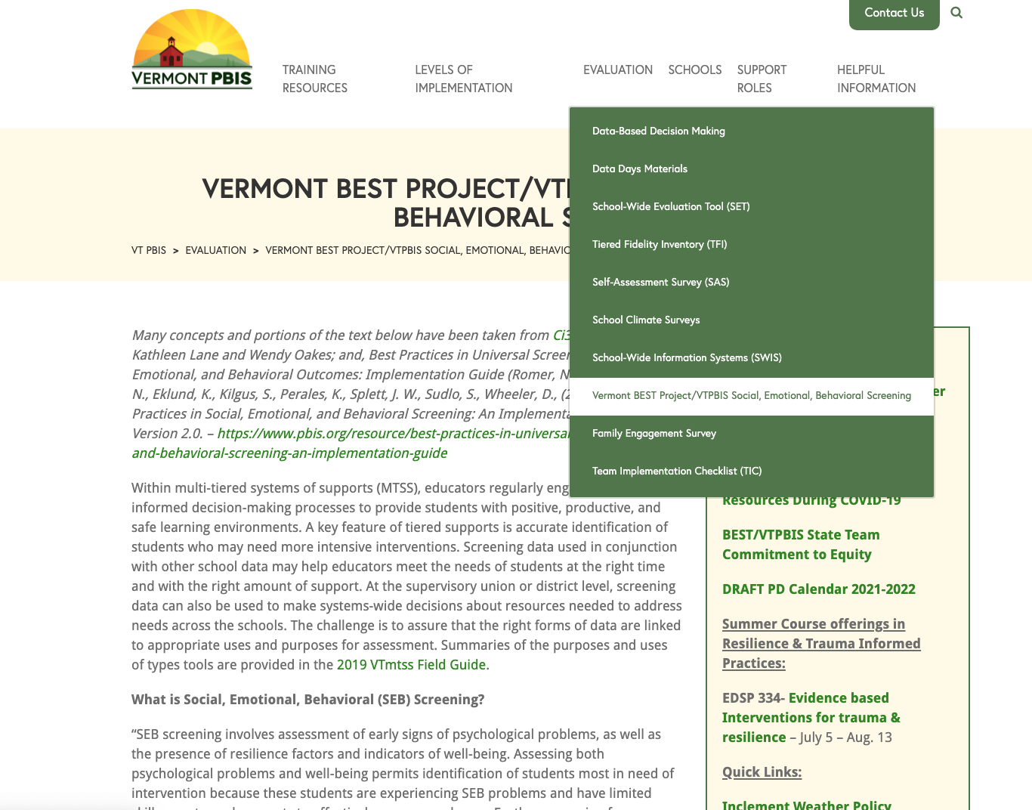

Slide 70
As students, family, school, and community members consider a “restart” of school, we must design education that works for all
Notes:
TIME TO CREATE A NEW NORMAL! Opportunity to examine what’s working in education and what’s not
And with the recent murder of George Floyd and others, the country is finally paying attention to the fact that racism in our society is pervasive and in we need to lact ON that by joining racial justice and education.
This is an opportunity to ensure that there is equity and access for all students - to ensure that everyone gets what they need to thrive socially, emotionally, and intellectually.
This is an opportunity to become more intentionally connected to our community partners
It’s an opportunity to create flexible learning environments that are compassionate.
This is our chance to authentically elevate the voices and perspectives of students, families, educators, and other adults to develop responsive transition plans.
We need to find ways to identify their hopes and concerns about transition while communicating the school’s desire to incorporate their perspectives into decision-making.

Slide 71
Resources
All resources can be found at
bit.ly/VTBEST2021
_
_
_
What questions do you have?
_
_

