Slide 1

Understanding Developmental Trauma:
Using a Tiered System of Support for Implementation
Kym Asam, LICSW
Regional Director of Schools and Clinical Programming
UVM BEST Project coach, TA and trainer

Slide 2
Webinar Objectives
Discuss the importance of adult wellness and work-force development
Introduce the four premises of trauma-responsive/informed schools
Differentiate between PTSD and developmental trauma
Understand the impact of trauma on multiple domains of functioning
Key skills in working with children who have experienced developmental trauma across tiers of support
Increase understanding of alignment between trauma informed schools and PBIS

Slide 3
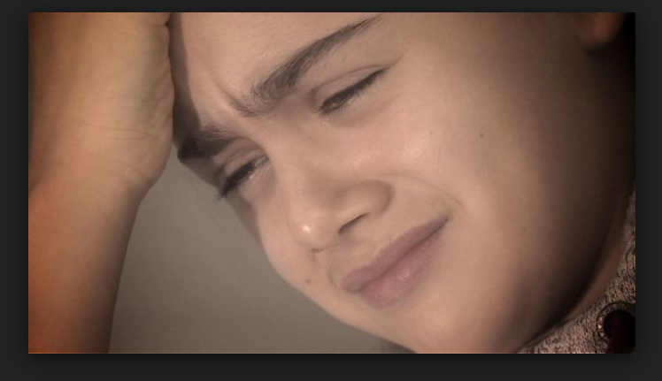

Content and Awareness
It’s not just them…

Slide 4
Polling Question #1
How many audience participants have had some training on developmental or complex trauma?

Slide 5
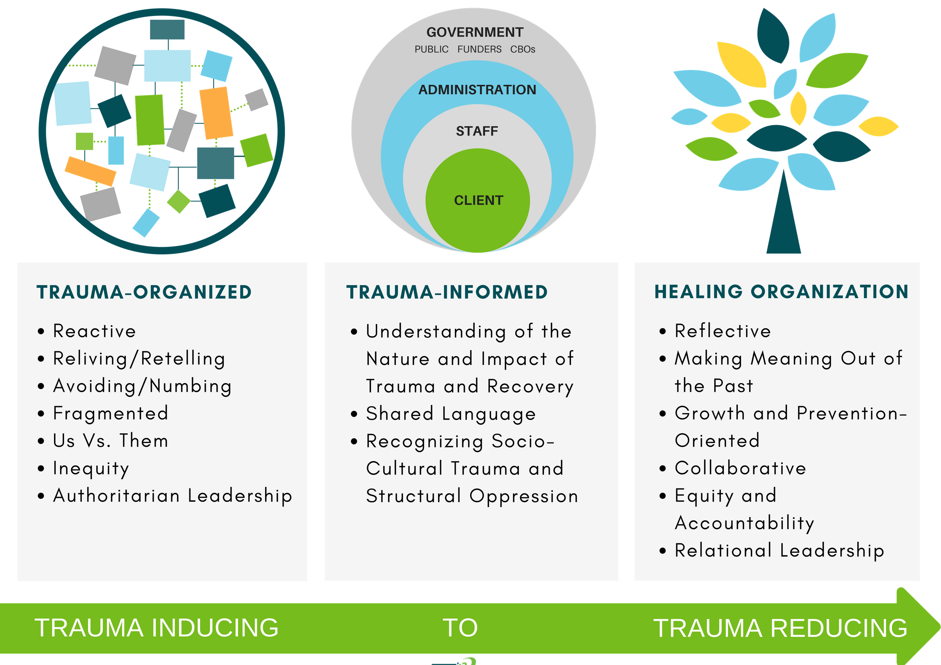

Overarching Principle and Progression
Trauma informed care is “universal precaution” to stop the spread of trauma and toxic stress
(Sandra Bloom)
SAFETY AND SECURITY

Slide 6

Public Health Crisis
AIDS
Obesity
Domestic Violence
COVID-19
Bird Flu
Developmental Trauma
More…

Slide 7



Insidious Trauma
“like drops of acid falling on a stone”

Slide 8

Historical Trauma

Slide 9




Four Premises of Trauma Responsive/Informed Schools:

Slide 10

1. Stress is contagious…reciprocally
Students
Workforce
Building Administrators
District/SU
© NFI Vermont 2019

Slide 11
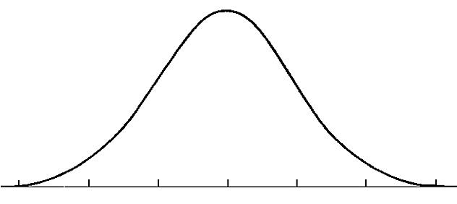
The Stress Continuum
Mild/Moderate Stress:
Optimum
Moderate/High Stress:
Overload
  Stress is community property and therefore…
  Everyone has some responsibility for the success of others because…
  Connections moderate stress
Low/No Stress:
Rest and restore
Toxic Stress:
Breakdown
Objective > Subjective
Stress: The amount of energy in your body
Stress is Contagious…
…but so is Calm.
Implicit Bias
© NFI Vermont 2018

Slide 12
2. Stress is a primary mediator of performance…
Stress
Performance
© NFI Vermont 2019

Slide 13

3. When unregulated, stress injures people, groups, and organizations
© NFI Vermont 2019

Slide 14
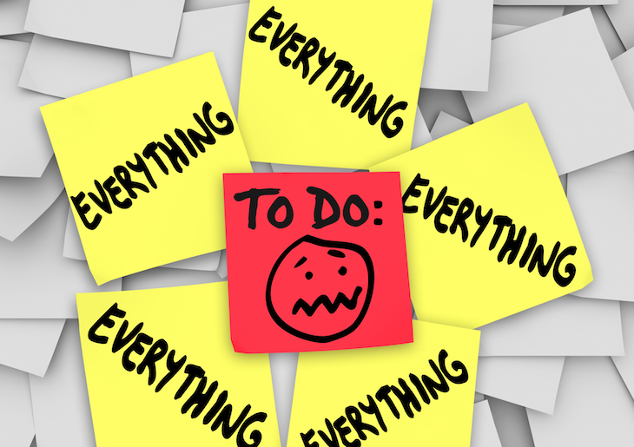
4. Biases, reduced self-care, and blame
4. As stress increases there is a greater focus on “what to do” with clients and less focus on our beliefs and biases about kids who struggle, and ways to reduce our stress
Blame and shame (e.g. gossip, put downs, complaints)…
  …which is a way to gain control, and
…a way to discharge pain/discomfort

Slide 15
Consequences of Unregulated Stress
Learned helplessness
Lack of creativity
Not working together
Low frustration tolerance
Ignoring the obvious
© NFI Vermont 2019

Slide 16
Vicarious Impact:
Vicarious Resilience/ Posttraumatic
Growth
“tragic yet inspiring”
Process
Evaluate
Reflect
Structural Support
Experiences/Emotions
Response
Traumatic Exposures
(Events)
Capacities
Dwell
Quell
Avoid
Maladaptive
Vicarious Trauma
Burnout
Empathy Fatigue
“tragic and hopeless”
Demands
Adapted from “Living on the edge” 2015
© NFI Vermont 2019

Slide 17

School Culture
Beliefs
Perceptions
Relationships
Attitudes
Rules (written and unwritten)
Physical and emotional safety
Classroom and public spaces
Embracing and celebrating diversity

Slide 18
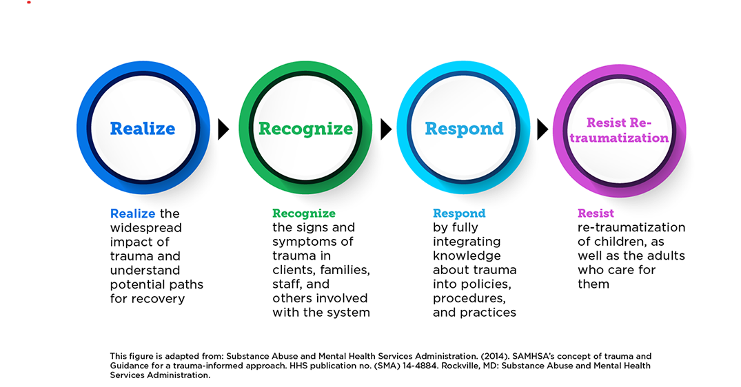
4 R’s of Trauma

Slide 19
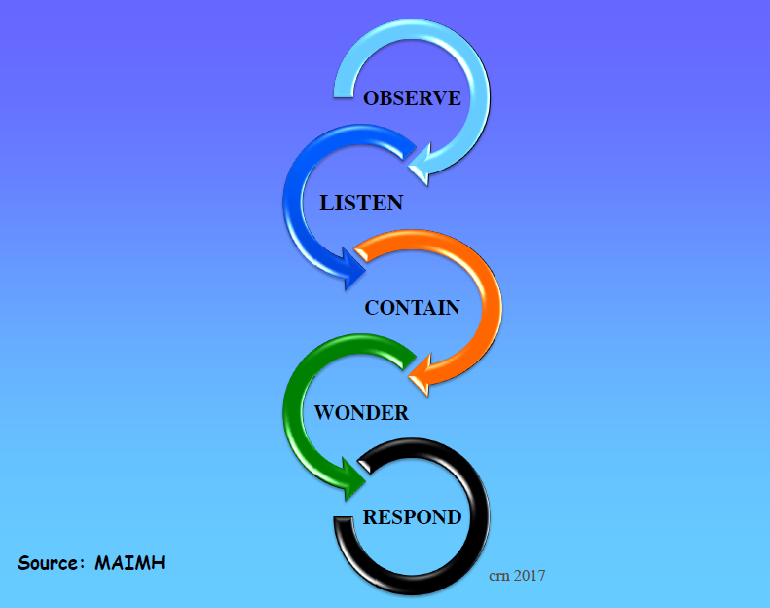
Healing Organizations: Inviting Humanity into the Work

Slide 20
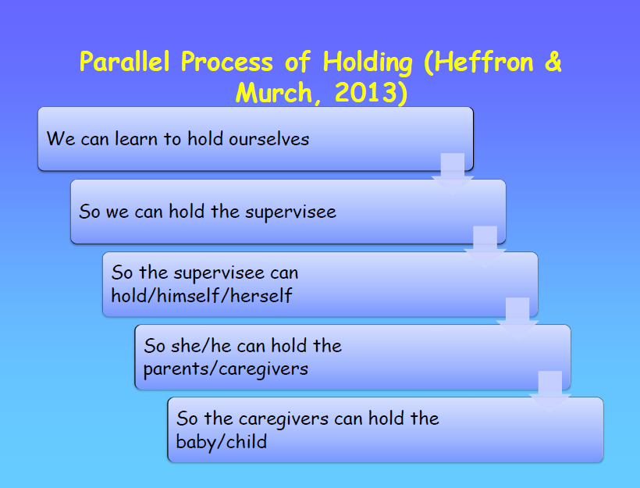
Reflective Supervision

Slide 21

Reflective Practices
Just as it is important to build resilience in our students, it is necessary to build resilience into the system. Educational organizations and their professionals should celebrate success but should be equally inclined to learn from failure and adapt to change.
Self-reflection sets the stage for building a culture of systemic improvement

Slide 22
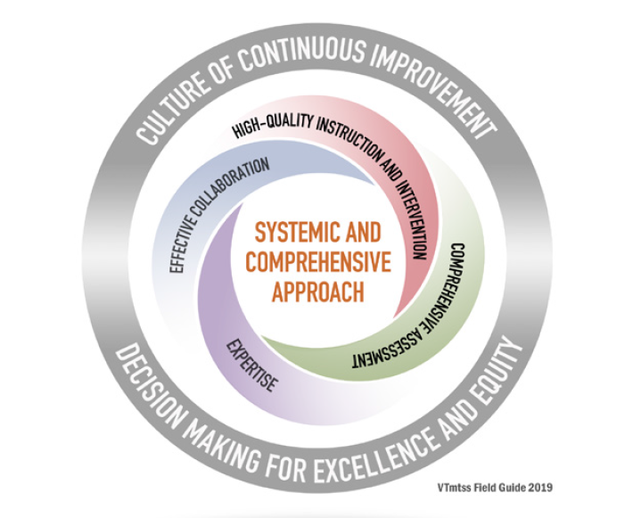
How do we think about trauma-informed practices within a Multi-tiered Systems of Support (VT MTSS)?
VT MTSS is:
Meet students where they are at and help them get to where they need to go!
Resilience is the capacity to grow despite adversity, is built through meaningful
positive relationships, social support, and the opportunity for children to meaningfully master skills.
Christopher Blodgett, Ph.D, CLEAR Trauma Center

Slide 23
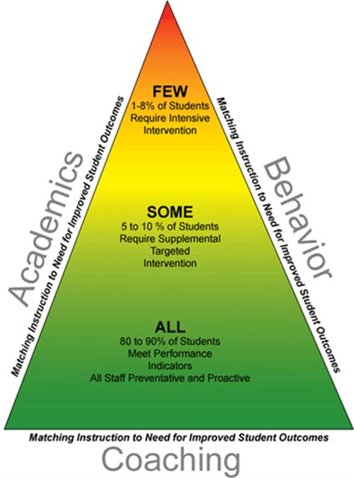
The triangle – Academic and social/emotional interventions
Intensive academic intervention
Intensive mental health intervention
Targeted academic instruction
Targeted social skill and emotional regulation instruction
Classroom/school wide instruction
Universal regulating interventions

Slide 24


Upstream versus Downstream Interventions
Physiology
Perceptions/impulses
Affect/Emotion
cognition
Behavior
© NFI Vermont 2018

Slide 25

Fear of adults
hunger
abuse
Substance abuse
Racial trauma
Community violence
Sexual abuse
neglect
Poor sleep hygiene
Incarcerated parent
Difficulty in school
© NFI Vermont 2018

Slide 26
Shift Your Perspective
Transition from a blame model to a repair model
Asking “how can we help” and “what can we learn from you?”
from
"What is wrong with you?"
to
"What has happened to you?"
(from Wisconsin Dept. of Health Services www.dhs.wisconsin.gov/tic)

Slide 27

Social Injury Requires Social Healing

Slide 28

What is Trauma?
Trauma is a sudden, unpredictable, physiological experience that overwhelms a person’s ability to cope. It is not just an event itself, but rather a response to a stressful experience in which a person’s ability to cope is dramatically undermined.
Direct, secondary, vicarious
Event(s)
Helplessness, isolation/loneliness, mistrust and shame
Experience
Heightened reactions to environmental stimuli
Effects
© NFI Vermont 2018

Slide 29

Developmental Trauma
Multiple events before age 5
Perpetrated from the caregiving system
Leads to developmental injuries in 7 areas
© NFI Vermont 2018

Slide 30

“Trauma is not a story of what happened to you a long time ago, it is what is in your body.”
Bessel van der Kolk

Slide 31
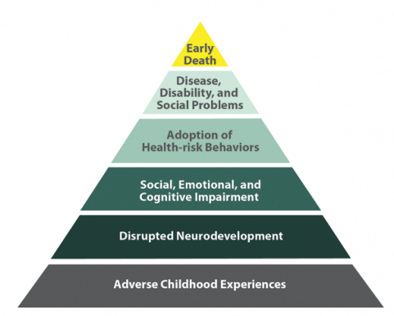
Adverse Childhood Experiences
Death
Conception

Slide 32

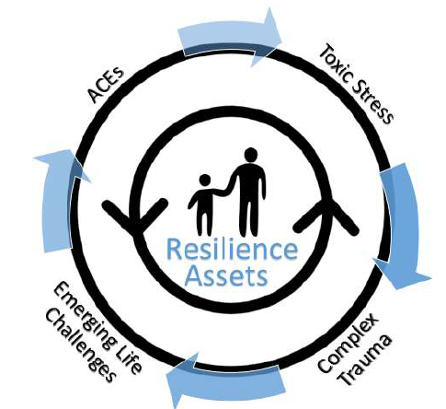
The ACE’s Antidotes
Sleep
Mental health
Healthy relationships
Exercise
Nutrition
Mindfulness
  Meditation
  Yoga
  Progressive muscle relaxation

Slide 33
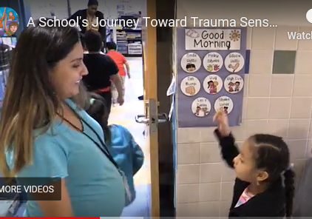
Upstream Interventions (Universal)
Lighting
Greetings and relational deposits
Non-contingent movement breaks
Alternative seating opportunities
PBIS
Manipulatives
Non-verbal communication
OT activities
Consistency and predictability
Matching affect
OTR
Lycra
Visual noise
Wall color
Stop and name
Community building circles
Mindfulness movements
Yoga
Prompting and pre-corrections
Wellness and reflective practices
Source: A School's Journey Toward Trauma-Sensitivity.

Slide 34
T
When Neural Networks Become Abnormally Organized, There is a Cascade of Neurobiological Problems
#1
Physiology:
Body & Brain
#2
Attachment & Relationships
#3
Emotion Regulation
#4
Cognition & Learning
#5
Behavioral Control
#6
Dissociation
#7
Self-esteem & Future Orientation
Domains of Impact/Developmental Injuries
UN-REGULATED STRESS
© NFI Vermont 2018

Slide 35

#1 Physiology: Body & Brain
Developmental Injuries
ACES Study
Hypersensitive/sensitized
Hyposensitive/desensitized
Regressions and Delays
Neurodevelopmental Delays and Exaggerated Stress Response
© NFI Vermont 2018

Slide 36
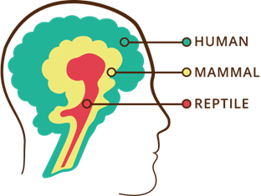
The Human Brain: Form and Function
Three interrelated, interconnected, interdependent “operating systems”…with unique functions and abilities
…that work most effectively under conditions of low to moderate stress.
Logic and Reason
Emotional
Survival
© NFI Vermont 2018

Slide 37


Trauma as a virus
Erratic
High levels of stress and adversity separate and impair the three “operating systems”
Trauma is like a virus in the operating systems of the brain (Bloom)
Healing a brain exposed to chronic adversity often requires unique interventions
Sluggish
Shuts down
© NFI Vermont 2018

Slide 38
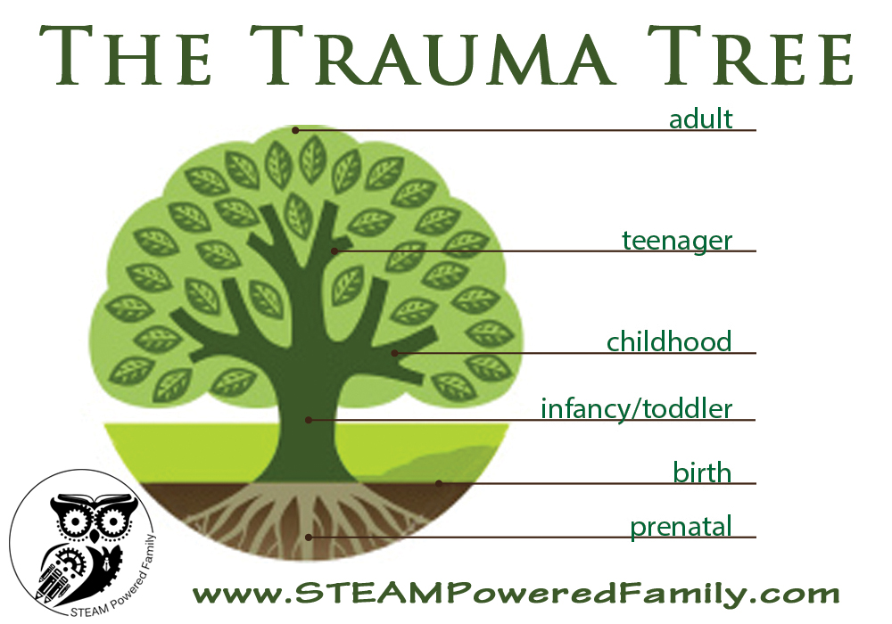

When it happens matters
Cortex
Limbic
Diencephalon
Brainstem

Slide 39
Effects of Trauma on Brain Functioning
Thalamus
Visual, auditory, olfactory,
kinesthetic, gustatory
Pre-frontal cortex
(integration and planning)
Amygdala
(Intensity/significance)
Hippocampus
(cognitive map)

Slide 40
#1 Physiology: Body & Brain
Developmental Injuries
Stabilize the nervous system
  Structure, Routine, Rituals
    Especially during transitions, discipline, saying “no”
  Movement
  Rhythmic activities
Regulate—Relate—Reason
Co-Regulation: Mimic early attachment needs
Addressing basic needs
© NFI Vermont 2018

Slide 41
Targeting the Tiers, PBIS approaches
Intensive
Brain stem
Limbic
Targeted
Universal
Cortex

Slide 42
Polling Question #2
How many participants use movement when working with students?

Slide 43

#2 Attachment & Relationships
Developmental Injuries
Attachment is the search for protection.
“We do to others what was done to us….unless we remember our pain” (Lieberman)
Highly insecure and mistrustful of others (particularly authority figures)
Lack of congruence between internal experience and external world response (invalidation)
Broad symptoms pattern including: bossy, controlling and commanding, clingy and dependent, avoidant and detached; separation anxiety
Highly sensitized/reactive to transitions, limits, hearing “no”, working cooperatively
Difficulty attuning to others and taking perspective
Unusual self-soothing habits and patterns
Reenactments
Atypical Seeking Behaviors
© NFI Vermont 2018

Slide 44
Healthy Attachment
Physical or Psychological Need
Safety and Security
Trust and mutual regard
Feelings are organized
“Felt” sense of ‘being-with” others
Intrinsic memory
Mental Map/ Road Map
Relaxed
State of Arousal
Attunement Needs Regarded
Adapted from Beverly James
© NFI Vermont 2018

Slide 45
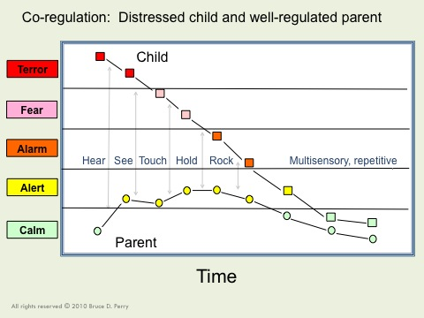
Co-Regulation
All rights reserved © 2006-2012 Bruce D. Perry and The ChildTrauma Academy
© NFI Vermont 2018

Slide 46
Unhealthy Attachment
Physical or Psychological Need
Activation of Stress Response System
State of Arousal
Mis-attunement
Needs Disregarded
Trauma
Adapted from Beverly James
© NFI Vermont 2018

Slide 47
Unhealthy Attachment
Physical or Psychological Need
Danger and Insecurity
Mistrust
Feelings are disorganized
“Felt” sense of ‘being-without” others
Poor self-regulation
Implicit memory
Mental Map/ Road Map
Activation of Stress Response System
State of Arousal
Mis-attunement
Needs Disregarded
Trauma
Adapted from Beverly James
© NFI Vermont 2018

Slide 48
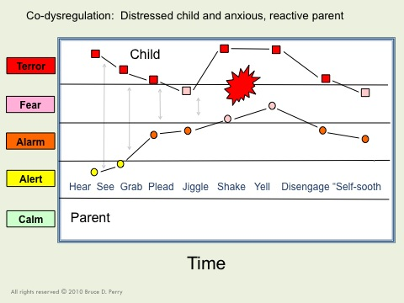
Co-Dysregulation:
Provocation & Escalation
All rights reserved © 2006-2012 Bruce D. Perry and The ChildTrauma Academy
© NFI Vermont 2018

Slide 49
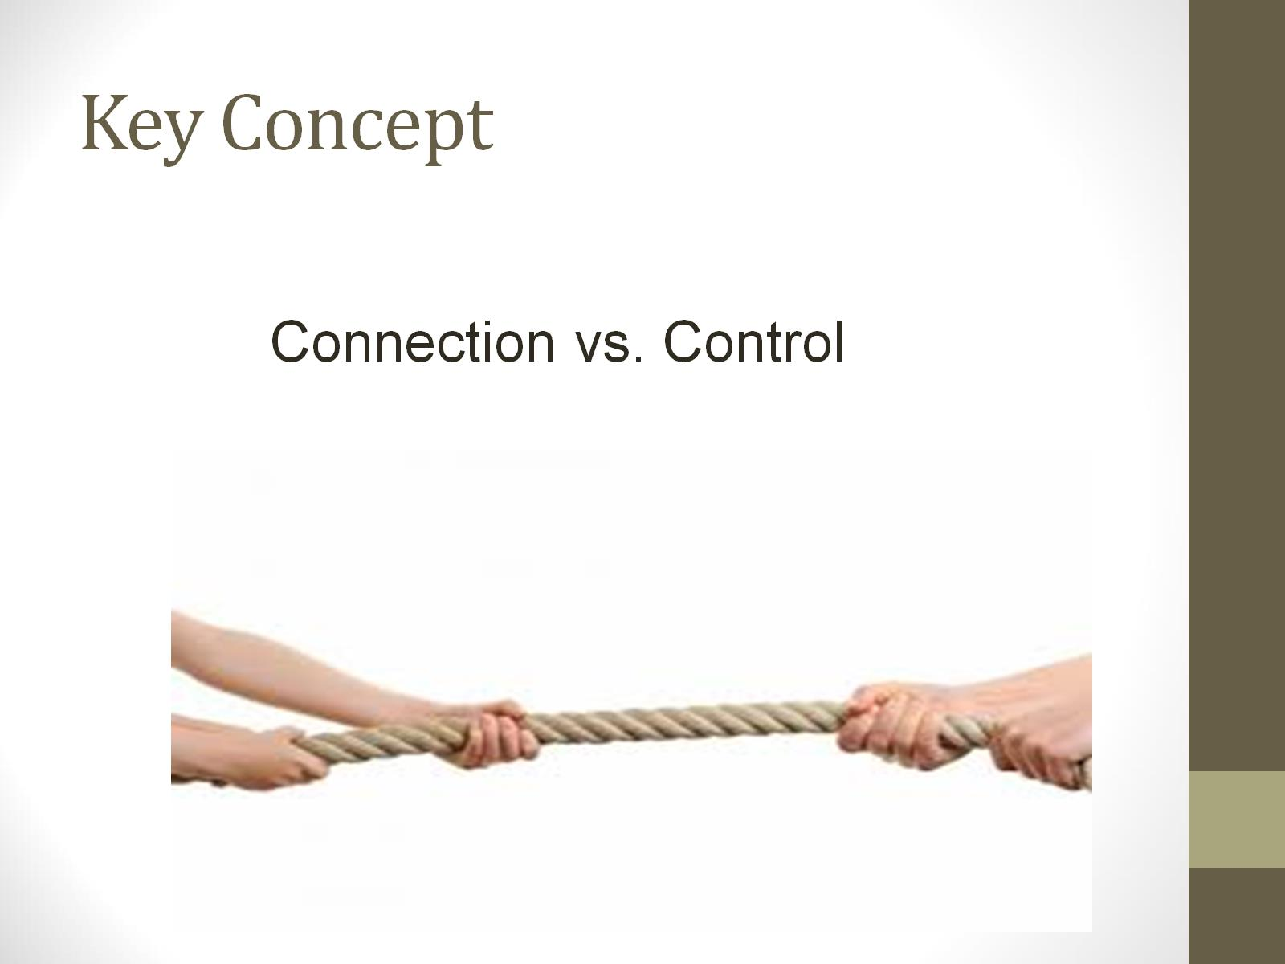
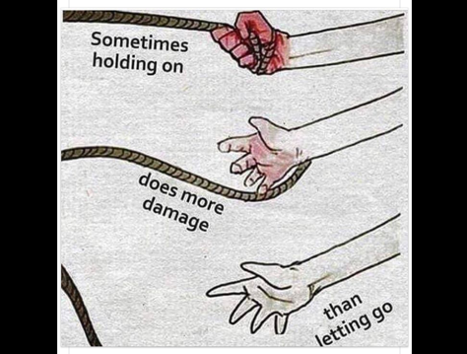
Key Concept

Slide 50
#2 Attachment & Relationships
Developmental Injuries
Relational deposits/Relational endurance
Create congruence between internal experience and external world response
  Validation not reassurance (enter the darkness)
Its not the rupture, it’s the repair—expect the rupture, work the repair
Avoid ensnarement in reenactment
5. Refine your language:
  Connection seeking not attention seeking
  Repair seeking
  Validation seeking not manipulation
PACE
Build architecture of healthy interactions -- attunement
Maintain awareness about the impact on relationships within workforce (contagion)
© NFI Vermont 2018

Slide 51

#3 Emotion Regulation:
Developmental Injuries
Difficulty knowing and identifying physiological states
Incongruence between internal physiological states and external expression
Poor affect identification and affect expression
Over-dependence on behavior to reveal internal affect states
Difficulty expressing needs in socially acceptable ways
Emotions have proven to be very dangerous for child; they often reenact this with others
Sleep and eating disruptions
© NFI Vermont 2018

Slide 52

Normative Danger Responses
Autonomic Nervous Response System
Fight
Flight
Freeze
Flock
Submit

Slide 53
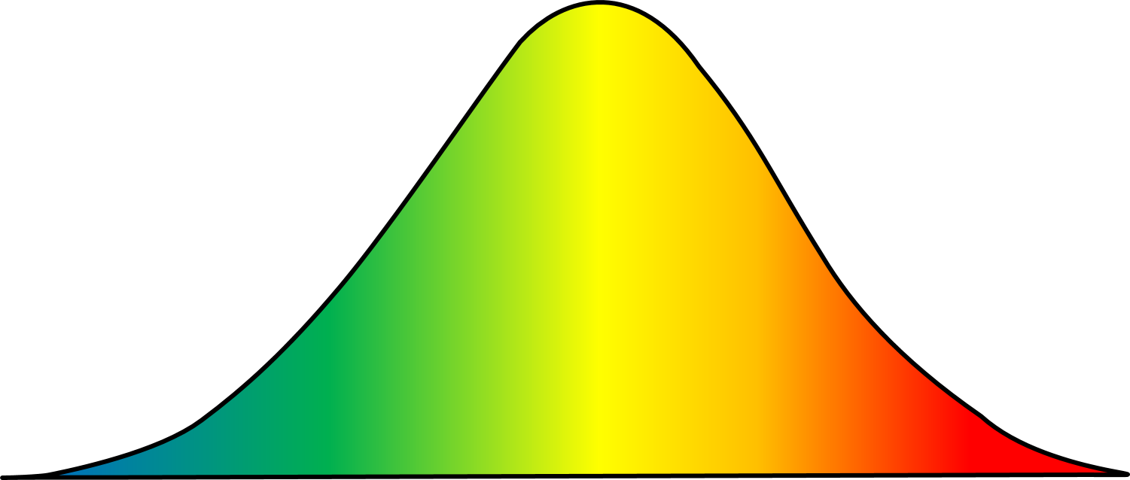
The Stress Continuum:
Typically Developing Person
Mild/Moderate Stress:
Optimum
Moderate/High Stress:
Overload
Low/No Stress:
Rest and restore
Toxic Stress:
Breakdown
Positive Tolerable Toxic
Resiliency Vulnerability
© NFI Vermont 2018

Slide 54
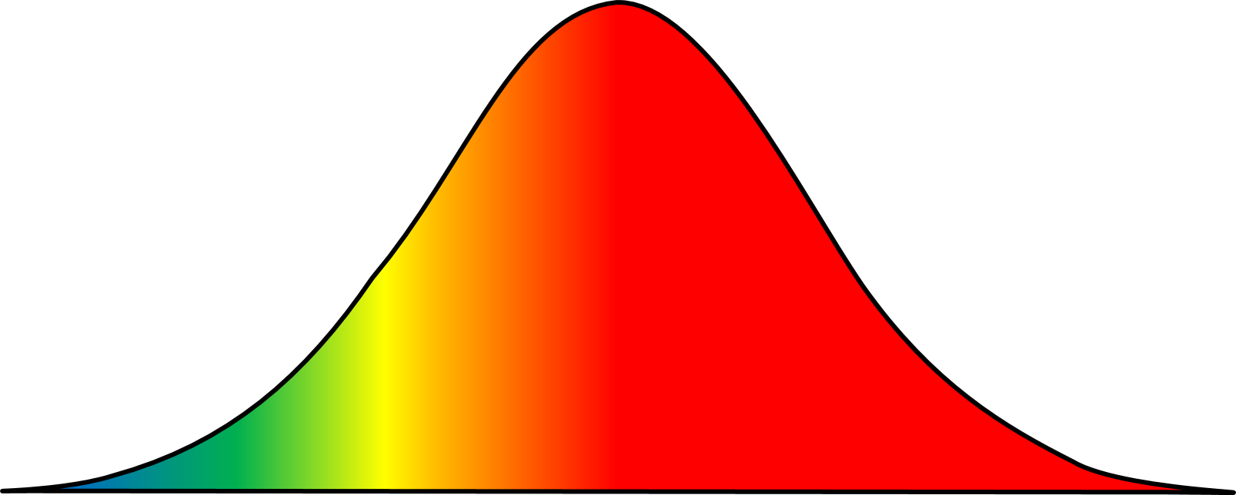
The Stress Continuum:
Person Exposed to Chronic Trauma (sensitized)
Mild/Moderate Stress:
Optimum
Moderate/High Stress:
Overload
Low/No Stress:
Rest and restore
Toxic Stress:
Breakdown
Positive Tolerable Toxic
Resiliency Vulnerability
© NFI Vermont 2018

Slide 55
Stage vs. Age
Stage = where child is at developmentally, regardless of chronological age
Ask yourself, “At what age do kids typically master this behavior?”
Intervene based on the developmental challenge, not the age of the child – this usually requires creativity!
Performance
Stress

Slide 57
#3 Emotion Regulation:
Developmental Injuries
Be an interpreter
Use movement, yoga, martial arts, music, OT activities, etc.
Teach affect identification and expression
Co-regulation strategies: RRR
© NFI Vermont 2018

Slide 58
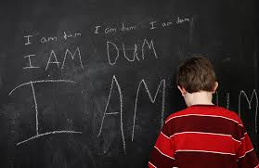
#4 Cognition & Learning:
Developmental Injuries
Rigid/concrete thinking
Poor cause and affect thinking/consequential thinking
Language Delays, Language Use
Difficulty with Executive Functioning
Cognitive Distortions
Attention, Memory and Curiosity Deficits
Learning challenges
Intrusive memories
© NFI Vermont 2018

Slide 59
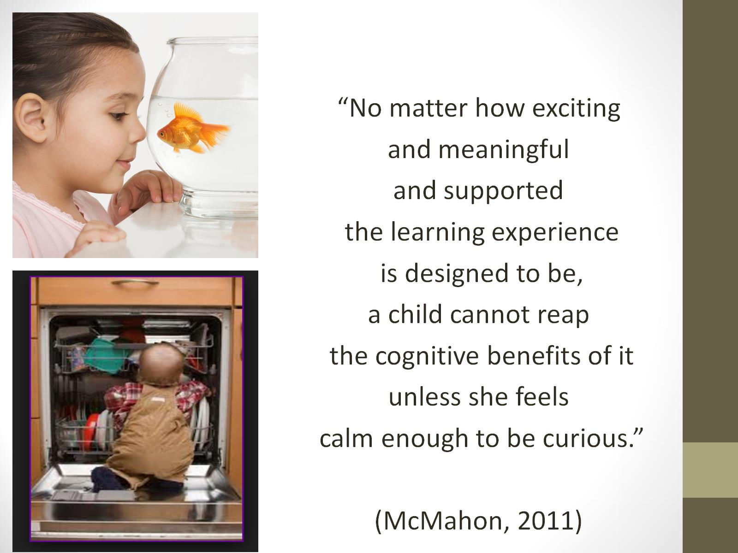

Slide 60
Polling question #3
How many participants have a morning, coffee routine?

Slide 61
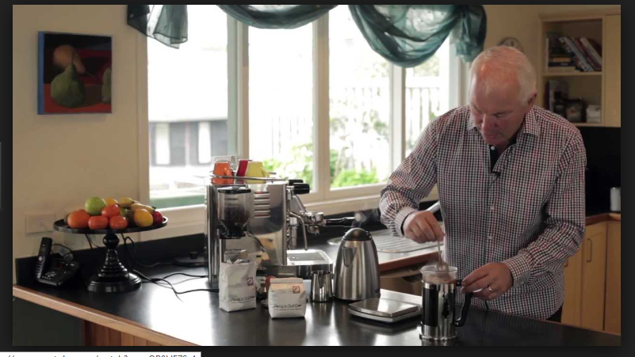
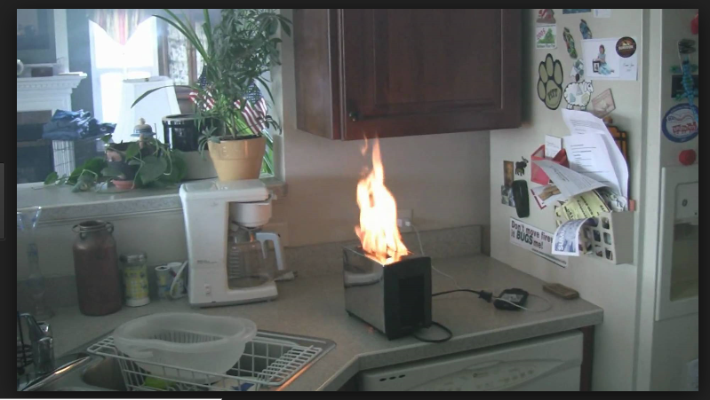
Interrupted Sequential Thinking

Slide 62
Sequential Thinking
A child’s successful completion of many academic tasks depends on the ability to bring a linear order to the chaos of daily experience. Traumatic experience can limit this ability to organize material sequentially, leading to difficulty in reading, writing and communicating verbally.
From Helping the Traumatized Child Learn

Slide 63
ALL
SOME
FEW
Building on competencies
(Intensive)
Emotion Mgt.
Instructional supports, practices, and interventions can be tiered – students can not! There are no “tier 2 students” (or tier 3 or tier 1). By assigning this type of label to students we make their current status permanent. That is the antithesis of the concepts underlying a multi-tiered system of supports.
MTSS FIELD GUIDE, 2019
Math
(Targeted)
Science
Adult Relationships
Attendance
(Universal)
Reading
Peer Interaction

Slide 64
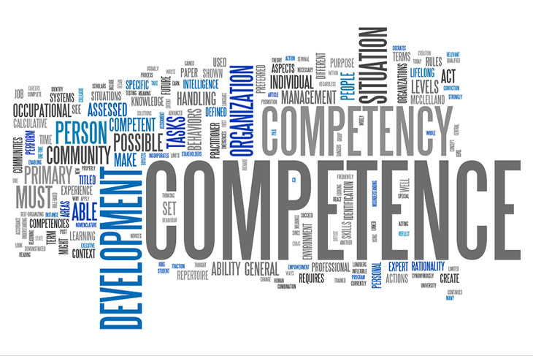
Competencies
Relational Connection
Self-Development and Identity
Executive Functioning
  Delaying and Inhibiting Responses
  Cognitive Flexibility
  Working Memory
  Margaret Blaustein and Christine Kinniburgh, ARC Model

Slide 65
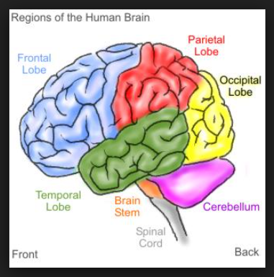
Move it!
Movement is important for learning and staying calm

Slide 66
#4 Cognition & Learning:
Developmental Injuries
Movement
Multi-sensory experiences
Targeted training in Executive Functioning
Structure and routine
© NFI Vermont 2018

Slide 67

#5 Behavioral Control:
Developmental Injuries
Impulse control, disinhibited, risk taking
Sleep and eating challenges
Managing fluctuating arousal
Trauma reenactment, repetition, avoidance
Opposition, resistance
Self-destructive, self-sabotaging
“Comfort” with chaos
Compliance, collapse, helplessness, defeat
© NFI Vermont 2018

Slide 68
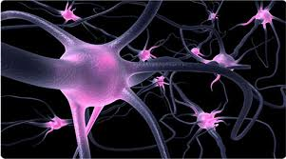
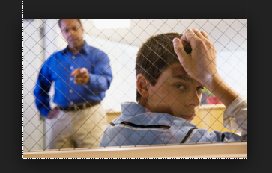
What Neural Pathways Does Traditional Discipline Create (punishing negative consequences)
Needs based vs. Compliance Based
Rule violation vs. Repair
suppress unwanted behavior, require obedience, and control another being.
does not teach new behaviors; discipline might teach or reinforce fear while suppressing behavior
negative outcomes; “…above and beyond individual, family, and community risk factors, exclusionary school discipline makes a significant contribution in and of itself to a range of negative developmental outcomes.” (Skiba et al., 2014. p. 556).

Slide 69

Seeing Problem Behavior as Stress Behavior
Stress lens shifts perspective (blame and will to injury and collaboration)
Actions are motivated by survival
Potential stress activation
Disconnection and marginalization (reenactment)
Who is in control
Regulate, relate, reason

Slide 70


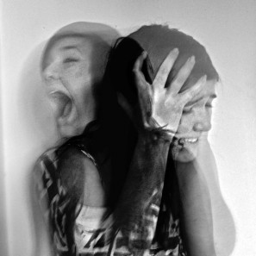
Re-Framing: An alternative Behavior Lens
Threats – I am unsafe, I need to protect myself because nobody else ever has.
Avoidance/passive – I am not competent, I am not worthy
Demanding – only I can meet my needs because nobody else has.
Attention seeking – I am insecure and uncertain.
Defiance = fear, Can’t vs. won’t
What you see on the outside…
…What is going on the inside
© NFI Vermont 2018

Slide 71
Reframing Motivation and Behavior
Seeking Attention
Avoid or Escape
Function of Behavior
Seeking Safety
Avoiding Danger
…and feeling behind the behavior

Slide 72

Collaboration Across Disciplines
Multiple perspectives are critical to a successful plan.
Who is “sitting” at the table?

Slide 73
Trauma-Informed Behavior Analysis (TIBA)
Trauma-Informed Behavior Plans will:
Individualize intervention based on need
Consider history of trauma to inform the plan
Consider medical needs
Utilize behavior analytic training informed by collaboration with other experts
Practice within expertise and accept cases if we are trained and/or have supervision
Refer and collaborate when needed

Slide 74
Covert Behaviors as Antecedents
non-observable neurobiological impairments that contribute to social, emotional and behavioral challenges that can make antecedents difficult to determine.

Slide 75

Common Neurobiological Impairments
Relationally Reactive
Neurosequential healing
Over activated Limbic region
Compromised reward neurology
I am bad
Executive Functioning

Slide 76
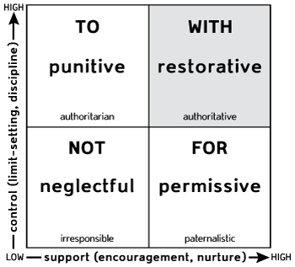
Social Discipline Window
Activates defense
Deactivates attachment
Empower
Relationship
attachment
reenactment
Disempower
Poor self-concept

Slide 77
But what about the consequences?
Context of caring relationships
Focus on repair vs. rule violation
Accountability and mastery
Membership vs. exclusion

Slide 78
#5 Behavioral Control:
Developmental Injuries
Understanding that symptoms are a means (attempt) to self-regulate
Stress behavior versus misbehavior (psychoeducation goal)
Accountability Formula= Validation + Empathy + Co-regulation + (validate child as victim before approaching as a perpetrator of harm)
Re-framing
Restorative Practices
Reduce stress as a priority
© NFI Vermont 2018

Slide 79

#6 Dissociation
Developmental Injuries
Disconnect between physiology, feelings, thoughts and actions
Memory deficits
Symptoms usually not within child’s conscious control
“Disguised” Symptoms:
  ADHD/ADD
  Freezing: stilling, collapsed, escape, numb, detached
  Avoidance: refusals, indifference, retreat, self-medicate
  Academic: work refusal, work avoidance, indifference, apathetic
  Helpless: Passive, possum, submissive, obedient, collapse, victimized, defeated
Movement, music, rhythmic activities
Orient externally with 5 senses
Music, rhythmic activities
Nurturing physical contact
Identify triggers
© NFI Vermont 2018

Slide 80
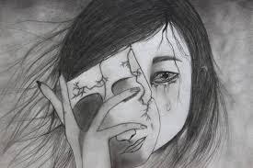
#7 Self-esteem & Future Orientation
Developmental Injuries
Shame, guilt and self-doubt 7. Lack of accurate self-appraisal
Living in a “series of now's” a. Self-Hate
Negative sense of the future b. Narcissism
“Only defective kids get abused” c. Isolation
Body image distortions
Poor self-awareness and self-knowledge
© NFI Vermont 2018

Slide 81
#7 Self-esteem & Future Orientation
Developmental Injuries
Validation not reassurance
Patience, persistence, empathy
Curiosity
Tolerating the affect of the child
Build resilience
© NFI Vermont 2018

Slide 82

Simple but essential
Neural Networks
Slow it Down
Repetition
Dosing
Contextual teaching and learning
Neural networks
Slow it down
Repetition
Dosing
Contextual opportunities

Slide 83

Questions?

