Slide 1

Understanding Developmental Trauma
Using a Tiered System of Support for Implementation
Kym Asam, LICSW
Regional Director of Schools and Clinical Programming
UVM BEST Project coach, TA and trainer

Slide 2
Webinar Objectives
Discuss the importance of adult wellness and work-force development
Introduce the four premises of trauma-responsive/informed schools
Differentiate between PTSD and developmental trauma
Understand the impact of trauma on multiple domains of functioning
Key skills in working with children who have experienced developmental trauma across tiers of support
Increase understanding of alignment between trauma informed schools and PBIS

Slide 3
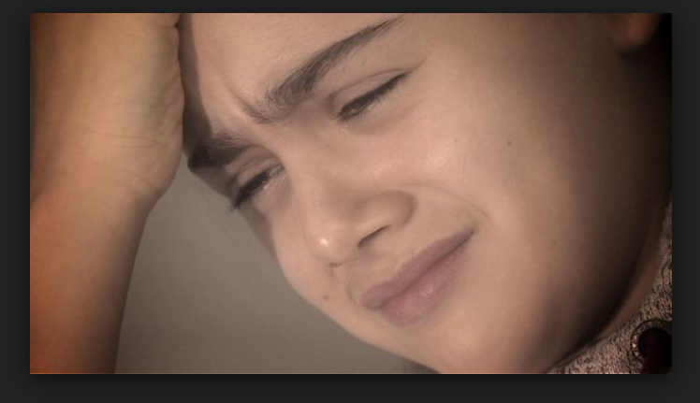

Content and Awareness
It’s not just them…

Slide 4
Polling Question #1
How many audience participants have had some training on developmental or complex trauma?

Slide 5
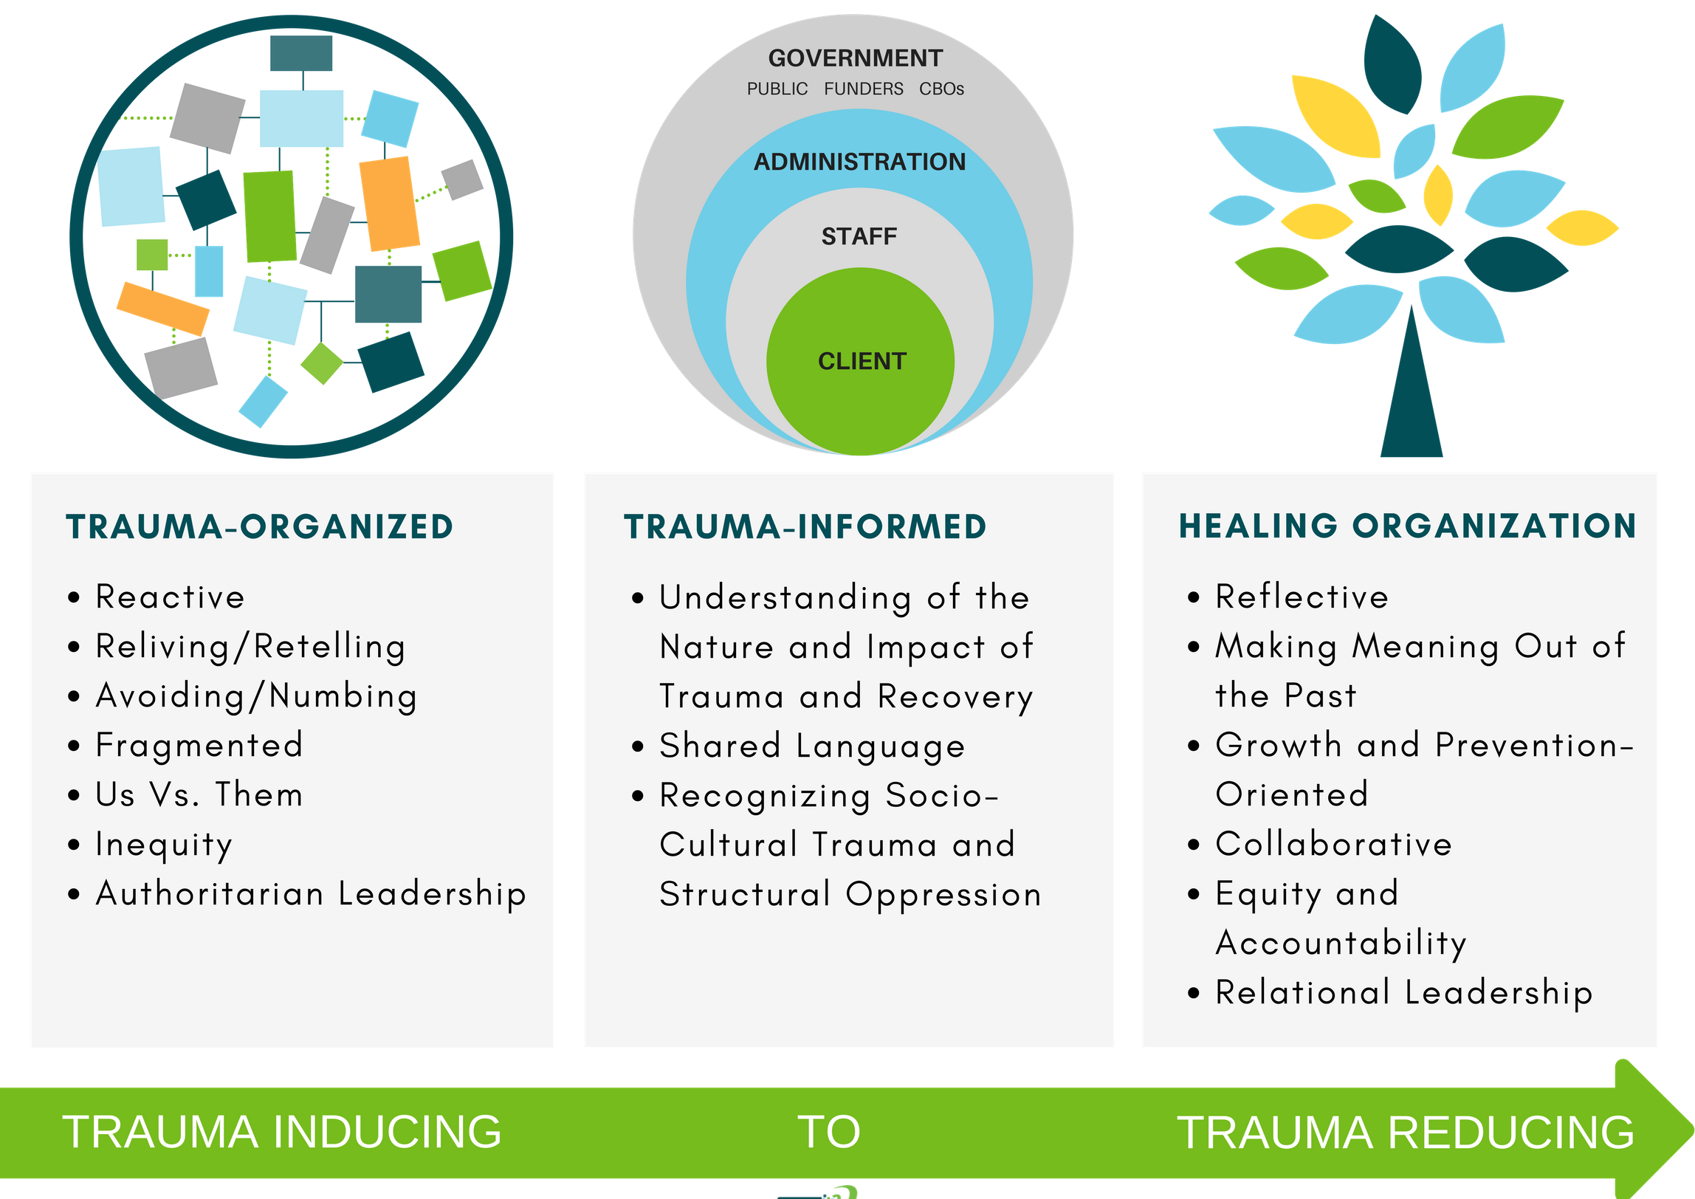

Overarching Principle and Progression
Trauma informed care is “universal precaution” to stop the spread of trauma and toxic stress
(Sandra Bloom)
SAFETY AND SECURITY

Slide 6

Public Health Crisis
AIDS
Obesity
Domestic Violence
COVID-19
Developmental Trauma
More…

Slide 7



Insidious Trauma
“like drops of acid falling on a stone”

Slide 8

Historical Trauma

Slide 9
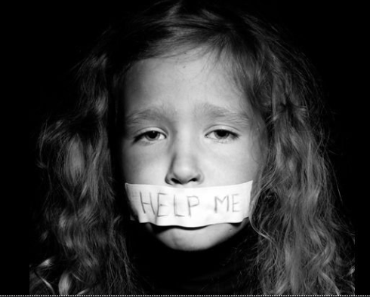
Social Injury Requires Social Healing

Slide 10




Four Premises of Trauma Responsive/Informed Schools:

Slide 11

1.Stress is contagious…reciprocally
students
Workforce
Building Administrators
District/SU
© NFI Vermont 2019

Slide 12
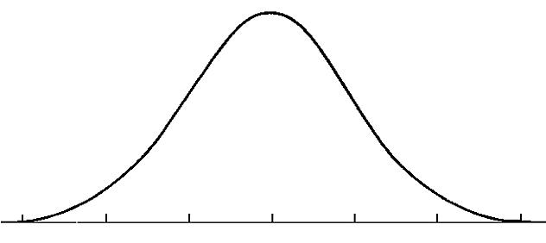
The Stress Continuum
Mild/Moderate Stress:
Optimum
Moderate/High Stress:
Overload
  Stress is community property and therefore…
  Everyone has some responsibility for the success of others because…
  Connections moderate stress
Low/No Stress:
Rest and restore
Toxic Stress:
Breakdown
Objective > Subjective
Stress: The amount of energy in your body
Stress is Contagious…
…but so is Calm.
Implicit Bias
© NFI Vermont 2018

Slide 13
2. Stress is a primary mediator of performance…
Stress
Performance
© NFI Vermont 2019

Slide 14

3. When unregulated, stress injures people, groups and organizations
© NFI Vermont 2019

Slide 15
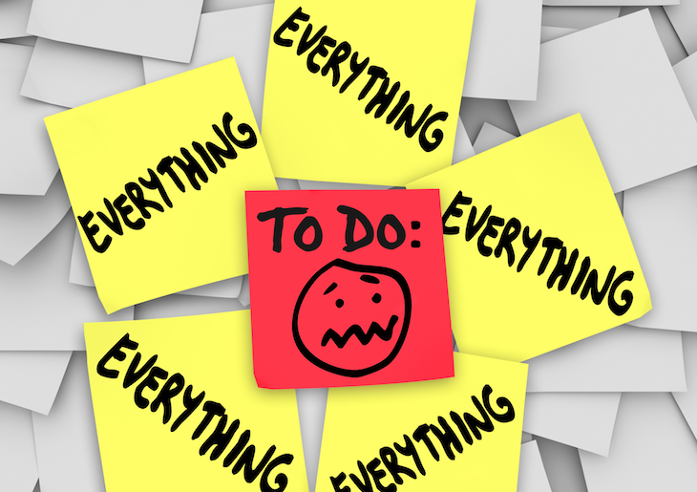
4. Biases, reduced self-care and blame.
4. As stress increases there is a greater focus on “what to do” with clients and less focus on our beliefs and biases about kids who struggle, and ways to reduce our stress
Blame and shame (e.g. gossip, put downs, complaints)…
  …which is a way to gain control, and
…A way to discharge pain/discomfort

Slide 16
Consequences of Unregulated Stress
Learned Helplessness
Lack of Creativity
Not working together
Low frustration tolerance
Ignoring the obvious
Consequence of Unregulated Stress
© NFI Vermont 2019

Slide 17
Vicarious Impact:
Vicarious Resilience/ Posttraumatic
Growth
“tragic yet inspiring”
Process
Evaluate
Reflect
Structural Support
Experiences/Emotions
Response
Traumatic Exposures
(Events)
Capacities
Dwell
Quell
Avoid
Maladaptive
Vicarious Trauma
Burnout
Empathy Fatigue
“tragic and hopeless”
Demands
Adapted from “Living on the edge” 2015
© NFI Vermont 2019

Slide 18

School Culture
Beliefs
Perceptions
Relationships
Attitudes
Rules (written and unwritten)
Physical and emotional safety
Classroom and public spaces
Embracing and celebrating diversity

Slide 19

Upstream Interventions (universal)

Slide 20
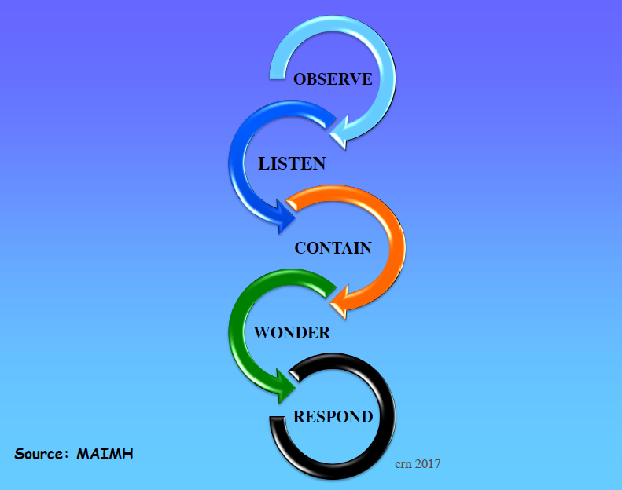
Healing Organizations: Inviting Humanity into the Work

Slide 21

Reflective practices
Just as it is important to build resilience in our students, it is necessary to build resilience into the system. Educational organizations and their professionals should celebrate success but should be equally inclined to learn from failure and adapt to change.
Self-reflection sets the stage for building a culture of systemic improvement

Slide 22
Change your mindset
from
"What is wrong with you?"
to
"What has happened to you?"
(from Wisconsin Dept. of Health Services www.dhs.wisconsin.gov/tic)
Transition from a blame model to a repair model
Asking “how can we help” and “what can we learn from you?”

Slide 23


Fear of adults
hunger
abuse
Substance abuse
Racial trauma
Community violence
Sexual abuse
neglect
Poor sleep hygiene
Incarcerated parent
Difficulty in school
© NFI Vermont 2018

Slide 24
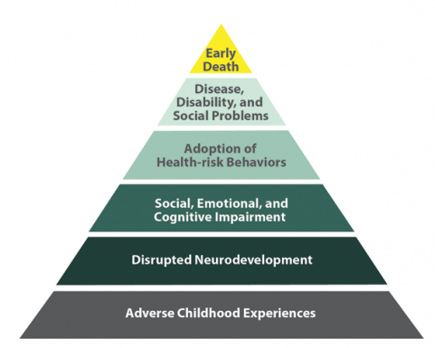
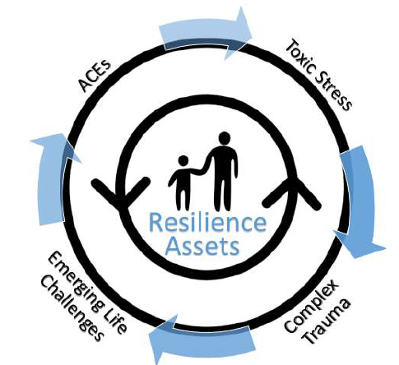
The ACE’s Antidotes
Sleep
Mental health
Healthy relationships
Exercise
Nutrition
Mindfulness
  Meditation
  Yoga
  Progressive muscle relax-
  ation

Slide 25
SEL = Upstream intervention
SEL not only helps to prevent internalizing and externalizing problems but also increases positive social attitudes and prosocial behavior as well as academic achievement.

Slide 26
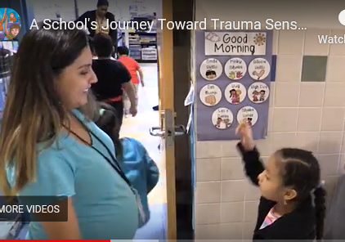
Upstream interventions (universal)
Lighting
Greetings and relational deposits
Non-contingent movement breaks
Alternative seating opportunities
PBIS
Manipulatives
Non-verbal communication
OT activities
Consistency and predictability
Matching affect
OTR
Lycra
Visual noise
Wall color
Stop and name
Community building circles
Mindfulness movements
Yoga
Prompting and pre-corrections
Wellness and reflective practices
Source: A School's Journey Toward Trauma-Sensitivity.

Slide 27
Polling Question #2
At what level is your school or are your schools currently implementing PBIS?

Slide 28
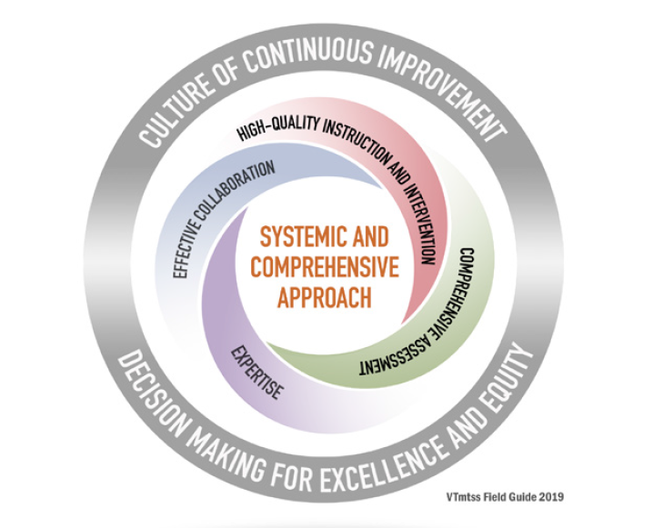
How do we think about trauma-informed practices within a Multi-tiered Systems of Support (VT MTSS)?
VT MTSS is:
Meet students where they are at and help them get to where they need to go!
Resilience is the capacity to grow despite adversity, is built through meaningful
positive relationships, social support, and the opportunity for children to meaningfully master skills.
Christopher Blodgett, Ph.D, CLEAR Trauma Center

Slide 29
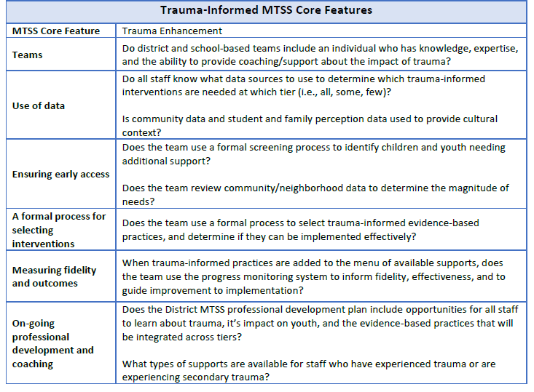
MTSS Core Features

Slide 30
Wisconsin DPI
Why use the PBIS framework for trauma-sensitive schools?
The fundamental purpose of PBIS is to make schools more effective & equitable learning environments. Rob Horner, Co-Director of the OSEP Technical Assistance Center for PBIS
Predictable
Positive
Consistent
Safe
WI Department of Public Instruction Trauma-Sensitive Schools Resources
http://sspw.dpi.wi.gov/sspw_mhtrauma

Slide 31
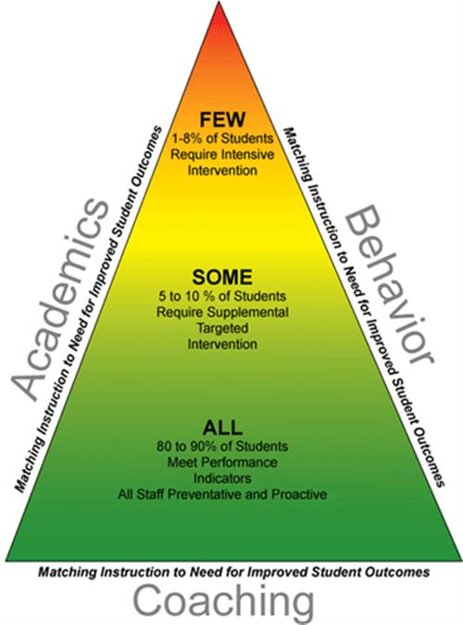
The triangle – Academic and social/emotional interventions
Intensive academic intervention
Intensive mental health intervention
Targeted academic instruction
Targeted social skill and emotional regulation instruction
Classroom/school wide instruction
Universal regulating interventions

Slide 32

What is Trauma?
Trauma is a sudden, unpredictable, physiological experience that overwhelms a person’s ability to cope. It is not just an event itself, but rather a response to a stressful experience in which a person’s ability to cope is dramatically undermined.
Direct, secondary, vicarious
Event(s)
Helplessness, isolation/loneliness, mistrust and shame
Experience
Heightened reactions to environmental stimuli
Effects
© NFI Vermont 2018

Slide 33

Developmental Trauma
Multiple events before age 5
Perpetrated from the caregiving system
Leads to developmental injuries in 7 areas
© NFI Vermont 2018

Slide 34

“Trauma is not a story of what happened to you a long time ago, it is what is in your body.”
Bessel van der Kolk

Slide 35
T
When Neural Networks Become Abnormally Organized, There is a Cascade of Neurobiological Problems
#1
Physiology:
Body & Brain
#2
Attachment & Relationships
#3
Emotion Regulation
#4
Cognition & Learning
#5
Behavioral Control
#6
Dissociation
#7
Self-esteem & Future Orientation
Domains of Impact/Developmental Injuries
UN-REGULATED STRESS
© NFI Vermont 2018

Slide 36
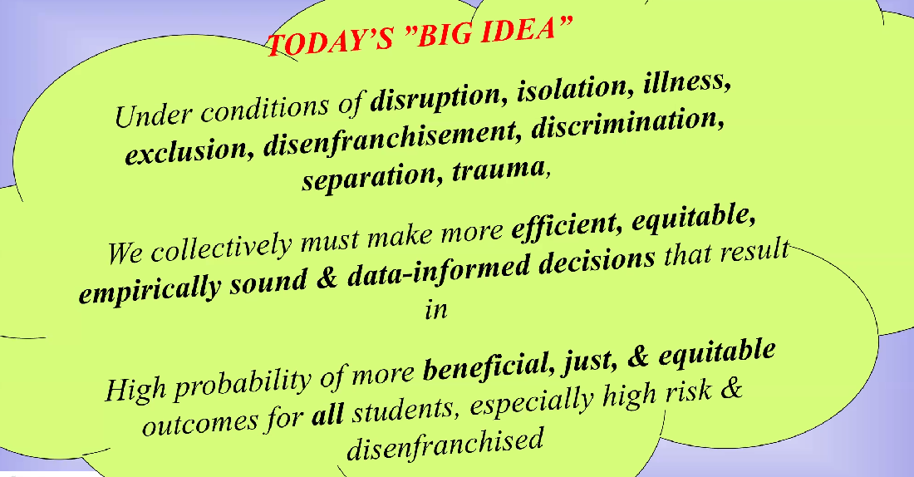
Data informed decisions for effective interventions

Slide 37

#1 Physiology: Body & Brain
Developmental Injuries
ACES Study
Hypersensitive/sensitized
Hyposensitive/desensitized
Regressions and Delays
Neurodevelopmental Delays and Exaggerated Stress Response
© NFI Vermont 2018

Slide 38
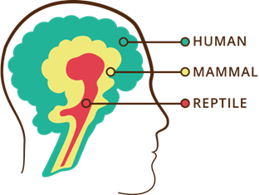
The Human Brain: Form and Function
Three interrelated, interconnected, interdependent “operating systems”…with unique functions and abilities
…that work most effectively under conditions of low to moderate stress.
Logic and Reason
Emotional
Survival
© NFI Vermont 2018

Slide 39


Trauma as a virus
Erratic
High levels of stress and adversity separate and impair the three “operating systems”
Trauma is like a virus in the operating systems of the brain (Bloom)
Healing a brain exposed to chronic adversity often requires unique interventions
Sluggish
Shuts down
© NFI Vermont 2018

Slide 40
#1 Physiology: Body & Brain
Developmental Injuries
Stabilize the nervous system
  Structure, Routine, Rituals
    Especially during transitions, discipline, saying “no”
  Movement
  Rhythmic activities
Regulate—Relate—Reason
Co-Regulation: Mimic early attachment needs
Addressing basic needs
© NFI Vermont 2018

Slide 41

#2 Attachment & Relationships
Developmental Injuries
Relational deposits/Relational endurance
Create congruence between internal experience and external world response
  Validation not reassurance (enter the darkness)
Its not the rupture, it’s the repair—expect the rupture, work the repair
Avoid ensnarement in reenactment
5. Refine your language:
  Connection seeking not attention seeking
  Repair seeking
  Validation seeking not manipulation
PACE
Build architecture of healthy interactions – attunement and co-regulation
Maintain awareness about the impact on relationships within workforce (contagion)
Attachment is the search for protection.
“We do to others what was done to us….unless we remember our pain” (Lieberman)
Highly insecure and mistrustful of others (particularly authority figures)
Lack of congruence between internal experience and external world response (invalidation)
Broad symptoms pattern including: bossy, controlling and commanding, clingy and dependent, avoidant and detached; separation anxiety
Highly sensitized/reactive to transitions, limits, hearing “no”, working cooperatively
Difficulty attuning to others and taking perspective
Unusual self-soothing habits and patterns
Reenactments
Atypical Seeking Behaviors
© NFI Vermont 2018

Slide 42
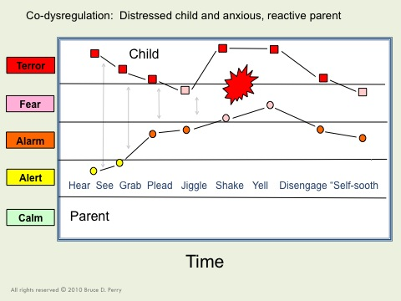

Co-Dysregulation:
Provocation & Escalation
All rights reserved © 2006-2012 Bruce D. Perry and The ChildTrauma Academy
© NFI Vermont 2018

Slide 43
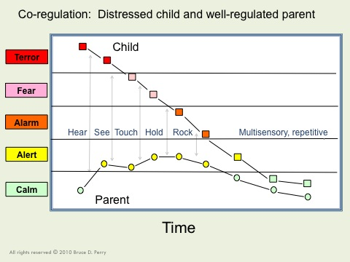
Co-Regulation
All rights reserved © 2006-2012 Bruce D. Perry and The ChildTrauma Academy
© NFI Vermont 2018

Slide 44

#3 Emotion Regulation:
Developmental Injuries
Be an interpreter
Use movement, yoga, martial arts, music, OT activities, etc.
Teach affect identification and expression
Co-regulation strategies: RRR
Difficulty knowing and identifying physiological states
Incongruence between internal physiological states and external expression
Poor affect identification and affect expression
Over-dependence on behavior to reveal internal affect states
Difficulty expressing needs in socially acceptable ways
Emotions have proven to be very dangerous for child; they often reenact this with others
Sleep and eating disruptions
© NFI Vermont 2018

Slide 45

Normative Danger Responses
Autonomic Nervous Response System
Fight
Flight
Freeze
Flock
Submit

Slide 46

The Stress Continuum:
Typically Developing Person
Mild/Moderate Stress:
Optimum
Moderate/High Stress:
Overload
Low/No Stress:
Rest and restore
Toxic Stress:
Breakdown
Positive Tolerable Toxic
Resiliency Vulnerability
© NFI Vermont 2018

Slide 47
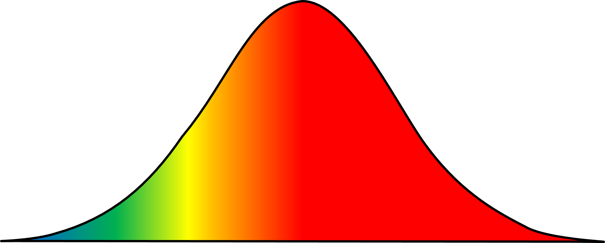
The Stress Continuum:
Person Exposed to Chronic Trauma (sensitized)
Mild/Moderate Stress:
Optimum
Moderate/High Stress:
Overload
Low/No Stress:
Rest and restore
Toxic Stress:
Breakdown
Positive Tolerable Toxic
Resiliency Vulnerability
© NFI Vermont 2018

Slide 48
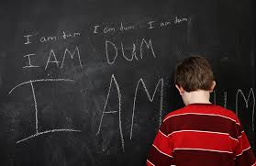
#4 Cognition & Learning:
Developmental Injuries
Movement
Multi-sensory experiences
Targeted training in Executive Functioning
Structure and routine
Build on Competencies
Rigid/concrete thinking
Poor cause and affect thinking/consequential thinking
Language Delays, Language Use
Difficulty with Executive Functioning
Cognitive Distortions
Attention, Memory and Curiosity Deficits
Learning challenges
Intrusive memories
© NFI Vermont 2018

Slide 49
Polling question #3
How many participants have a morning coffee or tea routine?

Slide 50

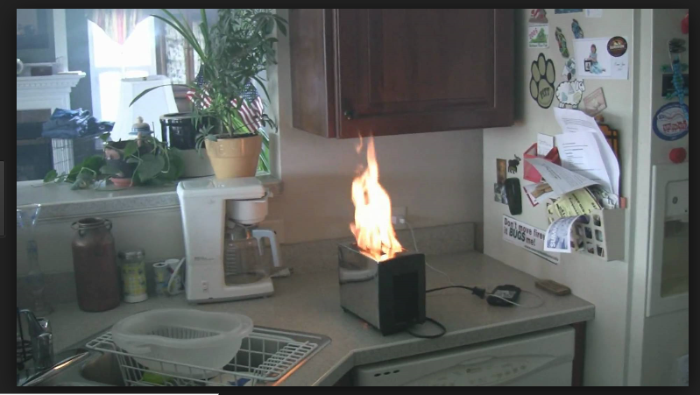
Interrupted Sequential Thinking

Slide 51
ALL
SOME
FEW
Building on competencies
Instructional supports, practices and interventions can be tiered – students can not! There are no “tier 2 students” (or tier 3 or tier 1). By assigning this type of label to students we make their current status permanent. That is the antithesis of the concepts underlying a multi-tiered system of supports.
MTSS FIELD GUIDE, 2019
Anger Mgt.
(Intensive)
Math
(Targeted)
Science
Adult Relationships
Attendance
(Universal)
Reading
Peer Interaction

Slide 52
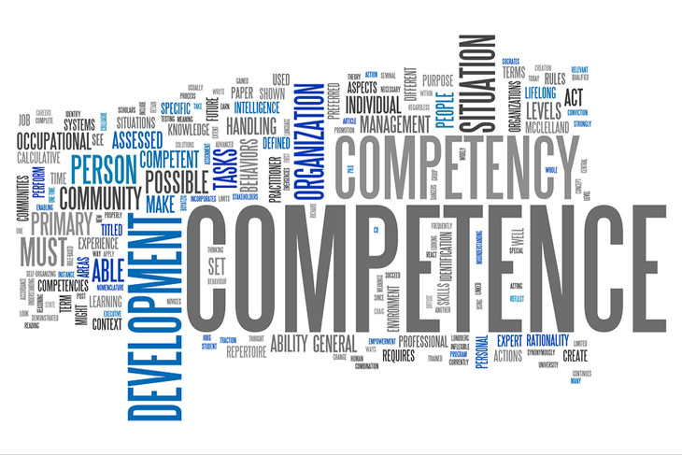
Competencies
Relational Connection
Self-Development and Identity
Executive Functioning
  Delaying and Inhibiting Responses
  Cognitive Flexibility
  Working Memory
  Margaret Blaustein and Christine Kinniburgh, ARC Model

Slide 53
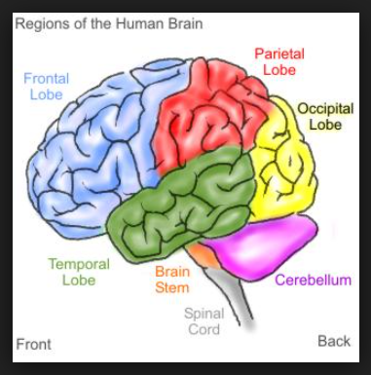
Move it!
Movement is important for learning and staying calm

Slide 54

#5 Behavioral Control:
Developmental Injuries
Understanding that symptoms are a means (attempt) to self-regulate
Stress behavior versus misbehavior (psychoeducation goal)
Accountability Formula= Validation + Empathy + Co-regulation + (validate child as victim before approaching as a perpetrator of harm)
Re-framing
Restorative Practices
Reduce stress as a priority
Impulse control, disinhibited, risk taking
Sleep and eating challenges
Managing fluctuating arousal
Trauma reenactment, repetition, avoidance
Opposition, resistance
Self-destructive, self-sabotaging
“Comfort” with chaos
Compliance, collapse, helplessness, defeat
© NFI Vermont 2018

Slide 55
What Neural Pathways Does Traditional Discipline Create
Needs based vs. Compliance Based
Rule violation vs. Repair
suppress unwanted behavior, require obedience, and control another being.
does not teach new behaviors; discipline might teach or reinforce fear while suppressing behavior
negative outcomes; “…above and beyond individual, family, and community risk factors, exclusionary school discipline makes a significant contribution in and of itself to a range of negative developmental outcomes.” (Skiba et al., 2014. p. 556).

Slide 56
Shifting Mindset to Shift Practices
Uninformed view
Trauma-informed view
Anger management problems
May have ADHD
Choosing to act out & disrupt classroom (e.g., disrespectful or manipulative)
Uncontrollable, destructive
Non-responsive
Uninformed response
Student needs consequences to correct behavior or maybe an ADHD evaluation
  WI Department of Public Instruction Trauma-Sensitive Schools Resources
  http://sspw.dpi.wi.gov/sspw_mhtrauma Adapted from Daniel & Zarling (2012)
Maladaptive responses (in school setting)
Seeking to get needs met
Difficulty regulating emotions
Lacking necessary skills
Negative view of world (e.g., adults cannot be trusted)
Trauma response was triggered
Trauma-informed response
Student needs to learn skills to regulate emotions & we need to provide support

Slide 57
Reframing Motivation and Behavior
Seeking Attention
Avoid or Escape
Function of Behavior
Seeking Safety
Avoiding Danger
…and feeling behind the behavior

Slide 58
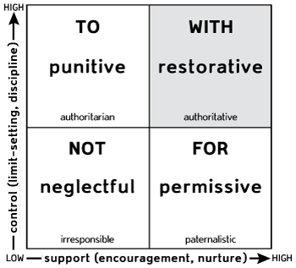
Social Discipline Window
Activates defense
Deactivates attachment
Empower
Relationship
attachment
reenactment
Disempower
Poor self-concept

Slide 59
But what about the consequences?
Context of caring relationships
Focus on repair vs. rule violation
Accountability and mastery
Membership vs. exclusion

Slide 60

Simple but essential
Neural Networks
Slow it Down
Repetition
Dosing
Contextual teaching and learning
Neural networks
Slow it down
Repetition
Dosing
Contextual opportunities

Slide 61

Questions?

