Slide 1
Bullying Prevention Webinar
Amy Wheeler-Sutton,
VTPBIS Training and Development Coordinator
School-based bullying prevention programs
decrease bullying by up to 25%
(McCallion and Feder, 2013)
_

Slide 2
Webinar Logistics
Orient to Webinar Screen
2 Ways to Interact:
  Raise your hand using the icon on your screen
  Type a question into the text box
Webinar will be recorded

Slide 3
Today’s Objectives
Participants will learn school-wide strategies for the prevention of bullying including:
  Embedding bullying prevention strategies into a PBIS framework
  Functions of bullying behavior
  Role of bystander
  Considerations for cyberbullying and RP
  Stop, walk, and talk strategy
  Bullying prevention assessments

Slide 4
Vermont’s Education Quality Standards
2122.1 School Facilities and the Learning Environment
Each school shall maintain
a safe, orderly, civil, flexible, and positive learning environment, which is
free from hazing, harassment, and bullying
and based on sound instructional
and classroom management practices
and clear discipline and attendance policies
that are consistently and effectively enforced.
Notes:
HHB behaviors negatively impact individual students and the entire school climate
Creating a strong and healthy climate can dramatically reduce the prevalence of these cases

Slide 5
Vermont’s 2017
Youth Risk Behavior Survey
16% of HS students and 22% of MS students report being the target of bullying behavior over the past 30 days
16% of students report being the target of cyberbullying behavior over the past 30 days
Both down slightly from 2015

Slide 6
Definitions
Bullying:
  Repeated over time
  Intended to ridicule, humiliate, or intimidate
  Occurs before, during, or after the school day on school property, on a school bus, or at a school-sponsored activity … or …

Slide 7
Vermont’s policies apply to
off-campus conduct that can be shown to
pose a clear and substantial
interference with another student’s
equal access to educational programs (i.e. cyberbullying, relational bullying, etc.)

Slide 8
Bullying Behavior Can Include:
Verbal/physical aggression
Intimidation, threatening, taunting, etc.
Teasing, name-calling, mimicking, etc.
Spreading gossip, leaving others out, etc.
Sending/posting messages containing false rumors, embarrassing photos, etc.
Adapted from Scott Ross, University of Oregon

Slide 9
Respond Immediately
Stop the behavior
Separate students, focus on emotional and physical safety for the targeted student
Notify appropriate school staff and begin investigation
  Details about investigation process in upcoming webinar
Create a safety plan if there is:
  Physical harm
  Known suicidal ideation
  Known difficulty accessing educational programs

Slide 10
Poll
Do you have a bullying prevention strategy in place at your school? If so, who is responsible?
  School counselor
  Administrators
  Resource officer
  Teachers
  All of the above

Slide 11
Bullying Prevention within PBIS Implementation
Interventions for target & student w/ bullying behavior
School-wide Expectations
-------------------
Define, Teach, Acknowledge,
Data System, Consequence System
Classroom Systems
Positive Culture
Bullying Prevention Curriculum
Adapted from Scott Ross, University of Oregon

Slide 12
Approaching Bullying from a
Function-Based Perspective
Most common functions of bullying:
  Attention from bystanders
  Attention and reaction of target
  Self-delivered praise
  Obtain items/activity/status
  Could be to avoid one of the above as well
Adapted from Scott Ross, University of Oregon
Notes:
All behaviors have a function
In order to change bullying behavior, we have to determine the function and reverse the incentive
Sometimes adults inadvertently reinforce behavior; haven’t examined function

Slide 13
Poll
Which function do you think is most common when talking about bullying?
  Attention from peers
  Self-delivered praise
  Obtain items/activity/status
  Avoid attention, praise, items/activity/status

Slide 14
Main Function = Peer Attention
Questions to consider:
  How can students get peer attention in a positive way?
  How can we use peer attention to reinforce students for the expected behavior (being respectful) or for standing up for one another?
  How can we remove the praise, attention, and recognition students get by bullying?
Adapted from Scott Ross, University of Oregon

Slide 15
Discussion Question
Does your school have any effective strategies in place to reinforce students with peer attention for exhibiting expected behaviors (being respectful)?
If not, do you have any ideas?
Please write your answers in the chat box.

Slide 16
Importance of the Bystander
Stand for Courage (grades 6-12)
Supports youth leaders and adults to empower, engage, and educate by providing materials to:
    Teach: curriculum explicitly addresses how to prevent and respond to aggressive behavior
    Recognize: nominate anyone that stands for courage
    Reward: winners eligible for prizes such as tickets to sporting events/concerts, celebrity visit to school, etc.
      Should be peer-based reinforcement (to match function)
_
Adapted from Scott Ross, University of Oregon

Slide 17
Importance of the Bystander
57% of bullying situations stop when a peer intervenes on behalf of the student being bullied
(Hawkins, Pepler, and Craig, 2001)
_
Adapted from Scott Ross, University of Oregon

Slide 18
Importance of the Bystander
Bystanders’ beliefs in their social self-efficacy are positively associated with defending behavior and negatively associated with passive behavior from bystanders... If students believe they can make a difference, they’re more likely to act.
(Thornberg et al, 2012)
Students who experience bullying report that allying and supportive actions from their peers (such as spending time with the student, talking to him/her, helping him/her get away, or giving advice) were the most helpful actions from bystanders.
(Davis and Nixon, 2010)
_
_

Slide 19

Importance of the Bystander
Students who experience bullying are more likely to find peer actions helpful than educator or self-actions.
(Davis and Nixon, 2010)
Why do you think this statement is true?
Please answer in the chat box.
_
Notes:
Kids report that bullying gets worse after telling adults

Slide 20
Considerations for Cyberbullying
Why is it so prevalent?
  Easier to lose sight of consequences
  Anonymity
  Lack of supervision
  Function of behavior
  “Reality”
  Access to technology 24/7
    Inescapable
    Far-reaching
Notes:
https://www.webwise.ie/trending/dealing-with-cyberbullying-in-schools-2/
https://www.scholastic.com/teachers/articles/teaching-content/cyberbullying-what-teachers-and-schools-can-do/

Slide 21
Prevalence of Cyberbullying
42% have been bullied online
1 in 4 have had it happen more than once.
21% have received mean or threatening messages
20% have admitted to cyberbullying others
58% have not told their parents about an online bullying incident
14% have received mean or hurtful comments
https://www.scholastic.com/teachers/articles/teaching-content/cyberbullying-what-teachers-and-schools-can-do/
_
Notes:
https://www.scholastic.com/teachers/articles/teaching-content/cyberbullying-what-teachers-and-schools-can-do/

Slide 22
Considerations for Cyberbullying
Prevention:
  Digital citizenship lessons (i.e. rights/ responsibilities, privacy, changing passwords, contact details, photos, etc.); SRO
  Healthy screen time; positive use of tech
  Empower bystanders
  Engage and educate families
Response:
  Take it seriously
  Encourage students to keep evidence, block, report
Notes:
https://www.webwise.ie/trending/dealing-with-cyberbullying-in-schools-2/
https://www.scholastic.com/teachers/articles/teaching-content/cyberbullying-what-teachers-and-schools-can-do/

Slide 23
Considerations for Cyberbullying
Have you added a row on your matrix for the Internet as a “location”?
What does it look like to be safe, respectful, and responsible online? At school? At home?
Notes:
https://www.webwise.ie/trending/dealing-with-cyberbullying-in-schools-2/
https://www.scholastic.com/teachers/articles/teaching-content/cyberbullying-what-teachers-and-schools-can-do/

Slide 24
Considerations for Bullying and Restorative Practices
Bullying = abuse, not conflict
If improperly facilitated, FTF meetings can escalate bullying concerns/reinforce power imbalances
Integrating Bullying Prevention and Restorative Practices in Schools: Considerations for Practitioners and Policymakers, Oct 2014, Center for Safe Schools
_

Slide 25
Considerations for Bullying and Restorative Practices
Can be useful in some cases, when:
  There is voluntary participation
  All persons affected are engaged and ready to hear the harm and plan steps to accountability and reintegration
  The person with bullying behavior is able to accept responsibility
  The safety of the target is ensured
  Support persons are invited
  All parties participate in preparation meetings
  Meetings are run by a trained adult facilitator
If person harmed doesn’t want to meet face-to-face, it should not happen
  Instead: separate restorative meetings with trained adult facilitator
Integrating Bullying Prevention and Restorative Practices in Schools: Considerations for Practitioners and Policymakers, Oct 2014, Center for Safe Schools
_

Slide 26

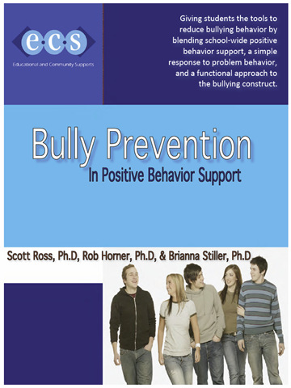
Available at www.pbis.org
Notes:
Free!

Slide 27
Poll
Have you ever seen this curriculum before?
  Yes, and we use it at our school.
  Yes, but we don’t use it at our school.
  No.

Slide 28
Core Features of an Effective
Bullying Prevention Effort
Student Skills:
School-wide behavioral expectations (respect)
Teach routines:
  Stop
  Bystander Stop
  Stopping
  Recruiting Help
Faculty / Staff:
Agreement on logic for bullying prevention effort
Teach students skills
Pre-correction, follow-up, and consistency
Actively supervise hot spots
Reward/acknowledge use of strategies
Clear data collection and use process
Advanced support options
Adapted from Scott Ross, University of Oregon
Notes:
Dispelling myth that bullying is a normal part of childhood
Teaching adults how to identify bullying to prevent misidentification as conflict
Increase awareness of bullying, effects, strategies for supporting students who are bullied
Consider physical environment – what changes can be made to deter bullying

Slide 29
Teach a Three-Step Skill
Stop:
Say and show “stop”
Walk:
Walk away
Talk:
Talk to an adult
Notes:
These skills can be used in all places at all times (including cyberbullying)
Keep it simple
To be used if you encounter behavior that is NOT respectful (or … substitute your school expectation related to respect)

Slide 30


The “Stop” Routine
If someone is directing problem behavior toward you or someone else, give them the “stop signal”
  Students decide on what it should look and sound like for whole school
    Firm hand signal
    Clear voice
    Short phrase
Notes:
Be careful of inadvertently rewarding the disrespectful behavior … discuss how showing/saying “stop” could be done so it still rewards the undesirable behavior
(adaptable to elementary, middle, and high school)

Slide 31

The “Walk” Routine
Sometimes, even when students tell others to “stop,” problem behavior continues
Students are taught to "walk away"
  Removes reinforcement for problem behavior
Teach students to encourage one another when they use the appropriate response

Slide 32
The “Talk” Routine
Even when students use “stop” and “walk away,” sometimes the behavior continues
Students should "talk" to an adult and get help
  "Talking”/reporting: when you have tried to solve the problem yourself and have used the "stop" and "walk" steps
  Tattling: when you do not use the "stop" and "walk" steps before talking to an adult and/or your goal is to get the other person in trouble

Slide 33
64% of children who were bullied did not report it
(Petrosina, Guckenburg, DeVoe, and Hanson, 2010).
Why do you think this is true?
Please answer in the chat box.
_

Slide 34
The “Stopping” Routine
Eventually every student will be told to stop. Teach all students what to do when given the “stop” message:
  Stop what you are doing
  Take a deep breath
  Go about your day (no big deal)
These steps should be followed even when they don’t agree with the “stop” message

Slide 35
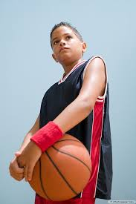
Stop Means Stop
The rule is:
If someone asks you
to stop,
you stop.

Slide 36
How Adults Respond
(To the target and/or upstander)
When problem behavior is reported, adults follow specific response sequence. Students are taught this sequence:
  Reinforce student for reporting (e.g. “I'm glad you told me.")
  Ask who, what, when, and where.
  Ensure student’s safety:
    Is bullying still happening?
    Is reporting child at risk?
    Fear of revenge?
    What does student need to feel safe?
    What is severity of the situation?
  Ask, "Did you tell the student to stop? Did you walk away from the problem behavior?”
    If yes, praise student for using appropriate response.
    If no, practice.

Slide 37
How Adults Respond
(To the student who is bullying and/or asked to stop)
Reinforce the student for discussing the problem with you
Ask, "Did ______ tell you to stop?”
    If yes: Ask, "How did you respond?
    If no: Practice the 3 step response.
Ask, "Did ______ walk away?
    If yes: "How did you respond?”
    If no: Practice the 3 step response.

Slide 38
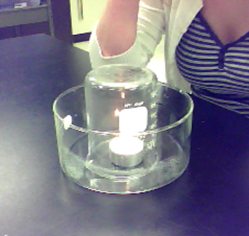
Example Activity from Lesson
Problem behavior is like fire
Cut off the oxygen, the candle goes out
Cut out the attention, the problem behavior stops
Notes:
Explain how problem behavior needs peer attend to keep it going, like candle needs oxygen to stay list
Discuss forms of peer attention (i.e. engaging with someone who teases you; laughing at someone being picked on; watching problem behavior and doing nothing)
Taking away peer attention is like taking the oxygen away from a candle (cover candle)
Explain how they can take away peer attention (stop, walk, talk)

Slide 39
Importance of Using Student Leadership
Student buy-in is half the battle
Students with social power should be involved in every phase of intervention development and implementation
  It has to be cool to do the right thing and stand up against bullying
Notes:
Getting students to buy-in to an intervention is half the battle (or more than half)
Student voice and modeling is critical

Slide 40
Student Leadership Team
8-10 students (nominated by peers)
Discussion:
  Disrespectful behavior is a problem. It damages the ability of others to succeed in school. It keeps happening because it results in attention from peers.
  We need your help developing school-wide routines.
  What would be best way to introduce/train these routines?
Students help develop, deliver, and report on efforts
Available to classmates as resource

Slide 41
How to Implement Bullying Prevention in PBIS Framework
Implement school-wide PBIS with fidelity
Form bullying prevention implementation team/assign to PBIS Leadership Team
Complete bullying prevention self-assessment
Survey students
  Helps motivate adults to take action against bullying
  Helps team tailor strategies to needs of school
  Baseline from which to measure progress
Introduce all stakeholders to bullying prevention
Gain faculty, staff, family, and student commitment
Train all adults (including bus drivers, cafeteria monitors, etc.)
Build bullying prevention lessons
Train all students
Booster/follow-up lessons
Collect and use data
_

Slide 42
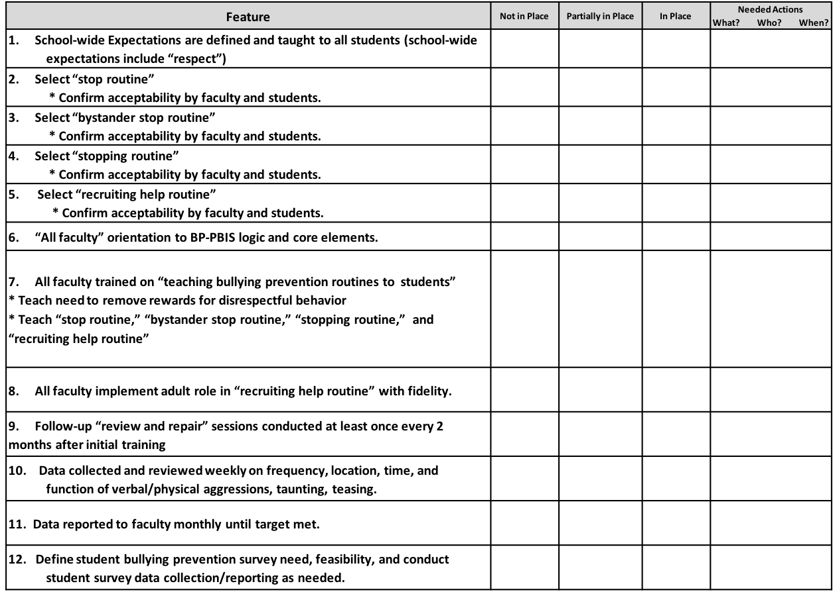
Bullying Prevention Self-Assessment

Slide 43
Student Survey
On a scale of 1 to 5, with 1 meaning completely disagree and 5 meaning completely agree, in your school, do:
  You feel safe?
  Other students treat you respectfully?
  You treat other students respectfully?
  Adults treat you respectfully?
  You treat adults in your school respectfully?
In the past week:
  1. Has anyone treated you disrespectfully? Yes / No
  2. Have you asked someone to “stop?” Yes / No
  3. Has anyone asked you to “stop?” Yes / No
  4. Have you seen someone else treated disrespectfully? Yes / No

Slide 44
Does It Work?
Experimental trial (Ross and Horner, 2009)
  72% reduction in bullying behaviors of at-risk students
  Targets 19% less likely to cry or fight back
  Bystanders 22% less likely to laugh, cheer, or join in
Over 1500 schools have implemented BP-PBIS
Follow-up studies in elementary and middle schools have shown significant reductions in self-reported bullying (Ross & Horner, 2013) and bullying-related office discipline referrals and suspensions (Good, McIntosh, & Gietz, 2011).

Slide 45
Resources
https://www.stopbullying.gov/
Bullying prevention playlist:
https://www.youtube.com/playlist?list=PLvzOwE5lWqhScOdC3xMzs9FoAAfpxA-Tz
Cyberbullying Resources:
https://www.webwise.ie/teachers/resources/
Pacer Center video:
http://www.pacer.org/bullying/video/player.asp?video=65
_
_
_
_

Slide 46
Wrapping Up
If anyone is interested in implementing this PBIS Bullying Prevention Curriculum, please contact amy.wheeler-sutton@uvm.edu.
Webinar on state laws and mandates to come
_

Slide 47
What questions/comments do you have?

