Slide 1

Bullying Prevention Webinar
You will be muted during this session. Please use the chat box or raise your hand.
This session is being recorded.
Amy Wheeler-Sutton,
Co-Director, VTPBIS
_
All materials can be found here: https://www.pbisvermont.org/training-resources/special-topics-webinars/

Slide 2
Connection Activity
Think back to a bullying situation you experienced yourself as a child/teenager or that you’ve experienced with one of your students.
What has stayed with you from that experience?

Slide 3
Today’s Objectives
Participants will learn school-wide strategies for the prevention of bullying including:
  Embedding bullying prevention strategies into a PBIS framework
  Functions of bullying behavior
  Role of bystander
  Considerations for cyberbullying, COVID, and RP
  Stop, walk, and talk strategy
  Bullying prevention assessments

Slide 4
Vermont’s Education Quality Standards
2122.1 School Facilities and the Learning Environment
Each school shall maintain
a safe, orderly, civil, flexible, and positive learning environment, which is
free from hazing, harassment, and bullying
and based on sound instructional
and classroom management practices
and clear discipline and attendance policies
that are consistently and effectively enforced.
Notes:
HHB behaviors negatively impact individual students and the entire school climate
Creating a strong and healthy climate can dramatically reduce the prevalence of these cases

Slide 5
Vermont’s 2019
Youth Risk Behavior Survey
17% of HS students and 24% of MS students report being the target of bullying behavior over the past 30 days
  Female students are nearly two times as likely as male students to experience bullying
  Students of color are significantly more likely to be bullied compared to white, non-Hispanic students
  LGBT students are twice as likely as heterosexual/cisgender students to be bullied
16% of HS students report being the target of cyberbullying behavior in the past 12 months
  Female students are significantly more likely than male students to experience electronic bullying
  LGBT students are twice as likely as heterosexual/cisgender students to experience electronic bullying

Slide 6
Definitions
Bullying:
  Repeated over time
  Intended to ridicule, humiliate, or intimidate
  Occurs before, during, or after the school day on school property, on a school bus, or at a school-sponsored activity … or …

Slide 7
Vermont’s policies apply to
off-campus conduct that can be shown to
pose a clear and substantial
interference with another student’s
equal access to educational programs
(i.e. cyberbullying, relational bullying, etc.)

Slide 8
Bullying Behavior Can Include:
Verbal/physical aggression
Intimidation, threatening, taunting, etc.
Teasing, name-calling, mimicking, etc.
Spreading gossip, leaving others out, etc.
Sending/posting messages containing false rumors, embarrassing photos, etc.
School-based bullying prevention programs
decrease bullying by up to 25%
(McCallion and Feder, 2013)
Adapted from Scott Ross, University of Oregon

Slide 9
Respond Immediately
Stop the behavior
Separate students, focus on emotional and physical safety for the targeted student
Notify appropriate school staff and begin investigation
Create a safety plan if there is:
  Physical harm
  Known suicidal ideation
  Known difficulty accessing educational programs

Slide 10
Poll
Do you have a bullying prevention strategy in place at your school? If so, who is responsible?
  School Counselor
  Administrators
  PBIS Team
  School Resource Officer
  Teachers
  All of the above

Slide 11
Bullying Prevention within PBIS Implementation
Interventions for target & student w/ bullying behavior
School-Wide Expectations
-------------------
Define, Teach, Acknowledge,
Data System, Consequence System
Classroom Systems
Positive Culture – School Connected-ness/Belonging
Bullying Prevention Curriculum
Adapted from Scott Ross, University of Oregon

Slide 12
Approaching Bullying from a
Function-Based Perspective
Most common functions of bullying:
  Attention from bystanders
  Attention and reaction of target
  Self-delivered praise
  Obtain items/activity/status
  Could be to avoid one of the above as well
Adapted from Scott Ross, University of Oregon
Notes:
All behaviors have a function
In order to change bullying behavior, we have to determine the function and reverse the incentive
Sometimes adults inadvertently reinforce behavior; haven’t examined function

Slide 13
Main Function = Peer Attention
Questions to consider:
  How can students get peer attention in a positive way?
  How can we use peer attention to reinforce students for the expected behavior (being respectful) or for standing up for one another?
  How can we remove the praise, attention, and recognition students get by bullying?
  What happens when we replace attention with connection?
Adapted from Scott Ross, University of Oregon

Slide 14
Discussion Question
Does your school have any effective strategies in place to reinforce students with peer attention for exhibiting expected behaviors (being respectful)?
If not, do you have any ideas?
Please write your answers in the chat box or unmute yourself.

Slide 15
Importance of the Bystander
57% of bullying situations stop when a peer intervenes on behalf of the student being bullied
(Hawkins, Pepler, and Craig, 2001)
Adapted from Scott Ross, University of Oregon

Slide 16
Importance of the Bystander
Stand for Courage (grades 6-12)
Supports youth leaders and adults to empower, engage, and educate by providing materials to:
    Teach: curriculum explicitly addresses how to prevent and respond to aggressive behavior
    Recognize: nominate anyone that stands for courage
    Reward: winners eligible for prizes such as tickets to sporting events/concerts, celebrity visit to school, etc.
      Should be peer-based reinforcement (to match function)
_
Adapted from Scott Ross, University of Oregon

Slide 17

StopTheB
https://cyberbullying.org/stoptheb-a-new-anti-bullying-movement
Notes:
cool new global initiative called StopTheB. It is for young people, by young people – and was founded by two sisters, Vasundhara (22) and Riddhi Oswal (16). The main aim of StopTheB is not only to raise awareness and educate on the issues, context, and dynamics of bullying and bystanding behaviors, but more importantly to inspire individuals to rise up, support targets, intervene when they feel comfortable, and otherwise simply do the kind thing.

Slide 18
Importance of the Bystander
Bystanders’ beliefs in their social self-efficacy are positively associated with defending behavior and negatively associated with passive behavior... If students believe they can make a difference, they’re more likely to act.
(Thornberg et al, 2012)
Students who experience bullying report that allying and supportive actions from their peers (such as spending time with the student, talking to him/her, helping him/her get away, or giving advice) were the most helpful actions from bystanders.
(Davis and Nixon, 2010)
_
_

Slide 19

Importance of the Bystander
Students who experience bullying are more likely to find peer actions helpful than educator or self-actions
(Davis and Nixon, 2010).
Why do you think this statement is true?
Please answer in the chat box.
_
Notes:
Kids report that bullying gets worse after telling adults

Slide 20
Other Important Elements
Non-punitive disciplinary measures
Parent trainings/meetings
Teacher trainings
Use of videos
Cooperative group work
Greater duration and intensity of the program
Improved playground supervision
Classroom management and expectations
Whole-school anti-bullying policy
Peer mediation was associated with an increase in victimization – it should not be used
Meta-Analysis of Bully Prevention Programs
Ttofi & Farrington, 2011, 2019

Slide 21
Considerations for Cyberbullying
Why is it so prevalent?
  Easier to lose sight of consequences
  Anonymity
  Lack of supervision
  “Reality”
  Access to technology 24/7
    Inescapable
    Far-reaching
Notes:
https://www.webwise.ie/trending/dealing-with-cyberbullying-in-schools-2/
https://www.scholastic.com/teachers/articles/teaching-content/cyberbullying-what-teachers-and-schools-can-do/

Slide 22
Prevalence of Cyberbullying
42% have been bullied online
  1 in 4 have had it happen more than once
21% have received mean or threatening messages
20% have admitted to cyberbullying others
58% have not told their parents about an online bullying incident
_
https://www.scholastic.com/teachers/articles/teaching-content/cyberbullying-what-teachers-and-schools-can-do/
Notes:
https://www.scholastic.com/teachers/articles/teaching-content/cyberbullying-what-teachers-and-schools-can-do/

Slide 23
Considerations for Cyberbullying
Prevention:
  Digital citizenship lessons (i.e. rights/ responsibilities, privacy, blocking/reporting, changing passwords, contact details, photos, etc.); SRO
  Healthy screen time; positive use of tech
  Empower bystanders; educate about effects
  Engage and educate families
Response:
  Take it seriously
  Encourage students to keep evidence, block, report (both to site and trusted adults)
Notes:
https://www.webwise.ie/trending/dealing-with-cyberbullying-in-schools-2/
https://www.scholastic.com/teachers/articles/teaching-content/cyberbullying-what-teachers-and-schools-can-do/
https://www.commonsense.org/education/digital-citizenship/curriculum?topic=cyberbullying-digital-drama--hate-speech

Slide 24
Considerations for COVID-19
After analyzing millions of websites, popular teen chat sites, and gaming platforms, AI-based startup L1ght recorded a 900% increase in hate speech directed toward the Chinese and a 40% rise in online toxicity among teens and children.
https://l1ght.com/Toxicity_during_coronavirus_Report-L1ght.pdf

Slide 25
Considerations for COVID-19
Social isolation - lack of school connectedness
Boredom
Heightened emotions
Parental stress/inattention
Very reliant on technology
  Less likely to report – don’t want their devices/ accounts taken away
Xenophobia

Slide 26
Considerations for COVID-19
What has your experience been with bullying (either in-person or cyber) during this time period?
What have you done differently to try to prevent/intervene in bullying situations?

Slide 27
Considerations for Bullying and Restorative Practices
Bullying = abuse, not conflict
If improperly facilitated, FTF meetings can escalate bullying concerns/reinforce power imbalances
Integrating Bullying Prevention and Restorative Practices in Schools: Considerations for Practitioners and Policymakers Oct 2014, Center for Safe Schools

Slide 28
Considerations for Bullying and Restorative Practices
Can be useful in some cases when:
  There is voluntary participation
  All persons affected are engaged and ready to hear the harm and plan steps to accountability and reintegration
  The person with bullying behavior is able to accept responsibility
  The safety of the target is ensured
  Support persons are invited
  All parties participate in preparation meetings
  Meetings are run by a trained adult facilitator
If person harmed doesn’t want to meet face-to-face, it should not happen
  Instead: separate restorative meetings with trained adult facilitator
Integrating Bullying Prevention and Restorative Practices in Schools: Considerations for Practitioners and Policymakers Oct 2014, Center for Safe Schools
_

Slide 29

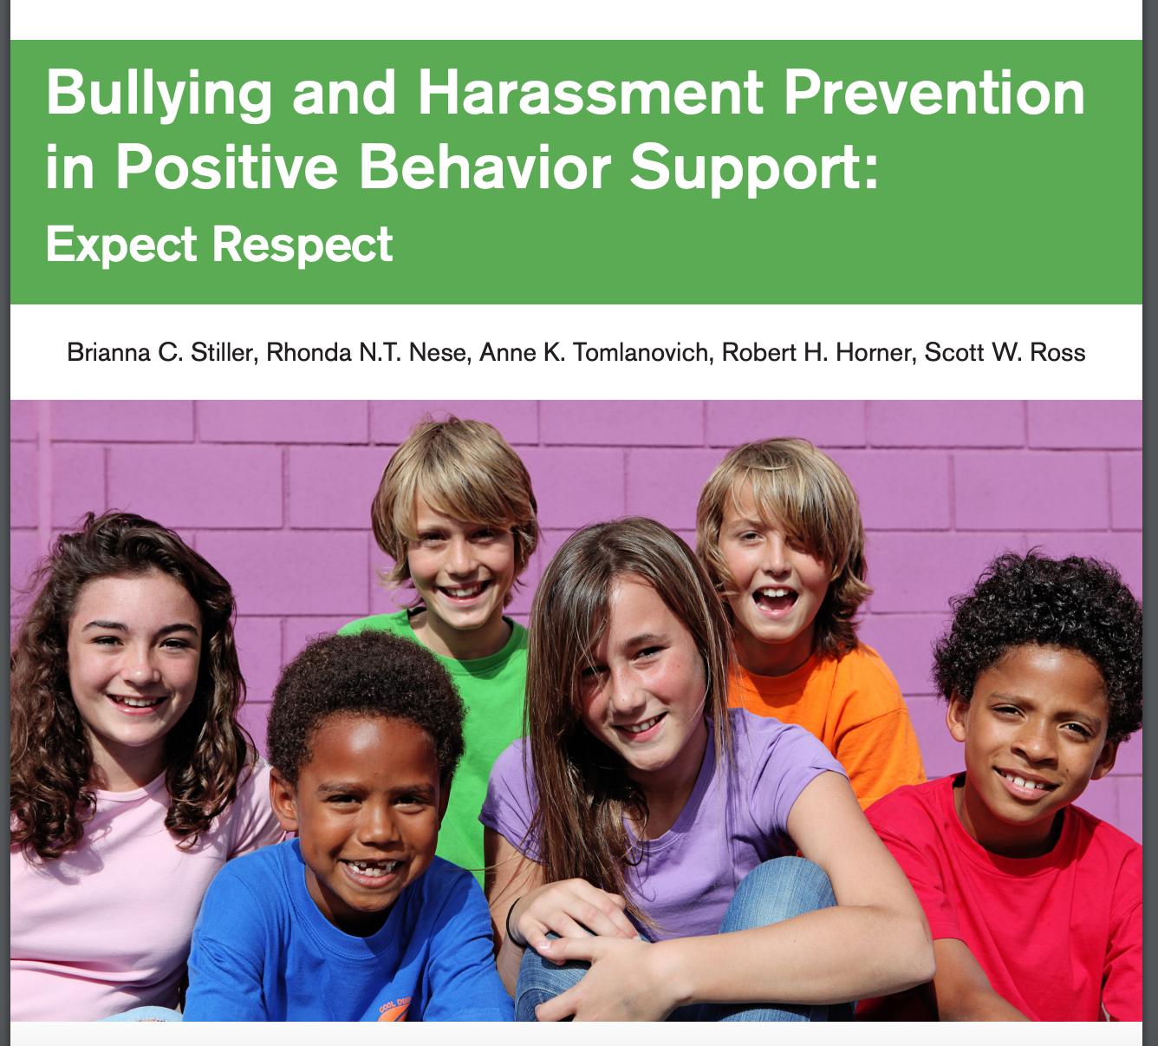
Available at https://www.pbis.org/topics/bullying-prevention
Notes:
Free!

Slide 30
Poll
Have you ever seen this curriculum before?
  Yes, and we use it at our school.
  Yes, but we don’t use it at our school.
  No.

Slide 31
Core Features of an Effective
Bullying Prevention Effort
Student Skills:
School-wide behavioral expectations (respect)
Teach routines:
  Stop
  Bystander Stop
  Stopping
  Recruiting Help
Faculty / Staff:
Agreement on logic for bullying prevention effort
Teach students skills
Pre-correction, follow-up, and consistency
Actively supervise hot spots
Acknowledge use of strategies
Clear data collection and use process
Advanced support options
Adapted from Scott Ross, University of Oregon
Notes:
Dispelling myth that bullying is a normal part of childhood
Teaching adults how to identify bullying to prevent misidentification as conflict
Increase awareness of bullying, effects, strategies for supporting students who are bullied
Consider physical environment – what changes can be made to deter bullying

Slide 32
Teach a Three-Step Skill
Stop:
Say and show “stop”
Walk:
Walk away
Talk:
Talk to an adult
Notes:
These skills can be used in all places at all times (including cyberbullying)
Keep it simple
To be used if you encounter behavior that is NOT respectful (or … substitute your school expectation related to respect)

Slide 33


The “Stop” Routine
If someone is directing problem behavior toward you or someone else, give them the “stop signal”
  Students decide on what it should look and sound like for whole school
    Firm hand signal
    Clear voice
    Short phrase
Notes:
Be careful of inadvertently rewarding the disrespectful behavior … discuss how showing/saying “stop” could be done so it still rewards the undesirable behavior
(adaptable to elementary, middle, and high school)

Slide 34

The “Walk” Routine
Sometimes, even when students tell others to “stop,” problem behavior continues
Students are taught to "walk away"
  Removes reinforcement for problem behavior
Teach students to encourage one another when they use the appropriate response

Slide 35
The “Talk” Routine
Even when students use “stop” and “walk away,” sometimes the behavior continues
Students should "talk" to an adult
  "Talking”/reporting: when you have tried to solve the problem yourself and have used the "stop" and "walk" steps
  Tattling: when you do not use the "stop" and "walk" steps before talking to an adult and/or your goal is to get the other person in trouble

Slide 36
64% of children who were bullied did not report it
(Petrosina, Guckenburg, DeVoe, and Hanson, 2010).
Why do you think this is true?
Please answer in the chat box.
_
Notes:
More likely to report if school climate is strong

Slide 37
The “Stopping” Routine
Eventually every student will be told to stop. Teach all students what to do when given the “stop” message:
  Stop what you are doing
  Take a deep breath
  Go about your day (no big deal)
These steps should be followed even when they don’t agree with the “stop” message. The rule is: If someone asks you to stop, you stop.

Slide 38
How Adults Respond
(To the target and/or upstander)
When problem behavior is reported, adults follow specific response sequence. Students are taught this sequence:
  Reinforce student for reporting (e.g. “I'm glad you told me. That must have been really hard.")
  Ask who, what, when, and where.
  Ensure student’s safety:
    Is bullying still happening?
    Is reporting child at risk?
    Fear of revenge?
    What does student need to feel safe?
    What is severity of the situation?
  Ask, "Did you tell the student to stop? Did you walk away from the problem behavior?”
    If yes, praise student for using appropriate response.
    If no, practice.

Slide 39
How Adults Respond
(To the student who is bullying and/or asked to stop)
Reinforce the student for discussing the problem with you
Ask, "Did ______ tell you to stop?”
    If yes: Ask, "How did you respond?
    If no: Practice the 3-step response.
Ask, "Did ______ walk away?
    If yes: "How did you respond?”
    If no: Practice the 3-step response.
Follow school protocol for reporting

Slide 40
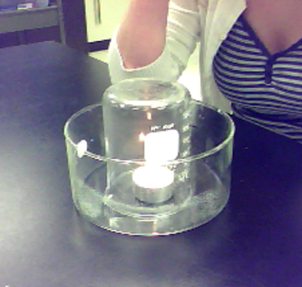
Example Activity from Lesson
Problem behavior is like fire
Cut off the oxygen, the candle goes out
Cut out the attention, the problem behavior stops
Great videos:
http://blogs.egusd.net/pbis/
Notes:
Explain how problem behavior needs peer attention to keep it going, like candle needs oxygen to stay list
Discuss forms of peer attention (i.e. engaging with someone who teases you; laughing at someone being picked on; watching problem behavior and doing nothing)
Taking away peer attention is like taking the oxygen away from a candle (cover candle)
Explain how they can take away peer attention (stop, walk, talk)

Slide 41
Importance of Using Student Leadership
Student buy-in is half the battle
Students with social power should be involved in every phase of intervention development and implementation
  It has to be cool to do the right thing and stand up against bullying
Difference between elementary vs. middle/high (who do you want to be friends with; success of efforts)

Slide 42
Student Leadership Team
8-10 students (nominated by peers)
Discussion:
  Disrespectful behavior is a problem. It damages the ability of others to succeed in school. It keeps happening because it results in attention from peers.
  We need your help developing school-wide routines.
  What would be best way to introduce/train these routines?
Students help develop, deliver, and report on efforts
Available to classmates as resource
Idea: use HS leaders to go down to MS
Do you utilize student leaders in your bullying prevention efforts?

Slide 43
How to Implement Bullying Prevention in PBIS Framework
Implement school-wide PBIS with fidelity
Form bullying prevention implementation team/assign to PBIS Leadership Team
Complete bullying prevention self-assessment
Survey students
  Helps motivate adults to take action against bullying
  Helps team tailor strategies to needs of school
  Baseline from which to measure progress
Introduce all stakeholders to bullying prevention
_

Slide 44
How to Implement Bullying Prevention in PBIS Framework
Gain faculty, staff, family, and student commitment
Train all adults (including bus drivers, cafeteria monitors, etc.)
Build bullying prevention lessons – skills on matrix
Teach all students
Booster/follow-up lessons
Collect and use data
_

Slide 45
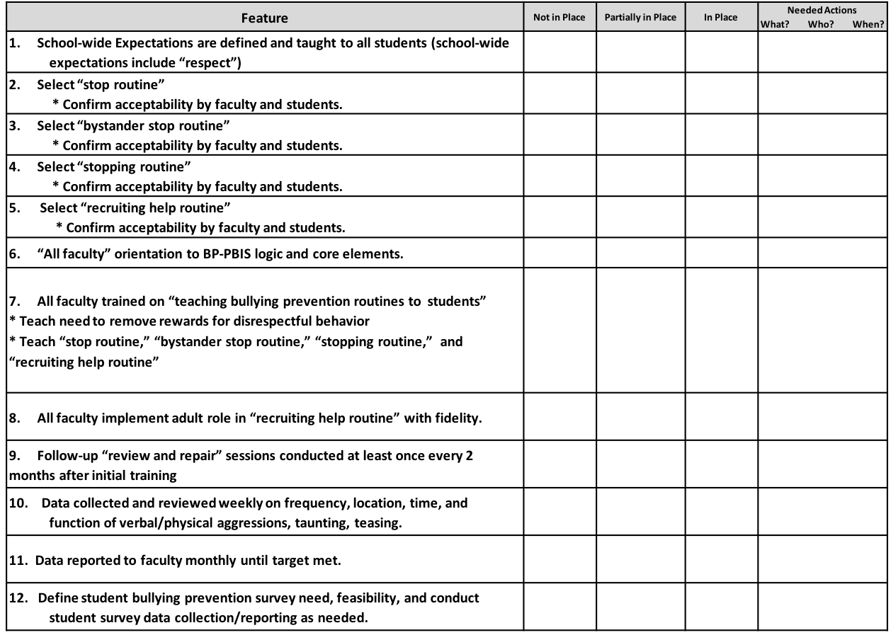
Bullying Prevention Self-Assessment

Slide 46
Student Survey
On a scale of 1 to 5, with 1 meaning completely disagree and 5 meaning completely agree, in your school, do:
  You feel safe?
  Other students treat you respectfully?
  You treat other students respectfully?
  Adults treat you respectfully?
  You treat adults in your school respectfully?
In the past week:
  1. Has anyone treated you disrespectfully? Yes / No
  2. Have you asked someone to “stop?” Yes / No
  3. Has anyone asked you to “stop?” Yes / No
  4. Have you seen someone else treated disrespectfully? Yes / No

Slide 47
Does It Work?
Experimental trial (Ross and Horner, 2009)
  72% reduction in bullying behaviors of at-risk students
  Targets 19% less likely to cry or fight back
  Bystanders 22% less likely to laugh, cheer, or join in
Over 1500 schools have implemented BP-PBIS
Follow-up studies in elementary and middle schools have shown significant reductions in self-reported bullying (Ross & Horner, 2013) and bullying-related office discipline referrals and suspensions (Good, McIntosh, & Gietz, 2011).

Slide 48
Resources
https://www.stopbullying.gov/
https://cyberbullying.org/
Bullying prevention playlist:
https://www.youtube.com/playlist?list=PLvzOwE5lWqhScOdC3xMzs9FoAAfpxA-Tz
Cyberbullying Resources: https://www.webwise.ie/teachers/resources/
Pacer Center video: http://www.pacer.org/bullying/video/player.asp?video=65
CASEL Webinar: https://casel.org/events/understanding-and-preventing-youth-bullying-peer-victimization-during-the-pandemic/
Resource for Vermont families: https://vtlawhelp.org/bullying-harassment?fbclid=IwAR0Dd5I7MYw27mhFLiXM2GaIrq8ufXAJsOizOEBmU0565na9bfzUeme-duc
VT Model Policy: https://education.vermont.gov/documents/healthy-safe-schools-hhb-model-policy
VT Statute: https://legislature.vermont.gov/statutes/section/16/009/00570
_
_
_

Slide 49
Wrapping Up
What questions do you have?
If anyone is interested in implementing this PBIS Bullying Prevention Curriculum OR implements the Second Step Bullying Prevention Curriculum, please contact amy.wheeler-sutton@uvm.edu.
As you’re leaving, type one action step you’d like to take following this webinar.
_

