Slide 1
Applying Check-in/Check-out (CICO) to Meet Different Needs in Different Environments
Presented by the VTPBIS State Team

Slide 2
Welcome!
You will be muted during this session. Please use the chat box or raise your hand.
This session is being recorded. Please email Anne Dubie for access.
You can show or hide your video.
All materials can be found here: https://www.pbisvermont.org/training-resources/webinars/

Slide 3
Acknowledgements:
Leanne Hawken, Ph.D

Slide 4
Context
SUs/SDs and schools planning for students and staff to return following COVID-19 closures must prioritize efforts to address social and emotional learning and mental and behavioral health needs.
Notes:
This has been identified as a top priority and we can all agree that SEBL is critical to accessing learning.
Finally in a place in this country where social/emotional/behavioral needs in education is getting the attention.

Slide 5
PBIS as a Supportive Framework
PBIS has meant the world to us as we have made the transition back to in-person learning. I have said a million times over the past 3 months that PBIS provides a perfect framework for us to articulate, teach, practice, and reinforce all of these new routines in our buildings.
Matt Young, Principal,
Peoples Academy Middle School

Slide 6
Agenda
Framework Guiding our Efforts
Solidifying the Targeted Level
Check-In/Check-Out Defined
Variations of CICO
Considerations with COVID-19

Slide 7
Notes:
Talk about MTSS
Systems: Importance of a teaming infrastructure
Agree that it’s a priority and communicate widely
Work with community partners
Practices: Have an understanding of SEL
Have an inventory of what already exists
Bring in community resources/interventions
Data: Formal/Informal surveys and screeners
Use data to prioritize making the smallest change for the greatest impact

Slide 8
Guiding Principle for Equity
“Instructional supports, practices, and interventions can be tiered – students can not! There are no “tier 2 students” (or tier 3 or tier 1). By assigning this type of label to students we make their current status permanent. That is the antithesis of the concepts underlying a multi-tiered system of supports.”
VTmtss Field Guide 2019

Slide 9
Continuum of Support for “Dylan”
Universal
Targeted
Intensive
Anger Mgt.
Math
Label Behavior, Not Students!
Science
Adult relationships
Attendance
Reading
Peer Interaction
Notes:
Every student has competencies. Label behavior not STUDENTS. Everyone at one point or another needs targeted or intensive supports. Dylan is doing great in reading but may need more support in Math and with anger management.

Slide 10
Targeted Supports – Systems What do you already do?
How do you identify students for targeted math/reading supports?
How do teachers know that these supports exist?
How do parents learn about these supports?
How do you decide if/how well the intervention is working?

Slide 11
Two Functions of Targeted System for Behavior:
Systems-level design and accountability
Student intervention planning and monitoring
Notes:
How do you identify students for targeted math/reading supports?
How do teachers know that these supports exist?
How do parents learn about these supports?
How do you decide if/how well the intervention is working?

Slide 12
Targeted Interventions:
Match to function
Require a “request for assistance” process
Include criteria for success
Are voluntary
Involve all adults in the school

Slide 13
Examples: Targeted Interventions Based on Function
Access Adult Attention/Support:
Check-In/Check-Out
Adult Mentoring Programs
Access Peer Attention/Support:
Social Skills Instruction
Peer Mentoring
Self-Monitoring with Peer Support (function: academic task escape)
Access Adult Attention (around academics):
Organization/Homework planning support
Homework completion club
Tutoring

Slide 14
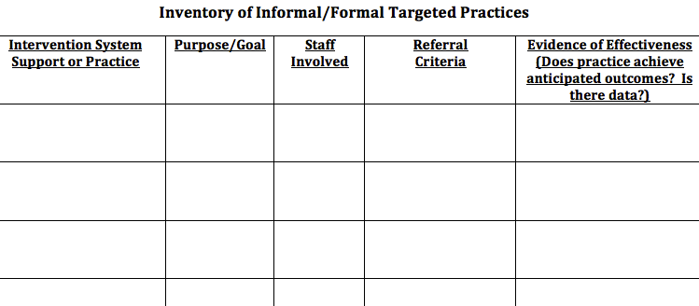
Inventory of Targeted Practices:

Slide 15
EXAMPLE

Slide 16
Shifting Practices/Policies/Procedures
Need to move from interventions focused on compliance to interventions focused on connection and support

Slide 17
Poll – What is your experience with CICO?
What is Check-in/Check-out?
Our school is currently exploring implementation of Check-in/Check-out as a targeted intervention
Our school has a well-established CICO intervention in place (supporting 7-12% of our student population)
Our school has a well-established CICO intervention in place AND has adapted the use of CICO for issues beyond student need for attention from adults

Slide 18
Check-In/Check-Out (CICO)
Research-based intervention
Evidence that school can successfully implement
Evidence of decreased problem behavior
Effective for 60-75% of students in need of Targeted supports
Less effective for students who do not find adult attention reinforcing, but research is promising!

Slide 19
Key Features of CICO
Check in and out with a Coordinator at the beginning and end of day
Increased instruction and feedback on behavioral expectations with the teacher after each class or instructional routine through a Daily Progress Report (DPR)
Parent/Guardian provides positive feedback and encouragement to child at the end of each day
Student receives reinforcement when behavioral goals are met
Notes:
It works!
Provides prompts for positive feedback (5:1)
Provides structure for corrective feedback
Easily embedded into classroom routines
If 70% of students not responding to CICO, need to examine systems features
Circling numbers is not an intervention
Can be expanded to additional problem behaviors once Basic CICO is in place

Slide 20
CICO Program Logistics
Daily CICO Progress Report (DPR)
Same expectations for all
Common schedule
All staff are taught rules for accepting, completing, and returning the card
Daily Progress Report compatible with SWIS
Home Report Process
Can be same as progress card
Can be a unique reporting form

Slide 21
Notes:
Standard for all students?
3-5 expectations?
3-point rating scale?
No more than 10 check-in periods?

Slide 22
CICO Home Report
Name: ______________________________________________ Date: _____/______/______
☐ I met my goal today!
☐ I had a hard day today.
One thing I did really well today is ___________________________________________________________
________________________________________________________________________________________
Something I will work on for tomorrow is _____________________________________________________
________________________________________________________________________________________
Comments: _______________________________________________________________________________
Parent Signature: __________________________________________________________________________

Slide 24
SWIS CICO School-wide Report:

Slide 25
Before implementing CICO, consider:
All-faculty, student, family orientation to the CICO intervention
Assessment of need:
ODR rates
Staff assessment
Referral from home
Team to manage CICO implementation
CICO Coordinator

Slide 26
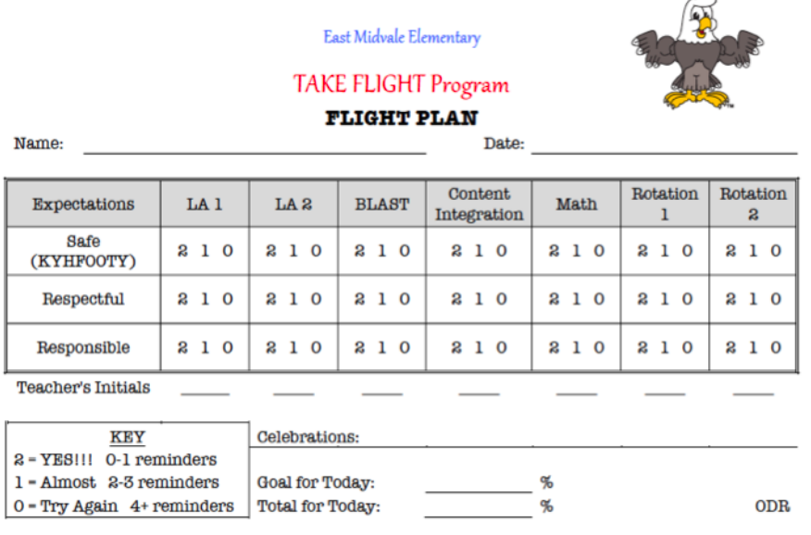

Slide 27
CICO is All About Relationships and Connection!
Focus on providing reinforcement that involves time with adults or other students to build connections
Tangible reinforcers earned should always be paired with verbal praise/attention from adults
Graduate students by transitioning attention

Slide 28
Adapting CICO to Meet Different Needs

Slide 29
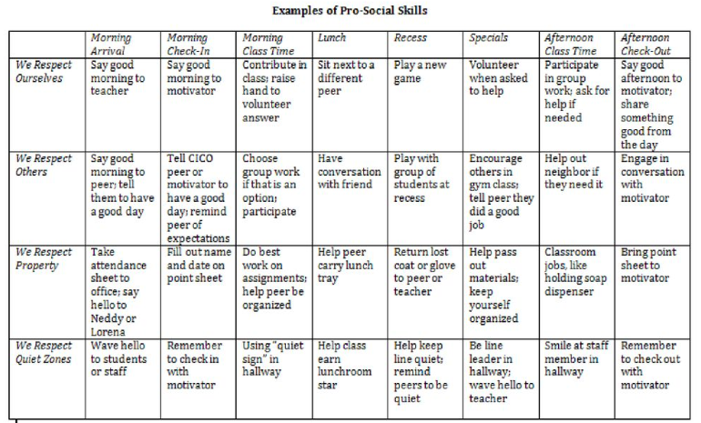
Adding Pro-Social Characteristics to Teaching Matrix

Slide 30
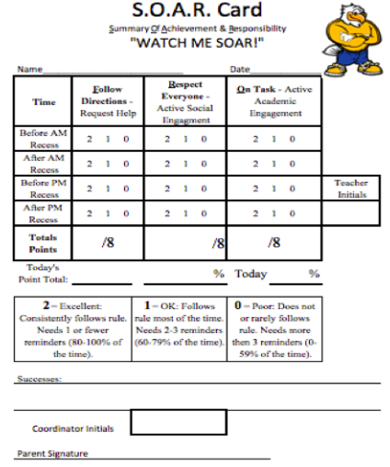
DPR for Internalizing Characteristics

Slide 31
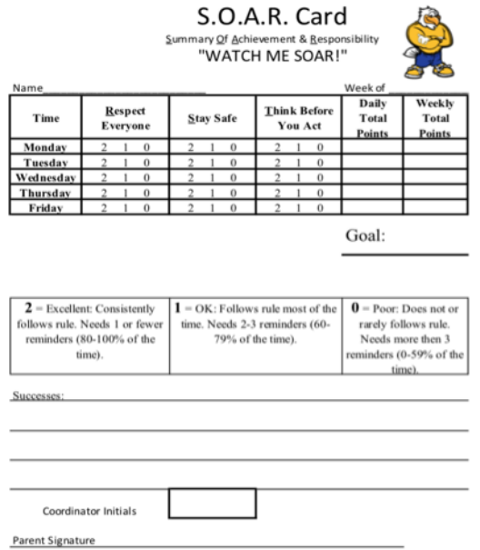
DPR for Recess

Slide 32
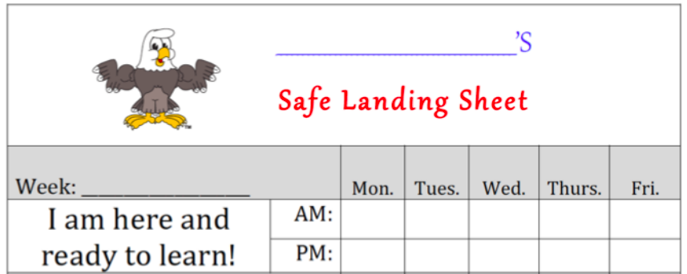
DPR for Attendance

Slide 33
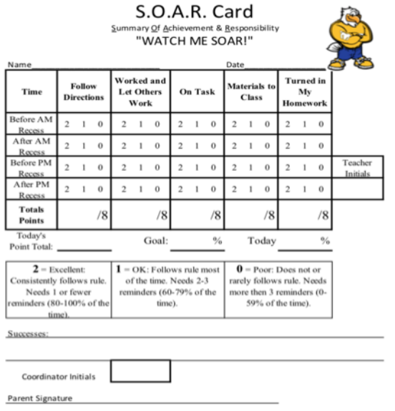
DPR for Academics/ Organization

Slide 34
DPR for Social/Academic

Slide 35
DPR Individualized

Slide 36
Poll: Prior to COVID-19, to what extent were you adding features or individualizing CICO?
All students have received the same intervention with few or no modifications
All students on CICO receive ratings based on the school-wide(PBIS) expectations but have a different number of periods depending on need
Some students on CICO have individualized CICO expectations and periods
All students on CICO have interventions that are individualized to meet their specific needs

Slide 37
Activity
Consider which of these modifications to CICO match the needs of your students.
Which might you incorporate?
What changes would you need to make to ensure they are successful?
What questions do you have?

Slide 38
Adapting CICO for Differing Learning Environments – Identifying Student Need
For students previously receiving CICO, assess whether the student displays a need for CICO while distance learning is in place
Teams should feel empowered to set intervention entrance criteria using distance learning standards:
Work completion
Engaging in virtual environment without interrupting/disrupting others
Showing up for virtual learning/attendance
Participating in learning and social interactions

Slide 39
Assess Student Need by Checking In

Slide 40
Adapting CICO for Differing Learning Environments – Who, When, How?
Who will do the check-ins?
CICO coordinator? Classroom teacher? Family members? Who else is available?
Student can self-monitor
Must provide instruction, especially to younger students
Research on self-monitoring is effective even if inaccurate
When and how often will check-ins occur?
May be too ambitious to do several times per day
Perhaps 2-3 times a week
Perhaps just Monday morning check-in and Friday afternoon check-out
How will you check in?
Maybe on Zoom
Perhaps text or phone call

Slide 41
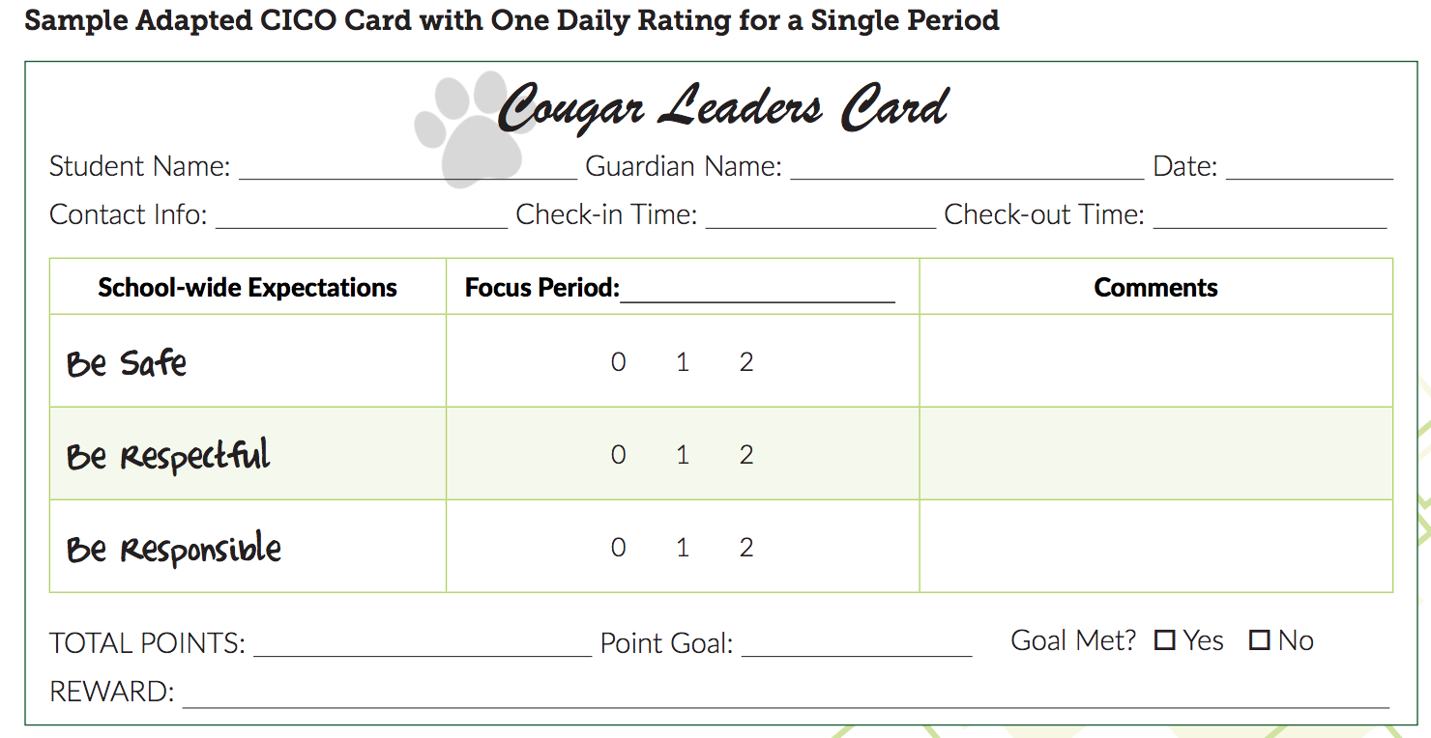

Slide 42
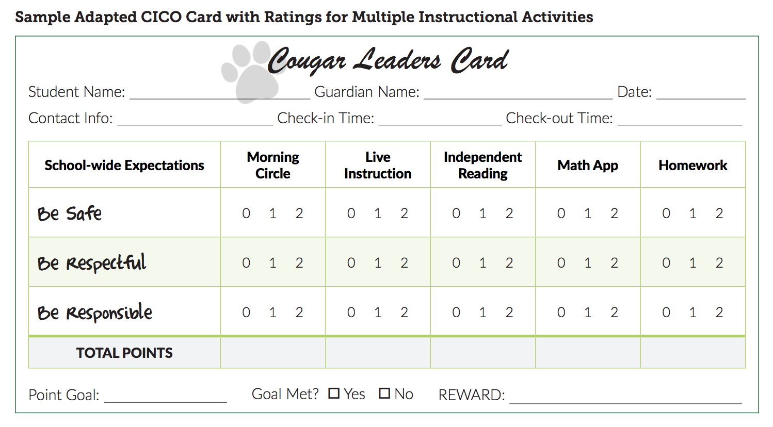

Slide 43
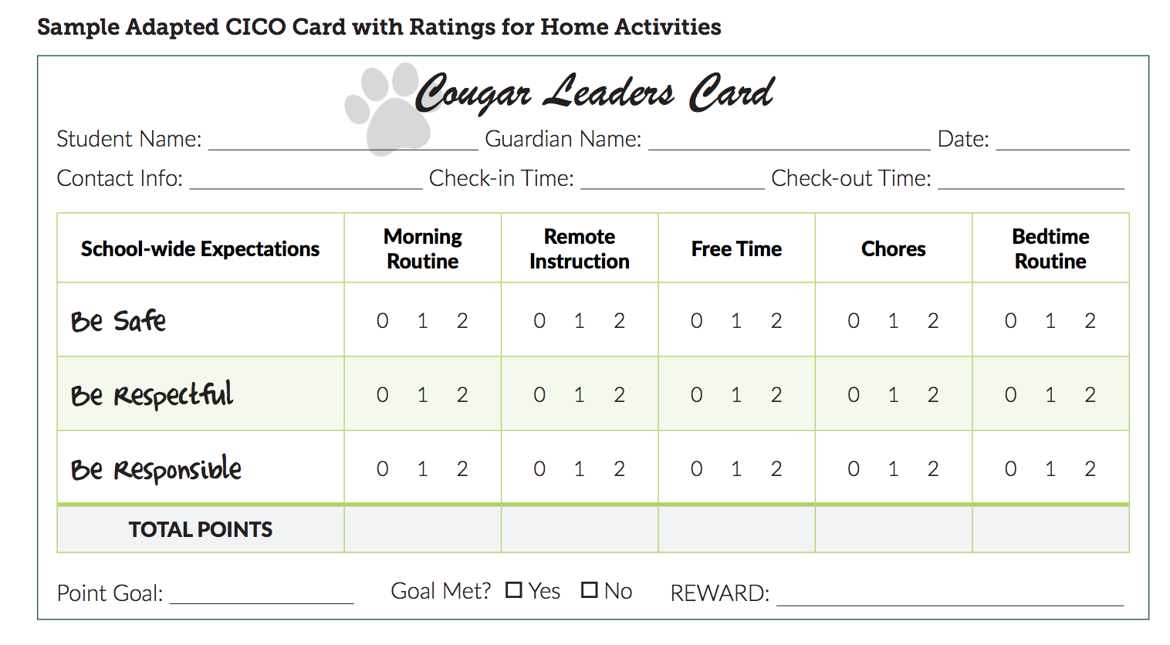

Slide 44
Remote Check-in Examples

Slide 45
Daily Reinforcement:
Remember: practice, feedback, reinforcement
Set goal so students can experience immediate success
Ideas for reinforcement:
Snack with coordinator
Lunch with friends
Extended time for lunch
Tell jokes
Online karaoke
Doodle together
Tell stories
Notes:
Avoid electronics

Slide 46
Adapting Data-Based Decision Rules:
May need to change goal line from 80% to 50-60%
Perhaps biggest concern is the student just showing up
Student may not meet goals due to factors not under their control
May check in daily with a Google form – “How do you feel?” “Are you ready for learning?”

Slide 47
Collecting, Using, and Sharing Data
Keep as uniform as possible
SWIS CICO:
Same number of periods
Scores of 0-1-2
Can leave blank if no check in during certain periods
Consider a google from for modified CICO
Share data with staff, students, and families

Slide 48
Connect with Family Members!
Find out from family members how process is going at least once/week
If key components not going well, don’t scrap the intervention
Ask what you need to teach/re-teach
Have you taught it well enough for the intervention to be successful?

Slide 49
Take Home Messages
Focus on key, active CICO elements:
Connections of students with adults at school
Regular feedback/instruction on behavior and practice in self-monitoring
Home/school communication
Use data for decision-making
Assess, adapt, monitor progress, re-adapt!

