Slide 1
De-escalation and
Relationship Building Skills
Ken Kramberg

Slide 2
Self Defeating Vs. Bad Behavior
The Power Of Language

Slide 3
CHILDREN WHO ARE HEARD LISTEN
Kids want to tell their story

Slide 4
WHEN DEALING WITH IN AN EMOTIONALLY CHARGED EVENT
YOU MUST DEAL WITH THE FEELINGS FIRST
BEFORE YOU CAN DEAL WITH THE BEHAVIOR
FEELINGS , THOUGHTS , BEHAVIOR

Slide 5
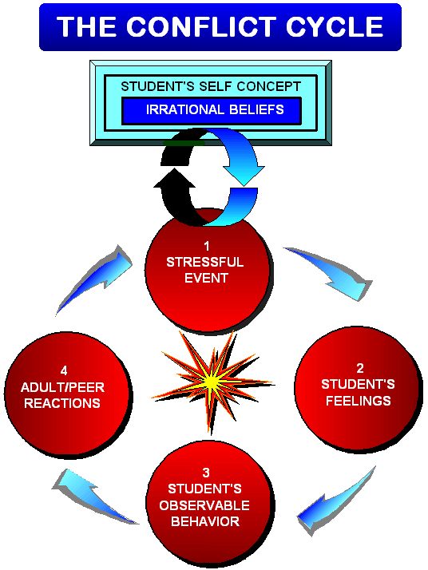
Notes:
The Conflict Cycle
Participant Manual page 24
This is simply a full page visual for participants to refer back to. Nothing new here.

Slide 6
Remember, during crisis act like a thermostat, not like a thermometer!
Notes:
Remember, during crisis, act like a thermostat, not like a thermometer!
Participant Manual page 28
You will have counter-aggressive feelings; things will go wrong. This is the reason volunteers don’t last long in a program serving troubled students. When we treat others with kindness and respect, and we do good for them, we expect some kind of reciprocation; at least appreciation. Our students do not usually respond in ways that endear them to volunteers. As the responsible staff, our response to the student’s behavior is the critical point. We will either reinforce the student’s self-fulfilling prophecy, or present him with an alternative example. To make a difference we must do what’s best for the student not act on our feelings. In effect, we have to bring the student’s emotions under control while controlling our own emotions. A good analogy is that of the thermometer and the thermostat. A thermometer reflects the heat in the setting whereas the thermostat controls the temperature. Helping adults will be good emotional thermostats.
If you do what comes “naturally” you will usually make matters worse.

Slide 7
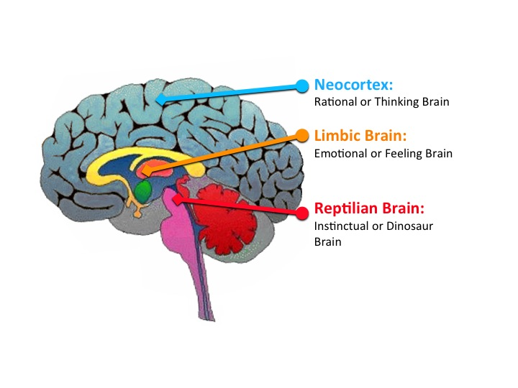

Slide 8


Slide 9

1 DRAIN OFF
Drain off the student’s intense emotions by acknowledging the feelings
2 TIMELINE
Use affirming and listening skills to discover the student’s point of view
3 CENTRAL ISSUE
Identify the student’s vital interest and give them their choices

Slide 10
            THE “SCRIPT”
            Acknowledge the feelings: Make 2-3 validating statements
            Affirm : Make 2-3 affirming statements
            Get the child’s perspective and restate
            Set limits and give choices as needed

