Slide 1
Facilitating Data Days
Presented by the VTPBIS State Team
November 7, 2019
Notes:
Sherry

Slide 2
Webinar Logistics
Orient to Webinar Screen
This webinar will be recorded
Please note, your microphone will be muted unless otherwise indicated
Notes:
Sherry

Slide 3
POLL: How would you best describe your school’s data-based decision-making so far this year?
We are fluent and effective in using our data to identify problems and make changes
We know how to use the data and are working to sustain it
We are still learning and growing in this area
What is data-based decision-making?
Notes:
Sherry

Slide 4
Purpose
To build competence and confidence in your role as facilitators of data review
To introduce/review useful tools and strategies for problem solving around fidelity and student outcome data
To explore strategies for sharing data to build momentum
Notes:
Sherry

Slide 5
Agenda
Why collect and analyze data?
Who facilitates the process?
What data should you be looking at?
How will you use the data for problem-solving and decision-making?
When and to whom will you share the data?
What are next steps?
Notes:
Sherry

Slide 6
Start with Outcomes
How will you know if PBIS is working if you are not sure where it should be taking you?
Notes:
Amy

Slide 7
Sample Outcome Statements
“Given school-wide implementation of PBIS with fidelity, we will decrease the number of student suspensions and expulsions by 10% by the end of the school year.”
“As a result of teaching and rewarding homework completion, students will submit homework on 80% of opportunities across the next quarter.”
Notes:
Amy

Slide 8
POLL: To what extent has your school team identified specific outcomes for this year?
We have identified measurable outcomes based on data with specific strategies that we are monitoring
We have generally defined outcomes with general strategies for change
We do not have specified outcomes but we know we want to achieve overall behavior improvement
We are not sure what outcomes we want to achieve
Notes:
Sherry

Slide 9
Using PBIS Data Will Help You:
Identify strengths
Identify a possible problem
Build a precise “problem statement”
Select a solution (intervention)
Assess if a solution is (a) being implemented and (b) being effective.
Notes:
Sherry
Data help us ask the right questions…they do not provide the answers: Use data to
Identify problems
Refine problems
Define the questions that lead to solutions
Data help place the “problem” in the context rather than in the students.

Slide 10
Types of Data to Consider
Intensive:
TFI
I-SWIS
EST
FBA/BSP
Targeted:
TFI
SWIS-CICO
EST
FBA/BSP
Universal Screening
Universal:
TFI
SAS
SWIS
Attendance
Grades
Leadership Team Self-Assessment
School Climate
Family Engagement
Notes:
Sherry
What else?

Slide 11
Big Ideas About Data
All data should serve a purpose
Collect data with fidelity
Be prompt about looking at data and acting upon it
Use multiple sources of data to confirm what you see
Use data to support, not punish
Notes:
Sherry

Slide 12
Characteristics of an Effective Data Team
Notes:
Sherry

Slide 13
Data Analyst: Role & Responsibilities
Establish the role of a data analyst (and backup person)
Use the data sources needed for problem solving and decision making (DIBELS, SWIS, etc.)
Create written data summaries in advance to assist the team:
Determine if there are problems;
Jumpstart problem-solving discussion; and
Evaluate impact of solutions and fidelity of implementation
Notes:
Sherry

Slide 14
Data Analyst: Role & Responsibilities (cont’d)
Launch meeting with data summary that helps define the problem with precision
Start problem solving by defining the problem with precision
Refine precision of problem statement through inferences and hypothesis
Generate reports during the meeting as questions about the data arise
Notes:
Sherry

Slide 15
POLL: To what extent does someone serve as data analyst in your PBIS planning meetings?
1. Data has not been used in our meetings so there has been no need for a data analyst
2. There is no one in particular serving in this role. The Team reviews and analyzes the data together at the meetings.
3. One person on the team brings data to the meeting for the team to review.
4. There is a person identified in this role who prepares data for review and points out trends in advance for discussion and problem solving at meetings.
Notes:
Sherry

Slide 16
Effective meetings extend before and after the actual meeting time. Other key roles are necessary!
BEFORE:
Set agenda and send to team
Collect data, review, and prepare summary statements
DURING:
Follow agenda & time frames
Review data
Make precision problem statements
Develop solutions
Take notes and set action items
AFTER:
Complete action items
Follow-up on action item status
Notes:
Sherry

Slide 17
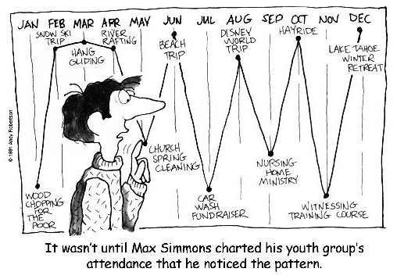
Consider Team-Initiated Problem Solving!
https://vimeo.com/user18175786/videos
Notes:
Sherry

Slide 18
TIPS Offers:
A process for using data to make decisions:
Formal problem-solving steps that a group can use to build and implement solutions.
Access to the right information at the right time in the right format
A structured meeting process
Formal roles (facilitator, recorder, data analyst)
Specific expectations (before, during & after meetings)
Access and use of data
Use of electronic and projected meeting minutes
Notes:
Sherry

Slide 19
Innovation Neutral: Use for Reading, Behavior, Math, School Improvement
Notes:
This is a microcosm of the drivers within a theory of improvement process outined in the AOE Comprehensive needs assessment toolkit.

Slide 20
Decision-Making Can Occur at Many Levels
Whole school
Small groups or school areas
Individual student
Same basic process
Notes:
Sherry

Slide 21
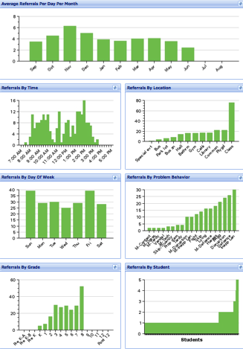
SWIS Big 7: Core Reports
Avg. Referrals Per Day Per Month
Time
Location
Day of Week
Problem
Behavior
Grade
Student
Notes:
Sherry

Slide 22
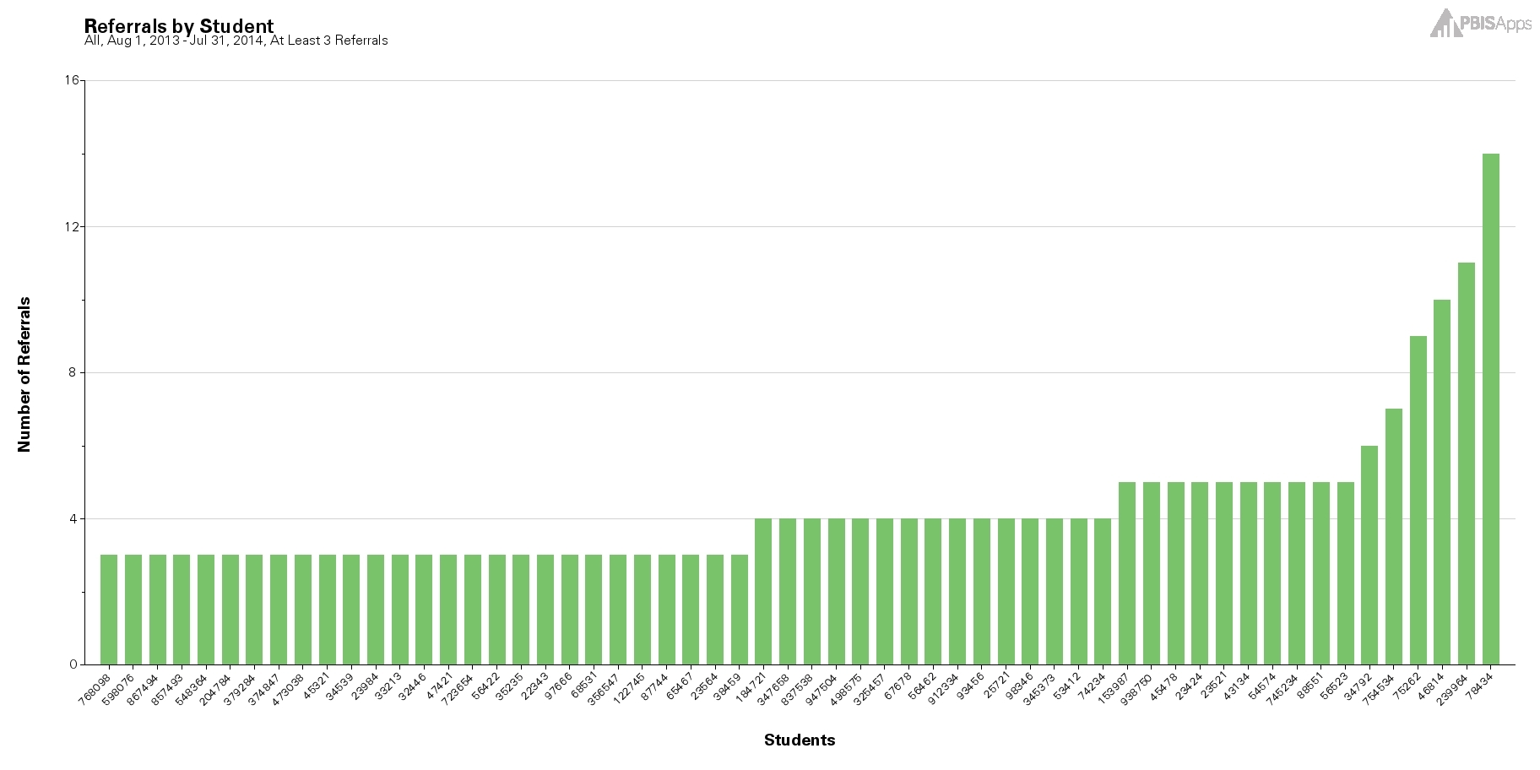
Using the Referrals by Student Report as a Universal Screening Tool
Notes:
Student with 2-5 are candidates for more support in behavior, academic, or both areas.

Slide 23
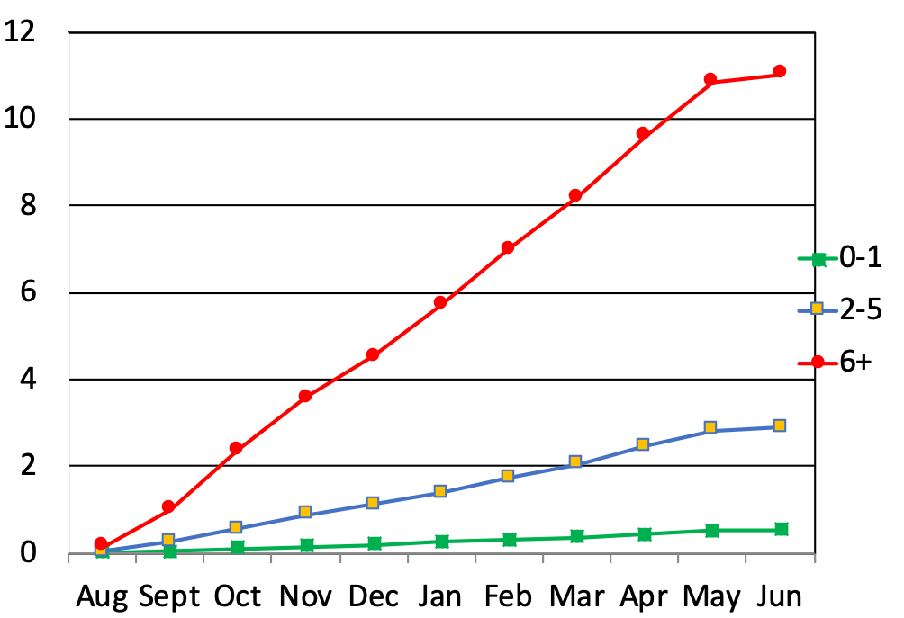
Discipline Data for Universal Screening
Cumulative Mean ODRs Per Month
for 325+ Elementary Schools 08-09
The “October Catch”
Jennifer Frank, Kent McIntosh, Seth May, & Scott Spaulding
Notes:
Sherry
A research study by Frank, McIntosh, and May highlights the value of proactive decision making.
What the research study found was that as a school year progresses, the cumulative mean of office discipline referrals increases for each of the three tiers. Students who may benefit from Tier III supports see the most significant increase in ODRs over time.
However, when schools used SWIS as a tool for universal screening and intervened early they were able to break the pattern. When the pattern was proactively broken, a significant stabilization in ODRs occurred and future incidents and problems were preempted.

Slide 24
Great Article on the “October Catch”: https://www.pbisapps.org/community/Pages/The-October-Catch.aspx
Notes:
Sherry
https://www.pbisapps.org/community/Pages/The-October-Catch.aspx

Slide 25
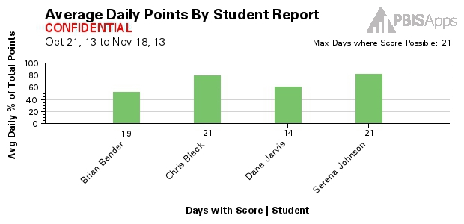
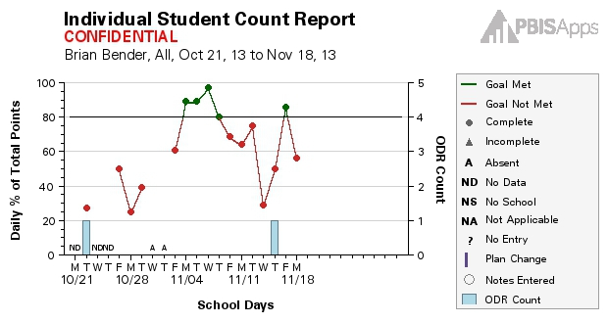
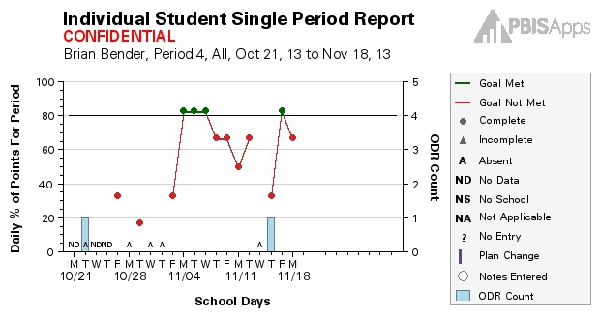
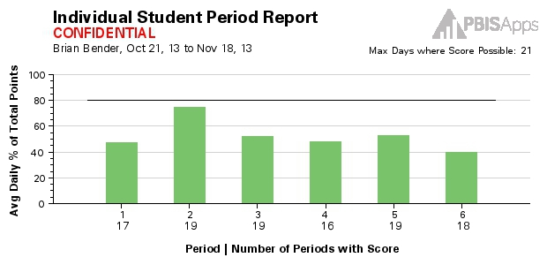
CICO - Reports:
School-wide Report
Average Daily Points
Student Count
Student Period
Student Single Period
Notes:
Sherry

Slide 26
Do you have decision rules for CICO?
Consider referring students for additional supports when:
You see failure for 2-6 weeks
Student receives 6th ODR
Five absences in 30 days
Problem behaviors become dangerous
There is a mental health concern
The family requests additional supports
Fade students from CICO who:
Consistently meet their goals for at least four weeks. This is an average across days.
Haven’t received an ODR for at least four weeks.

Slide 27
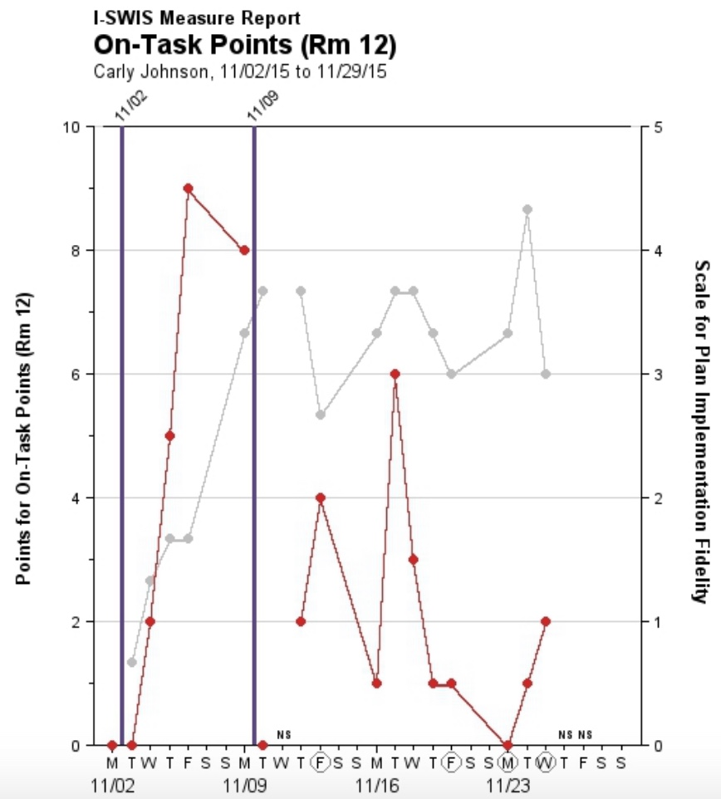
I-SWIS Reports:
Notes:
Sherry

Slide 28
TIPS Problem-Solving “Mantra”
REMEMBER to use…..
Do we have a problem? (identify)
What is the precise nature of our problem? (define, clarify, confirm/disconfirm inferences)
Why does the problem exist, & what can we do about it? (hypothesis & solution)
What are the actual elements of our plan? (Action Plan)
Is our plan being implemented, & is it working? (evaluate & revise plan)
Innovation neutral: Use for Reading, Behavior, Math, School Improvement
Notes:
Sherry

Slide 29
Why Does the Problem Exist & What Can We Do About It? (hypothesis & solution)
Problem Statement: The sixth graders are disruptive & use inappropriate language in the cafeteria between 11:30 AM and 12:00 PM
Hypothesis: We believe they are trying to get attention from their peers.
Notes:
Sherry

Slide 30
Solution Development for Disruption in Cafeteria
Prevention: Remove/alter “trigger” for problem behavior | Maintain current lunch schedule, but shift classes to balance numbers.
Teaching: Define, instruct & model expected behavior | Teach behavioral expectations in cafeteria
Reward: Expected/alternative behavior when it occurs; prompt as necessary | Establish “Friday Five”: Extra 5 min of lunch on Friday for five good days.
Extinction: Increase acknowledgement of presence of desired behavior | Encourage all students to work for “Friday Five”… make problem behavior less rewarding than desired behavior
Corrective Consequence: Use non-rewarding/non-reinforcing responses when problem behavior occurs | Active supervision and continued early consequence (ODR)
Data Collection: Indicate how you know when you have a solution | Maintain ODR record and supervisor weekly report
Notes:
Sherry

Slide 31
…include logistics:
Notes:
Sherry
Action Plan Elements:
Who?
By When?
Goal with Timeline
Fidelity of Implementation Measure
Effectiveness of Implementation Measure

Slide 32
Is Our Plan Being Implemented & Is It Working? (evaluate & revise plan)
Notes:
Sherry
Define the goal for solving the problem
What will ‘it’ look like when you say it is not a problem
Define how you will know that the solutions were implemented as planned (with fidelity)?
How often will you conduct a status review?
Define how you will know that the solutions had a positive effect on student achievement, social competence, and/or safety?
How often will you monitor student progress?
What will the data tell you when the problem is solved?
Base on team-established standard
Easier to monitor if quantifiable (“countable”)
Record on meeting minute form for progress monitoring at future meeting(s)

Slide 33
Notes:
Sherry

Slide 34
Decision Making for Quality Improvement
Team assessments
Self assessments
Walkthrough reports
PBIS Assessments
SET
SAS
TFI
Outcome Data
Fidelity Data
Office Discipline Referrals
Minor (staff managed) referrals
Absences
Tardiness
Climate/Culture
Academic Assessments
What else?
Notes:
Sherry
Disaggregation simply means separating something into its component parts, or break apart.
Only by evaluating both outcome and fidelity data (cause and effect) can leaders and teachers understand the complexities of student achievement (academic or behavior) and the value of our systems and practices.
We cannot begin to truly understand what it will take to achieve our intended outcomes until we understand the relation between cause and effect, how our fidelity and outcome data intersect.
Instead of segmenting data reviews (looking just at outcome or just at fidelity data) looking at the shaded section (where the data intersects) we can get a more comprehensive view of reality and can make higher quality decisions.

Slide 35
Fidelity Data
Notes:
Amy

Slide 36
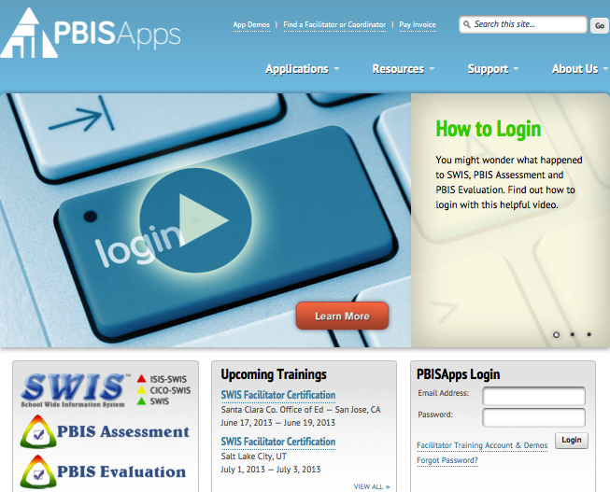
www.pbisapps.org
Notes:
Amy

Slide 37
Tiered Fidelity Inventory (TFI)
Purpose: | Assess leadership team’s perceptions of PBIS implementation at the Universal Level
Format: | Survey on www.pbisapps.org
Completed by: | Leadership Team, School Coordinator, and SU/District Coordinator (external coach if possible)
When? | January – March (or 2-3 times per year)
Notes:
Amy

Slide 38
Uses of the TFI
Formative Assessment
Determine current PBIS practices in place and needed prior to launching implementation
Progress Monitoring
Self-assess PBIS practices by tier to guide implementation efforts and assess progress by tier
Build action plan to focus implementation efforts
Annual Self-Assessment
Facilitate sustained implementation of PBIS
State Recognition
Determine schools warranting recognition for fidelity of implementation
Notes:
Amy

Slide 39
TFI Items
Tier I: 15 items
Tier II: 13 items
Tier III: 17 items
Notes:
The TFI includes 15 items for Tier I, 13 items for Tier II, and 17 items for Tier III.

Slide 40
Understanding TFI Results:
www.pbisapps.org
Scale
Subscale
Items
Notes:
Amy

Slide 41
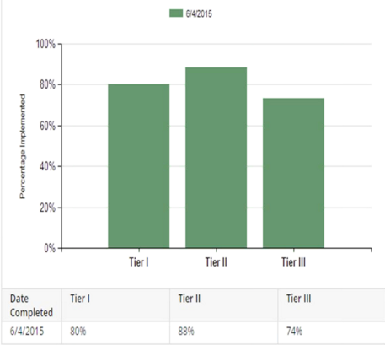
Example Scale Report
Notes:
Amy

Slide 42
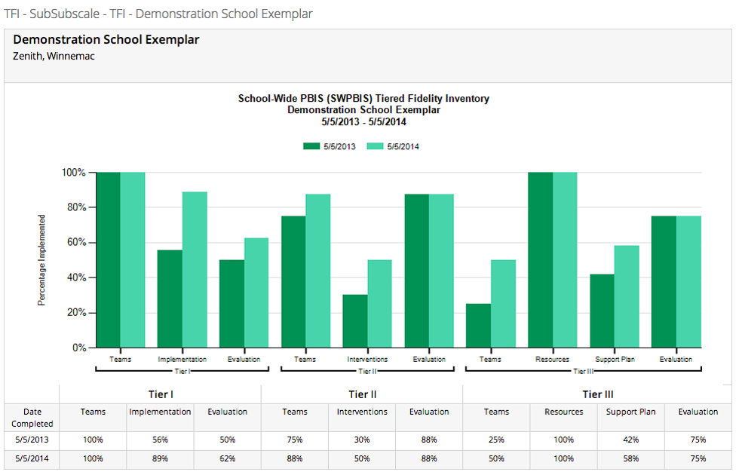
Sub-Subscale and Item Reports
Sub-subscale
Tier I
Teams
Implementation
Evaluation
Tier II
Teams
Interventions
Evaluation
Tier III
Teams
Resources
Support plan
Evaluation
Notes:
Amy

Slide 43
TFI Item 1.3: Behavioral Expectations
Feature | Possible Data Sources | Scoring Criteria
Behavioral Expectations: School has five or fewer positively stated behavioral expectations and examples by setting/location for student and staff behaviors (i.e., school teaching matrix) defined and in place. | •TFI Walkthrough Tool •Staff handbook •Student handbook | 0 = Behavioral expectations have not been identified, are not all positive, or are more than five in number. 1 = Behavioral expectations are identified but may not include a matrix or be posted. 2 = Five or fewer behavioral expectations exist that are positive, posted, and identified for specific settings (i.e., teaching matrix) AND at least 90% of staff can list at least 67% of the expectations.
Main Idea:
Having school-wide, positive expectations is among the best ways to establish a positive social culture.
Notes:
Having behavioral expectations that are positively stated is one of the best ways to establish a positive school culture. The results of the TFI Walkthrough Tool will assist in assessing whether 90% of the staff can name at least 67% of the expectations.

Slide 44
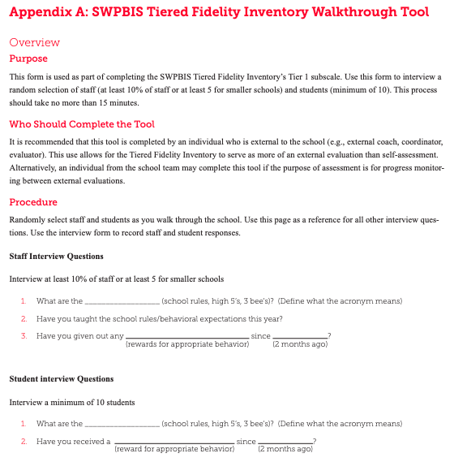
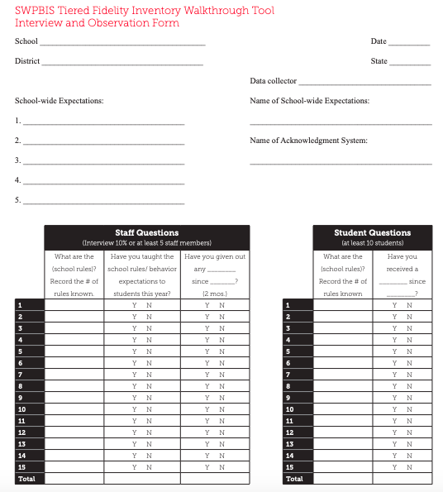
TFI Walkthrough: Appendix A
Notes:
The TFI Walkthrough Tool is Appendix A: pages 27-28 of the TFI. This is a tool that is used by a coach/external person to complete prior to the TFI. The first page provides an overview and the questions to ask staff and students. The second page is a place for recording the information. This provides an efficient way to calculate the percentages to assist with the TFI items.

Slide 45
TFI Item 2.5: Options for Tier II Interventions
Feature | Possible Data Sources | Scoring Criteria
Options for Tier 2 Interventions: Tier 2 team has multiple ongoing behavior support interventions with documented evidence of effectiveness matched to student need. | School Tier 2 handbook Targeted Interventions Reference Guide (aka Targeted Inventory) | 0 = No Tier 2 interventions with documented evidence of effectiveness are in use 1 = Only 1 Tier 2 intervention with documented evidence of effectiveness is in use 2 = Multiple Tier 2 interventions with documented evidence of effectiveness matched to student need

Slide 47
3.4 Student Support Team
Feature | Possible Data Sources | Scoring Criteria
Student Support Team: For each individual student support plan, a uniquely constructed team exists (with input/approval from student/family about who is on the team) to design, implement, monitor, and adapt the student-specific support plan. | Three randomly selected Tier III student support plans developed in the past 12 months (see Appendix C: TFI Tier III Support Plan Worksheet) | 0 = Individual student support teams do not exist for all students who need them. 1 = Individual student support teams exist, but are not uniquely designed with input from student/family and/or team membership has partial connection to strengths and needs. 2 = Individual student support teams exist, are uniquely designed with active input/approval from student/family (with a clear link of team membership to student strengths and needs), and meet regularly to review progress data.
Main Idea:
Each student receiving Tier III supports benefits from having an individualized team comprised of relevant stakeholders.

Slide 49
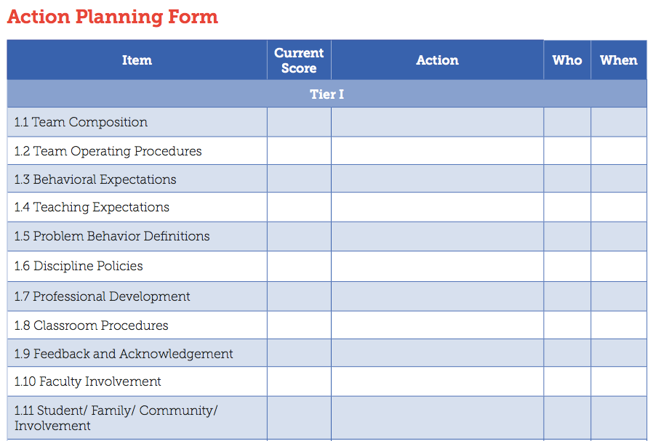
Action Planning Form
Notes:
Amy

Slide 50
Self-Assessment Survey (SAS)
Purpose: | Assess staff perceptions of PBIS practices in place and priority for changes Design annual action plan
Format: | Survey
Completed by: | All staff Manual or on-line scoring, graphing
When? | Annually, January - March
Notes:
Amy

Slide 51
Two Main Questions
What systems are in place now?
What systems are most in need of improvement?
Notes:
Amy

Slide 52
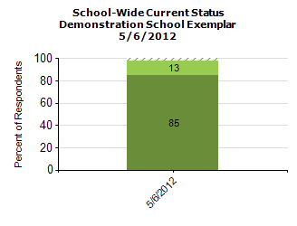
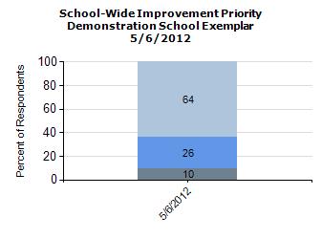
Total Score:
Notes:
Amy

Slide 53
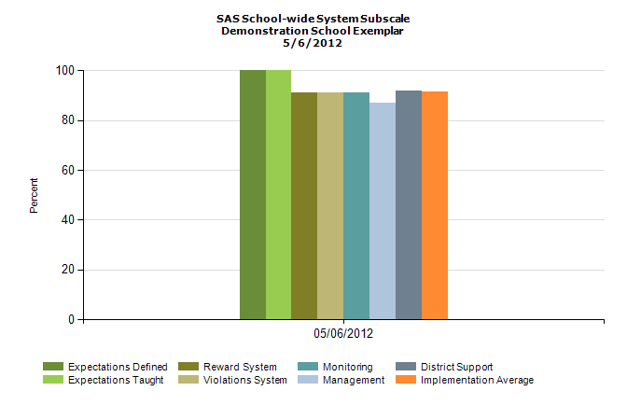
Subscale:
Notes:
Amy

Slide 54
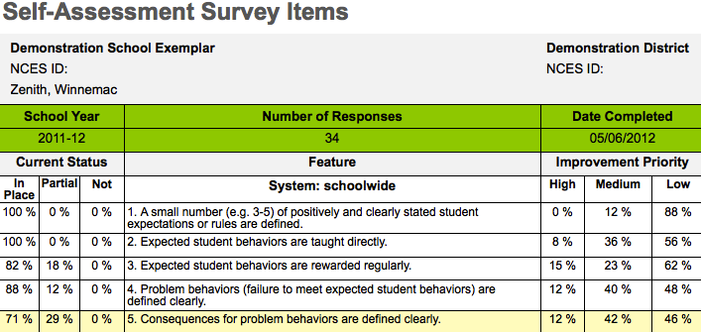
Items:
Notes:
Amy

Slide 55
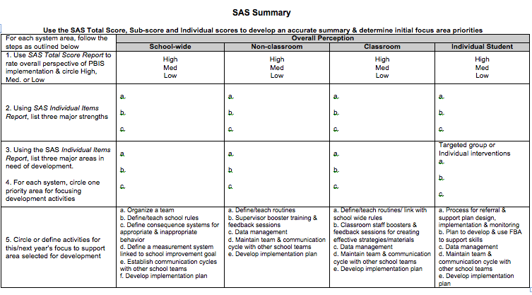
SAS Team Summary Tool
Notes:
Amy

Slide 56
Other Tools to Consider
TFI Learning Walks
PBIS School Climate Survey – students, staff, parents

Slide 57
For More Information
https://www.pbisvermont.org/evaluation/
www.pbisapps.org
*Note: Other fidelity measures (e.g., BOQ, BAT, etc.) will remain on the PBIS Apps website.
Notes:
Amy

Slide 58
Ways to Share Data
See Sample Data Presentation
Email a monthly report; give context, provide connections, and suggest next steps
Create a data wall focusing on data related to school-wide goals
Share data at monthly staff meetings. Invite all staff to participate in finding ways to improve outcomes
Present to parents, school boards, community
Involve students!!!
Notes:
Amy
It is always a good time remember the positive impact sharing data with staff can have on achieving the valued outcomes in your building. When the whole school understands the goals and sees progress from the efforts, everyone is more likely to embrace the interventions iimplemented to meet those goals. The best way to share data is the way that feels most natural, leads to effective decisions, and offers opportunities for everyone to engage in planning.

Slide 59
Responsibilities for Facilitating Data Review and Improvement Planning:
Schedule Data Days – Fall, Winter, Spring
Identify/enhance the role of the Data Analyst
Complete the TFI + SAS
Plan professional development around priorities identified through assessments
TIPS/SWIS learning module
Universal Screening
Training in classroom management, FBA/BSP, crisis prevention and intervention, other
Notes:
Amy
The leadership team plays a critical role in developing systems to support universal and targeted practices
Create procedures for all universal and targeted interventions.
Communicate to staff and families
Create links between universal and targeted systems

Slide 60
General Recommendations for PBIS Decision-Making
Never stop doing what is already working
Always look for the smallest change that will produce the largest effect
Avoid defining a large number of goals
Do a small number of things well
Do not add something new without also defining what you will stop doing to make the addition possible.
Notes:
Amy
Use data in “decision layers”
Don’t drown in the data
It’s “OK” to be doing well
Decisions are more likely to be effective and efficient when they are based on data.
The quality of decision-making depends most on the first step (defining the problem to be solved)
Define problems with precision and clarity

Slide 61
Upcoming Relevant Trainings
Data Days – full-day, in-person: November 20th
Lake Morey, Fairlee, VT
Universal Screening Webinar: December 4th
Coordinators Learning and Networking Meetings:
January 9 (North) + 10 (South)
May 7 (North) + 8 (South)
April Core PBIS Trainings

Slide 62
Resources
TIPS Meeting Minutes Template (Google Doc version)
Drill Down Video
TIPS Resources
TIPS Meeting Videos Including Academics
VT AOE Comprehensive Needs Assessment Toolkit

Slide 63
Questions?

