Slide 1

Universal Screening for Behavior and Implications for Interventions
Presented by Kym Asam, LICSW

Slide 2
Welcome!
You will be muted during this session, except during breakouts.
Need help?
Type into the chat box
You
can show or hide your video.
Materials can be found at: https://www.pbisvermont.org/training-resources/webinars/

Slide 3
Learning Objectives
Participants will:
Understand the context and rationale for identifying students at risk of social/emotional/behavioral challenges.
Consider several informal and formal screening tools
Identify the systems needed to implement Universal Screening
Discuss the process of matching results with proactive and preventative practices.
Examine the systems in place to collect, analyze and act upon data

Slide 4
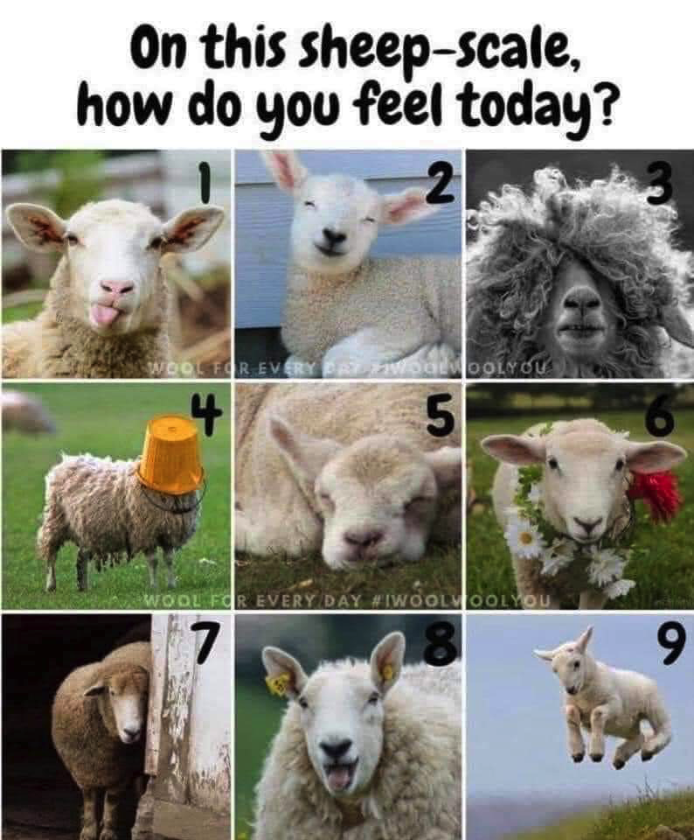

Slide 5
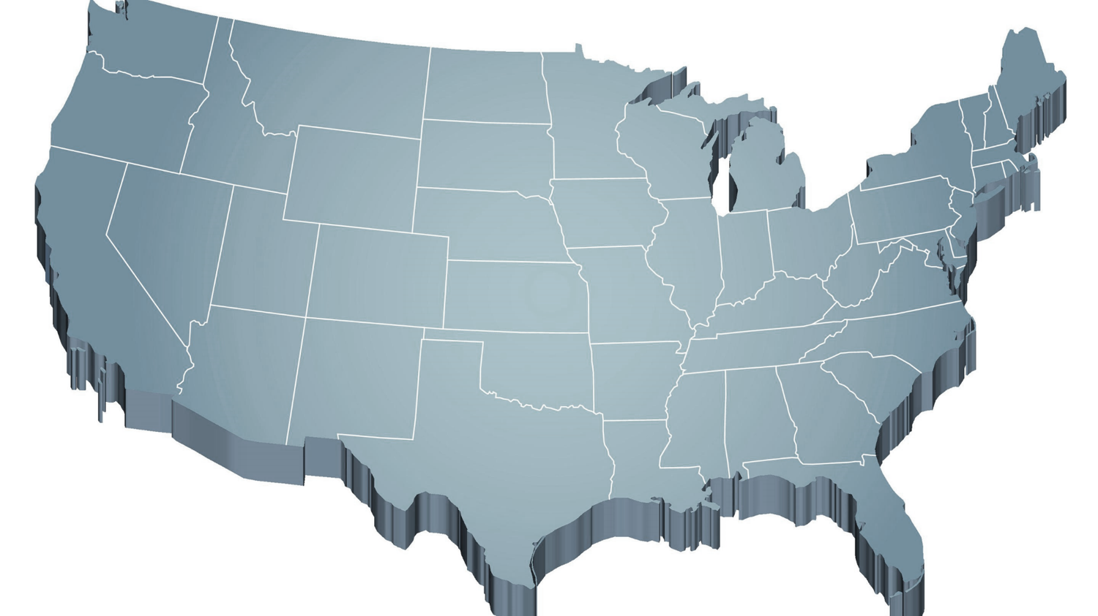
Shift to a systems level perspective
Internalizing
Externalizing
ED <1%
EBD 12-20%
Source: Forness, S.R., Freeman, S.F., Paparella, T., Kauffman, J.M., & Walker, H.M. (2012). Special education implications of point and cumulative prevalence for children with emotional or behavioral disorders. Journal of Emotional and Behavioral Disorders, 20, 4-18.

Slide 6


Context: Challenges and Opportunities

Slide 7
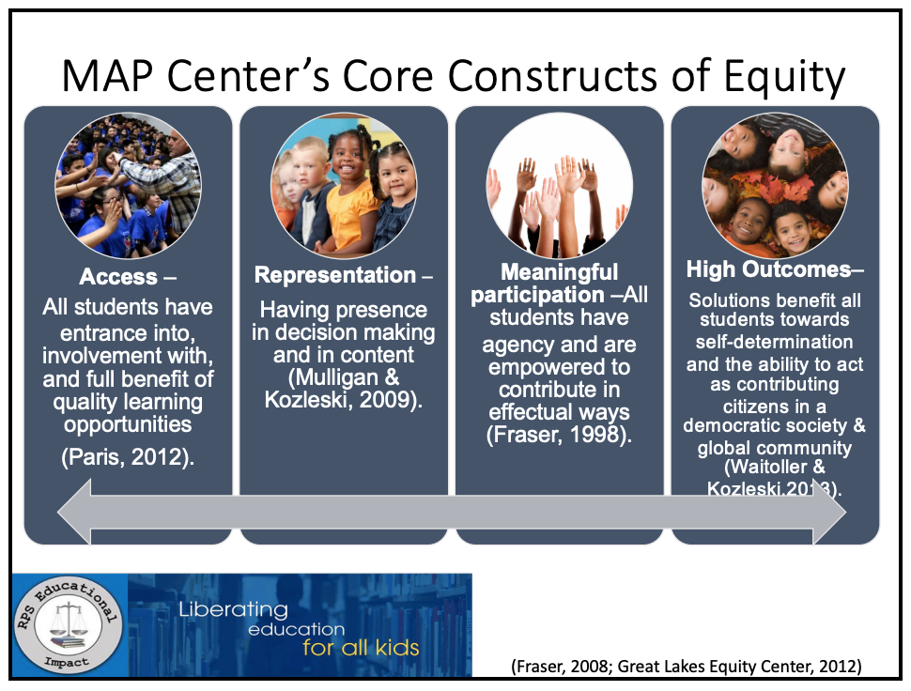

Slide 8
Educational Equity . . .
exists when educational policies, practices, interactions, and resources are representative of, constructed by, and responsive to all people so that EACH INDIVIDUAL has access to, meaningfully participates in, AND has positive outcomes from high-quality learning experiences, regardless of individual characteristics and group memberships.
(Fraser, 2008; Great Lakes Equity Center, 2012)

Slide 9
Access and Equity for All!
1-5% of Students may need Intensive Supports
Few
10-15% of Students may need Targeted Supports
Some
ALL Students!
Universal Practices in place for 100% of students
80% of Students should be successful when accessing Universal Supports

Slide 10
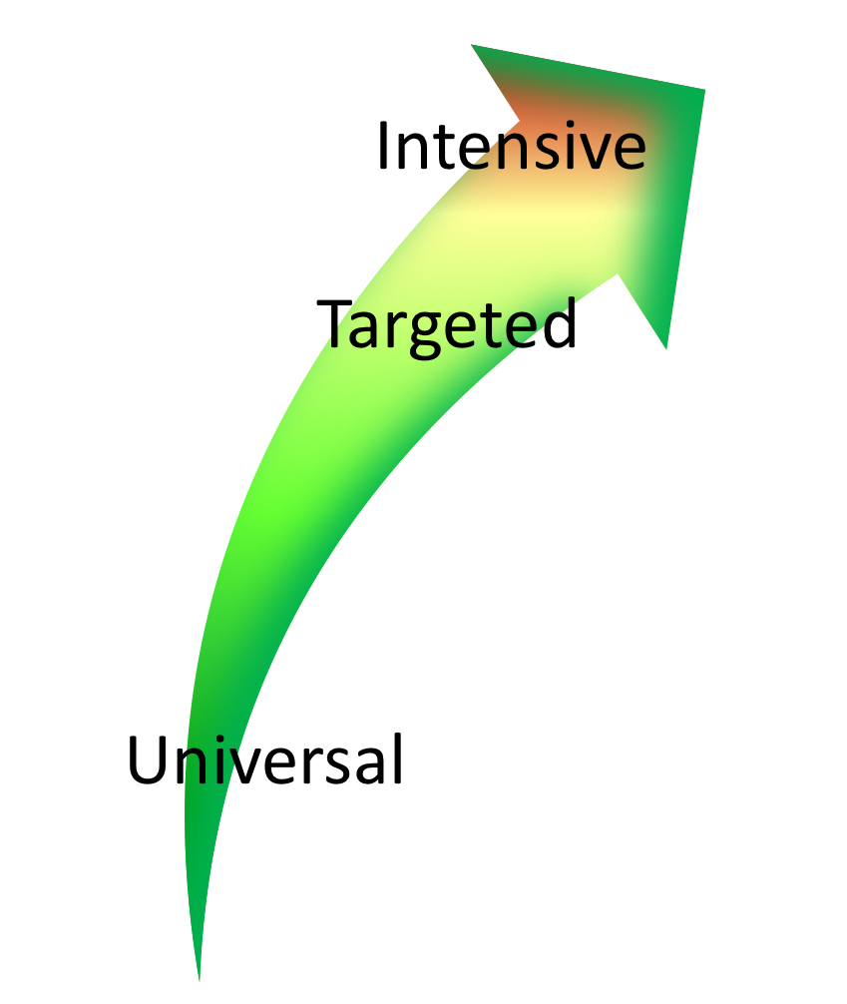

Continuum of Support Within
MTSS for Behavior and MTSS for Academics
Anger Mgt.
Math
Label Behavior, Not Students!
Science
Adult relationships
Attendance
Reading
Peer Interaction

Slide 11
Type into the chat box:
What data do you collect/use to assess the social/emotional/behavioral strengths and challenges at your school?
How do you use this data for decision-making?

Slide 12
Informal Screening Data Sources:
Attendance/Tardy data
Teacher/Counselor/Parent Concerns
Office Referral Data (Major and Minors)
Health Office Visits
Time Out of Classroom Logs
Academic Performance/Assignments Completed
Counseling Center Visits
Common Area Observations

Slide 13
Types of Data to Consider
Consider Community Data – MH, Substance Abuse, Homelessness, Placement, etc.
Intensive:
TFI
I-SWIS
EST
FBA/BSP
Targeted:
TFI
SWIS-CICO
EST
FBA/BSP
Universal Screening
Universal:
TFI
SAS
SWIS
Attendance
Grades
School Climate
Family Engagement
Weekly Check-In

Slide 14
Screening data helps us ask the right questions.
They do not provide the answers.

Slide 15
What is social/emotional/behavioral screening?
Assessment of early signs of social risk or behavior problems, as well as the presence of resilience factors and indicators of wellbeing.
Mechanism for supporting students who need additional supports after receiving evidenced-based universal social/emotional/behavioral supports (i.e. PBIS)

Slide 16
Two methods of Screeners and Surveys
Informal Screeners
Formal SEBL Screeners
Ways to check-in with students frequently and with staff and families regularly to identify support needs as they emerge
Ways to get input from students, families, and staff about well-being and/or climate at the school
Validated instruments that focus on social/emotional/behavioral risks and strengths.
A reliable method for determining students with elevated levels of risk.

Slide 17
Informal Screeners – why and what
Students must feel physically and psychologically safe in order to actively engage in learning
Invite voice, choice, and ownership
Help identify students or staff perhaps at higher risk for significant stress or trauma from COVID-19
Establish most efficient and effective use of MH providers, school psychologists, school counselors, community partners

Slide 18
Methods of Screening
Surveys
Circles
Phone calls
Drive-by visits
Advisories
Video-chat/face-time
Using existing data
What else?

Slide 19
Screening Using Existing Data
Student | GPA | Course Failures | Days Absent | Concerning Behaviors
Josh | 3.1 | 0 | 2 | 0
Mary | 4.1 | 0 | 0 | 0
Kelly | 2.8 | 1 | 0 | 1
Jacob | 1.4 | 3 | 11 | 12
Susan | 3.5 | 0 | 3 | 0
Mark | 1.9 | 1 | 5 | 7

Slide 20
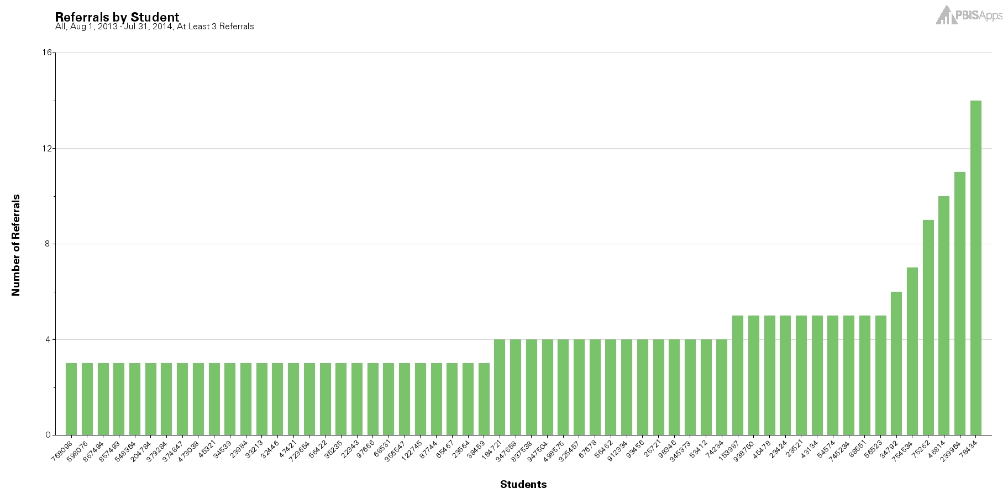

Using the Concerning Behaviors (Referrals) by Student Report as a Universal Screening Tool

Slide 21
Survey Resources
Closegap – wellness check
Making Caring Common – Relationship Mapping, Check-in Surveys for Middle/HS
PBIS Center – Check-in/Check-out Survey, Input and Satisfaction Surveys
WestEd – Learning from Home Survey
Panorama – Question bank of surveys for students, educators, and parents
See document here.

Slide 22
Please Type Into Chatbox:
What other data might your “team” look at to determine supports needed?

Slide 23
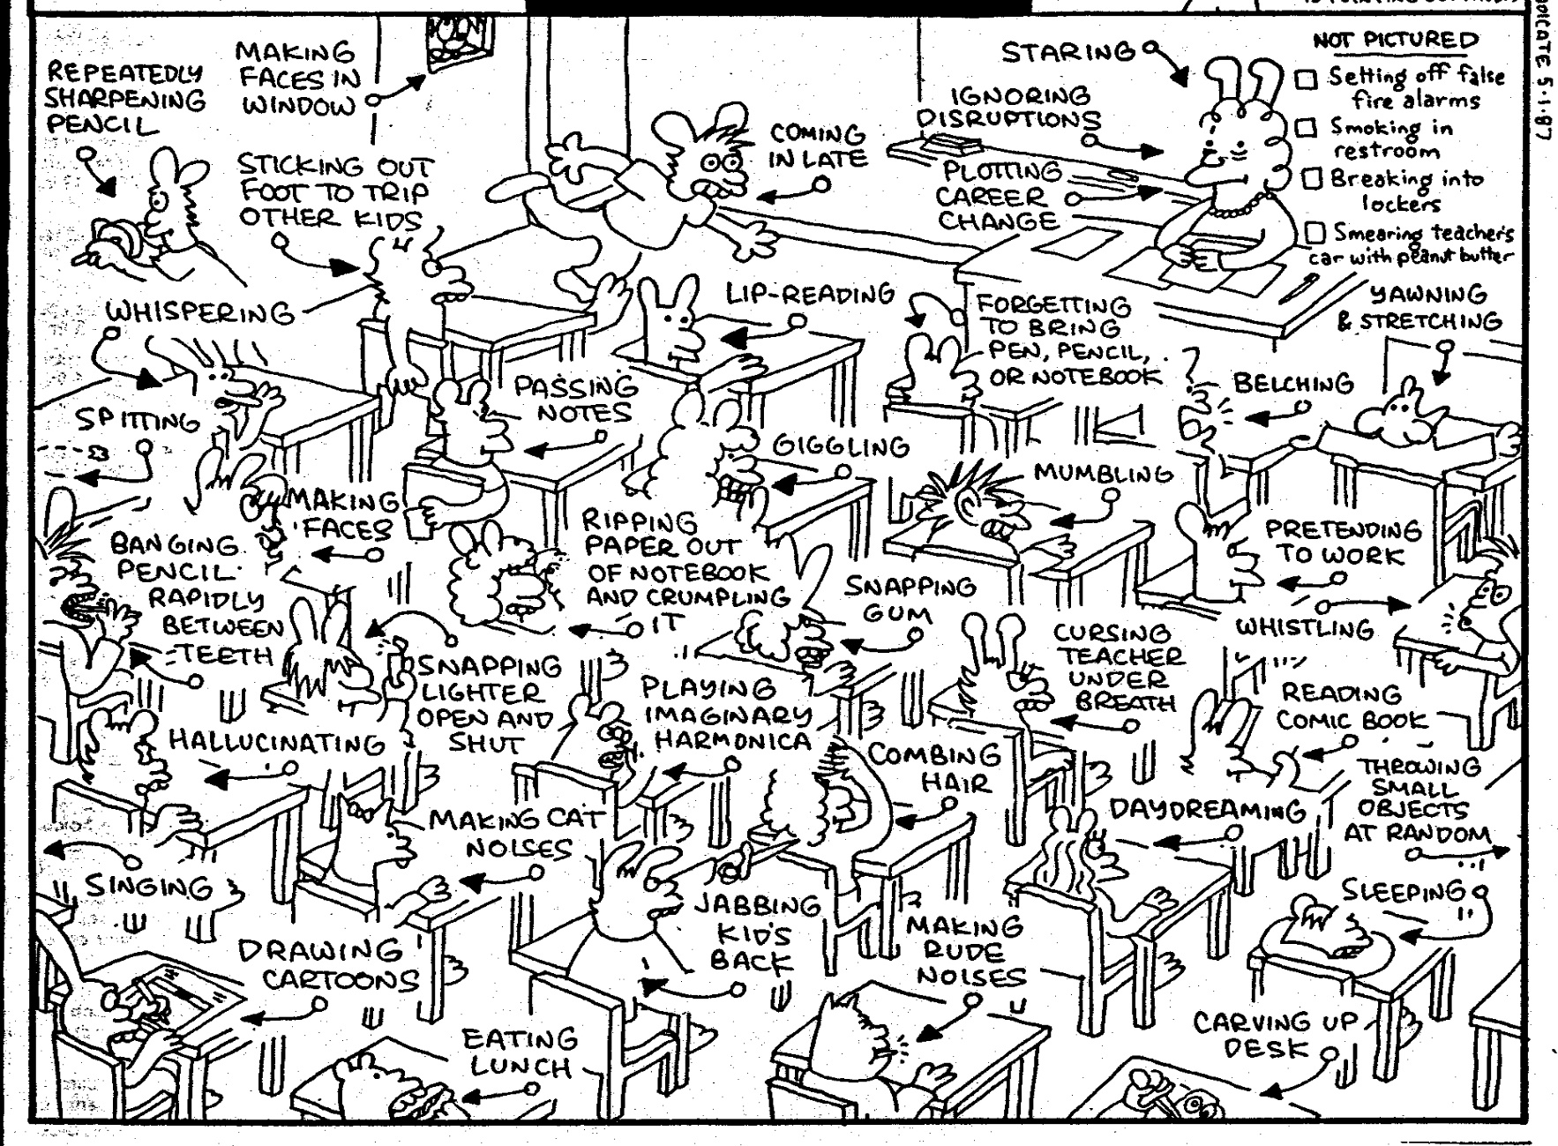
How do we formulate an accurate measure of risk?

Slide 24
Why (Formal) Universal Screening?
To find students whose problems are not immediately obvious.
To identify problems with a high degree of accuracy.
Early identification leads to early intervention.
To select interventions based on results of rating scales on the screening tools. This is most effective and efficient.

Slide 25
Poor Outcomes for Unidentified and Untreated Youth
Poor grades
Impaired personal relationships
High school dropout
Unemployment
Incarceration
Substance abuse
Suicide

Slide 26
Please Type Into Chatbox:
Is your school implementing a Social/Emotional/Behavioral Screener? If so, what tool are you using?

Slide 27
When to Screen?
At least 6-8 weeks into the school year and 2-3 times/year (Oct and Feb)
  Need enough time for observation, interaction, and experience with a student so ratings are reliable and valid. You need to KNOW THE STUDENT!
  If done too early and too quickly, the results will largely be invalid, the needed treatment directions will be unclear (or incorrectly focused)
Review process and tools with all staff prior to screening

Slide 28
Screening can help identify:
Students with externalizing problems?
Students with internalizing problems?

Slide 29
Multi-Stage & Multi-Gate Approach to Screening
Universal Screen
Elevated? Screen #2
Elevated? Request for assistance
Not elevated? Done.
Not elevated? Done.
Stage 1
Stage 2
Stage 3

Slide 30

What to do with screening data/information?

Slide 31
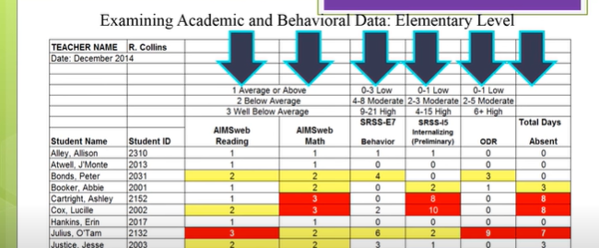
The comprehensive picture

Slide 32
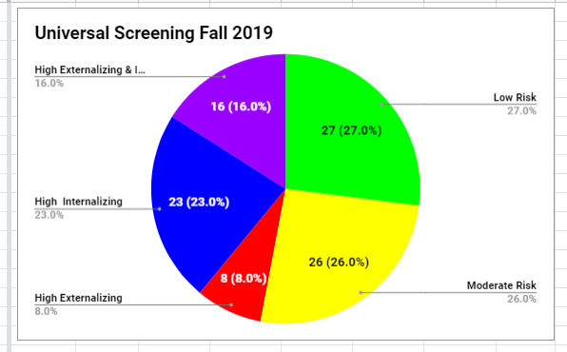
Dothon Brook Example

Slide 33
Connecting Results from Screenings to Interventions
Intervention: | Target Population: | Evidenced to Address:
Second Step | Grades K-6 | Prosocial skills Violence prevention
Botvin Life Skills | Grades 7-12 | Prosocial skills Substance use prevention
Support for Students Exposed to Trauma | Grades 4-9 | Address impact of trauma
Check In, Check Out | Grades K-12 | Reteach expectations, increased adult attention
Small group instruction of needed skills (social, coping, problem solving) | Grades K-12 | Reteach lessons from curriculum available at T1
MATCH-ADTC (anxiety, depression, trauma, conduct) | Grades K-12 | Modular approach to address less intense presenting problems
Coping Cat | Grades 2-8 | Address impact of anxiety
Bounce Back | Grades K-5 | Address impact of trauma
SPARCS | Grades 6-12 | Address impact of trauma
Aggression Replacement Training | Grades 6-12 | Address physical aggression
TF-CBT | Grades K-12 | Address impact of trauma

Slide 34

What Screening Tools are out There?
https://www.ci3t.org/screening

Slide 35
Systems Considerations
Identified as priority
Resources secured
Team in place
SEB curriculum in place
Families informed
Ethical/legal –
Policies/procedures
Process for selecting screener
Tier 1 interventions with fidelity
EST ready to act on data
Interventions implemented
Roll-out
Commitment to continued inquiry
Screening Systems Considerations Assessment

Slide 36

Another amazing resource!
https://smhcollaborative.org/wp-content/uploads/2019/11/universalscreening.pdf
_

Slide 37
What’s Next?
Review Screening Systems Considerations Assessment
Determine where is your school in this process
Review and select tools

Slide 38


Slide 39


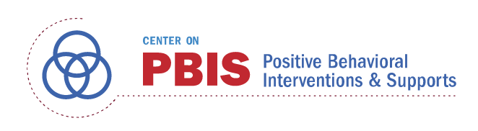




Acknowledgements

