Slide 1

PBIS and School Mental Health
Howard Center School Professional Development
August 20, 2018

Slide 2
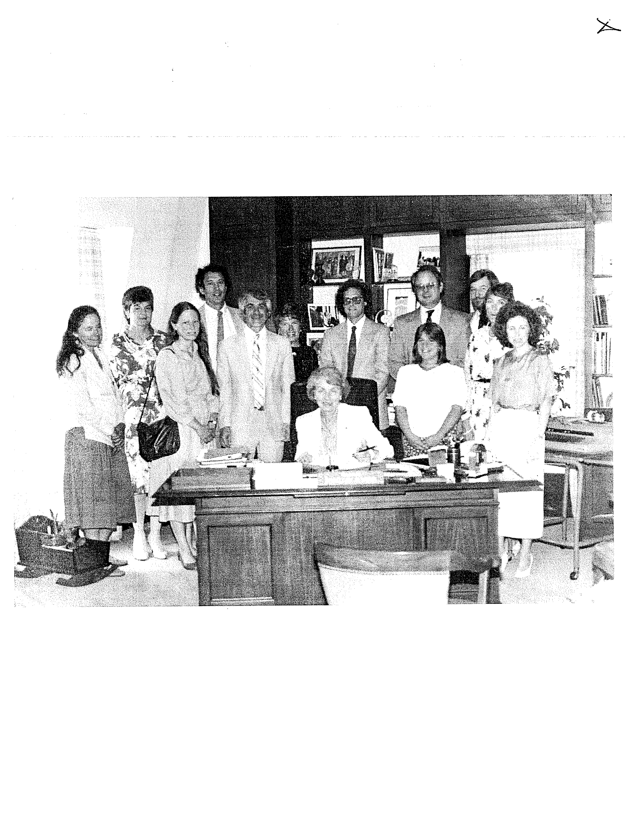
A little about me..

Slide 3
A little about you…
How many of you know if you are working in a PBIS school?
How many of you are unsure?
What is your current knowledge about PBIS?
I know a lot
I know a little bit
I’m just learning about it
Notes:
How many of you know if you are working in a PBIS school?
How many of you are unsure?
What is your current knowledge about PBIS?
I know a lot
I know a little bit
I’m just learning about it

Slide 4
Today’s Objectives:
Develop a common understanding of the PBIS framework
Explore the rationale behind MH and PBIS integration
Understand how the role of the MH clinician can fit into the PBIS framework
Consider some strengths, challenges and next steps
Share resources

Slide 5
THE PBIS FRAMEWORK

Slide 6
What is School-wide PBIS?
Framework for enhancing adoption & implementation of
Continuum of evidence-based interventions to achieve
Academically & behaviorally important outcomes for
All students

Slide 7
Advantages
Promotes effective decision making
Improves climate & learning environment
Changes adult behavior
Reduces punitive approaches
Reduces OSS and ODRs
Improves student academic performance
Notes:
A well tested framework for ensuring effectiveness;

Slide 8
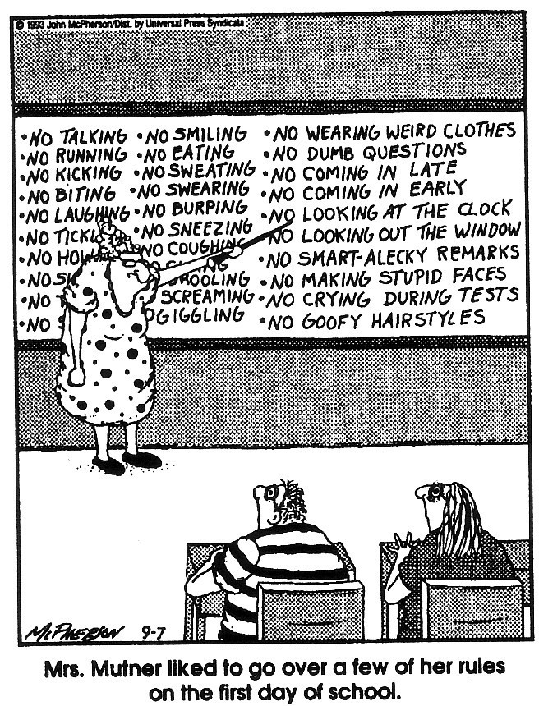
(Close to Home c Reprinted with permission of Universal Press Syndicate. All rights reserved.)

Slide 9
PBIS and ABA:
Understanding the Connections
Positive Behavior Interventions and Supports (PBIS) emerged from Applied Behavior Analysis (ABA), established in the 1960’s as an approach to problems of behavior adaptation.
Notes:
Positive Behavior Interventions and Supports (PBIS) emerged from Applied Behavior Analysis (ABA).
Many contributors to PBIS are ABA practitioners.
Most direct linkages involve the work with students who have the most complex needs.
PBIS has its roots in applied behavioral analysis. Many of you are ABA trained or perhaps have your BCBA. Your training can contribute significantly to the work of PBIS in schools.
History - ABA emerged as a discipline in the 60’s with it’s focus on helping people change behavior so it was socially adaptive in society..
The early founders of ABA moved the scientific techniques of behavior analysis and the experimental analysis of behavior (Sidman, 1960; Skinner, 1953) to the realm of real human problems.
Movement away from experimenting on behavior to real human problems.
Initially PBIS was developed as an alternative to aversive interventions used with students with severe disabilities who engaged in extreme forms of self-injury and aggression (Durand & Carr, 1985; Meyer & Evans, 1989).
PBIS has been applied successfully with a wide range of students in a wide range of contexts (Carr et al., in press; Horner, Albin, & O'Neill, 1991).
PBIS has extended from an intervention approach for individual students to an intervention approach for entire schools (Colvin, Sugai, Good, & Lee, 1996; Colvin, Kame'enui & Sugai, 1993; Lewis, Colvin, & Sugai,in press; Lewis, Sugai & Colvin, 1998; Taylor-Greene, et al., 1997; Todd, Horner, Sugai, Sprague, 1999; Sugai, Sprague, Horner, Walker, in press).
9

Slide 10
Who Benefits from PBIS? Everyone!
Intensive individual interventions
5%
Targeted small group, short term individual interventions
15%
Universal practices ~
in place for 100% of the school population
80%

Slide 11
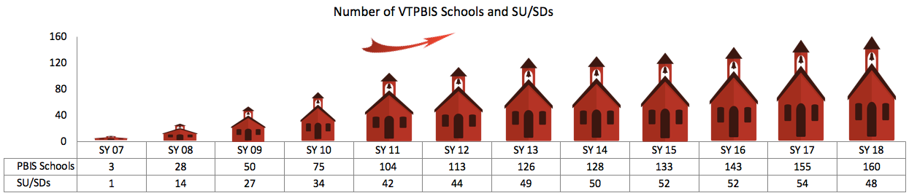
Sustainability of VTPBIS Over Time

Slide 12
PBIS
Supporting
Staff Behavior
Supporting
Decision
Making
SYSTEMS
DATA
PRACTICES
Smallest effort
Evidence-based
Biggest, durable
effect
Supporting
Student Behavior
Notes:
5 Components of MTSS cuts across Data, Systems and Practices

Slide 13
Universal
Targeted
Intensive
Continuum of Support for “Dylan”
Anger Mgt.
Math
BEHAVIOR
LABEL__________
NOT
_______________
Science
Adult relationships
STUDENTS!
Attendance
Reading
Peer Interaction
Notes:
LABEL BEHAVIOR
NOT
STUDENTS!

Slide 14
Supporting
Staff Behavior
Supporting
Decision Making
OUTCOMES
Systems
Data
Practices
Supporting Student Behavior
Notes:
3
PRACTICES

Slide 15
School-wide (Universal/Tier 1) PBIS is about..
Defining behavior expectations
Teaching expected behavior
Acknowledging expected behavior
Discouraging problem behaviors
Creating procedures for record-keeping and decision making

Slide 16
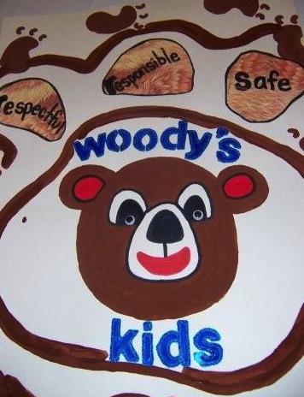
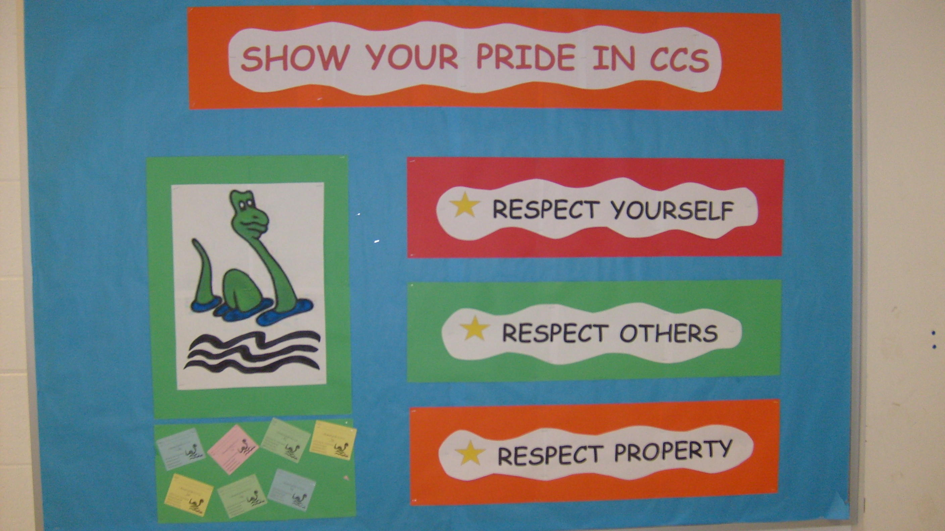
Defining Behavior Expectations:
Few in number,
positively stated, and
in behavioral terms.
Example:
Be Safe
Be Respectful
Be Responsible

Slide 17
Do you know the behavioral expectations of the PBIS schools that you work in?

Slide 18
Teaching Behavior Expectations:
Teaching Matrix |  | SETTING
 |  | All Settings | Hallways | Playgrounds | Cafeteria | Library/ Computer Lab | Assembly | Bus
 | Respect Ourselves | Be on task. Give your best effort. Be prepared. | Walk. | Have a plan. | Eat all your food. Select healthy foods. | Study, read, compute. | Sit in one spot. | Watch for your stop.
 | Respect Others | Be kind. Hands/feet to self. Help/share with others. | Use normal voice volume. Walk to right. | Play safe. Include others. Share equipment. | Practice good table manners | Whisper. Return books. | Listen/watch. Use appropriate applause. | Use a quiet voice. Stay in your seat.
 | Respect Property | Recycle. Clean up after self. | Pick up litter. Maintain physical space. | Use equipment properly. Put litter in garbage can. | Replace trays & utensils. Clean up eating area. | Push in chairs. Treat books carefully. | Pick up. Treat chairs appropriately. | Wipe your feet. Sit appropriately.
2. NATURAL CONTEXT
1. SOCIAL SKILL
Expectations
3. BEHAVIOR EXAMPLES
Teaching & Lesson Plans
Notes:
Behavioral errors more often occur because:
Acquisition Deficits (can’t do)
Performance Deficits (won’t do)
Fluency Deficits (not enough practice)
Repetition is key to learning new skills:
For a child to learn something new, it needs to be repeated on average of 8 times
For a child to unlearn an old behavior and replace with a new behavior, the new behavior must be repeated on average 28 times (Harry Wong)

Slide 19
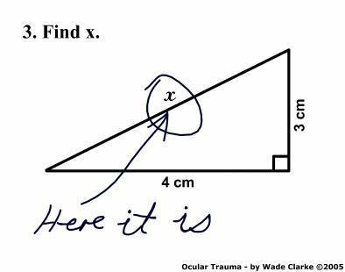
Teaching Expectations:
Be Explicit

Slide 20
What role do you/can you play in teaching lessons about the behavior expectations? How could these lessons be shared with families?

Slide 21
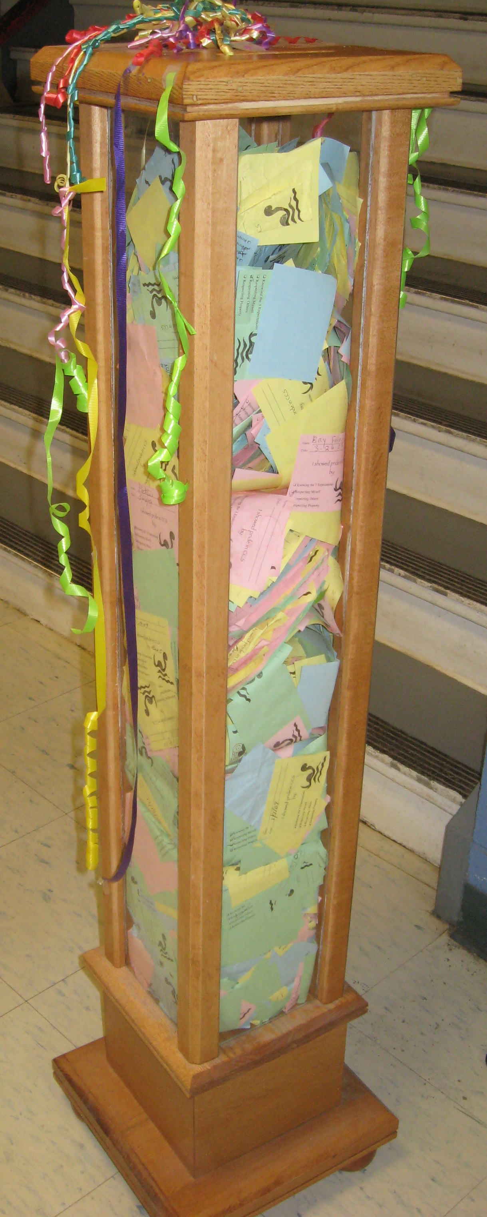
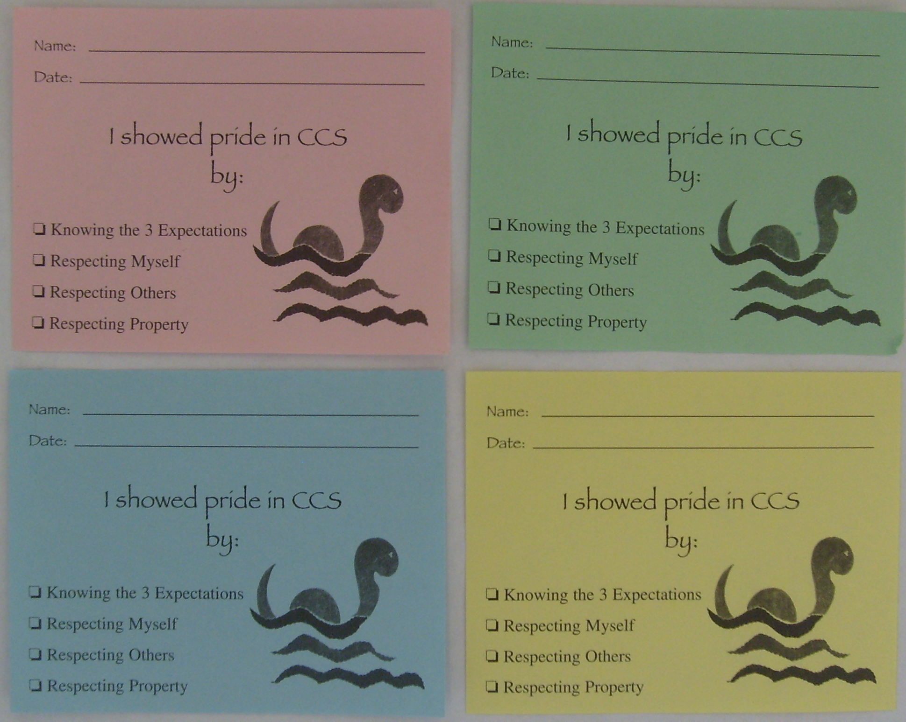
Acknowledging Behavior:
Providing students feedback to let them know when and how they are meeting expectations (positive acknowledgement)

Slide 22
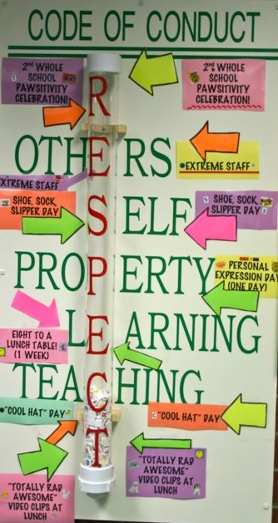

Slide 23

PBIS Big Ideas!
PBIS is about changing adult behavior
We are trying to achieve a ratio of 6-8 positive to 1 negative adult-student interaction

Slide 24
  In your role within a school, how can you use the following school-wide (Tier 1) practices with your students?
  Defining Behavior Expectations
  Teaching Behavior Expectations
  Rewarding Behaviors

Slide 25

Discouraging Problem Behavior:
  Consistent practices for preventing problem behaviors
  Distinguishing between minor and major behaviors
  Practices for responding to problem behaviors
  Continuum of procedures for responding to problem behavior

Slide 26

Preventing Problem Behavior:
Increase “Opportunities to Respond”!
Good classroom management – Move, Scan, Interact!
De-Escalation Techniques:
When a student is Anxious…..Be Supportive!
When a student is Defensive…..Be Directive!
Notes:
De-Escalation Tecniques:
When student shows anxiety….Be supportive!
What does anxiety look like?
What can adults do to be supportive?
When student is defensive…Be directive!
What does defensive behavior look like?
What can adults do to be directive?

Slide 27
Discouraging Problem Behavior:
  Procedures for responding to problem behaviors….

Slide 28
  How do you/can you collaborate with school staff to develop common strategies for your students in the following areas?
  -Preventing problem behaviors
  -Responding to problem behaviors
  -Following school procedures for
  -responding to problem behaviors

Slide 29
Continuum of Supports at the Targeted/Intensive Levels
Small group interventions
Group interventions with individualized focus
Simple FBA with individual interventions
Multiple-domain FBA/BIP
Wraparound
Needed when students have more than two office discipline referrals or when requested

Slide 30
Examples: Targeted Interventions Based on Functions of Behavior
Access Adult Attention/Support:
  Check-In/Check-Out
  Adult Mentoring Programs
Access Peer Attention/Support:
  Social Skills Instruction
  Peer Mentoring
  Self-Monitoring with Peer Support (function: academic task escape)
Academic Skills Support
  Organization/Homework planning support
  Homework completion club
  Tutoring

Slide 31

Function Based Supports for Challenging Behaviors at School
Why is the behavior occurring, what’s its function?
Check progress. Did plan work?
If not, review & revise.
Behavior plan includes function-based strategies
Prevent behavior from occurring
Teach replacement behaviors
Respond differently to reduce intensity

Slide 32
Building Supports along the Tiered Framework
Universal practices should be incorporated into behavior support plans – school-wide expectations, PBIS lesson plans, reinforcement, and strategies for discouraging problem behavior
All students should have access to the school-wide acknowledgement system. They may also need something in addition and at more frequent intervals to help shape their behavior.

Slide 33
Supporting
Staff Behavior
Supporting
Decision Making
OUTCOMES
Systems
Data
Practices
Supporting Student Behavior
Notes:
3
PRACTICES

Slide 34
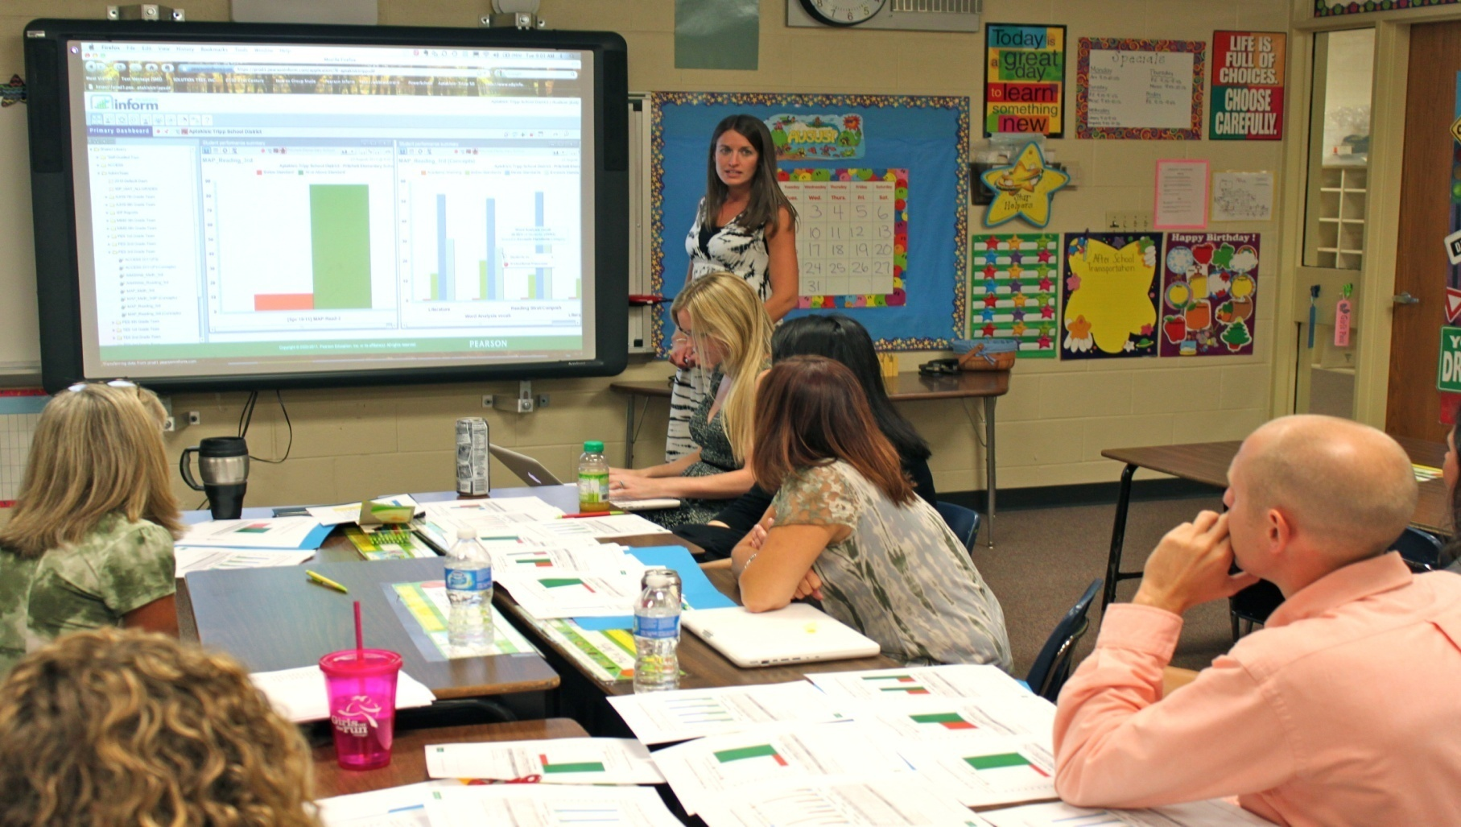
Moving Away from Admiring the Problem
Notes:
Teams meeting regularly to:
Review their data
Determine if PBIS practices are being used
Determine if PBS practices are being effective
Identify the smallest changes that are likely to produce the largest effects
But focusing on the use of evidence-based practices

Slide 35
Types of Data to Consider:
Intensive:
TFI
SWIS-ISIS
EST
FBA/BSP
Targeted:
TFI
SWIS-CICO
EST
FBA/BSP
Universal Screening
Universal:
TFI
SAS
SWIS
Attendance
Grades
Leadership Team Self-Assessment
Notes:
What else?

Slide 36
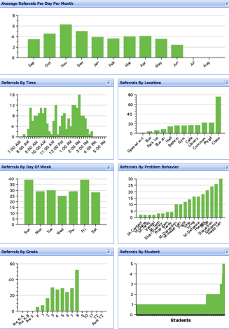
Student Outcome Data:
Avg. Referrals Per Day Per Month
Time
Location
Day of Week
Problem
Behavior
Grade
Student

Slide 37

Process for Problem-Solving/
Decision-Making:
Prevention: | Remove/alter “trigger” for problem behavior
Teaching: | Define, instruct & model expected behavior
Reward: | Expected/alternative behavior when it occurs; prompt as necessary
Extinction: | Increase acknowledgement of presence of desired behavior
Corrective Consequence: | Use non-rewarding/non-reinforcing responses when problem behavior occurs
Data Collection: | Indicate how you know when you have a solution
Notes:
This slides illustrates how we use
Prevention
Teaching
Rewards
Extinction
Corrective Consequences and
Data Collection to address disruption in the cafeteria

Slide 38
Supporting
Staff Behavior
Supporting
Decision Making
OUTCOMES
Systems
Data
Practices
Supporting Student Behavior
Notes:
3
PRACTICES

Slide 39
Necessary Conversations (Teams)
Tier 1
Tier 2
Tier 3
SU/District Team
•Coordinates implementation
•Ensures access to resources
•Reviews data across schools
SU/District Team – Targeted/Intensive:
•Secures resources
•Focuses on student outcomes
•Focuses on fidelity of practices across the district/SU
SU/District
School Leadership Team
•Plans and implements 6 school components of PBIS
School Systems Level Team – Targeted/Intensive:
•Creates procedures for referral, screening & evaluation
•Communicates with staff and families
School
Student Level Team
•Matches students to interventions
•Evaluates & monitors student progress
Student Level Team
•Completes FBA/BIP
•Evaluate & monitor student progress
Facilitates wraparound
Student

Slide 40
Stages of Implementation
Implementation of an “innovation” (PBIS)
occurs in stages
Exploration
Installation
Initial Implementation
Full Implementation
Innovation
Sustainability
2-4 years
Fixsen, Naoom, Blase, Friedman, & Wallace, 2005

Slide 41
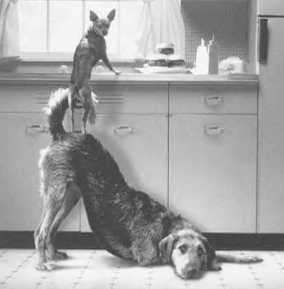
Mental Health supports are needed at every level of PBIS!
Notes:
visual

Slide 42
Why Partnerships are needed:
About 20% of children need MH intervention
About 70% of those get no treatment
School is “defacto” MH provider
School is ideal environment to promote protective factors and positive social/emotional development
It is challenging for educators to address the factors beyond school
It is challenging for community providers to address the factors in school

Slide 43
PBIS Provides a Solid Foundation…. but More is Needed…
Many schools implementing PBIS struggle to implement effective interventions at Tiers 2 and 3
Youth with “internalizing” issues may go undetected
PBIS systems (although showing success in social climate and discipline) often do not address broader community data and mental health prevention.

Slide 44
Enter…Interconnected Systems Framework (ISF)!
  Tiered prevention logic
  Cross system problem solving teams
  Use of data to decide which evidence based practices to implement.
  Progress monitoring for both fidelity and impact.
  Active involvement by youth, families, and other school and community stakeholders.
  http://www.pbis.org/school/school_mental_health/interconnected_systems.aspx
Notes:
Features:
Effective teams that include community mental health providers
Data-based decision making
Formal processes for the selection & implementation of evidence-based practices (EBP)
Early access through use of comprehensive screening
Rigorous progress-monitoring for both fidelity & effectiveness
Ongoing coaching at both the systems & practices level

Slide 45
  MH Clinician as Social Emotional Leader in the School
Systems
  Coach and consult at Tier 1
  Coach and coordinate systems, teams, and interventions at Tier 2
  Coach and facilitate individualized teams and work with directly with individuals
  Facilitate training and support to administrators, teachers, other stakeholders
Data
  Universal Screening
  Progress Monitoring
  Contributing Home and Community Data
Practices (to provide and train)
  Social Skills
  Classroom practices
  Restorative Practices
  Function-based Thinking
  MH Diagnoses and Concerns

Slide 46
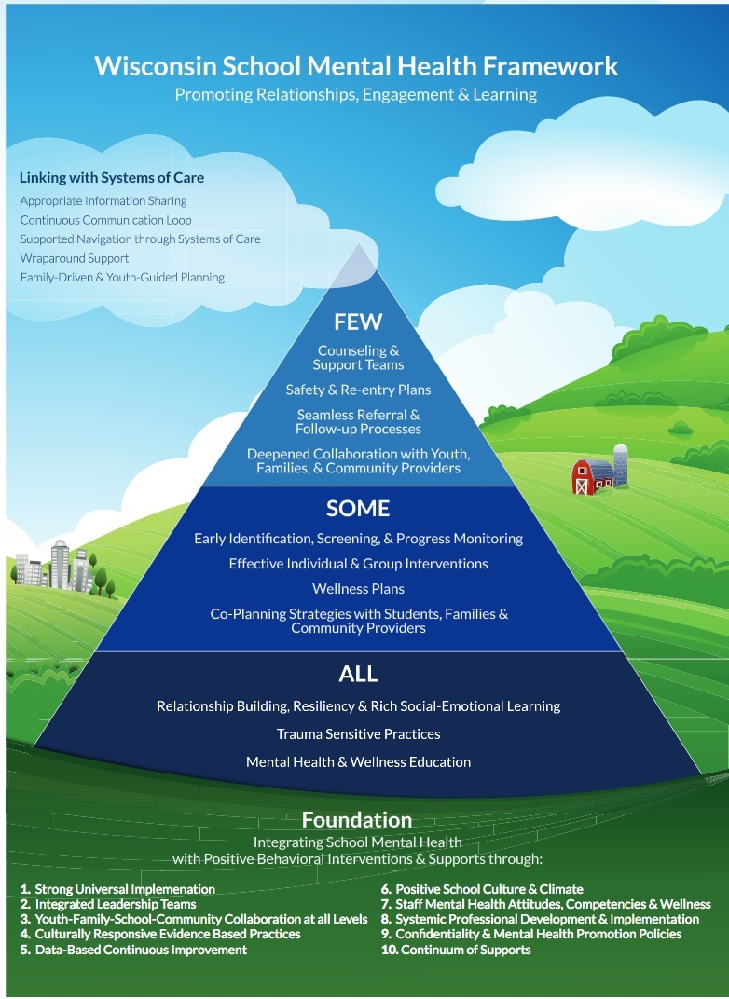

Slide 47
What Would it Take?
Change in roles and functions of staff
Change in routine and procedures
Change in how interventions are selected and monitored
Professional development of MH Clinicians
Change in the language we use
What else?

Slide 48
Strengths of this Approach
Most efficient use of expertise and resources
Greater opportunity to expand services and supports beyond the school
Continuity of care between home and school
Howard Center agreements are already in place
Funding can support this change
What else?

Slide 49
Challenges of this Approach
This is not what you were trained to do
Changing roles can be threatening
Professional development and Community of Practice is needed for MH Clinicians

Slide 50
Next Steps
Engage your school and MH leaders in a dialogue about PBIS/MH interconnections
Can you become members of the systems level teams?
Do a gap analysis of what is in place and what’s missing?
Examine what kind of PD you might need and create a plan
Attend the VTPBIS Leadership Forum on October 10th
What else?

Slide 51


Slide 52
Resources
www.pbis.org
www.pbisvermont.org
PBIS/MH Practice Brief: https://www.pbis.org/Common/Cms/files/Forum15_Presentations/RDQ%203%20Brief%20-%20Clinician%20Role.pdf
Family engagement resources at: http://www.pbisvermont.org/resources/for-families/family-resources
  Interconnected Systems Framework: http://www.pbis.org/school/school_mental_health/interconnected_systems.aspx

