Slide 1
May 11, 2020
Intro to Function-Based Thinking (FBT)
Presented by: Jeremy Tretiak MA, BCBA, VT-LBA

Slide 2
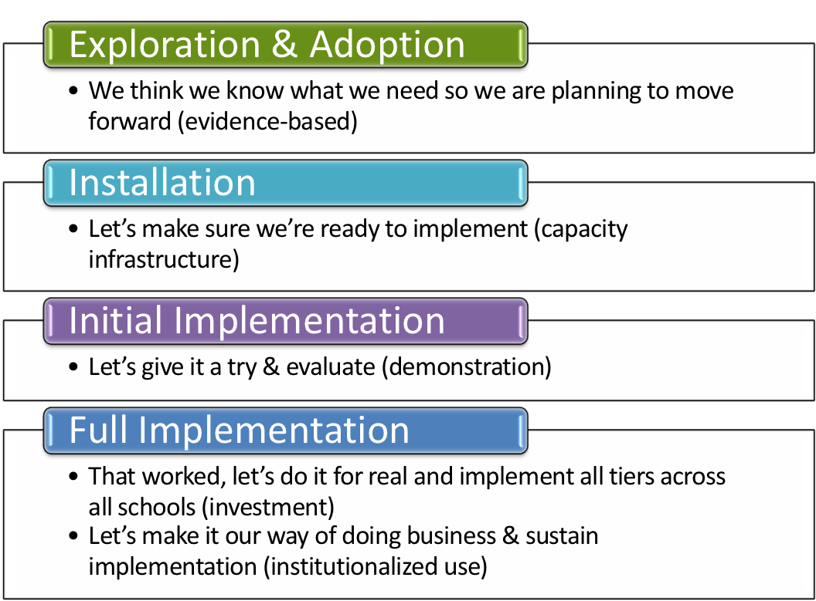
Where is your school in the implementation process?
Adapted from Fixsen & Blase, 2005
Notes:
Emphasis is that you have identified that you have a need. How did you identify it? Is it climate, behavioral challenges, both? Why do you want to explore an evidence based practice?

Slide 3
Objectives
By the end of this session, you will have improved your ability to:
determine the function of a student’s challenging behavior
choose an effective, function-based response to a student’s challenging behavior
understand how your behavior influences others’ behavior

Slide 4
FBA Thinking (FBT)—What is it?
Based on the more thorough concept of FBA = Functional Behavior Assessment
Always considers how the environment influences behavior—environment shapes behavior
A model for systematically defining problem behaviors, assessing the environment, and selecting interventions that match the function of behavior.
Notes:
Teri

Slide 5
The Continuum of FBA
 | FBA Thinking (FBT) | SIMPLE | COMPLEX
FOR | On the spot decision-making about effective responses (i.e. consequences) to student’s challenging behaviors | High frequency behaviors that are not dangerous or only mildly to moderately disruptive, may occur in only 1-2 settings | Dangerous behaviors or highly disruptive behaviors that persistently occur in 3 or more school settings
WHAT | A way of thinking about why a student is engaging in a challenging behavior, and how you can respond in a way that will effectively reduce the behavior | Relatively simple and efficient process to gather data to hypothesize about the function of behavior and use this information to guide behavior support planning | Time-intensive process involving gathering information from multiple sources, a written FBA and BSP, emergency planning, family-centered planning, and collaboration with outside agencies
BY WHOM | You! | Team of school-based personnel (ex: teachers, special educator, counselor, administrator, behavior support personnel) | School-based team, including professionals trained to develop and implement intensive interventions for students with severe problem behaviors (i.e. behavior specialist)
EVERYONE!

Slide 6
Benefits
More effective interventions/responses to behavior—it’s an evidence-based approach!
Early, ongoing intervention can stop new onset behaviors from becoming entrenched
Time savings for teachers and administrators due to reduced problem behaviors
Using FBT improves efficiency of higher intensity intervention
Notes:
*Emphasize ‘ongoing nature’ of FBT (vs. a formalized one-time process)

Slide 7
Behavior Pathway—ABC’s
Setting Events/
Conditions
Antecedent
(A)
Behavior
(B)
Consequence
(C)
F u n c t i o n
Notes:
7
Function can be determined once a pattern is established.

Slide 8
The Word “Consequence”
Definition: Anything that happens after a behavior.
Consequences can either:
Encourage (increase some dimension of) behavior
or
Discourage (decrease some dimension of) behavior
Past consequences influence likelihood the behavior will occur currently and in the future.
Patterns in consequences help us understand function.

Slide 9
How About Antecedents?
1
2
3
Setting Events/
Conditions
Antecedent
Behavior
Consequence
1 = Environmental control strategies
2 = Prompting and cueing strategies
3 = Consequence-based strategies
Notes:
9
Discuss ‘opportunities for intervention’—describe stop light analogy
Effects of environmental control—describe sledding hill analogy
Leads to a more thorough understanding of function

Slide 10
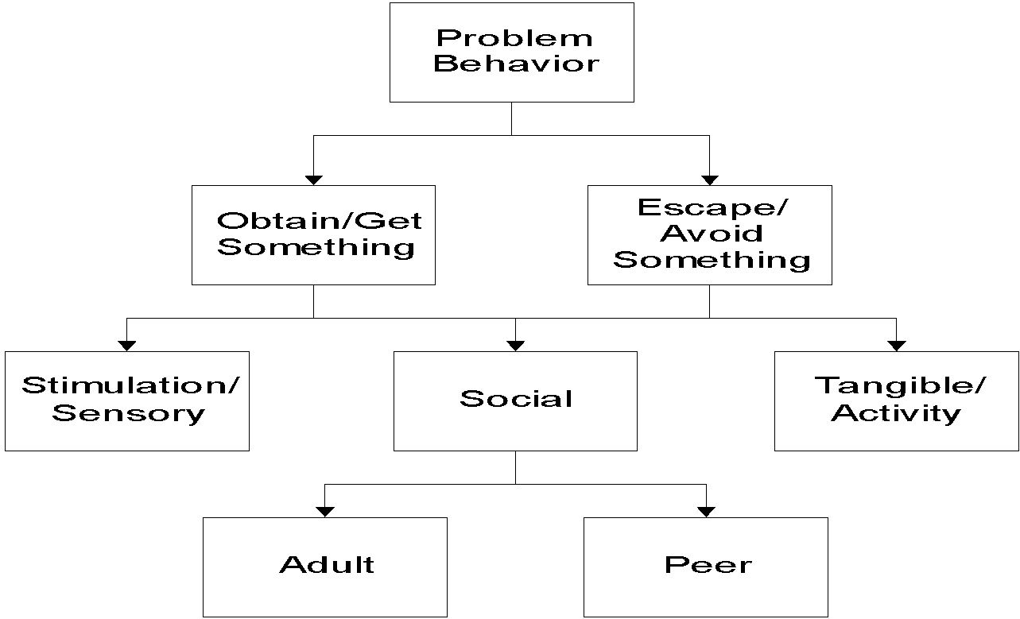
Functions of Behavior

Slide 11
3 Steps to an FBT Intervention
1. Gather information and develop hypothesis
2. Develop a plan
3. Assess if the plan is working

Slide 12
Step 1: Gather Information (Data)
Data come in many forms
Typical school-based data collection:
* Behavior Observation and Data Form
* Minors * Attendance/Tardies
* Nurse’s visits * Work completion
More formalized behavior data collection:
*Time sampling * Frequency counts * Scatterplot
* Subjective ratings scale * A-B-C Charts

Slide 13
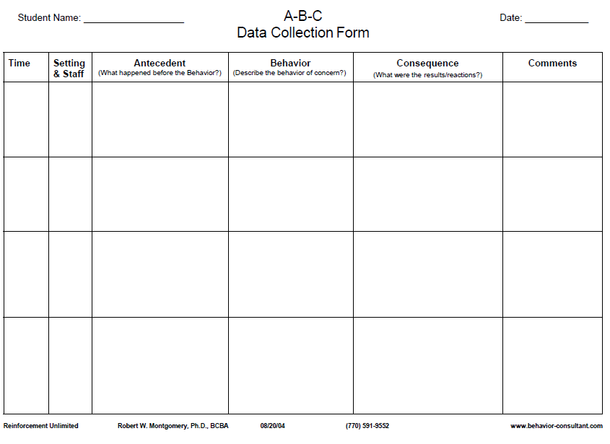
FACTS!
No opinions, judgements, or guesses.
Notes:
Objective, measurable and observable
Emphasize that understanding of function is a working hypothesis—data collection is ongoing

Slide 14
Practice: FBA Hypothesis
Setting Event
Antecedent
Behavior
Consequence
Typically on days when John has worked alone for 30 min…
when given math worksheets & other assignments…
he doesn’t do his work and uses profanity.
The teacher gives the rest of the class a task to do then sits with John to give him support and help him do the work.
Notes:
Define these terms clearly

Slide 15
John puts his head down, then back up, then stares out window for 5 minutes before using profanity, saying he won’t do the work
John has been working alone for 30 min
Teacher hands math worksheets out and gives direction to complete silently
The teacher gives the rest of the class a task to do, then sits with John to give him support and help him do the work
The same pattern has been observed for the previous 4 math classes
Notes:
Objective, measurable and observable
Emphasize that understanding of function is a working hypothesis—data collection is ongoing

Slide 16
Practice: FBA Hypothesis
Setting Event
Antecedent
Behavior
Consequence
Typically on days when John has worked alone for 30 min…
when given math worksheets & other assignments…
he doesn’t do his work and uses profanity.
The teacher gives the rest of the class a task to do then sits with John to give him support and help him do the work.
Function of the Behavior = (Teacher) Attention

Slide 17
Practice: FBA Hypothesis
Setting Event
Antecedent
Behavior
Consequence
Typically on days when Sarah comes in late because she overslept
when given math worksheets & other assignments…
she doesn’t do her work and uses profanity.
Sarah is sent out of the classroom.

Slide 18
1. Sarah was given math worksheets and instructed to complete them before she could go grab a snack from the cafeteria
1. Sarah engages in side conversation with a peer, throws an object
1. Teacher redirects Sarah to the worksheet task
The same pattern has been observed several times previously in math classes
Sarah came in to school late because she overslept
2. Teacher redirects Sarah to the worksheet task
2. Sarah begins to swear at teacher and says she is not doing the worksheet
2. Sarah is sent out of the classroom (to the office) by teacher
Notes:
Objective, measurable and observable
Emphasize that understanding of function is a working hypothesis—data collection is ongoing
ALSO CONSIDER: Adult behavior can be tracked/considered in this format too! (Probably not time for that discussion in this webinar).

Slide 19
FBA Hypothesis
Setting Event
Antecedent
Behavior
Consequence
Typically on days when Sarah comes in late because she over-slept
when given math work sheets & other assignments…
she doesn’t do her work and uses profanity.
Sarah is sent out of the classroom.
Function of the Behavior = Avoids (work)

Slide 20
Common School Examples
To Obtain/ Get :
Peer attention
Adult attention
Desired activity
Desired object/ items
Sensory stimulation: auditory, tactile, etc.
To Avoid/ Escape:
Difficult Task
Boring Task
Physical demand
Non-preferred activity
Peer attention
Staff attention
Reprimands

Slide 21
More Examples
Obtain/Get Reinforcers
I yell and others look at me
I fight and others listen to me
I wander and people talk to me
I hit in order to get toys from other kids
Escape/Avoid Aversives
I cry when work gets hard and the teacher tells me to take a time out
I throw a book during math class and the teacher will send me out of class
I stand against the wall in PE so my classmates do not throw the ball at me

Slide 22
Consequences, revisited
Definition: Anything that happens after a behavior.
Consequences can either:
Encourage or reinforce (increase some dimension of) behavior
or
Discourage or punish (decrease some dimension of) behavior

Slide 23
Consequences: Reinforcement
Definition: Anything that happens after a behavior that increases the probability that the behavior will be repeated in the future.
Positive: results in the student accessing a desirable situation (e.g., a preferred activity, a token, praise, any attention)
Example: Sarah gets the teacher’s attention when she blurts out in class, and Sarah’s blurting out increases in frequency. Important: Sarah LIKES teacher attention.

Slide 24
Consequences: Reinforcement
Definition: Anything that happens after a behavior that increases the probability that the behavior will be repeated in the future.
Negative: results in the student getting away from an aversive situation (e.g., disrupting class to get kicked out so that work is avoided)
Example: Sarah calls out during math instruction, so she is sent out of the class. Calling out increases in frequency over time.

Slide 25
Consequences: Punishment
Definition: Anything that happens after a behavior that decreases the probability that the behavior will be repeated in the future.
Example: Sarah calls out throughout a class period, and she receives a low mark for ‘participation’ for that class period. Sarah’s calling out decreases as a result.

Slide 26
Disciplinary Consequences
Reinforcement or Punishment?
Send student out of the room for refusing to complete a task
Verbally redirect a student who continually calls out to get your attention
KEY POINT: You only know whether a consequence serves as reinforcement or punishment by observing its effect on a target behavior

Slide 27
Step 2: Develop a Plan
Identify a consistent response to the problem behavior that does not reinforce the behavior
Identify a replacement behavior that fulfills the same function as the problem behavior and ask/answer:
Does the behavior need to be taught?
How will the behavior be taught? By whom?
How will the behavior be reinforced?
“Fair-Pair” Rule

Slide 28
Step 2: Develop a Plan--Avoidance
Avoidance
To avoid a task
To avoid a person/interaction
What to do
No fun until it’s done
Built-in breaks (non-contingent)
Permit escape for a specified time (contingent on asking)

Slide 29
Step 2: Develop a Plan--Attention
Attention
Engages in behavior to satisfy need for attention
Chronic blurting out, excessive helplessness, tattling, minor disruptions
What to do
Be careful about accidentally reinforcing the problem behavior with undue attention/redirection
Planned ignoring
Teach and provide attention to replacement behaviors
Notes:
*Tootling!*

Slide 30
Competing Behavior Pathway
Desired Behavior (End result)
Maintaining
Consequence
Setting Events /
Conditions
Problem Behavior
Maintaining
Consequence
Antecedent
Function
Replacement Behavior
(More immediate target)
Notes:
30

Slide 31
Case Study Pathway: Sarah
Complete math task
Maintaining
Consequence
Routine: Math Class
Function
Student didn’t get much sleep last night
Avoids math task
Asked to do a math task
Gets sent out of class
Sits silently
Write name on paper
Notes:
31
Other pieces to consider: remediating lagging math skills that might be increasing desire to escape/avoid
Pathway so far primarily focuses on behavior and consequence, but antecedents next…

Slide 32
Antecedents, Revisited
1
2
3
Setting Events/
Conditions
Antecedent
Behavior
Consequence
1 = Environmental control strategies
1 = Prompting and cueing strategies
1 = Consequence-based strategies
Notes:
32
Discuss some possible considerations with Sarah Case Study re: antecedent interventions

Slide 33
Step 3: Assess If Plan Is Working
Assess if the plan is working
- Collect data
- Compare pre- and post-intervention information
- Adjust your plan as needed
or
- Refer for more help if needed, using the data you collected to
support your referral and to jumpstart next steps

Slide 34
Why FBT? To recap…
Using a function-based approach, you can respond in a way that will:
Avoid accidentally reinforcing challenging behavior
Effectively discourage problem behavior
Reinforce an acceptable replacement behavior

Slide 35
Next Steps?
How do you plan to use the information shared in this presentation?
Questions for me?
Notes:
Ask some people to share their plans

Slide 36
Training Available
Available through the Vermont PBIS Team:
Basic FBA to BSP
VTPBIS Leadership Team Training at the Intensive Level
See Vermont PBIS website for current trainings offered, or contact a coach for more options

Slide 37
Stay Connected
https://www.facebook.com/groups/PBISVermont/
https://twitter.com/vtpbis
Please share all of the awesome things you are doing by using #VTPBIS or @VTPBIS

Slide 38
Wrap-Up
Contact us with any questions!
Jeremy Tretiak MA, BCBA, VT-LBA
e-mail: jeremy@gmbehavior.org

