Slide 1
Navigating SWIS Webinar
Presented by the VTPBIS State Team

Slide 2
You will be muted during this session. Use the chat box or raise your hand.
You can show or hide your video.
This session is being recorded. Email Anne Dubie for access.
All materials can be found here: https://www.pbisvermont.org/training-resources/webinars/

Slide 3
Agenda
What is SWIS?
Data-Based Decision Making
PBIS Applications Demonstration
Paperless Referrals
SWIS During COVID-19
Resources and Support
Questions and Answers

Slide 4
Poll
What is your level of familiarity with SWIS?
I have never used it before.
I have explored it a little.
I have used it, but not in many years.
I use it occasionally.
I use it frequently.

Slide 5
What is SWIS?
School-Wide Information System
A web-based decision system used to improve behavior support in schools by providing school personnel with accurate, timely, and practical information for making decisions about school environments based on data.
Big Idea
It’s more than just record keeping, it’s about decision making.

Slide 6
Big Ideas
Make better decisions based on data
Respond consistently to behavior
Regularly monitor patterns of behavior across school
Identify contexts (e.g., locations, grade levels, schedules) where more support is needed
Understand why problem behaviors continue (i.e., perceived motivation or function of the behavior)
Reduce referral disproportionality by race, ethnicity, disability, gender, and other characteristics
Repeatedly giving people the right information, at the right time, in the right format is the single most effective way to improve decision making and valued outcomes.

Slide 7
What is SWIS not?
SWIS is not a replacement the SLDS.
Big Idea
Designed as repository of data for school behavior team to use
Not designed or recommended as data reporting tool to satisfy state requirements
Big Idea

Slide 8
Data-Based Decision Making
The value of data emerges only when analysis provides insight that direct decisions for students.
—Stephen H. White,
Beyond the Numbers, 2005

Slide 9
Data-Based Decision Making
The quality of decision making depends most on the first step – defining problems to be solved
Precise (who, what, where, when, how often, why)
Clear (general agreement across team)

Slide 10
Improving Decision Making
Problem
Solution
Problem
Problem Solving
Solution
Action Planning
Notes:
Compare that to the old model of identifying a problem and then jumping right to solutions.
Instead, we’ll use our decision-making model to more clearly define the context of problems before moving into solution development.
Then those solutions are put into an action plan so that our solutions are really implemented with integrity.

Slide 11
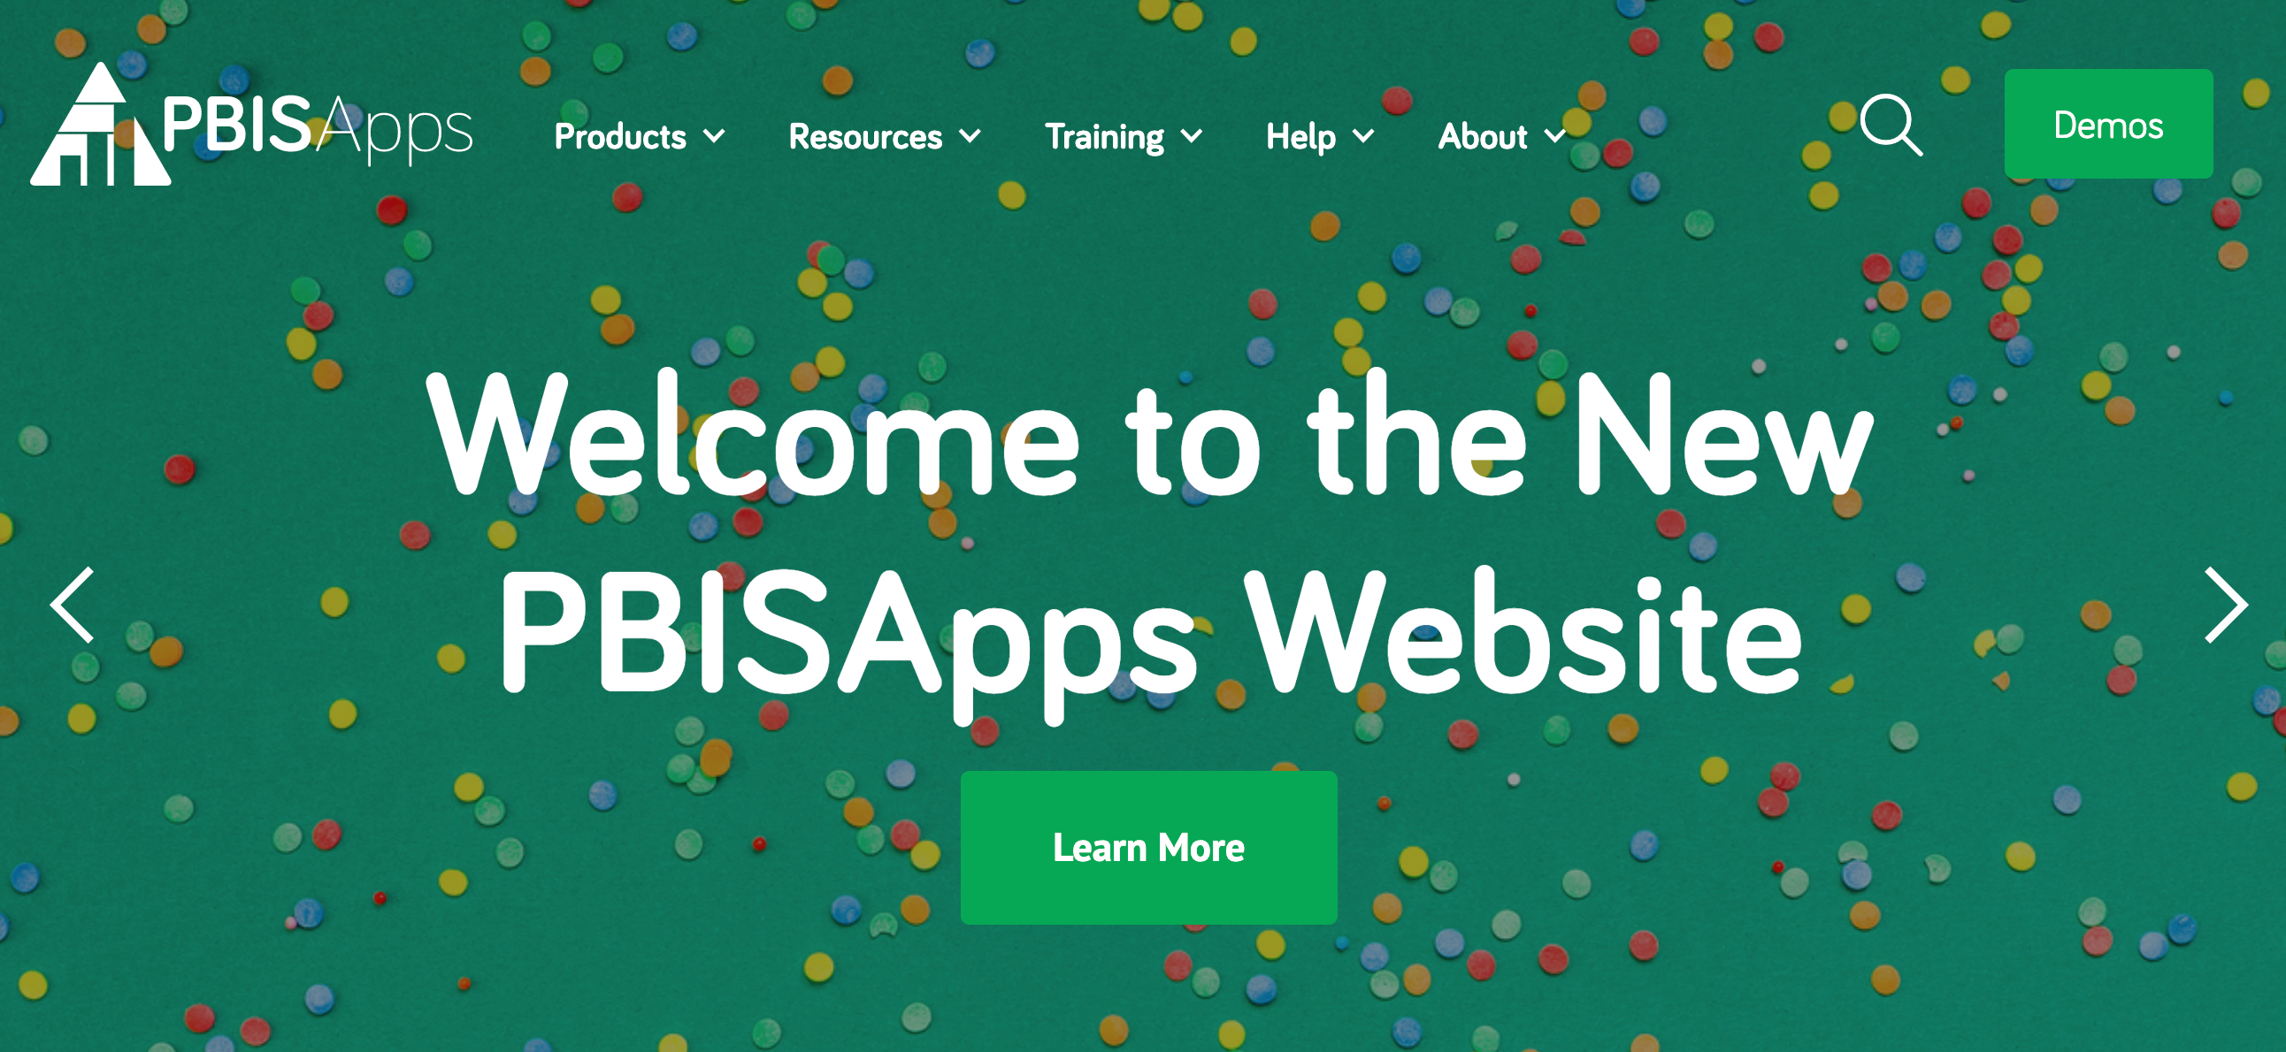
PBIS Applications
www.pbisapps.org
Notes:
PBIS Apps, SWIS Suite and PBIS Assessments! All one login!

Slide 12
Managing the SWIS Account (Tools)
Invoices (due Oct. 1)
Person Management
Add/update/modify student and staff records
Account Settings
Personal preferences
School Settings
Core Settings
***Enrollment, school days***
Application Settings
IEP information, custom fields, etc.
Notes:
School Settings should always align with the team agreements, staff training, referral forms, and best practices for collecting and reporting behavior data. These should be set after discussion and agreements across the team and with all SWIS users. During the school year, they should only be changed after agreement from the team and users. However, SWIS Admin and Data Entry users can change number of School Days to accurately record changes in school calendar (snow days, boiler broke – no school, etc.) and School Enrollment when there is a significant change (e.g., >5%).

Slide 13
Swift at SWIS Demonstration
SWIS Dashboard
Core SWIS Reports (monthly review)
Average Referrals
Location
Problem Behavior
Time
Student
Day of Week
Grade
Additional Reports (quarterly/annual review)
Student Dashboard (as needed)
Drill Down (identifying problems)
Data Integrity (quarterly/monthly)
www.pbisapps.org
Notes:
Introduction to Swift at SWIS User’s Manual
Introduction to Demo Account at PBISApps.org
SWIS School Summary Report
Dashboard access
Core SWIS Reports
Core Reports: Average Referrals, Location, Problem Behavior, Time, Student, Day of Week, Grade
Opening multiple reports
Report options
Print/Export options
Additional Reports
Additional Reports: Average Referrals – Multi-Year, Location Multi-Year, Suspension/Expulsion, Ethnicity, *Staff (for School Admin only)
Student Dashboard
Brief Introduction to Drill Down
Precise problem identification
Report Filters
Be specific & don’t drown in the data!

Slide 14
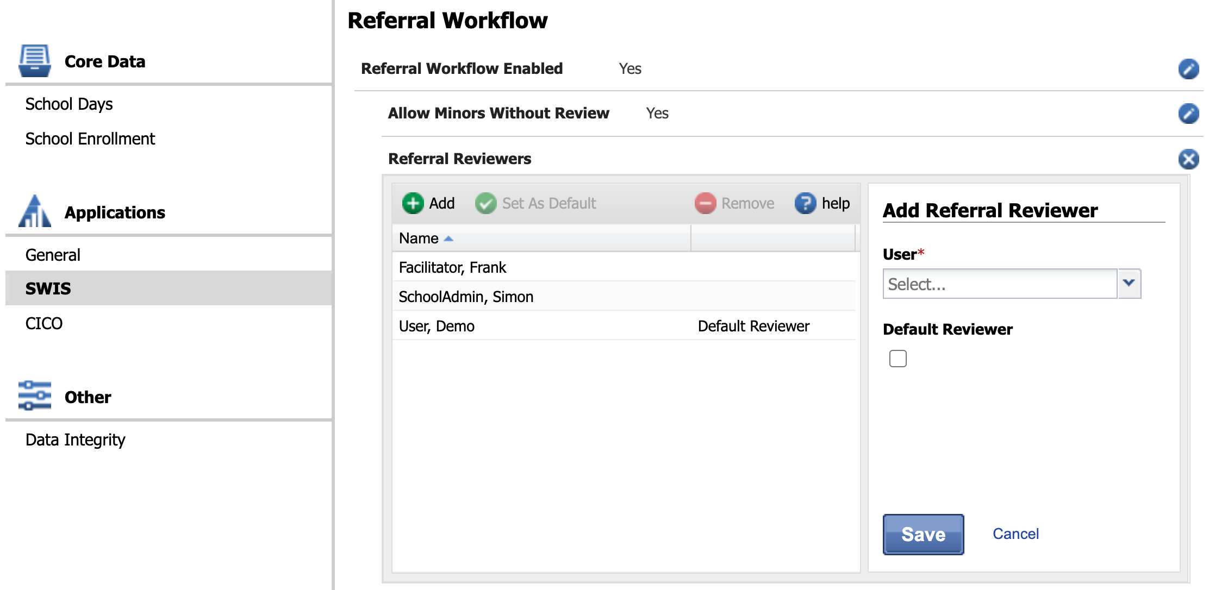
Paperless Referrals
Video: https://www.pbisapps.org/Resources/Pages/Enabling-Paperless-Referral-Workflows.aspx

Slide 15
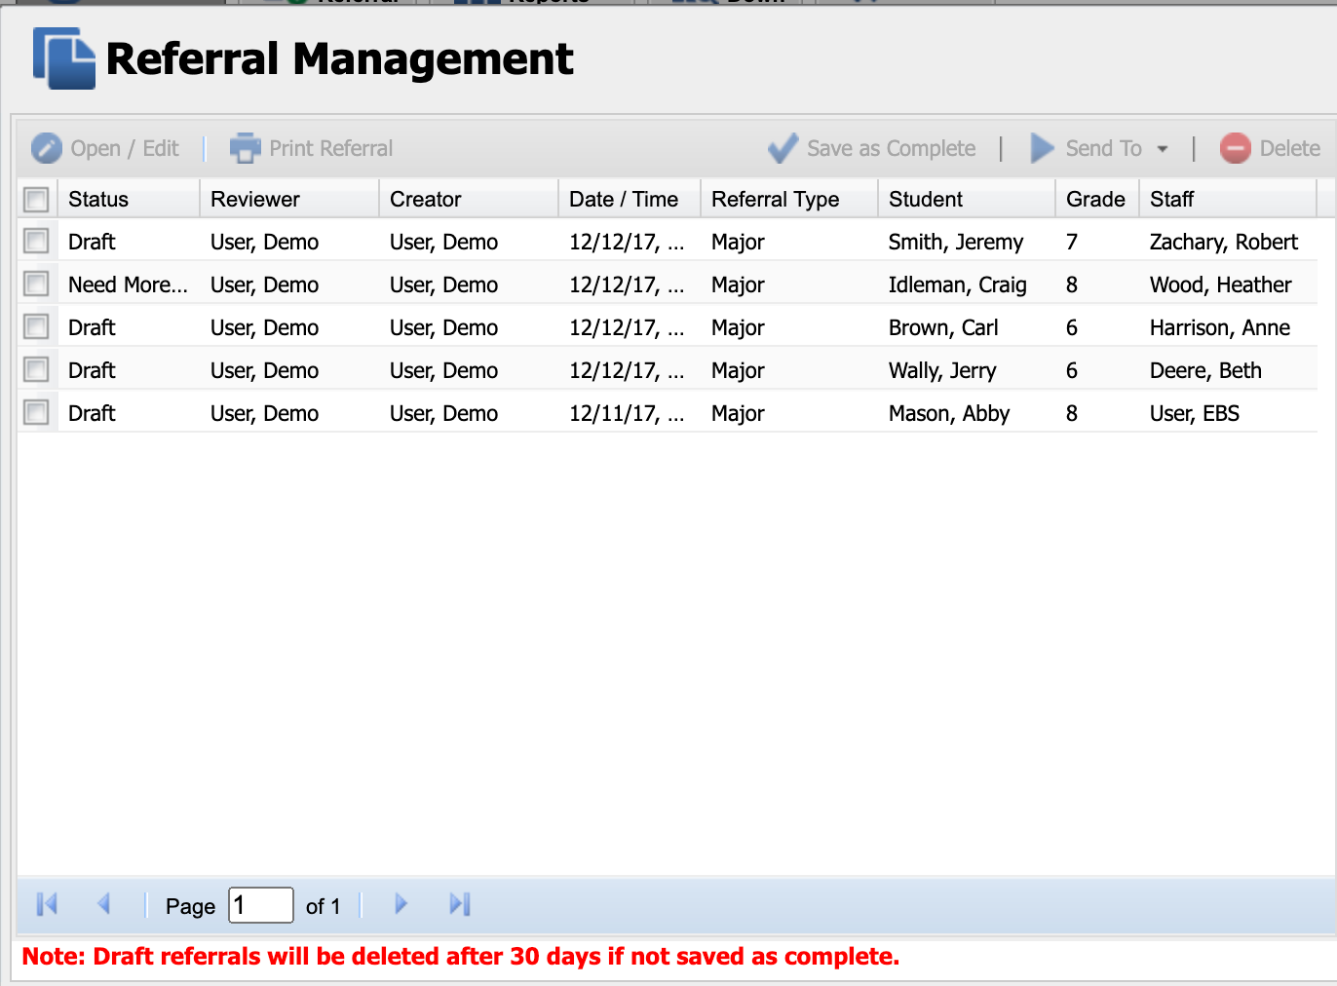

Slide 16
SWIS During COVID-19
Should you still document behaviors?
Data about what’s working/not working for specific students and overall
Indicators of when more support is needed
Review referral process to meet needs of context
Consider paperless referrals
Add “remote learning” as location on paper referral form
How to define, document, and address online behaviors
Update school days to reflect the number of days during the month where behavior data was collected (last year + this)

Slide 17
SWIS Data Link
Districts can now upload student/staff rosters and referrals from your student information system into SWIS – eliminating double entry
If you are a single school, you can upload student/staff rosters using Person Import
If there are pieces of information SWIS requires that aren’t collected in your district system, you will need to customize your SIS to collect that data (i.e. Perceived Motivation)
Can’t use custom fields
More information here

Slide 18
Next Steps:
Learn about Team-Initiated Problem-Solving (TIPS)
VTPBIS Leadership Forum: Oct. 3rd
Webinar: Understanding and Identifying Social/Emotional/Behavioral Data
In-Person Data Day: Analyzing Social/Emotional/Behavioral Data
Coaching

Slide 19
Technical Assistance Procedures for SWIS
1
Use available web and print resources to locate relevant information (10-15 minutes)
2
Contact Anne Dubie (give 48 hours for her to respond)
3
Contact PBISApps staff if the request/question is urgent
Notes:
When you do have a question or problem related to SWIS, here is the official procedure.
Check the User’s Guide, support articles, and other online resources to find out if others have had the same question of problem.
However, after 20 minutes of searching in the most logical places, please feel free to contact Anne Dubie via phone or email and I will respond within 48 hours if at all possible.
Because of my role and other responsibilities there might be times when I am not able to get back to you within 48 hours. I’ll try to communicate or set my out-of-office message so that you know whether to expect a response.
The PBISApps staff as a rule do not provide direct support directly to school users, they do understand that as facilitators we are sometimes unavailable due to travel, illness, etc. If after 48 hours you still haven’t heard back from me then go ahead and contact the PBISApps staff directly. Let them know who your facilitator is (Sherry) and that we were unavailable. If they can, they will point you in the right direction.

Slide 20
Questions and Answers

Slide 21
Screengrabs from Demo Account

Slide 22
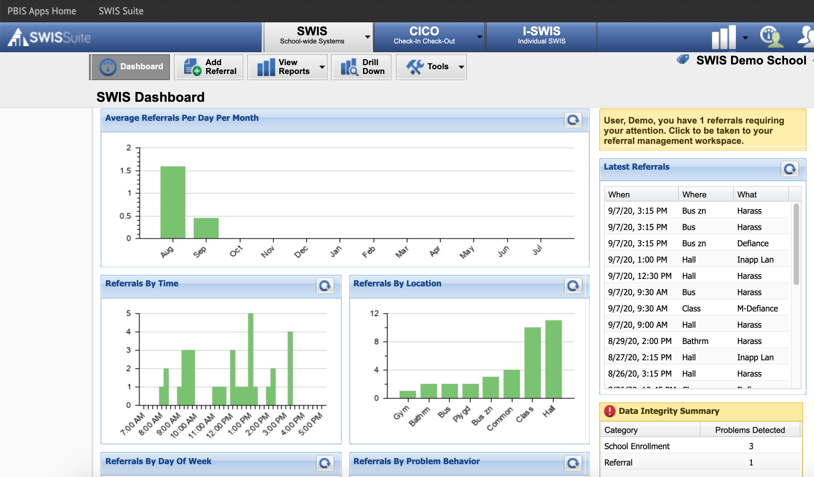

Slide 23
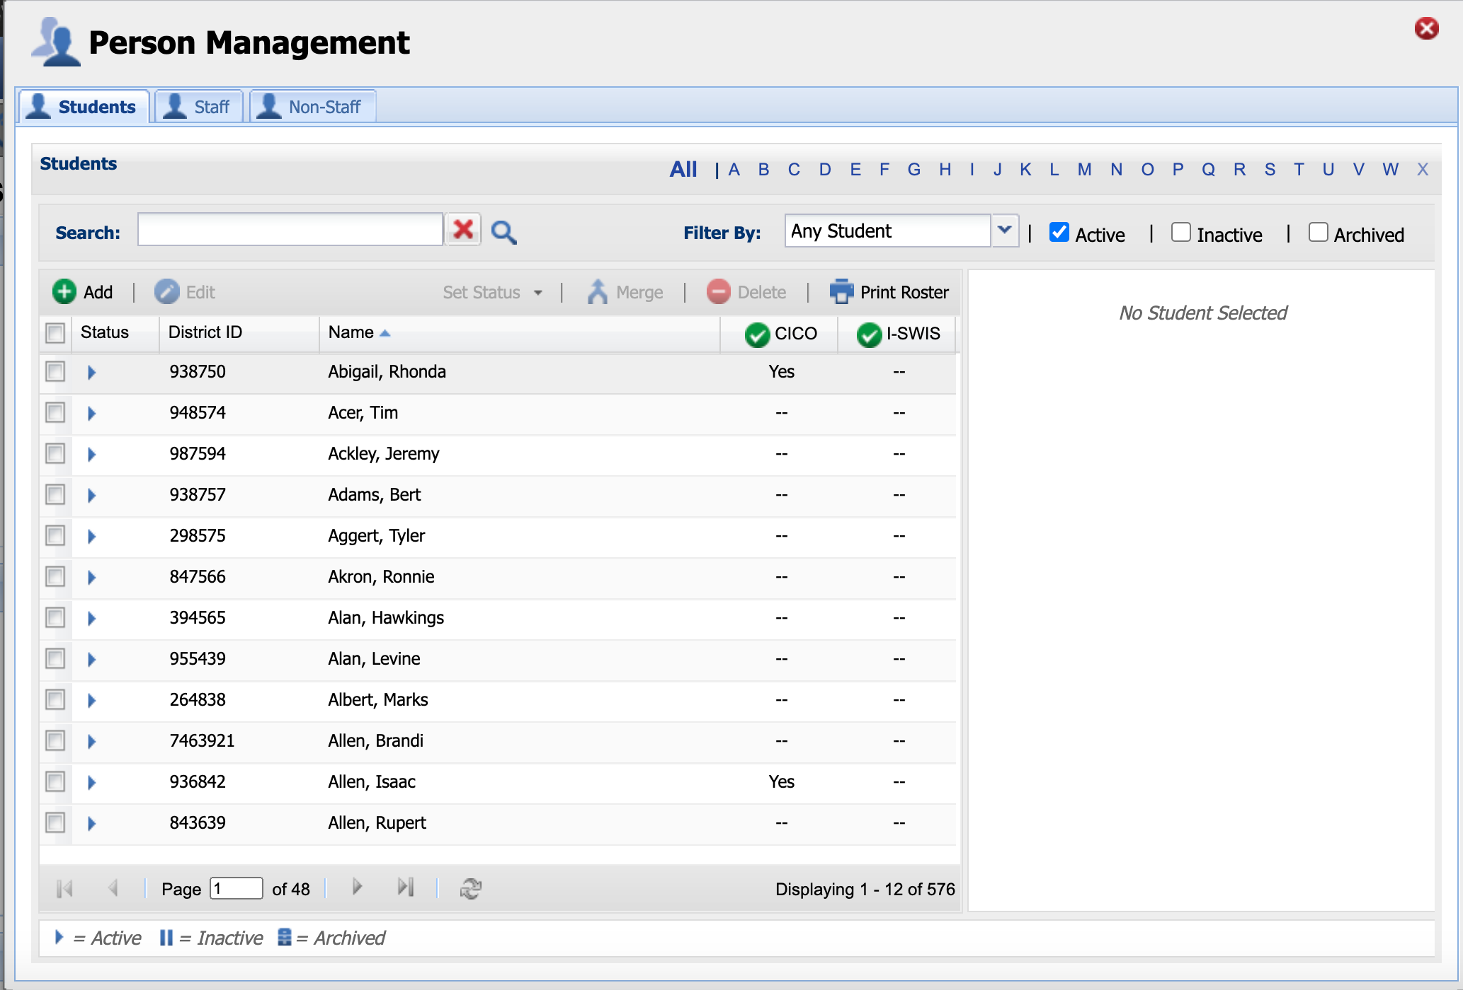

Slide 24
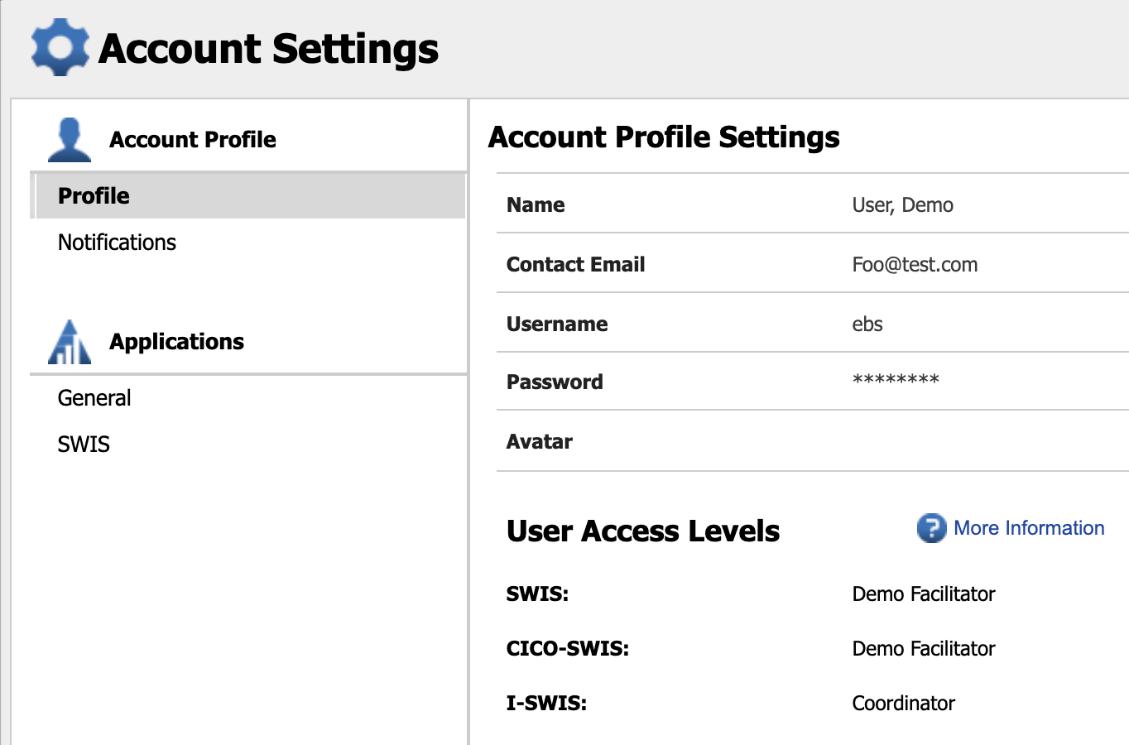

Slide 25
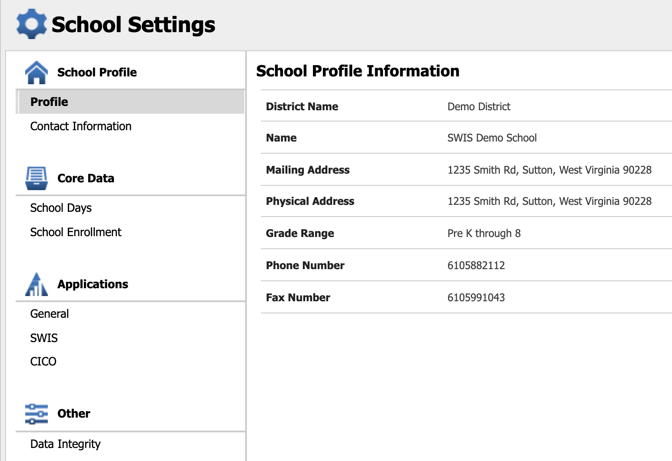

Slide 26
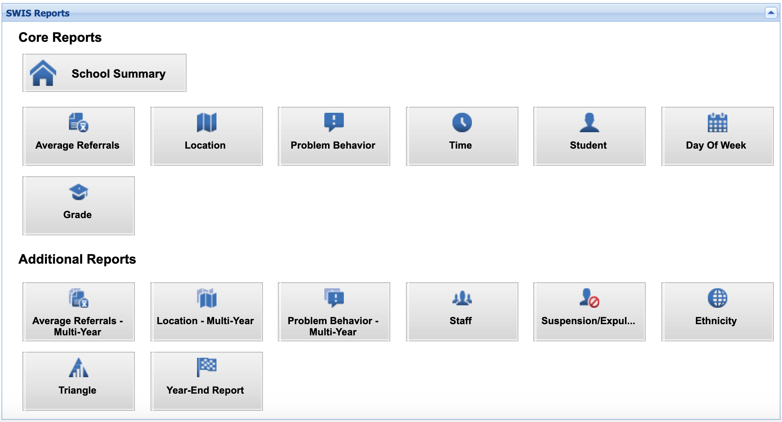

Slide 27
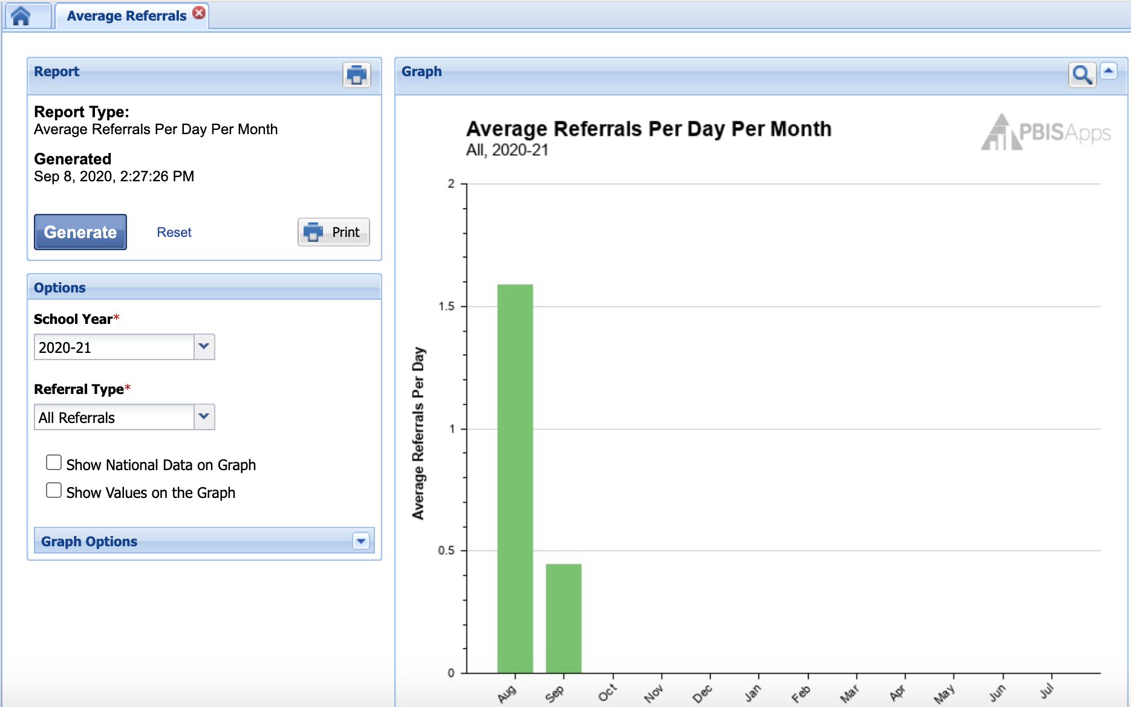

Slide 28
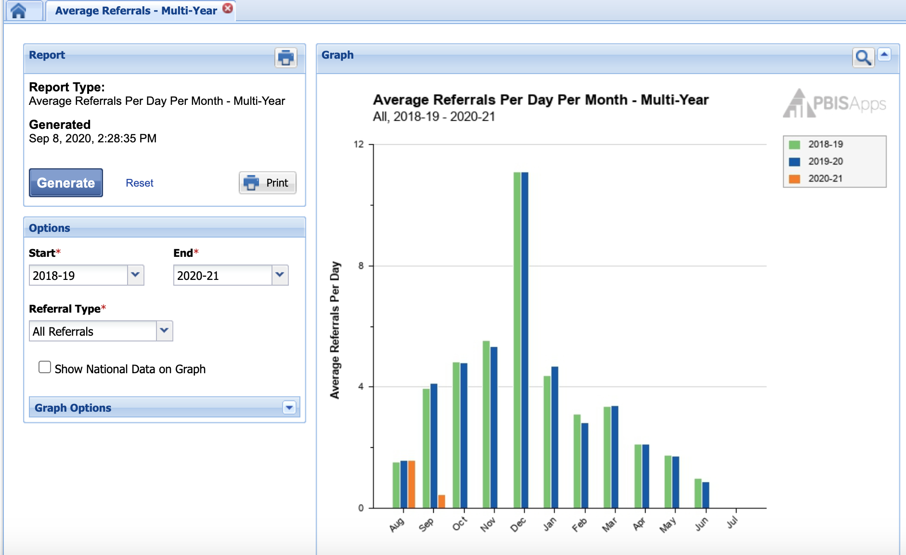

Slide 29
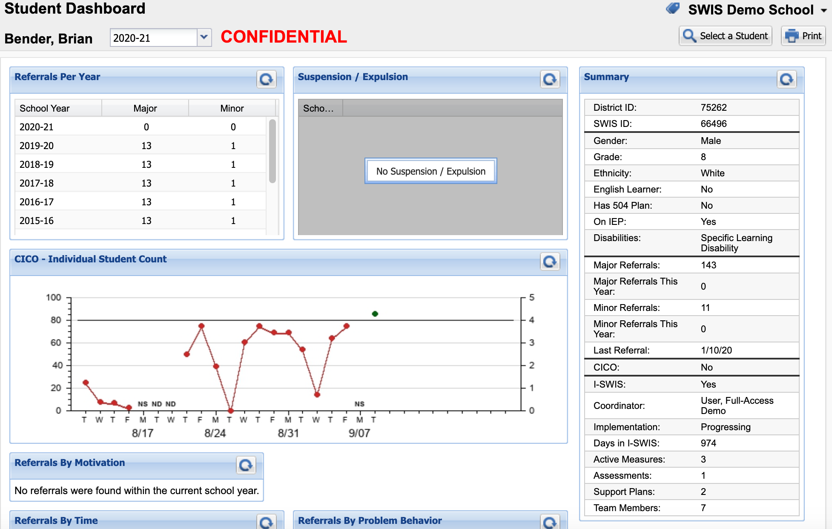

Slide 30
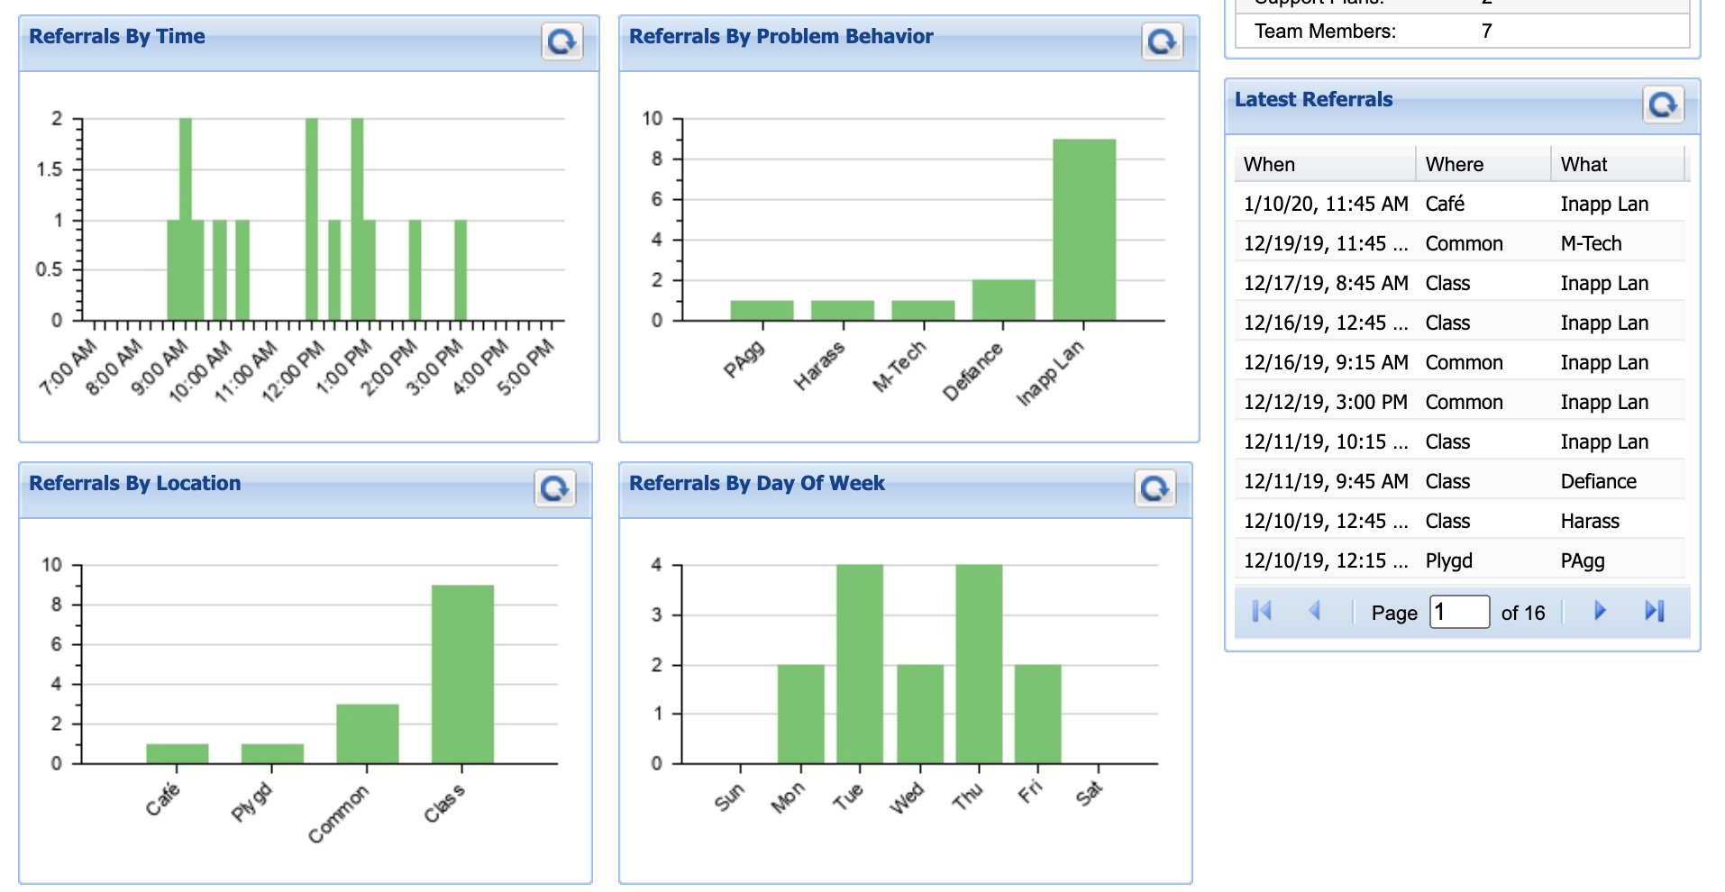

Slide 31
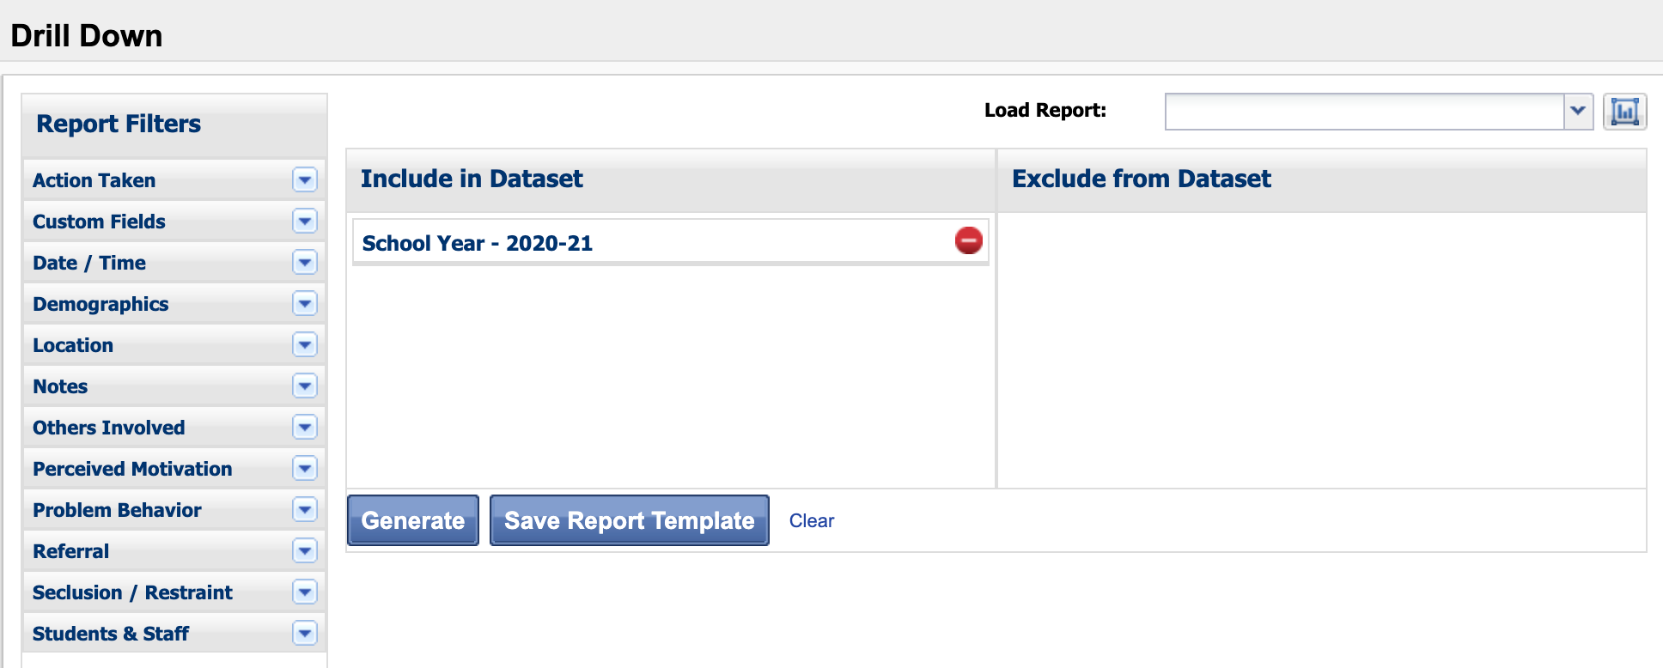

Slide 32
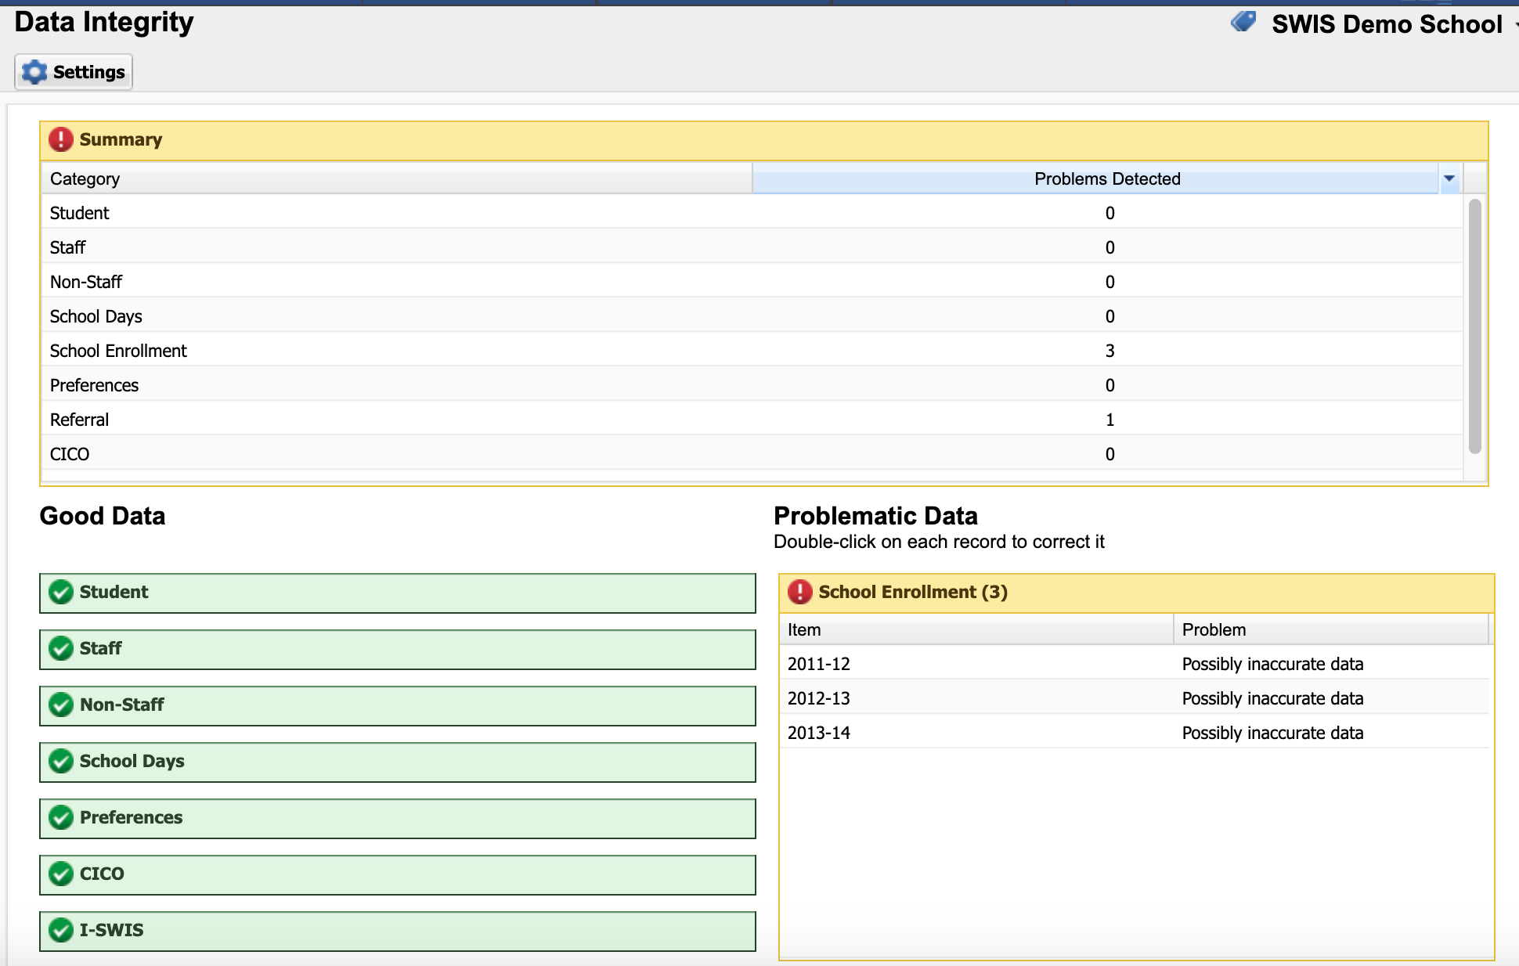

Slide 33
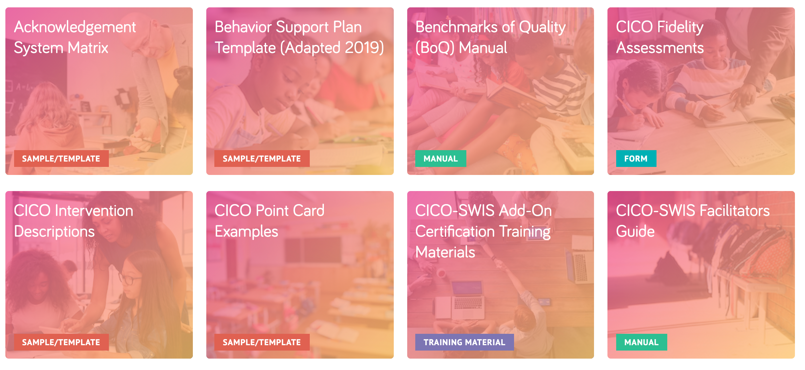
Resources and Support
Publications

Slide 34
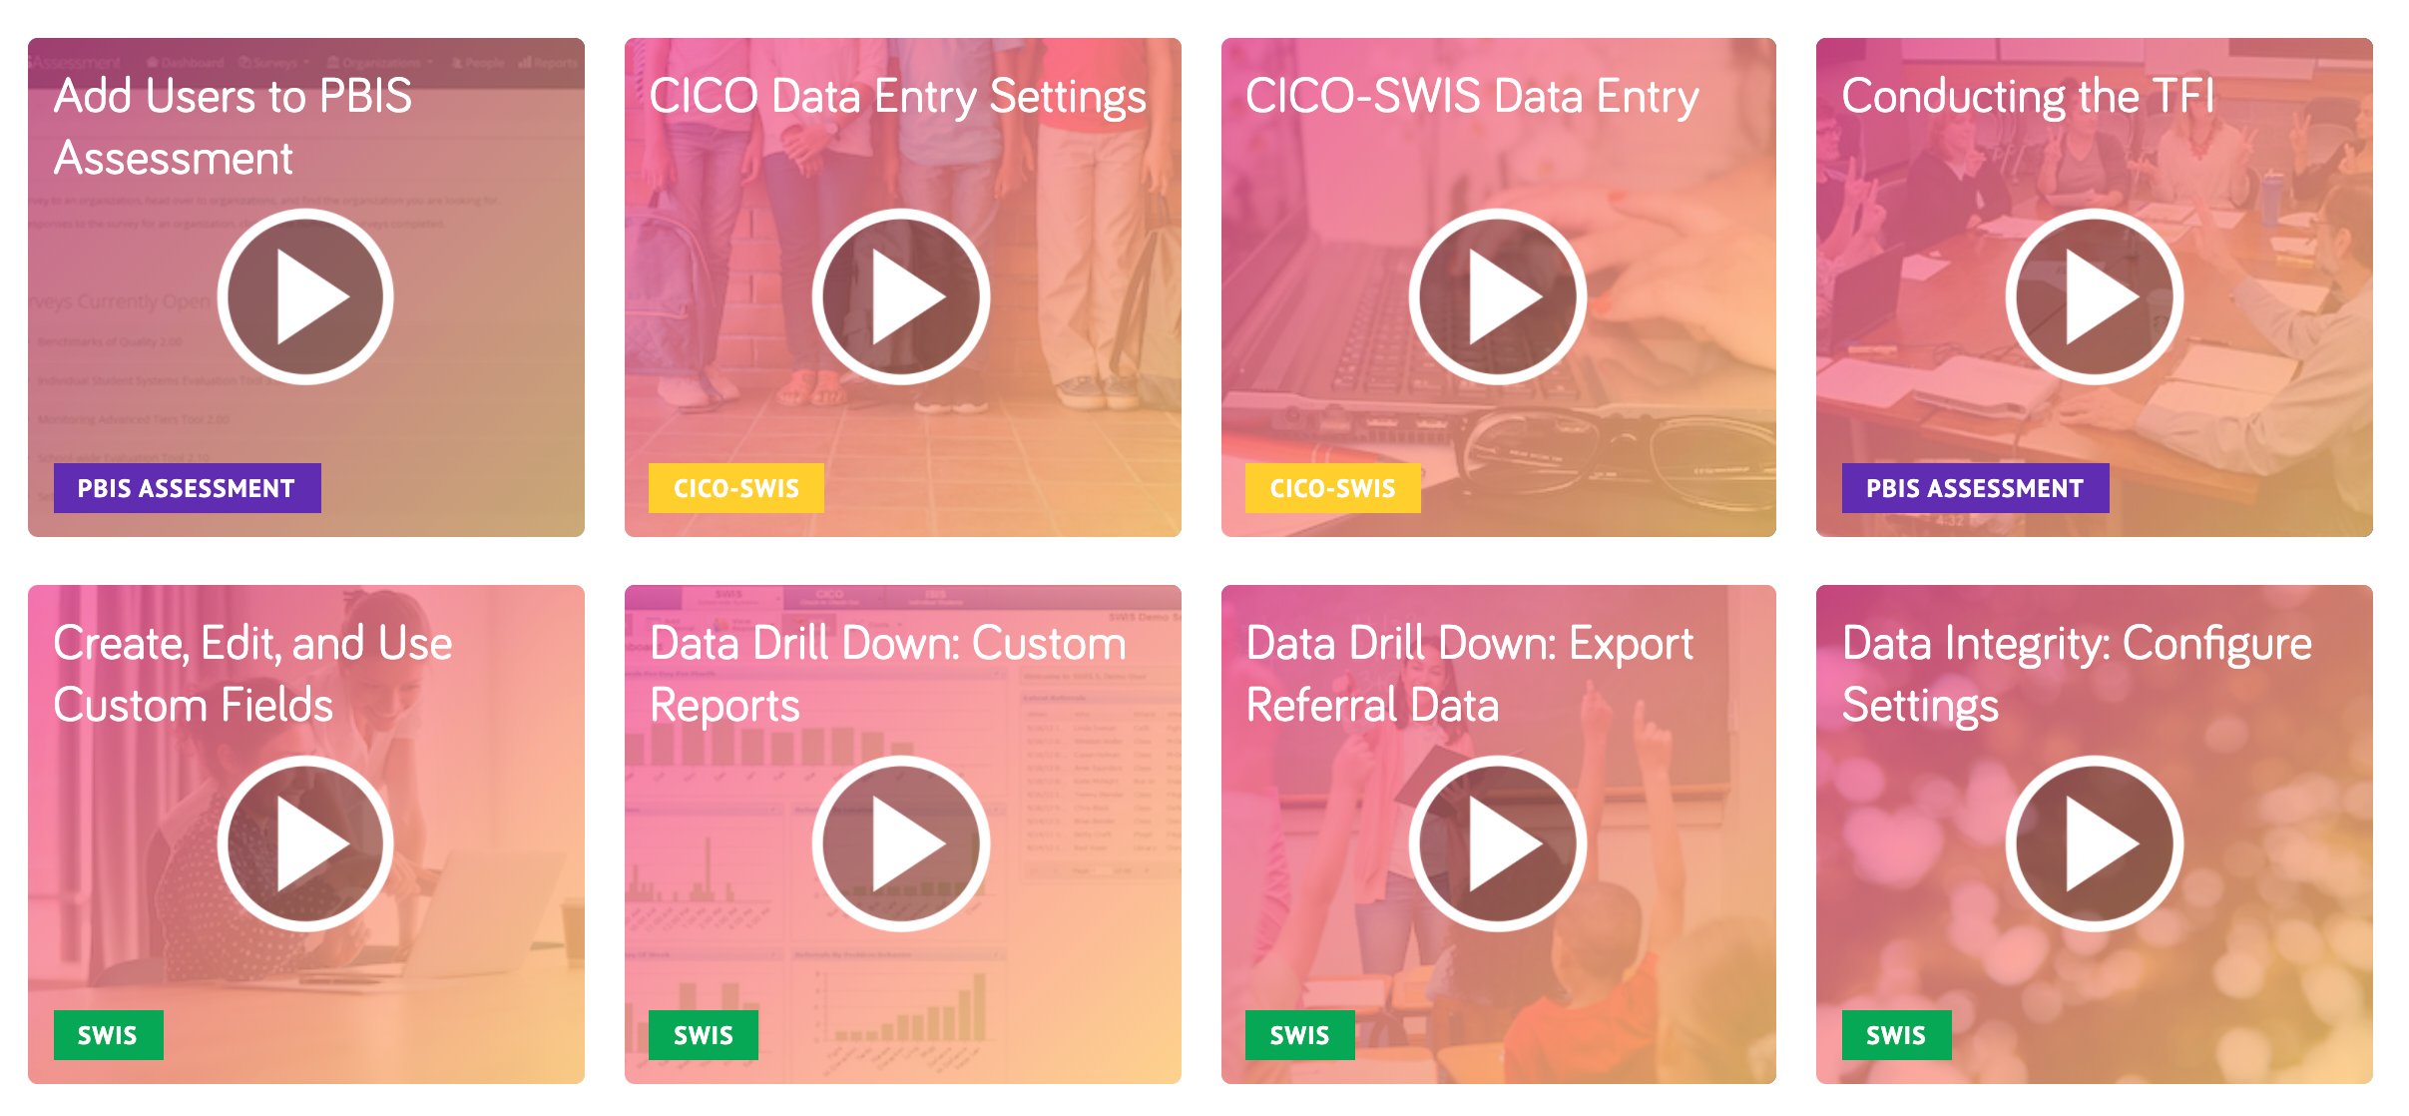
Resources and Support
Video Tutorials

Slide 35
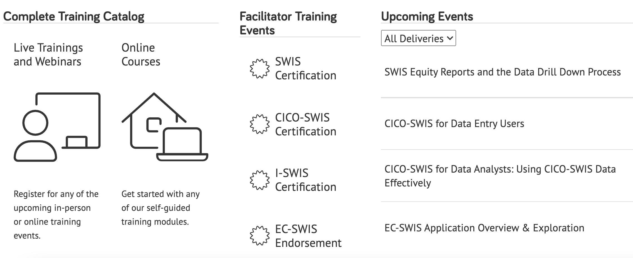
Resources and Support
Trainings

Slide 36
Resources and Support
Teach by Design transforms complex research into straight-forward solutions. We give K-12 leaders and educators tools and strategies you need to make your classrooms more effective and equitable places where you spend more time teaching and less time negotiating student behavior. Every second Tuesday of the month we will come out with a new article designed to help you with a common problem. Then, catch a new episode of Expert Instruction: The Teach by Design Podcast every third Tuesday of the month and listen in on our conversations with researchers, practitioners, and community members who do this work every day.

Slide 37
Resources and Support
Support

