Slide 1
INSERT School Name PBIS Update!
Insert School Mascot/Logo and Expectations
HERE

Slide 2
PBIS Data Update!
THANK YOU ALL!
(INSERT # of Staff or %) of Staff Members Completed
the Self-Assessment Survey!

Slide 3
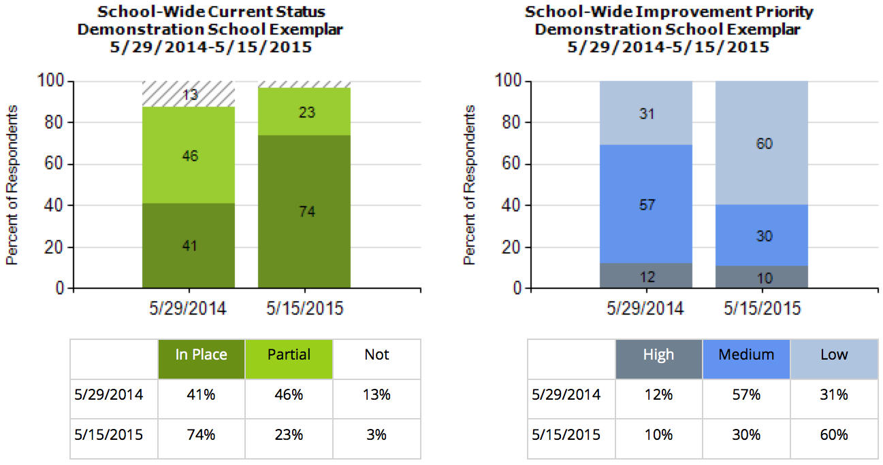
This year --% of our staff completed the SAS. --% indicated that they think school-wide system is in place compared to --% last year. --% of staff still say this is a medium or high priority for improvement.
INSERT your SAS Graph

Slide 4
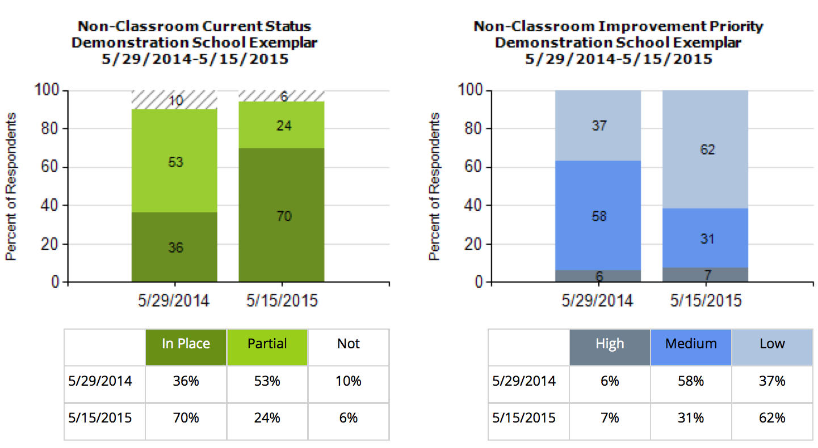
--% of staff think that non-classroom settings are in place, an increase of --% since last year. Only --% say this is still a high priority for improvement.
INSERT your SAS Graph

Slide 5
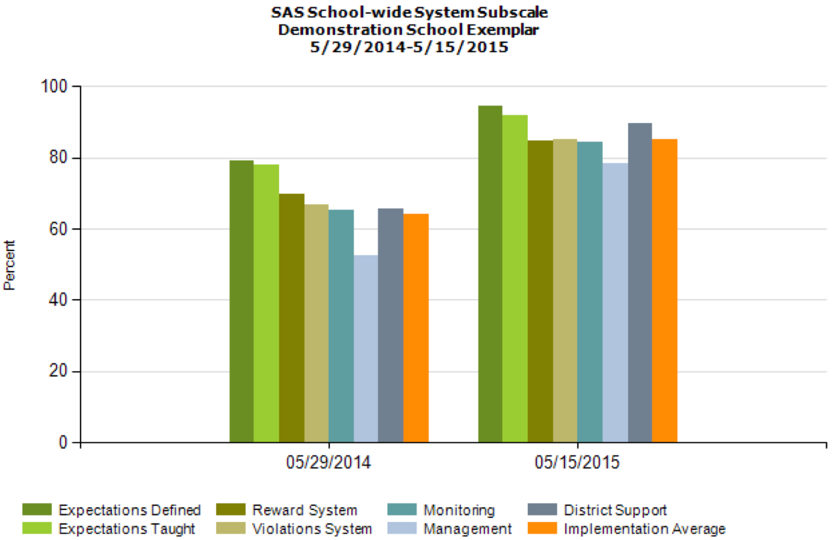
Overall, staff perception of implementation has improved across all categories!
INSERT your SAS Multi-year by Element Graph

Slide 6
This year our PBIS team took the TFI to assess PBIS fidelity of PBIS at the Universal level. This year --% of PBIS features are in Place compared to Last year’s TFI where only --% of features were in place.
INSERT your TFI Universal Score Graph

Slide 7
Last month, students in grades 3-5 completed the School Climate Survey. Results show --% of items scored at 3 or higher. Lowest scores were – and – across all sub-groups.
INSERT your School Climate Survey Items Report

Slide 8
Based on your feedback our team has determined the following areas for improvement:
INSERT GOAL
INSERT GOAL
INSERT GOAL
(USE the SAS, TFI, and School Climate Summary to help articulate these)

Slide 9
Thanks!
Questions about PBIS?
Contact one of the team members:
Jane Principal
Tom Coordinator
Physical Ed
Sharon Teacher
Johnny Naysayer
Carol Counselor
INSERT Team Members HERE

