Slide 1

Accessing, Completing, and Analyzing Results of the Tiered Fidelity Inventory (TFI), Self-Assessment Survey (SAS), and School Climate Survey
Need help?
Type into the chat box.
You will be muted during this session.
Presented by the VTPBIS State Team
This session will be recorded.
Materials can be found at: https://www.pbisvermont.org/training-resources/webinars/

Slide 2
Learning Objectives
Acknowledging
Acknowledging our context
Establishing
Establishing outcomes for action planning
Understanding and accessing
Understanding and accessing the TFI and SAS
Exploring
Exploring the School Climate Survey
Putting
Putting it all together for Action Planning

Slide 3
Lean On Your Framework
PBIS has meant the world to us as we have made the transition back to in-person learning. I have said a million times over the past 3 months that PBIS provides a perfect framework for us to articulate, teach, practice, and reinforce all of these new routines in our buildings.
Matt Young, Principal,
Peoples Academy Middle School

Slide 4
Supporting
Staff Behavior
Supporting
Decision Making
OUTCOMES
Systems
Data
Practices
Supporting Student Behavior
Notes:
3
DATA

Slide 5
Context:
VTPBIS schools are asked to complete the Tiered Fidelity Inventory (TFI) and Self-Assessment Survey (SAS) OR School Climate Survey every year between January and March.
Schools implementing PBIS with fidelity will be better able to integrate MH supports and resources.
The impact of the past two year’s disruptions on individual teachers, students and families is significant, making it essential to expand the data used to guide social/emotional/behavioral learning and well-being.
Collecting robust data on perceptions of school climate can be used to determine whether students and teachers are feeling connected and engaged in their learning environments, despite the disruptions.
Notes:
Office discipline referrals, attendance, and even academic performance may be more difficult to rely on.

Slide 6

Big Ideas About Data
All data should serve a purpose
Collect data with fidelity
Be prompt about looking at data and acting upon it
Use multiple sources of data to confirm what you see
Use data to support, not punish
Notes:
Sherry

Slide 7

Start with Outcomes
How will you know if PBIS is working if you are not sure where it should be taking you?
Notes:
Amy

Slide 8
What Are Your Outcomes?
Outcomes should be:
Locally determined
Contextually and culturally relevant
Observable and measurable
Summarized in goal statements
Consider using a “SMART Goal Format”
Notes:
Amy

Slide 9
Sample Outcomes
Reduce problem behaviors (BODFs)
Reduce bullying
Increase attendance/engagement
Improve school climate
Improve fidelity of interventions
Improve academic scores
Increase supports from community partners
Notes:
Amy

Slide 10
Sample Outcome Statements
“Given school-wide implementation of PBIS with fidelity, we will decrease the number of student suspensions and expulsions by 10% by the end of the school year.”
“As a result of completing a school climate survey for staff, students, and family members, improvements in three priority areas will be made by the end of the year.”
Notes:
Amy

Slide 11
Types of Data to Consider
Intensive:
TFI
I-SWIS
EST
FBA/BSP
ISF-II
Targeted:
TFI
SWIS-CICO
EST
FBA/BSP
Universal Screening
ISF-II
Universal:
TFI
SAS
SWIS
Attendance
Grades
Leadership Team Self-Assessment
School Climate
Family Engagement
ISF-II
Notes:
Sherry
What else?

Slide 12

Data help us ask the right questions.
They do not provide the answers.
Notes:
Assess current status and fidelity of implementation (school-wide)
Assess impact on students
Prioritize areas for change
Acknowledge incremental success along the way
Show staff you value and use their input to make changes (SAS)
Reward staff and student performance
Determine breaks between “roll-outs”
Share results with stakeholders

Slide 13
Poll
To what extent are you knowledgeable about the TFI and the SAS?

Slide 14
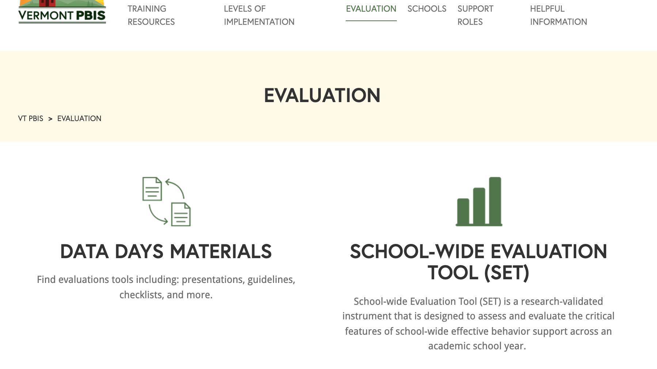

Slide 15
The Tiered Fidelity Inventory (TFI) Will Help Your Team Get to Outcomes
Notes:
Amy

Slide 16
TFI
What? An efficient and effective validated measure to assess fidelity of core PBIS features at all 3 tiers – Teams, Implementation, and Evaluation
Why? To guide and sustain effective implementation of PBIS
When? Expectation is once a year for all schools
  Window open January 1st - March 31st
  Consider completing TFI more than once to monitor/assess progress
  Contact Anne Dubie if you would like your window opened
  Teams should anticipate 30 minutes to complete each tier’s assessment the first time
Notes:
Amy

Slide 17
Uses of the TFI
Formative Assessment
  Determine current PBIS practices in place and needed prior to launching implementation
Progress Monitoring
  Self-assess PBIS practices by tier to guide implementation efforts and assess progress by tier
  Build action plan to focus implementation efforts
Annual Self-Assessment
  Facilitate sustained implementation of PBIS
State Recognition
  Determine schools warranting recognition for their fidelity of PBIS implementation

Slide 18
Tier 1: Team - Big Ideas:
Teams need people with multiple skills and perspectives to implement PBIS well.
Specific features are necessary to ensure meetings are effective for action planning and tracking progress.
Notes:
Sherry

Slide 19
Tier 1: Implementation – Big Ideas:
Identifying behavioral expectations and teaching them
Operational definitions for problem behavior and consistent responses improve the predictability of social expectations
The key is staff consistency
PBIS expectations and consequences integrated into classroom systems
Students will sustain positive behavior if there are formal systems with strategies for rewarding and re-teaching appropriate behavior
Actively engage families, students, and faculty
Notes:
Sherry

Slide 20
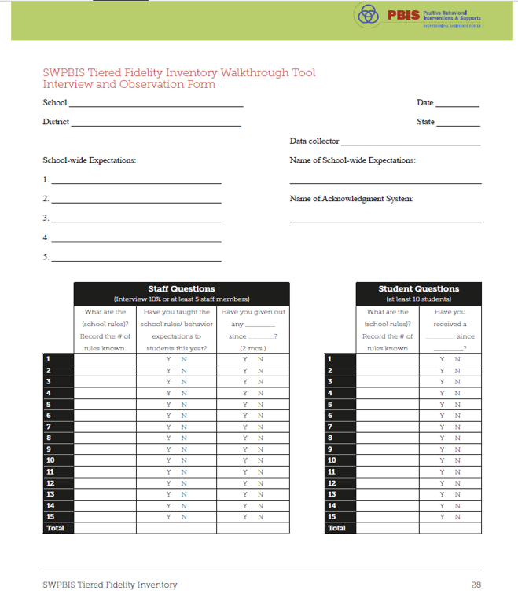
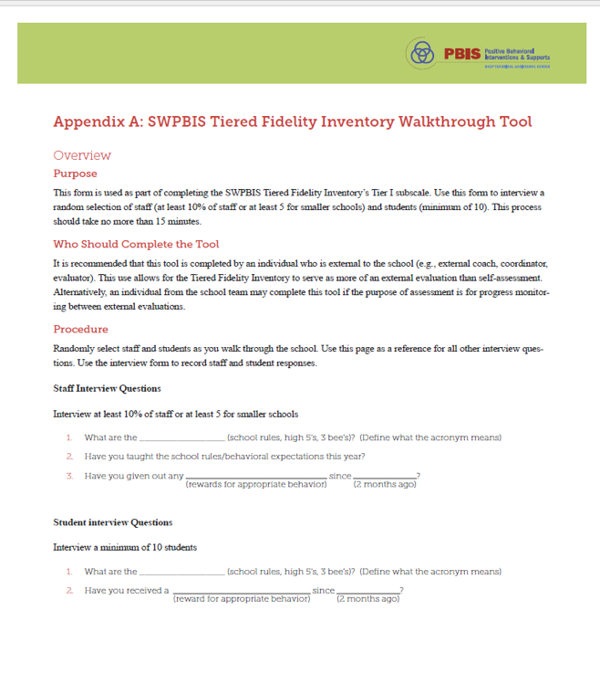
Notes:
The TFI Walkthrough Tool is Appendix A: pages 27-28 of the TFI. This is a tool that is used by a coach/external person to complete prior to the TFI. The first page provides an overview and the questions to ask staff and students. The second page is a place for recording the information. This provides an efficient way to calculate the percentages to assist with the TFI items.

Slide 21
Tier 1: Evaluation – Big Ideas:
Teams need the right information at the right time to make effective decisions.
Measuring fidelity data is essential for maintaining effective implementation of PBIS.
Implementation of Tier 1 is likely more sustainable if the Team self-assesses at least annually AND reports this data to key stakeholders.
Notes:
Sherry

Slide 22
After Assessment
Analyze data:
  Total score report (all 3 tiers averaged)
  Subscale report (broken down by tier)
  Sub-sub scale report (broken down by components)
  Individual items report
    Celebrate your 2’s, examine your 0’s and 1’s
Notes:
Amy

Slide 23
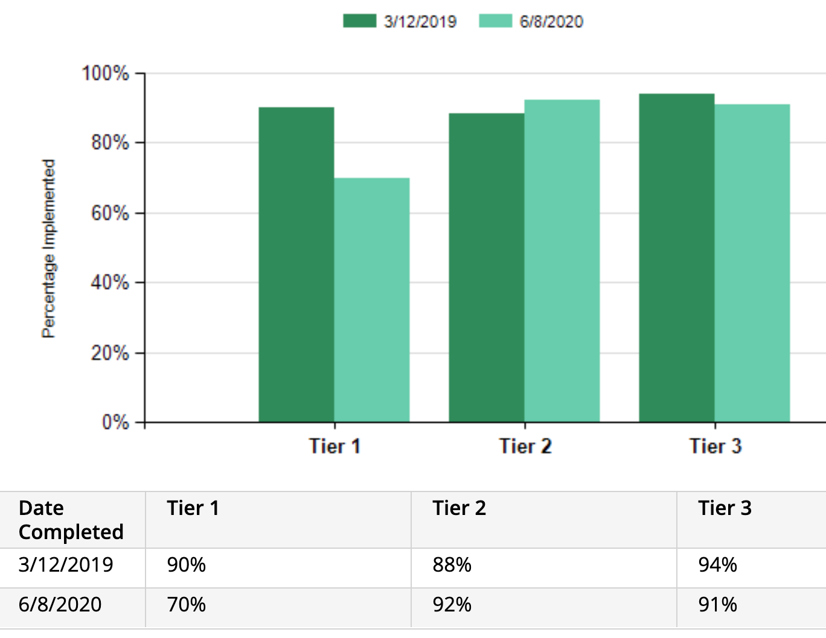
Example Scale Report
What do you notice?
What do you wonder?
What might you prioritize?

Slide 24
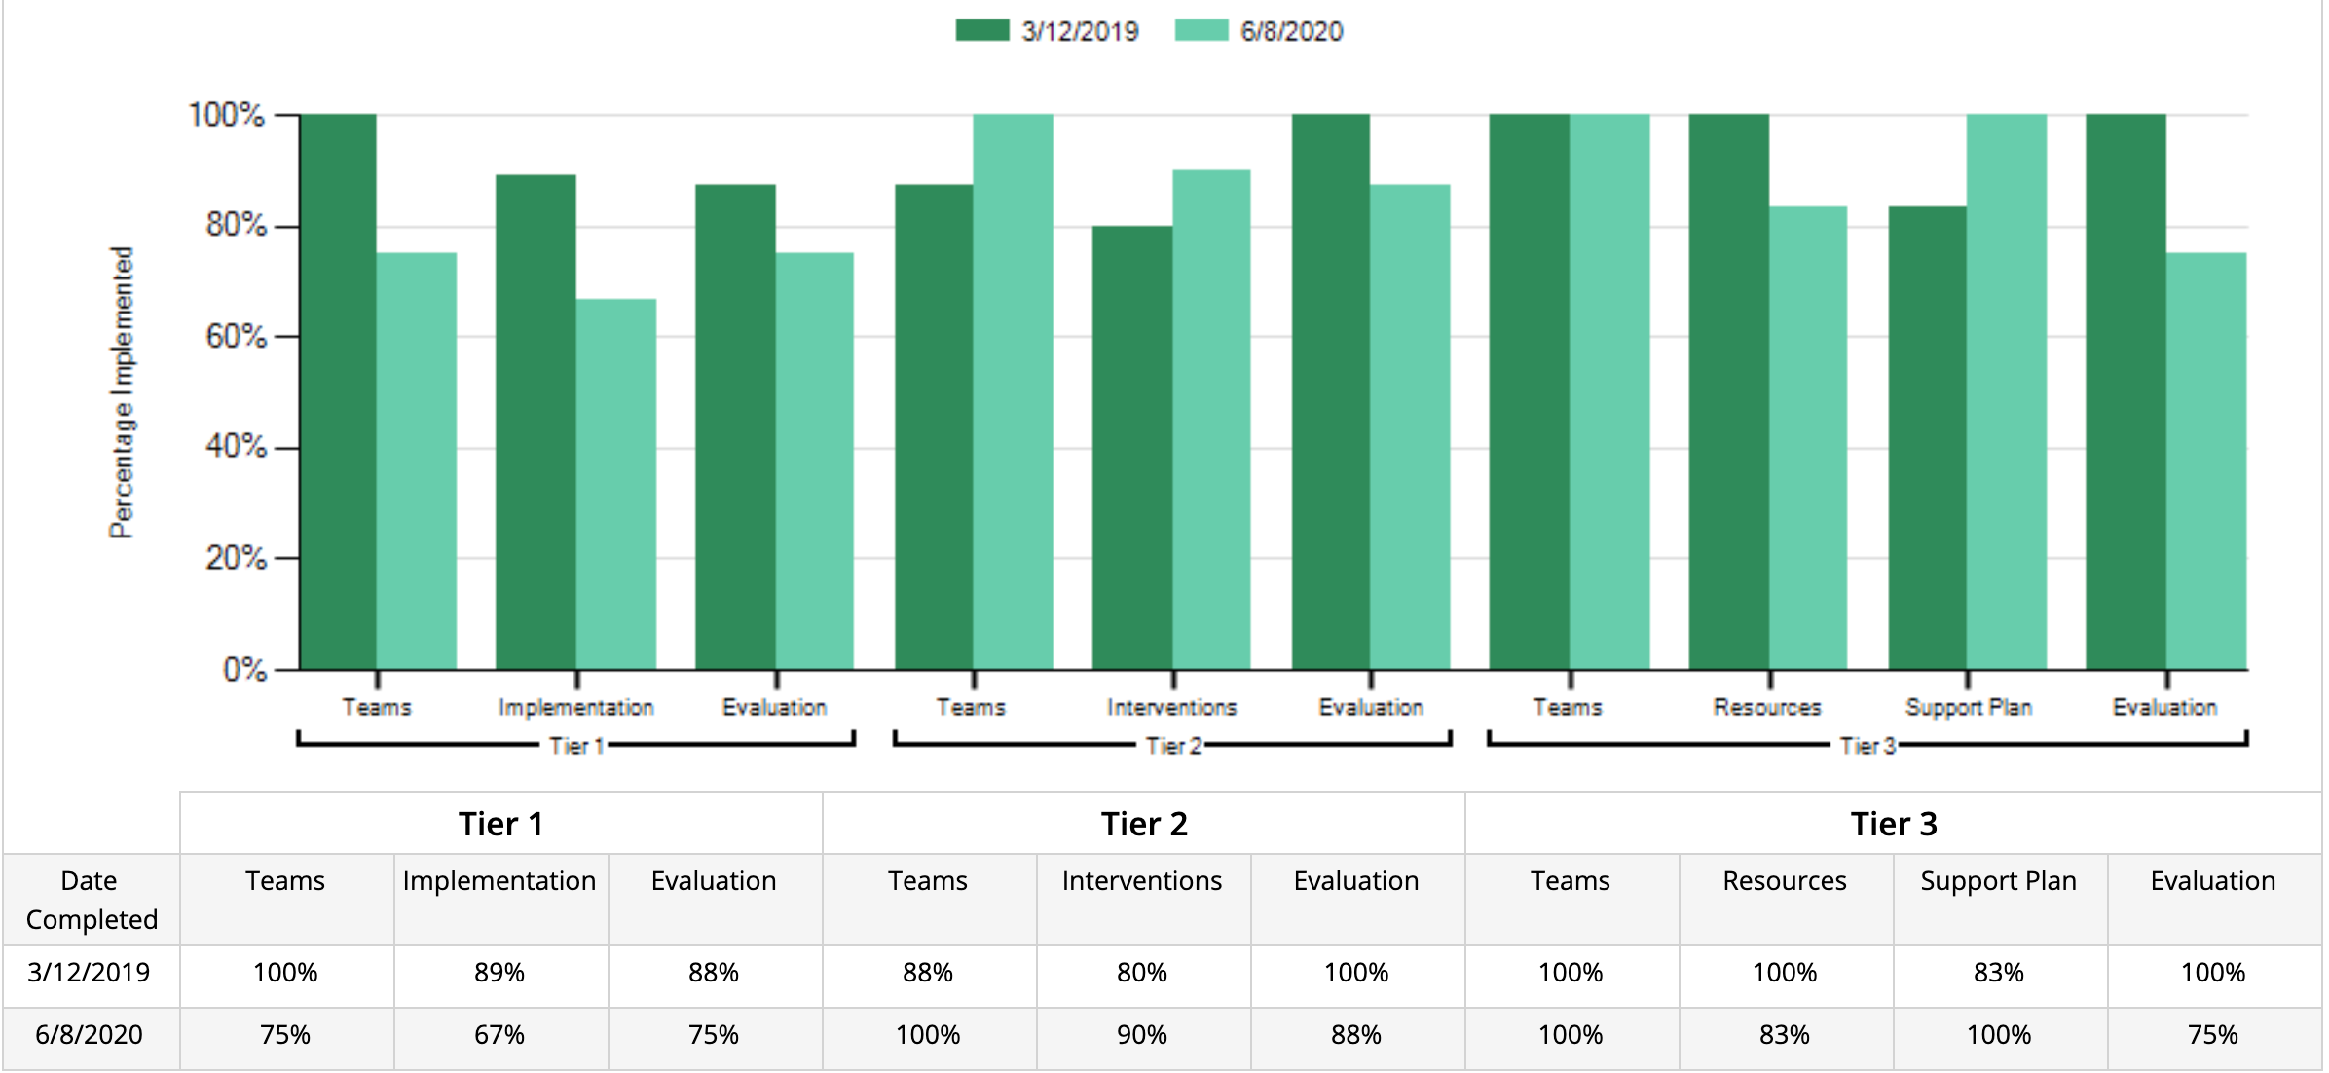
Example Subscale Report
What do you notice?
What do you wonder?
What might you prioritize?
Notes:
Amy

Slide 25
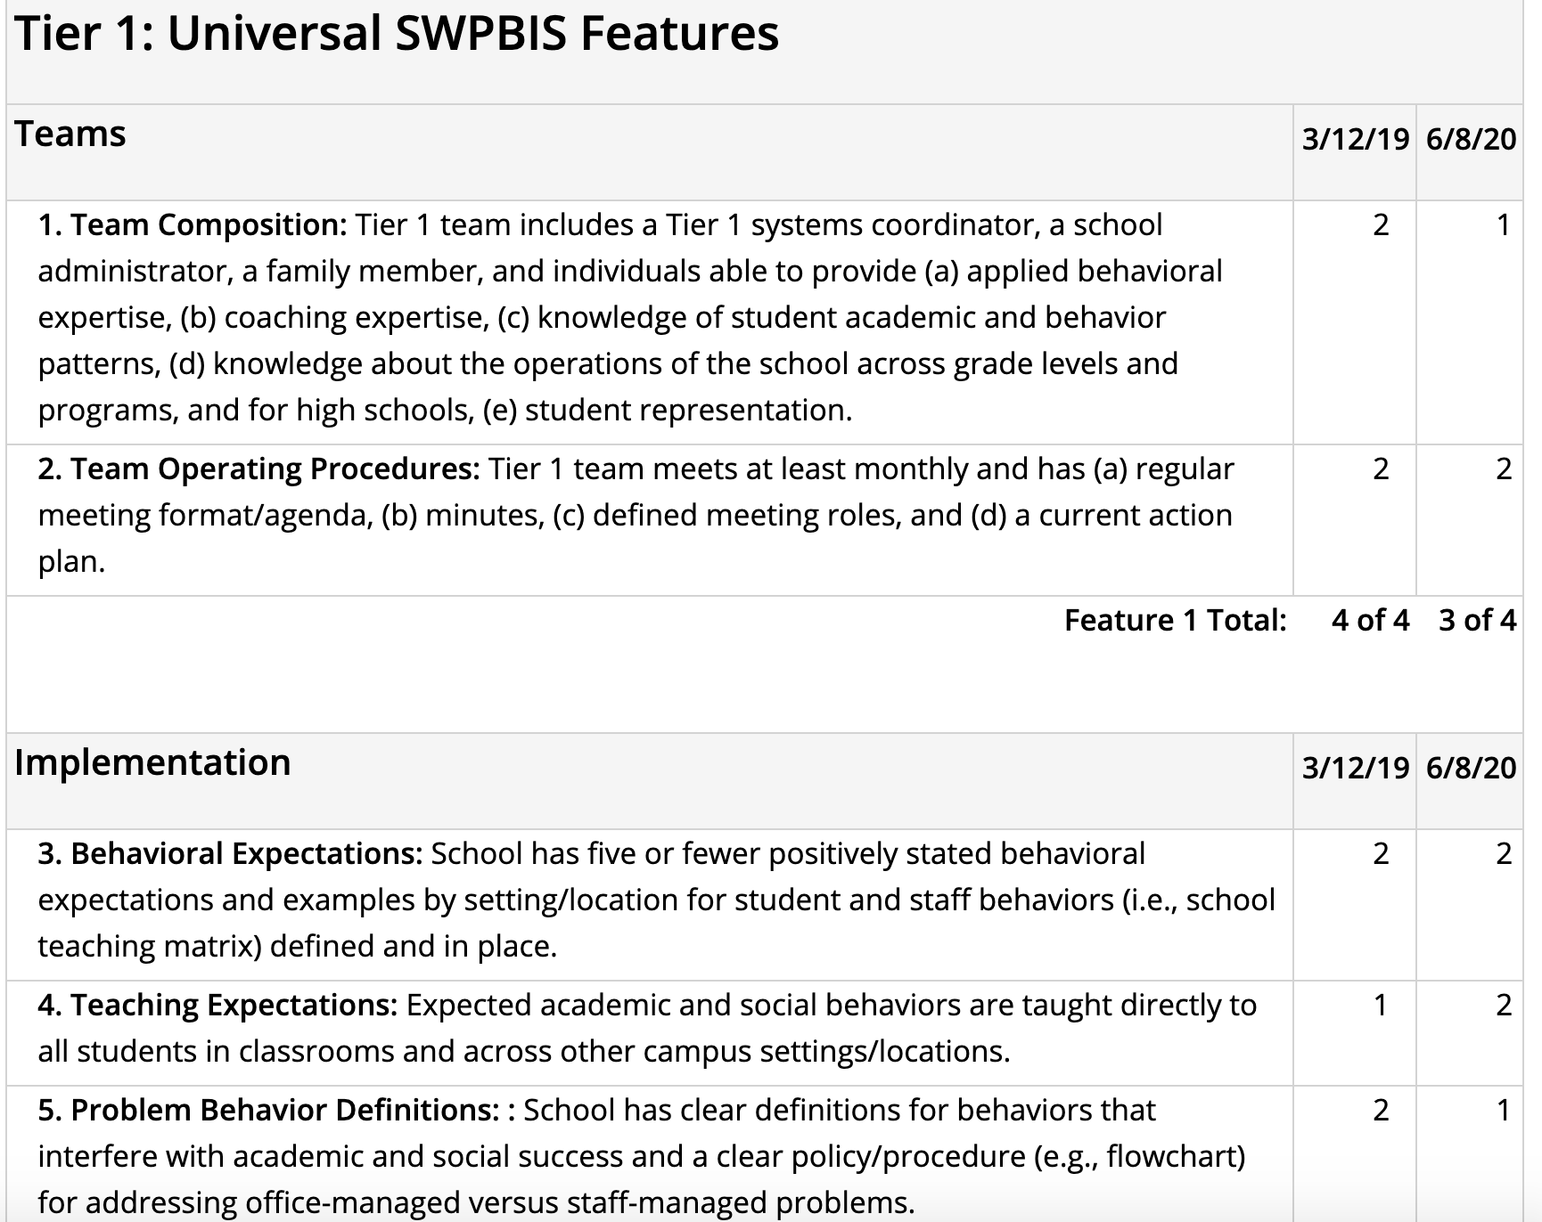
Example Items Report
What do you notice?
What do you wonder?
What might you prioritize?

Slide 26
New This Year!
Before you start, it will ask you which tiers you are assessing at this time
You can’t leave any response blank
The three questions at the end are removed (i.e. percent of students being successful)

Slide 27
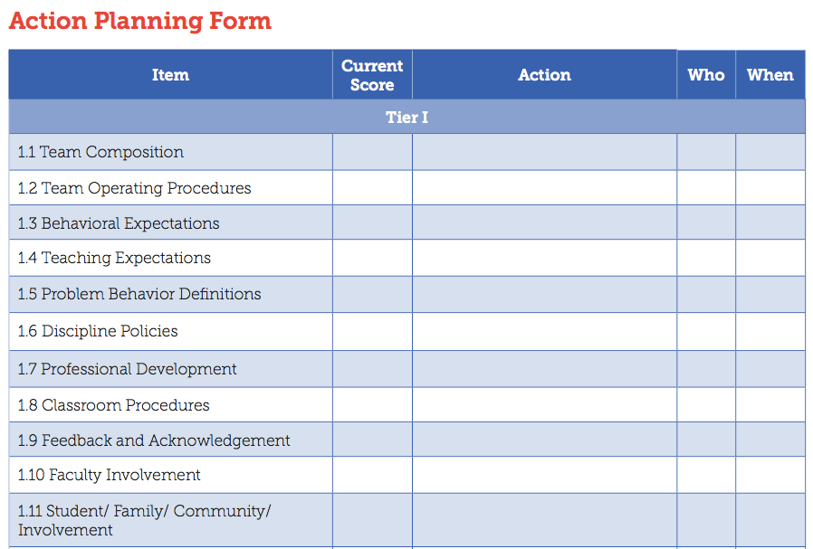
Action Planning Form
Notes:
Amy

Slide 28
Self-Assessment Survey (SAS)
Purpose: | Assess staff perceptions of PBIS practices in place and priority for changes Design annual action plan
Format: | Survey
Completed by: | All staff Manual or on-line scoring, graphing
When? | Annually, Jan. - March

Slide 29
Two main questions:
What systems are in place now?
What systems are most in need of improvement?

Slide 30
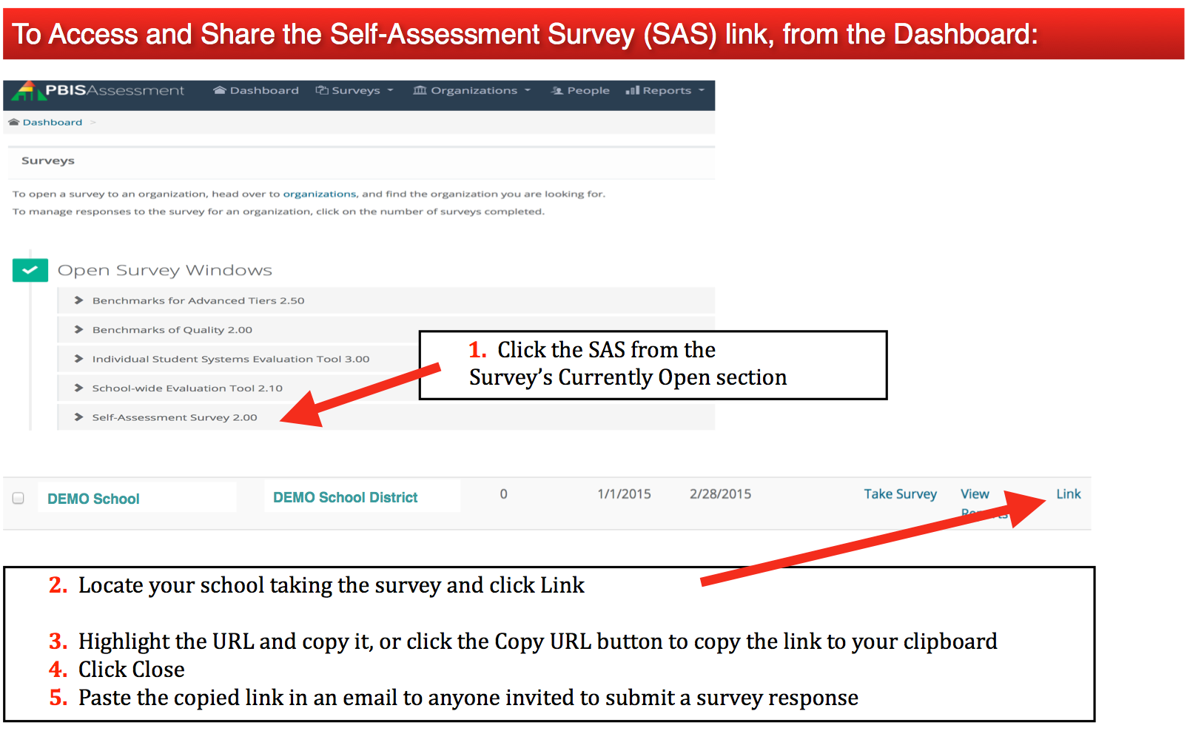
To Take the SAS…

Slide 31
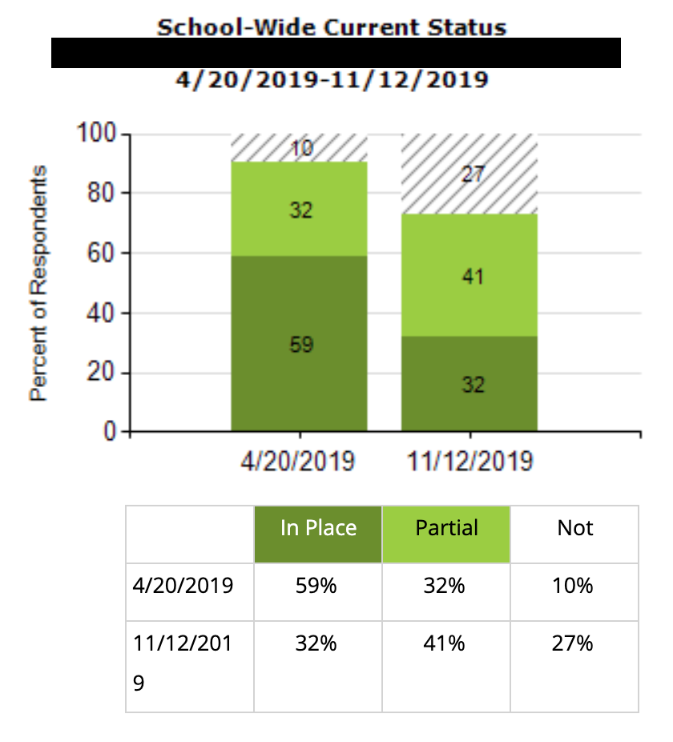
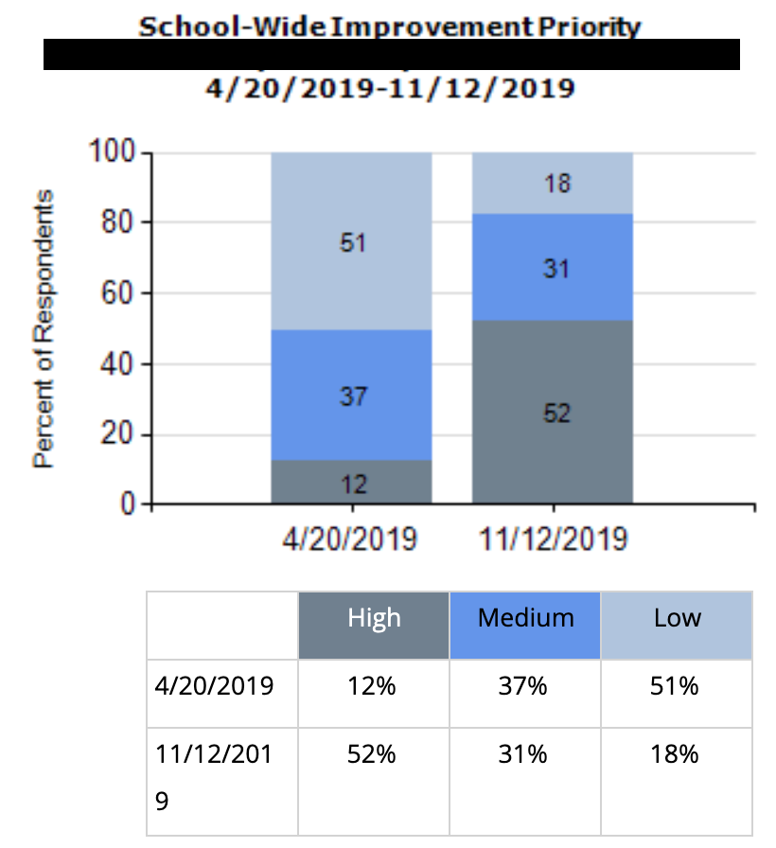
Total Score:
What do you notice?
What do you wonder?
What might you prioritize?

Slide 32
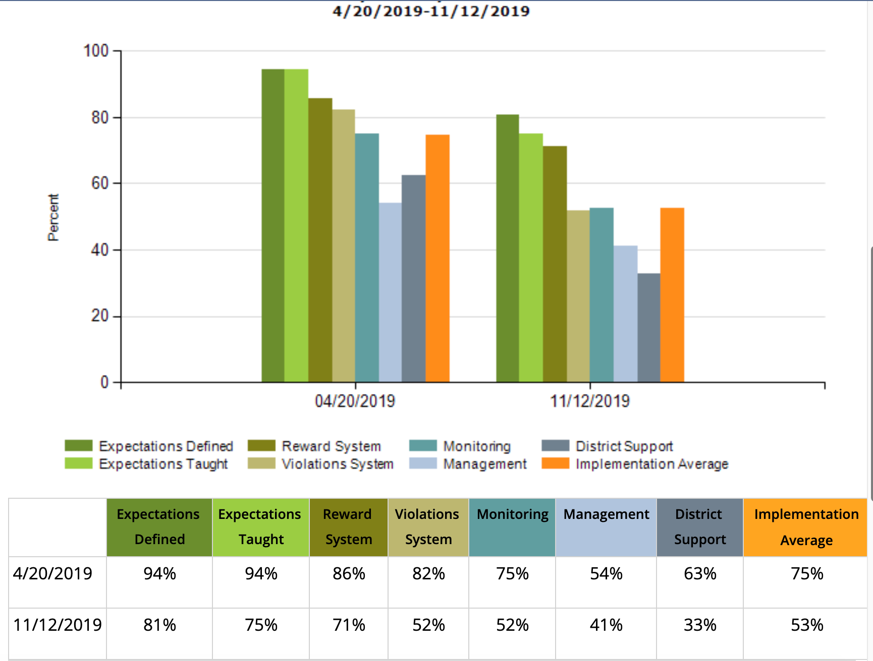
Subscale:
What do you notice?
What do you wonder?
What might you prioritize?

Slide 33
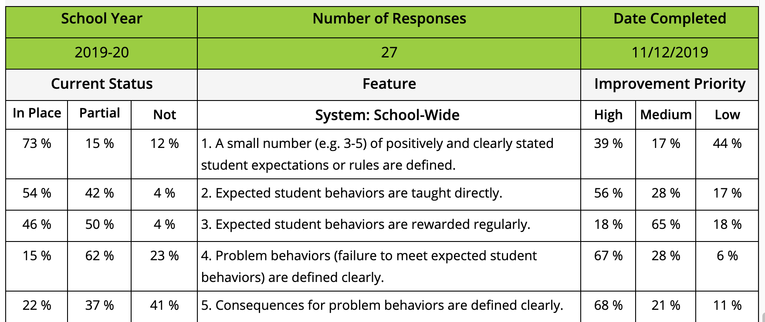
Items:
What do you notice?
What do you wonder?
What might you prioritize?

Slide 34
SAS Analysis
Use SAS Summary Graph to rate overall perspective of PBIS implementation & circle High, Med., or Low.
Using SAS Tally Pages, list three major strengths.
Using the SAS Tally pages, list three major areas in need of development.
For each system, circle one priority area for focusing development activities.
Circle or define activities for this/next year’s focus to support area selected for development.

Slide 35
Why Schools like the SAS:
Honors the input of all staff
Perceptions are important
Used in action planning
Reporting out to staff about priorities for change based on their feedback contributes to buy-in

Slide 36

PBIS School Climate Survey
*Not automatically opened for you – email Anne.Dubie@uvm.edu.

Slide 37
School Climate Survey – What?
Four Surveys:
  Students (grades 3-5; 11 questions)
  Students (grades 6-12; 9 questions)
    Measures based on school connectedness, school safety, school orderliness, and peer/adult relationships
  Staff (29 questions)
    Measures connectedness, structure of learning, school safety, physical environment, peer and adult relationships, and parental involvement
  Family Members (21 questions)
    Measures teaching and learning, school safety, interpersonal relationships, institutional environment, parent involvement

Slide 38
School Climate Survey – Benefits
Efficiency and ease of access
Multiple perspectives
Capacity for comparison across participants (gender, grade, race/ethnicity), time, and more!

Slide 39
School Climate Survey Readiness
Parent Permission/opt out
Introduction to Surveys
Plan for Reviewing Results and Action Planning

Slide 40
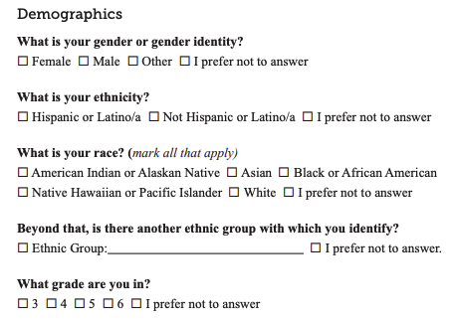
Sample Survey - Elementary

Slide 41
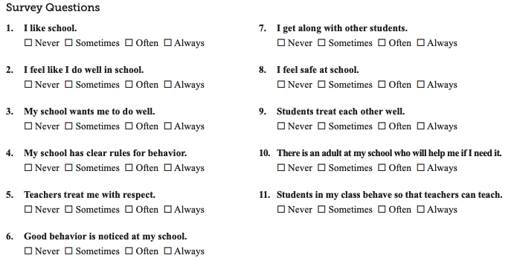
Sample Survey - Elementary

Slide 42
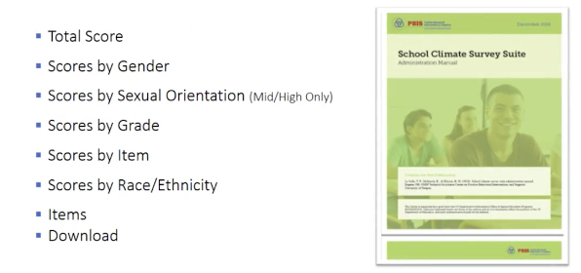
Reports for Students

Slide 43
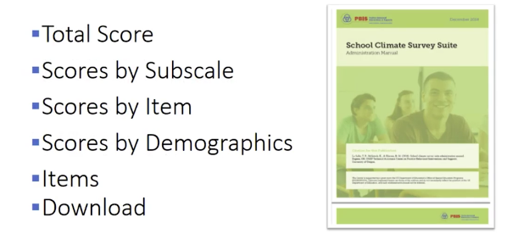
Reports for School Personnel and Families

Slide 44
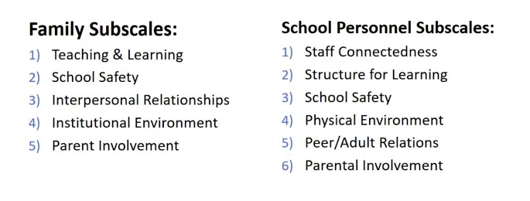
Subscale Reports – Families and School Personnel

Slide 45
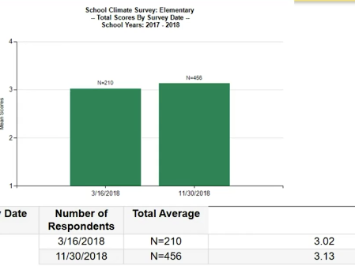
Sample Reports – Total Scores

Slide 46
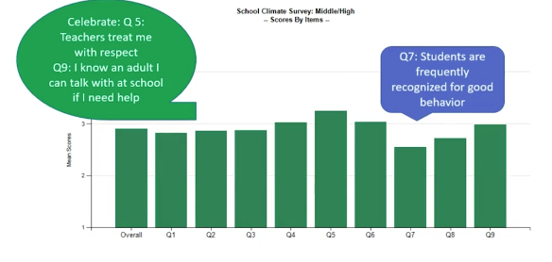
Report by Items – Highs and Lows

Slide 47
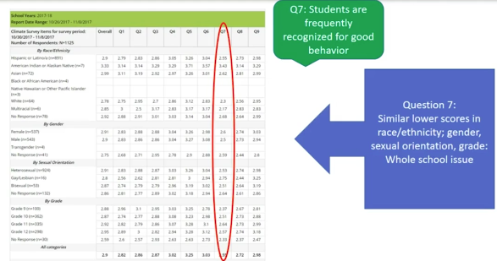
Items Reports for Details

Slide 48
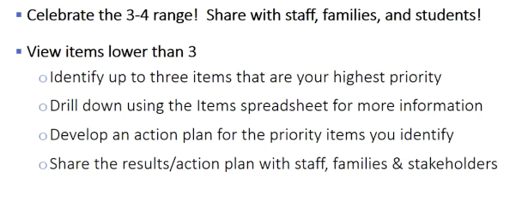
Moving to Action Planning

Slide 49
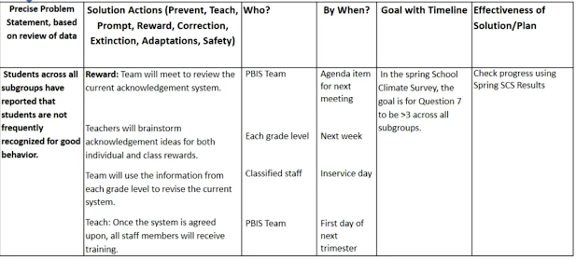
Action Planning

Slide 50
Putting it All Together

Slide 51
Formulate Questions Before Looking at Data
What are key subgroups in your setting?
What themes or major problems are you most concerned about?
What do you predict based on what you know?

Slide 52
Examine Overall Patterns
Patterns between groups
Patterns within groups
Patterns across time

Slide 53
Examine PBIS data alongside School Climate data to clarify picture
How do data from one area inform, explain, clarify complementary data?
  Out-of-school suspensions have increased for ELL students and ELL students report the lowest perceptions on adult-peer relations

Slide 54
Create Data-Informed Action Steps
Celebrate strengths
Target concerns/areas for growth

Slide 55
Dissemination Presentation Suggestions and Activities

Slide 56
Disseminating Data: Use Data as a Story-Telling Device
What data are you collecting?
What questions can you answer with this data? (remember proposed outcomes)
Who is your targeted audience for your story?
How could you display the data to convey the story of PBIS?
REMEMBER!
Before we can measure success, we must define success!
Notes:
Amy

Slide 57
Create an Infographic or Brief Power Point Presentation!
Simple is better!
Start with one graph or table and some descriptive text
See Staff Presentation Template in Materials
Notes:
Amy

Slide 58
Next Steps
Schedule a time to complete the TFI as a Leadership Team
Decide if your school will complete the SAS or the School Climate Survey
  SAS: Schedule a time for the full staff to complete the SAS
  School Climate Survey:
    Decide whether you will open the survey for staff, students, and/or families
    Decide when you want the survey window opened
    Email Anne Dubie (anne.dubie@uvm.edu)

Slide 59
What are your questions?

