Slide 1
Accessing, Completing, and Analyzing Results of the Tiered Fidelity Inventory (TFI), Self-Assessment Survey (SAS), and School Climate Survey
You will be muted during this session, except during breakouts.
Need help?
Type into the chat box
Presented by the VTPBIS State Team
This session will be recorded.
Materials can be found at: https://www.pbisvermont.org/training-resources/webinars/

Slide 2
Learning Objectives
Acknowledging
Acknowledging our context
Establishing
Establishing outcomes for action planning
Understanding and accessing
Understanding and accessing the TFI and SAS
Exploring
Exploring the School Climate Survey
Putting
Putting it all together for Action Planning

Slide 3
Lean On Your Framework
PBIS has meant the world to us as we have made the transition back to in-person learning. I have said a million times over the past 3 months that PBIS provides a perfect framework for us to articulate, teach, practice, and reinforce all of these new routines in our buildings.
Matt Young, Principal,
Peoples Academy Middle School

Slide 4
Supporting
Staff Behavior
Supporting
Decision Making
OUTCOMES
Systems
Data
Practices
Supporting Student Behavior
Notes:
3
DATA

Slide 5
Context:
VTPBIS schools are asked to complete the Tiered Fidelity Inventory (TFI) and Self-Assessment Survey (SAS) every year between January and March.
Schools implementing PBIS with fidelity will be better able to integrate MH supports and resources.
The impacts of this year’s disruptions on individual teachers, students and families is unknown, making it essential to expand the data used to guide social/emotional/behavioral learning and well-being.
Collecting robust data on perceptions of school climate can be used to ensure students and teachers are feeling connected and engaged in their learning environments, despite the disruptions.
Notes:
Office discipline referrals, attendance, and even academic performance may be more difficult to collect as schools move between learning modes.

Slide 6
Big Ideas About Data
All data should serve a purpose
Collect data with fidelity
Be prompt about looking at data and acting upon it
Use multiple sources of data to confirm what you see
Use data to support, not punish
Notes:
Sherry

Slide 7
Start with Outcomes
How will you know if PBIS is working if you are not sure where it should be taking you?
Notes:
Amy

Slide 8
What Are Your Outcomes?
Outcomes should be:
Locally determined
Contextually and culturally relevant
Observable and measurable
Summarized in goal statements
Consider using a “SMART Goal Format”
Notes:
Amy

Slide 9
Sample Outcomes
Reduce problem behaviors (from ODRs or BODFs)
Reduce bullying
Increase attendance/engagement
Improve school climate
Improve fidelity of interventions
Improve academic scores
Increase supports from community partners
Notes:
Amy

Slide 10
Sample Outcome Statements
“Given school-wide implementation of PBIS with fidelity, we will decrease the number of student suspensions and expulsions by 10% by the end of the school year.”
“As a result of completing a school climate survey for staff, students, and family members, improvements in three priority areas will be made by the end of the year.”
Notes:
Amy

Slide 11
Types of Data to Consider
Intensive:
TFI
I-SWIS
EST
FBA/BSP
ISF-II
Targeted:
TFI
SWIS-CICO
EST
FBA/BSP
Universal Screening
ISF-II
Universal:
TFI
SAS
SWIS
Attendance
Grades
Leadership Team Self-Assessment
School Climate
Family Engagement
ISF-II
Notes:
Sherry
What else?

Slide 12
Data help us ask the right questions.
They do not provide the answers.
Notes:
Assess current status and fidelity of implementation (school-wide)
Assess impact on students
Prioritize areas for change
Acknowledge incremental success along the way
Show staff you value and use their input to make changes (SAS)
Reward staff and student performance
Determine breaks between “roll-outs”
Share results with stakeholders

Slide 13
Poll
To what extent are you knowledgeable about the TFI and the SAS?

Slide 14
The Tiered Fidelity Inventory (TFI) Will Help Your Team Get to Outcomes
Notes:
Amy

Slide 15
TFI
What? An efficient and effective validated measure to assess fidelity of core PBIS features at all 3 tiers – Teams, Implementation and Evaluation
Why? To guide and sustain effective implementation of PBIS
When? Expectation is once a year for all schools
Window open January 1st - March 31st (for TFI and SAS)
Consider completing TFI more than once to monitor/assess progress
Contact Anne Dubie if you would like your window opened
Teams should anticipate 30 minutes to complete each tier’s assessment the first time
Notes:
Amy

Slide 16
Notes:
https://www.pbis.org/resource/conducting-the-tiered-fidelity-inventory-and-walkthrough-remotely

Slide 17
Uses of the TFI
Formative Assessment
Determine current PBIS practices in place and needed prior to launching implementation
Progress Monitoring
Self-assess PBIS practices by tier to guide implementation efforts and assess progress by tier
Build action plan to focus implementation efforts
Annual Self-Assessment
Facilitate sustained implementation of PBIS
State Recognition
Determine schools warranting recognition for their fidelity of PBIS implementation

Slide 18
Tier 1: Team - Big Ideas:
Teams need people with multiple skills and perspectives to implement PBIS well.
Specific features are necessary to ensure meetings are effective for action planning and tracking progress.
Notes:
Sherry

Slide 19
Tier 1: Implementation – Big Ideas:
Identifying behavioral expectations and teaching them
Operational definitions for problem behavior and consistent responses improve the predictability of social expectations
The key is staff consistency
PBIS expectations and consequences integrated into classroom systems
Students will sustain positive behavior if there are formal systems with strategies for rewarding and re-teaching appropriate behavior
Actively engage families, students, and faculty
Notes:
Sherry

Slide 20
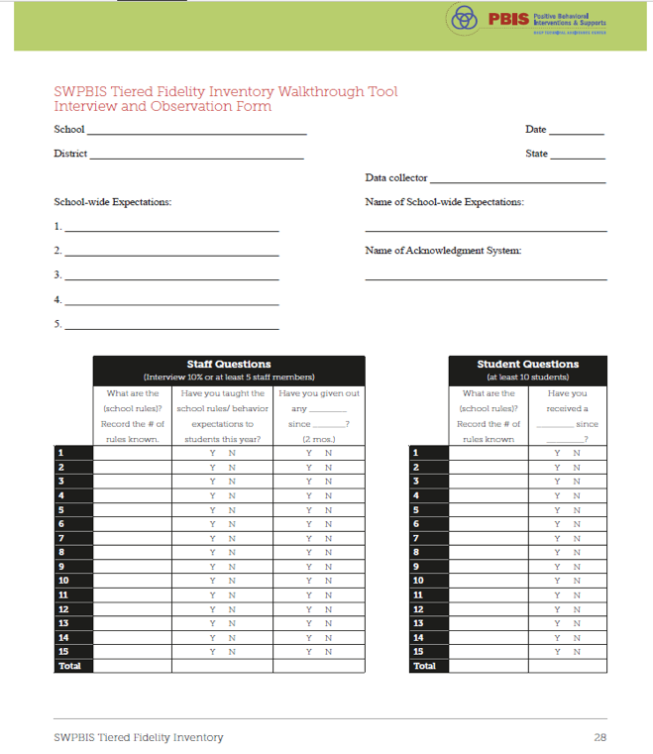
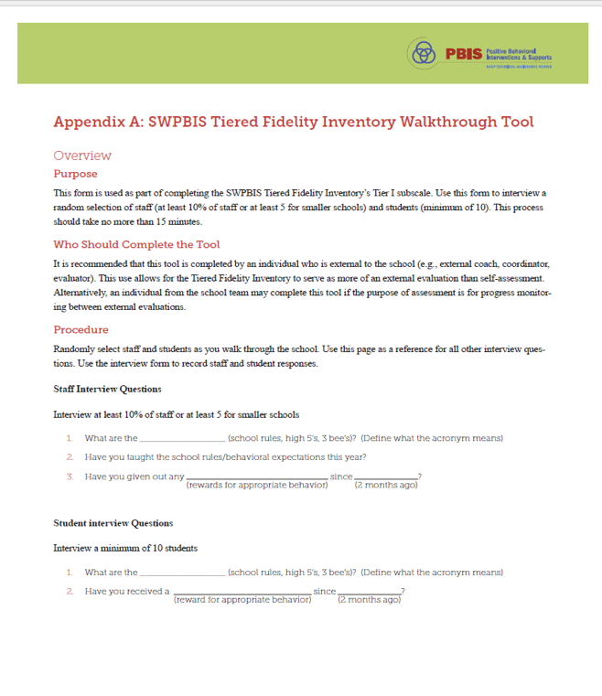
Notes:
The TFI Walkthrough Tool is Appendix A: pages 27-28 of the TFI. This is a tool that is used by a coach/external person to complete prior to the TFI. The first page provides an overview and the questions to ask staff and students. The second page is a place for recording the information. This provides an efficient way to calculate the percentages to assist with the TFI items.

Slide 21
Tier 1: Evaluation – Big Ideas:
Teams need the right information at the right time to make effective decisions.
Measuring fidelity data is essential for maintaining effective implementation of PBIS.
Implementation of Tier 1 is likely more sustainable if the Team self-assesses at least annually AND reports this data to key stakeholders.
Notes:
Sherry

Slide 22
TFI Item 2.5: Options for Tier II Interventions
Feature | Possible Data Sources | Scoring Criteria
Options for Tier 2 Interventions: Tier 2 team has multiple ongoing behavior support interventions with documented evidence of effectiveness matched to student need. | School Tier 2 handbook Targeted Interventions Reference Guide (aka Targeted Inventory) | 0 = No Tier 2 interventions with documented evidence of effectiveness are in use 1 = Only 1 Tier 2 intervention with documented evidence of effectiveness is in use 2 = Multiple Tier 2 interventions with documented evidence of effectiveness matched to student need

Slide 24
3.4 Student Support Team
Feature | Possible Data Sources | Scoring Criteria
Student Support Team: For each individual student support plan, a uniquely constructed team exists (with input/approval from student/family about who is on the team) to design, implement, monitor, and adapt the student-specific support plan. | Three randomly selected Tier III student support plans developed in the past 12 months (see Appendix C: TFI Tier III Support Plan Worksheet) | 0 = Individual student support teams do not exist for all students who need them. 1 = Individual student support teams exist, but are not uniquely designed with input from student/family and/or team membership has partial connection to strengths and needs. 2 = Individual student support teams exist, are uniquely designed with active input/approval from student/family (with a clear link of team membership to student strengths and needs), and meet regularly to review progress data.
Main Idea:
Each student receiving Tier III supports benefits from having an individualized team comprised of relevant stakeholders.

Slide 26
After Assessment
Analyze data:
Total score report (all 3 tiers averaged)
Subscale report (broken down by tier)
Sub-sub scale report (broken down by components)
Individual items report
Celebrate your 2’s, examine your 0’s and 1’s
Notes:
Amy

Slide 27
Example Scale Report
What do you notice?
What do you wonder?
What might you prioritize?

Slide 28
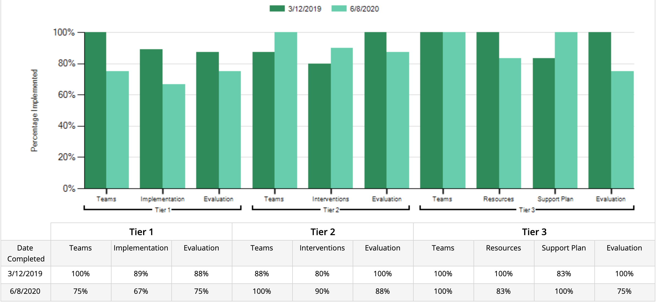
Example Subscale Report
What do you notice?
What do you wonder?
What might you prioritize?
Notes:
Amy

Slide 29
Example Items Report
What do you notice?
What do you wonder?
What might you prioritize?

Slide 30
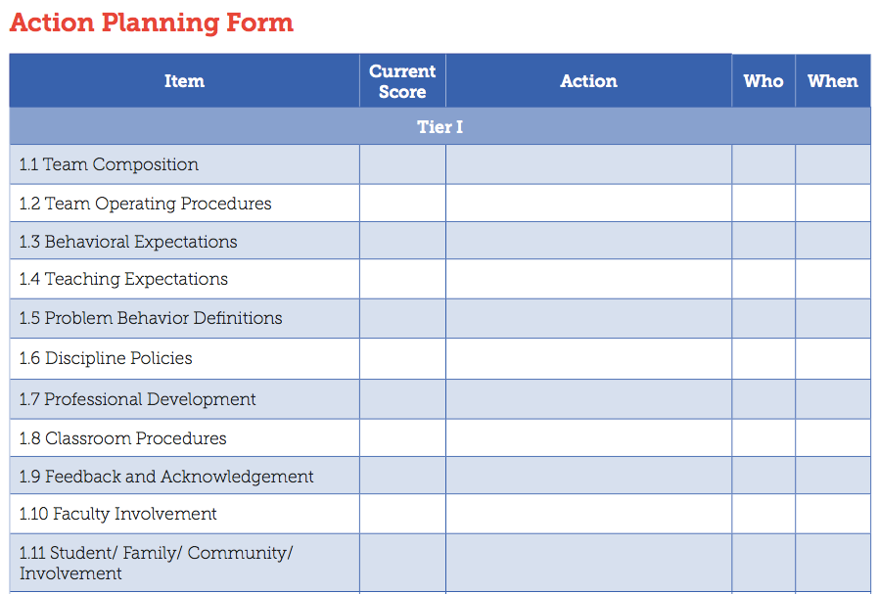
Action Planning Form
Notes:
Amy

Slide 31
Self-Assessment Survey (SAS)
Purpose: | Assess staff perceptions of PBIS practices in place and priority for changes Design annual action plan
Format: | Survey
Completed by: | All staff Manual or on-line scoring, graphing
When? | Annually, preferably in the spring

Slide 32
Two main questions:
What systems are in place now?
What systems are most in need of improvement?

Slide 33
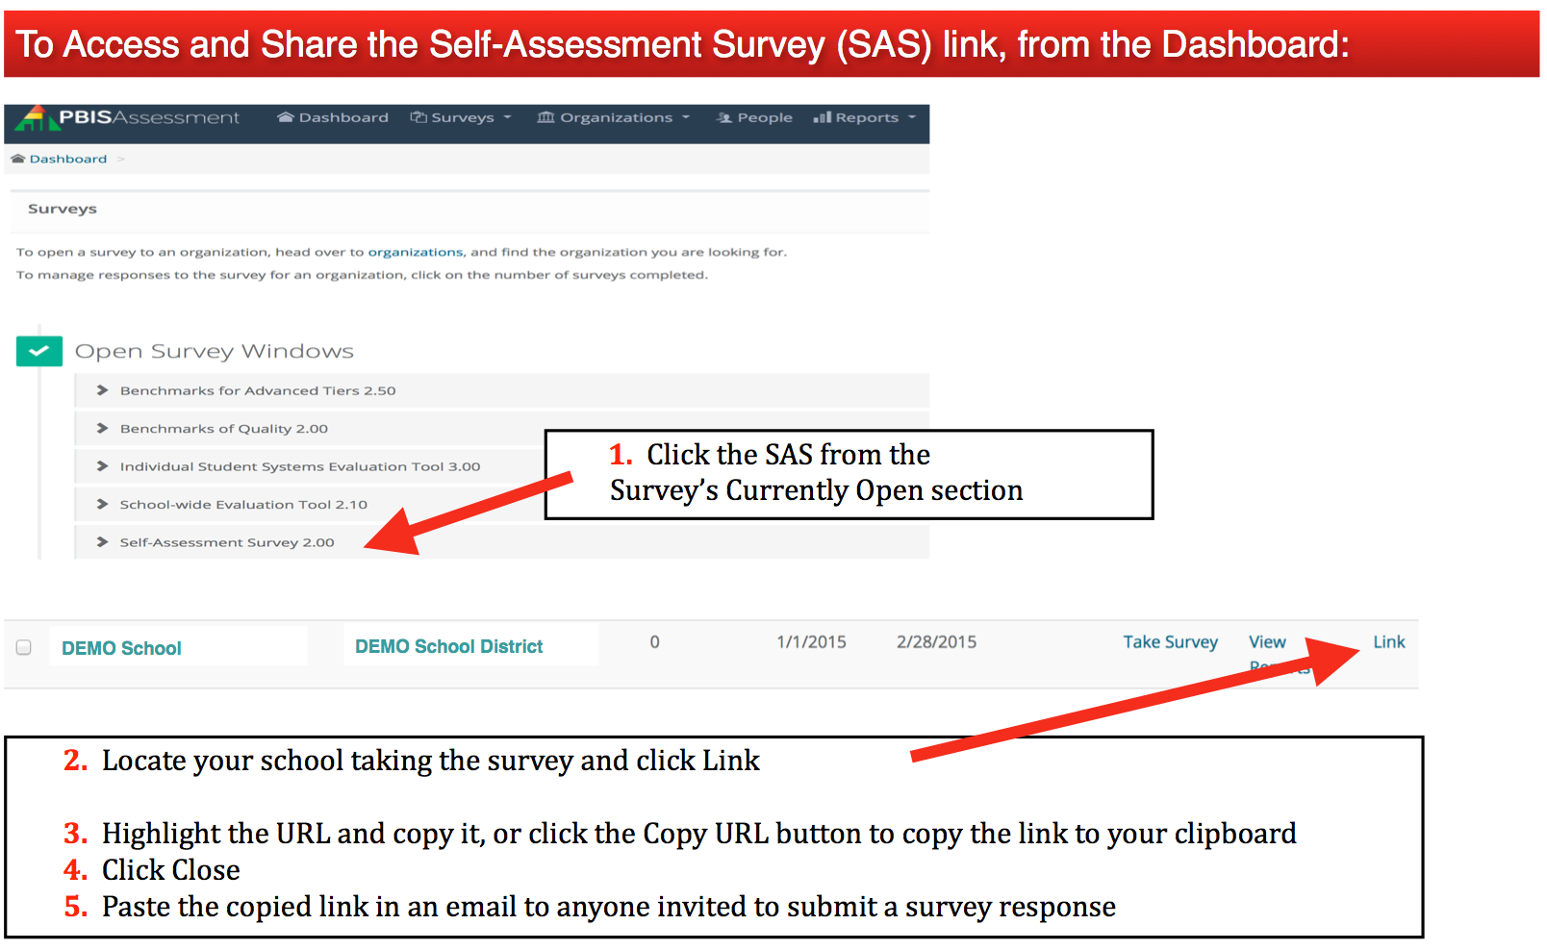
To Take the SAS…

Slide 34
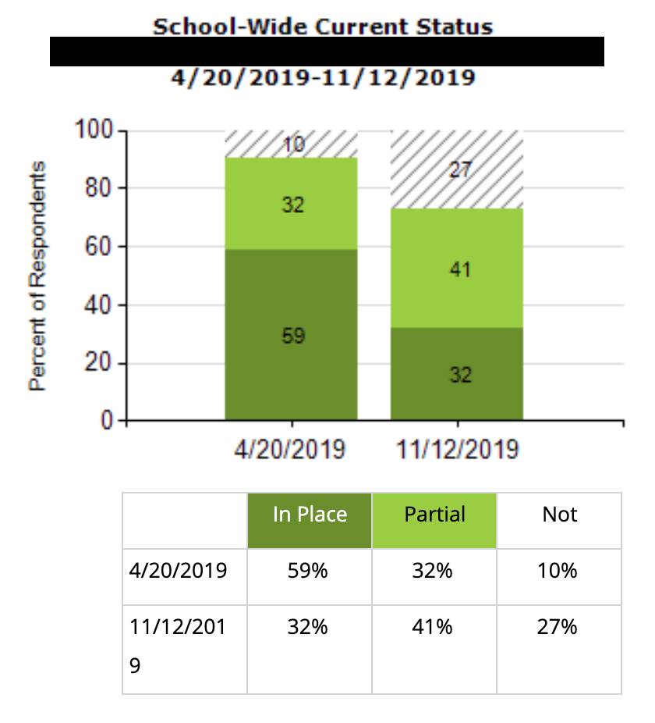
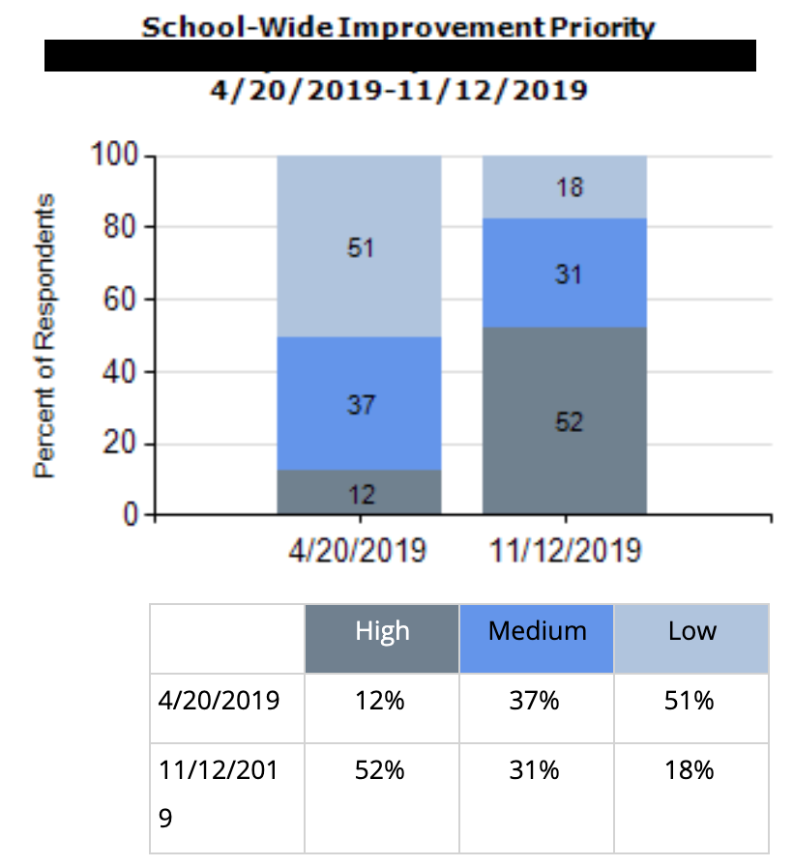
Total Score:
What do you notice?
What do you wonder?
What might you prioritize?

Slide 35
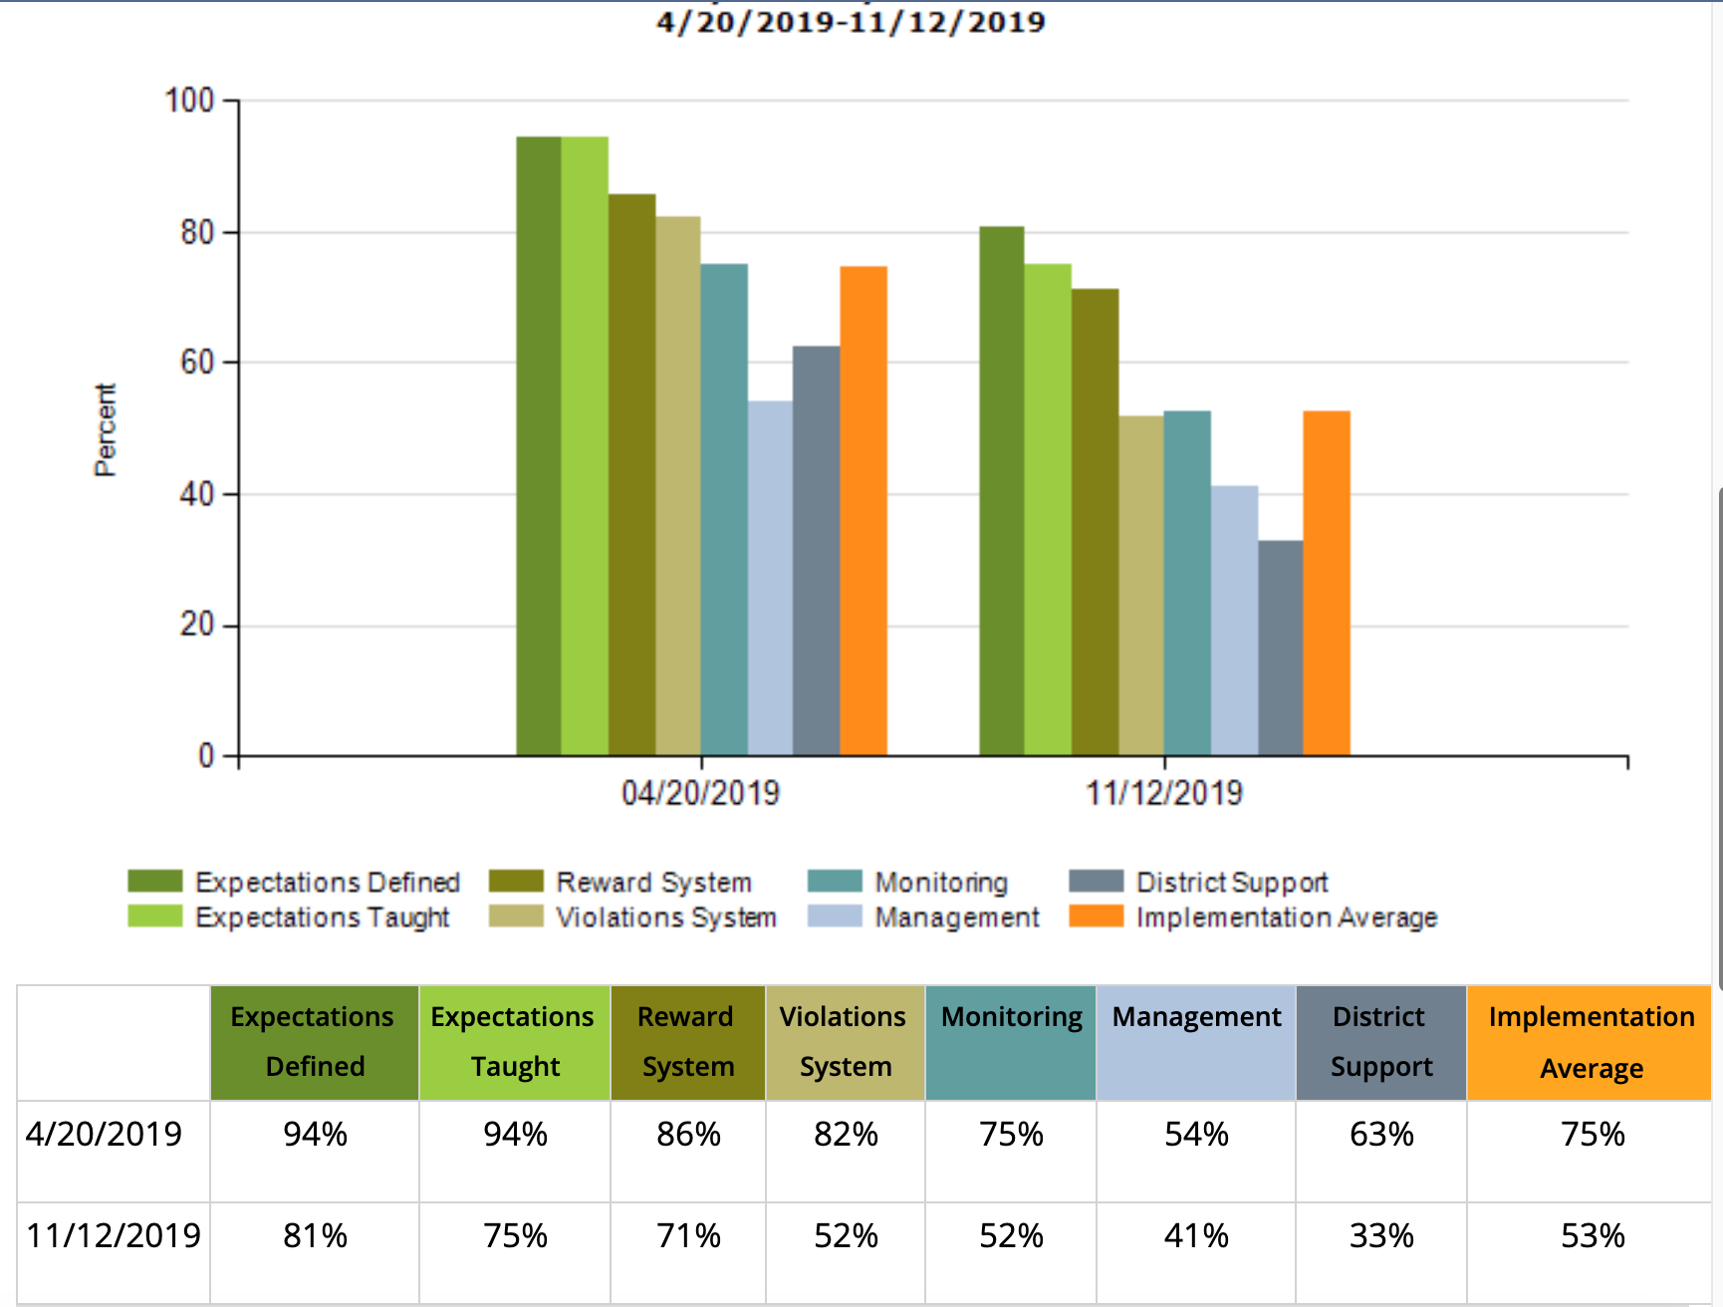
Subscale:
What do you notice?
What do you wonder?
What might you prioritize?

Slide 36
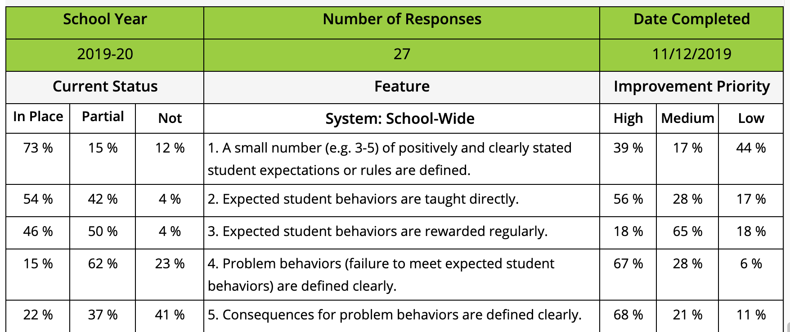
Items:
What do you notice?
What do you wonder?
What might you prioritize?

Slide 37
SAS Analysis
Use SAS Summary Graph to rate overall perspective of PBIS implementation & circle High, Med. or Low
Using SAS Tally Pages, list three major strengths
Using the SAS Tally pages, list three major areas in need of development.
For each system, circle one priority area for focusing development activities
Circle or define activities for this/next year’s focus to support area selected for development

Slide 38
Circle or define activities for this/next year’s focus to support area selected for development
Overall Perception
School-wide | Non-classroom | Classroom | Individual Student
a. Organize a team b. Define/teach school rules c. Define consequence systems for appropriate & inappropriate behavior d. Define a measurement system linked to school improvement goal e. Establish communication cycles with other school teams f. Develop implementation plan | a. Define/teach routines b. Supervisor booster training & feedback sessions c. Data management d. Maintain team & communication cycle with other school teams e. Develop implementation plan | a. Define/teach routines/ link with school wide rules b. Classroom staff boosters & feedback sessions for creating effective strategies/materials c. Data management d. Maintain team & communication cycle with other school teams e. Develop implementation plan | a. Process for referral & support plan design, implementation & monitoring b. Plan to develop & use FBA to support skills c. Data management d. Maintain team & communication cycle with other school teams e. Develop implementation plan

Slide 39
Why Schools like the SAS:
Honors the input of all staff
Perceptions are important
Used in action planning
Reporting out to staff about priorities for change based on their feedback contributes to buy-in

Slide 40
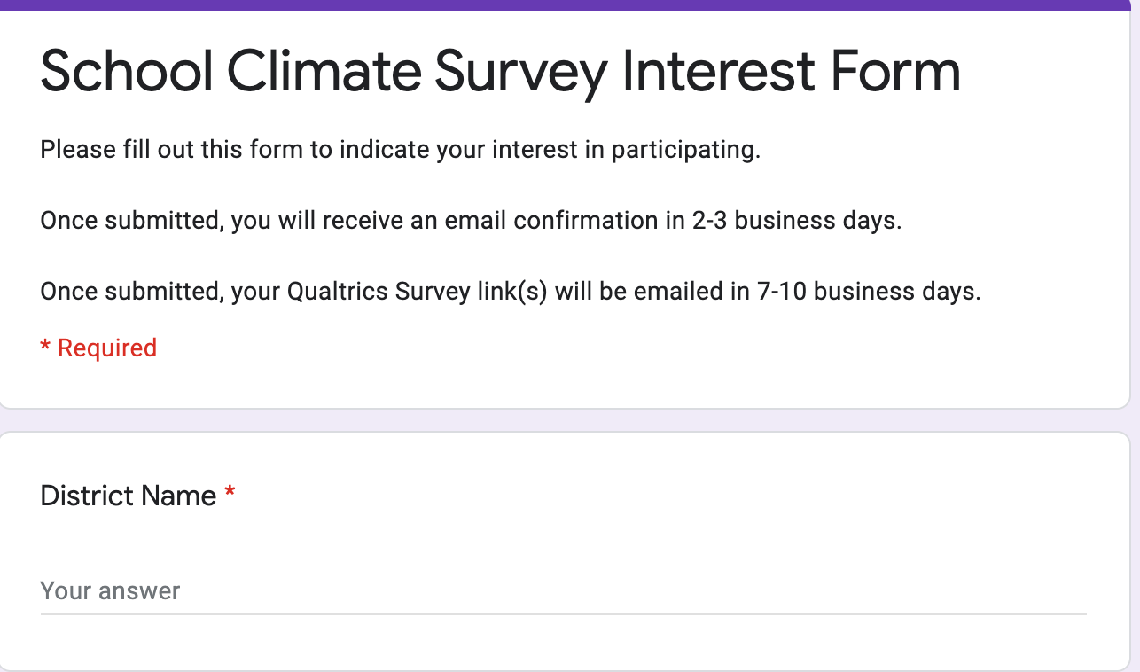
Introducing the PBIS School Climate Survey
(and modified version)

Slide 41
School Climate Survey – What?
Four Surveys:
Students (grades 3-5; 11 questions)
Students (grades 6-12; 9 questions)
Measures based on school connectedness, school safety, school orderliness, and peer/adult relationships
Staff (29 questions)
Measures connectedness, structure of learning, school safety, physical environment, peer and adult relationships, and parental involvement
Family Members (21 questions)
Measures teaching and learning, school safety, interpersonal relationships, institutional environment, parent involvement

Slide 42
School Climate Survey (Modified)
A brief introductory statement clarifying that students should consider their feelings related to all school related activities including remote, hybrid, or in person events when taking the survey.
All standard items with the use of skip logic to remove questions related to the physical environment for students and personnel that indicate they are fully remote.

Slide 43
School Climate Survey – Benefits
Efficiency and ease of access
Multiple perspectives
Capacity for comparison across participants (gender, grade, race/ethnicity), time, settings, and more!
Adaptability

Slide 44
School Climate Survey Readiness
Parent Permission/opt out
Introduction to Surveys
Plan for Reviewing Results and Action Planning

Slide 45
Sample Survey - Elementary

Slide 46
Sample Survey - Elementary

Slide 47
Reports for Students

Slide 48
Reports for School Personnel and Families

Slide 49
Subscale Reports – Families and School Personnel

Slide 50
School Climate Survey Scoring

Slide 51
Sample Reports – Total Scores

Slide 52
Report by Items – Highs and Lows

Slide 53
Items Reports for Details

Slide 54
Moving to Action Planning

Slide 55
Action Planning

Slide 56
Putting it All Together

Slide 57
Formulate Questions Before Looking at Data
What are key subgroups in your setting?
What themes or major problems are you most concerned about?
What do you predict based on what you know?

Slide 58
Examine Overall Patterns
Patterns between groups
Patterns within groups
Patterns across time

Slide 59
Examine PBIS data alongside School Climate data to clarify picture
How do data from one area inform, explain, clarify complementary data?
Out-of-school suspensions have increased for ELL students and ELL students report the lowest perceptions on adult-peer relations

Slide 60
Create Data-Informed Action Steps
Celebrate strengths
Target concerns/areas for growth

Slide 61
Dissemination Presentation Suggestions and Activities

Slide 62
Disseminating Data: Use Data as a Story-Telling Device
What data are you collecting?
What questions can you answer with this data? (remember proposed outcomes)
Who is your targeted audience for your story?
How could you display the data to convey the story of PBIS?
REMEMBER!
Before we can measure success, we must define success!
Notes:
Amy

Slide 63
Create an Infographic or Brief Power Point Presentation!
Simple is better!
Start with one graph or table and some descriptive text
See Staff Presentation Template in Materials
Notes:
Amy

Slide 64
What are your questions?

