Slide 1
Function-Based Thinking and Beyond
10/17/2023
Jeremy Tretiak MA, BCBA, VT-LBA
VTPBIS Coach & Trainer
CPI Trainer

Slide 2
Gratitude—Thank you…
…for being present today
…for surviving, and perhaps even thriving, over
the last few years
…to those who bring years of experience
…to those who decided to join this profession recently

Slide 3
A hope…
…to add tools to your toolbox, or at least hone tools you’ve always had but that’ve gathered a bit of rust and dust in the face of the stressors of our last couple of years
…to share and celebrate our collective knowledge

Slide 4
An opening activity…
Invitation to type into the chat box:
What brings you here today?
What brings you to/keeps you in education?
What values guide your professional work?

Slide 5
Learning Targets
Describe behavior using the three-term contingency
Understand that behavior serves a function (a need or desire) and describe some basic ways to determine that function
Understand some of the factors that influence behavior

Slide 6
Learning Targets
Understand the concept of the “Competing Behavior Pathway”
Explore a few intervention strategies
Learn to enhance the power of relationship

Slide 7
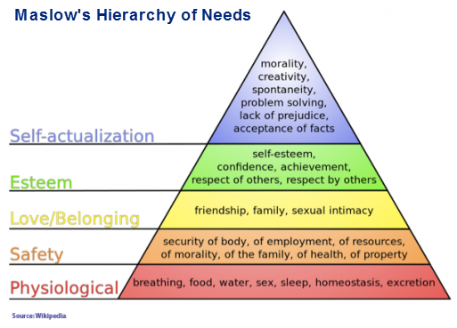
What’s This All About?
ACCESS!

Slide 8
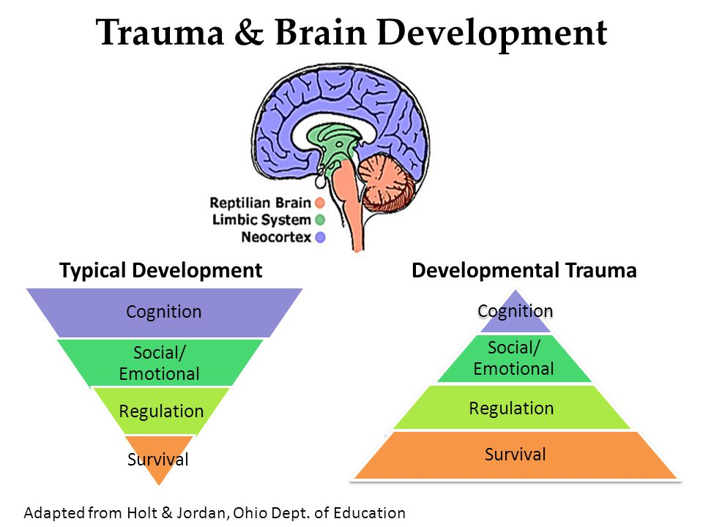

Slide 9
Building resilience…

Slide 10
Another concept to empower the learner…

Slide 11
From ‘deficit’ to ‘skills-based’ mindset
How do we use constructional approaches vs. pathological approaches
Pathological: decrease problem/interfering behavior
Constructional: strict focus on shaping behavior from its current starting point
Example of young girl throwing things off her desk
Premise: there is no such thing as irrational or maladaptive behavior
For further reading: see T.V. Joe Layng and/or Israel Goldiamond’s work.)

Slide 12
Why Behave?
Behavior serves a function for the individual.
To describe a persistent behavior as “not working,” “maladaptive,” “problem,” etc., is not exactly accurate, at least from the individual’s perspective.
What need does the behavior meet for the individual?

Slide 13
Why Behave?
The behavior is effective for
the individual, or else the person
wouldn’t engage in it.

Slide 14
Our role?
Our job: to teach and reinforce behavior that is more efficient and effective for the individual within the school environment.
Make historically challenging behavior inefficient, ineffective, and irrelevant.
Avoid invalidating – think about relationship.

Slide 15
Develop a Plan – Contextual Fit
A good (and likely effective) plan contains elements that
are:
Equitable
Knowledgeable
Valid
Relevant
Ecological Perspective and Humanism
Systems of inter-related variables

Slide 16
Function-Based Thinking (FBT) – What is it?
The Universal approach to evidence-based behavioral intervention strategies
On-the-spot/in-the-moment, ranging to long-term
DATA-BASED!
What “turns the behavior on?” Off?
Environment influences behavior…
…and we are part of the environment.

Slide 17
Why Function-Based Thinking?
Avoid accidentally reinforcing interfering behavior
Effectively discourage interfering behavior
Teach and reinforce meaningful replacement behaviors

Slide 18
A Paired Activity
Discuss an experience where you thought you were applying (or observed someone else applying) a consequence that was intended to stop/decrease a behavior, but the actions in fact had the opposite effect. How did you know?

Slide 19
A-B-C & Function-Based Thinking – Behavior Pathway
Setting Event/
Condition
Antecedent
Behavior
Consequence

Slide 20
The Three (four)-Term Contingency
Antecedent: the “signal” to engage in a behavior.
Behavior: the thing we are focused on – must be defined in an observable, measurable way (i.e., multiple people can observe it and agree that it happened or didn’t happen, and it must be ‘countable’ in some way).
Consequence: the change in an environment that occurs immediately following a behavior – influences future likelihood that the behavior occurs again.

Slide 21
The Three (four)-Term Contingency, ctnd.
A → B → C
[Current Setting Events(A → B → C)]
{[Current Setting Events(A → B → C)] x Learning History}
Human behavior is a complicated thing.

Slide 22
Clarifying Consequences
We are not talking exclusively about disciplinary responses
Past consequences influence FUTURE EVENTS
Patterns in the consequences associated with behavior help us determine function
PROBABILITIES!

Slide 23
Reinforcement and Punishment
Reinforcement = maintenance/increase
Punishment = decrease
This isn’t about our personal beliefs – the data will tell us what’s going on
There is no one-size-fits-all intervention—this is a framework for determining what we need to do differently. And what skills need to be taught.

Slide 24
Why Behave?, revisited

Slide 25
A-B-C & Function-Based Thinking, an example
Setting Event
Antecedent
Behavior
Consequence
Typically, on days when Sarah comes in late because she overslept…
when she’s given math worksheets & other written assignments…
she engages in side-conversations and uses profanity when redirected.
Sarah is sent out of the classroom.

Slide 26
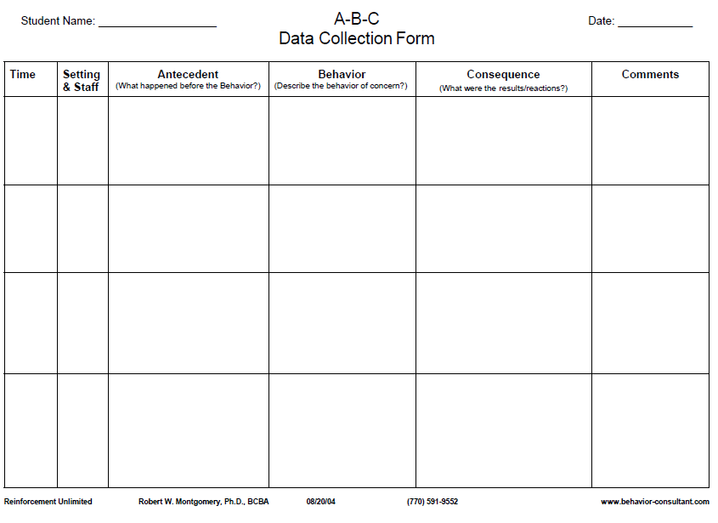
1. Sarah was given math worksheets and instructed to complete them before she could go grab a snack from the cafeteria
1. Sarah engages in side-conversation with a peer
1. Teacher redirects Sarah to the worksheet task
8:30 am. Math Class w/ Mr. T.
Sarah came to school late because she overslept
The same pattern has been observed several times previously in math classes
2. Teacher redirects Sarah to the worksheet task
2. Sarah begins to swear at teacher and says she is not doing the worksheet
2. Sarah is sent out of the classroom (to the office) by teacher
Notes:
Objective, measurable and observable
Emphasize that understanding of function is a working hypothesis—data collection is ongoing
ALSO CONSIDER: Adult behavior can be tracked/considered in this format too! (Probably not time for that discussion in this webinar).

Slide 27
WTF?
What’s the function?
And what else should we be considering?

Slide 28
Gathering Information – ASK!
What are the most common routines/settings when/where the behavior is likely to occur?
Who are the people most likely to be associated with this behavior (peers and/or adults)?
Are there predictable “signals” in the environment that correlate with the behavior?

Slide 29
Gathering Information, ctnd.
Are there predictable consequences in the environment that correlate with the behavior?
Are there variables outside the direct control of the situation that might influence the likelihood that the behavior will occur?
Can we work on these variables directly, or do we need to think about them indirectly?
What are the lagging skills (academic, social/emotional) that need to be taught?

Slide 30
What’s Working?
Let’s not forget to ask about what’s going well!

Slide 31
Where’s the Data? Small group discussion…
What is your comfort level collecting data?
How do you collect, manage, and use academic data to evaluate your practices?
Could these efforts/experiences translate to behavior?

Slide 32
Why Behave?, revisited…again

Slide 33
Some common classroom examples….WTF?!
Off-task
Calling out
Out of seat
Talking to peers
IT DEPENDS!

Slide 34
What to do with all the data? Enter: The Competing Behavior Pathway…
Routine:
Outcome Behavior
Consequence/Function
Desi
FINISH
HERE!
Setting Event/Conditions
Antecedent
Interfering Behavior
Consequence/Function
Alternative Behavior
START HERE!

Slide 35
This is about Teaching and Shaping
Notes:
Cortney

Slide 36
Shifting to some strategies to maximize opportunities for success
Notes:
Cortney

Slide 37
Building Rapport
Some evidence that it’s possible to operationalize and work on building rapport (McLaughlin & Carr, 2005)
Providing non-contingent positive experience/item
Increasing responsiveness to communication and attempts to communicate (particularly for positive experiences/items)
Strengthening reciprocity and turn-taking (particularly through mutual, shared interests)

Slide 38
Some classroom-based strategies…
There are no “magic” solutions to behavioral challenges, but you can work to build relationship and provide structure for voice and choice (agency)…
Observe the 2 x 10 strategy (Raymond Wlodkowksi): spend 2 minutes per day talking with a student about something other than school – make personal connections.*
Research supports addressing each student by name along with one quick personal connection at the start of each class period to increase on-task time (Allday, et al., 2007 [and other studies]).**
On-task behavior went from 45% baseline to 72% intervention
*https://www.panoramaed.com/blog/2x10-relationship-building-strategy
**https://www.ncbi.nlm.nih.gov/pmc/articles/PMC1885415/

Slide 39
Some classroom-based strategies…
Provide structure and consistency: predictable responses to behavior; schedules and routines that minimize unexpected change
Post schedules
Advanced warning of any changes
Transition routines
Transitions, again
Set up high probability sequences to ease transitions to tougher work demand
Exciting transition activities to start class-time

Slide 40
Some classroom-based strategies…
Offer choice; provide opportunities for students to assert some “control”
Paired choice within activity, setting, assignments, etc.
Let a student be an expert
Teach and reinforce functional communication skills and “safe escape”
Develop plans with students to access a safe place if they are overwhelmed
Embed reminders and provide praise for using these strategies
Offer cognitively distracting tasks for time out/reset zones
Sensory kits--time out alone does not relieve anxious thoughts that often influence behavior

Slide 41
Some classroom-based strategies…
Strengths-based learning opportunities
Play to a diversity of strengths and be flexible with expectations for each student
Develop new skills as completely as possible before moving on
Try to start the day or class with a positive experience (maybe not homework collection)
Pair yourself and the classroom with “good feelings”—make yourself trustworthy and reinforcing!
Be mindful of your body language and tone of voice (think trauma sensitive)
Body position; voice volume
Sarcasm and humor

Slide 42
Some classroom-based strategies…
When vs. No
Avoid yes/no answers and yes/no questions
Teach students to avoid these questions
Tell students “when” they can engage in a behavior
Reward/recognize practice not performance
Studies that show kids will try harder on difficult work when effort vs. intelligence is praised (Dweck & Mueller, 1998; http://socialpsychonline.com/2016/07/psychology-success/)

Slide 43
Some classroom-based strategies…
Explicitly teach students how to be mindful of their own bodies
Teach students to do “body checks:” identify how escalation feels in the body (e.g., where/what/intensity)
Provide teaching of strategies to relieve tension when it is noticed
Tension/relaxation, holding breath, deep breathing
Practice when things are “good”
And finally…do all these same things to take care of yourself--especially this one right above here.

Slide 44
Closing us out
Gratitude for your time and participation
Closing activity: How do you plan to use the information shared in this presentation?
jeremy@gmbehavior.org

