Slide 1

Understanding Universal Screening for Social, Emotional, and Behavioral Risks and Strengths and Key Considerations for COVID-19
Presented by the VTPBIS State Team
Notes:
Please make sure you have copies of the materials so you and your team can familiarize yourself with them.

Slide 2
Welcome!
You will be muted during this session, except during breakouts.
Need help?
Type into the chat box
You
can show or hide your video.
This session will be recorded.
If you’d like to access the recording, please email anne.dubie@uvm.edu.

Slide 3

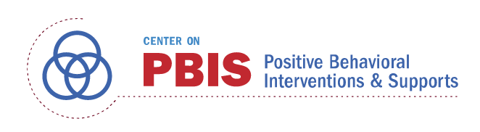





Acknowledgements
Notes:
Also:
WestEd
Kym Asam
AIR
Harvard

Slide 4
Agenda
What is the context?
Why is it important?
What are considerations?
How do we get started?
What does it look like?
What is screening?

Slide 5
Check your battery:
Poll

Slide 6
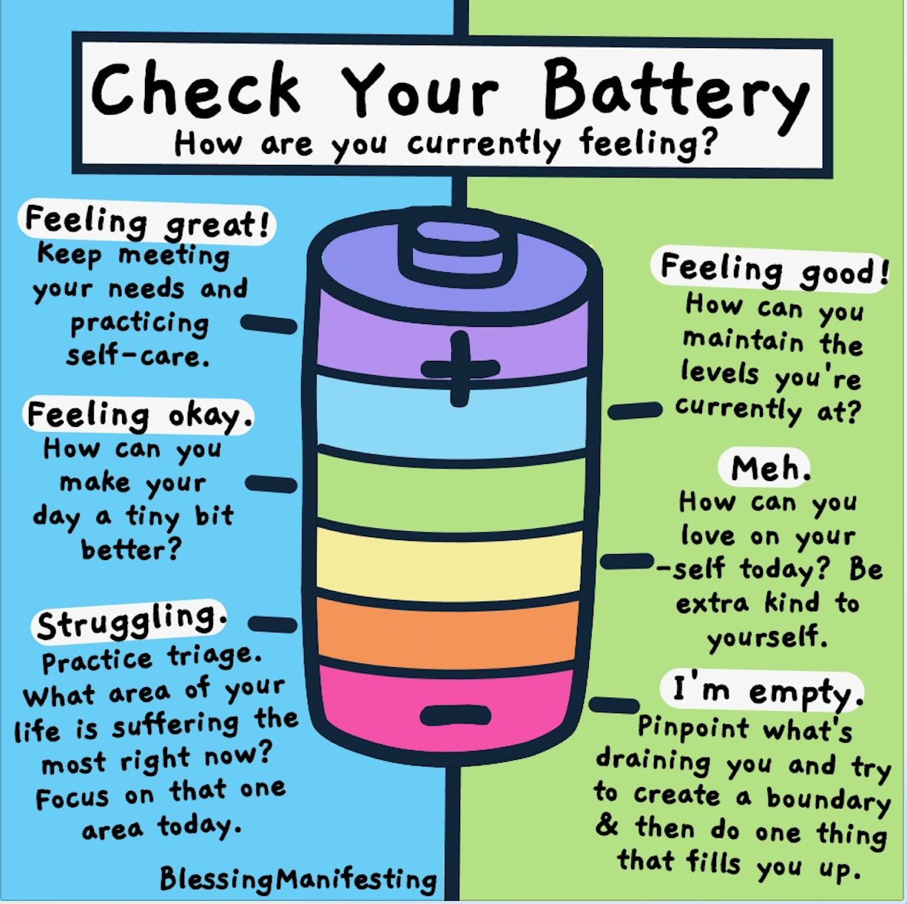

Slide 7
Context
SUs/SDs and schools planning for students and staff to return following COVID-19 closures must prioritize efforts to address social and emotional learning and mental and behavioral health needs.
Notes:
This has been identified as a top priority and we can all agree that SEBL is critical to accessing learning.
Finally in a place in this country where social/emotional/behavioral needs in education is getting the attention.

Slide 8
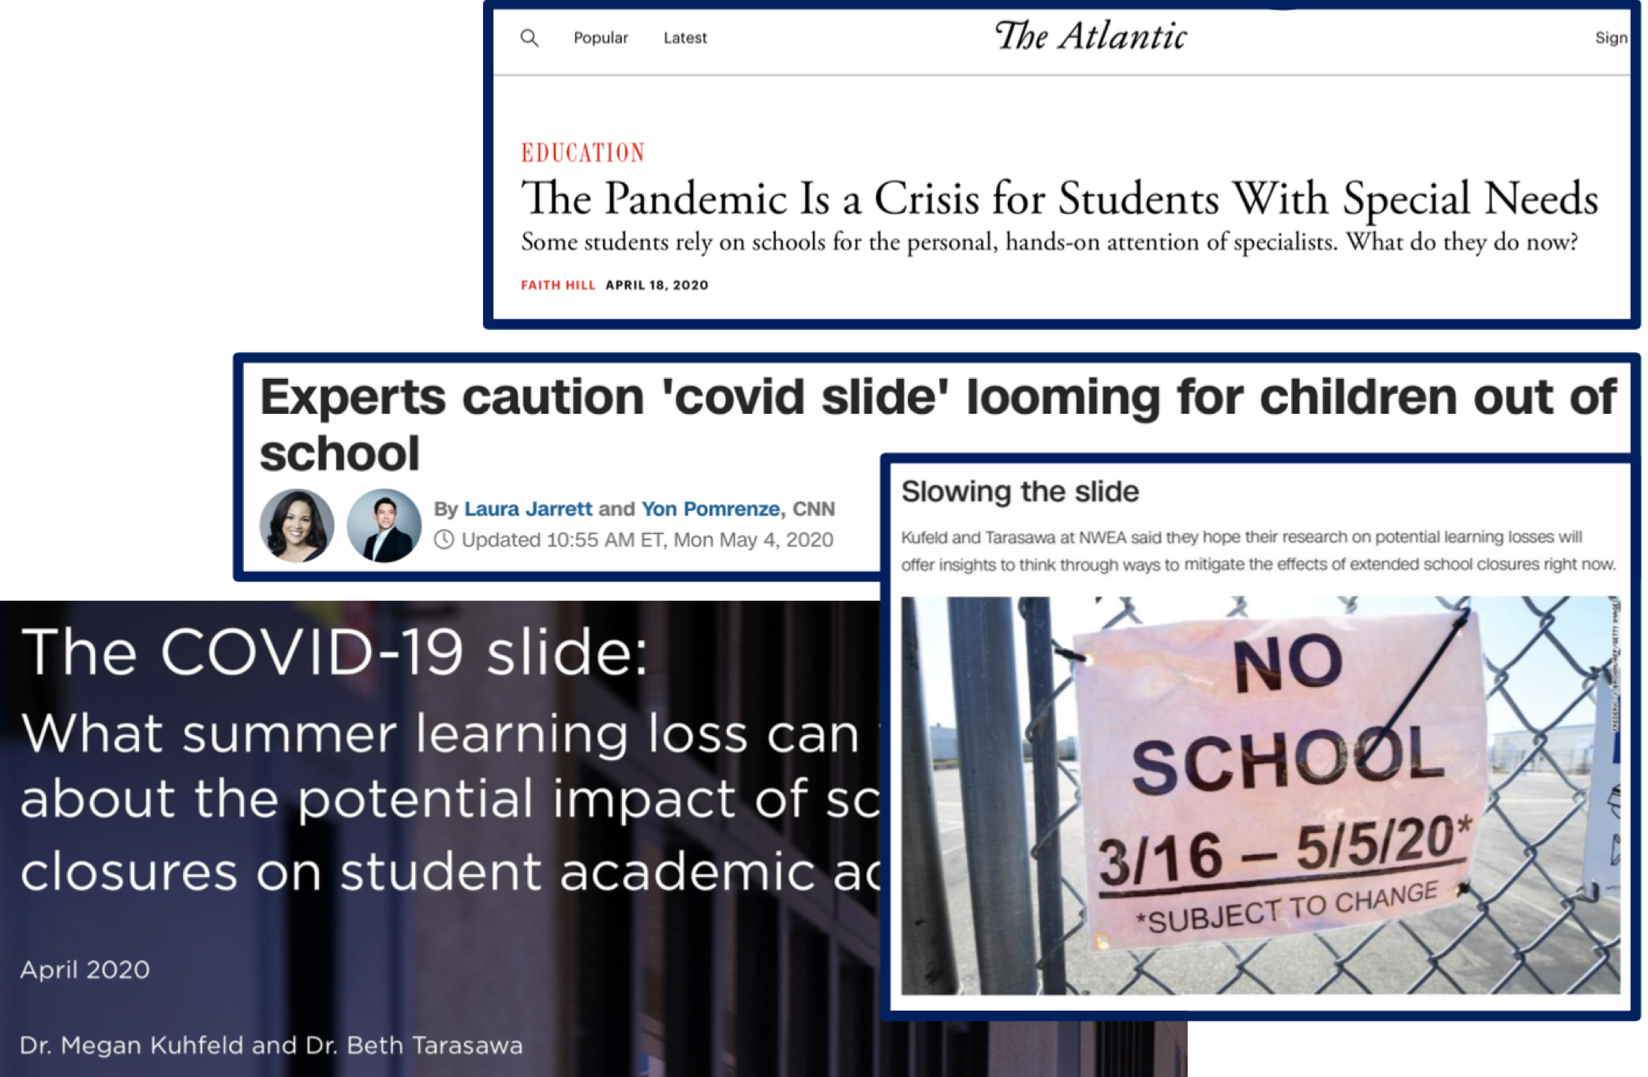

Context: Challenge
Notes:
It is clear that we have the biggest challenges in education right now. Between the predictions about our ability to catch up academically, the loss of many connections over the last year, the tension about racism in education after the murders of George Floyd and others.
We are beyond the normalcy bias which means that we expect things will continue in the future the way they typically occurred in the past – continue to be “normal”).

Slide 9
As students, family, school, and community members consider a “restart” of school, we must design education that works for all
Type into chatbox:
What is something you are hopeful will come from all of this?
Notes:
TIME TO CREATE A NEW NORMAL! Opportunity to examine what’s working in education and what’s not
And with the recent murder of George Floyd and others, the country is finally paying attention to the fact that racism in our society is pervasive and in we need to lact ON that by joining racial justice and education.
This is an opportunity to ensure that there is equity and access for all students - to ensure that everyone gets what they need to thrive socially, emotionally, and intellectually.
This is an opportunity to become more intentionally connected to our community partners
It’s an opportunity to create flexible learning environments that are compassionate.
This is our chance to authentically elevate the voices and perspectives of students, families, educators, and other adults to develop responsive transition plans.
We need to find ways to identify their hopes and concerns about transition while communicating the school’s desire to incorporate their perspectives into decision-making.

Slide 10
Need to reach students now more than ever!
Students have not had access to social-emotional support for several months
School staff may be only trusted and safe adults for some students
Some students are returning to new schools, as their schools were forced to merge or close prior to COVID-19
Students and staff did not get closure
Notes:
It is our moral imperative to connect relationally with students, staff and families. How we show up is just as important as what we do.

Slide 11
A Strong and Healthy Start: Safety and Health Guidance for Vermont Schools
“In partnership with mental health partners, develop and implement universal social and emotional screenings in order to identify students who need support”
Vermont Agency of Education
AOE Document on Universal Screening Assessments
Notes:
We have to be careful in interpreting this guidance. We need to adequately define what is meant by “screening” instead of leaving it up to the (mis)interpretation of practicing school personnel.

Slide 12
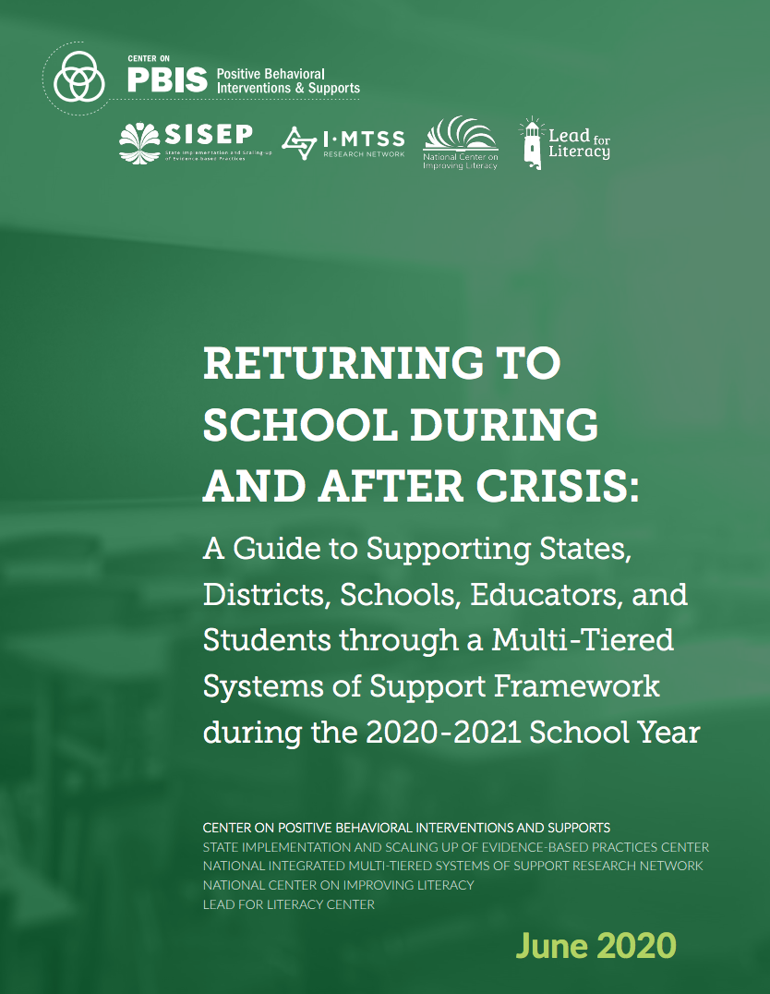

Slide 13
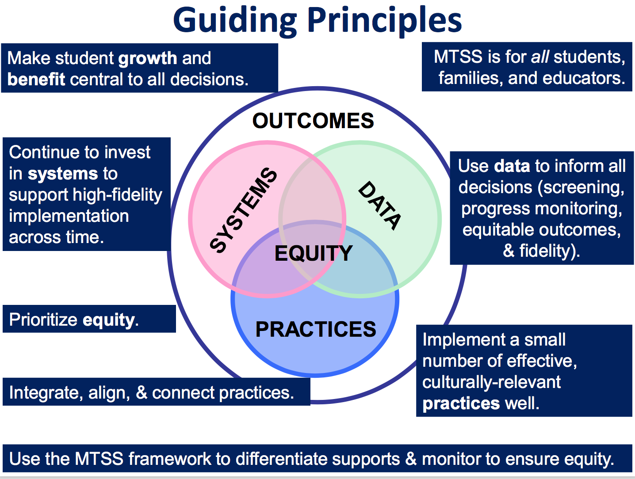
Notes:
Talk about MTSS
Systems: Importance of a teaming infrastructure
Agree that it’s a priority and communicate widely
Work with community partners
Practices: Have an understanding of SEL
Have an inventory of what already exists
Bring in community resources/interventions
Data: Formal/Informal surveys and screeners
Use data to prioritize making the smallest change for the greatest impact

Slide 14
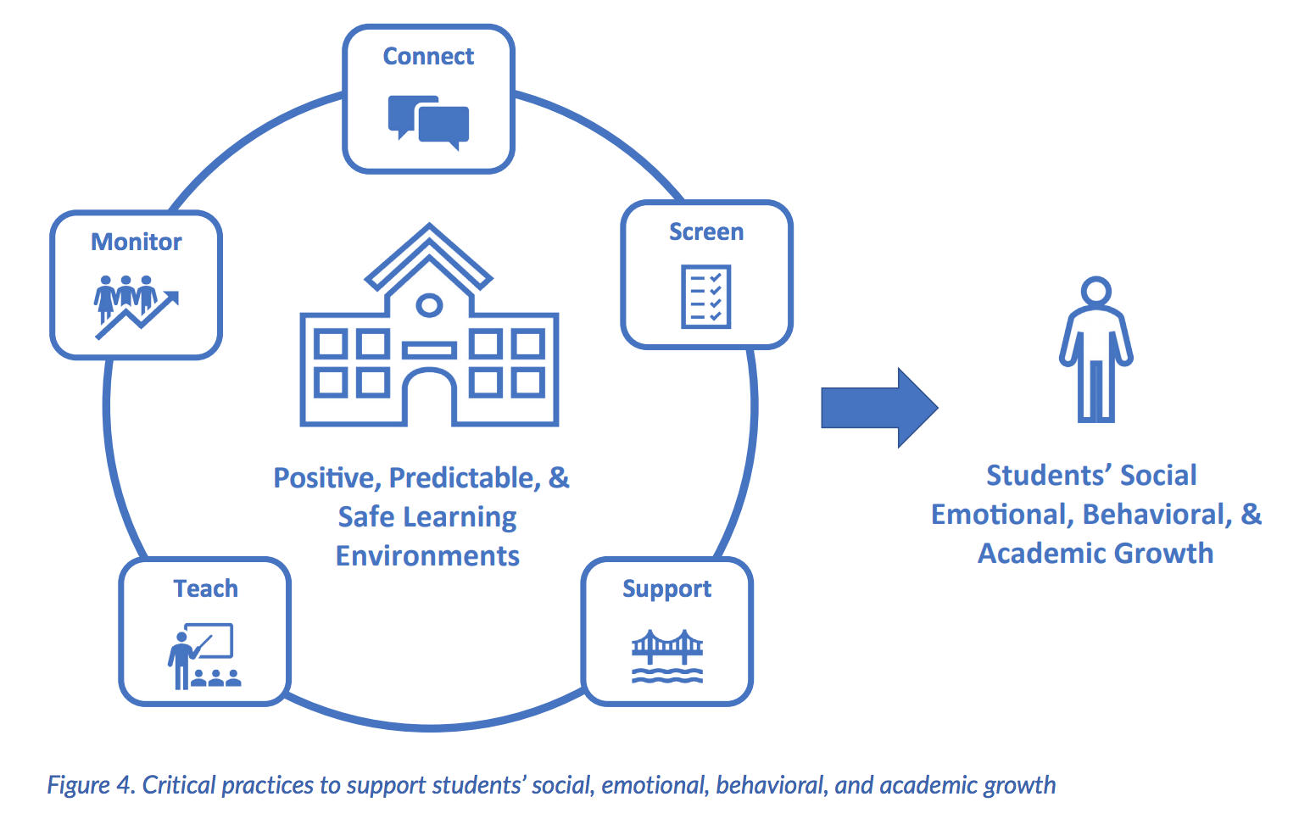
Notes:
Connect. Enhance relationships among educators, students, and families to promote effective communication during times of disrupted learning. Check in with students daily and with families regularly to identify support needs as they emerge.
• Screen. Formally or informally screen to efficiently identify students who need more support (related to health, safety, SEB needs, academic concerns). For students who require additional support, differentiate and intensify Tier 1 and consider Tier 2 or Tier 3.
• Support. Establish a safe environment (in class and/or online). Teach, prompt, and acknowledge predictable routines, positive expectations and SEB skills. Bridge expectations (teach connections) across settings (e.g., home, school, community).
• Teach. Effectively teach and prompt critical academic skills, and actively engage students in learning. Prompt and reinforce expectations and SEB skills throughout instruction. Provide positive and supportive feedback to support skill development.
• Monitor. Continue to monitor implementation and safety, health, SEB, and academic needs to (a) enhance supports for all students and (b) identify students who require more support (Tier 2 or Tier 3) over time. Match the intensity of monitoring to the intensity of need.

Slide 15
What is social/emotional/behavioral screening?
Assessment of early signs of social risk or behavior problems, as well as the presence of resilience factors and indicators of wellbeing.
Mechanism for supporting students who need additional supports after receiving evidenced-based universal behavior supports (i.e. PBIS)
Notes:
SEB screening differs from other assessments of attitudes and feelings such as within school climate surveys in that SEB screening focuses on an individual student’s level of SEB health.
School climate surveys typically yield data that are aggregated across groups to indicate a given school’s safety and SEB health as perceived by a variety of stakeholders (student, staff, parents) and can provide another source of important data especially in regard to environmental and contextual factors.
“At risk of” is a big category. We would like to know if there are any warning signs that we can easily address by matching student need with interventions.

Slide 16
Two Types of Screeners
Informal screeners and surveys
Formal SEBL Universal Screeners
Notes:
Screeners with a little s and screeners with a capital S.

Slide 17
1. Informal Screeners and Surveys
Ways to check-in with students frequently and with staff and families regularly to identify support needs as they emerge
Can use other existing data to identify needs as well.
Notes:
Can provide valuable data for getting important feedback as well as assessing connections and engagement.

Slide 18
2. Formal Universal Screeners for SEBL
Validated instruments that focus on social/emotional/behavioral risks and strengths.
A reliable method for determining students with elevated levels of risk.
Notes:
The use of screening data is well established as a valid and reliable method for determining students with elevated levels of risk (Kamphaus & Distephano, 2007; Romer & McIntosh, 2005; Elliott & Gresham, 2008).
Recognize typical base rates and norm comparison data may be skewed.

Slide 19
Informal Screeners and Surveys
Notes:
Screen. Formally or informally screen to efficiently identify students who need more support (related to health, safety, SEB needs, academic concerns).

Slide 20
Why Conduct Informal Screening Now?
Students must feel physically and psychologically safe in order to actively engage in learning
Invite voice, choice, and ownership
Help identify students or staff perhaps at higher risk for significant stress or trauma from COVID-19
Establish most efficient and effective use of MH providers, school psychologists, school counselors, community partners
Notes:
those experiencing death or loss of someone close to them; those with significant disruption to lifestyle such as food insecurity, financial insecurity; those with a history of trauma and chronic stress or other pre-existing mental health problems; those with exposure to abuse or neglect;

Slide 21
Methods of Screening
Surveys
Circles
Phone calls
Drive-by visits
Advisories
Video-chat/face-time
Using existing data
What else?

Slide 22
Please Type Into Chatbox
Do you have an informal screening or survey at your school to assess for social/emotional/behavioral concerns? If so, what are you doing?

Slide 23
Informal Screeners and Surveys - Examples

Slide 24
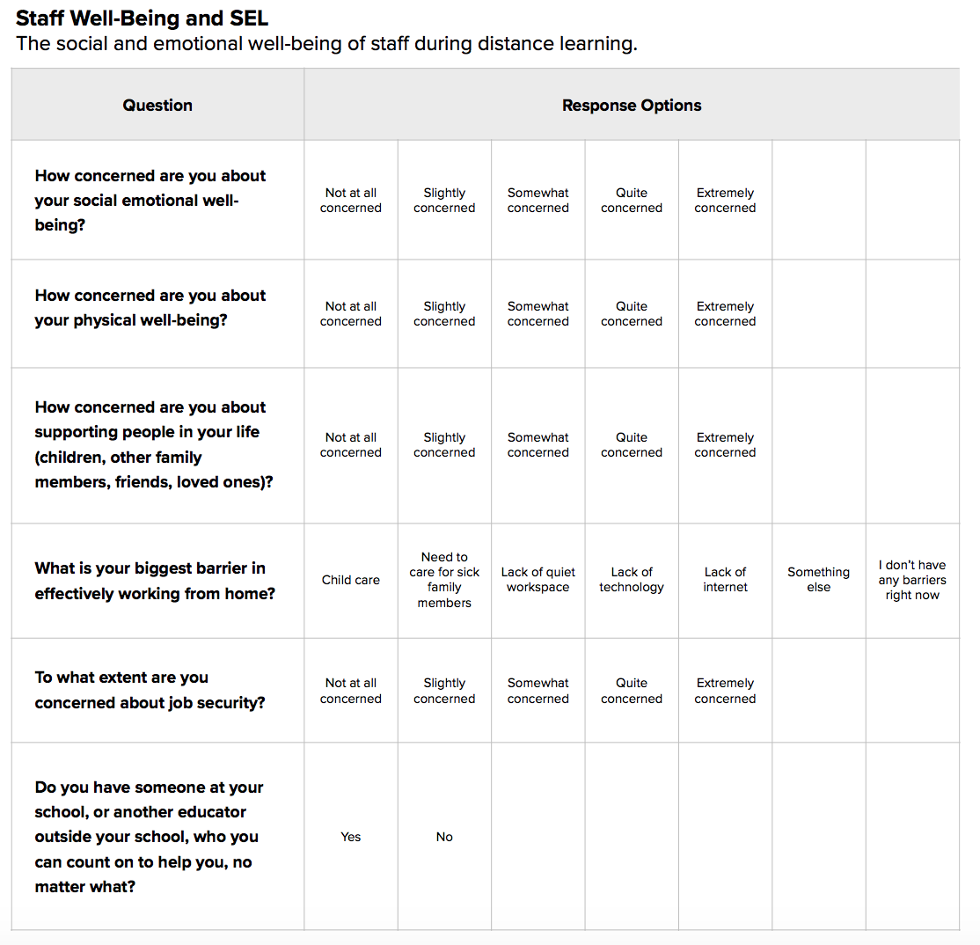
Panorama Education

Slide 25
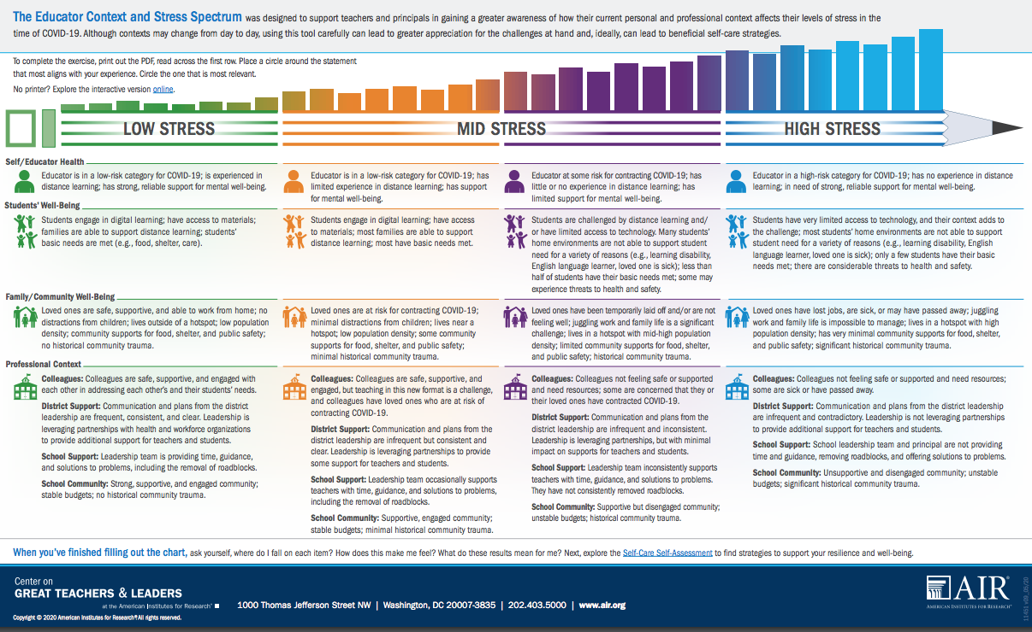
https://gtlcenter.org/sites/default/files/Stress_Spectrum.pdf
Notes:
Center on Great Teachers and Leaders’ Educator Context and Stress Spectrum was designed to support teachers and principals in gaining a greater awareness of how their current personal and professional context affects their levels of stress in the time of COVID-19. Although contexts may change from day to day, using this tool carefully can lead to greater appreciation for the challenges at hand and, ideally, can lead to beneficial self-care strategies:

Slide 26
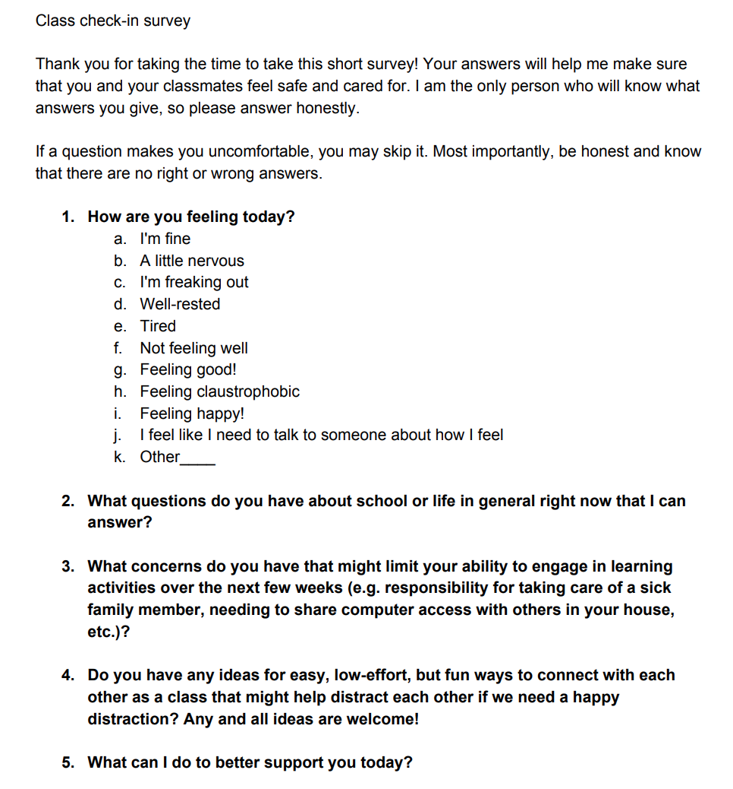
Harvard Graduate School of Education – Making Caring Common Project:
https://mcc.gse.harvard.edu/resources-for-educators/covid-check-in-survey

Slide 27
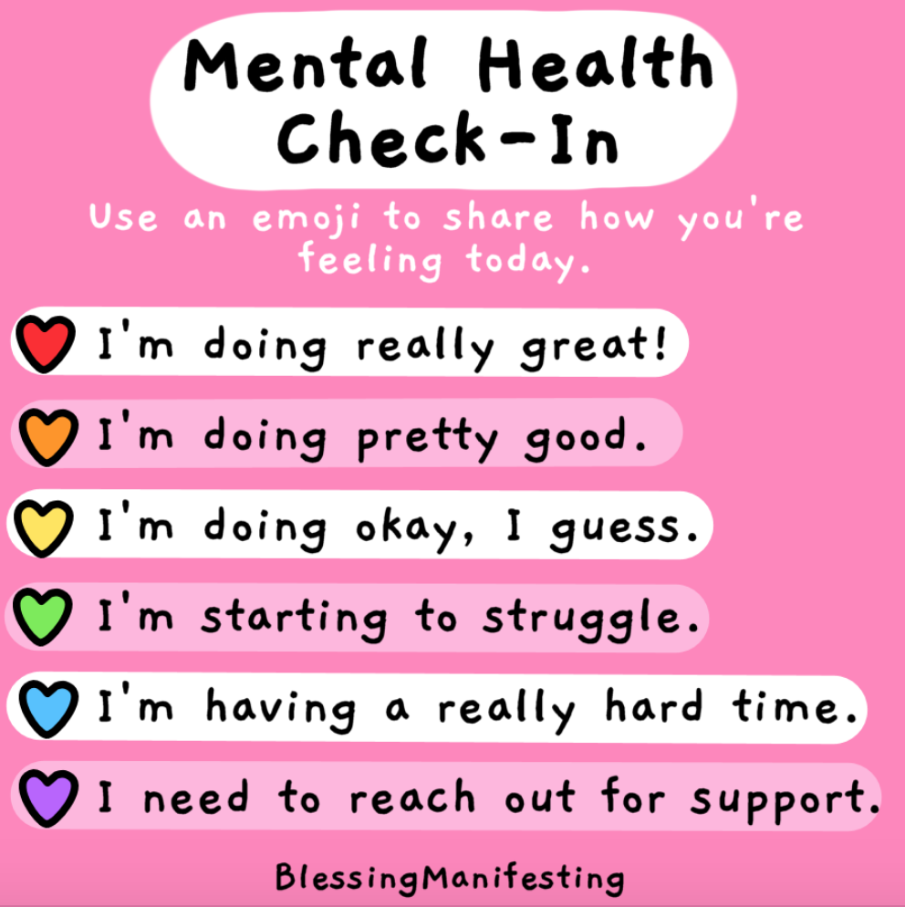

Slide 28
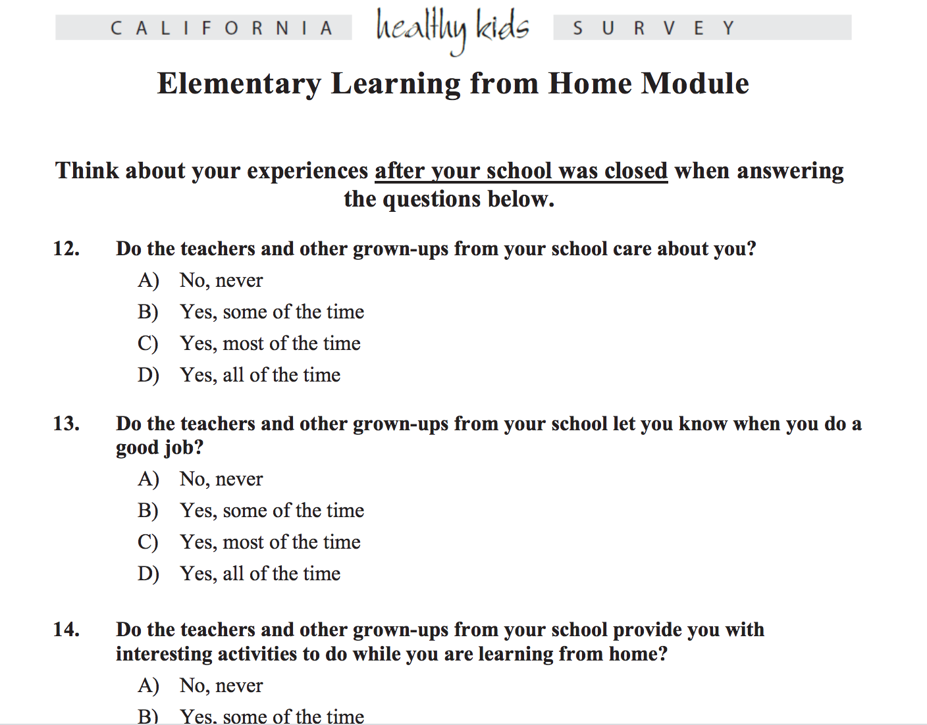
https://calschls.org/survey-administration/learning-from-home-survey/
Notes:
CALSCHLS – Developed by WestEd

Slide 29
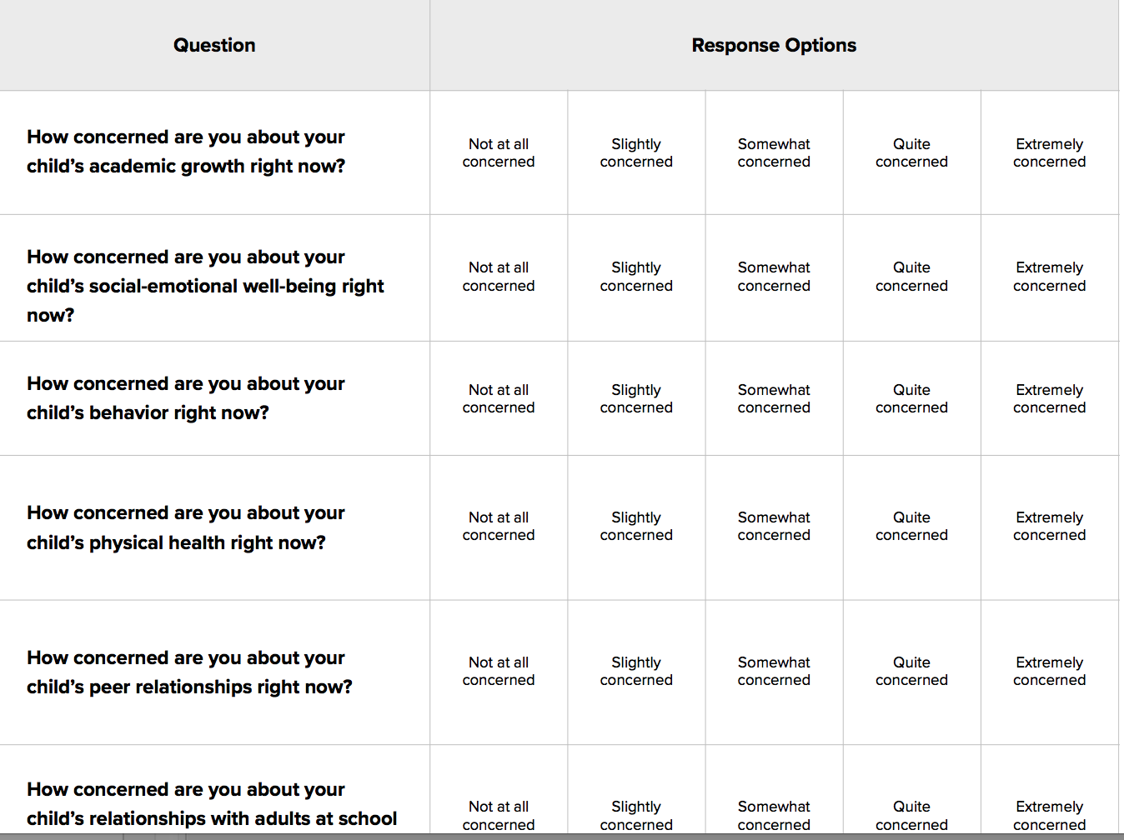
Panorama Education

Slide 30
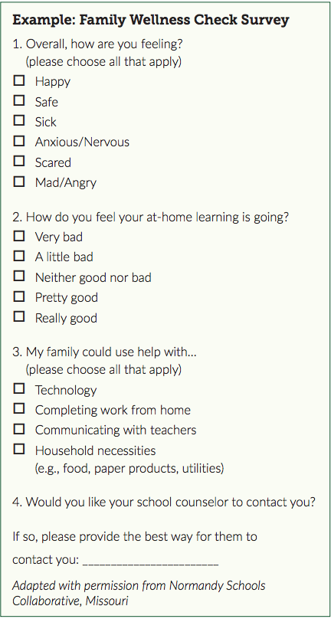
- Guidance on Adapting Check-In/Check-Out for Distance Learning (page 4)

Slide 31
Other SEBL Data to Consider
Behavior Data and Observation Form Referrals (Office Discipline Referrals, or ODRs)
Nurses visits
Suspension/expulsion
Student level of engagement in distance learning
Referrals (from staff, parents, other)
MH caseloads
Data Collection Questions
Notes:
Data can include those experiencing death or loss of someone close to them; those with signi cant disruption to lifestyle such as food insecurity, Financial insecurity; those with a history of trauma and chronic stress or other pre-existing mental health problems; those with exposure to abuse or neglect;

Slide 32
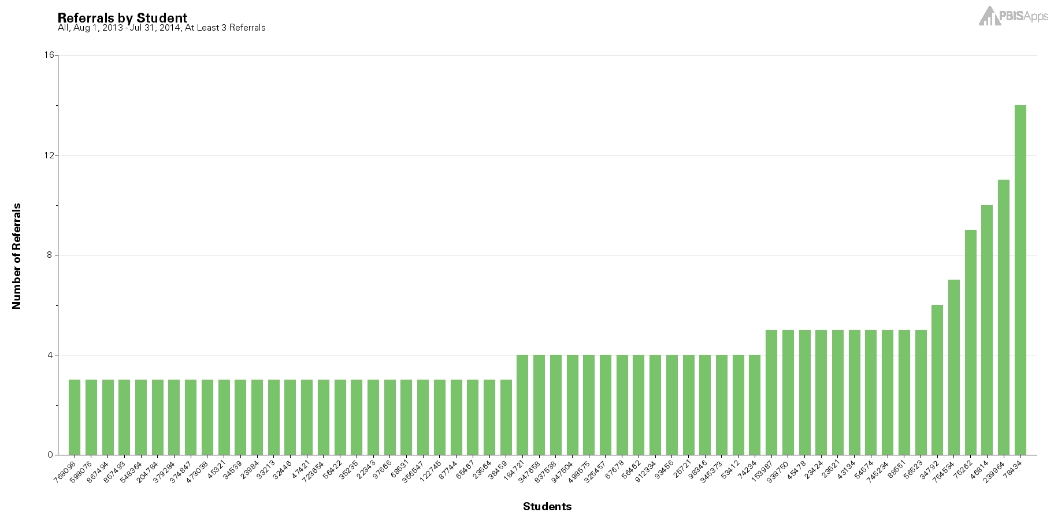

Universal, Tier I
Notes:
SWIS also assists schools in the decision making process by serving as a universal screening tool. Using the data-based decision rules of 0-1 ODRs, 2-5 ODRs, and 6+ ODRs schools can quickly identify those students to watch; those students who may benefit from targeted, small group services and Tier II supports; as well as those students who may benefit form more individualized and intensive supports.
By regularly reviewing SWIS graphs and reports, schools/facilities can progress monitor their efforts and be proactive in their actions and decisions.

Slide 33
Tracking Indicators of Risk
Student | GPA | Course Failures | Days Absent | ODRs
Josh | 3.1 | 0 | 2 | 0
Mary | 4.1 | 0 | 0 | 0
Kelly | 2.8 | 1 | 0 | 1
Jacob | 1.4 | 3 | 11 | 12
Susan | 3.5 | 0 | 3 | 0
Mark | 1.9 | 1 | 5 | 7

Slide 34
Tracking Positive Behavior Expectations
Student | ODRs | Be Safe | Be Kind | Be Responsible
Josh | 0 | 3 | 3 | 2
Mary | 0 | 3 | 2 | 3
Kelly | 1 | 3 | 3 | 3
Jacob | 12 | 1 | 3 | 2
Susan | 0 | 3 | 2 | 3
Mark | 7 | 2 | 3 | 1
Notes:
School created simple 3-point scale for each of the school-wide expectations
Teachers given instructions for rating students and they provide overall rating to each expectation
How would this work in your school?

Slide 35
Relationship Mapping
To identify students who do (or do not) have positive and stable relationships with adults in school
To connect at least one adult in school to every student who does not currently have a positive and trusting relationship with an adult
https://mcc.gse.harvard.edu/resources-for-educators/relationship-mapping-strategy

Slide 36
Please Type Into Chatbox:
What other data might your “team” look at to determine supports needed?

Slide 37
Agile Thinking is Needed
Example: Do students feel like they have an adult they can go to when they are upset?
  Barrier: Confidentiality
  Solution: Use aggregate data to inform what the leadership team can do to support all students’ access to someone when they are upset

Slide 38
Informal Screening:
Key Considerations
MTSS work in progress
  Strong teaming infrastructure is needed
  Referral process is understood by all
Prioritize SEBL and communicate importance
Have common understanding of SEBL
Identify supports and interventions up front
  Inventory
  Ensure capacity to respond
Use community partners
Notes:
When students return to school, they need to immediately know what social, emotional, and behavioral resources are available. While staff can encourage students to use those services, staff are still responsible to refer students with clear or suspected needs to the EST/Targeted Team/ even in the absence of a student self-report or self-referral.
What functions do your interventions address? It may be helpful to connect with local service agencies and community partners to help identify these needs and provide additional support. Build a broad coalition to integrate SEL and academic supports into transition plans, and create and maintain a caring, safe, and supportive environment for all students and adults.

Slide 39
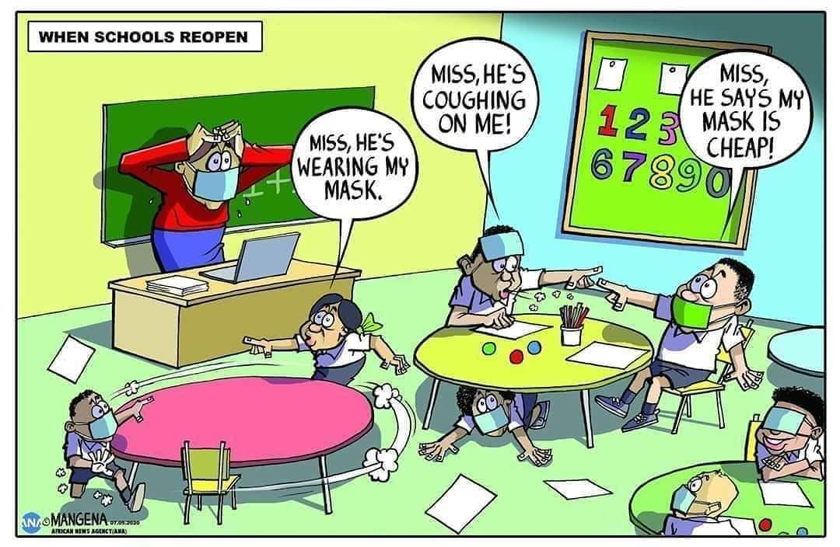
How do we formulate an accurate measure of risk?
Notes:
With the number of behaviors that occur in the classroom on a daily basis, it can sometimes be difficult to formulate an accurate measure of the real challenges and needs if we rely solely on anecdotal, gut reactions. It can also sometimes be a challenge to figure out where to start when there can be so many variations in the types of behaviors.
Role of educator challenging to meet differentiated needs of students.

Slide 40
Why (Formal) Universal Screening?
To find students whose problems are not immediately obvious.
To identify problems with a high degree of accuracy.
Early identification leads to early intervention.
To select interventions based on results of rating scales on the screening tools. This is most effective and efficient.
Notes:
As we already said, we’re doing a multitude of screenings in schools anyway. Just like with our other screenings, early identification leads to early intervention. Using formalized screening measures allows schools to select interventions that are based on results of rating scales rather than guesses.
Screening allows us to be objective.
Matching interventions to what is going on with the student. A simplistic example would be supporting a shy, withdrawn student with a standard CICO intervention

Slide 41
Poor Outcomes for Unidentified and Untreated Youth
Poor grades
Impaired personal relationships
High school dropout
Unemployment
Incarceration
Substance abuse
Suicide
Notes:
One in five children (up to 20% of students) have a diagnosable, mental, emotional, or behavioral disorder.
Only 1% of students on IEP for ED (nationally)..
Despite the prevalence of mental health concerns, only 45% of youths with a diagnosis receive treatment. And less than 25% of those youths receive any form of treatment in the schools, despite the overwhelming evidence supporting early prevention and intervention.
Many diagnoses commonly occur together
Depression and anxiety have increased.
National Association of Adult Survivors of Child Abuse and childwelfare.gov:
Children exposed to violence are more likely to abuse drugs and alcohol, suffer from depression, engage in criminal behavior, and fail or have difficulties in school.
WHAT DO WE KNOW!
Academic Success is linked with social and behavioral skills
Early identification with intervention can decrease the likelihood of academic failure
Preventive supports reduce the need for more intensive supports later
.

Slide 42
What does Universal SEBL Screening Look Like?
Teachers (or others) complete a standardized questionnaire, behavior rating scale, or clinical assessment tool on every student to determine if they are experiencing or at-risk for some social, emotional, or behavioral problem (for example, trauma, stress, anxiety, depression, anger, or aggression).
Notes:
Under normal (pre-pandemic) circumstances, a psychometrically-sound screening-to-services process requires the use of (a) multiple assessment approaches or tools; (b) completed by multiple raters (including the student him or herself); (c) evaluating student behavior across multiple settings; (d) where the ratings, observations, and data are reliable and the results are valid; and all completed (e) within a multiple-gated process.

Slide 43
Please Type Into Chatbox:
Is your school implementing a Social/Emotional/Behavioral Screener? If so, what tool are you using?

Slide 44
Interventions with an Evidence Base
Advance organizers
Anger Management Skills Training
Behavioral Interventions
Choice
Class Wide Peer Tutoring
Cognitive organizers
Cognitive Restructuring
Cognitive-Behavioral Therapy
Computer-Assisted Instruction
Contingency Management
Daily Behavior Report Cards
Exposure-Based Techniques
Family Therapy
Functional Assessment
Functional Communication Training
Integrated Cognitive-Behavioral Therapy
Interdependent Group-Oriented Contingency Management
Interpersonal Therapy for Adolescents
Milieu Language Teaching
Mnemonics
Modeling
Modified Task Presentation Strategies
Moral Motivation Training
Multimodal Interventions
Multisystemic Therapy
Opportunities to respond
Pacing
Parent Training
Peer Mediated Interventions
Peer tutoring
Peer-Mediated Conflict Resolution and Negotiation
Picture Exchange Communication System
Pivotal Response Training
Pre-correction
Presentation Strategies
Problem Solving
Procedural prompts and behavioral momentum
Replacement Behavior Training
Self instruction
Self mediated strategies
Self monitoring
Self-Management
Social Skills Training
Task Modification
Task Selection Strategies
Token Economy System
Verbal Mediation
Video Modeling
TARGETED INTERVENTIONS
Vannest K, Reynolds CR, Kamphaus RW. BASC-2 intervention guide for emotional and behavioral problems. Bloomington, MN: Pearson Assessments; 2009.
Notes:
How do we know which intervention to use for each child? We need to have a formalized way to determine what type of intervention is most appropriate for each student. Just like in an RTI model where we use Universal academic assessments to identify students at risk and to provide early intervention. We need to do the same behaviorally and ensure that we are being more intentional with our intervention selection.

Slide 45
When to Screen?
At least 6-8 weeks into the school year
  Need enough time for observation, interaction, and experience with a student so ratings are reliable and valid
You need to KNOW THE STUDENT!
If done too early and too quickly, the results will largely be invalid, the needed treatment directions will be unclear (or incorrectly focused),
Notes:
If such “Screening” is done too early and too quickly, the results will largely be invalid, the needed treatment directions will be unclear (or incorrectly focused), the time will be wasted. . . . and worse, some students may be harmed by not getting or getting the wrong therapeutic services.
When students return to school this Fall, we are fully expecting a social, emotional, and behavioral transition or re-entry process that is somewhat different than “normal.” While we can’t exactly predict how individual students will re-enter (hence the screening process outlined later in this Blog), we do expect different levels of social, emotional, and behavioral variability across students as a “normal” response. . . both to the medical, economic, educational, social, and/or other life condition effects of the pandemic, and to the racial bias and equity events triggered by the murder of George Floyd and others.

Slide 46
Screening can help identify:
Students with externalizing problems?
Students with internalizing problems?
Notes:
Students exhibiting anxiety, depression or other internalizing behaviors are not as easily recognizable. Although ODRs give descriptions of behavior incidents that occurred, they do not assess the motivating factors behind behavior and often times miss the less externalizing student who don’t typically “Act Out.”
Bristol: n some cases, students were scoring extremely high risk on BESS but were not referred to the Tier II team and had no referral data. Others were considered normal risk but they had received many referrals, either major or minor. We thought it would be helpful for teachers to see this and be able to reflect on their students needs.

Slide 47
Multi-Stage & Multi-Gate Approach to Screening
Universal Screen
Elevated? Screen #2
Elevated? Refer to team
Not elevated? Done.
Not elevated? Done.
Stage 1
Stage 2
Stage 3

Slide 48
Features of Good
Universal Screening
Accurate
Cost efficient
Acceptable
Useful
Notes:
As far as accuracy, whenever using any screening or assessment tool you want to make sure it is normed based on the student population that you work with. So you’ll want to select an evidence based, norm-referenced screening tool in order to get the most accurate results.
Efficiency, Effectiveness.

Slide 49
What Screening Tools are out There?
http://www.ci3t.org/screening

Slide 50

SSBD
https://pacificnwpublish.com
_
Evidence-based
Pre-K – 9th grade
Internalizing & Externalizing
Three gate systematic process
Cost: $225 + $30 / 100 students

Slide 51
SSBD Multi-Stage or
Multi-Gate Process
Teacher Screening
Review class roster
Rank order top 5 students in each group
Teacher Rating
Complete two rating scales for top 3 externalizers and top 3 internalizers
Direct Observation
In class & playground
Code academic engaged time & peer social behavior

Slide 52
Multiple Gating Procedure
(Adapted from Severson et al. 2007)
Teachers Rate Top 3 Students in Each Dimension on (Externalizing & Internalizing) Behavior Criteria
Gate 1

Slide 53
Externalizing refers to all behavior problems that are directed outwardly by the student toward the external social environment.
Externalizing behavior problems usually involve behavioral excesses (i.e., too much behavior) and are considered inappropriate by teachers and other school personnel.

Slide 54
Externalizing Examples
Aggression to others/things
Hyperactivity
Non-compliance
Disruptive
Arguing
Defiance
Stealing
Not following directions
Calling out

Slide 55
Nominate 5 Students & Rank 3
Class Roster
Josh | JoAnne
Mary | Laura
Kelly | Helen
Jacob | Mike
Susan | Dave
Sam | Ben
Chuck | Michelle
Liz | Courtney
Beth | Jesse
Karen | Leonard
Justin | Amanda
Externalizing
Josh
Mary
Kelly
Jacob
Susan
Externalizing Top 3
1. Susan
2. Jacob
3. Kelly

Slide 56
Internalizing refers to all behavior problems that are directed inwardly (i.e., away from the external social environment) and that represent problems with self.
Internalizing behavior problems are often self-imposed and frequently involve behavioral deficits and patterns of social avoidance.

Slide 57
Internalizing Examples
Exhibits unusual sadness
Sleeps a lot
Is teased or bullied by peers
Does not participate in games
Very shy or timid
Acts fearful
Does not stand up for self
Withdrawn
Avoids social interactions

Slide 58
Nominate 5 Students & Rank 3
Class Roster
Josh | JoAnne
Mary | Laura
Kelly | Helen
Jacob | Mike
Susan | Dave
Sam | Ben
Chuck | Michelle
Liz | Courtney
Beth | Jesse
Karen | Leonard
Justin | Amanda
Internalizing
Helen
Chuck
Amanda
Sam
Liz
Internalizing Top 3
1. Liz
2. Chuck
3. Amanda

Slide 59
Multiple Gating Procedure
(Adapted from Severson et al. 2007)
Gate 1
Teachers Rank Order, then Select Top 3 Students on Each Dimension (Externalizing & Internalizing)
Pass Gate 1
Teachers Rate Top 3 Students in Each Dimension
(Externalizing & Internalizing) on Critical Events Index and Combined Frequency Index
Gate 2
Tier 2
Intervention
Pass Gate 2

Slide 60
Scoring
Teachers complete Critical Events Index checklist and Combined Frequency Index for top three internalizers and externalizers
  Internalizers with 4+ and externalizers with 5+ critical events immediately pass gate two and are eligible for a simple targeted intervention (i.e. CICO)

Slide 61
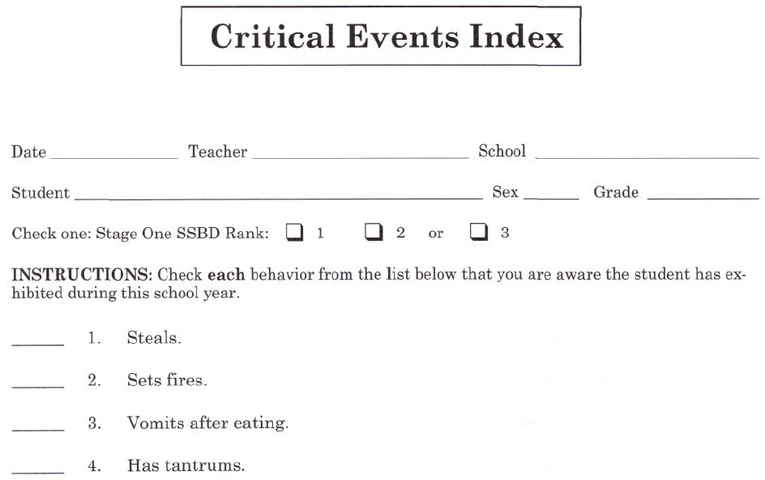
Sample of SSBD Critical Events Form

Slide 62
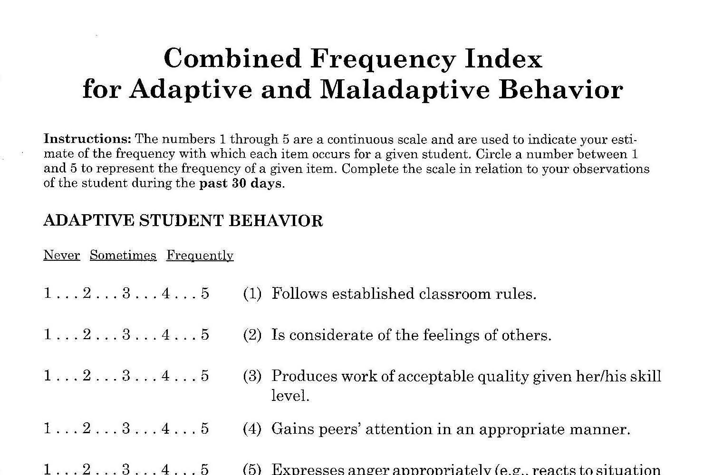
Sample of SSBD CFI Form

Slide 63
SSBD Screening Process
Pool of Regular Classroom Students
TEACHER SCREENING
on Internalizing and Externalizing Behavioral Dimensions
3 Highest Ranked Pupils on Externalizing and on Internalizing Behavior Criteria
PASS GATE 1
TEACHER RATING
on Critical Events Index and Combined Frequency Index
Exceed Normative Criteria on CEI of CFI
PASS GATE 2
DIRECT OBSERVATION
of Selected Pupils in Classroom and on Playground
Exceed Normative Criteria on AET and PSB
PASS GATE 3
Pre-referral Intervention(s)
Child may be referred to Intensive Level
Team for Individualized Supports
Notes:
The system closely aligns with the three-tier service delivery system of RTI.
Advantages: Strong reliability and validity evidence, as well as endorsements from experts in the field
Identifies students who may be under-identified (i.e., students with internalizing behaviors)
Manual provides reproducible forms
Disadvantages:
Quite complex, with the different stages, forms, raters, and observers.
Substantial training may be required
Parents are not involved in any of the stages
Does not allow teachers to identify students who display both internalizing and externalizing behaviors
May be time consuming for teachers
Does not allow for progress monitoring

Slide 64
List of Screeners
Student Risk Screening Scale http://miblsi.cenmi.org/MiBLSiModel/Evaluation/Measures/StudentRiskScreeningScale.aspx
Social Skills Improvement System http://www.pearsonclinical.com/education/products/100000322/social-skills-improvement-system-ssis-rating-scales.html
Strengths and Difficulties Questionnaire www.sdqinfo.org
Systematic Screening for Behavior Disorders http://store.cambiumlearning.com
BASC™-2 Behavioral and Emotional Screening System (BASC-2 BESS) http://www.pearsonassessments.com
Social, Academic & Emotional Behavior Risks Screener http://ebi.missouri.edu/?p=1116
_
_
_
_
_
_
Notes:
&

Slide 65
VT Example:
Mt. Abe Union Supervisory District
Use the BESS and SSIS through Aimsweb
Screen 3x per year
SEL Coordinator works with school PBIS coordinators to compile other relevant data (ODRs, nurses visits, absences)
Students with elevated risk are matched to interventions
SU Team views data from systems perspective
Grade-level teams view data for particular students

Slide 66
Systematic Screening: Considerations
Recommended 2-3 times/year
  October & February
Group administration of Stage 1
Teachers should have known students for at least one month (longer this year)
Review definitions/examples of externalizing and internalizing problems

Slide 67
Systematic Screening:
Systems Considerations
Teaming infrastructure
Referral process
Universal foundation in place
Equity issues
SEBL is a stated priority
Time for training and coaching

Slide 68
So pretty simple, right? Well…
Family’s right to privacy (opt out option)
Training & TA
Availability of supports
Policy and liability issues
What else?

Slide 69
Recommended Steps to Readiness
Need identified
Approval secured
Team formed
Supports identified
Policies for other screening reviewed
Evidence based system identified
Policies & procedures developed
P&P shared with families (opt out)
P&P for notifying families shared
Point of contact for oversight
Point of contact at SU/SD
Resources available

Slide 70
Preparation for Screening
How to Get
Started
Before actual screening––
Have a solid Universal system (with interventions) already in place
Have an inventory of targeted interventions matched to function
Tie in to existing systems (integration, NOT add-on)
Identify your school’s risk factors, or other behavior indicators you will track
Create a calendar for when your screenings will occur

Slide 71
Preparation for Screening
How to Get
Started
Select a Coordinator––
Someone with strong:
Organizational skills
Leadership skills
Experience with assessment tools

Slide 72
Preparation for Screening
How to Get
Started
Before actual screening––
Provide plan for seamless transition from screening to intervention
Provide teacher training
Provide parental notification of screening and parental consent to intervene with youth identified by screener

Slide 73
What’s Next?
Review Universal Screening Steps to Readiness
Determine where is your school in this process
Review and select tools

Slide 74
http://www.ci3t.org/screening
_

Slide 75

Another amazing resource!
https://smhcollaborative.org/wp-content/uploads/2019/11/universalscreening.pdf
_
Notes:
Nate (940-945)

Slide 76
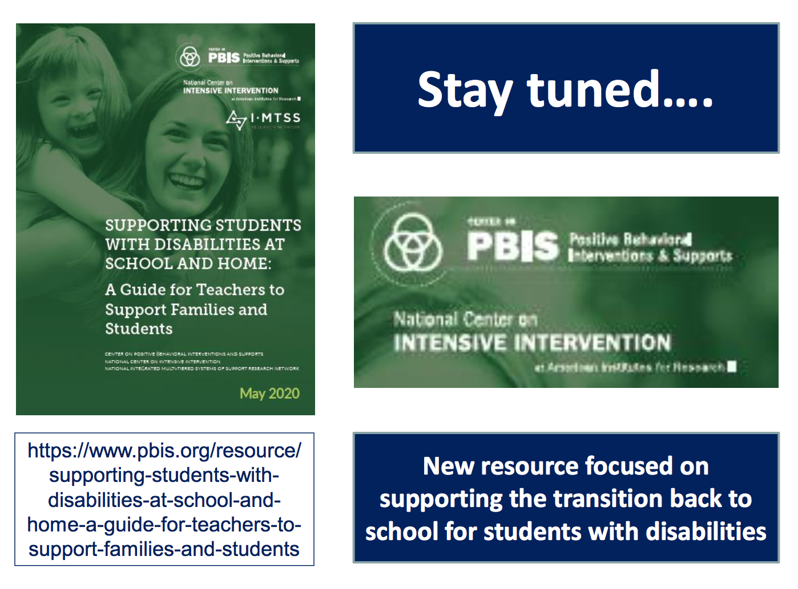

Slide 77
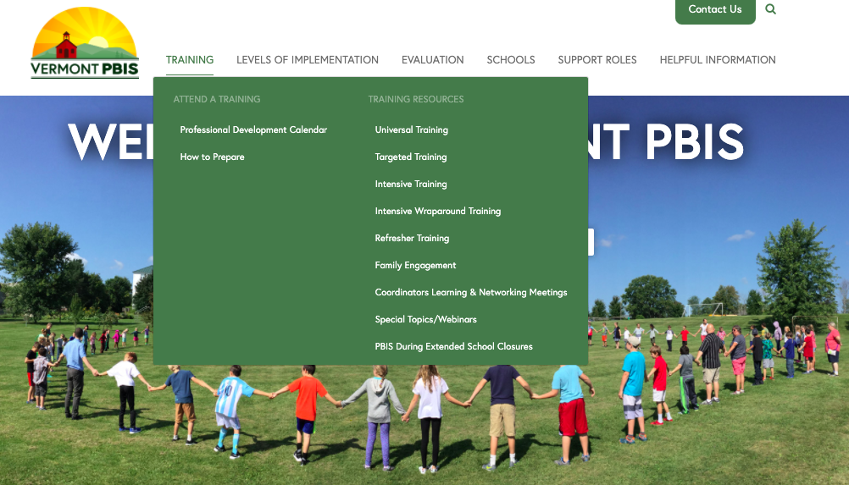
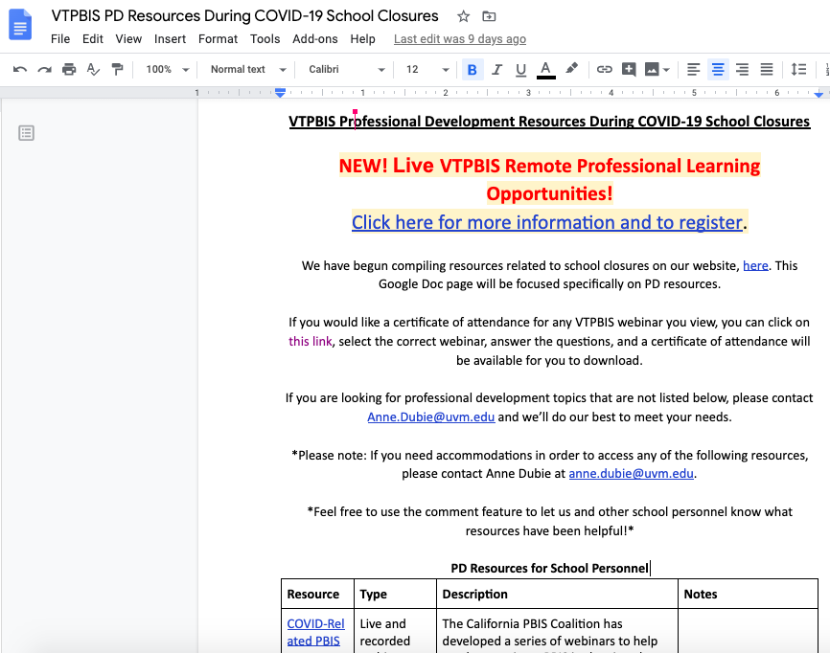
PBIS-Specific Resources
Family Engagement
Teaching Resources
Mental Health
PD Resources
Notes:
PBIS During Extended School Closures Webpage: https://www.pbisvermont.org/training-resources/pbis-during-extended-school-closures/
PD Resources During School Closures Google Doc: https://docs.google.com/document/d/1qhuRYIvwbLdbR-lEWwvCaod99QoDugwV-CVgpM74T_k/edit

Slide 78
Resources
All resources can be found at www.pbisvermont.org
_
_
_
What questions do you have?
_
_

Slide 79
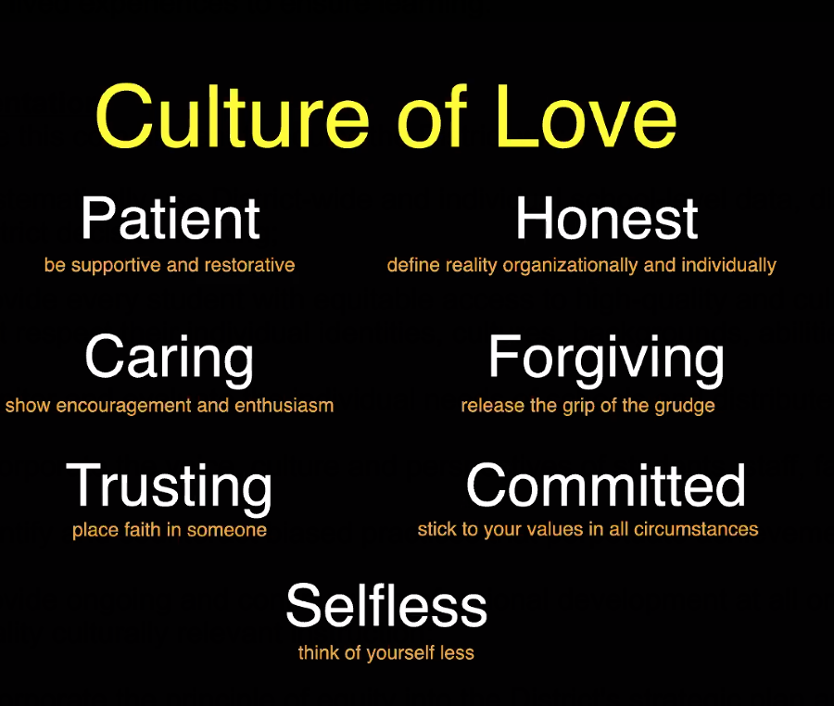
Dr. Luvelle Brown
Notes:
Most effective instructional practice is the smile. Say you are smiling under your mask.

